Slide 1
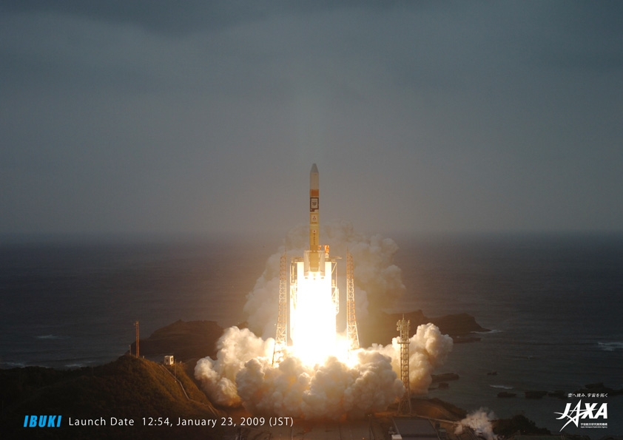
Question 8: Japan’s Greenhouse Gases Observing Satellite, GOSAT, and its IR hyperspectral sensor, TANSO-FTS, measuring CO₂ and CH₄:
How well has it performed?
What are the experiences with its operations?
The ACOS/GOSAT Experience
David Crisp JPL/CALTECH
Hyper Spectral Workshop, Miami

Slide 2
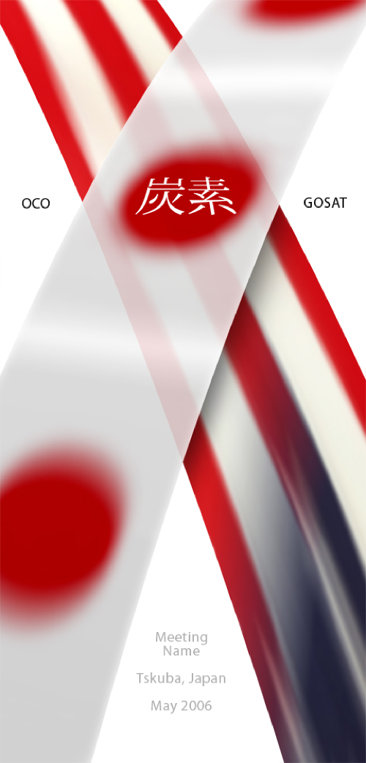
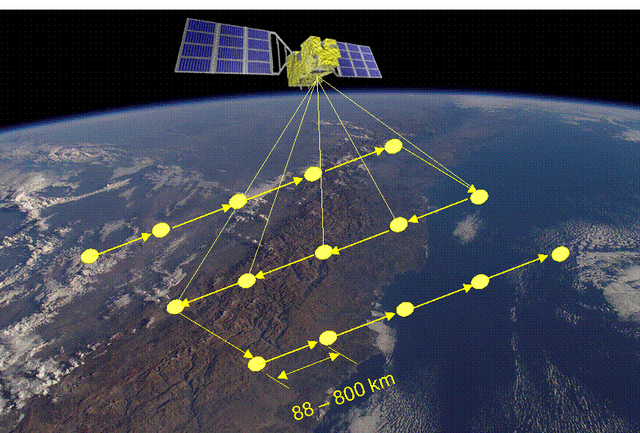
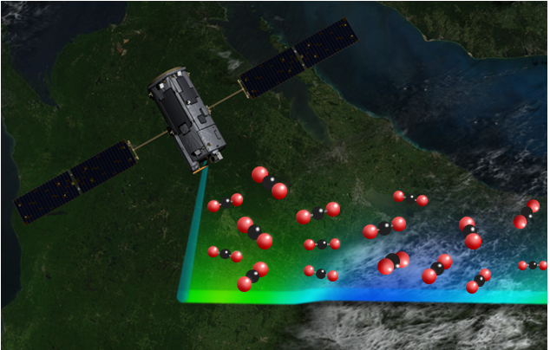
OCO and GOSAT Collaboration
The OCO and GOSAT teams formed a close partnership during the implementation phases of these missions to:
Cross calibrate the OCO instrument and TANSO-FTS
Cross validate OCO and GOSAT X_{CO2} retrievals against a common standard
The primary objectives of this partnership were to:
Accelerate understanding of this new data source
Facilitate combining results from GOSAT and OCO
GOSAT
OCO
3-day ground track repeat cycle resolves weather
Continuous high resolution measurements along track

Slide 3
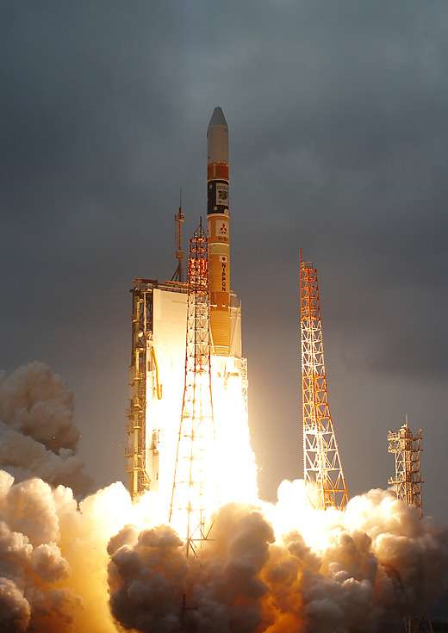
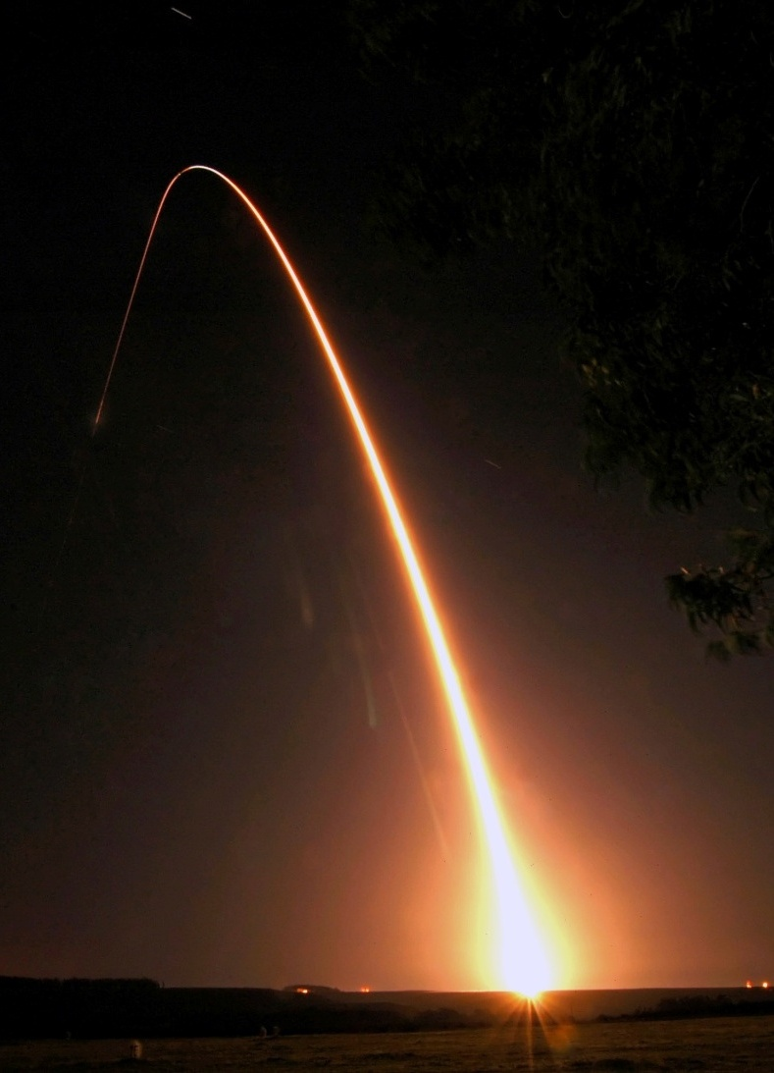
The Launch of GOSAT & Loss of OCO
24 Feb 2009
GOSAT launched successfully on 23 January 2009
OCO was lost a month later when its launch system failed
Notes:
OCO is designed to provide the data needed to find the missing pieces of the carbon puzzle (sinks)

Slide 4
Working with the GOSAT Team
Immediately after the loss of OCO, the GOSAT Project manager invited the OCO Team to participate in GOSAT data analysis
NASA reformulated the OCO team as the “Atmospheric CO₂ Observations from Space” (ACOS) team
This collaboration benefits the GOSAT team by:
Combining the ground based calibration and validation resources of both teams to maximize the accuracy of the GOSAT data
Combining the scientific expertise from both teams to accelerate our understanding of this new, space-based data source
This collaboration benefits the NASA OCO by
Providing direct experience with the analysis of space based CO₂ measurements
Accelerating the delivery of precise CO₂ measurements from future NASA carbon dioxide monitoring missions

Slide 5
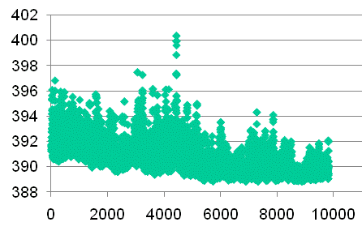
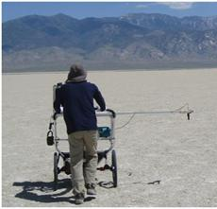
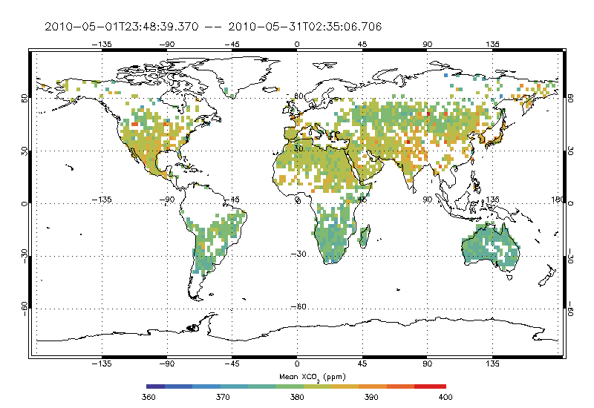
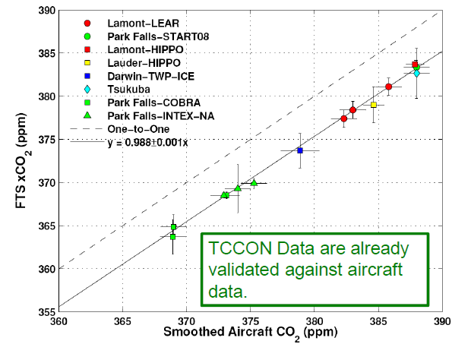
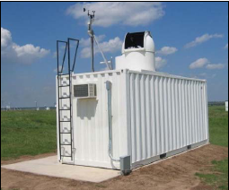
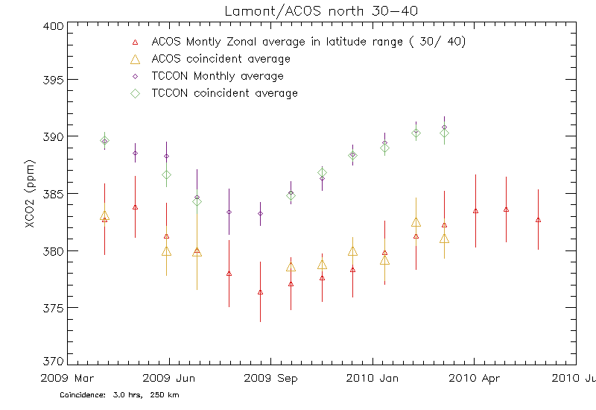
Scope of the ACOS/GOSAT Collaboration
The ACOS team is collaborating closely with the GOSAT teams at JAXA and NIES to:
Conduct vicarious calibration campaigns in Railroad Valley, Nevada, U.S.A. and analyze results of those campaigns
Retrieve X_{CO2} from GOSAT spectra
Model development, implementation, & testing
Data production and delivery
Validate GOSAT retrievals by comparing
GOSAT retrievals with TCCON measurements
Other validation standards (surface pressure, aircraft and ground-based CO₂ measurements
Picarro CO₂

Slide 6
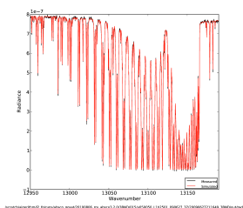
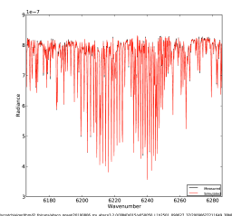
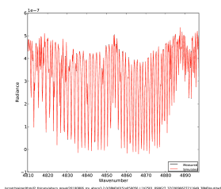
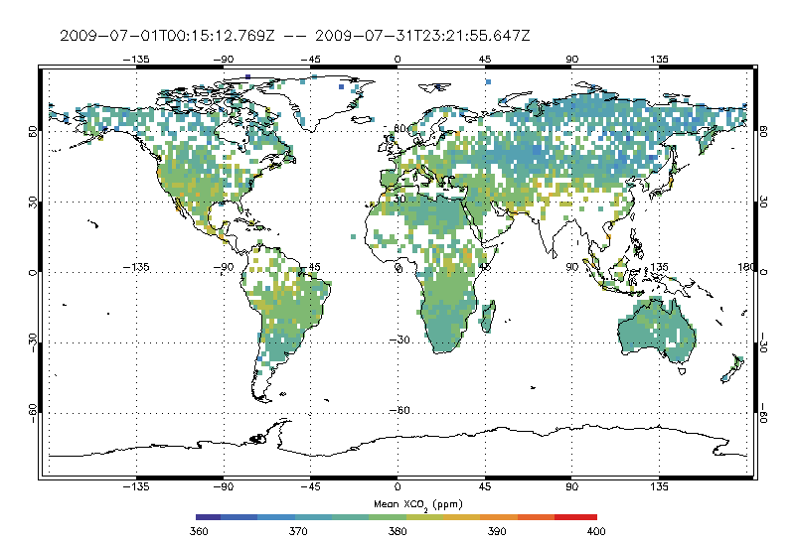
Retrieving X_{CO2} from GOSAT Data
The OCO Retrieval Algorithm was modified to retrieve X_{CO2} from GOSAT measurements
“Full-physics” forward model
Inverse model based on optimal estimation
State Vector
CO₂ profile (full)
H₂O profile (scale factor)
Temperature profile (offset)
Aerosol Profiles
Surface Pressure
Albedo (Mean, Slope)
Wavelength Shift (+ stretch)
Calibrated GOSAT Spectra
(L1B Data)
Forward Model
Spectra + Jacobians
State Vector First Guess
not converged
Apriori + Covariance
Inverse Model
(Optimal Estimation)
converged
Update State Vector
Calculate XCO₂
Diagnostics

Slide 7
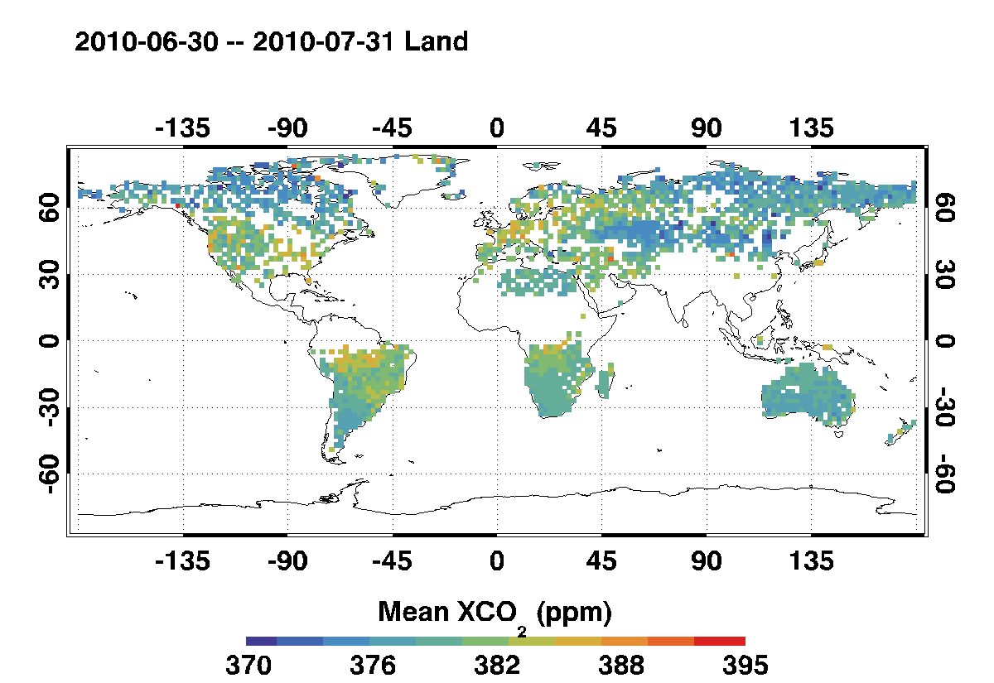
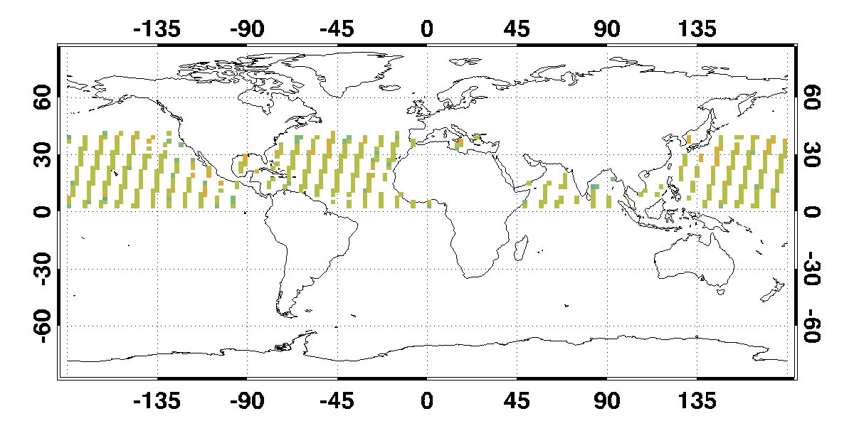
ACOS/GOSAT Data Products: X_{CO2} Retrievals
X_{CO2} Retrievals for July 2010

Slide 8
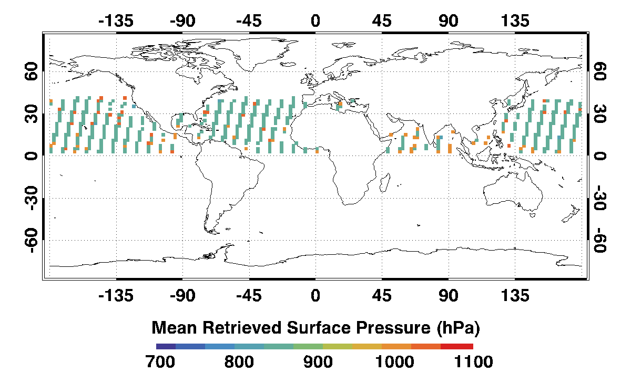
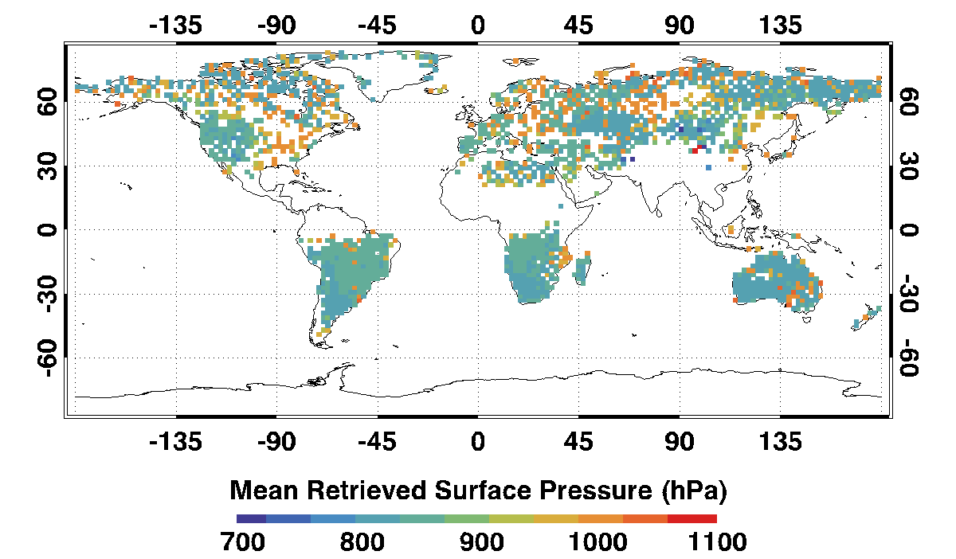
ACOS/GOSAT Data Products: Surface Pressure Retrievals
Surface Pressure Retrievals for July 2010

Slide 9
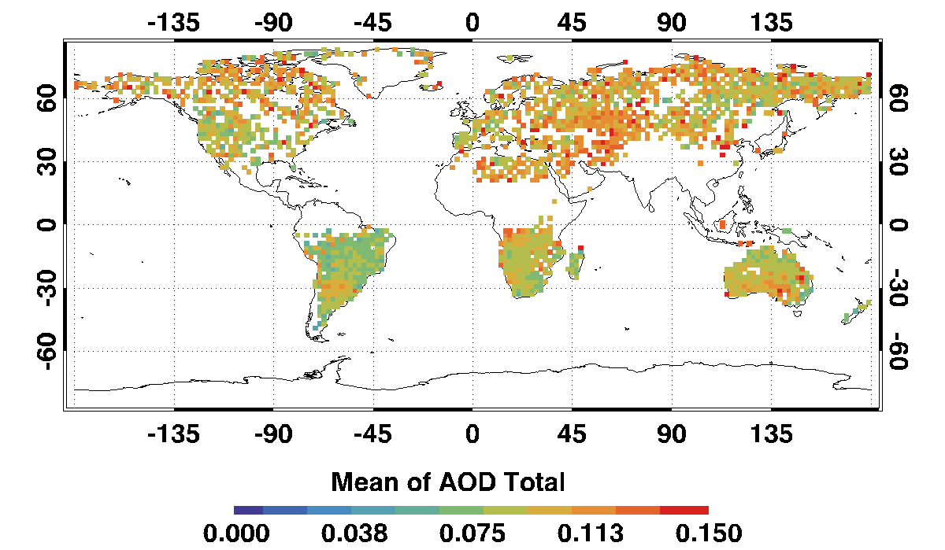
ACOS/GOSAT Data Products: Aerosol Optical Depth Retrievals
AOD Retrievals for July 2010

Slide 10
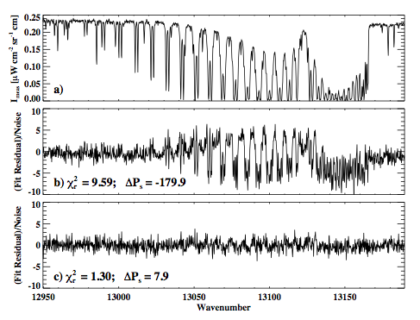
Experiences with its operations: The ACOS Cloud Screen
A Spectroscopic cloud screening algorithm based on the O₂ A-band is currently being used for GOSAT retrievals
Fits a clear sky atmosphere to every sounding in the O₂ A band.
High values of χ² and large differences between the retrieved surface pressure and the ECMWF prior indicate the presence of clouds
Over non-glint ocean, a simple albedo test is also used.
Example A-Band fit
Poor fit (χ² = 9.6) indicates presence of cloud
Small residuals and good agreement between retrieved and ECMWF surface pressure indicates cloud free

Slide 11
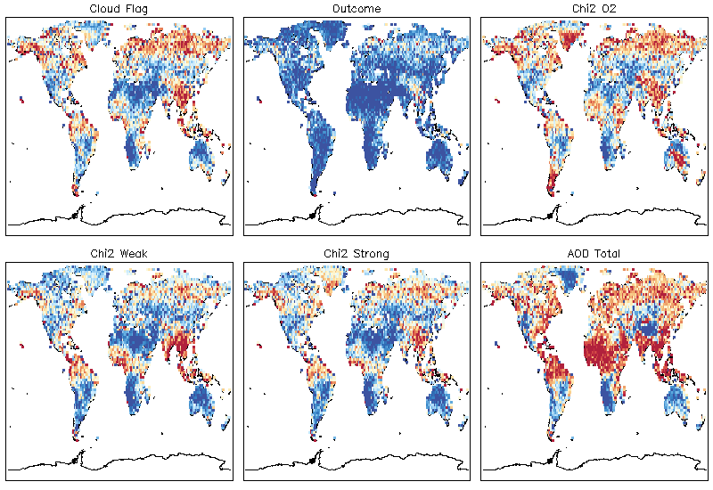
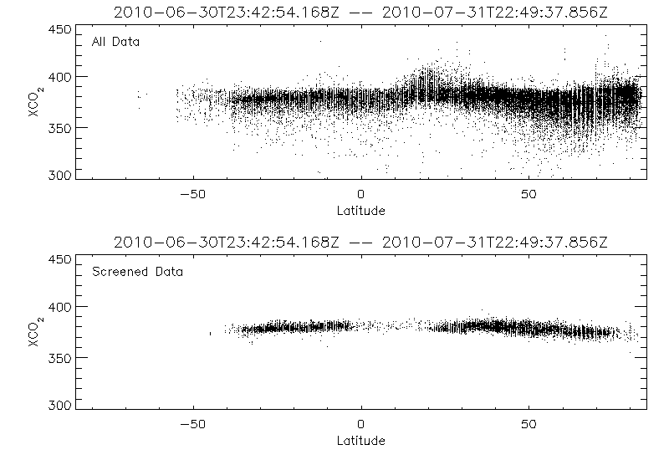
Experiences with its operations: Post Screening Improves Accuracy
Errors can be further reduced by post-screening retrievals, based on a series of criteria, including:
Measurement SNR
Convergence
Goodness of spectral fit
Surface pressure error
Evidence for clouds or optically thick aerosols
A postiori retrieval error
Evidence of known biases
The cloud screen is responsible for the largest data reductions.
Improved cloud screening algorithms are a major focus of our development effort

Slide 12
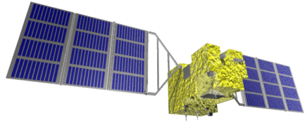
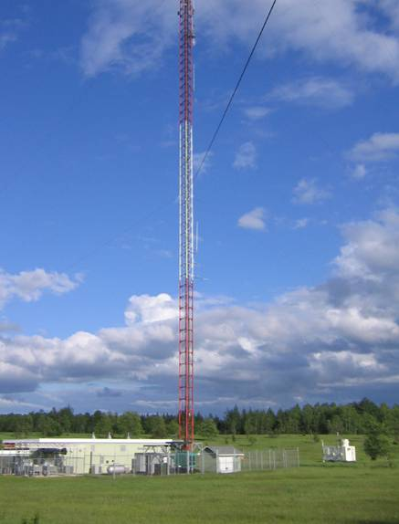
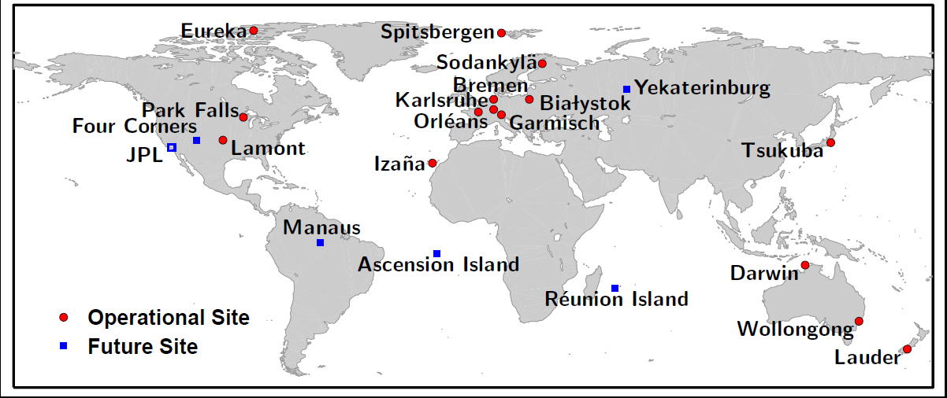
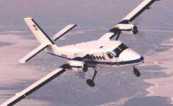
Experiences with its operations: Validation of GOSAT Products
Current and Planned TCCON Stations
447-m WLEF Tower
GOSAT X_{CO2} retrievals are being compared with those from the ground based Total Carbon Column Observing Network to very their accuracy
Park Falls, WI
FTS

Slide 13
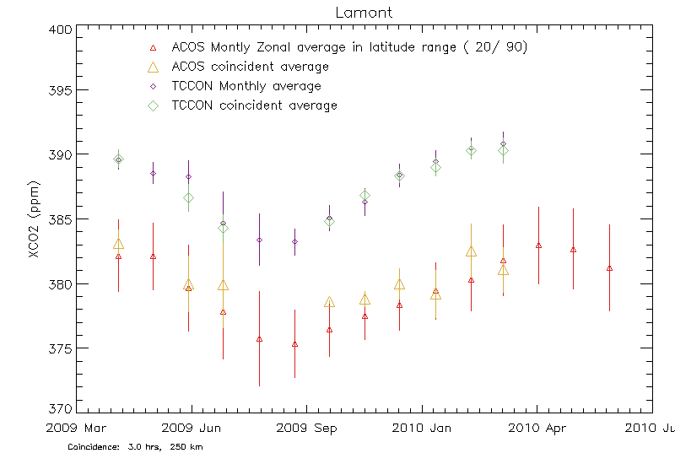
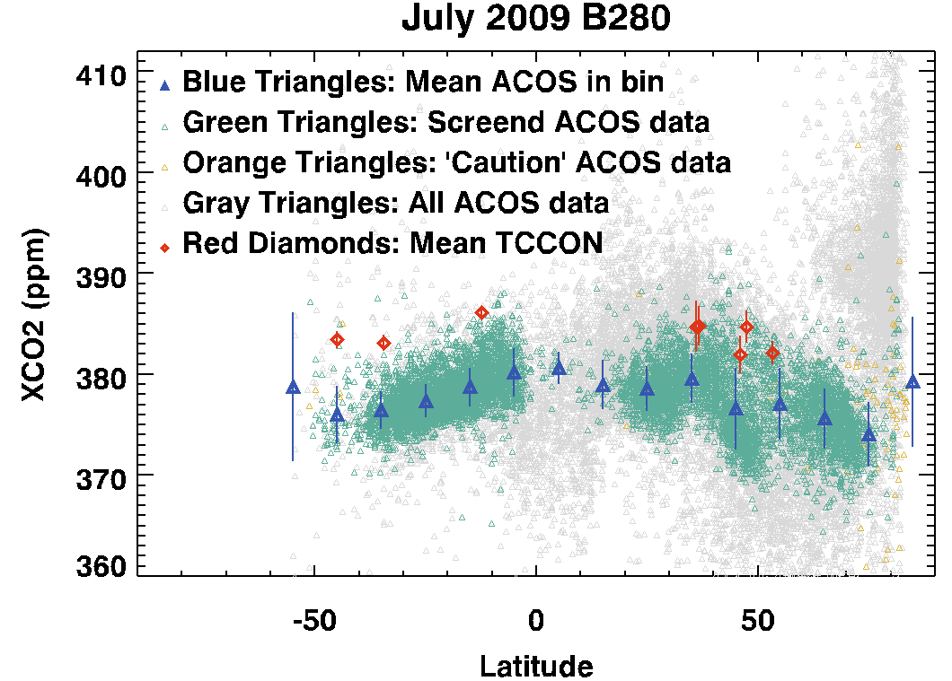
How Well has it Performed? Comparisons of GOSAT and TCCON
Wunch et al.
ACOS GOSAT retrievals show
A consistent global bias of ~2% (7 ppm) in X_{CO2} when compared with TCCON and aircraft measurements.
X_{CO2} variations that are a factor of 2 to 3 larger than that measured by TCCON.

Slide 14
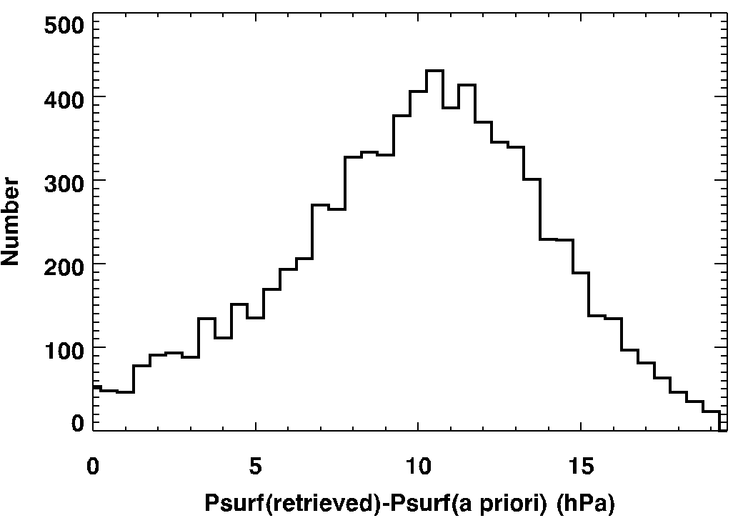
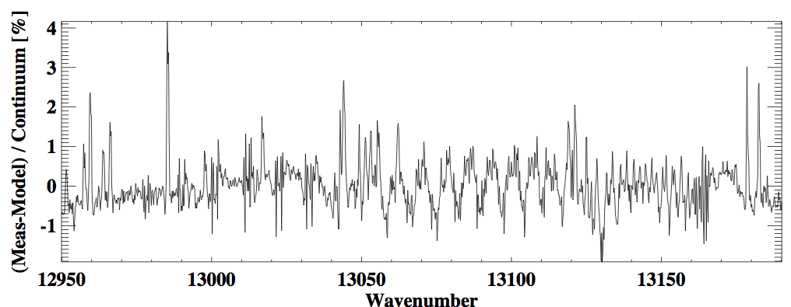
Sources of Bias in the X_{CO2} Maps
About half of the global 2% bias is caused by a ~10 hPa (1%) high surface pressure bias associated with:
Radiometric and spectroscopic calibration errors
Non linearity and ILS corrections currently being implemented
Uncertainties in the O₂ A-band absorption cross sections
Oversimplified treatment of line mixing and line shape
Improvements in the CO₂ spectroscopy and aerosol retrieval approach are also being implemented to address
remaining bias
P_{s} – P_{s} (a priori)
GOSAT
Typical O₂ A-band retrieval residuals.

Slide 15
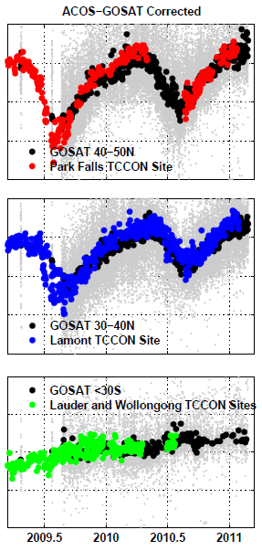
Validation of X_{CO2} at TCCON Sites
Once the known biases are removed, retrievals of X_{CO2} compare well against “ground truth” from the TCCON (Total Carbon Column Observing Network).
Both the hemispheric gradients and the seasonal cycles are captured in the bias-corrected GOSAT X_{CO2} retrievals.
Park Falls, WI
Lamont, OK
Lauder, NZ

Slide 16
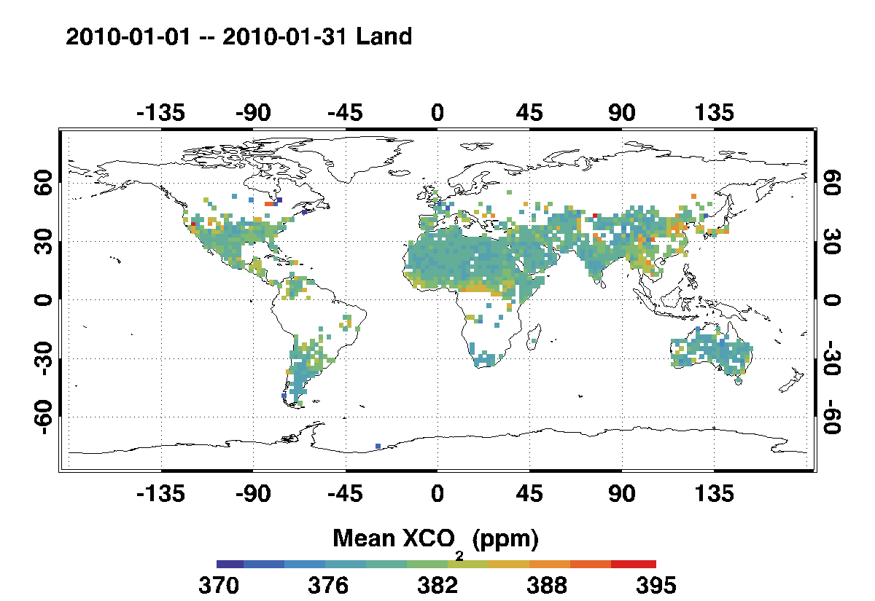
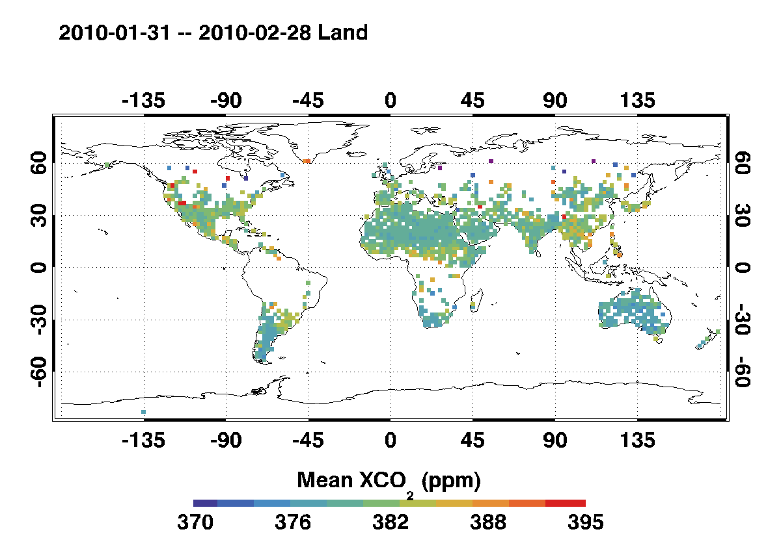
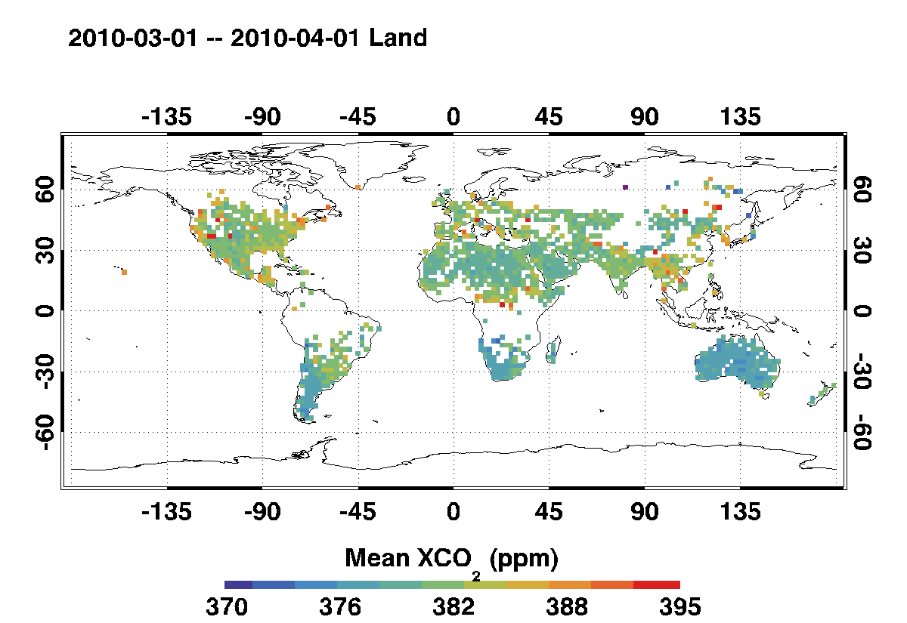
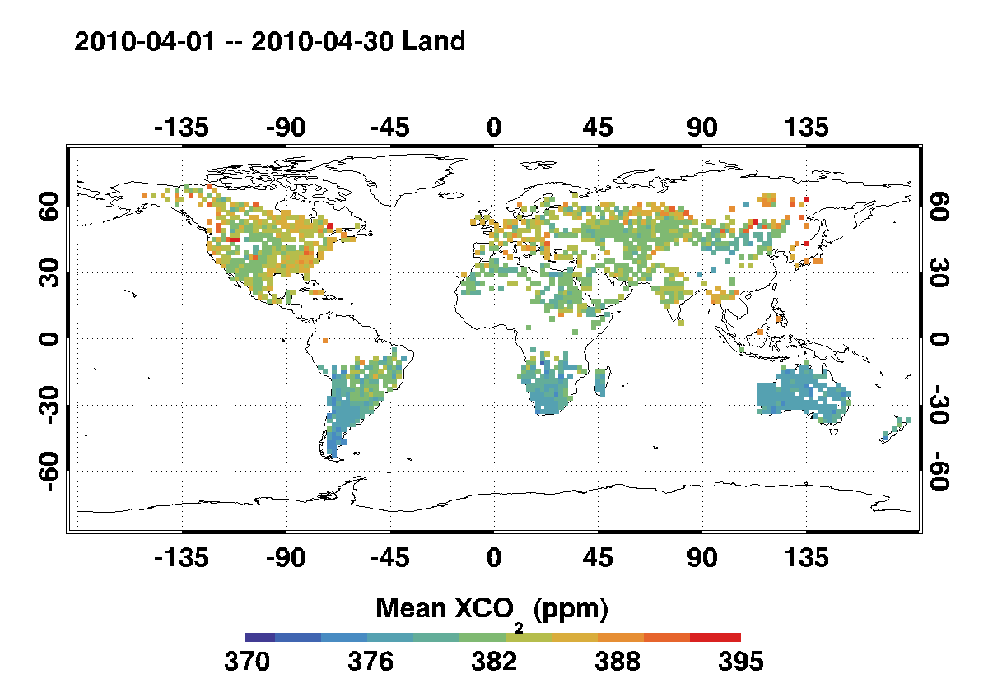
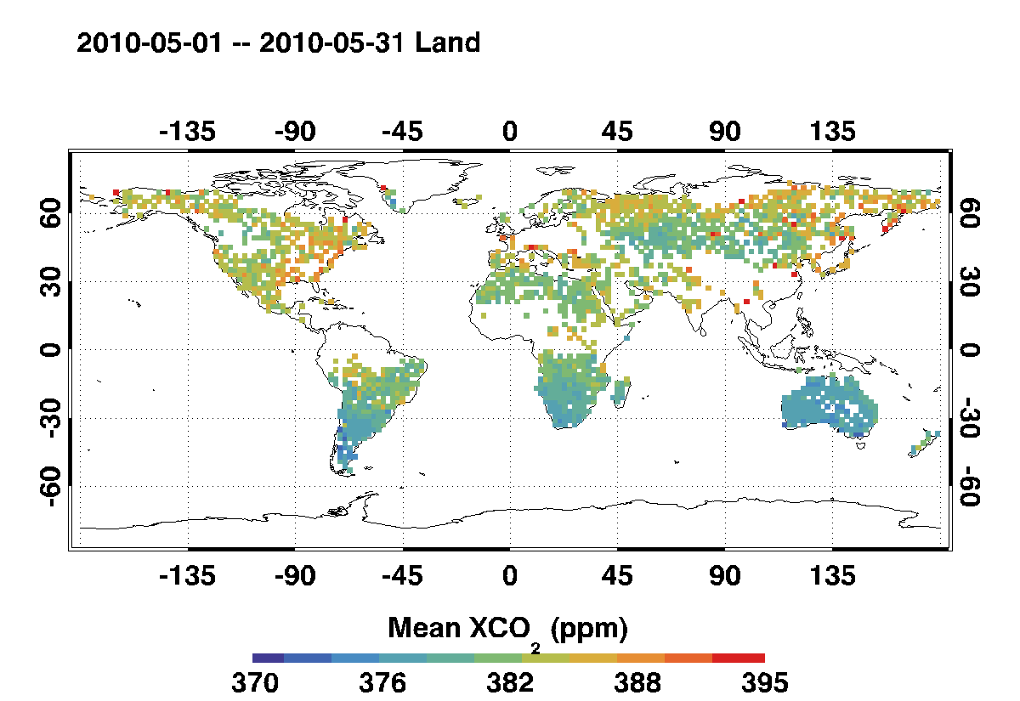
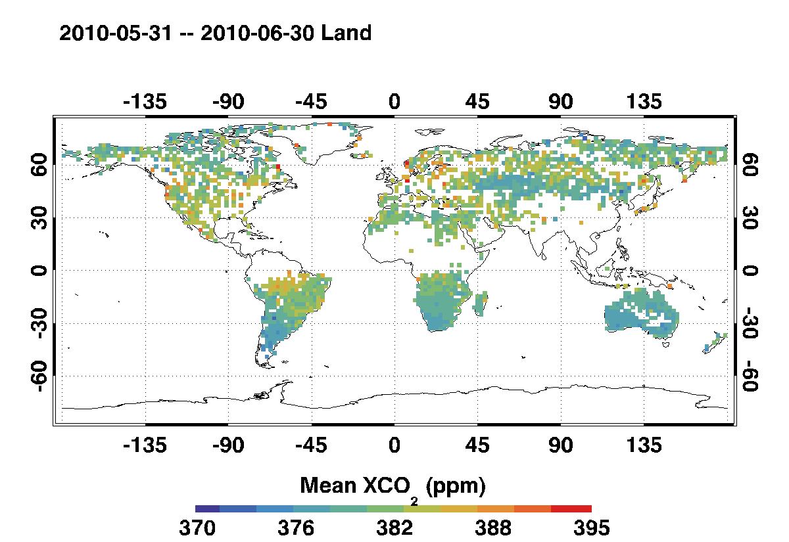
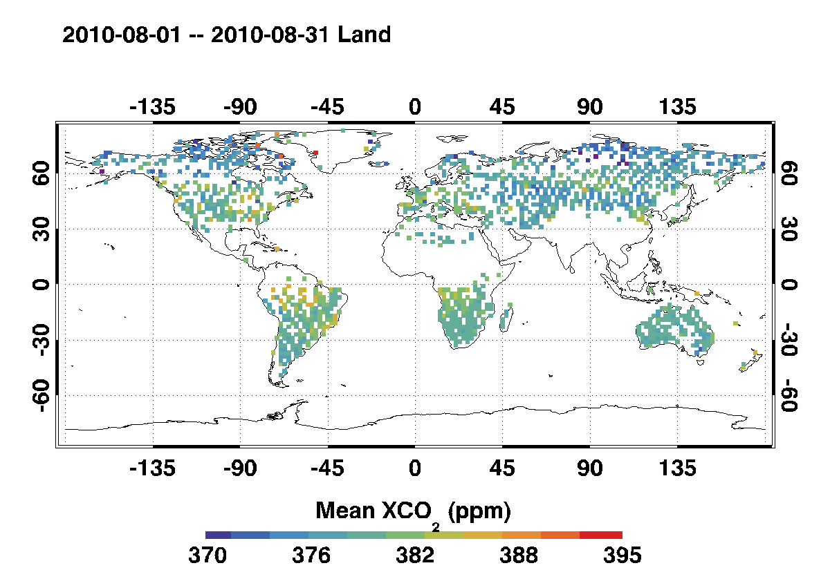
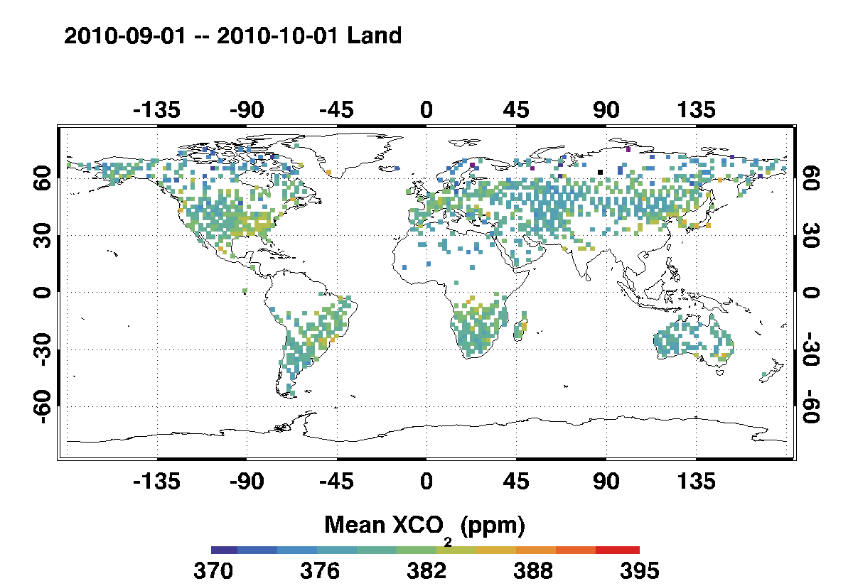
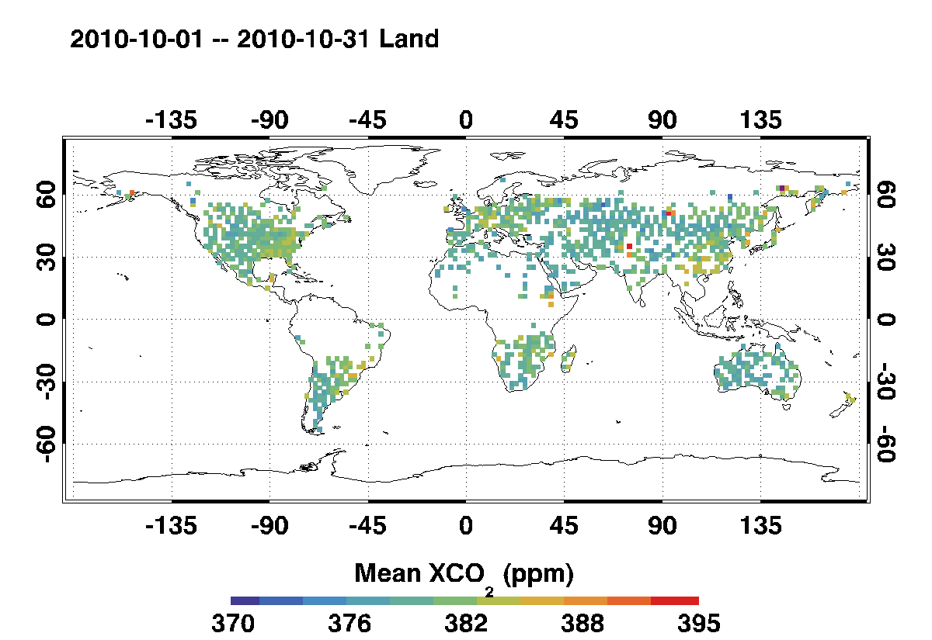
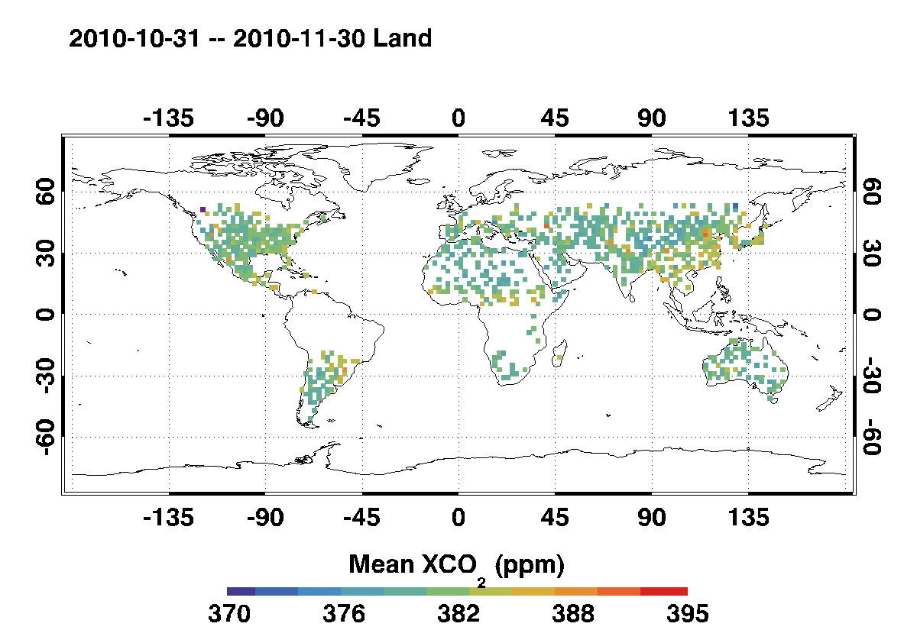
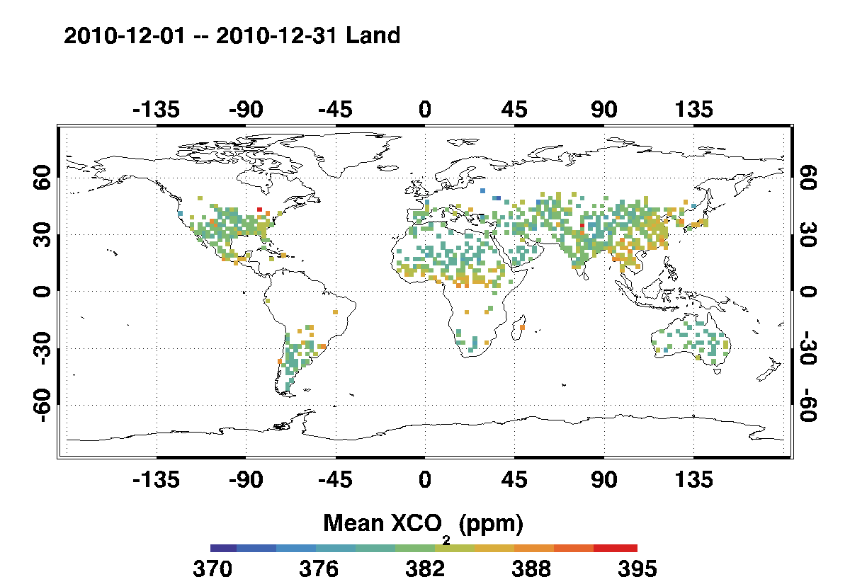
Experiences with its operations: A Year of ACOS/GOSAT X_{CO2}

Slide 17
ACOS GOSAT Data Release
The ACOS L2 Standard Products are now being distributed on the GSFC Mirador site.
http://mirador.gsfc.nasa.gov/
You can find the data, along with a README and a Data Quality Statement at the site:
http://disc.sci.gsfc.nasa.gov/acdisc/documentation/ACOS.shtml

Slide 18
Conclusions and Future Plans
The ACOS/GOSAT collaboration is returning benefits to both teams
The OCO-2/ACOS retrieval algorithm is:
currently in place and is generating a production product for GOSAT
still evolving, to address know errors and biases
The vicarious calibration experiments have helped to identify and correct for changes in the pre-launch GOSAT calibration parameters.
Comparisons with TCCON measurements have revealed a global, -2% bias in the preliminary ACOS X_{CO2} retrievals
About 2/3 of this bias can be attributed to a +10 hPa bias in the retrieved surface pressure
Lessons learned from this experience are expected to substantially accelerate the delivery of high quality products from the OCO-2 mission, which is currently scheduled for launch in February 2013

