Slide 1
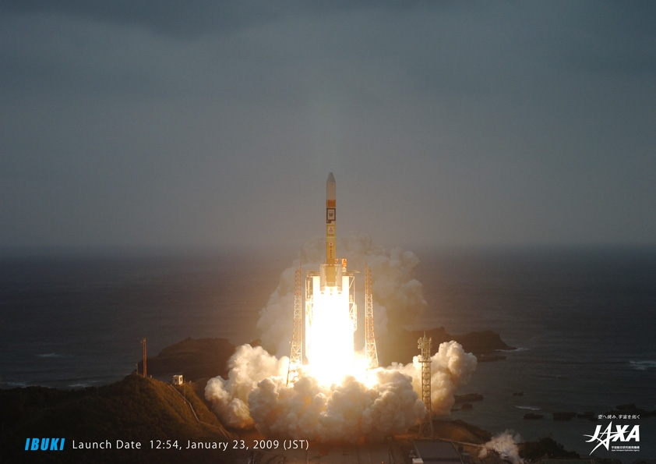
Question 8: Japan’s Greenhouse Gases Observing Satellite, GOSAT, and its IR hyperspectral sensor, TANSO-FTS, measuring CO₂ and CH₄:
  What was its intended range of applications?
  How well has it performed?
  What are the experiences with its operations?
  What are the future plans?
Henry L Buijs, ABB/BOMEM
David Crisp JPL/CALTECH
For
Hiroshi Suto, EORC/JAXA
Hyper Spectral Workshop, Miami

Slide 2
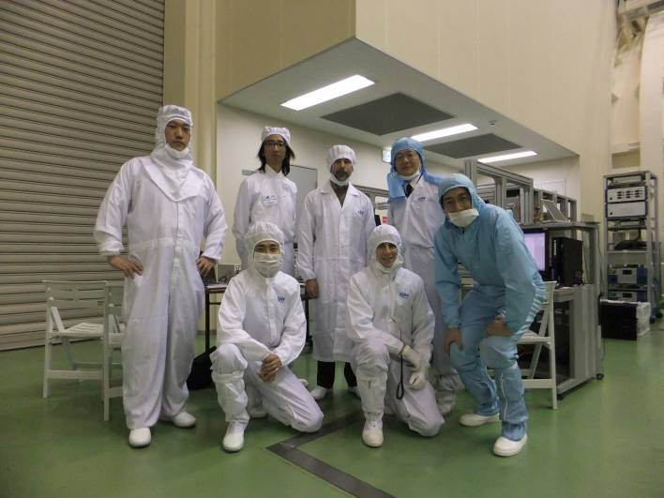
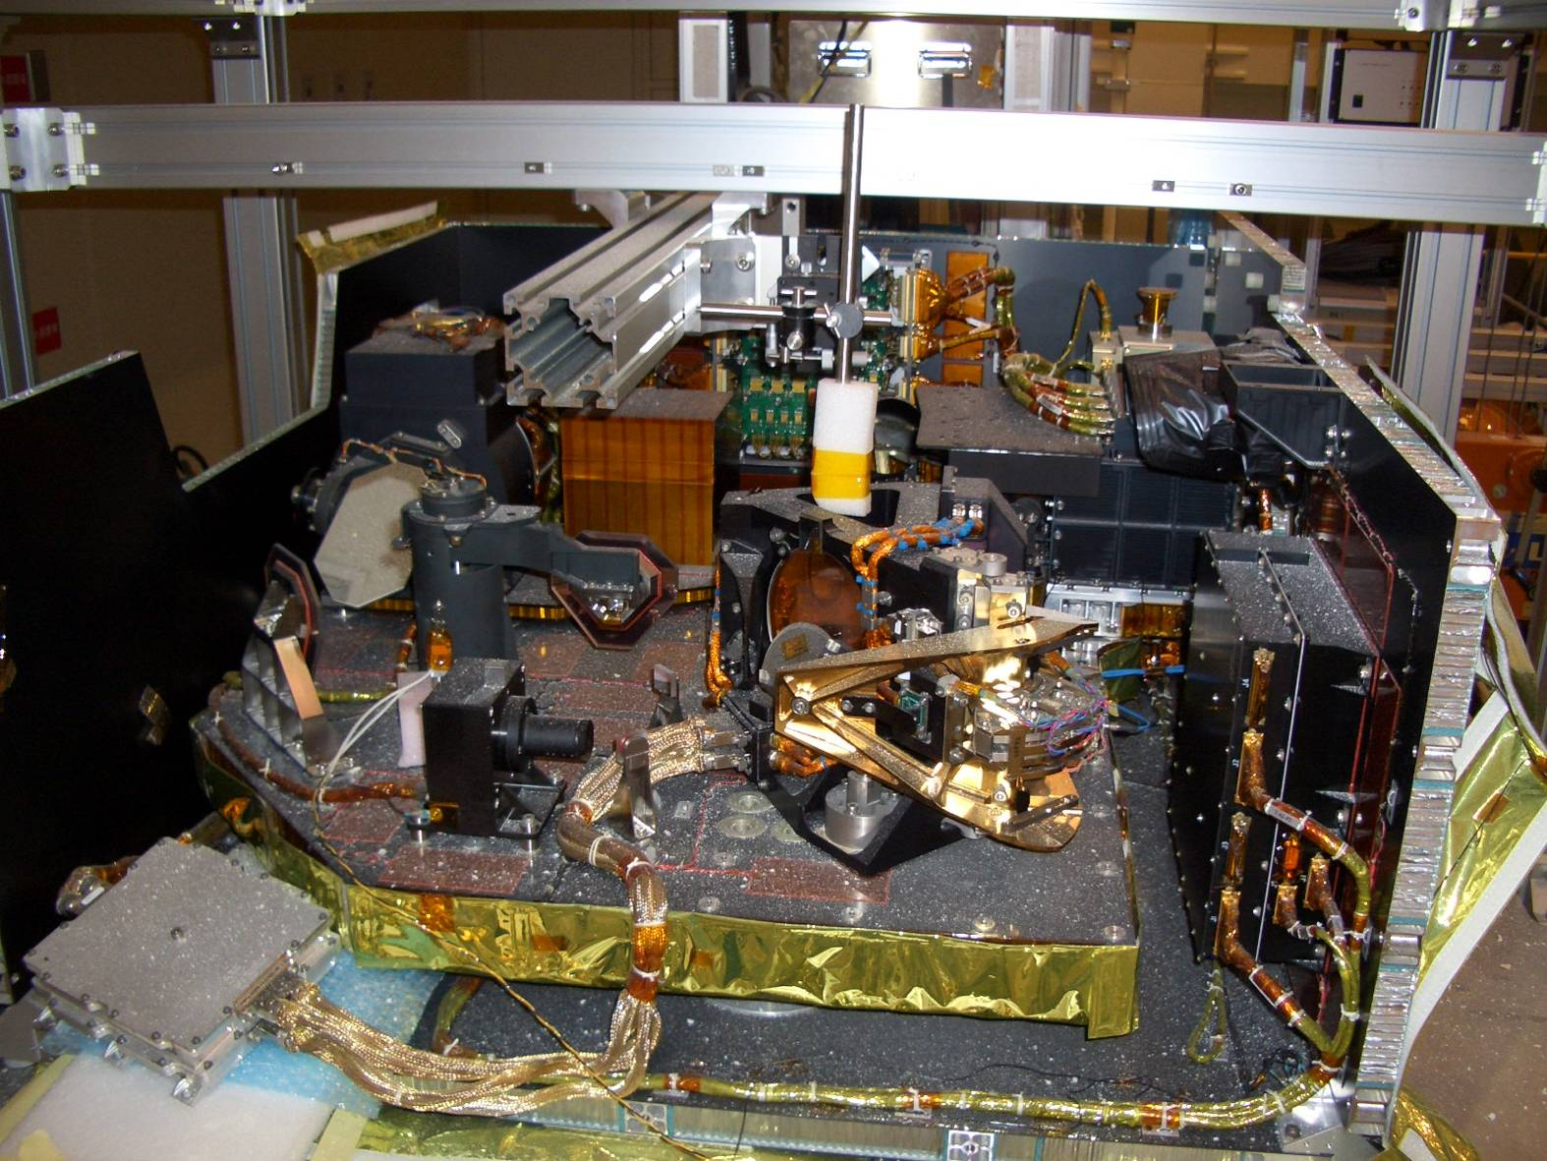
Great Earthquake
2011/03/11
2011/03/17
We hope we will be back from this serious situation.

Slide 3
Program Overview
GOSAT
  Greenhouse gases Observing SATellite.
  Nickname = “IBUKI”
  Goal of mission
  To monitor the global distribution of Green House Gases (GHG’s), especially, the CO₂ and the CH₄.
  -with relative accuracy of 1% for CO₂ and 2% for CH₄
  To reduce sub-continental scale CO₂ annual flux estimation errors by half
  - 0.54GtC/yr to 0.27GtC/Yr
(C)NIES

Slide 4


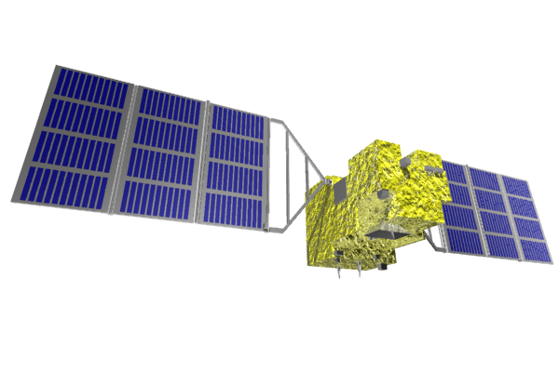




Organization
GOSAT is the joint project of JAXA, MOE (Ministry of Environment) and NIES (National Institute for Environmental Studies).
MOE
JAXA
Sensor development
Satellite development
H-IIA launch
Satellite operation
Data acquisition
Calibration
  Algorithms development
  Data use for science
  Validation
NIES
Satellite:
Mission Instruments:

Slide 5
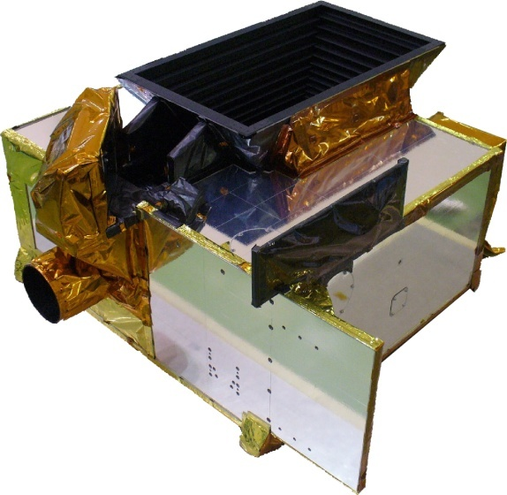
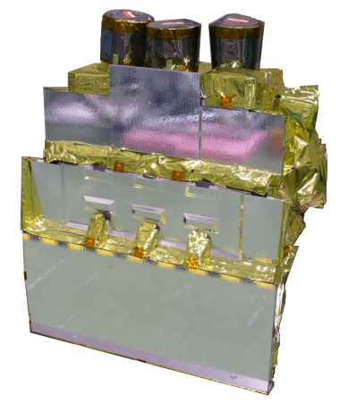
TANSO onboard GOSAT
Size | Main body | 3.7 m x 1.8 m x 2.0 m （Wing Span 13.7m）
Mass | Total | 1750kg
Power | Total | 3.8 KW (EOL)
Life Time | 5 years
Orbit | sun synchronous orbit
 | Local time |  | 13:00+/-0:15
 | Altitude |  | 666km
 | Inclination |  | 98deg
 | Repeat |  | 3 days
Launch | Vehicle |  | H-IIA
 | Schedule |  | Jan. 23 2009
TANSO=Thermal And Near infrared Sensor for carbon Observation
TANSO-FTS
(Fourier Transform Spectrometer)
SWIR reflected on the earth’s surface
-TIR radiated from the ground and the atmosphere
Mass: 15 kg
Volume: 34 cm x 22 cm x 24 cm
97.1% reliability (predicted)
TANSO-CAI
(Cloud and Aerosol Imager)
Ultraviolet (UV) (0.38 micron), visible (0.67 micron), NIR (0.87 micron), and SWIR (1.6 micron)

Slide 6
TANSO FTS characteristics
 | Band1 | Band2 | Band3 | Band4
Spectral coverage (μm) | 0.758-0.775 | 1.56-1.72 | 1.92-2.08 | 5.56-14.3
FWHM(cm-1) | 0.6 | 0.27 | 0.27 | 0.27
Spectral resolution(cm-1) | 0.2
Dynamic Range H | 5.5e-7 | 5.2e-7 | 3.8e-7 | 340K
Dynamic Range M | 1.8e-6 | 1.7e-6 | 1.3e-6
Dynamic Range L (W/cm2/sr/cm-1) | 5.7e-6 | 5.2e-6 | 3.8e-6
SNR gain H / IGM 4s | 300
Wave number (cm-1) | 13050cm-1 | 6200cm-1 | 5000cm-1 | 700cm-1
input radiance (W/cm2/sr/ cm-1) | 5.5e-7 | 5.2e-7 | 3.8e-7 | 280K
IFOV at Nadir | 15.8mrad / 10.5km

Slide 7
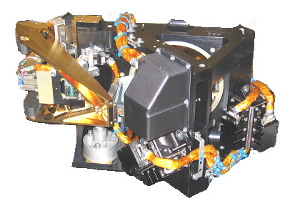
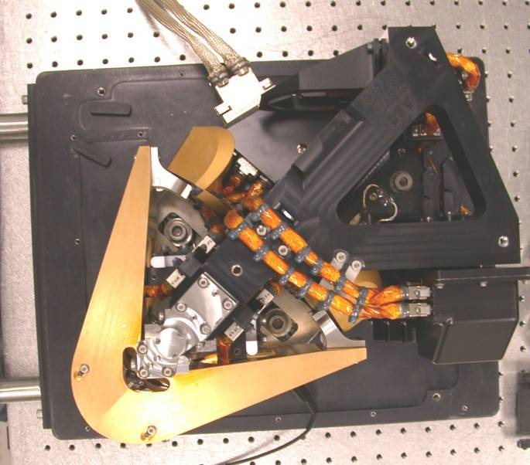
TANSO FTS characteristics
Michelson-like
Cube corners on “V”-shape scan arm
Double-sided sweep, 2.5 cm MPD (0.2 cm⁻¹ resolution)
Self-compensated beamsplitter (proprietary)
Laser metrology based on 1310 nm laser diodes
  Fringe count for actuator servo-control + IR sampling
  Direction determination
Aluminum structure
  Flex mounts to interface with carbon fiber optical bench

Slide 8
Spectral Coverage and Absorption Lines
3 narrow bands
  0.76micron
  1.6micron and
  2micron
A wide band
  5.5 – 14.3 micron
With 0.2cm⁻¹ spectral resolution
Column density of CO₂ is mainly retrieved by using the absorption lines between 1.6micron (Band 2) region.
  The intensities of these lines are less temperature dependent and not interfered by other molecules.
O₂ A band absorption at 0.76 micron are used to estimate the effective optical path length.

Slide 9
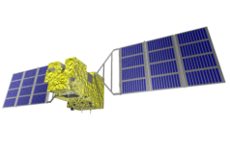


Pointing and Footprints
cross track patterns
Cross Track | X km | Y km
1 | 789 | 90
3 | 263 | 283
5 | 158 | 152
7 | 113 | 115
9 | 88 | 86
Camera FOV > 30 km
TANSO FTS IFOV=10.5 km
TANSO CAI IFOV=0.5, 1.5 km
SWATH 900km
North
TANSO-CAI
IMC ID=5
Camera
Equator
Sun Glint
West
TANSO-FTS
Polarization Bands
P
East
S
South

Slide 10
Scanning modes
Observation per IFOV
  Selectable, 1.1 s., 2 s. and 4s.
  Scan times are synchronized to orbit time
    To permit precise revisit location every 3 days
Selectable number of cross track IFOVs
Also specific target selection
  Including sun glint tracking over water

Slide 11


Operation
  Solar Irradiance Cal.
FTS SWIR & TIR
CAI
  Lunar Cal
Solar Flux
  FTS TIR
Day side
Night side
Special observation mode: FTS-Diagnostic Mode,
Viewing the diffused LD light during a few orbit.

Slide 12
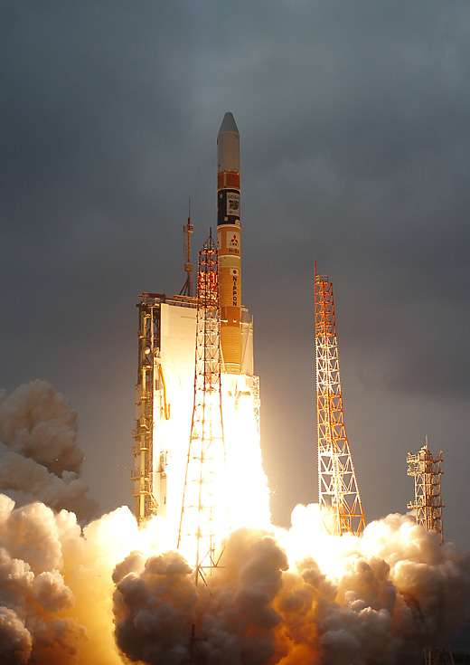
How well has it performed?
GOSAT was successfully launched from Tanegashima Space Center on a H-IIA Launch vehicle on 23 January 2009
“First Light” images and spectra taken on 9 February 2009
Initial Cal/Val completed an routine operations started in July 2009
  First global maps collected in April 2009
First Level 2 X_{CO2} and X_{CH4} products released in February 2010
3 Research Announcements released
  106 proposals have been selected
  Next RA Meeting: 19-20 May, Edinburgh, U.K.

Slide 13
How well has TANSO-FTS performed?
FTS exceeds signal to noise ratio expectations in all bands
Spectral quality is very good
  Very accurate ILS
  Very stable repeatable spectra
Requires correction algorithm for vibration resonance effect
4s. Scan time gives best results
  Has precise compensation for vibration influence
Minor non-linearity effect due to ADC in band 1
  Correction algorithm being developed.
Calibration issues with Thermal IR band 4
Goal of mission not yet achieved
  Retrieval issues still being worked

Slide 14
First FTS Data
Successfully detected from space at Visible (760nm) and SWIR(1.6, 2.0um) with High resolution.

Slide 15
TANSO-FTS Anomalies
A few anomalies have been identified and are under investigation
10-20 % of recorded interferograms have anomalous fluctuations.
  Can be distinguished by checking level 1 data quality flag.
TANSO-FTS Zero Path Difference (ZPD) shift
  Problem mitigated by resetting FTS once every 2 weeks
Sampling laser signal level decreases very slowly due to misalignment
  No impact on performance (small wavelength shift).
TANSO-FTS onboard camera data detected a few km pointing offset .
Radiometric response degradation has been observed
  The largest impacts seen at the shortest wavelengths
TANSO-FTS Band 1 Nonlinearity – Currently under investigation
15

Slide 16
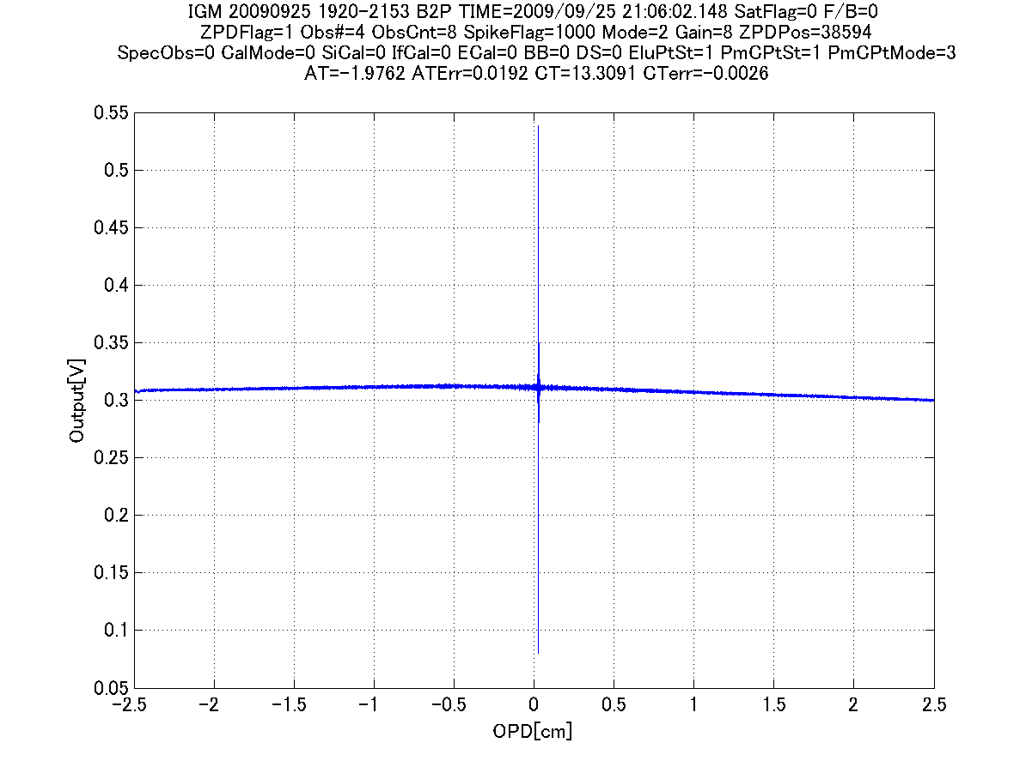
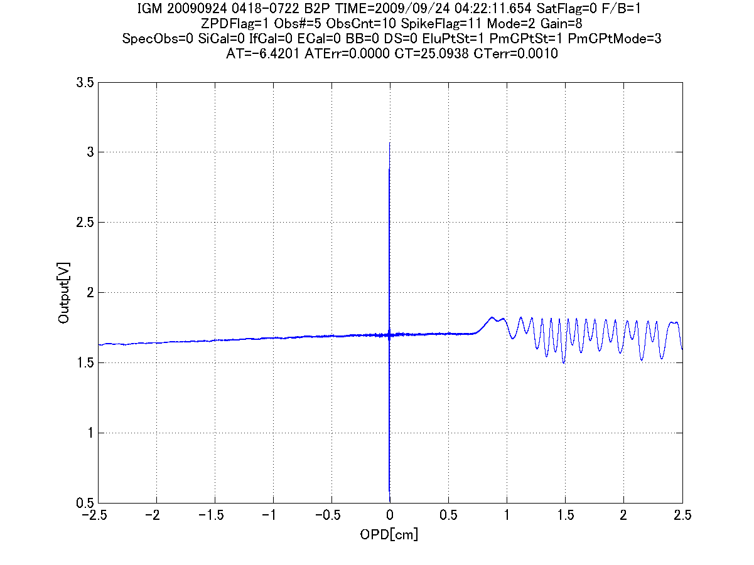
Pointing AT-Instability
Typical “good” IGM
Typical “anomaly” IGM
Before v.050, we can not assigned these type of IGM by listed flags.
16
Notes:
16

Slide 17
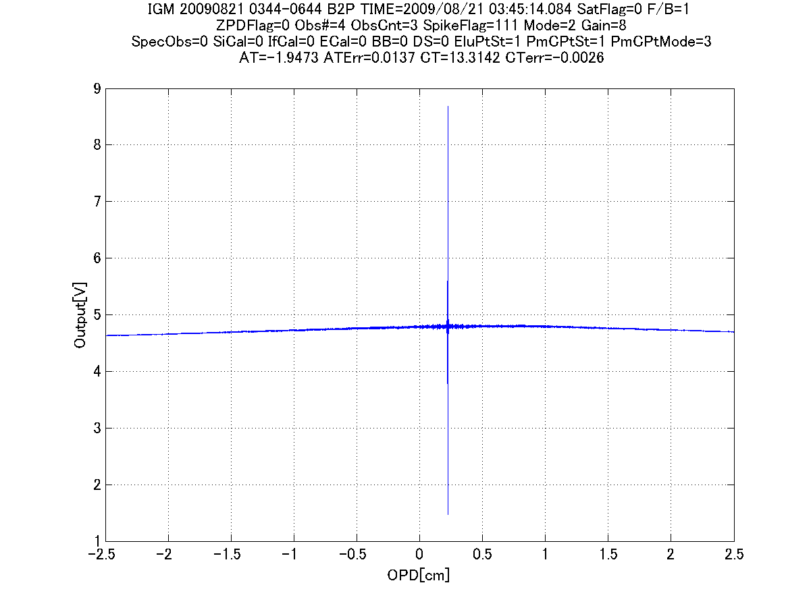
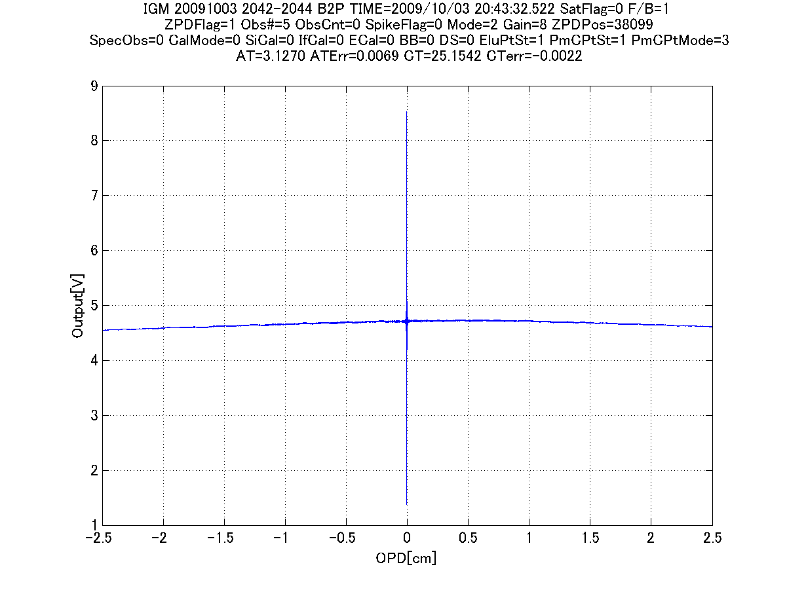
ZPD shift (1/2)
From 04 May. UT6:00, the change of Zero Path Difference Position (ZPD) was observed.
The changing speed and number are random, no regularity
17

Slide 18
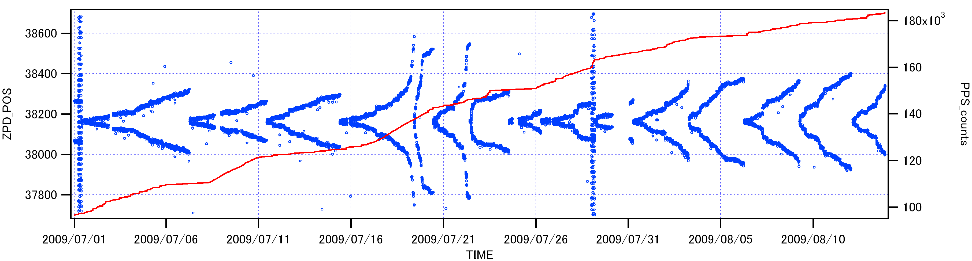
ZPD shift (2/2)
To avoid the large shifts, ZPD position is corrected if necessary.
(Criteria is +/- 40 shifts)
18
Notes:
18

Slide 19
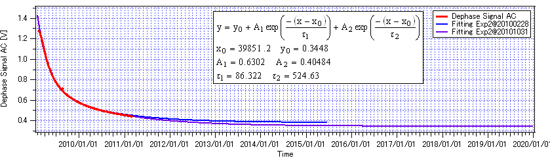
Degradation of sampling signal
  All level of sampling signal (phase/dephase, AC/DC: to determine the mirror position) are decreasing on-orbit.
  >> Fitting curve suggests us that the degradation speed tend to be slow and stop in near future.
The trend of Dephase AC signal
(lowest signal in critical signal, Fringe/Dephase AC)
19
Notes:
19

Slide 20
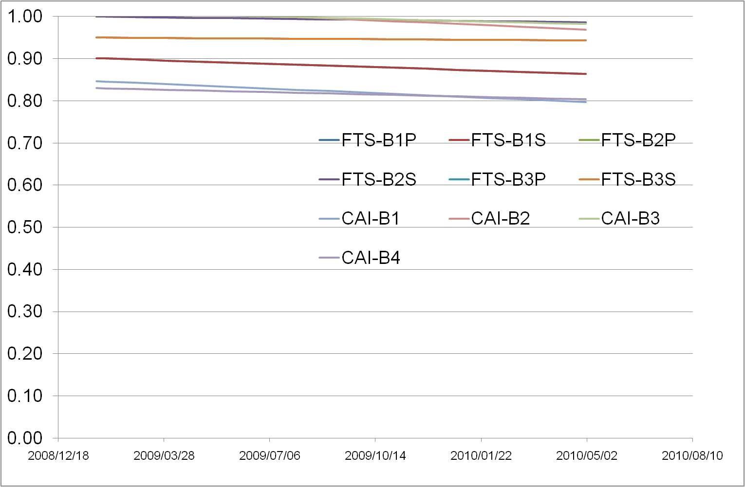
Radiometric Degradation
  Band1 degradation might be mainly caused by just after launch or pre-launch calibration error.
20

Slide 21
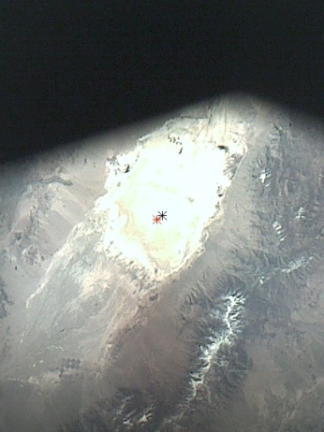
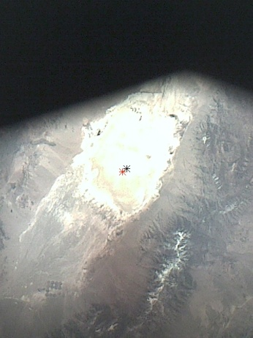
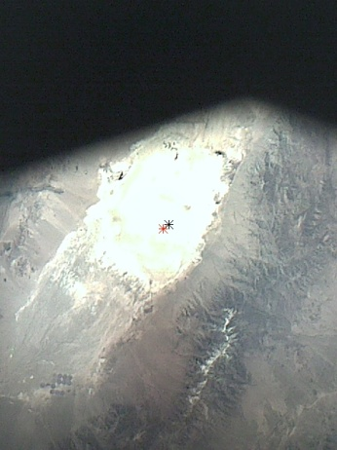
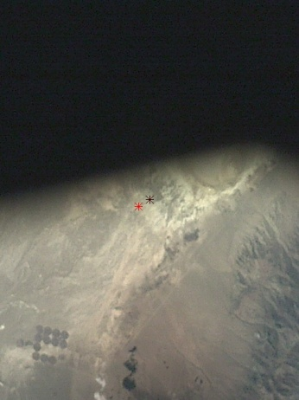
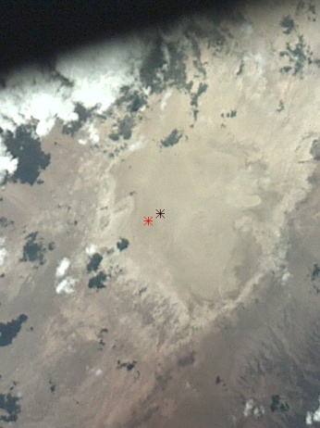
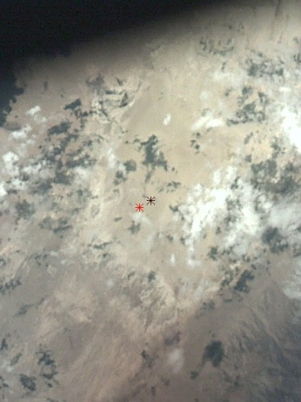
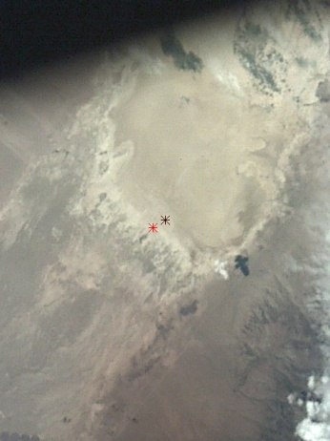
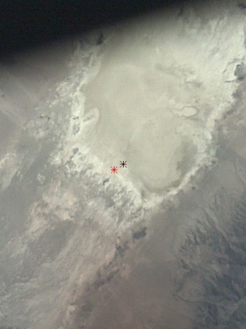
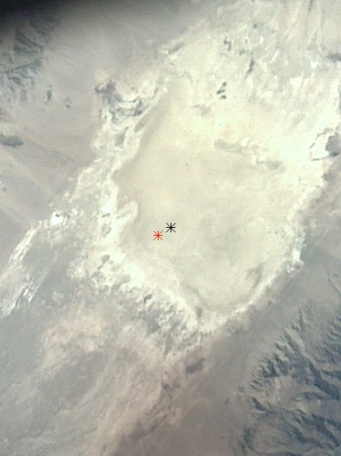
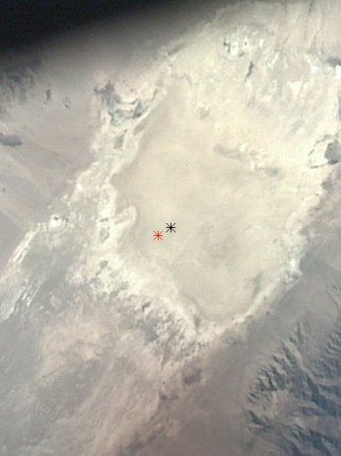
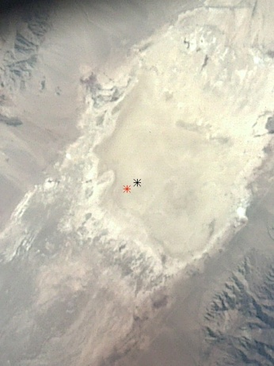
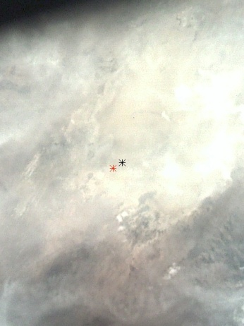
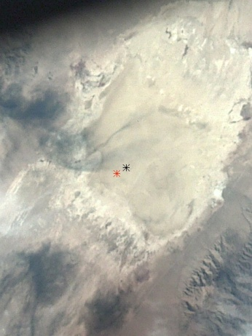

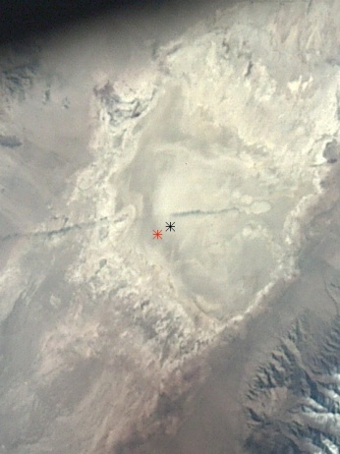
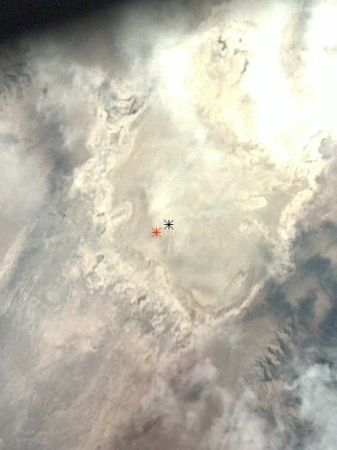
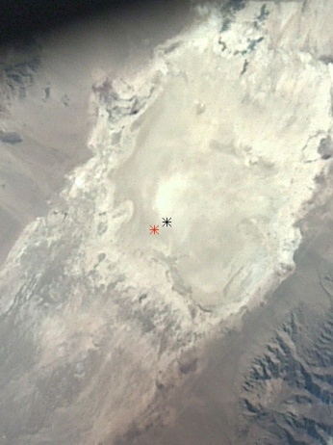
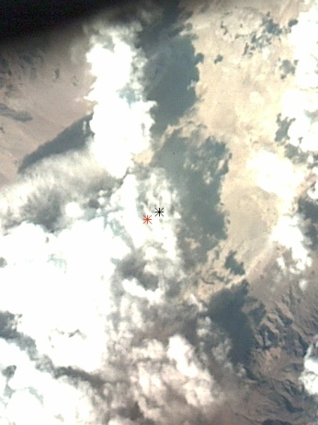
Pointing anomaly
4/27
4/30
5/6
6/23
6/26
6/29
7/2
7/5
10/3
10/6
10/9
10/12
10/15
10/18
10/21
10/24
10/27
10/30
21

Slide 22
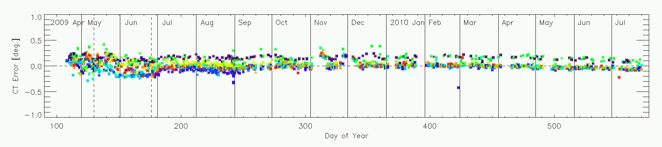
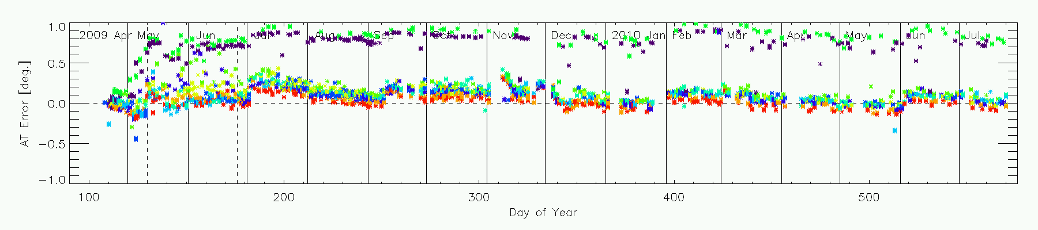
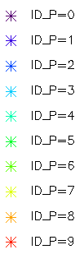
Pointing anomaly (5 point mode)
Pointing target position error was analyzed applying onboard Camera image.
Pointing has systematic offset values that are changing with time.
  Along-track (AT) values show greater offsets than Cross-track (CT)
CT
AT
22
Notes:
22

Slide 23
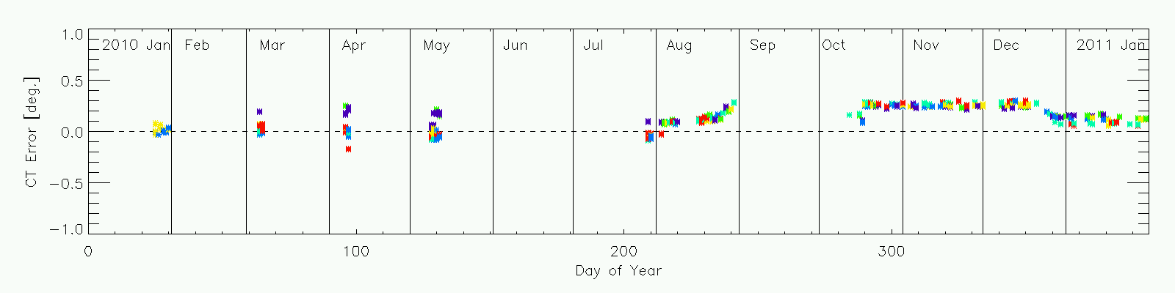
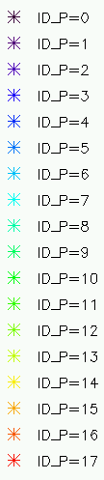
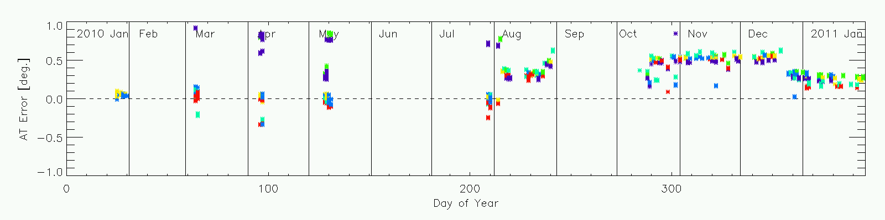
Pointing anomaly (3 point mode)
Pointing target position error was analyzed using onboard Camera images.
Pointing still has systematic offsets that change with time, but both amplitude of offset and variability are substantially smaller in 3-point mode
CT
AT
23
Notes:
23

Slide 24
Radiometric Degradation
Vicarious Calibration Campaign | Days from Launch | TANSO-FTS |  |  | TANSO- CAI
 |  | B1 | B2 | B3 | B1 | B2 | B3 | B4
June 23-July 4, 2009 | 160 | -11±7% | -3±7% | -4±7% | -17% | +4% | 0% | -18%
June 21-22 2010 | 520 | -14±5% | -2±5% | -6±5% | -21% | -4% | -4% | -20%
  Band1 FTS and CAI degradation may have occurred just after launch or may be due to a pre-launch calibration error.
24

Slide 25
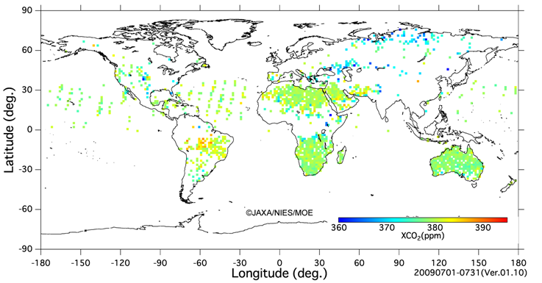
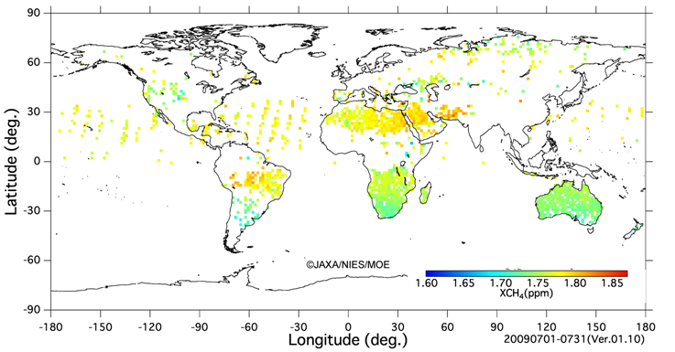
Global Map for GHG
NIES is using the GOSAT measurements to retrieve X_{CO2} and X_{CH4}
These data have biases, and are affected by dust aerosols, however, the overall data distribution trend is reasonable.
XCO2 2009/07
The retrieved results will be revised as the instrument calibration and retrieval algorithms improve.
XCH4
2009/07
25

Slide 26
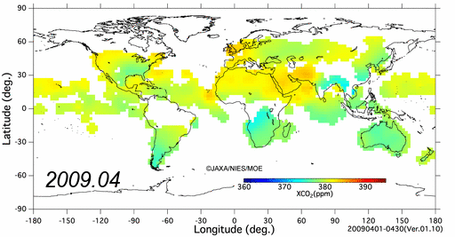
Global Map for GHG
Level 3 data provided by NIES
26

Slide 27
Biases for GOSAT Data
  Biases of CO₂ and CH₄ (+8.9ppm and +0.02ppm)
  Surface pressure bias might be main cause.
  - Band1 non-linearity (mainly caused by 16bit ADC character)
  - Band1 ILSF
  - aerosol handling
  NIES, ACOS and JAXA will try to find a solution.
27

Slide 28
Summary of GOSAT Performance
GOSAT has been successfully collecting global measurements needed to retrieve X_{CO2} and X_{CH4} since April 2009
While a few instrument anomalies have been identified, their impacts on the GOSAT data products are being mitigated through
  An on-orbit radiometric calibration program, incorporating
    Direct observations of the lunar disk
    Observations of reflected sunlight from primary and backup targets
  An on-orbit geometric calibration program using internal cameras
  Annual vicarious calibration campaigns in Railroad Valley, Nevada
  Laboratory measurements using the GOSAT Engineering Model
GOSAT Level 1B products can be obtained from:
http://data.gosat.nies.go.jp/

