Slide 1
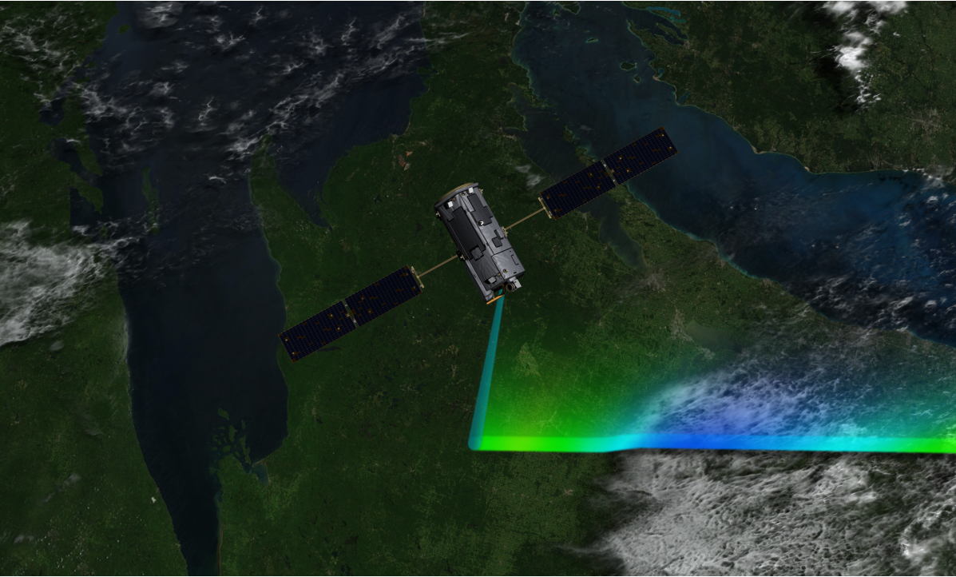
Satellite Hyperspectral Sensor Workshop
The NASA OCO-2 CO₂ directed satellite mission:
What does NASA consider as its capabilities?
Operational uses by NOAA?
What does NASA consider as an appropriate NOAA operational follow-on mission
D. Crisp
Jet Propulsion Laboratory, California Institute of Technology
OCO-2 Science Lead
30 March, 2011
Copyright 2011 California Institute of Technology. Government sponsorship acknowledged.

Slide 2
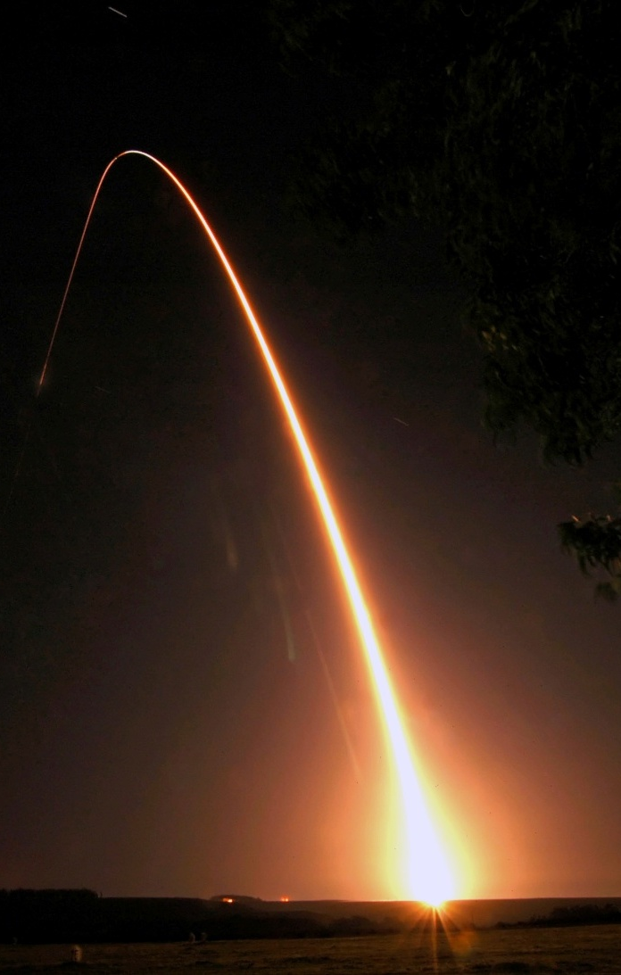
The Loss of OCO and the Birth of OCO-2
NASA’s Orbiting Carbon Observatory (OCO) was designed to provide the measurements needed to estimate the atmospheric CO₂ dry air mole fraction (X_{CO2}) with the sensitivity, accuracy, and sampling density needed to quantify regional scale carbon sources and sinks over the globe and characterize their behavior over the annual cycle.
February 2009: The OCO spacecraft was lost when its launch vehicle’s fairing failed to deploy
December 2009: The U.S. Congress added funding to the NASA FY2010 budget to restart the OCO Mission
The OCO-2 spacecraft bus and instrument are currently on track for a February 2013 launch
1:55 AM
24 Feb 2009
Notes:
OCO is designed to provide the data needed to find the missing pieces of the carbon puzzle (sinks)

Slide 3
Capabilities of OCO-2
A decade ago, when the OCO mission was proposed, the primary objective was to acquire global, space-based observations of CO₂ with the precision, coverage, and resolution needed to characterize regional scale natural CO₂ sinks, which are now absorbing more than half of the CO₂ that is being emitted by human activities
More recently, the interest in global, space-based observations of greenhouse has intensified, but the focus has shifted, emphasizing the need to quantify emissions from human activities
  The current emphasis is on monitoring treaty compliance and the efficacy of greenhouse gas mitigation strategies
This change in focus, combined with new insight into the carbon cycle has introduced new challenges for remote sensing observations of greenhouse gases
While OCO-2 is not optimized for that mission, it will provide opportunities to validate observation strategies for future CO₂ monitoring missions

Slide 4

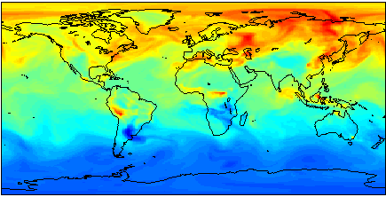
Global Measurements are Essential
To limit the rate of atmospheric carbon dioxide buildup, we must
  Control emissions associated with human activities
  Understand & exploit natural processes that absorb carbon dioxide
We cannot manage what we cannot measure
Identifying sources and sinks of atmospheric carbon dioxide from atmospheric measurements is intrinsically challenging
Kawa et al., 2008
Plumes from medium-sized power plants (4 MtC/yr) elevate X_{CO2} levels by ~0.5% (2ppm) for 10’s of km downwind [Yang and Fung, 2010].
372
380
  Variations of CO₂ are rarely larger than 1-2% on 100 – 1000 km scales

Slide 5
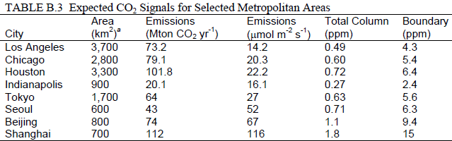
Is 1 ppm Good Enough?
Large metropolitan areas with strong, discrete sources are easier to detect, but also rarely produce full column X_{CO2} perturbations larger than 1 ppm
PBL (1 km)
(1) Committee on Methods for Estimating Greenhouse Gas Emissions Board on Atmospheric Sciences and Climate Division on Earth and Life Studies, National Research Council of the National Academy of Science, National Academies Press, 2010.
A satellite instrument with a 1 ppm sensitivity over a ~100 km down-track segment of its orbit might not detect Los Angeles, Chicago, Houston, or Tokyo.

Slide 6
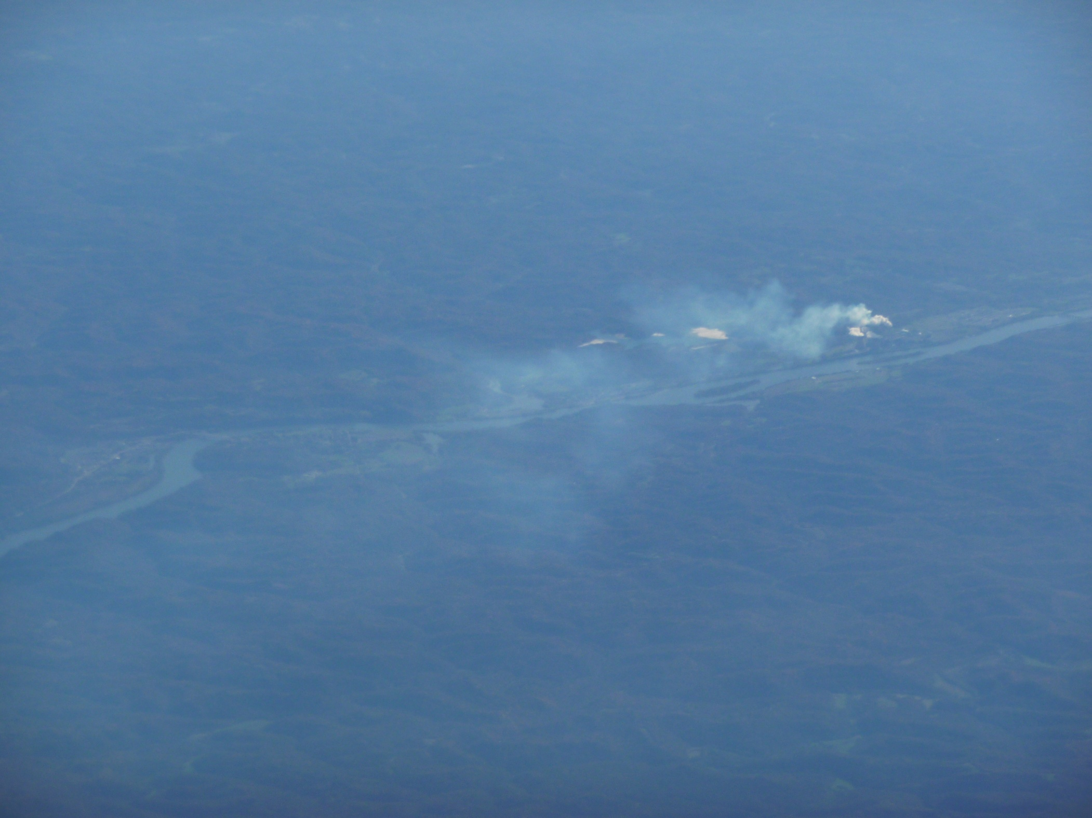
The Minimum Measurable Point Source Flux
For a satellite like OCO, designed to measure the column averaged dry air mole fraction, X_{CO2}, the minimum measurable flux can be approximated as follows:
  Assume the minimum detectable change in X_{CO2} is ΔXCO2_{min} (e.g. 1 ppm)
  If the CO2 flux, F, is constant over an accumulation time interval, t, the change in XCO2 is given by: ΔXCO2 = F⋅ t
  If we have an average horizontal wind speed, u(θ ), in direction, θ , over time, t, and a footprint has a horizontal dimension, x(θ ), then the residence time, t = x/u
  The minimum increase in the vertical column is therefore related to the minimum detectable flux as follows
  ΔXCO2_{min} = F_{min} ⋅ x / u
  Rearranging, gives
  F_{min} = u ⋅ ΔXCO2_{min} / x
For a given X_{CO2} sensitivity, the minimum measureable CO₂ flux is proportional to wind speed and inversely proportional to footprint size

Slide 7
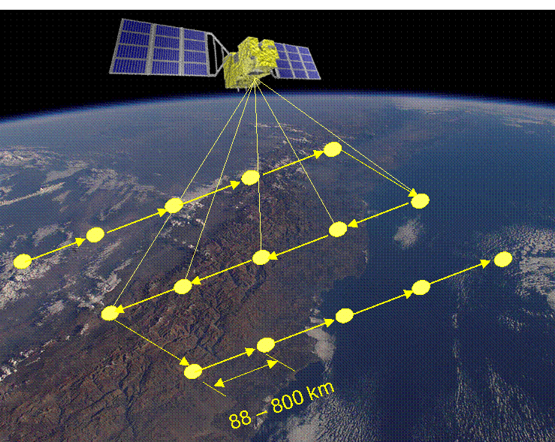
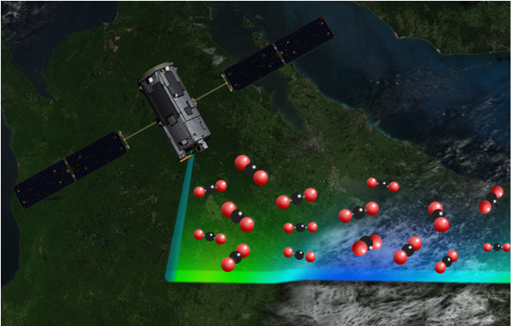
OCO-2 and GOSAT
GOSAT
 | GOSAT | OCO
Gases Measured | CO₂, CH₄, O₂, O₃, H₂O | CO₂, O₂
Instruments | SWIR/TIR FTS, CAI | Grating Spectrometer
IFOV / Swath (km) | FTS: 10.5 / 80-790 (160) CAI: 0.5 / 1000 | 1.29 x 2.25 / 5.2-10.4
Spectral Ranges (µm) | 0.758-0.775, 1.56-1.72, 1.92-2.08, 5.56-14.3 | 0.757-0.772, 1.59-1.62, 2.04-2.08
Soundings/Day | 10,000 | 500,000 to 1,000,000
Sampling Rate | 0.25 Hz | 12 to 25 Hz
Orbit Altitude | 666 km | 705 km
Local Time | 12:48 | 13:30
Revisit Time/Orbits | 3 Days/72 Orbits | 16 Days/233 Orbits
Launch Vehicle | H-IIA | Taurus 3110 (TBD)
Launch Date | January 2009 | February 2013
Nominal Life | 5 Years | 2 Years
GOSAT was optimized for spectral & spatial coverage
OCO-2
OCO-2 was optimized for sensitivity and resolution

Slide 8
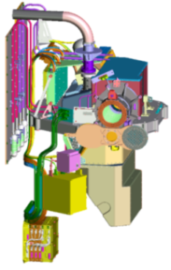
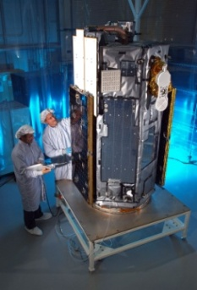
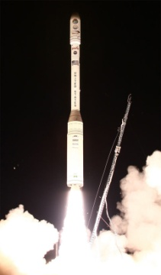
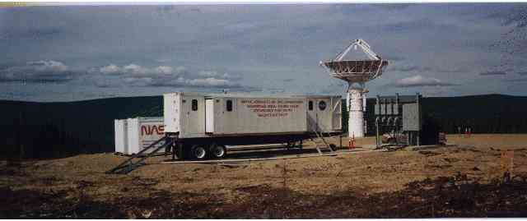

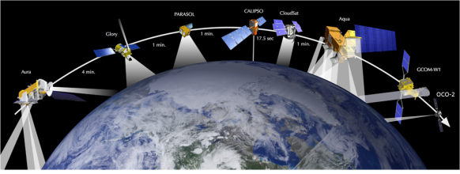
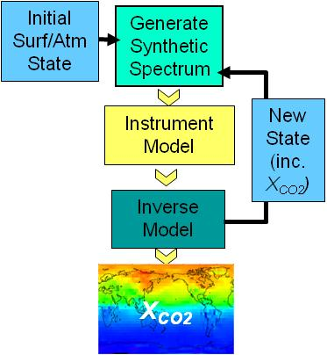
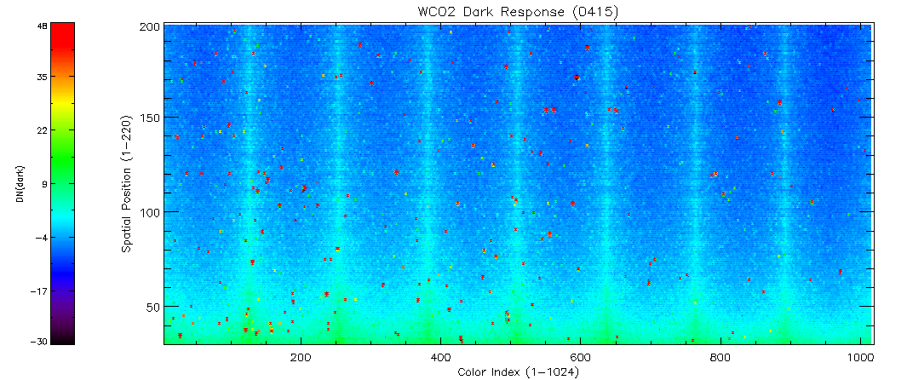
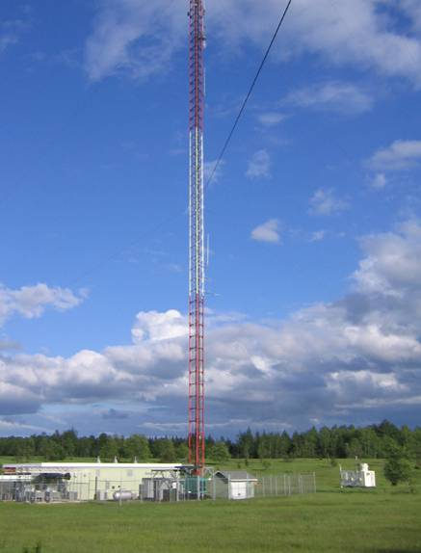



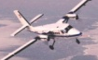
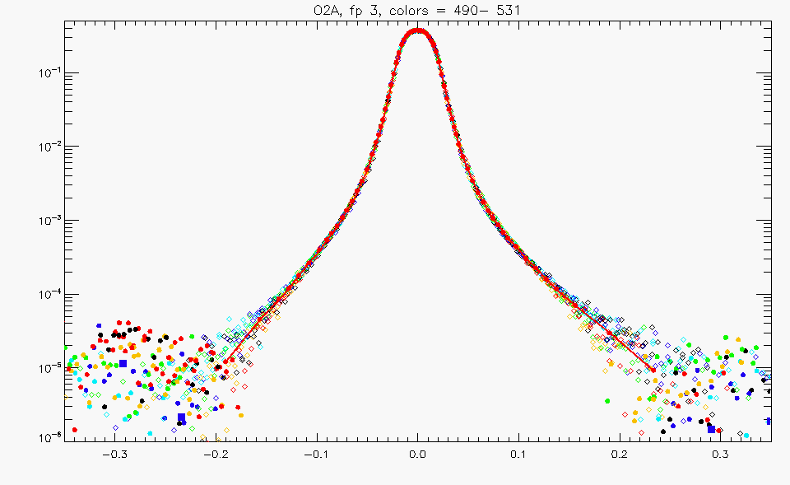
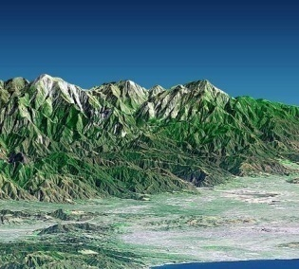

OCO Mission Overview
3-Channel Spectrometer
Dedicated Spacecraft bus
Dedicated Launch
Vehicle
“Routine”
Mission Operations
Formation Flying as part of the A-Train Constellation
NASA NEN (GSFC) and SN (TDRSS)
Validation Program
Science Data Operations Center (JPL)
Products Delivered to a NASA Archive
L2 X_{CO2} Retrieval
Calibrate Data
Please visit http://oco.jpl.nasa.gov for more information

Slide 9
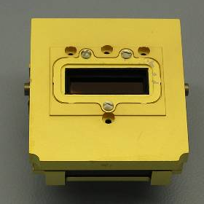
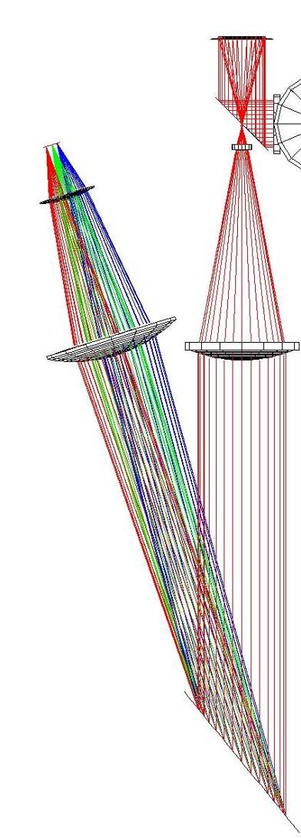

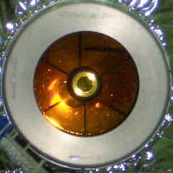
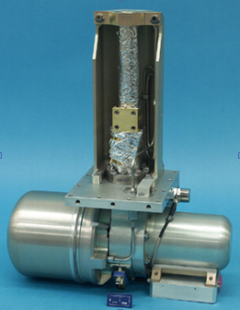
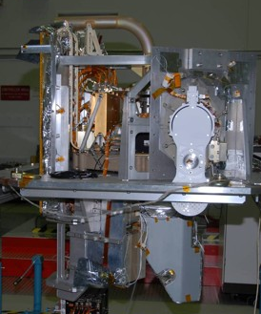
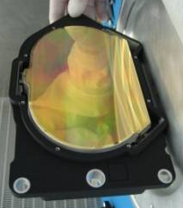
The OCO-2 Instrument
3 co-bore-sighted, high resolution, imaging grating spectrometers
  O₂ 0.765 μm A-band
  CO₂ 1.61 μm band
  CO₂ 2.06 μm band
Resolving Power > 20,000
Optically fast: f/1.8 (high SNR)
Swath: < 0.8° (10.6 km at nadir)
  8 cross-track footprints
  1.29 x 2.25 km at nadir
Mass: 140 kg, Power: ~105 W
Changes from OCO
  Design modified to mitigate residual image & slit alignment anomalies found in testing
  New cryocooler
Beamsplitter
&Pre-Filter
Relay
Optics
FPA
Polarizer
Cold
Filter
Slit
Telescope/
Recollimator
Camera
Collimator
Cryocooler
Light
Trap
Grating

Slide 10
Information Content of OCO-2 Spectra
O₂ A-band at 760 nm provides constraints on surface pressure, optical path length, and thin cloud/aerosol distribution
Absorption in weak CO₂ band at 1610 nm is almost linearly dependent on CO₂ column
Strong CO₂ band at 2060 nm
  Somewhat less sensitive to the CO₂ column abundance
  Very sensitive to clouds and aerosols
  Also sensitive to water vapor column abundance and temperature profile
Simultaneous retrievals in these three band provide X_{CO2} estimates

Slide 11

OCO-2 Spacecraft
Orbital Sciences LEOStar-2 Bus
  0.94 m x 2.1 m hexagonal structure
  128 Gb of data storage
  150 Mb/s X-band + 2 Mb/s S-band
  3-axis stabilized: 4 Reaction wheels + 3 torque bars
  Articulated solar arrays
  Propulsion system for orbit maintenance
Minimal changes to replace obsolete parts
    RAD6000 modified to replace the static read-only memory (SRAM)
    S-band updated from analog to digital
    Reaction wheels modified to address lifetime issues
    Star tracker replaced with new model
    Obsolete Si course sun sensors replaced with GaAs sensors

Slide 12
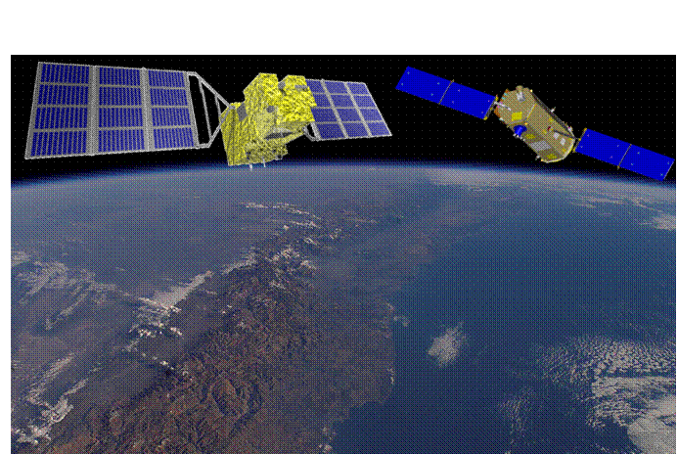

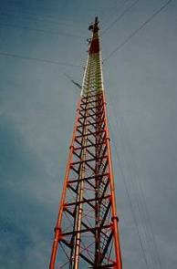
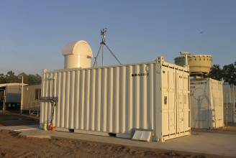

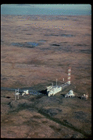

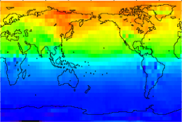

Measuring CO₂ from Space
Record spectra of CO₂ and O₂ absorption in reflected sunlight
Retrieve variations in the column averaged CO₂ dry air mole fraction, X_{CO2} over the sunlit hemisphere
Validate measurements to ensure X_{CO2} accuracy of 1 - 2 ppm (0.3 - 0.5%)
Initial Surf/Atm
State
Generate Synthetic Spectrum
OCO/AIRS/GOSAT
Instrument Model
New State (inc. X_{CO2})
Difference Spectra
FTS
Tower
Inverse Model
Aircraft
X_{CO2}
Flask
Notes:
The OCO mission was developed specifically to address these issues.
This small NASA mission will collect the space based CO2 measurements needed to identify CO2 sources and sinks and quantify their variability over the seasonal cycle.
The approach is similar to that of the GOSAT mission.
OCO will measure CO2 and oxygen absorption in the spectrum of reflected sunlight.
Our team will use these data to determine the spatial variability of a quantity called the “column averaged dry air mole fraction, or XCO2”. This is a measure of the CO2 concentration in the air
We will then validate these measurements against the best available CO2 data to verify their accuracy.
This validation is essential, because as you will see, the CO2 measurements that we are proposing to make are among the most precise measurements ever attempted from a space-based platform.

Slide 13
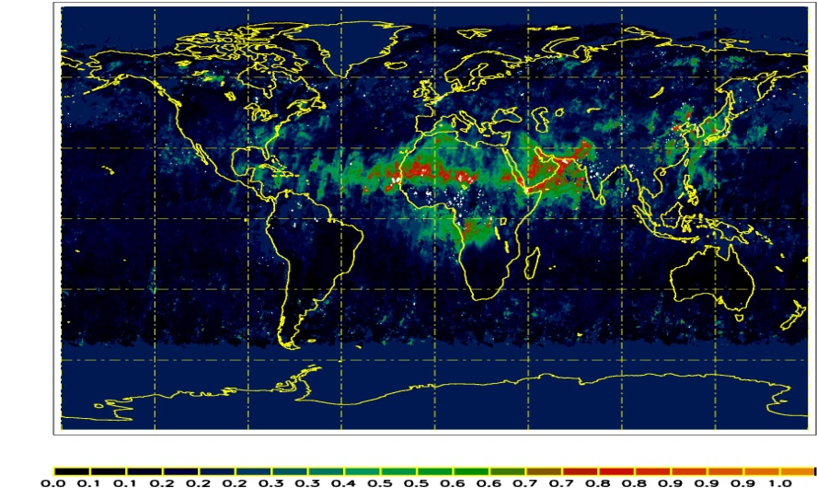
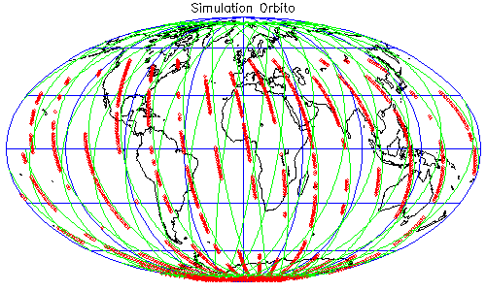
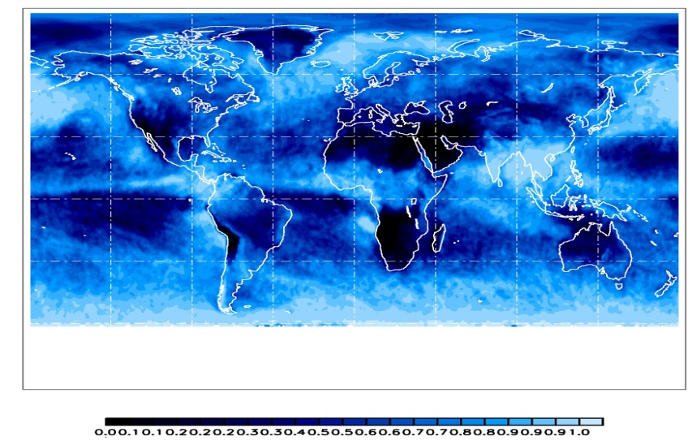
Spatial/Temporal Sampling Constraints
1-Day
MISR Aerosol
Factors Limiting Sampling Density
Orbit ground track
Clouds and Aerosols
  OCO can collect usable samples only in regions where the cloud and aerosol optical depth < 0.3
Low surface reflectance
Very rough surfaces
MODIS Cloud

Slide 14
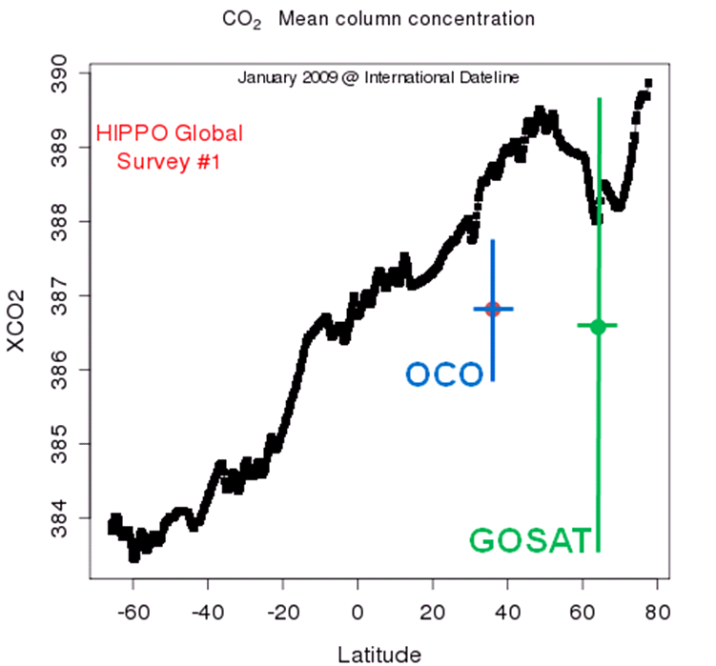
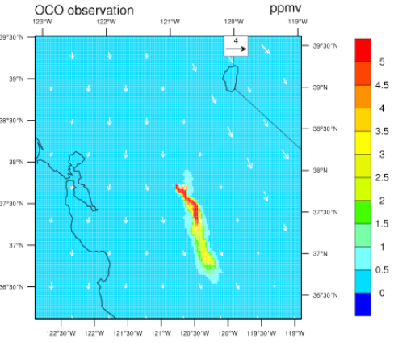
OCO-2 Is Optimized for High Precision
CO₂ sources and sinks must be inferred from small (<2%) spatial variations in the (387 ±5 ppm) background CO₂ distribution
  Space based NIR measurements constrain the column averaged CO₂
  Largest variations near the surface
High precision is essential to resolve small spatial variations in X_{CO2}
  OCO-2 yields single-sounding random errors < 1 ppm over most of the sunlit hemisphere
Small spatial gradients in X_{CO2} verified by HIPPO flights [Wofsy et al. 2010]
Plumes from medium-sized power plants (4 MtC/yr) elevate X_{CO2} levels by > 0.5% (2ppm) for 10’s of km downwind [Yang and Fung, 2010].
380
Kawa et al. 2008
372

Slide 15

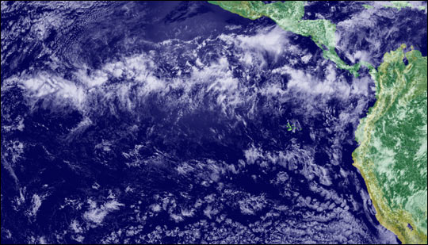
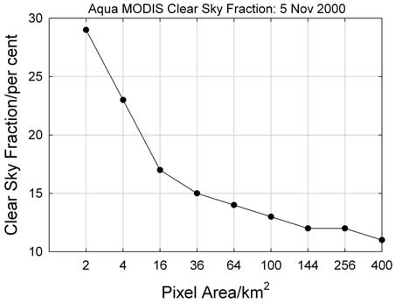
OCO-2 Optimized for High Spatial Resolution
High Sampling Rate:
OCO-2 collects up to up to 8 soundings @ 3 Hz along a narrow swath (<10.6 km at nadir)
    Yields 200 – 400 soundings per degree of latitude over sunlit hemisphere
  Soundings that can be averaged along the track to increase precision
Small footprint (<3 km² at nadir) :
Increases sensitivity to CO₂ point sources
  The minimum measureable CO₂ flux is inversely proportional to footprint size
Increases probability of recording cloud free soundings in partially cloudy regions
  OCO: 27% @ Nadir, 19% for Glint
  GOSAT (85 km²): ~10%
OCO-Nadir
OCO-Glint
GOSAT

Slide 16


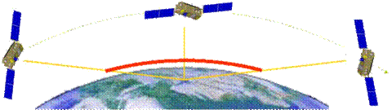


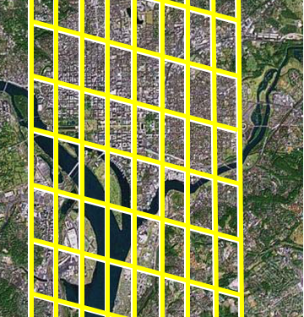
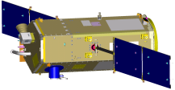
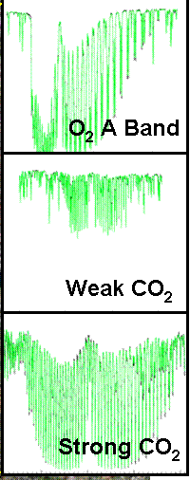

Observation Modes Optimize Sensitivity and Accuracy
Nadir Observations:
+ Small footprint (< 3 km²)
− Low Signal/Noise over dark surfaces (ocean, ice)
Glint Observations:
+ Improves Signal/Noise over oceans
More cloud interference
Target Observations:
Validation over ground based FTS sites, field campaigns, other targets
Glint Spot
447-m WLEF Tower
Ground Track
Local Nadir
Park Falls, WI

Slide 17
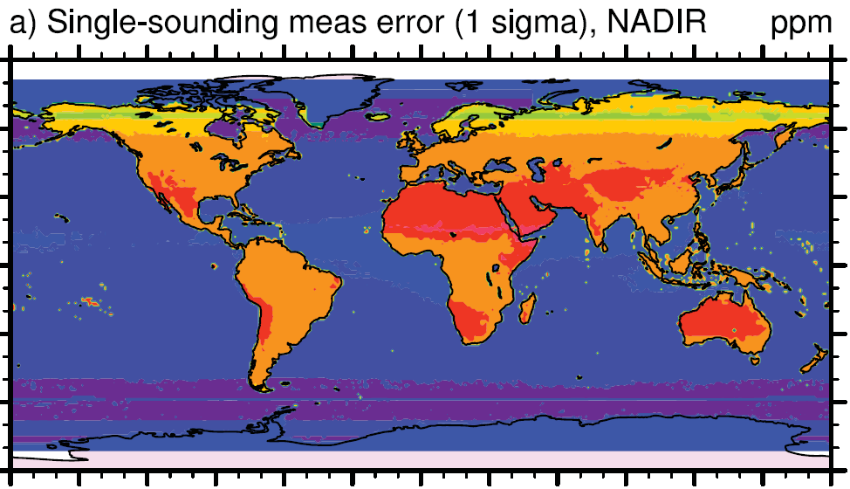

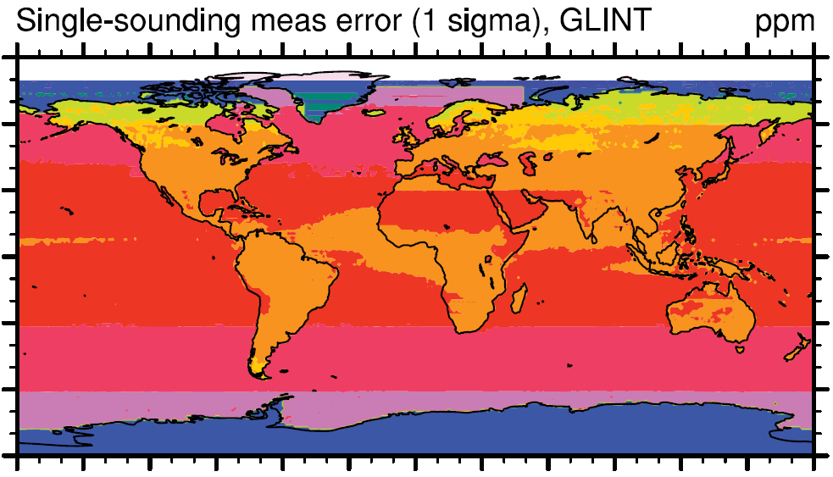

OCO-2 Provides High SNR over both Continents and Oceans
  Full global coverage is needed to:
      Resolve X_{CO2} over land and ocean for the full range of latitudes,
      Minimize errors from CO₂ transport in and out of the observed domain
Near IR solar measurements of CO₂ over the ocean are challenging
Typical nadir reflectances: 0.5 to 1%
Most of the sunlight is reflected into a narrow range of angles, producing the familiar “glint” spot
OCO-2 combines glint and nadir measurements to optimize sensitivity
3-5 ppm
<0.4 ppm
OCO single sounding random errors for nadir and glint [Baker et al. ACPD, 2008].
Notes:
Spatial variations in clouds and surface topography over continents can introduce biases and random errors in the X_{CO2} product. Nadir observations provide the best spatial resolution, which maximizes the number of topographically homogenous, cloud-free scenes over continents.
Nadir observations are not ideal for over ocean and ice covered surfaces, because these surfaces are very dark a nadir, and return little useful signal. However, these surfaces do reflect a large fraction of the incident sunlight in the direction, producing the familiar sun glint phenomena. Measurements of O₂ and CO₂ the absorption of sun glint yield adequate sensitivity to monitor X_{CO2} over the entire globe.
To maximize its sensitivity to X_{CO2} over both continents and oceans, OCO alternates between nadir and sun glint observations on altering 16-day orbit repeat cycles, obtaining complete maps of globe in both modes every 32 days.

Slide 18
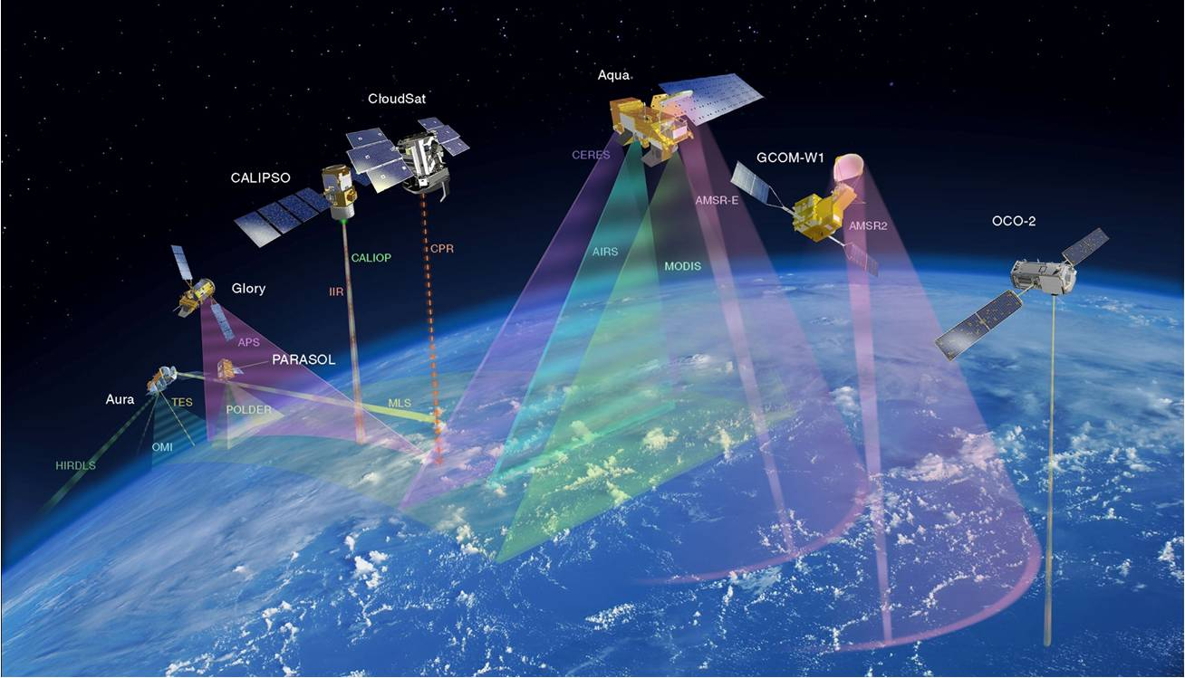
OCO-2 Flies at the Head of the A-Train
Like OCO, OCO-2 will fly at the head of the A-Train. However, OCO-2 may fly along the CloudSat/CALIPSO path, rather than the Aqua path to maximize synergy with CloudSat/CALIPSO/MODIS products.

Slide 19
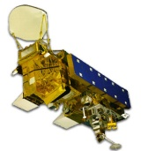
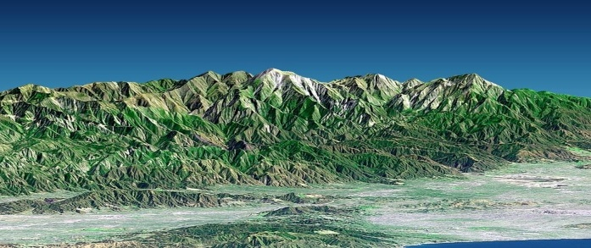
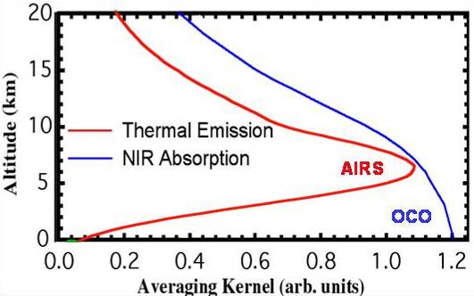
Measuring CO₂: Synergy with AIRS and TES
Atmospheric CO₂ can be inferred from both thermal IR or solar remote sensing data
Thermal IR instruments (AIRS,TES , IASI) measure CO₂ above the mid-troposphere
  Directly measure the greenhouse forcing by CO₂ in the present climate
  Provides limited information on sources/sinks
Solar NIR instruments (GOSAT, OCO-2) measure the total CO₂ column
  Most sensitive to surface fluxes
  Provides insight needed to predict future rates of CO₂ buildup and climate impacts
Combining solar NIR and thermal IR measurements could provide insight into vertical atmospheric transport of CO₂

Slide 20
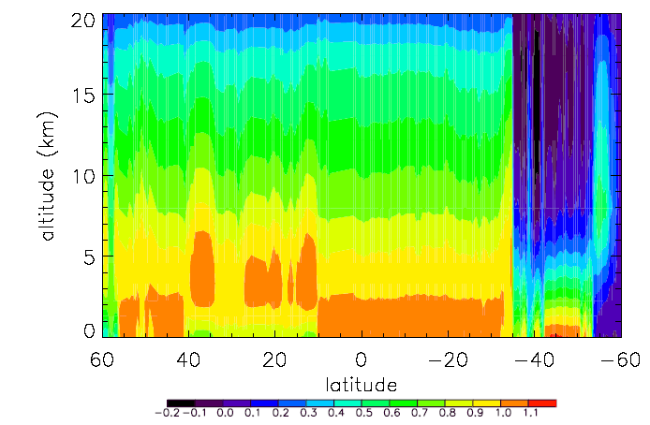
Example: X_{CO2} Averaging Kernel over an OCO-2 Dayside Orbit Track
While the OCO-2 averaging kernel is weighted toward the surface, the actual vertical sensitivity for nadir-viewing observations will vary along orbit track as the surface reflectance and aerosol abundance change.

Slide 21

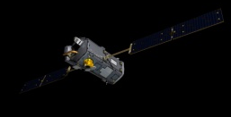


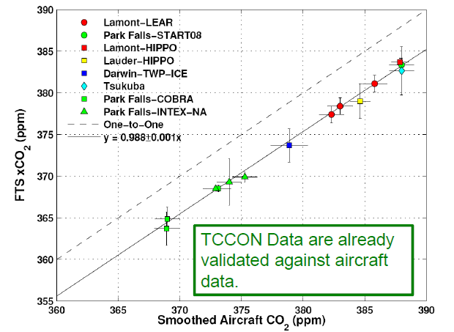
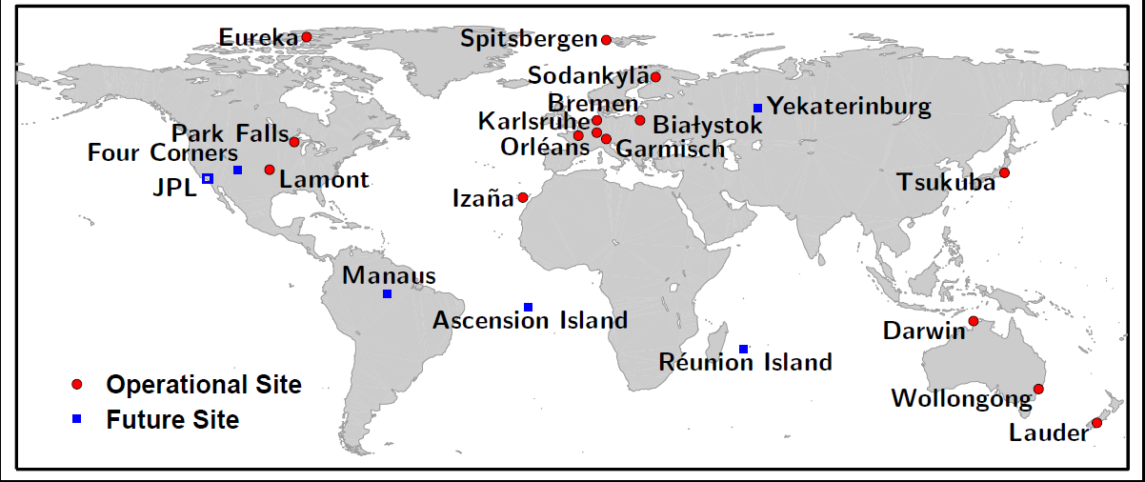
Validating Space-based X_{CO2} against the Ground-Based Standard: TCCON
OCO-2 data will be validated through comparisons with the Total Carbon Column Observing Network (TCCON)
  TCCON measures the absorption of direct sunlight by CO₂ and O_{2,} in the same spectral regions used by OCO-2.
    Validated against aircraft measurements
  OCO-2 will acquire thousands of X_{CO2} soundings over TCCON stations on a single overpass.
447-m WLEF Tower
Park Falls, WI
FTS

Slide 22
Operational Uses by NOAA
Operational Use of OCO-2/OCO-3* CO₂ measurements
This is a great discussion topic
  How does NOAA plan to use the data?
    Natural sources and sinks – impacts on climate
    Fossil fuel emissions (establishing baselines, verifying GHG reduction efficacy , etc.)
    Combine with AIRS CO₂ and CO to provide constraints on model vertical/horizontal transport
  What are the data latency requirements?
    2.75 hours?, 1 week, 1 month, annual?
  What accuracy is needed?
    Is 1 ppm “accuracy” essential?
    Is 1 ppm precision good enough for short latency applications?
*Proposed Mission Only – Pre-decisional for planning and discussion purposes only

Slide 23

Operational Uses by NOAA: OCO-2 Surface Pressure Measurements
OCO-2 will collect 0.5 to 1 million soundings over the sunlit hemisphere each day
  Over 100,000 of these soundings were expected to be sufficiently cloud free to enable surface pressure (and X_{CO2}) retrievals
  For each X_{CO2} retrieval, the O₂ A-Band measurement yields an surface pressure retrieval, with typical accuracies of ± 1 hPa
OCO-2 surface pressure measurements can be combined with AIRS temperature and moisture measurements in meteorological data assimilation models to assess their impact on weather forecasts.
  Largest impacts expected in data sparse regions– such as over oceans
OCO-2 would demonstrate this capability, but is not (currently) designed to deliver measurements on NWP time scales (2.75 hr)

Slide 24
Reducing Data Latency
OCO data latency requirements originally chosen to minimize cost
  One downlink per day, up to 7 days to deliver data to the GDS, more than one month to produce geophysical data products to customers
For operational applications (weather forecasting, surveillance), data latency would become a driving requirement: must be < 2.75 hours
Delivery of geophysical data products (X_{CO2}) within 2.75 hours requires:
  Downlinks (@X-band, 150 Mbps, 1 Gbyte/pass) at least once each orbit
  At least 2 “primary” ground stations (with tuned X-band demodulators)
  Reliable, high rate (>10 Mbps) transmission lines from station to the GDS
  Faster retrieval algorithms/more computing power at the GDS
  Operational interface to customer
These upgrades could be included for either OCO-2 or the proposed OCO-3 mission* at relatively low cost if included early in the mission implementation planning (i.e. NOW)
Pre-decisional - for planning and discussion purposes only

Slide 25

Other NWP Variables : Column H₂O
Near-IR retrievals of water vapor column abundance
Spectra collected in the 2.06 µm channel include numerous strong water vapor lines, useful for retrieving the H₂O column abundance
These retrievals are most sensitive to the H2O amounts near the surface, (where thermal IR remote sensing methods are least sensitive)
Comparisons of near-IR and thermal-IR measurements would improve estimates of boundary layer humidity and vertical mixing
H₂O

Slide 26

Operational Uses by NOAA: OCO-2 Cloud and Aerosol Measurements
Characterization of optically thin clouds and aerosols
OCO-2 cloud and aerosol measurements could be combined with CloudSat and CALIPSO measurements to more completely constrain the occurrence of thin, high clouds and their impact on the solar radiation budget.
  A-Band spectrometers were originally included on both CloudSat and CALIPSO, but were descoped during the implementation phases of these missions to control cost
  The OCO-2 A-Band observations will help to address this need
High-resolution O₂ A-band measurements can be combined with MODIS cloud measurements to
    Improve detection over continents and ice-covered surfaces
    Provide information about the vertical distribution of thin clouds
  Spectral signature of water ice absorption in 1.61 and 2.06 µm bands clearly discriminates ice and liquid water droplets

Slide 27
Looking ahead
OCO-2: On track for a 2013 launch and 2-year nominal mission
  The only life limiting consumable is fuel for orbit maintenance (> 5 years)
OCO-3*: NASA’s Architecture for Earth Science (June 2010) and the Presidents 2012 NASA budget proposal include funds to assemble the OCO-2 instrument spares to produce a follow-on instrument
  Available for a flight of opportunity as early as 2015
  Currently assessing a wide range of host missions
    ISS, conventional nadir pointing platforms (JPSS), as well as agile (OCO-like) spacecraft in sun-sync & non sun-sync orbits
    A pointing mechanism is under development to preserve glint and target capabilities on nadir-pointing platforms
ASCENDS*: NASA’s next step in CO₂ measurements
  Would use LIDAR to provide day/night measurements for all seasons and latitudes
  Baselined for a launch in the 2020 time frame
*Proposed Mission Only – Pre-decisional for planning and discussion purposes only

Slide 28
Appropriate NOAA Follow-on Missions
Following OCO-2, the next logical step for NOAA would be:
A Broad swath, passive CO₂ instruments on operational satellites
  The ESA CarbonSat instrument is a good target design
    500 km wide swath, yielding global coverage on weekly time scales
    Preserves OCO-2 like precision and accuracy
  The primary “technology” drivers: downlink and analysis of the very large amounts of data returned by this system
GEO applications
  Provides opportunities to measure diurnal variations in CO2
  However, this opportunity poses some new challenges
    TCCON measurements indicate that XCO2 rarely varies by more than 1 ppm away from large sources.
      Improvements in instrument sensitivity (SNR), stability, and calibration will be needed to resolve these small variations
      Improvements in the algorithms are needed to produce bias-free retrievals over the diurnal cycle

Slide 29
Summary
OCO-2 is currently on track for a February 2013 Launch
The OCO-2 Instrument will collect over 500,000 to 1,000,000 soundings/day along a narrow swath, either along the ground track, or in the direction of the local “glint” spot
Integration with ground and airborne networks is essential for validating, interpreting, and maximizing the benefit of remote sensing observations
OCO-2 surface pressure measurements can be used to assess the value of future space-based surface pressure measurements in weather prediction models
Need a long-term vision to establish and address community priorities
  Must incorporate ground, air, and space-based assets
  Must balance calls for new observations with need to maintain climate data records

