Slide 1
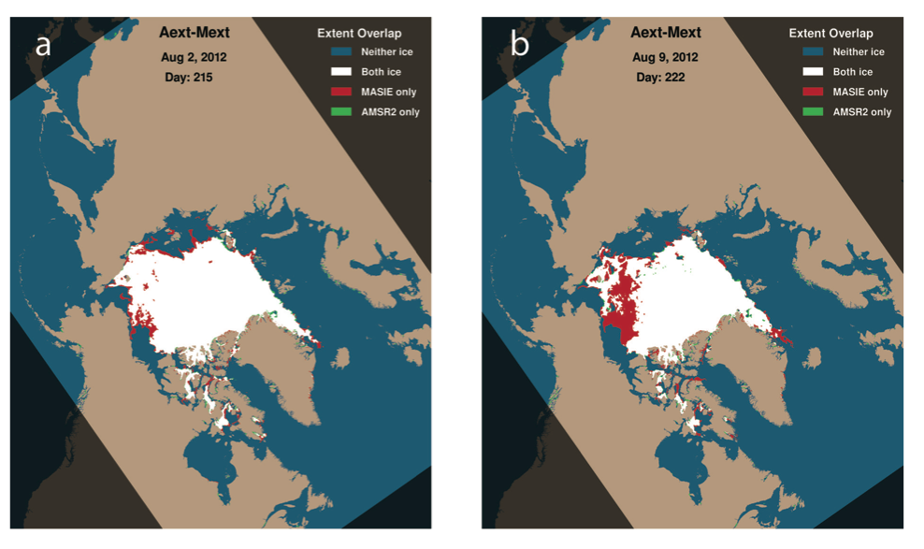
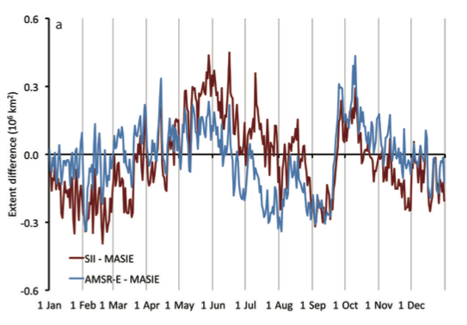
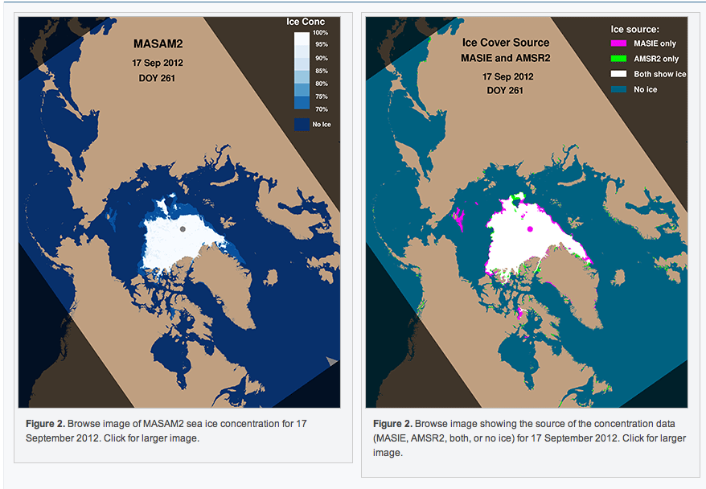
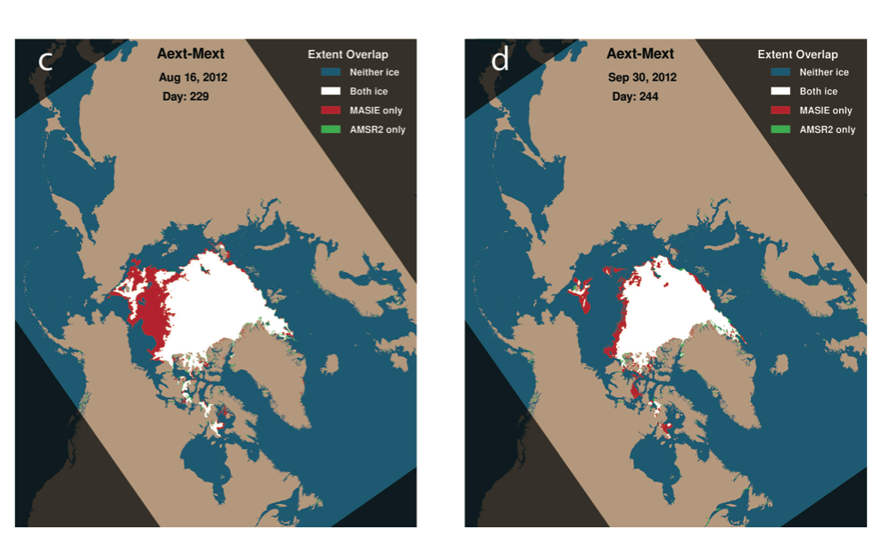
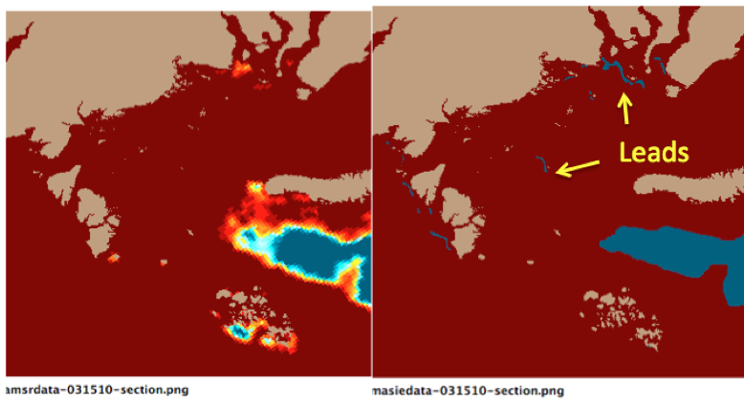
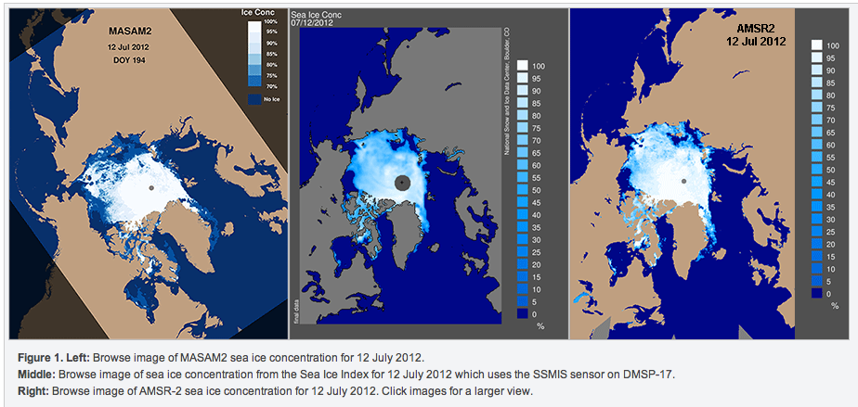
Sea Ice Concentration Fields for Operational Forecast Model Initialization: An R2O Success Story
Florence Fetterer (NSIDC) Ann Windnagel (NSIDC) J. Scott Stewart (Exploratory Thinking ) and Walt Meier (NASA Goddard)
http://nsidc.org/noaa/news.html
Research and Operations
The Problem
The Navy sought to improve 7-day predictions of the location of the sea ice edge by the Arctic Cap Nowcast/Forecast System (ACNFS).
Inadequate ice initialization fields were suspected. The Naval Research Laboratory’s forecast model assimilated microwave-based sea ice concentration estimates daily, but did not incorporate information about the location of the sea ice edge.
ACNFS has about 3.5 km resolution at the North Pole, but was being initialized with SSMIS passive microwave concentration at 25 km grid cell size.
The Solution: A better ice concentration product for model initialization
We blend maps of the ice edge produced manually every day with high-resolution passive microwave ice concentration estimates.
A manually produced 4km daily ice map (Multisensor Analyzed Sea Ice Extent or MASIE) tells us where the ice is.
10km AMSR2 passive microwave data give us an estimate of what the concentration of that ice is.
A more accurate, higher resolution product, MASAM2, results.
Result
In testing done by NRL, assimilating the blended product directly for a year (July 2012 – July 2013) improved the predicted ice edge location by 36%.
Over the summer months, using the blending technique improves the predicted ice edge location by about 60%.
Accuracy is assessed by comparing forecast ice edge position with that from an independently produced NIC marginal ice zone product.
Based on these results, the Naval Oceanographic Office begin using the methodology in operational model runs in February 2015.
Products are pushed daily to the NIC and to NOAA
Testing done at NRL shows the largest reduction in ice edge location error when the blended MASIE and AMSR2 product is used. The greatest reduction in error occurs during the melt season. From Posey et al. (2015).
Remote sensing is a tremendously valuable resource for tracking sea ice for both the operational and climate research modeling communities. The operational groups (like short term forecasters) and climate researchers (e.g. IPCC) have different objectives and thus different observational needs. (after Meier et al., 2015)
The first goal in NOAA’s Arctic Action Plan is “Forecast sea ice”. The U.S. Navy, too, wants to make better short-term operational sea ice forecasts. The Naval Research Laboratory’s 1/12° Arctic Cap Nowcast/Forecast System (ACNFS) is a development platform for the operational model that is run at the Naval Oceanographic Office, producing forecasts of sea ice drift, concentration, thickness and more that are used for operations by the National Ice Center (NIC) and by the NOAA National Weather Service.
Details
NAVO assimilates AMSR2 swath data and IMS data (same as MASIE) from NOAA CLASS
There, the forecast model code reproduces our MASAM2 blending technique with IMS and AMSR2 data
NAVO requires data from an operational, 24/7 guaranteed-access source (i.e. NOAA CLASS and IMS, not NSIDC and MASIE)
The MASAM2 blended product
10 km AMSR2 ice concentration data is interpolated to the 4km MASIE grid
The 4km MASAM2 blended product is then produced according to these rules:
If MASIE indicates no ice at a grid cell, set the ice concentration to 0
If MASIE indicates ice, and AMSR2 has an ice concentration value > 70 %, set the ice concentration to the AMSR2 value
If MASIE indicates ice, and AMSR2 has an ice concentration value < 70 %, set the ice concentration to 70%
A 4km MASIE cell is designated “ice” if analysts at NIC think it has between 40% and 100% ice concentration. We use the midpoint, 70%, for these cells.
NOAA@NSIDC hosts the prototype at http://nsidc.org/data/g10005
Why is MASIE better than passive microwave at seeing where ice is? What are typical differences?
We assert that the MASIE product is a more reliable indicator of the presence or absence of ice than is AMSR2 data
Manual analysis of numerous data sources is more dependable than a passive microwave concentration product alone.
NIC analysts have access to data sources that are of higher resolution than AMSR2.
Passive microwave concentrations are problematic in well documented ways:
In summer, melt water on ice has the same signature as open water
In winter, new and thin ice often escapes detection
At any time of year, wind/aerosols and “land spillover” can lead to false ice detection
Low concentration, as in the marginal ice zone, often escapes detection.
Typically, MASIE detects more ice than AMSR or SSMIS, especially in the summer (Meier et al., 2015, and figure at right).
Melt and low concentrations can cause problems. MASAM2 helps.
MASAM2 is provided in NetCDF4 along with browse images of concentration, and of where the input sources matched or differed.
Differences between MASIE and the two passive microwave products: AMSR (blue) and SSMIS (from the Sea Ice Index, red) over the course of 2010. For most of the year, MASIE shows greater ice extent. From Meier et al., 2015.
Undetected small features can cause problems. MASAM2 helps.
Maps of MASIE and AMSR2 extent differences for four days in summer 2012, showing the effects of an early August storm on the passive microwave. Missing ice in the large red expanse on 16 August (c) would have an especially deleterious effect on forecasts of ice edge location. From Meier et al., 2015.
A segment of a concentration product from September 2010 illustrates MASIEs ability to resolve individual floes. The images aredisplayed using the NRL ice concentration color bar, at left.
Acknowledgments
Pamela Posey and the modeling group at NRL-Stennis collaborated with us and made this work possible.
NIC’s Sean Helfrich provided information about the IMS product, which is the source data for MASIE.
The work was funded by a grant from NRL and the University of Southern Mississippi.
References
Fetterer, F., J. S. Stewart, and W. N. Meier. 2015. MASAM2: Daily 4-Km Arctic Sea Ice Concentration, 2012-2014. Boulder, Colorado USA: National Snow and Ice Data Center. doi: http://dx.doi.org/10.7265/N5ZS2TFT.
Meier, W. N., F. Fetterer, J. S. Stewart, and S. Helfrich. 2015. How do sea ice concentrations from operational data compare with passive microwave estimates: Implications for improved model evaluations and forecasting. Ann. Glaciol. 56(69). doi: 10.3189/2015AoG69A694
Posey, P. G., Metzger, E. J., Wallcraft, A. J., Hebert, D. A., Allard, R. A., Smedstad, O. M., Phelps, M. W., Fetterer, F., Stewart, J. S., Meier, W. N., and Helfrich, S. R.: Assimilating high horizontal resolution sea ice concentration data into the US Navy's ice forecast systems: Arctic Cap Nowcast/Forecast System (ACNFS) and the Global Ocean Forecast System (GOFS 3.1), The Cryosphere Discuss., 9, 2339-2365, doi:10.5194/tcd-9-2339-2015, 2015.
From the MASAM2 documentation: Comparison of the blended product with SSMI (middle) and AMSR2 (right) sea ice concentration on a sample day in July 2012.
AMSRE ice concentration from 15 March 2010 (left) and the MASIE ice/no ice field for the same day. The small leads resolved by MASIE are important for heat transfer in the ACNFS operational model.
6th Symposium on the Impacts of an Ice-Diminishing Arctic on Naval and Maritime Operations Naval Heritage Center, Washington, D.C. 4-16 JuIy 2015

