Slide 1
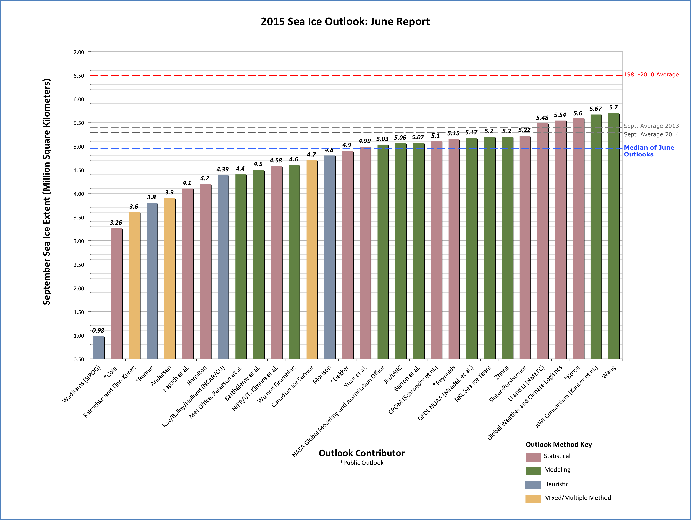
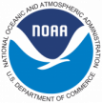
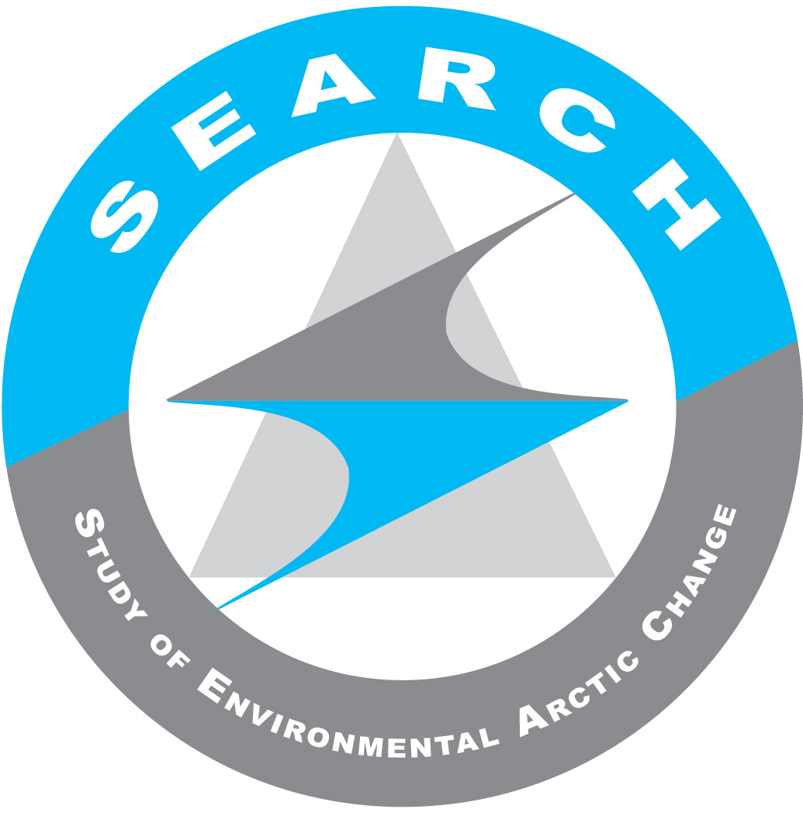
Arctic Sea Ice Predictability & the Sea Ice Prediction Network (SIPN)
Helen Wiggins, Arctic Research Consortium of the U.S. (ARCUS), Julienne Stroeve, National Snow and Ice Data Center (NSIDC), and Betsy Turner-Bogren (ARCUS); on behalf of the Sea Ice Prediction Network (SIPN) Leadership Team
SIPN Leadership Team: Julienne Stroeve, NSIDC (Project PI/NSF PI); Cecilia Bitz, U. Washington (ONR PI); Edward Blanchard-Wrigglesworth, U. Washington; Walt Meier, NASA (Co-PI) ; Jim Overland, NOAA/University of Washington; Muyin Wang, NOAA/University of Washington; Hajo Eicken, UAF (Co-PI); Jenny Hutchings, Oregon State University; Larry Hamilton, U. New Hampshire (Co-PI); Helen Wiggins, ARCUS (ARCUS PI); Adrienne Tivy, National Research Council of Canada; Philip Jones, Los Alamos National Laboratory (DOE PI); Elizabeth Hunke, Los Alamos National Laboratory
www.arcus.org/sipn
Project Background
Current Project Highlights
Decline in the extent and thickness of Arctic sea ice is an active area of scientific effort and one with significant implications for ecosystems and communities.
Forecasting for seasonal timescales (i.e., the summer and into fall) is of particular interest to many stakeholders.
However, seasonal forecasting is challenging due to the variable nature of weather and ocean behavior over that timescale as well as current limits to data and modeling capabilities.
The Sea Ice Prediction Network (SIPN), funded in 2013, is developing a collaborative network of scientists and stakeholders to advance research on sea ice prediction and communicate sea ice knowledge and tools.
The 2015 Sea Ice Outlook (SIO):
SIO provides online reports during the summer melt season that synthesize different projections of the arctic sea ice minimum at both pan-arctic and regional scales. Monthly reports in June, July, and August include a summary of those predictions and discussion about the range of predictive methods, current Arctic sea ice and weather conditions, and other variables that affect sea ice. A post-season report will be developed in late fall 2015. http://www.arcus.org/sipn/sea-ice-outlook
Project Objectives
The 2015 June report predicts an average September sea ice extent of 5.0 million square kilometers. The report combines estimates from 32 contributions and reflects a range of perspectives on Arctic sea ice—from observations of current conditions, to advanced numerical models, to qualitative submissions from citizen scientists.
Coordinate and evaluate activities to predict sea ice
Integrate, assess and guide observations
Synthesize predictions and observations
Disseminate predictions and engage key stakeholders
SIPN Action Teams: SIPN Action Teams are comprised of members of the sea ice prediction community and are convened on an ad hoc basis.
The 2015 Sea Ice Modeling Action Team participates in and reviews the Sea Ice Outlook Initial Condition Experiment based on 1 May 2015 conditions and PIOMAS.
The 2014 Sea Ice Outlook (SIO) Action Team developed the SIO post-season report to assess processes that affected sea ice dynamics during the 2014 melt season, discuss the various outlook methods, and recommend changes and improvements to the SIO for the 2015 season.
Join the Network!
We are inviting project collaborators and network participants of all disciplines and interests! Ways to participate range from simply signing up for the mailing list to joining an Action Team, which are small groups convened to develop a specific product or task.
Sign up for the SIPN mailing list or send in an interest form for joining the network through the website: http://www.arcus.org/sipn
2015 SIPN Webinar Series: These presentations provide overviews of topics relevant to the sea ice research community including sea ice modeling, sea ice observations, and stakeholder needs. Webinars archives are available online. http://www.arcus.org/sipn/meetings/webinars
The Sea Ice Prediction Network is supported through multi-agency funding:
National Science Foundation Arctic Sciences Section
Office of Naval Research, Office of Naval Research-Global
National Oceanic and Atmospheric Administration (NOAA)
National Aeronautics and Space Administration (NASA)
Department of Energy (DOE)
A contribution to the Study of Environmental Arctic Change (SEARCH)

