Slide 1
Observation, Monitoring, and Applications
Fred Moshary and Ruben Delgado

Slide 2
Presentation Outline..
CREST Lidar Network (CLN)
  Validation
  Products
  Local Aerosol Observations
  Plume Transport, Identification and Climatology
  Clouds and Aerosol-Cloud Interaction
  Coherent Wind Dopple Lidar and Applications
  Ozone Lidar
  Infrared Lidar
  Field Lidar Instruments
Ceilometer Applications for BL Profiling
Urban Sensor Networks and Observations/Applications
Remote Sensing of GHGs
PM2.5 Estimation for Air Quality Applications
Puerto Rico Weather Radar Network
novel Pandora spectrometers, and applications to studies of coastal Air-Quality, Atmospheric Deposition, and Ocean Color

Slide 3
CREST LIDAR NETWORK- CLN
8 CREST Scientists across four NOAA CREST Campuses.
Collaborations: NESDIS STAR (S. Kondragunta) ; ESRL (A. Brewer, G. Feindgold, R. Alvarez, A. Langford;) CIRES (M. Hardesty, , C. Senff, A. Choukulkar), NCAS (Q. Min)
NASA, JCET, ARL, Academic Institutions, Local Agencies, Industry
Profiling observations of Aerosols, Water Vapor, Trace Gases, Wind, and Atmospheric Structure for Climate, Weather and Air Quality Applications.
Four Mie/Raman Lidar systems across the Eastern US from New York to Virginia, and in Puerto Rico. Representing Extensive Ground-based Observational Capability
Understanding of Physical and Chemical Atmospheric Processes/Dynamics; Validation of Climate, Weather and Air Quality Forecast Models, Testbed for training students in Science and Engineering.

Slide 4
CREST Lidar Network
City College of New York (CCNY)
Backscatter Lidar: 355, 532 and 1064 nm
Raman Lidar: H₂O Vapor Mixing Ratio (407 nm /387 nm)
Hampton University (HU)
Backscatter Lidar: 355, 532 and 1064 nm
Raman Lidar: H₂O Vapor Mixing Ratio (407 nm /387 nm) Rotational Raman Temperature
University of Puerto Rico, Mayagüez (UPRM)
Backscatter Lidar: 355, 532 and 1064 nm
Raman Lidar: H₂O Vapor Mixing Ratio (407 nm /387nm)
University of Maryland, Baltimore County (UMBC)
Raman Lidar: H₂O Vapor Mixing Ratio (407 nm /387 nm)
Backscatter Lidar: 355, 532 (ǁ and ⊥) and 1064 nm Sigma Space Micropulse Lidar 527 nm Leosphere Scanning ALS-450 355 nm
Scanning Doppler Wind Lidar 1.5 μm
Scanning Doppler Wind Lidar 1.5 μm
Doppler Wind Lidar 1.5 μm

Slide 5
Observations
Daily observations (≥ 5 hours, barring intense cloud cover).
WMO-GALION schedule (2 hours around solar noon on Mondays, and two hours after sunset on Monday and Thursday evenings).
Continuous during US Air Quality Action Days (multiday polluted events).
Additional observations on exceptional events (long range transport of dust/smoke to the Eastern US) are identified on the GALION and CLN list serve.
Online Dissemination tool for CREST lidar data.
Products
Aerosol backscatter and extinction coefficients, Lidar Ratio, AOD
Angstrom exponents, Aerosol type and microphysical properties
H₂O vapor mixing ratio
Planetary Boundary Layer Height (PBLH)
Temperature
Wind speed and direction, vertical velocity
Turbulent Kinetic Energy Dissipation Rates
Electronic mail distribution list: cln@lists.umbc.edu

Slide 6

CLN Research Areas
Inversion algorithms, optical, chemical and physical properties of atmospheric aerosols, gases, and clouds.
Boundary Layer Dynamics (Air Quality and Wind Energy)
Continental and intercontinental plume transport to Eastern US and Caribbean.
AOD-PM_{2.5} Estimator Development from Ground, Satellite Observations, NWF and Global Models
New remote sensing technologies for atmospheric observations.

Slide 7
CLN
U.S. Air Quality Observation Systems
CREST Lidar Network (CLN) recognized by the National Science Technology Council Committee on Environment, Natural Resources, and Sustainability as one of three networks in north (MPLNET/CLN/NDACC) in their November 2013 report titled “Air Quality Observation Systems in the United States”. CLN also Recognized as one of the three North American Lidar networks within the international GALION framework for air quality and climate-relevant atmospheric composition and structure measurements; with coordinated observations in the eastern US and Puerto Rico.
Now Providing near real-time images to Local Environmental Agencies in MD, NY, NJ, CT, PR
CREST Chosen to host the 27th International Laser Radar Conference at the City College in New York City (July 2015)
Expansion of the CLN by including NCAS CSC systems- NOAA EPP Cross Center Collaboration

Slide 8
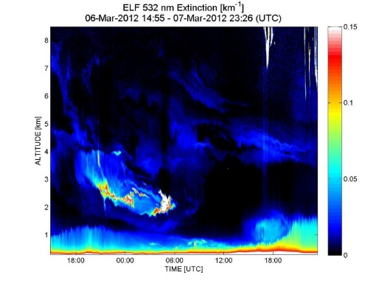
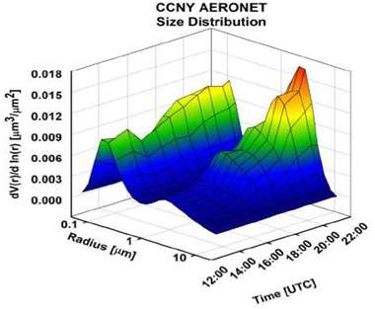
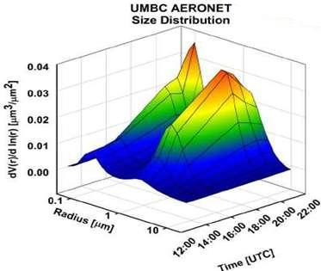
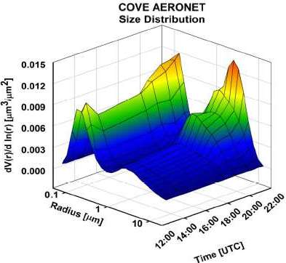
NETWORK OBSERVATIONS OF SMOKE AND DUST PLUMES
CCNY
UMBC
HU

Slide 9
Trans-Pacific transport of Asian dust to the Eastern US
CALIOP/CALIPSO:
Attenuated backscatter
coefficient.
(yellow-aerosol plume
red-cloud)
Volume depolarization ratio:
Aerosol value:
0.15-0.3 in East Asia
0.08-0.15 in US
Cloud value: >0.35
Dust classification,
Layer altitude: 3 - 8 km

Slide 10
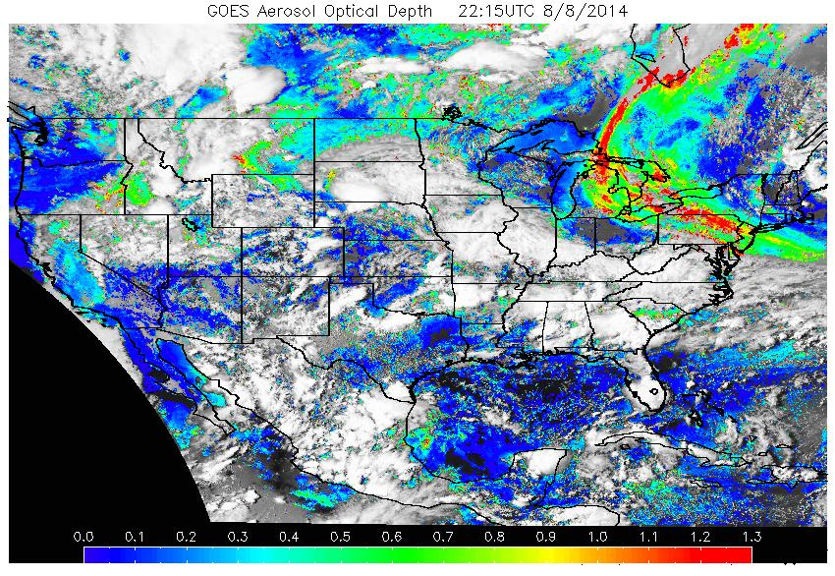
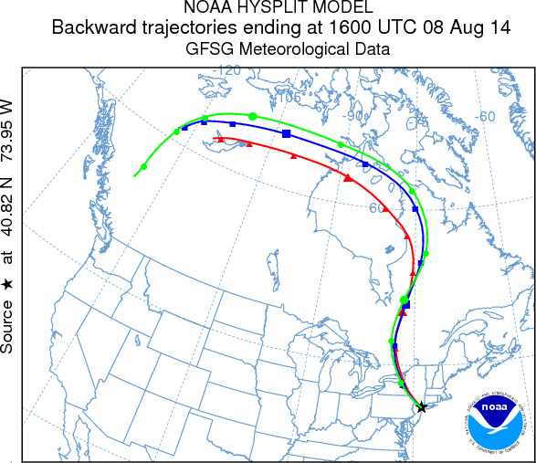
Canadian Smoke plumes transport to US east coast on Aug. 8, 2014
Lidar+AERONET-SP data show the aloft dense fine-mode particles at 4-8 km in NYC, indicating the Canadian smoke transport seen from NOAA-GOES AOD and HYSPLIT trajectories.
Smoke plumes
Clouds
Fine-mode particles (smoke)
80-90% fraction from the aloft layer
*Work on validation of NESDIS ASDTA smoke product and HYSPLIT Smoke Forecast (ARL)

Slide 11
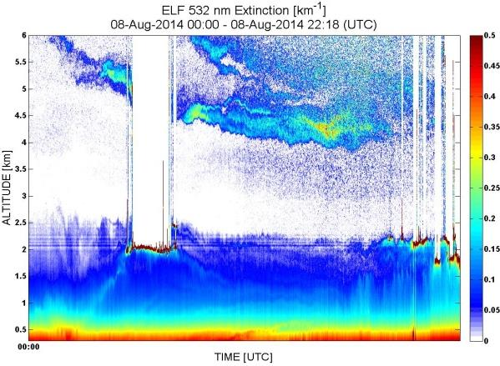
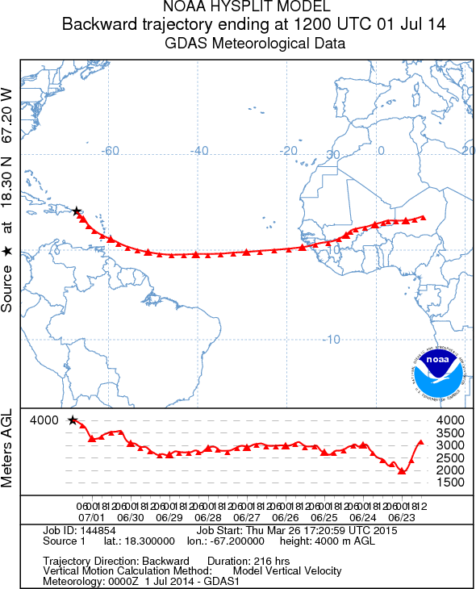
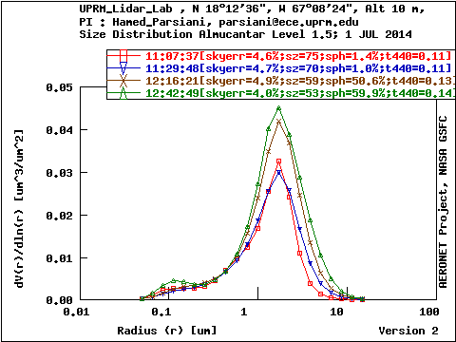
THE NETWORK OF NOAA CREST LIDARS
Hampton VA
New York
Baltimore
Puerto Rico
Saharan Dust Plumes

Slide 12
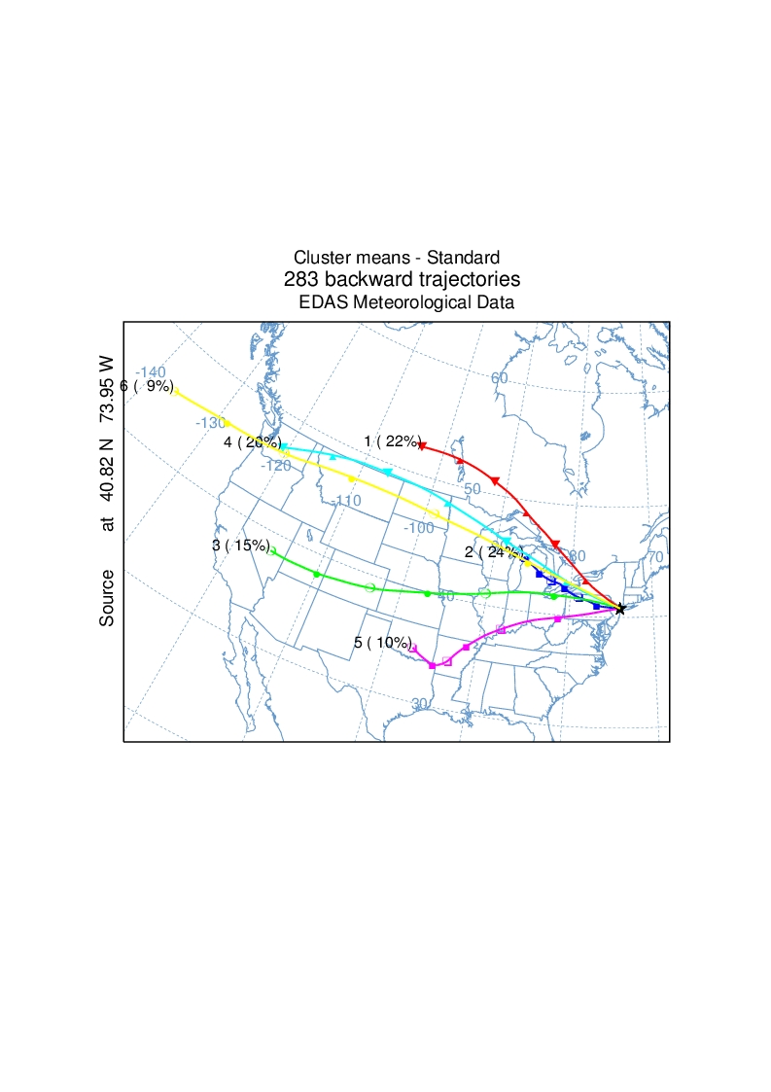
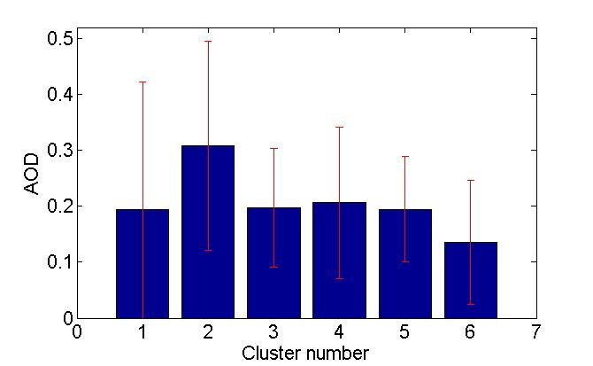
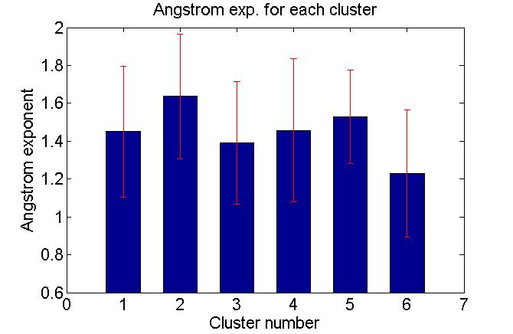
Cluster analysis of aerosol transport paths
Mean-AOD for each cluster
Mean-Angstrom exp. for each cluster
Total 6 clusters determined from the total spatial variance of all trajectories (4-km level, 72-hr long).
Cluster-2: highest AOD & Angstrom exp.
air-mass transported from the Great Lakes area,
(industrial emissions and biomass burning
aerosols from the NW US and Canada.)
Cluster-6: smaller AOD and Angstrom exponent
trans-pacific Asian dust transport.

Slide 13
Lidar Cloud Temperature Retrievals

Slide 14
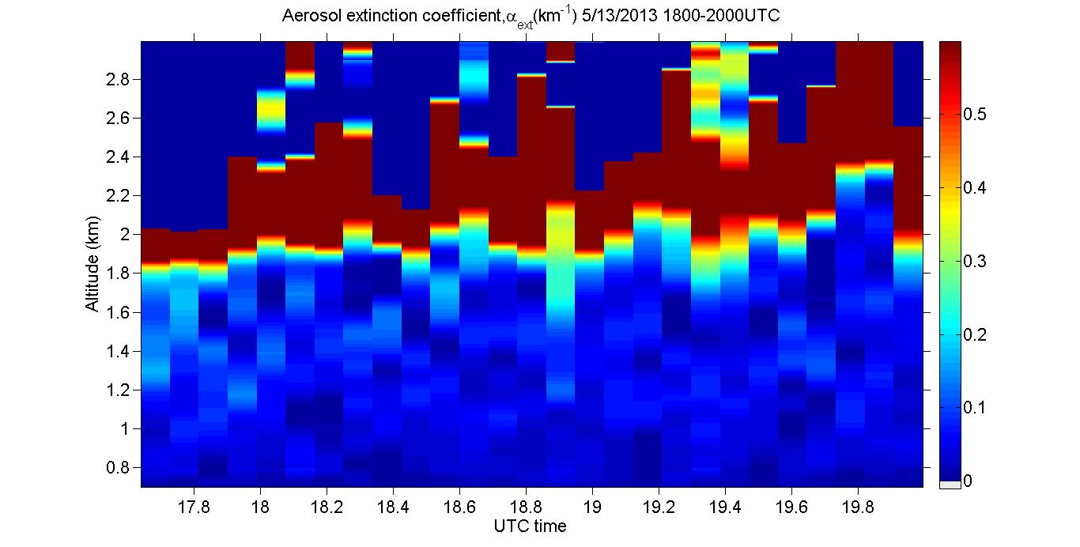
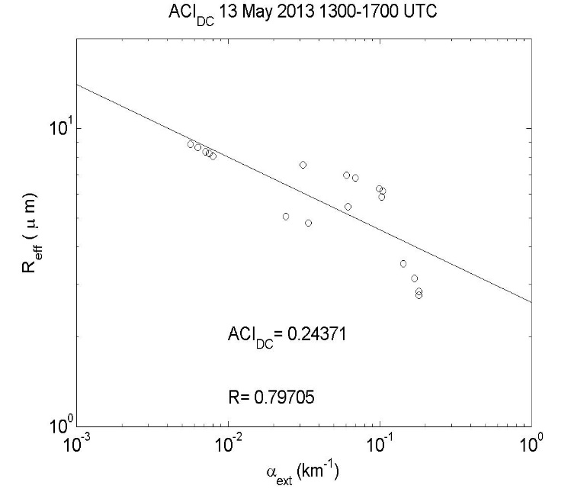
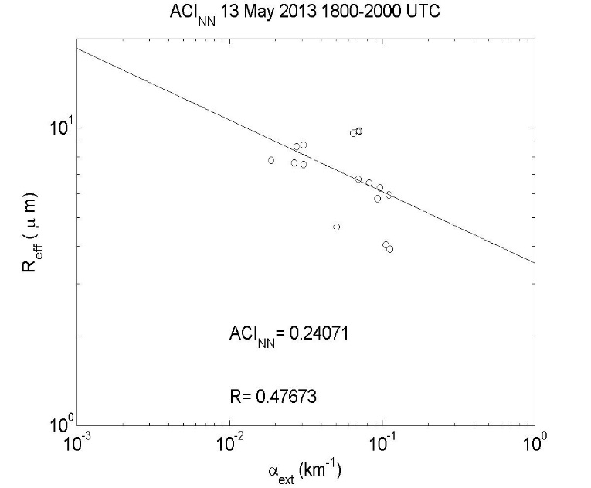
Aerosol Cloud Interaction (Twomey effect)
CREST Contact: Gross/Moshary (CCNY)
NOAA EPP funding
>Use profiling microwave radiometer observations to get cloud liquid water path
>Use multifilter shadowband radiometer to get cloud optical thickness
>Use of Raman Lidar to estimate aerosols near cloud base.
>Use multiple methods (NN approach versus dual band) to get Cloud Liquid Water Path to improve results.
Clear ACI effects observed with realistic correlations.
Demonstrate effects of urban aerosols on water phase cloud droplets
Lidar results show that these effects are strongly modified when aerosol layers are far from cloud base

Slide 15
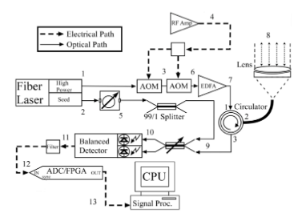
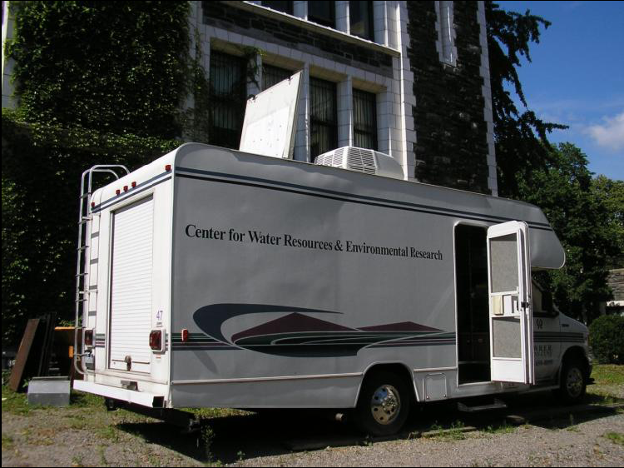
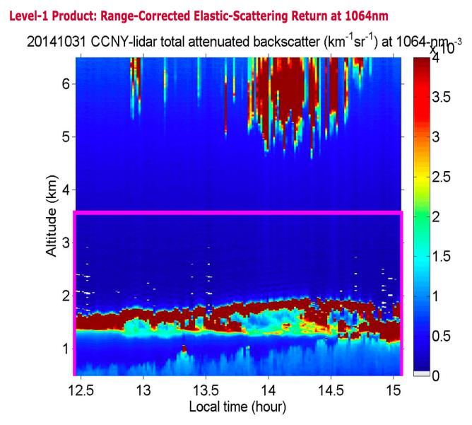
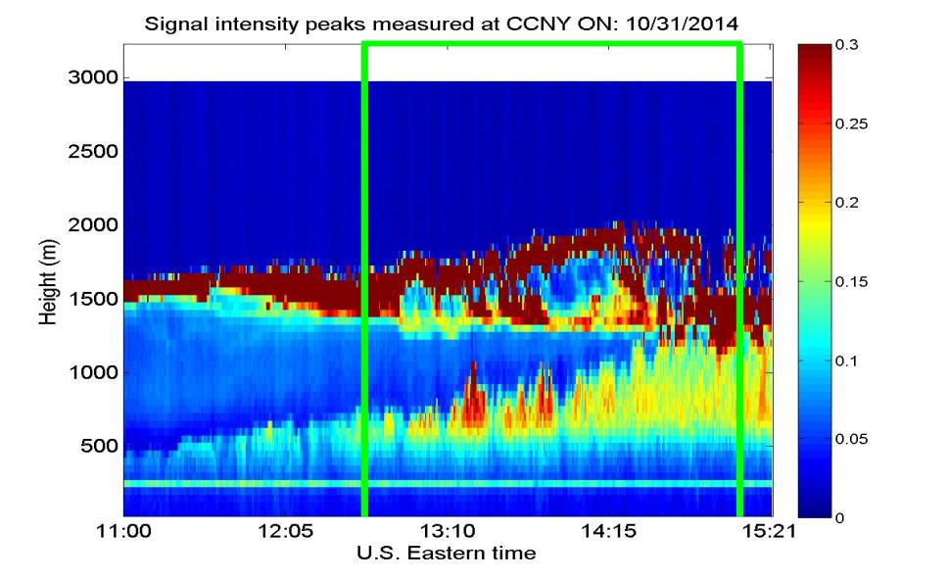
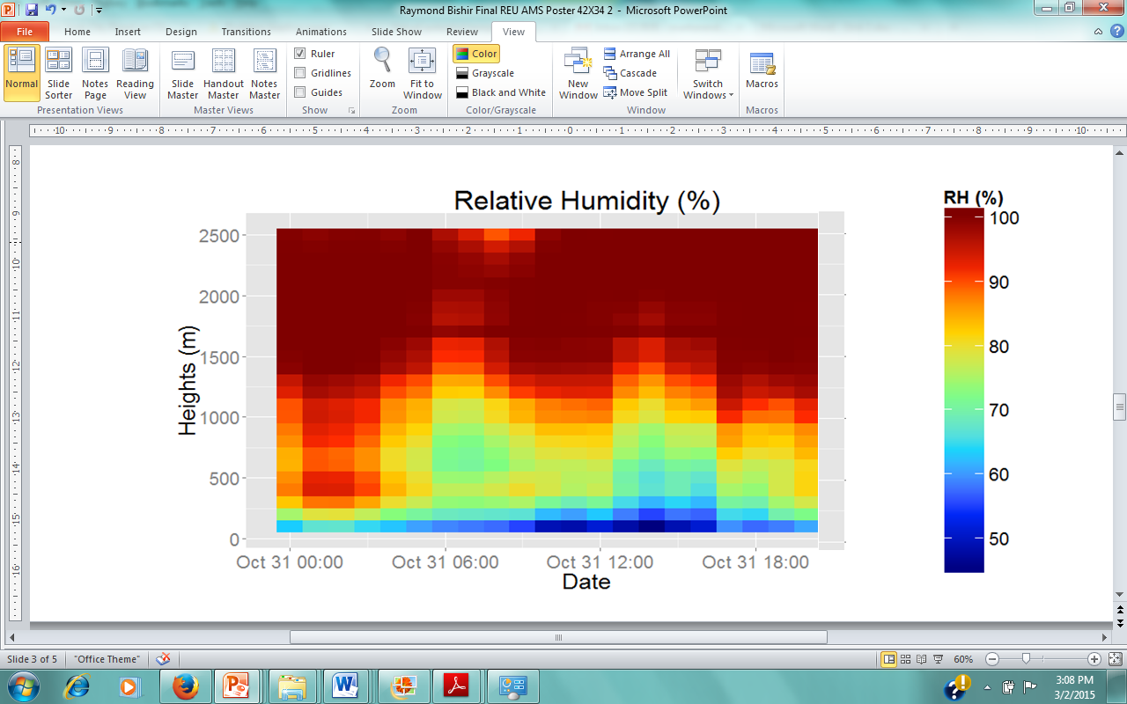
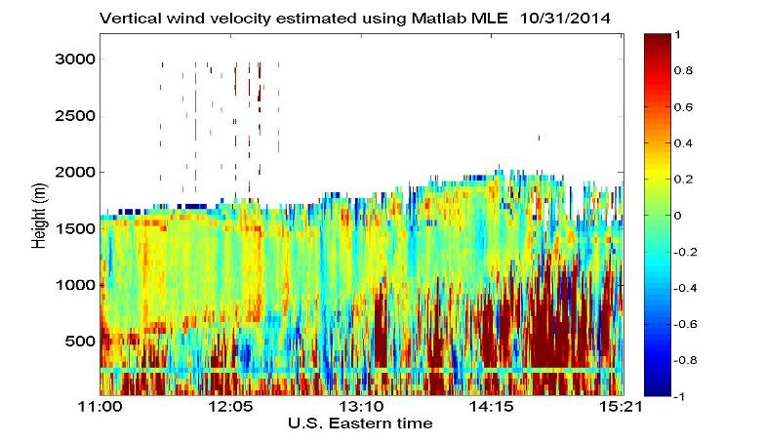
Coherent Doppler Lidar
Wind and Flux Measurements
CREST Contact: Arend/Moshary (CCNY)
EPP Funding
DDL
CDL
CDL Schematic
CDL Mobile Unit
Looking at the results from the DDL, a high aerosol concentration at a height of ~1500m is seen in all three wavelengths. The presence of these aerosols is key to the formation of clouds.
Profiling Microwave Radiometer
The rising and sinking motions of aerosols are then observed with the CDL.

Slide 16
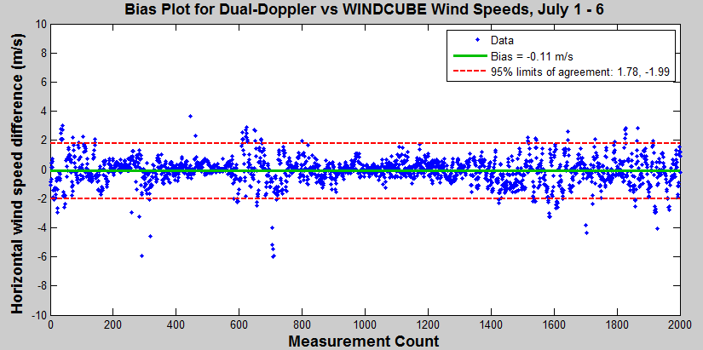
Lidar Uncertainty Measurement Experiment (LUMEX)
CREST Contact: R. Delgado,
Leveraged Project: Funded by EPP/MD Energy Administration
Field campaign June-August 2014 at NOAA Boulder Atmospheric Observatory. Phase2: XPIA Mar.-Apr. 2015.
Sensitivity analysis of different Doppler lidar systems and Inter-comparison of various single, dual and triple Doppler retrieval techniques.
Validation of turbulence analysis techniques and retrievals from Doppler lidars.
UMBC and NOAA ESRL intercomparison of Doppler wind lidar retrieval techniques and error of spatial representativeness analysis will allow to establish scanning strategies and retrieval algorithm based on the application (PBL studies or wind energy).
45º
tower
70º
profiler
Lidar 1
Validation of Dual Doppler Lidar
  Enhance the ease and accuracy of future wind
  measurement experiments
Characterization of Dual Doppler Scan Parameters
  Intersection angle, dwell time
Lidar 2

Slide 17
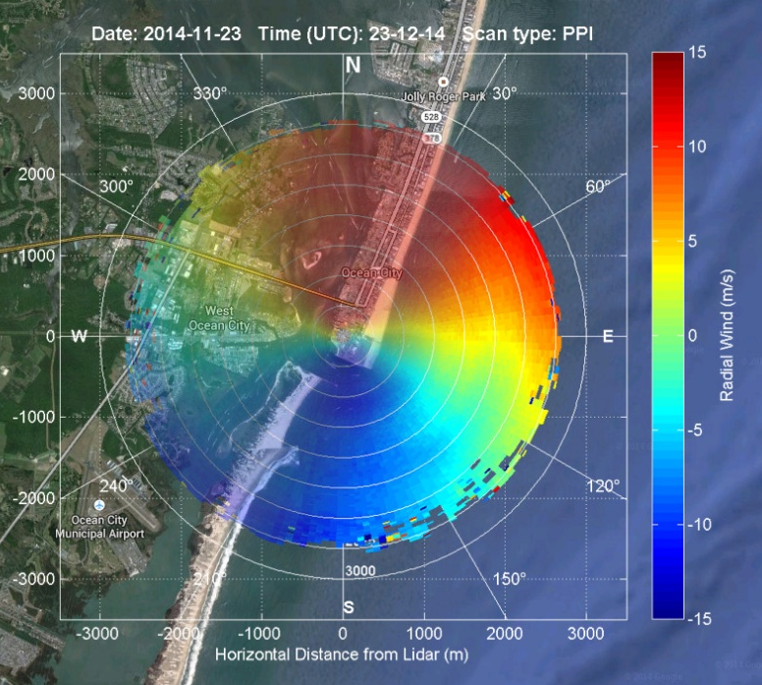
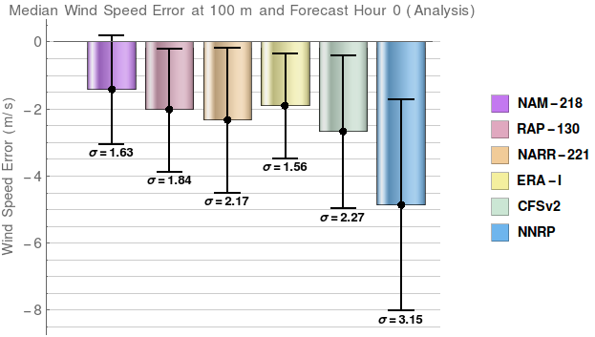
Coastal/Offshore Lidar Measurements for Renewable Energy Applications
CREST Contact: R. Delgado (UMBC)
Leveraged Project: Support MD coastal and offshore wind resource assessment.
Doppler wind lidar measurements to characterize seasonal wind variability within the Coastal (Land/Marine) Boundary Layer for wind resource assessment, and validation and assimilation of winds in NWP models.
Characterize meteorology controls on wind energy production (atmospheric stability, wind shear, turbulence).
Validate and improve numerical weather predictions (Reduction of uncertainties) (Figure 2).
Improve estimates of energy production (project revenue).
Investigate optimal turbine designs and wind farm layout strategies (minimize energy los)
Figure 1: UMBC Scanning Doppler Lidar @ Ocean City, MD
Model Grid
Size (km):
12
32
43-55
13
61-78
215-275
Figure 2: Lidar vs. Model Offshore Winds (Jul-Aug 2013)

Slide 18
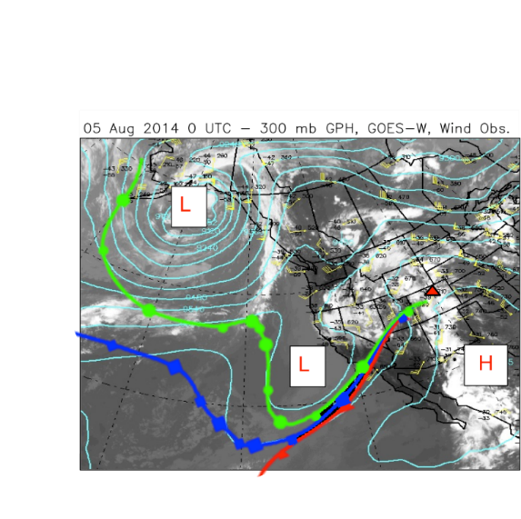
Tropospheric Ozone Enhancement in the Front During DISCOVER AQ 2014
CREST Contact: R. Delgado (UMBC)
Funding Source: EPP/ NASA / MD Dept. of Environment
Tropospheric Ozone Lidar Network (TOLNet). TOLNet is an interagency (NASA: GSFC-JPL- LARC, NOAA ESRL and Univ. Of Alabama-Huntsville) research initiative for ground‐based ozone lidar profiling. CCNY joining the network (leveraged funding).
Air quality applications/studies and to serve the GEOstationary Coastal and Air Pollution Events (GEO-CAPE) mission. Research on the influence of gases and aerosols in air quality, atmospheric composition and climate.
A Stratospheric-Tropospheric Exchange Event (STE) was characterized with the GSFC TROPOZ DIAL (top panel. The stratospheric air mass entered the troposphere near California’s Pacific Coast. It was then advected to the Rocky Mountain region (bottom left)
A relationship was determined in order to quantify STE residence times and occurrence. This implies that most STE events are rather shallow, with most of the stratospheric air dissipating in the upper troposphere over the period of the first 24 hours.
Sullivan et. al, Atmos. Meas. Tech., 7, 3529-3548, doi:10.5194/amt-7-3529-2014, 2014

Slide 19
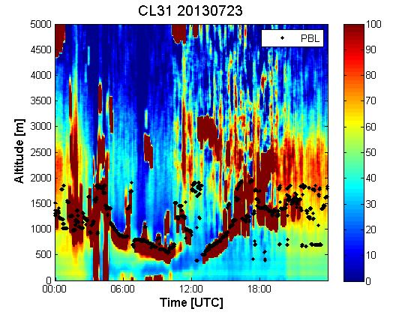
Ceilometer PBL Heights for Assimilation and Verification of Forecast Products
UMBC: Belay Demoz, Ruben Delgado, Howard University: Ricardo Sakai; NWS: Dennis Atkinson, Michael Hicks, Jason Chasse (Program Manager NextGen Aviation Weather at NOAA/NWS/ OS&T)
Funding Source: EPP/NWS
Observations of PBL height and dynamics, aerosol, clouds, an aloft aerosol plumes as function of diurnal cycle, season and ancillary MET data sets.
UMBC algorithm being used to retrieve PBL heights from the NWS Vaisala’s CL31 ceilometers, as part of a Proof of Concept Test bed.
Collocated measurements between CL31 ceilometer and UMBC Micropulse Lidar.
Collaboration between UMBC and Howard University.
PBL heights retrieved from CL31 will be implemented at nationwide ASOS sites, as support of scientific efforts of the NWS Sterling Field Support Center.

Slide 20
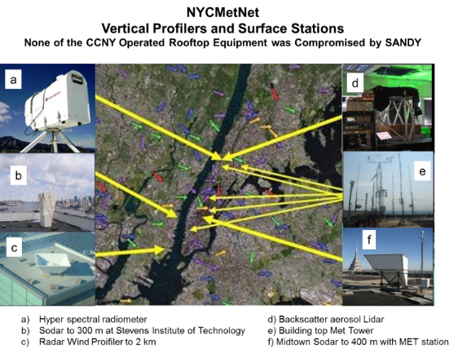
Sensors and Networks for Research on Urban Atmospheric Boundary Layer Dynamics and Processes
CREST Contact : Arend, Moshary, Ramamuthy (CCNY)
Collaborators ESRL: Alan Brewer, Mike Hardesty, NWS: Jeffery Tongue; NASA: Cynthia Rosensweig; NYC Department of Health: Tom Matte.
Leveraged Project, Funding Source (NOAA EPP/CPO, NSF, DHS)
Objectives:
- Characterize atmospheric stability
- Understand energy flux processes
- Measure the intensity of severe storms
NOAA Relevance: Understand and predict changes in the climate and weather of urban coastal regions. Share that knowledge and information with relevant stakeholders. Supports testing fundamental hypothesis and models of urban coastal meteorology.
- Arend, M., et. al. 2012, NYCMetNet Graphic, in Urban Meteorology: Forecasting, Monitoring, and Meeting Users' Needs, Board on Atmospheric Sciences and Climate, National Academy of Sciences, NRC,National Academies Press, Washington. pg. 54
Description: Develop and install unique ground based remote sensing and in-situ instruments and networks to observe flows and physical processes in the urban coastal atmospheric boundary layer.
Methodology: By implementing a structured multilevel data product strategy, many stages of analysis is performed, ranging from individual instrument and network integrity to the use of co-operating observations.

Slide 21
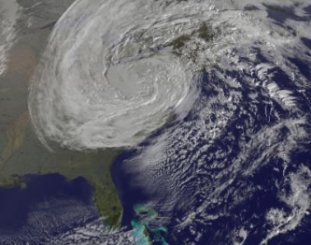
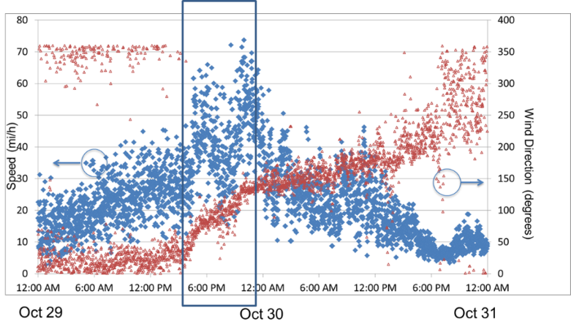
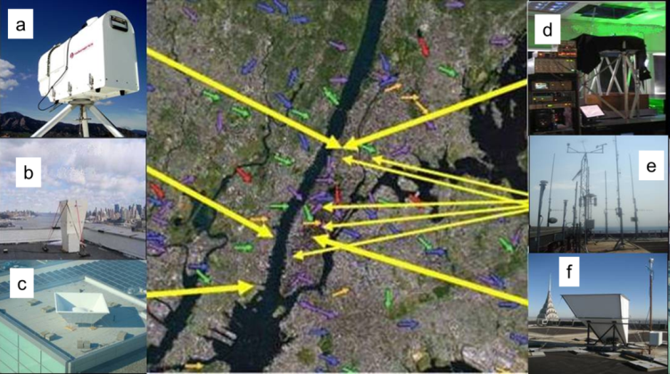
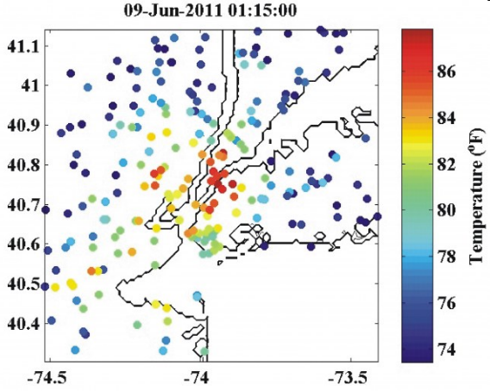
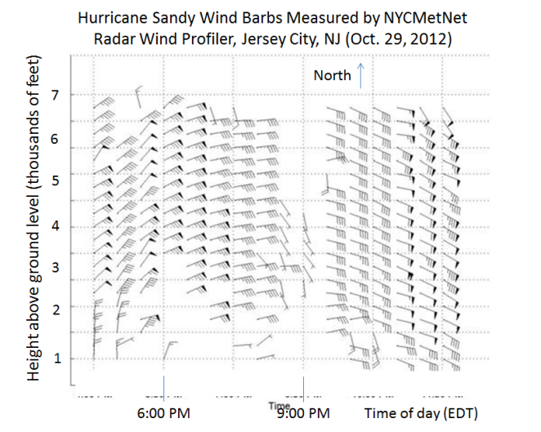
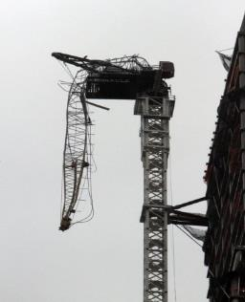
NYCMetNet for Urban
Meteorology and Mesoscale Model Validation
Rooftop Sonic Anemometer (1 min av)
Building top wind (260 m above ground)
Radar WIND Profiler (1/2hr av)

Slide 22
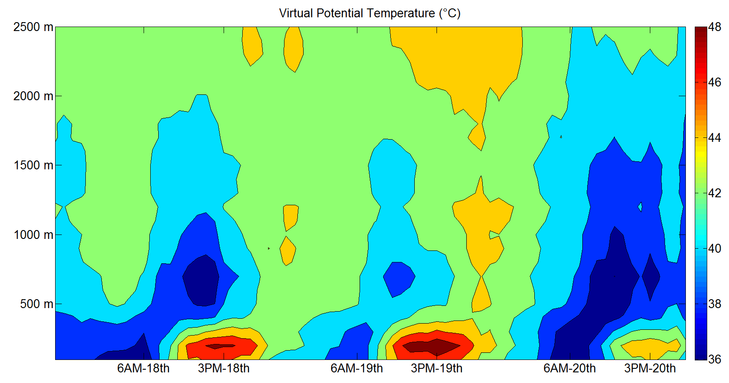
Characterize atmospheric stability using observations from Profiling Microwave Radiometer
Unstable
Neutral
Stable

Slide 23
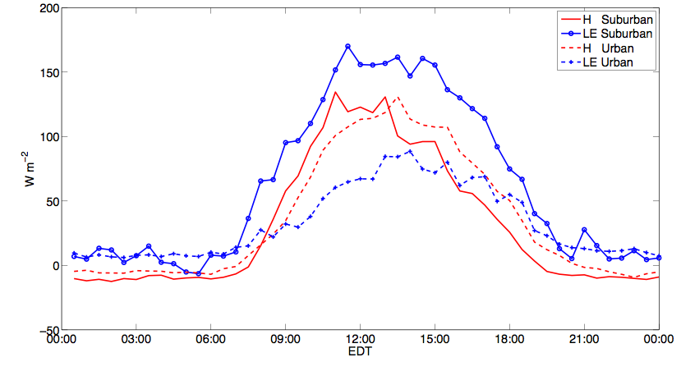
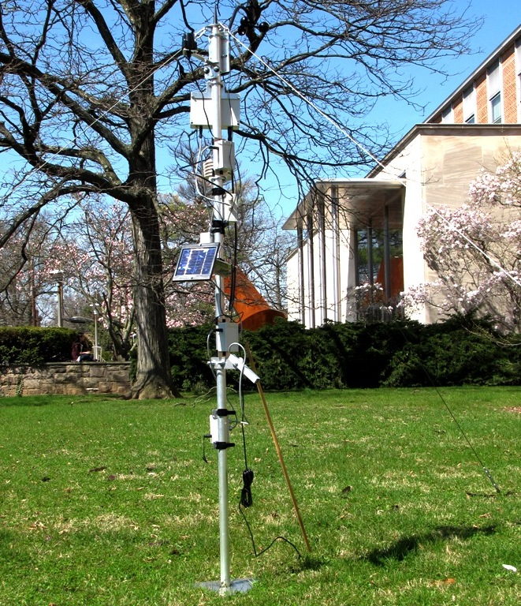
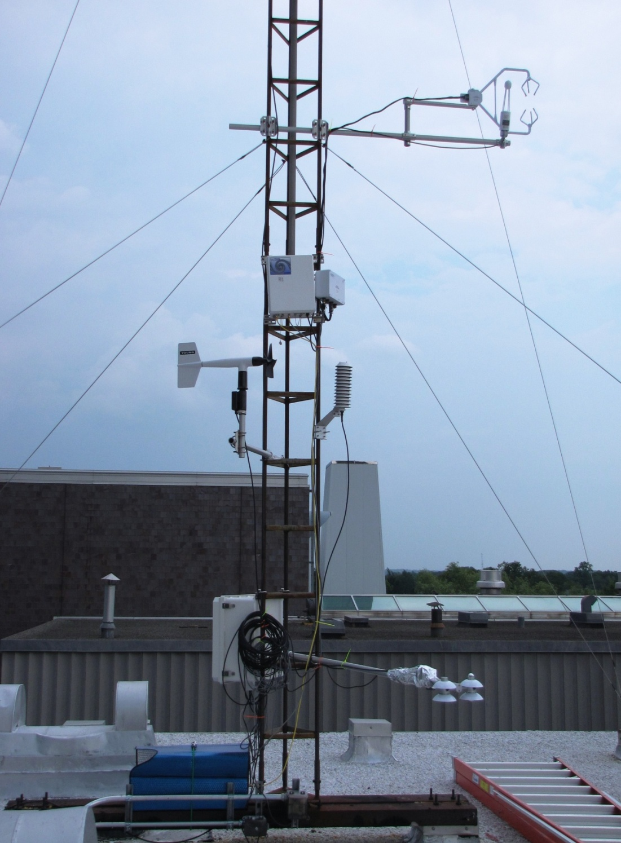
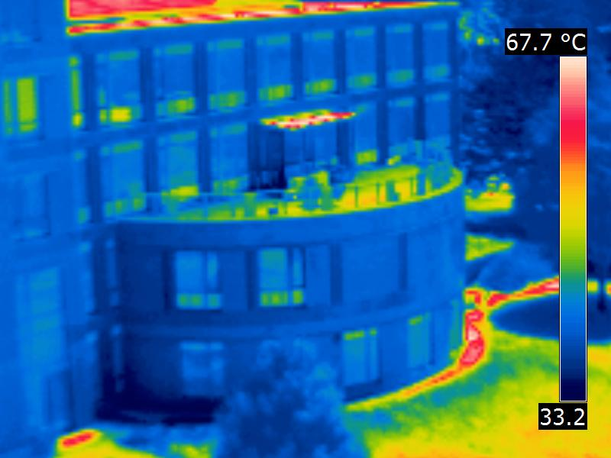
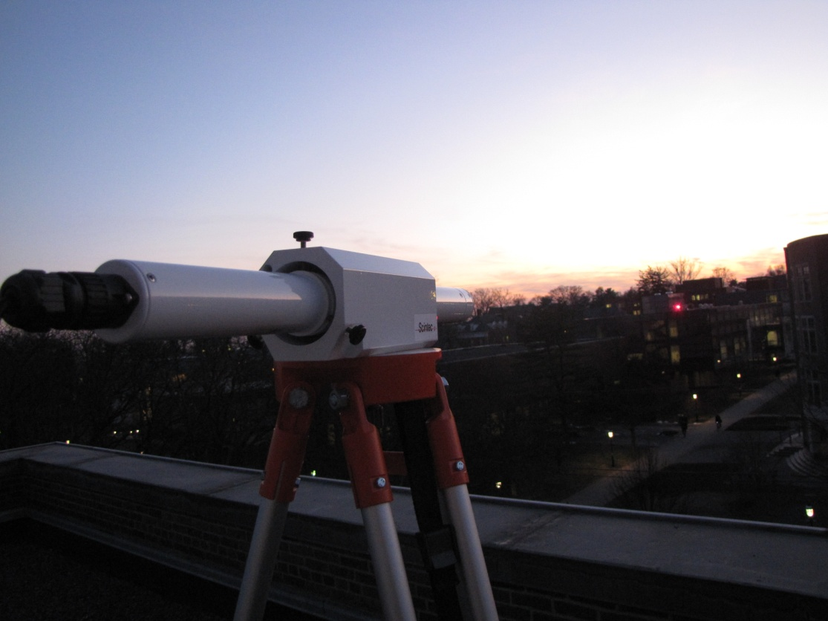
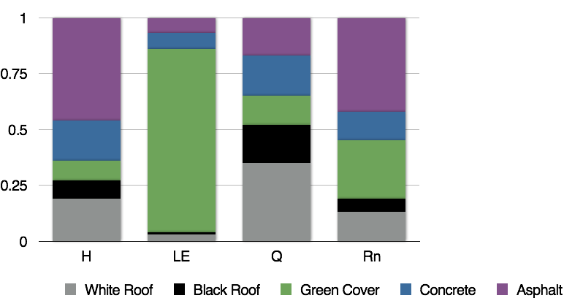
Urban Meteorology: Understand Energy Flux Process In Urban Settings
Sensor network
Flux Tower
Drivers of Urban Surface Energy Budget
IR Camera
Scintillometer
Multi-Scale Monitoring to Account for Urban Heterogeneity

Slide 24
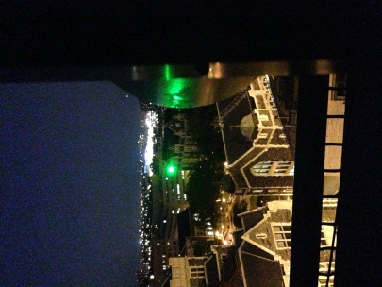
Remote Sensing of Greenhouse Gases
CREST Contact : Moshary/Gross (CCNY)
Collaborators DoE (BNL)
Potential Collaboration with ESRL CSD and CIRES for Urban Methane levels and leaks
Leveraged Project: Funding Source (NSF)
Objectives:
- Characterize GHGs at model grid scales
- Develop ranging instruments for GHGs
NOAA Relevance: Validation of atmospheric Chemistry and Climate models
Description: Develop instrumentation for remote sensing of GHGs.
Methodology: Take advantage of latest laser technology developments to design and demonstrate atmospheric remote sensing instruments based differential absorption technique
Long Path Nitrous Oxide Measurements in NYC and Comparisons to FTIR
Long Path Methane Measurements in NYC and Comparisons to a nearby point Sampler

Slide 25
PM_{2.5} Estimator from Satellite Aerosol Products
CREST Contact: Gross/ Moshary/Wu (CCNY); Hoff/ Delgado (UMBC)
S. Kondrogunta (NOAA) , M. Ku (NYS DEC), P. Ginoux (GFDL), J. McQueen (NWS ), MD DEP
Funding Source (EPP / NYSERDA)
NOAA Relevancy
1) Improve the application of MODIS and VIIRS Satellite AOD products to estimate surface level PM2.5
2) Work Closely with State Stake Holders
3) Optimize the use of combining ground based observations, and models with satellite observations.
1) Study connection between PM sampler measurements, AERONET AOD, and Lidar aerosol profiles
2) Study meteorological factors which lead to bias between PM25 measurements and estimators
3) Ingest WRF meteorology including PBL parameters into a NN module
4) Direct comparisons made with both NOAA/EPA IDEA PM25 estimator and CMAQ
Local measurements at CCNY show the importance of the PBL height in connecting AOD to PM2.5
Results over New York State show that WRF PBL averaged temperature is more robust than PBL height
Improvement seen in comparisons to both CMAQ and IDEA.

Slide 26
Aerosol Optical Depth to PM 2.5 Estimator Development from Ground, Satellite Observations, NWF and Global Models
  Regional Research Product:
  PM25 spatial Maps based on Satellite Retreivals and WRF models
  Future work will blend this map with a Kreiged version of the AIR-Now PM2.5 measurements

Slide 27
Puerto Rico Weather Radar Network
CREST Contact: Rafael Rodríguez-Solís (UPRM)
Collaborators (Sandra Cruz-Pol, José Colom, Leyda León - UPRM)
Leveraged: Funding Source NSF
High Spatial and Temporal Resolution Polarimetric Products
NOAA Mission Relevancy: Weather Ready Nation
.
Identify and validate techniques to efficiently and effectively utilize very high temporal and spatial resolution multi-sensor (including Doppler radar and emerging observational systems).
Support improved warnings and short-term forecasts for convective hazards.
Network operation of 3 TropiNet radars integrating OTG radars.

Slide 28
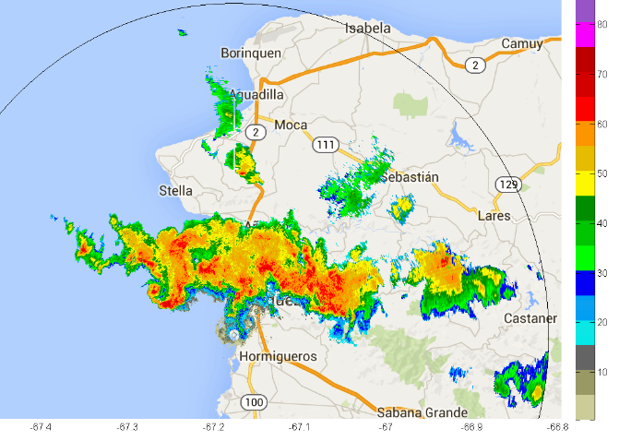
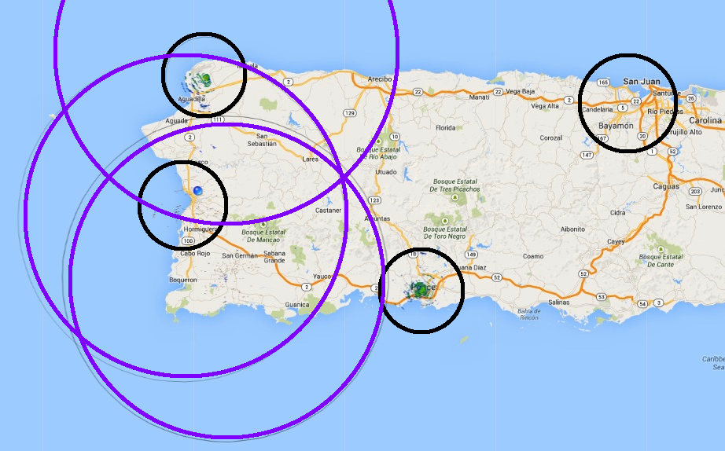
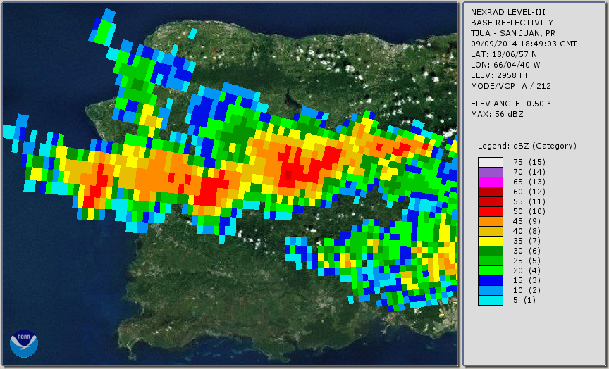
Establishment of Dense Weather Radar Network
Solar Powered OTG radars
Doppler Dual-Pol Tropinet

Slide 29
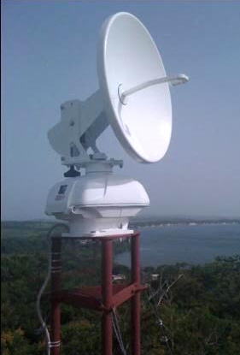
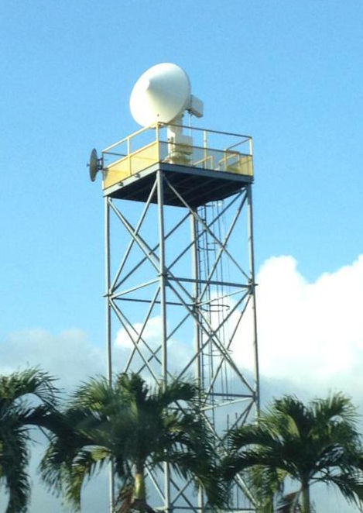
Radar Nodes
TropiNet Radar
  X-band
  Dual Polarized
  1.4 deg beamwidth
  40 km range (150 m cross-range resolution)
  Doppler
OTG Radar
  X-band
  Single Polarized
  3.8 deg beamwidth
  20 km range (150 m cross-range resolution)
  Solar powered
Project Leads: Drs. Sandra Cruz-Pol, José Colom, Rafael Rodríguez-Solís, Leyda León

Slide 30
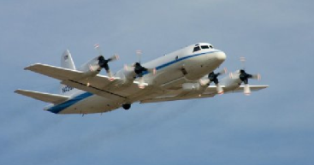
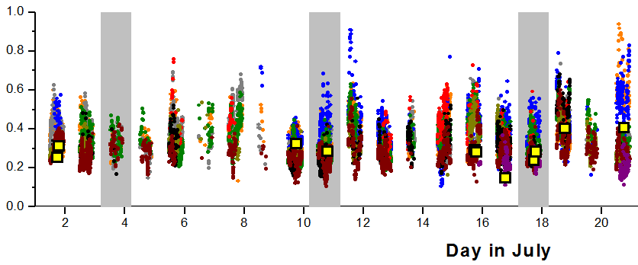
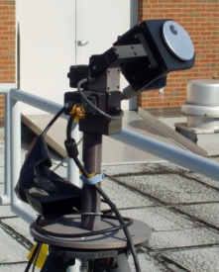
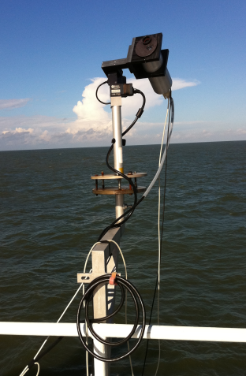

novel Pandora spectrometers, and applications to studies of coastal Air-Quality, Atmospheric Deposition, and Ocean Color
CREST Contact: M. Tzortziou (CCNY) I. Petropavlovskikh ‎(NOAA), R. Evans (NOAA), G. McConville (NOAA), J. Herman (NASA), J. Kaye (NASA), A. Cede ‎(NASA)
Funding Source: NOAA, NASA, NSF, EPA
The Pandora system network:
- in the US (e.g., NOAA in Boulder CO; NASA Greenbelt MD; Washington DC; NASA Langley VA; Boston MA; Houston TX; Four Corners NM; Annapolis MD; Smithsonian MD; UMD MD; and soon in CUNY, NY)
- in Europe (Helsinki, Finland, Innsbruck, Austria, Canary Islands)
- in Korea (Seoul and Busan)
Publications (selected):
Tzortziou et al. 2012; Tzortziou et al. 2013; Tzortziou et al. 2014; *Reed et al. 2014; *He et al. 2014; *Stauffer et al. 2013; Herman et al. 2009; Herman et al. In Review; Cede 2012, Flynn et al. 2014; Lamsal et al. 2014
Pandora is a small, low-cost, extensively validated spectrometer system for measurements of atmospheric trace gases (total amount, vertical profiles) and aerosols, from fixed and moving platforms (ground-based network, ships, mobile vehicles).
Products: NO₂, H₂O, O₃, SO₂, HCHO, aerosol properties.
Task Goal & Objectives: Understand impacts of anthropogenic emissions and climate change on atmospheric composition; study deposition of air pollutants at the land-ocean interface; assess environmental and ecological benefits of air-quality regulations
NOAA Mission Relevancy: Climate, Air-quality & Human health, Coastal Ocean Color, Validation of satellite retrievals, Weather-ready nation
NO2 Column

