Slide 1
NOAA-CREST Algorithm Development Activities
Led by – Pat McCormick and Alex Gilerson
May 7, 2015

Slide 2
Algorithm Development Outline
Theme I - Climate
Snow Cover & Properties Retrieval From Satellite Microwave
Near-real-time Cloud Detection From Weather Satellites
Theme II - Weather and Atmosphere
Improving High Resolution Satellite AOD in urban areas
Ceilometer PBL Heights for Assimilation and Verification of Forecast Products
Aerosol Properties Retrieved from OMPS Limb Profiler (LP) Measurements
Theme III - Water Resources and Land Processes
Algorithm Development for Merged Land Surface - Sea Ice Cryosphere Freeze/Thaw Product
A Short Term Rainfall Prediction Algorithm
Theme IV - Ocean and Coastal Waters
Algorithms for Chesapeake Bay and other coastal waters
Retrieval from Polarimetric Observations
Algal Bloom Detection using VIIRS bands
Hyperspectral Remote Sensing

Slide 3
SNOW COVER & PROPERTIES RETRIEVAL FROM SATELLITE MICROWAVE
Theme I: Climate
CREST Participants: Shahroudi and Rossow
Collaborators: Romanov (NOAA)
Funding Source: NOAA EPP
Goals: Develop Rigorous Radiative Model-Based Retrieval of Snow Properties
NOAA Relevance: Determine Snow Water Amounts
-Determine Land Surface Microwave Emissivities by Combining Microwave and IR Measurements to Account for Atmospheric and Surface Temp. Effects
-Determine Microwave Emissivity Signal of Snow
-Train Neural Network Using Microwave Radiative Transfer Model of Snow
-Retrieve Snow Cover, Depth, Density and Water Content
Global Snow Pack Properties Successfully Retrieved for 12-YR Period
(1 paper published, 1 paper in preparation)

Slide 4
NEAR-REAL-TIME CLOUD DETECTION FROM WEATHER SATELLITES
Theme I: Climate
CREST Participants: Rossow and Walker
Funding Source: NOAA and NASA
Goal: Adapt Successful ISCCP Cloud Detection Algorithm for Near-Real-Time and Higher Time Resolution Use
NOAA Relevance: Understanding Changing Climate
ISCCP Cloud Detection Algorithm Code was Revised to Provide Options for How Time-Statistics are Collected
- This Algorithm Works for all Imaging Radiometers on Geo-stationary and Polar Orbiting Satellites
- Capability is Being Transferred to NOAA as part of ISCCP R2O

Slide 5
IMPROVING HIGH RESOLUTION SATELLITE AOD IN URBAN AREAS
Theme II: Weather and Atmosphere
CREST Participants: B. Gross, N. Malakar, N. Chowdhury
Collaborators: Istvan Laszlo, Shobha Kondragunta (NESDIS-STAR), Min Oo (CIMSS), Rob Levy (NASA GSFC – SSAI)
Funding Source : NOAA EPP
Task Goals / NOAA Relevancy
1) Determine high resolution Satellite AOD retrieval performances in complex urban areas
2) Identify bias factors and develop regional approaches to improve performance
3) Outputs to support complementary PM2.5 retrieval efforts
1) Use Dragon Network Experiment which deployed ̴30 Aeronet Ground Stations over Baltimore/DC Area
2) Assess performance for both 10km and 3km MODIS products
3) Use Aeronet to remove atmosphere to extract surface albedo properties
4) Identify different albedos with different land classifications and modify operational code
Regional Algorithm Demonstrated for multiple case scenarios
Demonstration of potential improvement of High resolution (3km) in Baltimore/DC area and NYC area.
New focus on VIIRS 0.75km Intermediate Product
NYSERDA Proposal with S. Kondrogunta for VIIRS
Min Oo et al, IEEE TGRS 2011 ,
Min Oo et al Taylor and Francis, LLC, Chapter 15 (2013) N. Malakar, N. Chowdhury AMS 2014

Slide 6
Improving High Resolution Satellite AOD in urban areas
Aerosol Retrieval (AOD) over land is greatly affected by land surface albedo leading to significant over-bias over urban areas
These issues become even more significant when higher resolution aerosol products such as MODIS C006 3km Aerosol Retrievals and VIIRS Intermediate Product AOD (0.75km) become available
Old C005 10km product
Assessment of MODIS AOD
Using Baltimore / DC Dragon Network Experiment
̴40 Aeronet Measurements
Over 6 week period Summer 2011
New C006 3km product

Slide 7
Modifications to spectral albedo ratios
Direct Surface albedo reconstruction results in different behavior for different land classes
A regional algorithm built on different albedo ratios for 4 different land classes improves results
Regional Surface Spectral Ratio
C006 Surface Spectral Ratio

Slide 8
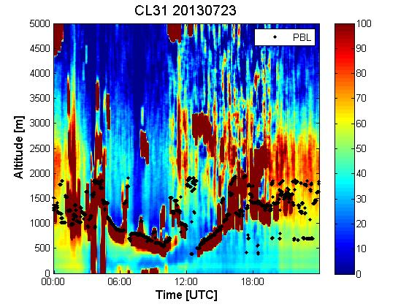
CEILOMETER PBL HEIGHTS FOR ASSIMILATION AND VERIFICATION OF FORECAST PRODUCTS
Theme II: Weather and Atmosphere
CREST Participants: Belay Demoz, Ruben Delgado, George Swift, Farrah Daham (leveraged undergrads), Qin Lin (CREST undergrad)
Collaborators: Ricardo Sakai (Howard U.), Dennis Atkinson, Michael Hicks, Jason Chasse (Program Manager NextGen Aviation Weather at NOAA/NWS/ OS&T) (NWS)
Funding Source: NOAA EPP and NWS
Project 2: Aerosol, Water Vapor, and Planetary Boundary Layer Climatologies with the CREST Lidar Network in support of satellite product validation and applications to air quality.
NOAA Relevance: Observations of PBL height and dynamics, aerosol, clouds, as function of diurnal cycle, season and ancillary MET data sets. Discriminate local and long range transport pollutant sources.
-The UMBC algorithm is being used to retrieve PBL heights from the NWS Vaisala’s CL31 ceilometers, as part of a Proof of Concept Test bed.
-Collocated measurements between CL31 ceilometer and UMBC Micropulse Lidar.
-Collaboration between UMBC and Howard University.
PBL heights retrieved from CL31 will be implemented at nationwide ASOS sites, as support of scientific efforts of the NWS Sterling Field Support Center.

Slide 9

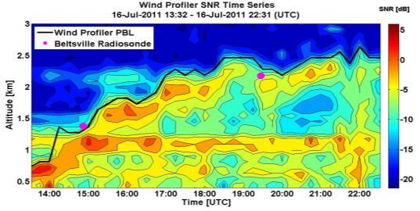
PBL-Height Algorithm Development
Hampton Univ.: Fractal Dimension*
PBL Height: Covariance Wavelet Transform* and Fractal Dimension method#.
PBL algorithm: Collaboration CREST/NCAS/NWS: Vaisala CL31 ceilometers.
*Compton et al., J. Atmos. Oceanic Technol., doi:10.1175/JTECHD-12-00116.1, 2013.
#Liqiao Lei et al., Proc. SPIE 8731, Laser Radar Technology and Applications XVIII, 873112 (May 2013); doi:10.1117/12.2014772.

Slide 10
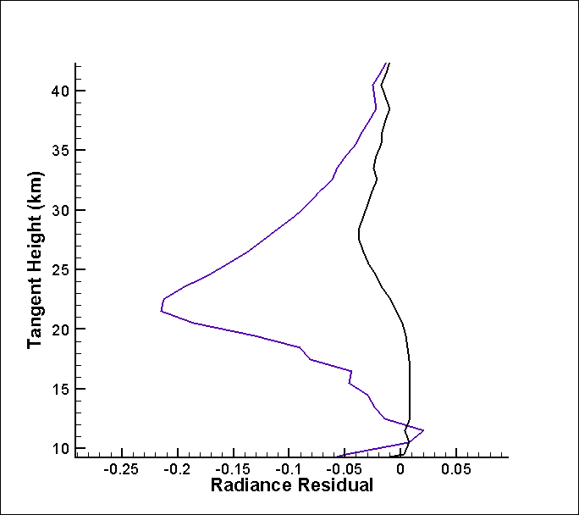
AEROSOL PROPERTIES RETRIEVED FROM OMPS LIMB PROFILER (LP) MEASUREMENTS
Theme II: Weather and Atmosphere
CREST Participants: Robert Loughman, Ernest Nyaku (leveraged graduate student), Ryan McCabe, Ashley Orehek (CREST undergrads);
Collaborators: P.K. Bhartia (NASA GSFC), Nick Gorkavyi and Zhong Chen (SSAI), Ghassan Taha (USRA), Lawrence Flynn (NOAA NESDIS)
Funding Source: NASA/SSAI Sub-Contract
Project 2: OMPS LP Aerosol Extinction Algorithm Improvements
NOAA Relevance: OMPS LP aerosol retrievals improve the OMPS LP ozone profile retrievals, and also have inherent value because of the impact of lower stratospheric / upper tropospheric aerosols on climate.
-The OMPS LP algorithm is being refined for more accurate aerosol extinction and microphysical property retrievals
-The algorithm is currently applied to Suomi NPP OMPS LP data, and will be applied to SAGE III and NOAA JPSS-2 data in the future
-Several problems (poor convergence, excessive dependence on a priori information) have been recently addressed to improve the algorithm
Radiance residuals are nearly eliminated by recent aerosol extinction retrieval algorithm improvements.

Slide 11
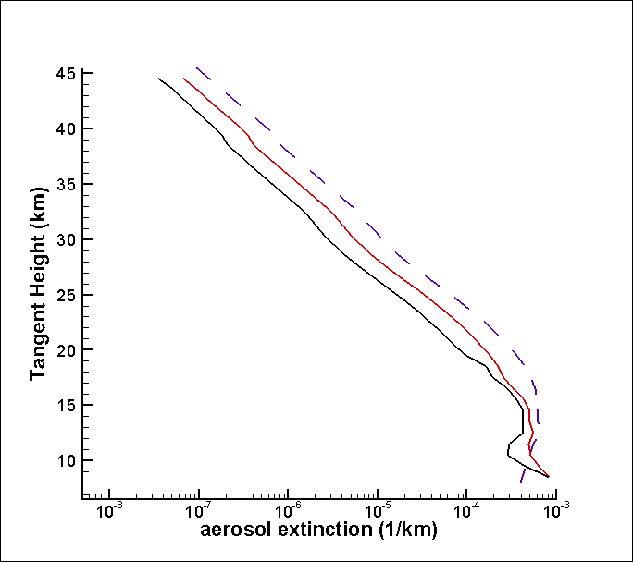
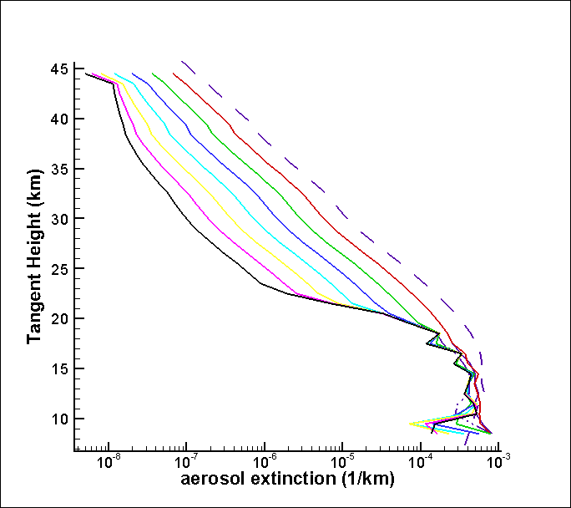
Retrieved Aerosol Extinction (Before Improvements)
Retrieved Aerosol Extinction (After Improvements)
Convergence criteria were much too loose
Convergence criteria were weighted towards higher extinction values
A priori profile was much too large (purple dotted line)
- Premature convergence -> Extremely poor retrieval performance at higher tangent heights
Convergence criteria tightened
Convergence criteria weighting was removed
- Appropriate additional iterations -> much better convergence, despite the poor a-priori profile
- Current solution (black line) now has radiance residuals near zero

Slide 12
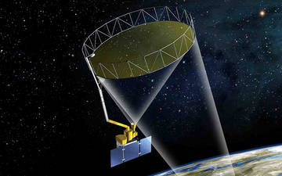
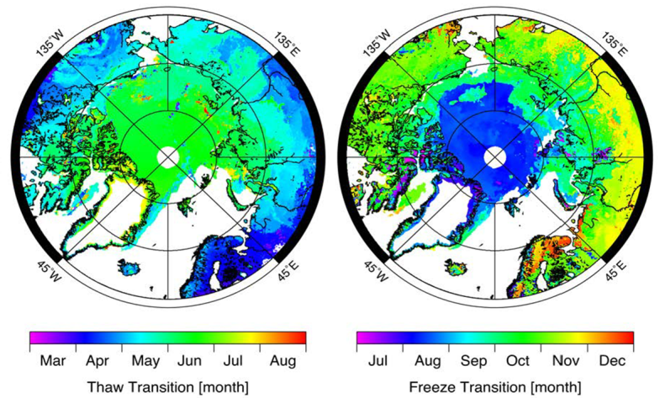
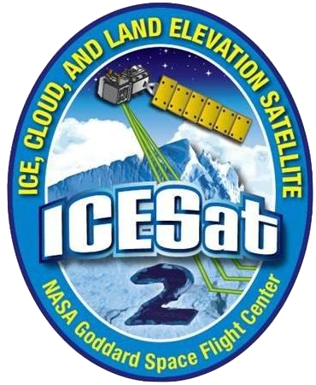
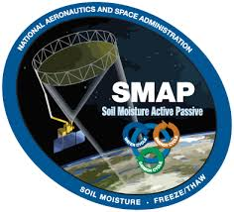
ALGORITHM DEVELOPMENT FOR MERGED LAND SURFACE - SEA ICE CRYOSPHERE FREEZE/THAW PRODUCT
Theme III: Water Resources and Land Processes
CREST Participants: Kyle McDonald, Nicholas Steiner, Cassandra Calderella
Collaborators: Benjamin Holt (NASA JPL)
Funding Source: NOAA CREST and NASA Earth Science
Objectives: Development of unified datasets of daily land surface freeze/thaw state and ocean ice freeboard extent and melt/freeze condition over the Arctic land and sea ice domains to enhance environmental modeling
Integration of SMAP datasets for operational characterization of cryosphere processes across the north polar land-ocean domain
Development of wavelet-based approach to map transition events on sea-ice and land.
Prototyping with ASCAT and QuikSCAT.
Operationalization with SMAP
EXPECTED OUTCOMES Enhance use of NRL environmental model for operational ice monitoring and climate studies

Slide 13
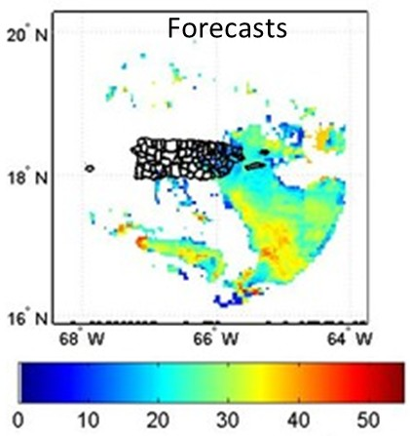
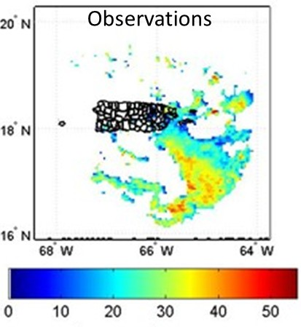
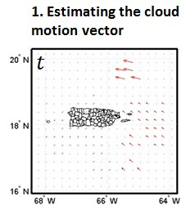
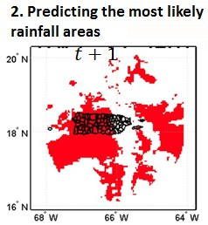
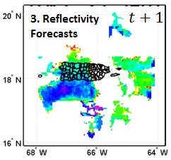
A SHORT-TERM RAINFALL PREDICTION ALGORITHM
Theme III: Water Resources and Land Processes
CREST Participants: Nazario D. Ramirez and Joan M. Castro (Ph.D. student) Collaborators: Robert J. Kuligowski (NOAA/NESDIS)
Funding Source: NOAA
Objectives:
To develop a real-time rainfall nowcasting algorithm to work with radar and the Hydro-Estimator data
To forecast every 15 minutes with lead times that varies from 15 to 90 minutes
NOAA Mission Relevancy:
Rainfall STRaP data can be assimilated by a hydrological model to forecast flash flood events and contribute to a Weather-Ready Nation
Methodology
The Short Term Rainfall Prediction (STRaP) algorithm is a real time and self-calibrated rainfall nowcasting algorithm
STRaP uses radar or Hydro-Estimator data.
Forecast is made every 15 minutes with lead times that varies from 15 to 90 minutes.
The major steps of the STRaP algorithm are:
Reflectivity 30-min forecasts (NEXRAD data)
Po
dBz
dBz
Potential users: NWS and USGS

Slide 14
Theme IV: Ocean & Coastal Waters
CREST Participants: A. Gilerson, S. Ahmed, B. Gross
Collaborators: P. DiGiacomo, M. Wang, C. Brown, R. Stumpf, M. Ondrusek (NOAA)
J. Chowdhary (NASA GISS), A. Gitelson (U. of Nebraska)
V. Lovko (Mote Marine Labs, Sarasota Fl).
Funding Source - EPP and leveraged
Task Goal & Objectives: Algorithms for advanced retrieval of Chl and water properties
NOAA Mission Relevancy:
Healthy oceans, Resilient coastal communities
Neural Network, multiband algorithms, polarimetric observations, comparison with field and satellite data
SIGNIFICANT CONTIRBUTION, EXPECTED OUTCOMES:
Chl algorithm for Chesapeake Bay
Methodology for polarimetric retrievals
New approach for VIIRS Karenia brevis algorithm

Slide 15
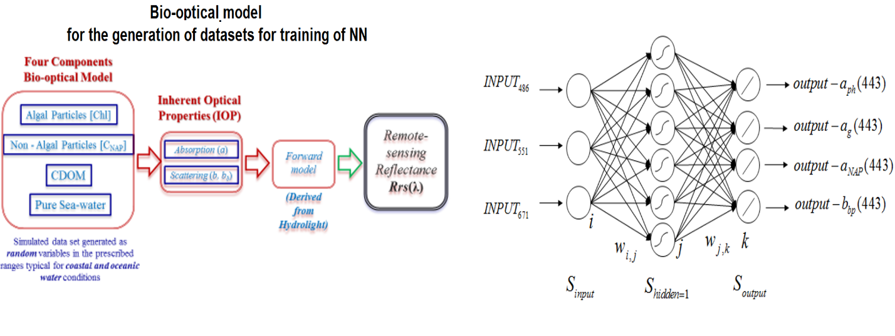
Algorithms for Chesapeake Bay and other coastal waters
Bio-optical model Neural Network
Architecture

Slide 16
Retrieval of [Chl] using NN
486, 551, 671 nm bands
CCNY field data
486, 551, 667 nm bands
MODIS on VIIRS bands vs in-situ (Chesapeake Bay program)

Slide 17
Multi-band algorithms which use 745nm band
Multi-band, CCNY field data
Reflectance spectra, CCNY field data
OC3V, CCNY field data
OC3V, satellite vs in situ data, CB program

Slide 18
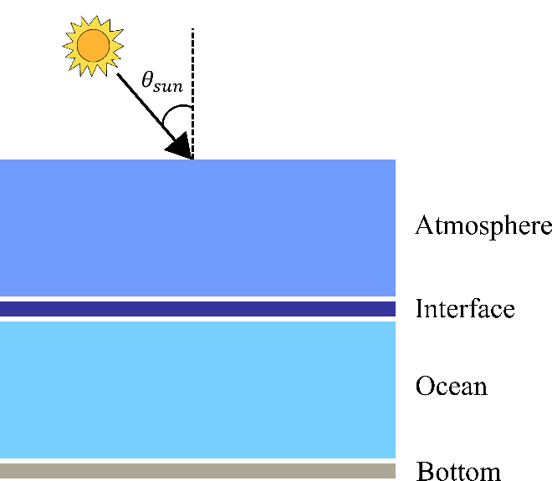

Retrieval of water parameters from polarimetric data
Vector Radiative Transfer modeling
Water molecules
CDOM
Phytoplankton particles
Non-algal particles
$$θ_{sun}=20° to 70°$$
Macrophysics (IOPs)
Absorption a
Scattering b
Volume Scattering Function (VSF)
Microphysics
(Scattering matrix)
Refractive index
Particle size distribution (PSD)
Hybrid Modeling
Two main properties of the particles needed in order to simulate for natural water environment:
IOPs ( absorption and scattering coefficients)
Microphysical parameters (Phase Matrix of scattering for all Stokes components)
Microphysical parameters
Bio-optical parameters
Radiative Transfer Simulations
[I,Q,U,V]^{T}

Slide 19
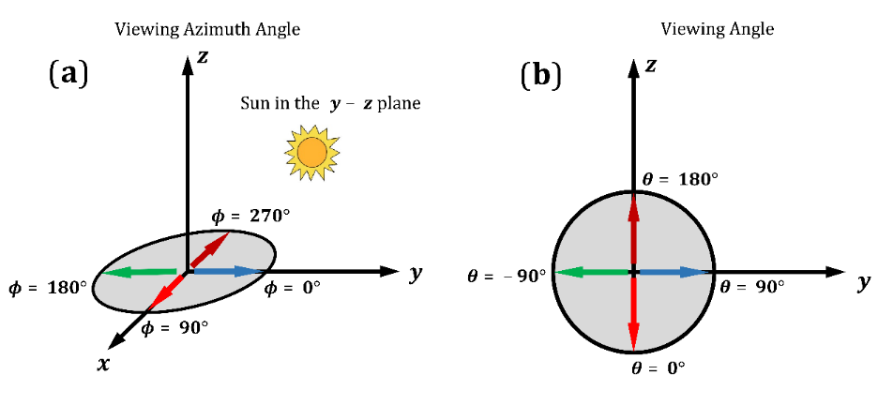
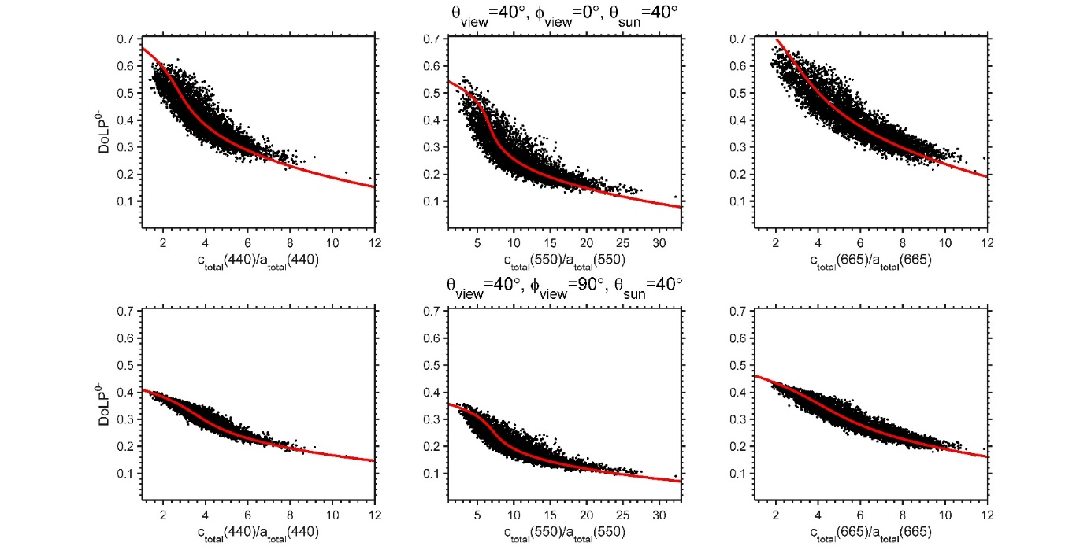
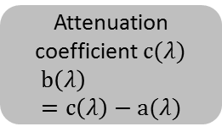
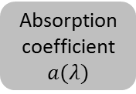
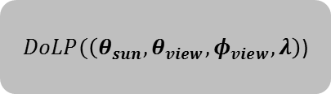
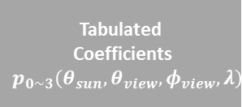
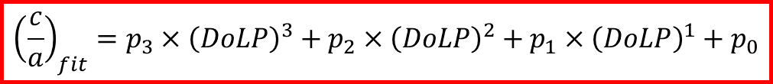
Relationship between the Degree of Polarization (DoLP) and attenuation/ absorption ratio c/a From RT simulations below water
Geometrical Interpretation
Geometry
DoLP at just below
A retrieval based on tabulated coefficients of the polynomial for three wavelengths, Sun, viewing, and azimuth angles
QAA
Input
Absorption coefficient $a(λ)$
$DoLP(\left(θ_{sun},θ_{view},φ_{view},λ\right)$)
+
Tabulated
Coefficients
$$p_{0\sim 3}\left(θ_{sun},θ_{view},φ_{view},λ\right)$$
Inverse algorithm
A third order polynomial fit:
$${\left(\frac{c}{a}\right)}_{fit}=p_{3}×{\left(DoLP\right)}^{3}+p_{2}×{\left(DoLP\right)}^{2}+p_{1}×{\left(DoLP\right)}^{1}+p_{0}$$
Attenuation coefficient $c(λ)$
$$b\left(λ\right)=c\left(λ\right)−a(λ)$$
Output

Slide 20
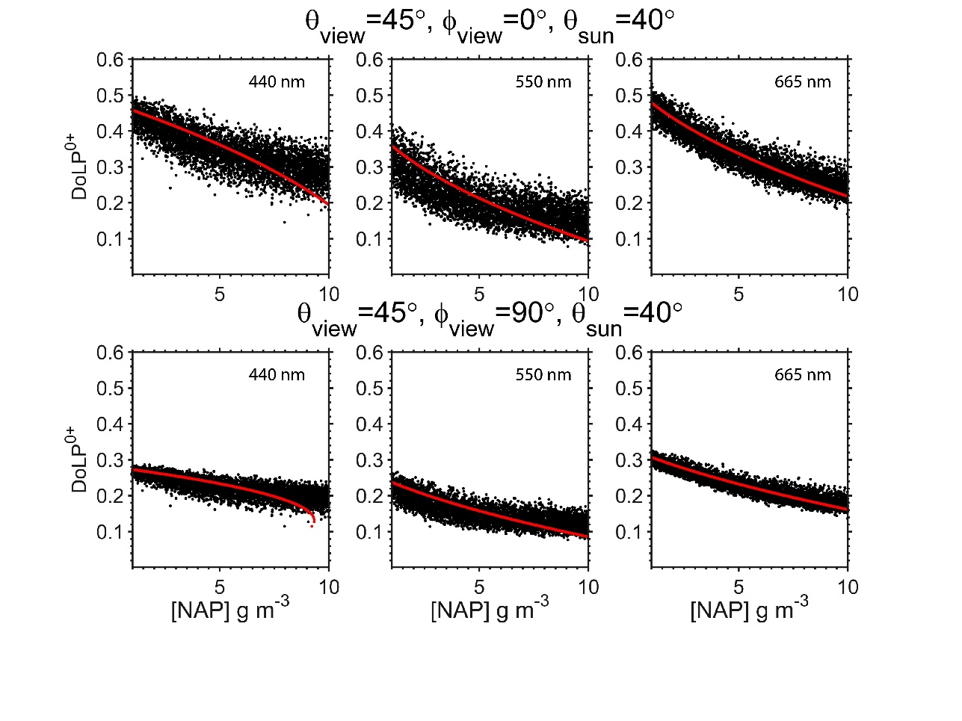
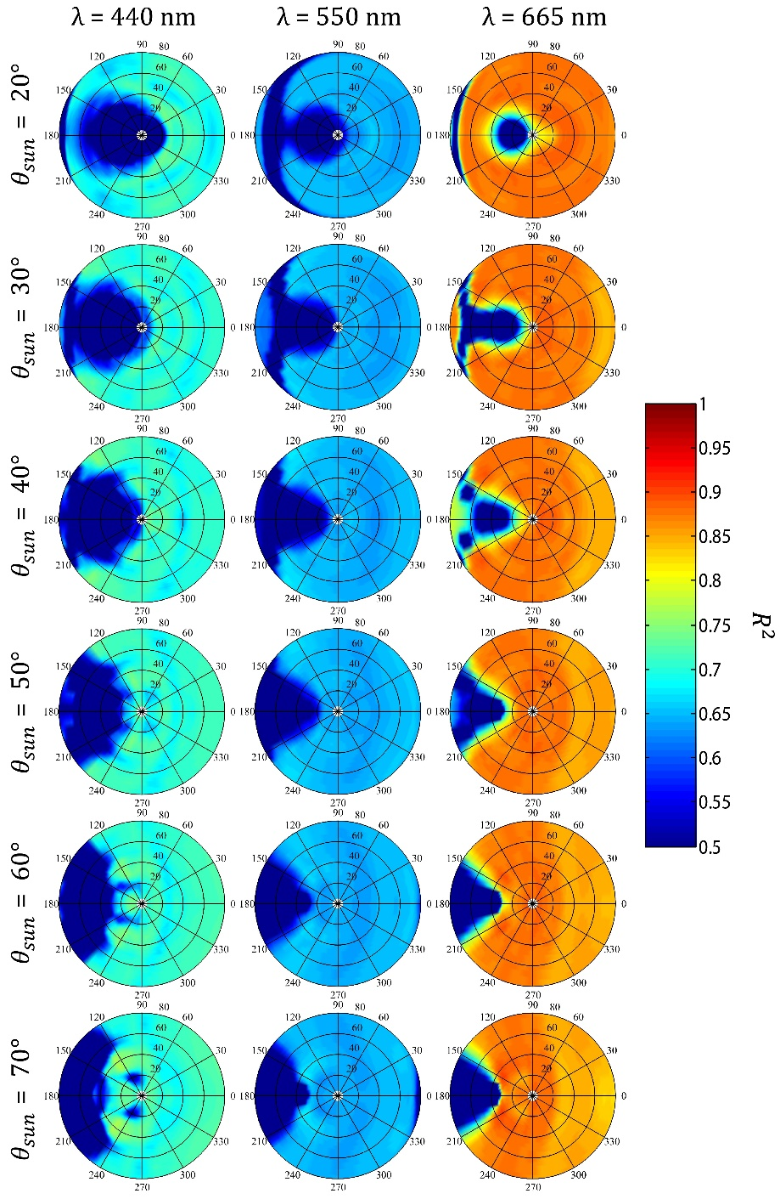
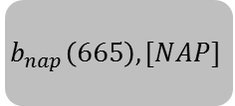
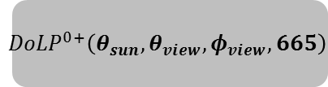
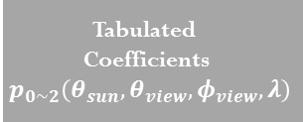

The retrieval of the concentration of minerals $[NAP]$
Input
$${DoLP}^{0+}\left(θ_{sun},θ_{view},φ_{view},665\right)$$
Inverse algorithm
Tabulated
Coefficients
$$p_{0\sim 2}\left(θ_{sun},θ_{view},φ_{view},λ\right)$$
$${\left(\frac{c}{a}\right)}_{fit}=p_{2}×{\left(DoLP\right)}^{2}+p_{1}×{\left(DoLP\right)}^{1}+p_{0}$$
Output
$$b_{nap}\left(665\right), [NAP]$$

Slide 21
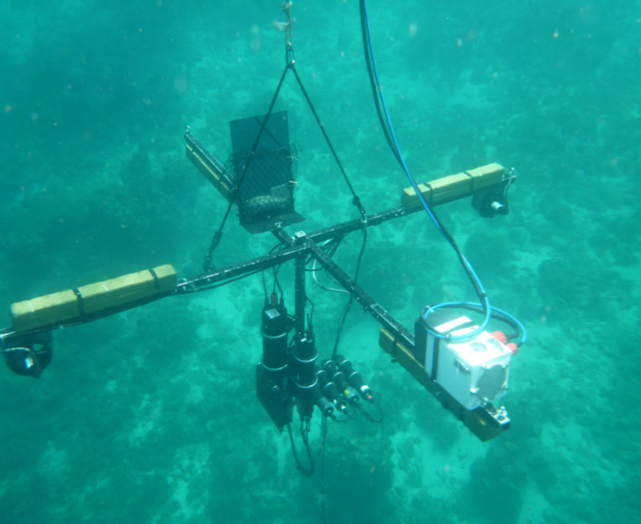
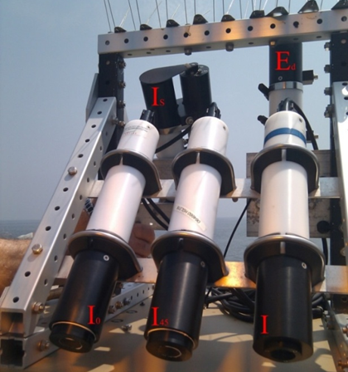
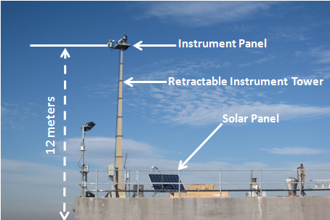
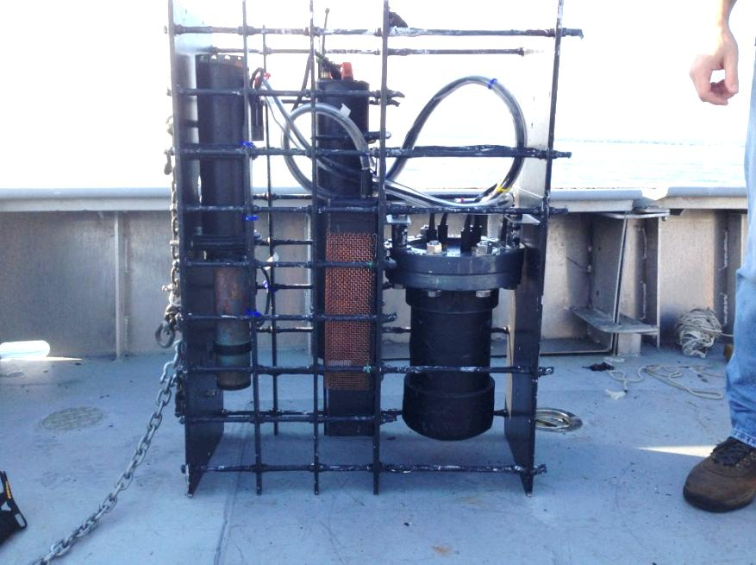
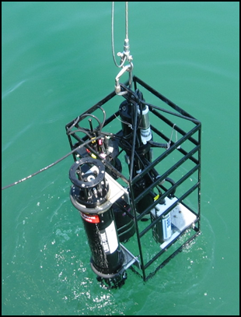
Validation of vector RT simulation results
Polarimeters
Underwater polarimeter
HyperSAS - POL
LISCO platform
FULL STOKES
POLARIZATION
CAMERA
THRUSTERS
DATA LOG &
STEPPER
MOTOR
HYPERSPECTRAL
RADIOMETERS
(0°, 45°, 90°, LH CP)
In water IOPs measurements
WET Labs AC-s
Water Quality Monitor (WQM)

Slide 22
VIIRS HAB DETECTION
Sam Ahmed, Alex Gilerson, Barry Gross
- Karenia Brevis (KB) Harmful Algal Bloom Detection in WFS by VIIRS obstructed by lack of 678 nm Chl fluorescence band used with MODIS & MERIS for HAB detection-
- New CREST approach for VIIRS uses 486, 551 and 671 bands for neural network retrievals of [Chl]
- Combined with knowledge of low backscatter of KB permits use of [Chl]/backscatter fromVIIRS to effectively detect & delineate KB HABS in WFS.

Slide 23
Algal Bloom Detection using VIIRS bands - NN [Chl] retrievals from 486,551,671 inputs
Bio-Optical Model
Neural Network Architecture

Slide 24
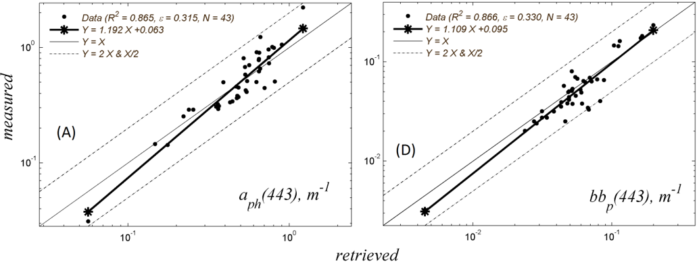
NNviirs v CCNY Field Measurements
Evaluations against CCNY Chesapeake Bay Field Measurements Dataset. Figure shows the values retrieved with the NN_{VIIRS} from in-situ radiometer measurements of Rrs at 486, 551 and 671nm plotted against the values of a_{ph}(443) m⁻¹(A), and bb_{p}(443) m⁻¹ (D) measured by in-situ instrumentation.

Slide 25
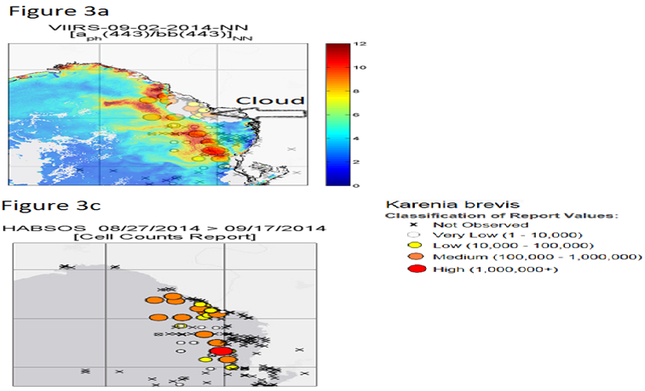
NN VIIRS KB Retrievals WFS COMPARED WITH IN-SITU HABSOS
NOAA HARMFUL ALGAL BLOOM OBSERVING SYSTEM (HABSOS)

Slide 26
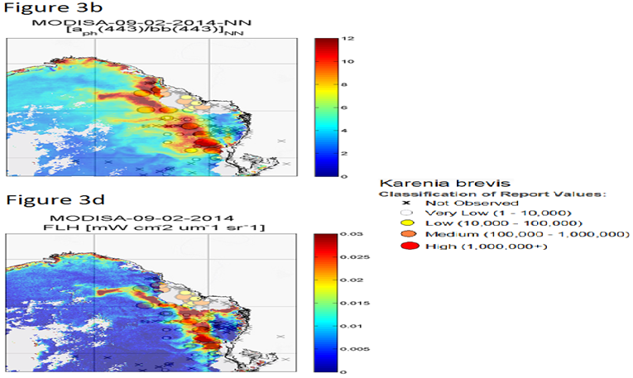
NN MODIS KB Retrievals WFS COMPARED WITH MODIS FLH
NOAA HARMFUL ALGAL BLOOM OBSERVING SYSTEM (HABSOS)

Slide 27
Hyperspectral Remote Sensing
Theme IV: Ocean and Coastal Waters
CREST Participants: Roy Armstrong, and William Hernandez (student)
Collaborators: Alan Strong and William Skirving (NESDIS), Robert Warner (NOS), Pablo Clemente-Colon (NESDIS – student mentor), Maria Cardona (NCAS student in SSIO)
Funding Source: NOAA EPP CREST and NCAS SSIO
Task 1: Develop multi-sensor approaches that combine active (LIDAR) and passive airborne hyperspectral (AVIRIS) imagery for retrieval of benthic composition and community structure in La Parguera, Puerto Rico.
Task 2: Develop an empirical relationship between LIDAR reflectivity and bottom albedo.
To develop a multi-sensor approach that combines active (LiDAR) and passive airborne hyperspectral (AVIRIS) (Guild et al., 2008) and multispectral (WV2) imagery, and field water optical measurements for retrieval of benthic composition and community structure in La Parguera, Puerto Rico.
Development of light-stress remote sensing algorithm (New SSIO)
- Bathymetry Algorithm
- Bottom Albedo Algorithm
- Future light-stress algorithm for coral reefs

Slide 28
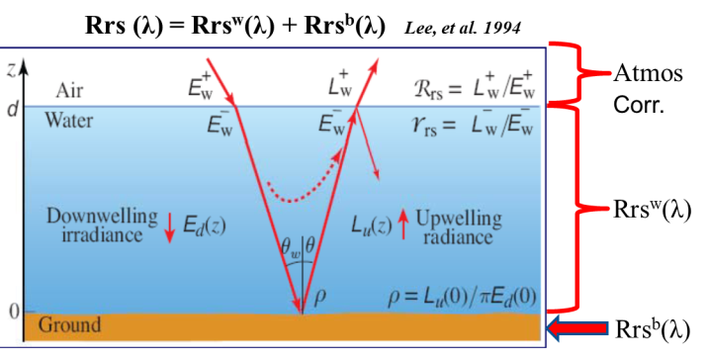
Bottom albedo and water column correction
Research
The AVIRIS hyperspectral sensor was used to obtain bottom albedo, as well as other IOP/AOP based on model drive image optimization techniques (Lee, et al., 1999, 2001, 2007).
LiDAR bathymetry and reflectivity were used in the semi-analytical model and to develop a correlation with the hyperspectral image albedo image after water column correction.

Slide 29
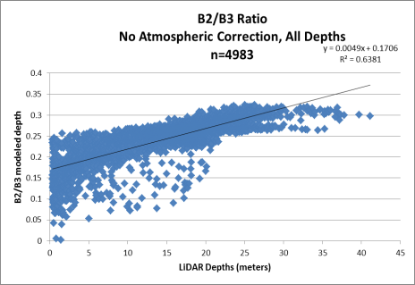
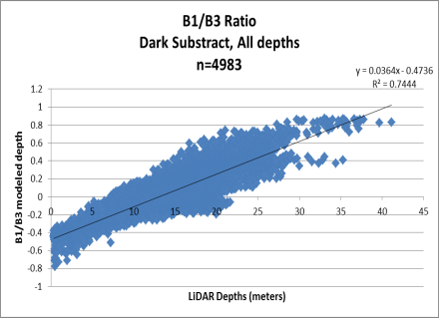
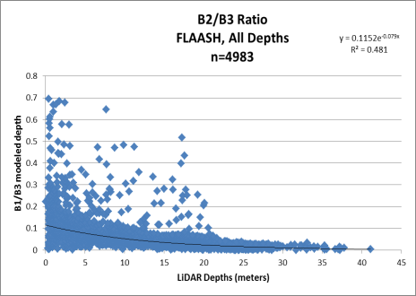
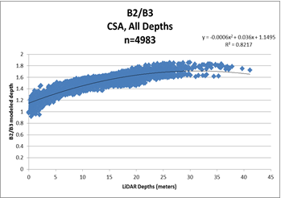
Depth Model Development
Notes:
WorldView 2 (n=3 band ratios)
No Atmospheric Correction
Dark
Subtract
FLAASH
Cloud Shadow
Average
0.371
0.466
0.218
0.792
Median
0.378
0.456
0.234
0.855
Maximum
0.599
0.772
0.417
0.875
Minimum
0.122
0.228
0.005
0.645

Slide 30
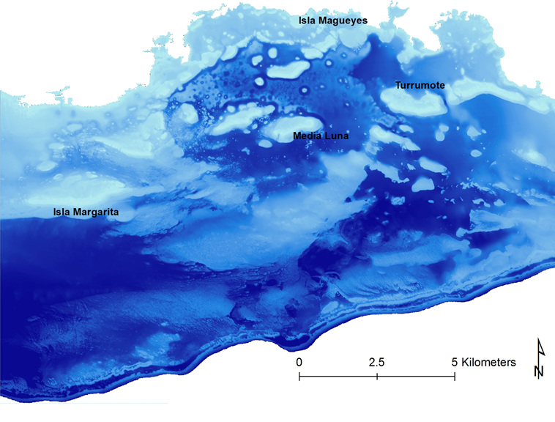
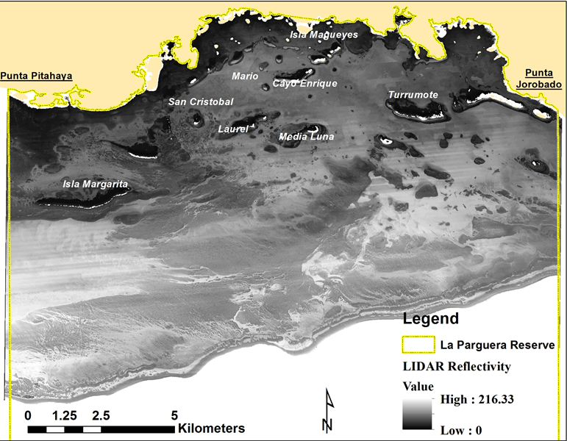
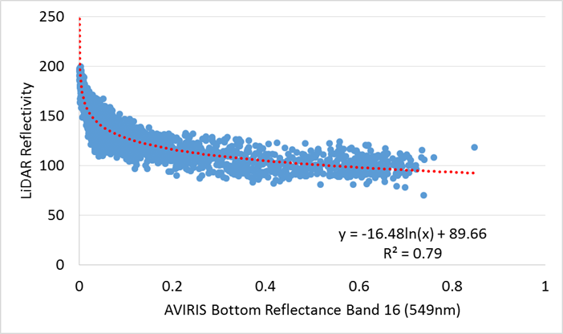
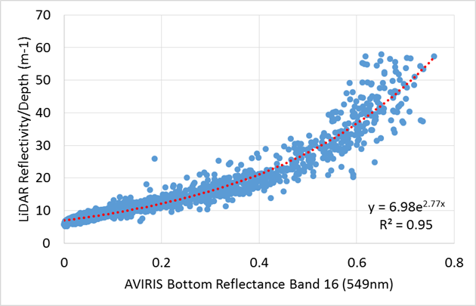
Bottom albedo AVIRIS Band 16 (549nm)
LiDAR Reflectivity
Before depth influence removal
After depth influence removal
Notes:
Correlation of bottom albedo bands from AVIRIS (top) and WV2 (bottom) were to the LiDAR reflectivity band after the removal of the influence of depth. This correlation was based on random points (n=4694) selected for La Parguera Reserve. Bottom albedo images for AVIRIS Band 16 (top). Lighter blue areas depicts areas of high albedo and dark blue areas depicts areas of lower albedo. Land area have been masked (white). Spectral first optical depth (Z90=2.3/Kd) as calculated from Kirk (1994) with derived Kd, for the AVIRIS image (bottom) Correlation between bottom albedo bands from AVIRIS (band 16, 549nm) with LiDAR reflectivity band before (top) and after (bottom) removal of the depth influence in the LiDAR reflectivity image. This correlation was based on random points (n=4694) selected for La Parguera Reserve.

