Slide 1
NOAA CREST Cal/Val Activities Led by: Sam Ahmed & Roy Armstrong
Calibration of Visible -- IR channels of weather satellites (Rossow)
Microwave Calibration (Luo)
SMART – Temimi/Khanbilvardi
SAFE – Tarendra Lakhankar
SBUV validation – McCormick/Anderson (HU)
UPRM Cal/Val – Armstrong
LISCO – Ahmed/Gilerson

Slide 2
Calibration of VIS-IR Channels on Weather Satellites
THEME I
CREST (Rossow)
NOAA (Heidinger, Inamdar), Ferrier (NASA), Stone (JPL), Doelling (NASA), Hinkelman (Washington)
Funding Source (NASA)
Produce Calibration of Imager VIS-IR Radiances Consistent Across All Weather Satellites
NOAA Relevance: Support Use of Radiance Data from Other Weather Satellites in NOAA’s Analyses
Refinement of AVHRR Calibration for 1979-2014 Anchored on ER-2 Flights in 1980s and MODIS in 2000s
Normalization of All Geostationary Satellite Instruments to AVHRR
Ties the Entire Weather Satellite Constellation to a Common Absolute Calibration Standard
This Capability is Being Transferred to NOAA as part of ISCCP R2O

Slide 3
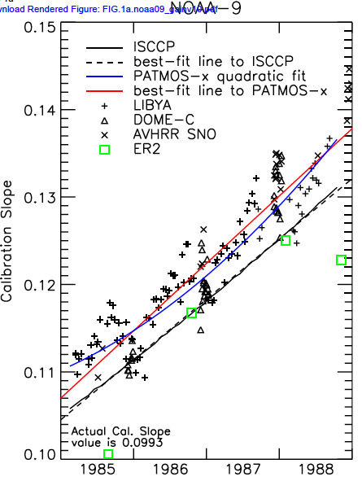
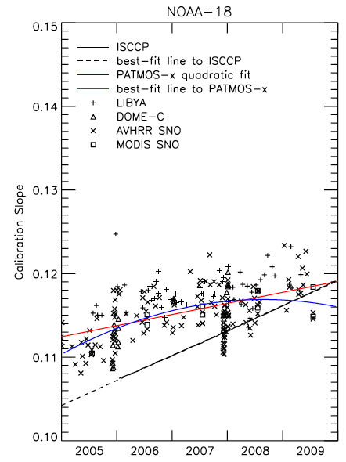
AVHRR VIS CALIBRATION ANCHORS Comparison of two calibrations of the AVHRR Visible radiances: the ISCCP calibration anchored on ER-2 under flights of NOAA-9 and the PATMOS-x calibration anchored on MODIS calibration of NOAA-18. The agreement is within the stated uncertainties of both results, about plus-minus 3%.

Slide 4
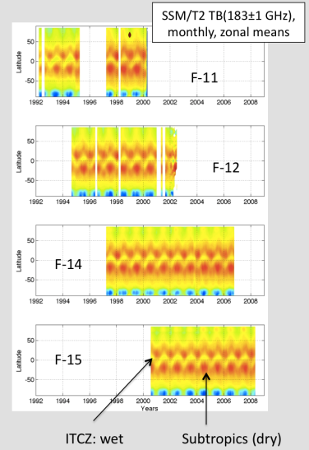
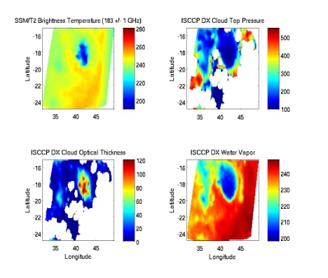
Calibration of SSM/T2 UTH radiances
CREST participants: J Luo and W. B. Rossow
Collaborators: John Bates and Lei Shi
Funding Source: NCDC
The project goal is to bring together UTH-related radiance data from multiple satellites and process them to establish a long-term, global, inter-calibrated radiance record from which UTH can be retrieved and UTH research can be conducted
Multiple calibration methods (e.g., SNO, natural target, zonal mean and radiative transfer model) were used inter-calibrate SSM/T2 radiance data from 1992 to 2008.
Collocated ISCCP data and 6.7 μm radiances from various GEOs were matched up to the SSM/T2 radiances.
Matched SSM/T2 & ISCCP

Slide 5
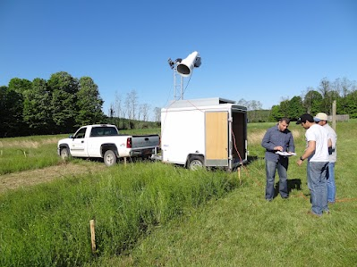
CREST-SMART: Soil Moisture Radiometric Testbed
CREST participants: M. Temimi, T. Lakhankar, K. McDonald, H. Norouzi, R. Khanbilvardi, N. Krakauer
Collaborators: X. Zhang (NOAA); M. Cosh (USDA);
Funding Source: Leveraged
Understand the spatial variability of soil moisture
Improve the retrieval of soil moisture to enhance flood forecasting and weather modeling to support NOAA’s goal of achieving a weather ready nation
A soil moisture observation network was deployed in Millbrook New York; the site was selected by NASA as a core validation site for SMAP soil moisture mapping mission
Marouane Temimi, Tarendra Lakhankar, Xiwu Zhan, Mike Cosh, Nir Krakauer, Victoria Kelly, Laetitia Kumissi. A ground based L band radiometer for the monitoring of soil moisture in the region of Millbrook, New York, USA. 2014. Vadose Zone Journal. doi:10.2136/vzj2013.06.0101.

Slide 6
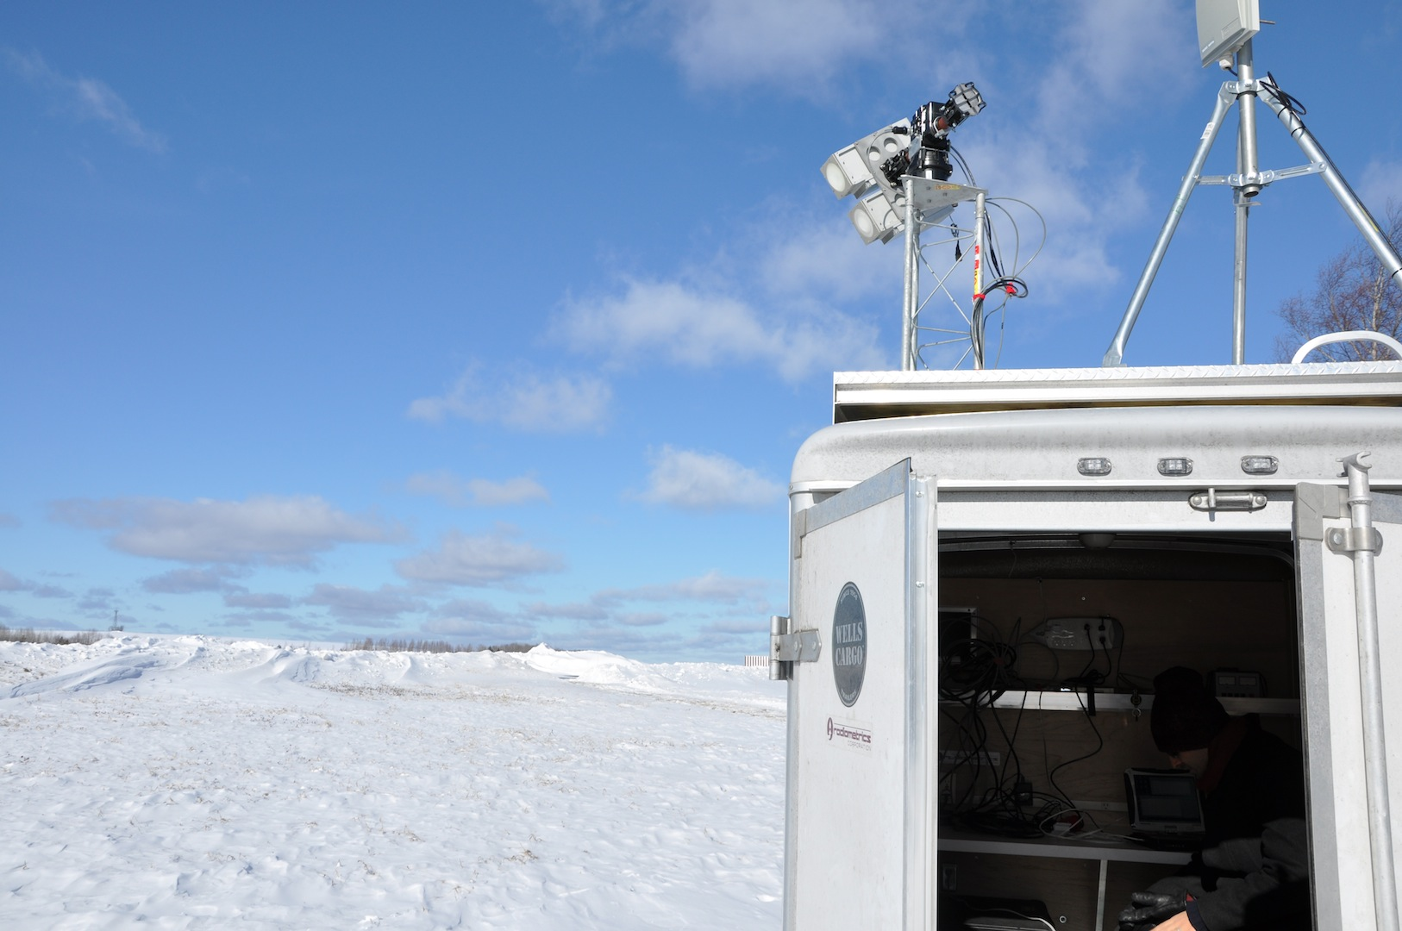
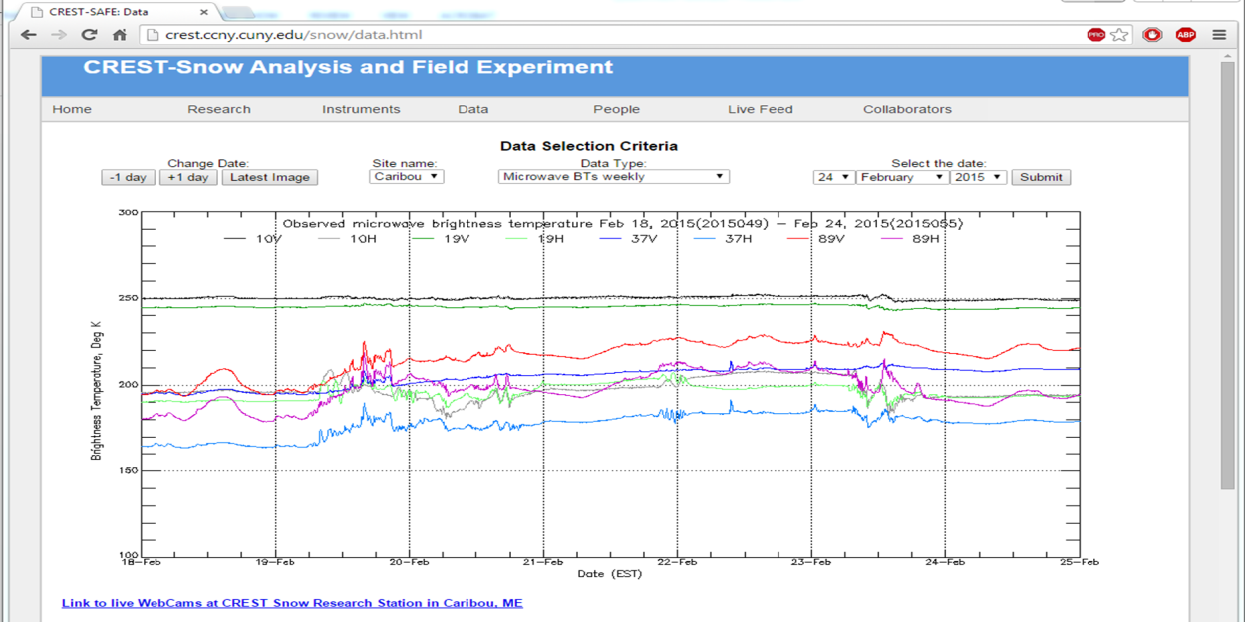
CREST-Snow Analysis and Field Experiment (CREST-SAFE)
Researchers: Tarendra Lakhankar, Peter Romanov, Reza Khanbilvardi, Bill Rossow
Students: Carlos Perez, Hiram Sanchez Collaborators: Al Powell (NOAA)
Funding Source: NOAA, DoD/NAVY, CUNY
Objectives:
Study seasonal changes in the snowpack
Develop snow depth/SWE retrieval techniques
Provide field work training for students
Test new instrumentation for snow research
NOAA Mission Relevancy
Weather-Ready Nation, Ow2: Improved water resource management
Instrumentations:
Dual-polarized Radiometers
10.65, 19, 37, 89 GHz
CIMEL sun-photometer
Solar radiation
Infrared skin temp sensor
Snow pack temp profiler
Air temp and humidity sensor
Wind speed and direction
Soil moisture sensors
Present Weather Sensor
Real time data for research community: http://crest.ccny.cuny.edu/snow
Potential End-users: (1) NOAA/NESDIS for Cal/Val of CRTM and other models, (2) DEP/NYC for Snowpack Modeling (3) NASA

Slide 7
INTER-COMPARISON AND VALIDATION OF OZONE MEASUREMENTS BY SAGE II AND SBUV/2 INSTRUMENTS
Weather – Atmosphere Theme
CREST Participants: Stanislav Kireev, M.P. McCormick John Anderson, and Sufia Khatun
Collaborators: Larry Flynn, Eric Beach (NOAA NESDIS)
Funding Source: NOAA EPP CREST
Averaged zonal total column ozone for the equatorial region for the different SBUV/2 instruments.
Goals / NOAA Relevancy
1) Inter-compare to check the consistency of the various NOAA SBUV/2 ozone measurements
2) Validate them against high vertical resolution ozone measurements from SAGE II
M.S. Thesis – Sufia Khatun, Aug. 2014
- There is good agreement between the SBUV/2 instruments derived column total ozone
- There is good agreement between the SBUV/2 instruments derived partial column ozone and SAGE II

Slide 8
Coastal Ocean Remote Sensing (Theme IV)
CREST participants: Roy Armstrong, William Hernandez (doctoral student)
Collaborators: Alan Strong and Mike Ondrusek (NESDIS), Robert Warner (NOS), Zhongping Lee and J. Wei(UMASS), Jeremy Kravitz (UPRM NASA funded student)
Funding Source (EPP and CREST and new SSIO)
Calibration and validation of VIIRS products (e.g. Kd 490) in southwestern Puerto Rico as part of a new SSIO with NESDIS
NOAA Mission Goals: Resilient Coastal Communities and Economies, Improved coastal water quality supporting human health and coastal ecosystem services
Monthly field sampling of water optical properties is conducted in Puerto Rico to validate VIIRS ocean color products
Includes spectral Kds using Satlantic HyperPro and AOPs and IOPs using profiling bio-optical package
Both Case-1 and Case-2 waters are sampled
J. Wei, Z. Lee, M. Lewis, N. Pahlevan, M. Ondrusek, and R. Armstrong. In review. Radiance transmittance measured at the ocean surface. Applied Optics

Slide 9
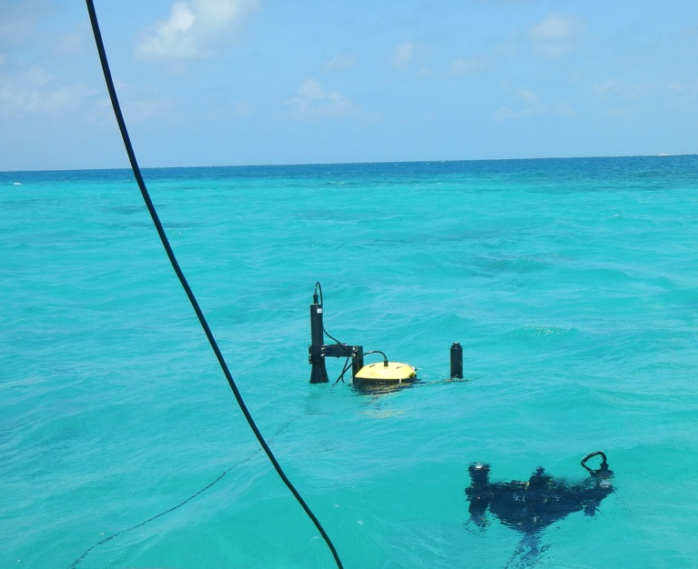
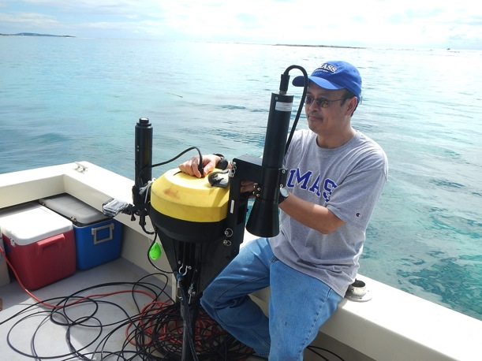
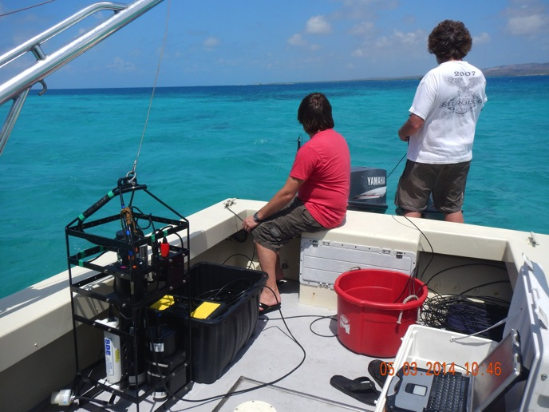
Bio-optical measurements in Southwestern Puerto Rico for cal/val of VIIRS and Landsat-8 data. HICO data cal/val pending.
Spectral radiance measurements in both optically deep and shallow waters. IOPs and AOPs including Kd 490.
Collaboration with NOAA and UMASS.

Slide 10
Theme IV: Ocean & Coastal Waters
CREST: S. Ahmed, A. Gilerson, F. Moshary, B. Gross
Collaborators: P. DiGiacomo, M. Wang, M. Ondrusek (NOAA)
R. Arnone (USM), Z.P. Lee (U. of Massachusetts), C. Davis (OSU)
Funding Source - EPP and leveraged
Task Goal & Objectives: Validation of ocean color satellite data using LIS Coastal Observatory and in-situ measurements
NOAA Mission Relevancy:
Healthy oceans, Resilient coastal communities
-Matchups with satellite data on the LISCO site, during ocean cruises
- SDR validation using radiative transfer approach
- evaluation of polarization effects
- tests of new instrumentation
EXPECTED OUTCOMES: AERONET and AERONET-OC data from LISCO, gain factors from RT simulations, instrumentation for shipborne above water observations in unpolarized and polarized modes

Slide 11
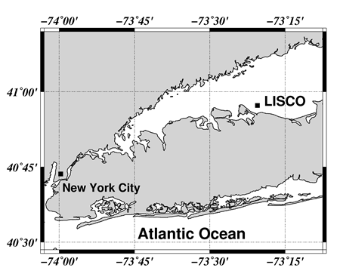
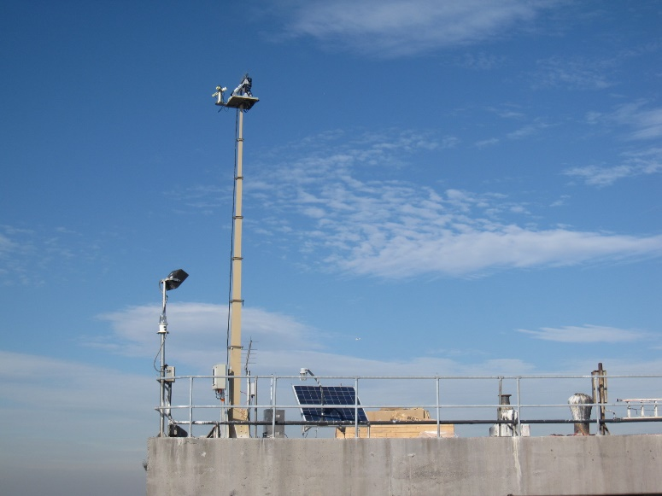
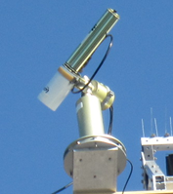
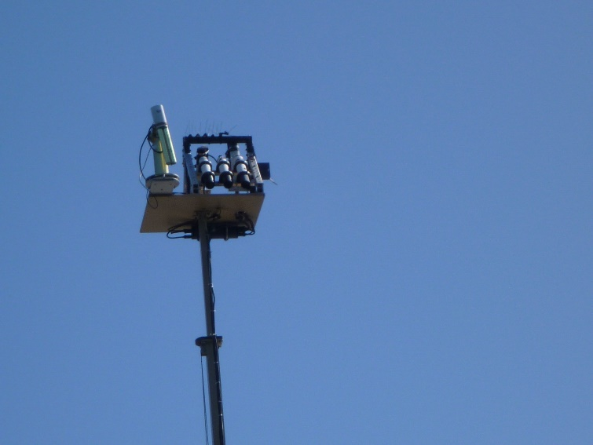
Long Island Sound Coastal Observatory (LISCO)
Mult-spectral SeaPRISM instrument. Transmits data to NASA AERONET every hour.
HyperSAS-POL with polarimetric sensors. Transmits data to CCNY server every hour.

Slide 12
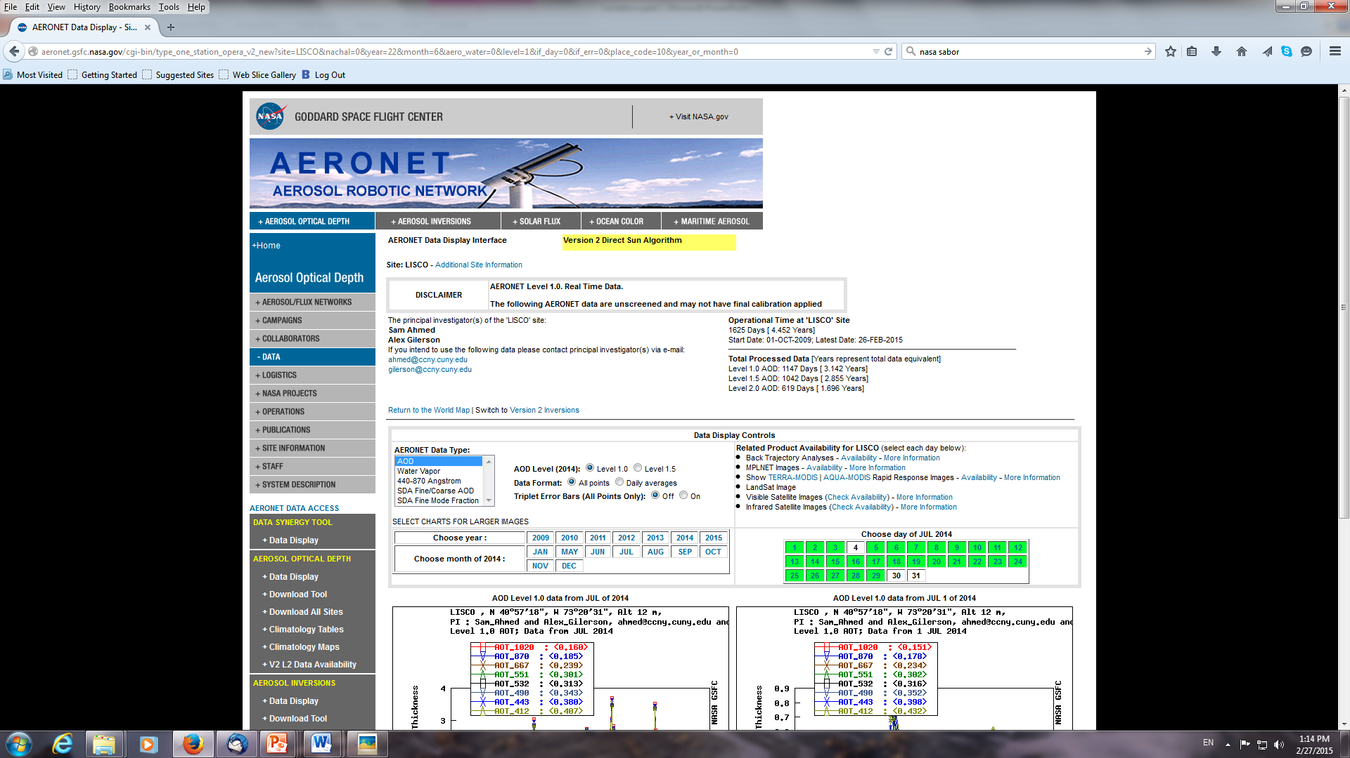
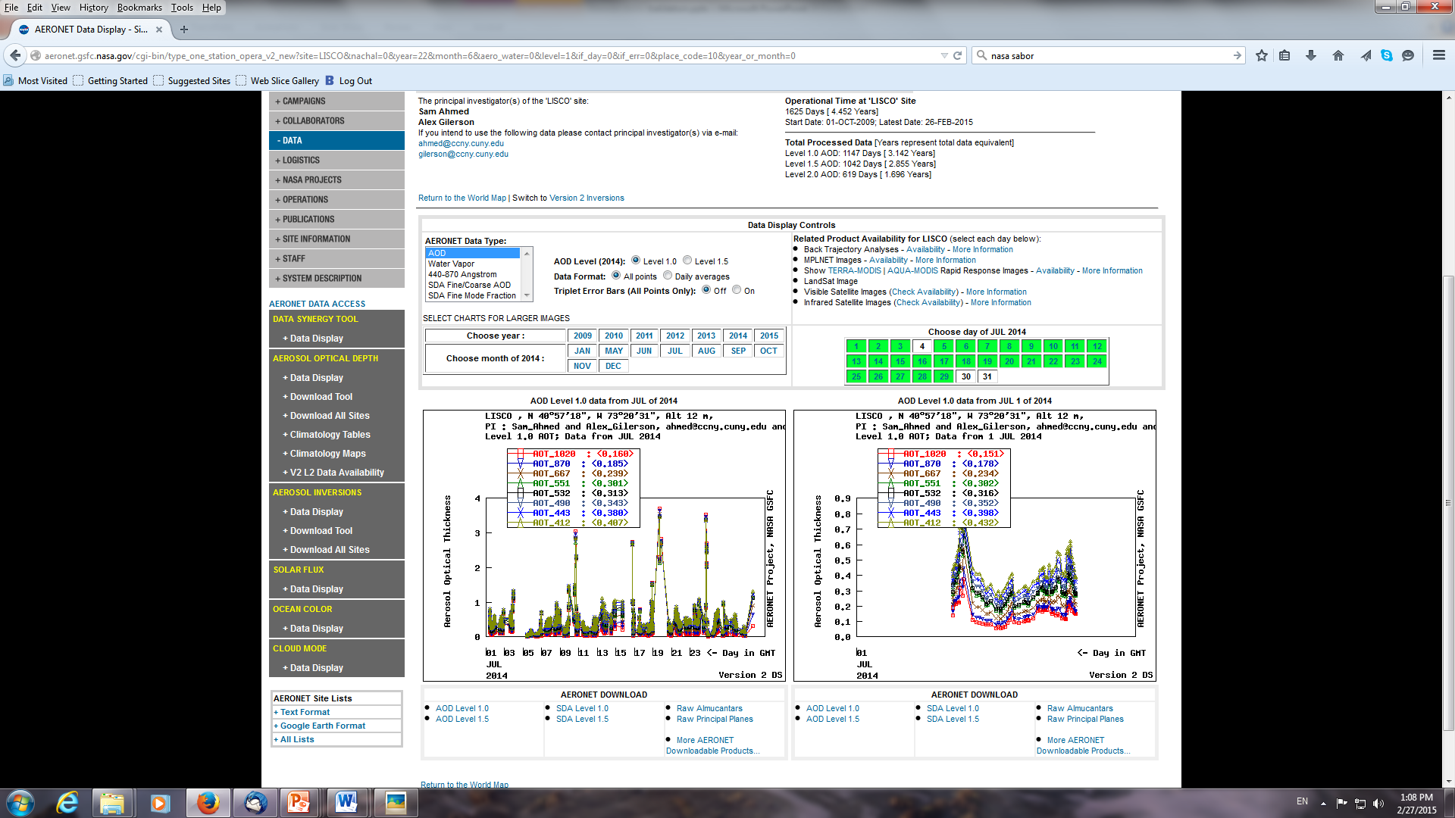
AERONET data for AOT and other aerosol parameters

Slide 13
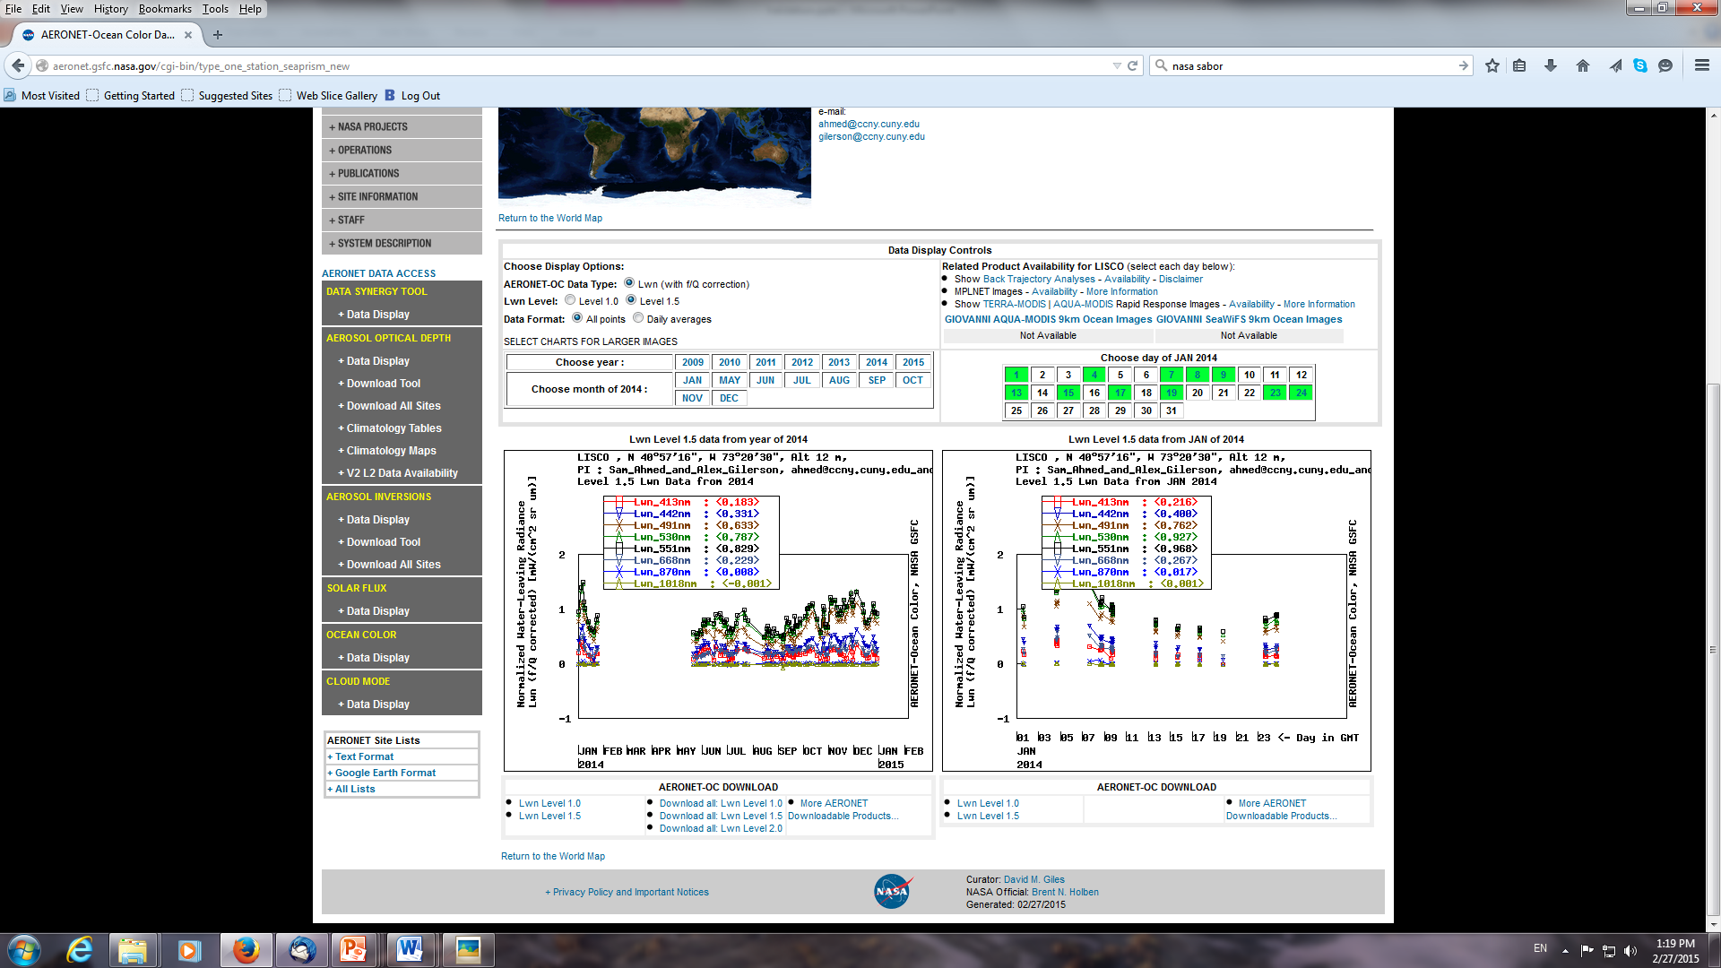
AERONET data for nLw

Slide 14
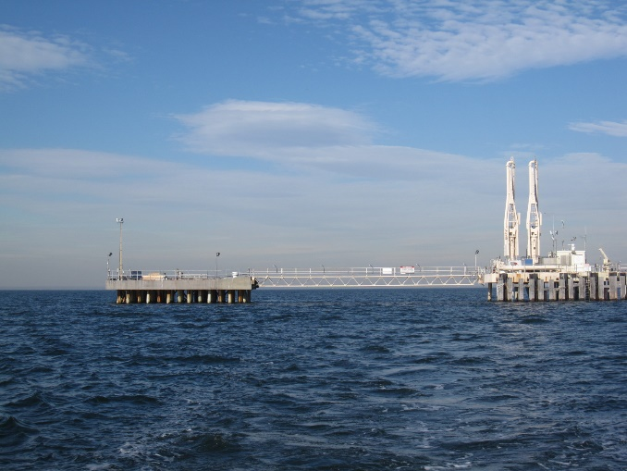
Matchups of Normalized Water Leaving Radiances for the LISCO Site (June 14 - January 15)
Time-Series Data
nLw from:
SeaPrism-LISCO
VIIRS-NOAA Database
VIIRS-NASA Database
MODIS Database

Slide 15
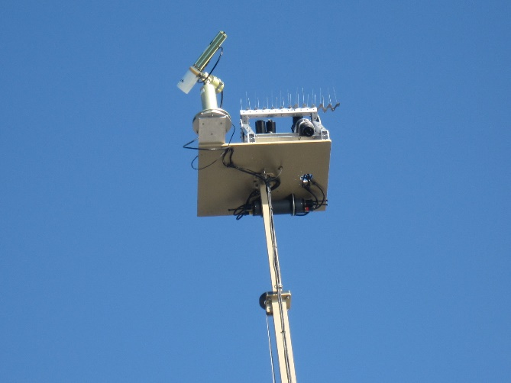
Spectral Comparison
NASA and NOAA (IDPS) processing for VIIRS
Noticeable increase of average LISCO nLW

Slide 16
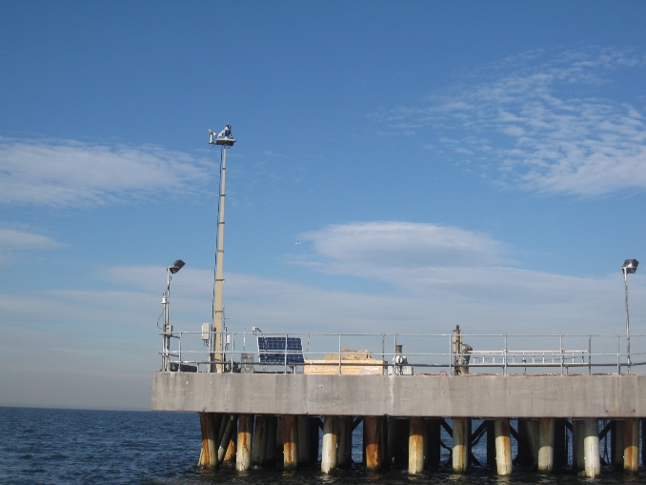
Match-up Comparison
Match-up plots show fairly high correlation for 491, 551, and 668nm for all sensors. Much lower correlation is observed for violet (413nm) and blue (442nm), which is independent of the processing scheme or the sensor.

Slide 17
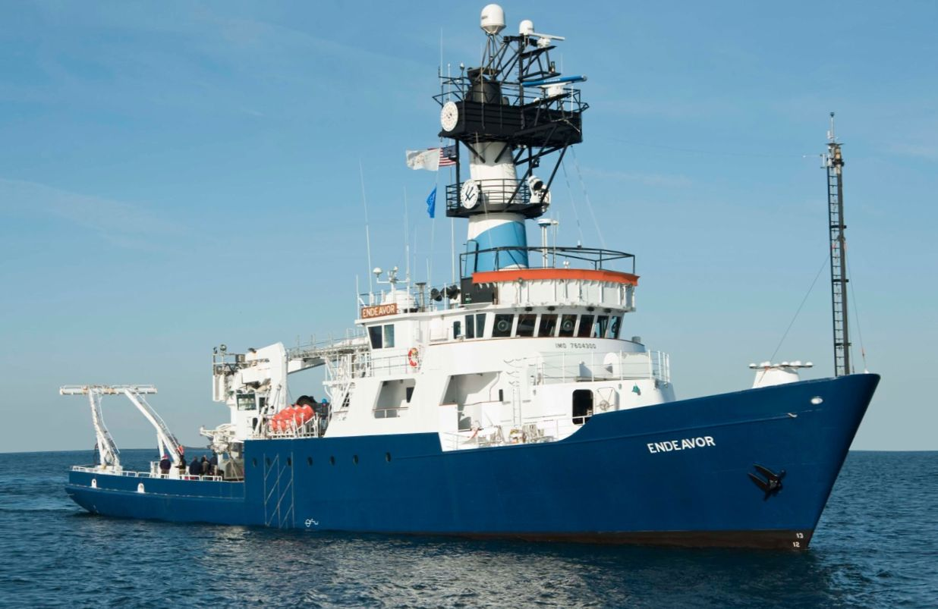
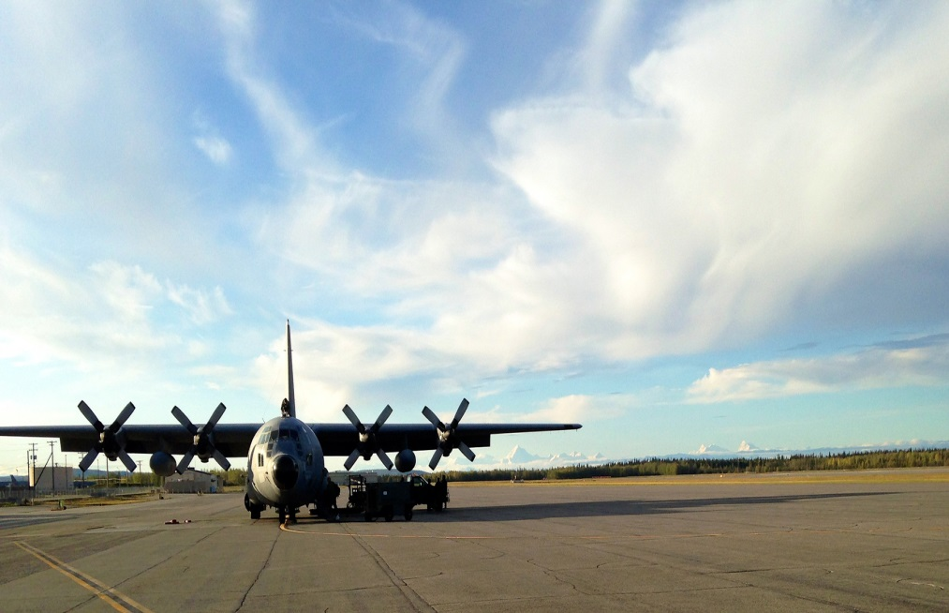
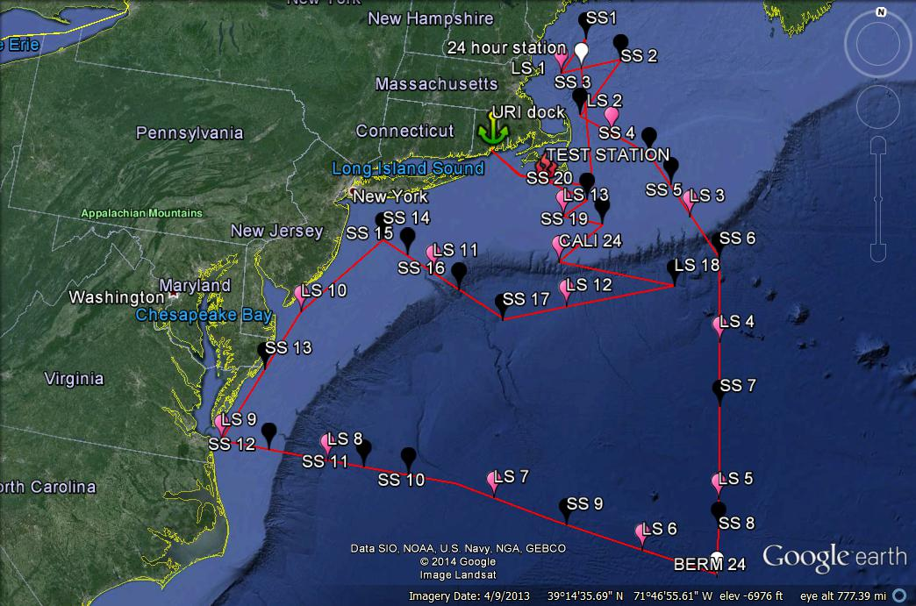
Ship-Airborne Bio-Optical Research (SABOR) NASA Cruise July 17- August 7, 2014
R/V Endeavor owned by NSF operated by University of Rhode Island, 185 feet, crew -12, scientists -15
Rhode Island – Bermuda – Norfolk, VA - Rhode Island
Research Scanning Polarimeter (RSP) and lidar were installed on the plain
NASA GISS, NASA Langley
CCNY, U. of Maine, Oregon State University, Sequoia Scientific, WET Labs

Slide 18
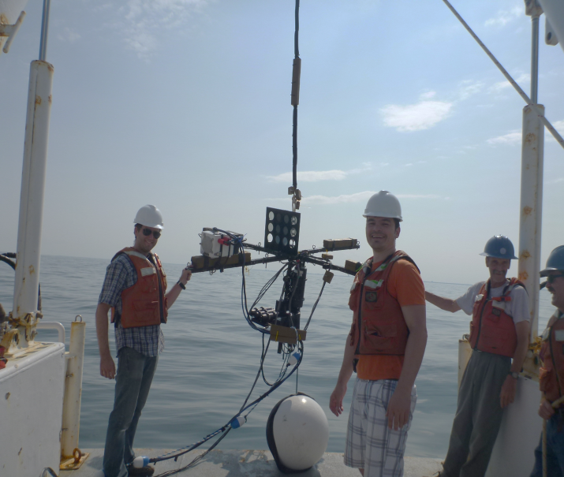
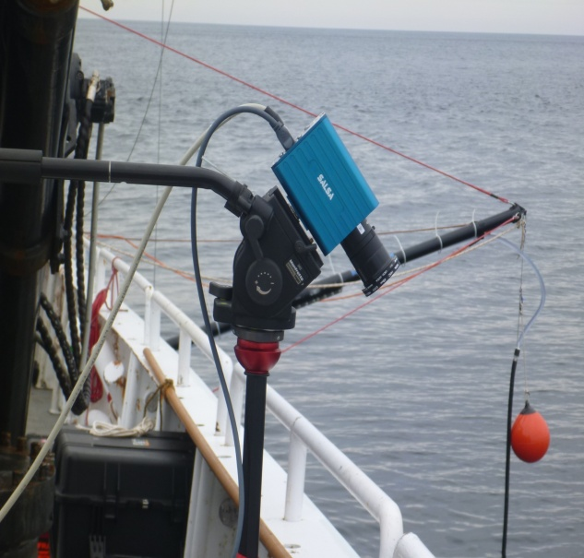
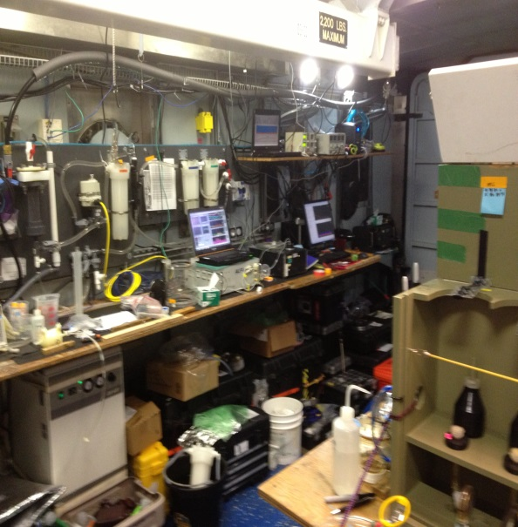
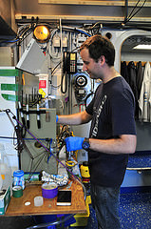
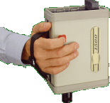
SABOR Cruise July-August 2014
Main focus of the cruise was on the lidar, polarization, organic carbon and ocean particulates with instruments on board of NASA Langley plane, on the ship and in water
Included satellite validation component
CCNY team: A. Gilerson and PhD students C. Carrizo and R. Foster
Polarimetric video camera
Flow through instrumentation for underway measurements and water analysis
GER spectroradiometer measures reflectance above and below water surface (512 channels between 300 and 1100 nm).

Slide 19
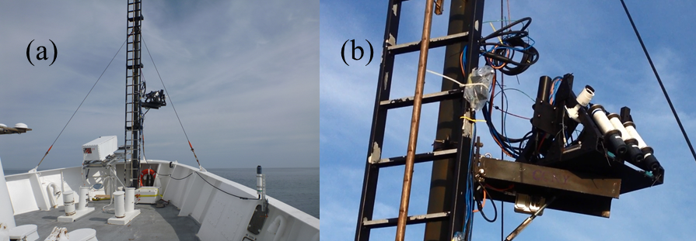
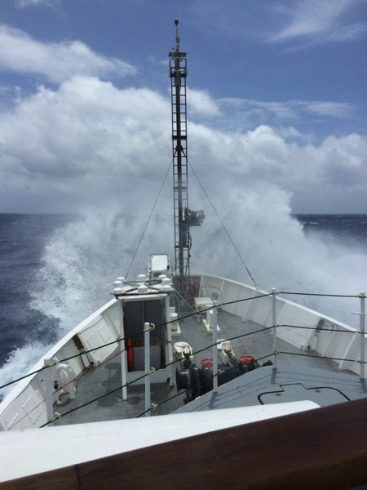
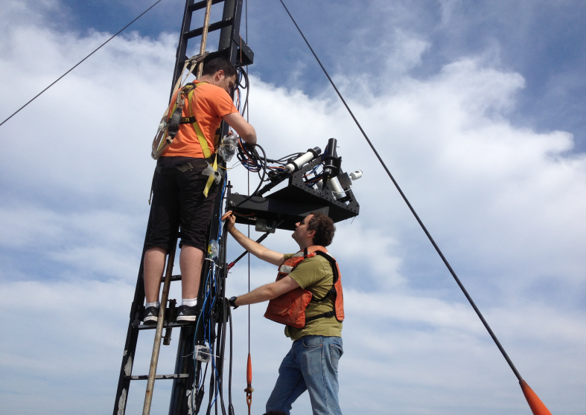
SABOR Cruise Validation Component
Hyper SAS – POL
Automated to point at 90° away from the Sun to avoid Sunglint.
Sky glint correction for a wind ruffled surface (unpolarized mode) r = 0.028.
Remaining Sun glint correction by subtraction of Rrs750 (Mobley 1999)

Slide 20
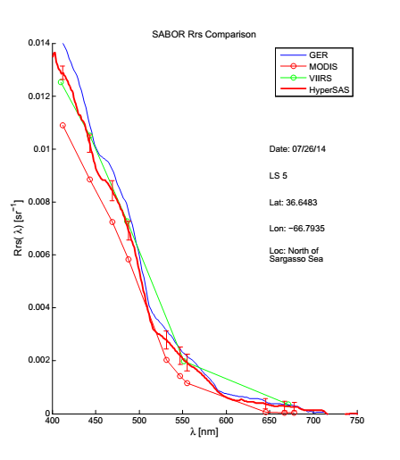
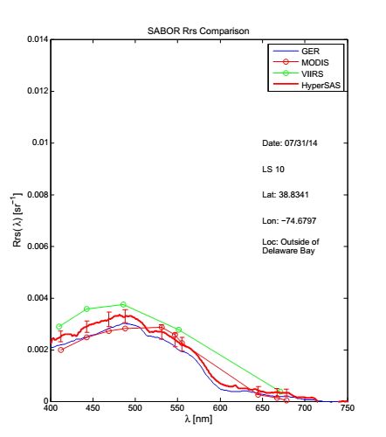
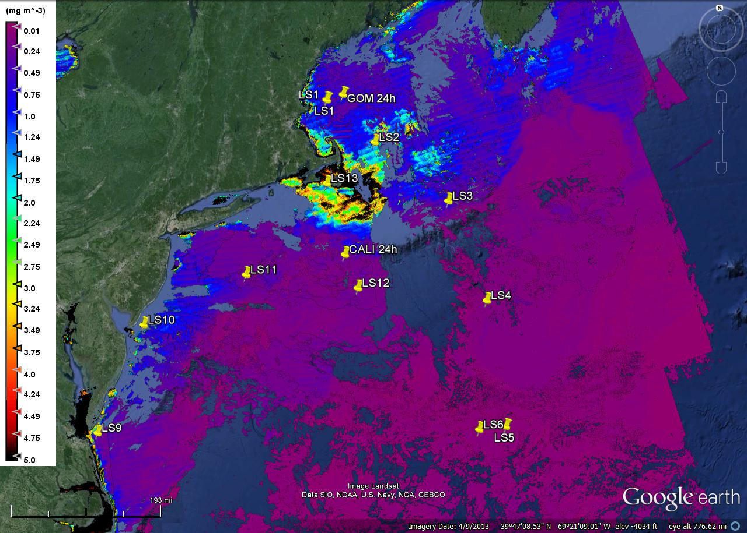
Spectral Remote Sensing Reflectance comparison between GER, HyperSAS MODIS and VIIRS on July 26th and on July 31st
VIIRS and MODIS
- Grid size: 3x3
- Pixels flagged: 0%
- Flags not checked: high and moderate sun glint contamination and stray light contamination.
Several other instruments from other groups (above and below water) were deployed, comparison is in progress

Slide 21
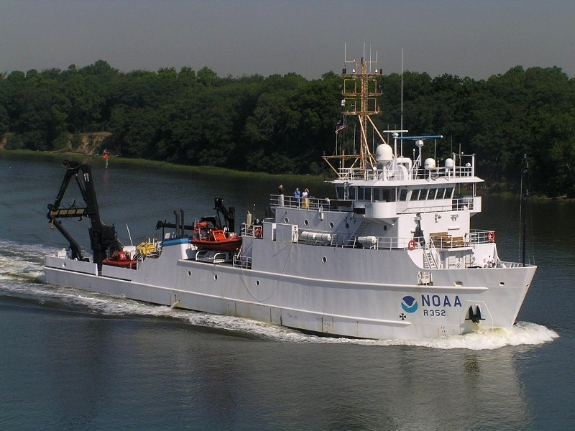
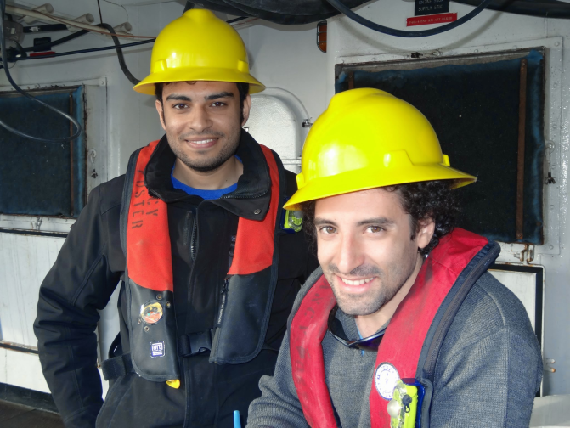
NOAA VIIRS Cal/Val Cruise, November 2014
R/V Nancy Foster
CCNY team: PhD students A. Ibrahim, A. El-Habashi
From R. Arnone, 02/12/15
Participants: NOAA/NESDIS, NASA – Goddard, NRL, U. Southern Mississippi, U. of Massachusetts, U. of South Florida, CCNY, Columbia U., JRC (Italy)

Slide 22
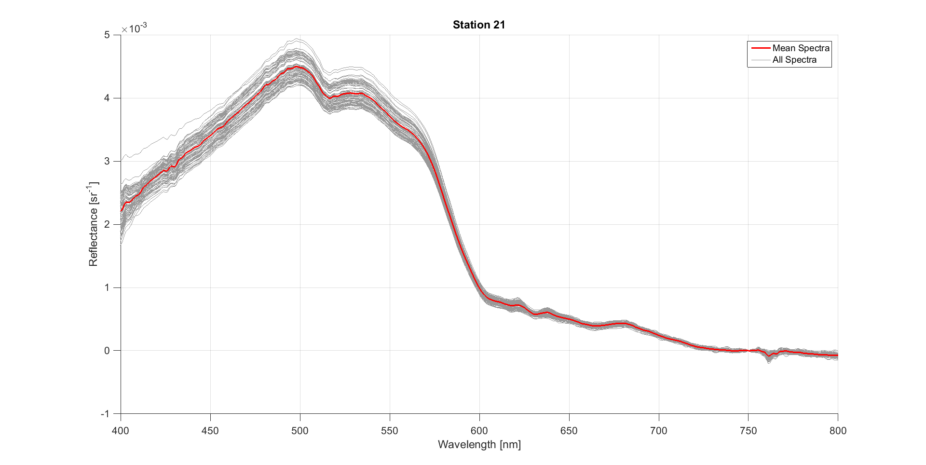
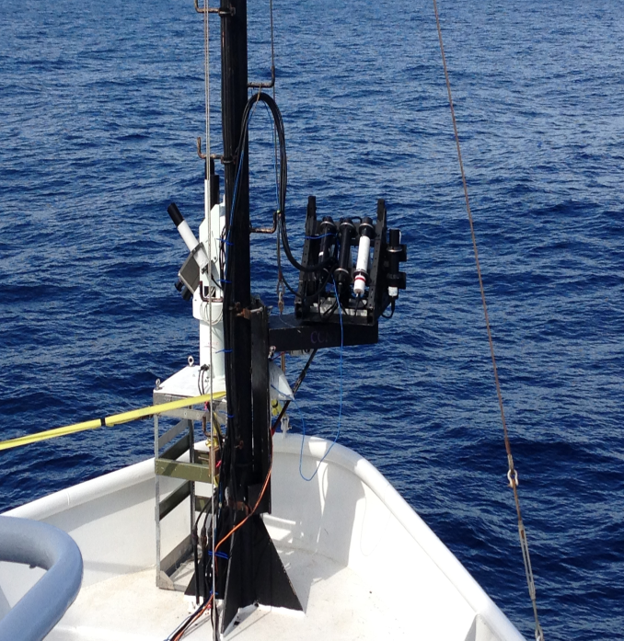
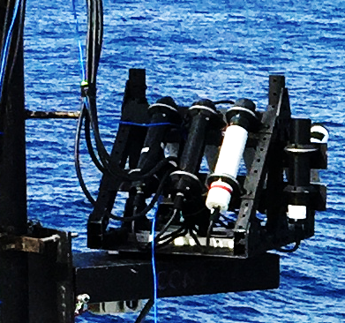
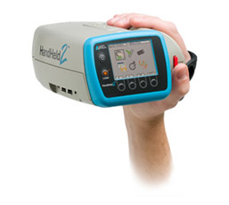
HyperSAS processing, Handheld spectroradiometers
HyperSAS integration time was 2000ms for water and 128-250 ms for sky measurements, 6-4000ms for ASD and 160 ms for GER
GER-1500
ASD Handheld2

Slide 23
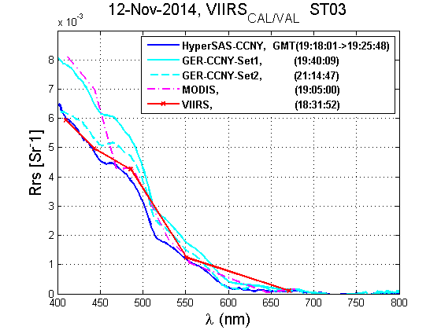
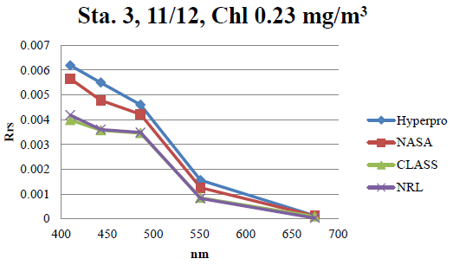
November 12, 2014 Blue water
From M. Ondrusek Dec 18, 2014

Slide 24
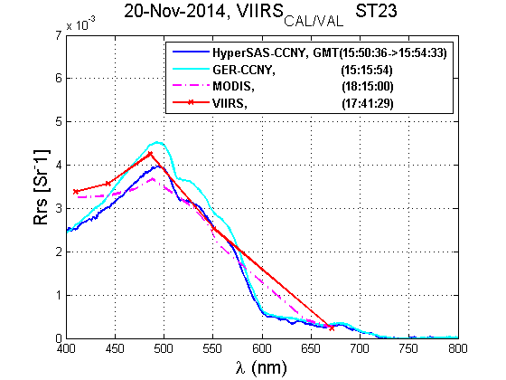
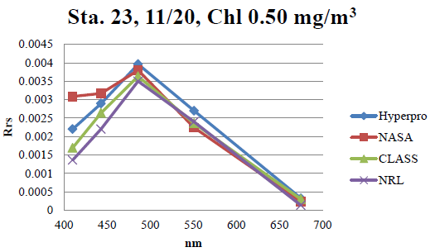
November 20, 2014 Turbid water on the way into port
Coastal waters,
2 hours difference
Multiple other instruments from other groups (above and below water) were deployed, comparison is in progress
From M. Ondrusek Dec 18, 2014

Slide 25
A Radiometric Approach for Calibration of Current and Future Ocean Color Satellite Sensors
Objectives:
To demonstrate a Radiative Transfer (RT) based radiometric vicarious calibration methodology for current and future satellite OC sensors.
We envision our methodology as being capable of carrying out OC sensor validation of SDR and possibly calibrations independently of the atmospheric correction process.
S. Hlaing, A. Gilerson, R. Foster, M. Wang, R. Arnone, S. Ahmed, Optics Express, 2014

Slide 26
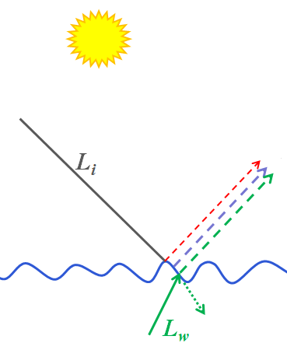
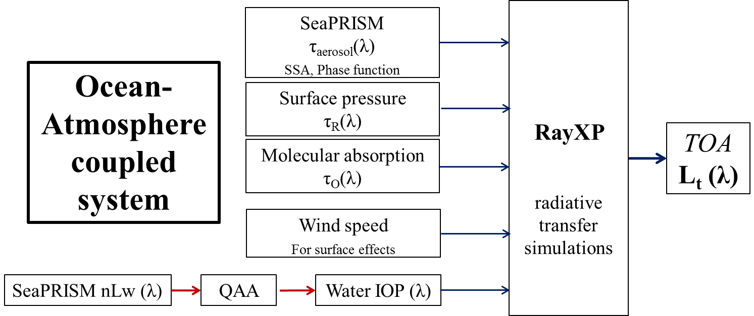
Methodology
TOA – Ocean - TOA

Slide 27
Matchup comparisons between the simulated and VIIRS L_{t} (λ)
WaveCIS
LISCO
Excellent correlations with the overall R values close to 1 are observed for both sites.
Spectral variation ranges of simulated and VIIRS L_{t} (λ) are the same.
Regression lines for the comparisons are very close to 1:1 diagonals: simulated L_{t} (λ) data are spectrally and magnitude wise consistent with those of measured (i.e. VIIRS).

Slide 28
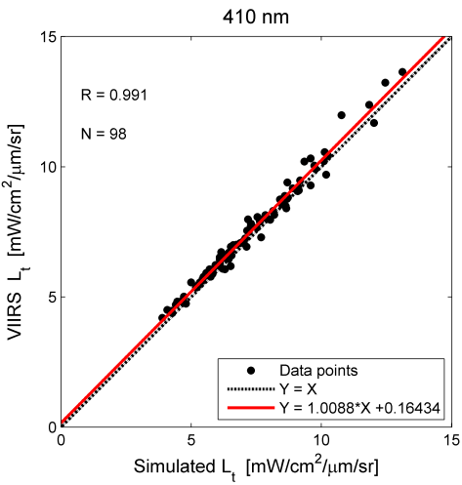
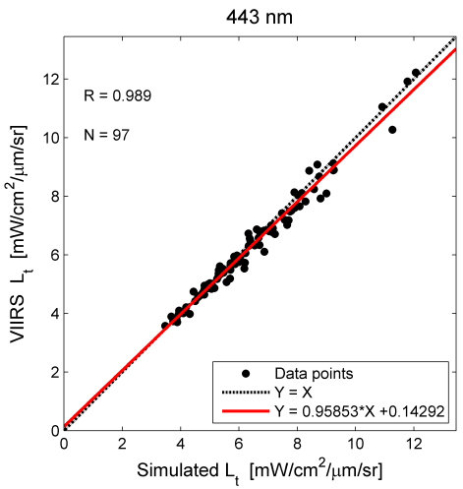
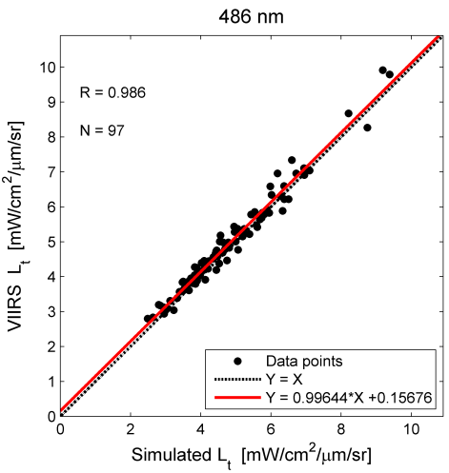
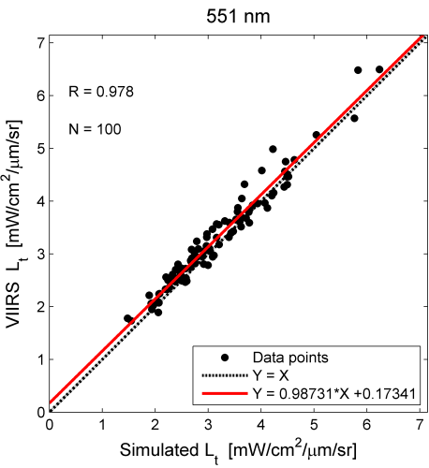
Matchup comparisons between the simulated and VIIRS L_{t} (λ) at each wavelength (Blue & Green parts of the spectrum)
Excellent correlations with the overall R values close to 1 are observed at every wavelengths.
Variation ranges of simulated and VIIRS L_{t} are the same.
Regression lines for the comparisons are very close to 1:1 diagonals.
These observations underscore that the simulated dataset is suitable for making assessments of the radiometric accuracy and stability of the Satellite Ocean Color sensors in blue and green wavelengths.

Slide 29
Derivation of the radiometric vicarious calibration gain factors
The g_{c} values derived for both VIIRS MODIS for blue and green wavelengths are within typical vicarious adjustment range.
For the 671, 745 and 862 nm channels of VIIRS, the g_{c} values significantly deviate from the typical vicarious adjustment range.
Such large deviations also exist for MODIS in NIR channels.
In the vicarious calibration study by Melin and Zibordi* for MODIS and SeaWiFS sensors based on the data from the AAOT AERONET-OC site but with a different methodology, similar trend is observed in Red and NIR.
simulated
satellite
For VIIRS three separate sets of g_{c}(λ) derived:
one set from combined match-up points for the LISCO and WaveCIS sites,
another two derived using match-up points for each site separately.
VIIRS
λ | 410 | 443 | 486 | 551 | 671 | 745 | 862
N for All | 80 | 77 | 74 | 74 | 76 | 75 | 76
Current MOBY | 0.9605 | 1.0019 | 1.0078 | 0.9724 | 1.0146 | 1.0389 | 1.0
WaveCIS | 0.9653 | 1.0118 | 0.9693 | 0.9478 | 0.8917 | 0.8538 | 0.7075
STD | 0.0191 | 0.0234 | 0.0277 | 0.0385 | 0.0560 | 0.1069 | 0.0774
LISCO | 0.967 | 1.0171 | 0.976 | 0.9605 | 0.9123 | 0.8682 | 0.6998
STD | 0.0211 | 0.0248 | 0.0288 | 0.0354 | 0.0413 | 0.0968 | 0.0505
All (LISCO and WaveCIS) | 0.9658 | 1.0135 | 0.9715 | 0.9525 | 0.901 | 0.8590 | 0.7009
STD | 0.0193 | 0.0238 | 0.0281 | 0.0376 | 0.0517 | 0.1031 | 0.0689
Very high potential of the approach is demonstrated, additional validation on other sites and improvement of aerosol retrieval are required
MODIS
λ | 412 | 443 | 488 | 547 | 667 | 748 | 869
N for WaveCIS | 60 | 62 | 61 | 62 | 61 | 62 | 51
Current MOBY | 0.9731 | 0.991 | 0.9935 | 0.9994 | 0.9996 | 0.9989 | 1.0
WaveCIS | 1.0060 | 1.0179 | 1.0007 | 0.9901 | 0.9693 | 0.8444 | 0.834
STD | 0.067 | 0.082 | 0.0984 | 0.13 | 0.193 | 0.104 | 0.233
*F. Mélin and G. Zibordi, Appl. Opt. 49, 798-810 (2010).

