Slide 1
CoastWatch / OceanWatch
Presented by
C. Mark Eakin

Slide 2
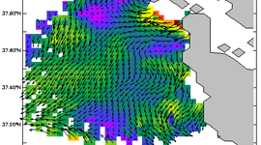
Requirement, Science, and Benefit
Mission Goals
Ecosystems (coastal)
Commerce and Transportation
Weather and Water
Climate
Benefits
Manage Living Marine Resources
Respond to Disaster Events
Monitor and Understand Coastal Ocean Dynamics
Assess Climate Impacts in Coastal Zone

Slide 3
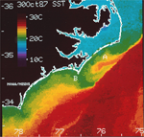
CoastWatch History
Established in 1987 in response to two significant environmental events:
Harmful Algal Bloom (HAB) event off the coast of North Carolina
Severe marine mammal die-off, >700 bottlenose dolphins died off the mid-Atlantic coast
Prompted Federal and State officials to explore additional data sources for monitoring the coastal waters, such as near real-time satellite data.

Slide 4
What is CoastWatch?
CoastWatch Mission
To provide and ensure timely access to near real-time satellite data to protect, restore, and manage U.S. coastal ocean resources, and understand climate variability and change to further enhance society’s quality of life.
Central Operations
Central Operations provides sea surface temperature, ocean color, reflectance, and ocean surface winds.
Regional Nodes Each of the Nodes provide specialized products to the users in that region.

Slide 5
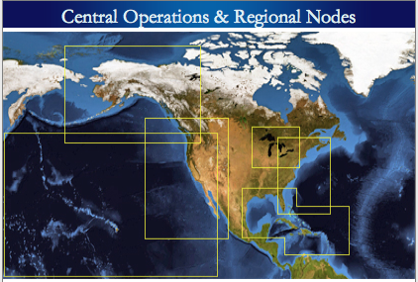
CoastWatch Structure
Central Operations
Regional Nodes
Alaska
West Coast
Central Pacific / OceanWatch
Great Lakes
East Coast
Caribbean / Gulf of Mexico
Great Lakes
Alaska
West Coast
East Coast
Central Pacific / OceanWatch
Gulf /
Caribbean

Slide 6
CoastWatch Data
The Beginning:
POES/AVHRR SST images and data
for the East Coast
Now:
A variety of environmental data (i.e. SST, ocean color, winds, reflectance, etc.)
Multiple satellite platforms (GOES, POES, MODIS, SeaWiFS, MERIS, Meteosat-9, QuikSCAT, DMSP)
All U.S. coastal waters, including Hawaii and Alaska
Multiple formats (CoastWatch HDF, GeoTIFF, PNG, ESRI shapefiles, NetCDF)

Slide 7
Challenges and Path Forward
Science challenges
Promote development of new environmental parameters needed for coastal management decisions
Next steps
Working with STAR Science Teams to transition new data to address coastal management needs
Transition Path
Move STAR products from science teams to regional nodes, providing experimental, preoperational, and operational products following the SPSRB process

