Slide 1
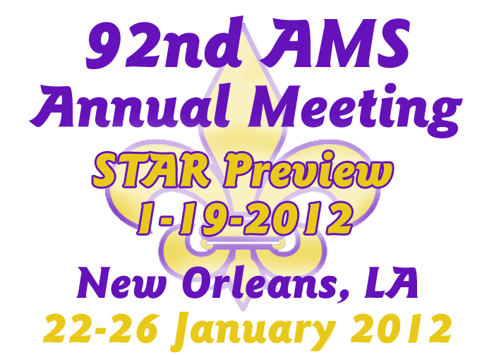
Dial in number: 888-396-1320
Passcode: 9371952

Slide 2
Order & Timing of the Talks
New York – CREST (9 papers) (100 – 130 pm)
Maryland – CICS and SCSB (12 papers) (130 – 215 pm)
Maryland – STAR - Camp Springs/Silver Spring (17 papers) (215 – 300 pm)
BREAK and switch to Room 701
Complete STAR (315 – 330 pm)
Wisconsin – CIMSS and ASPB (12 papers) (330 – 415 pm)
Colorado – CIRA and RAMMB (5 papers) (415 – 430 pm)

Slide 3
City College of New York/CREST
Cordero
Hosannah
Nazari
Vant-Hull
Seo
Aizenman
Molina
Rossow
Comarazamy

Slide 4
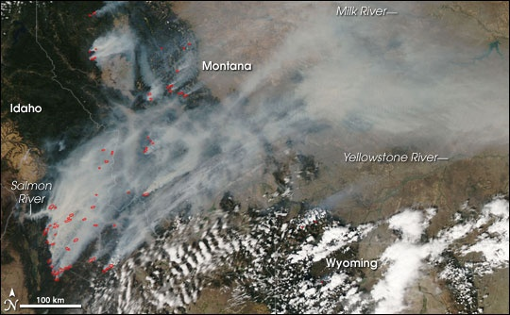
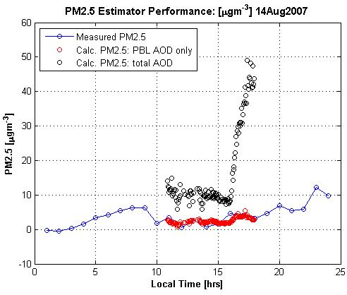
AMERICAN METEOROLOGICAL SOCIETY - 92nd Annual Meeting
Oral – “Smoke plume optical properties and transport observed by a multi-wavelength lidar, sunphotometer and satellite”
Lina Cordero^{a,b}, Yonghua Wu^{a,b}, Barry Gross^{a,b}, Fred Moshary^{a,b},Sam Ahmed^{a,b} ª NOAA-Cooperative Remote Sensing Science and Technology Center
^{b} Optical Remote Sensing Lab, Department of Electrical Engineering, The City College of New York
Smoke plumes optical properties and long-distance transport to the US east coast are observed with a lidar, sun-photometer and satellite.
The lidar observations indicate that the elevated smoke plumes were entrained into the turbulent PBL, and the surface PM_{2.5} concentrations show the corresponding increasing trends.
When correctly identifying the PBL-AOD contribution from the total column AOD, the static relationship between PM_{2.5} mass concentration and AOD could be satisfied to a reasonable accuracy.
1
2
3
4

Slide 5
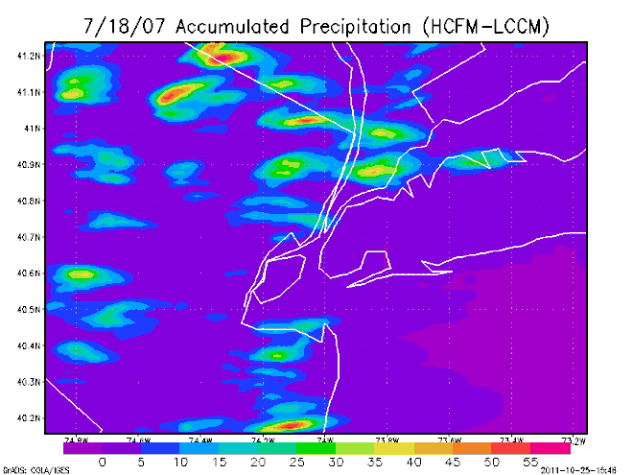
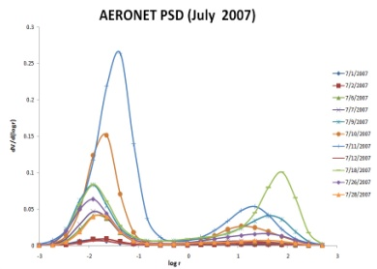
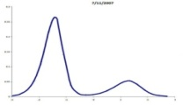
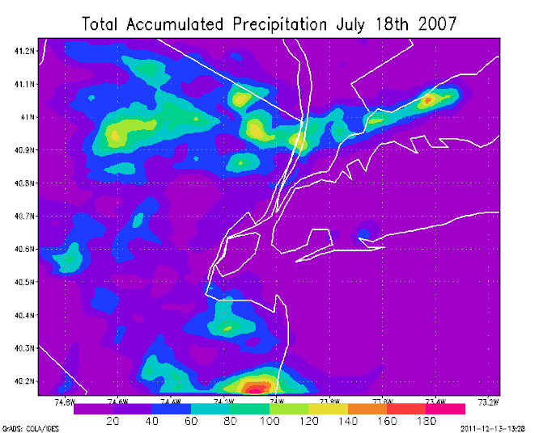
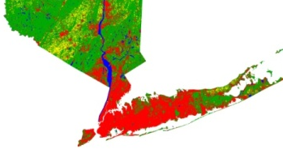
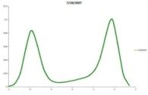
92nd Annual Meeting of the American Meteorological Society:
Quantifying the Effects of Local PSD on
Localized Urban Precipitation Events Using a Cloud-Resolving Mesoscale Model
Nathan Hosannah
Cities impact precipitation
  LCLU, UHI, & Aerosol
  Storm Dynamics
Research Tools
  AERONET, NWS, USGS
  RAMS
    3 Grids, 16km,4km,1km , 30s
    NCEP Data
Results
  Ingesting varied PSD affects precipitation patterns
  LCLU impacts precipitation totals
NCEP
RAMS

Slide 6

Development Of An Advanced Technique For Mapping
And Monitoring Sea And Lake Ice For The Future GOES-R Advanced Baseline Imager (ABI)
Rouzbeh Nazari, PhD
The City University Of New York, NOAA CREST
This research aims to generate the following products:
Product 1: Hourly Ice Map
Product 2: Daily Ice Map with Cloud
Product 3: Daily Cloud-free ice map
(multi-date image composited approach)

Slide 7
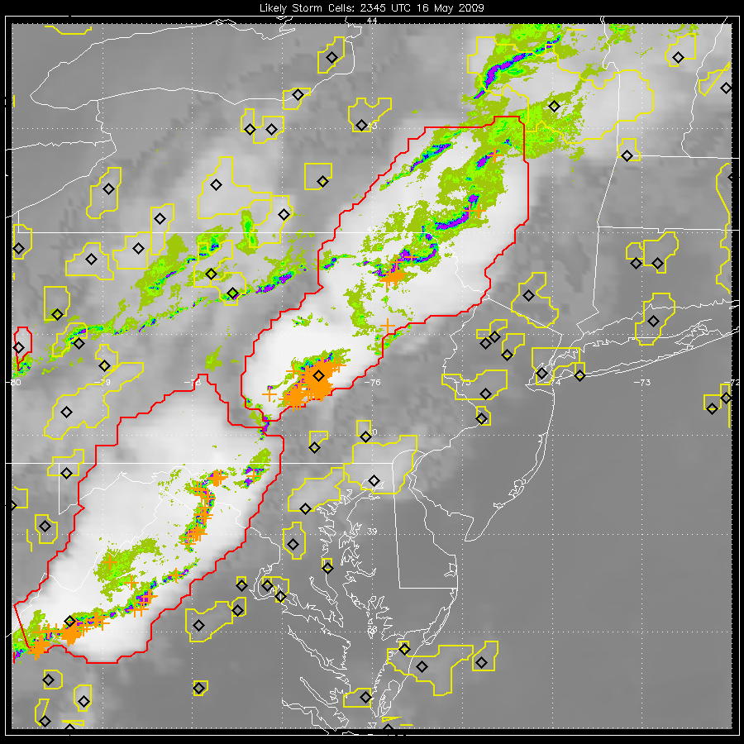
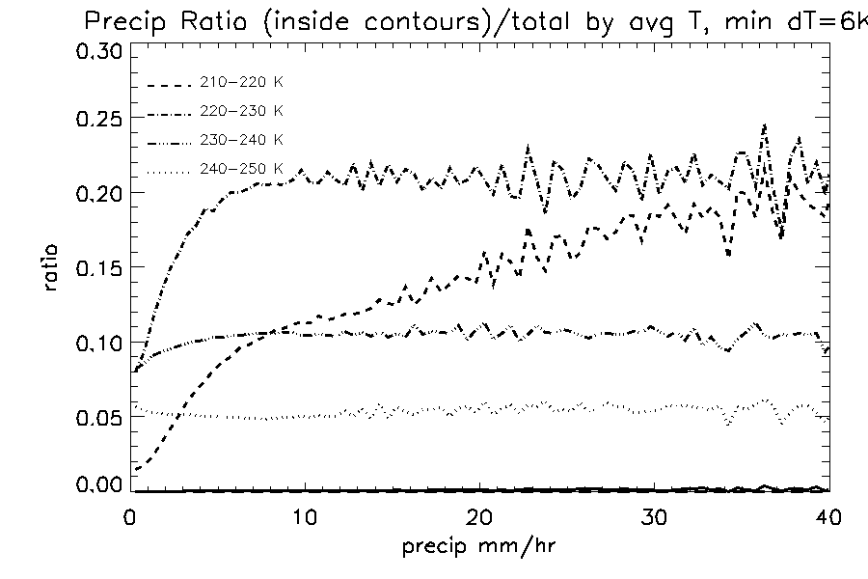
26th Conference on Hydrology:
Oral – “Convective Towers and Precipitation Frequency and Intensity”
B. Vant-Hull, F. Autones, S. Mahaneh, R. Rabin, J. Mecikalski, R. Khanbilvardi
Convective Towers (top)
  Selected by RDT IR algorithm
  May be subset of larger cloud mass
Precipitation Distributions
  Ratios of pixels inside/total formed for each tower average cloud top temperature
  Above 5 mm/hr, the distributions inside and outside the towers are the same until the average cloud top temperature becomes colder than 220 C
Green-blue: radar
Orange: lightning
Red/Yellow:
RDT towers
Black Diamonds:
cold points

Slide 8

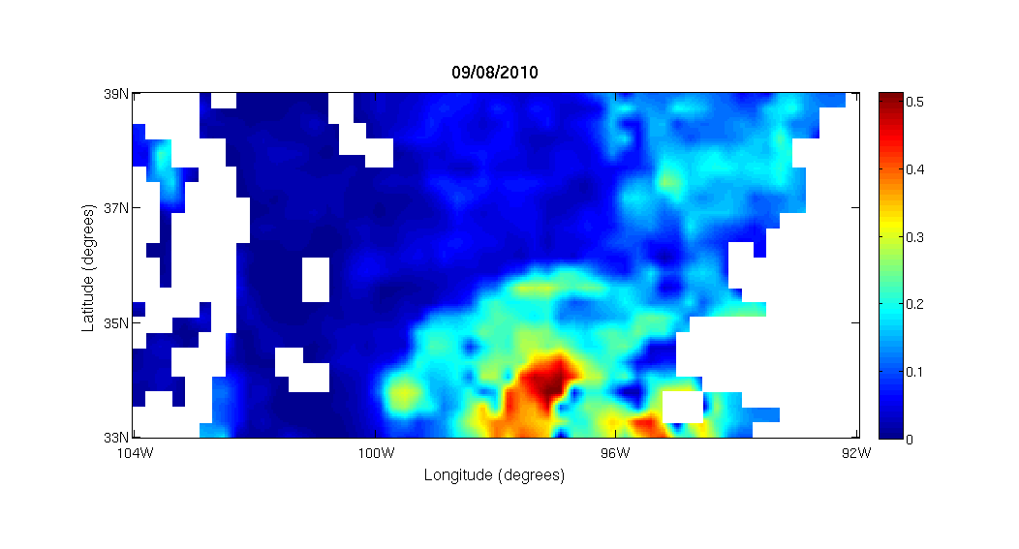
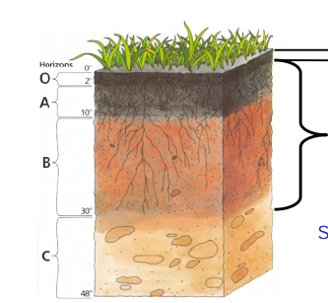
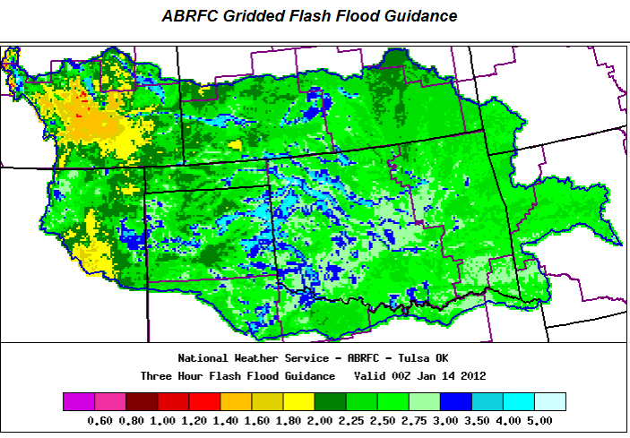
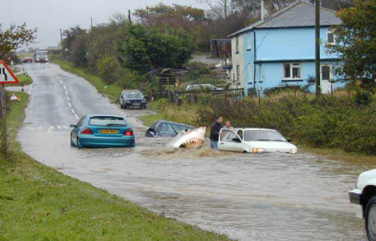
Oral– “Satellite Based Soil Moisture Data on Gridded Flash Flood Guidance for Arkansas Red River Basin”
Dugwon Seo, Dr.Reza Khanbilvardi, Dr.Tarendra Lakhankar and Brian Cosgrove (NWS/OHD)
Developed a framework for integrating the satellite based soil moisture with hydrological modeling system.
Currently working on spatial, vertical, and temporal assimilation of soil moisture data using SMOS in to the GFFG system.
Verified current GFFG System with reported flood events in ABRFC for 2010 and 2011.
~5cm

Slide 9
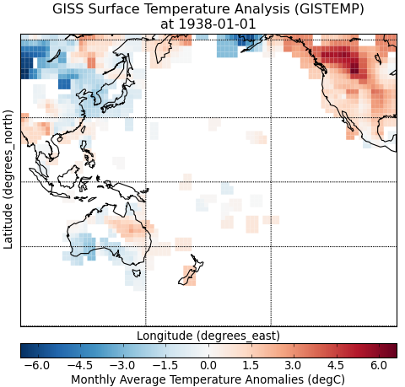
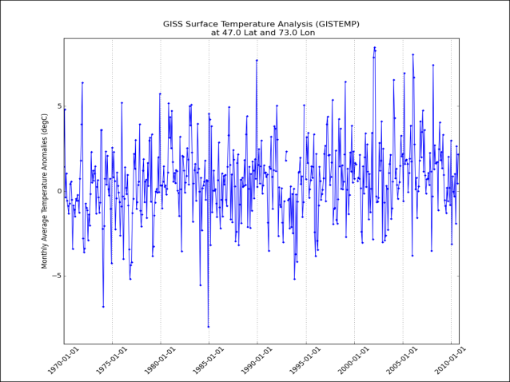
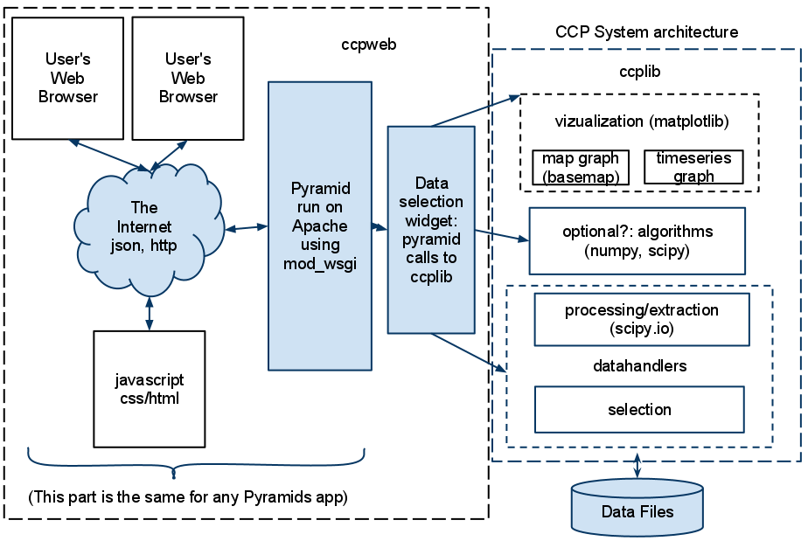
Second Symposium on Advances in Modeling and Analysis Using Python
Oral - Web Based Visualization Tool for Climate Data Using Python
Hannah Aizenman, M. Grossberg, D. Jones, N. Barnes,
J. Smerdon, K. Anchukaitis, and J. E. Geay
Embeddable and extensible
Supports a variety of datasets
Generates assorted visualizations
Modular component based architecture
https://code.google.com/p/ccp-viz-toolkit/
22-26 January 2012
92nd AMS Annual Meeting – New Orleans, LA
Notes:
9

Slide 10
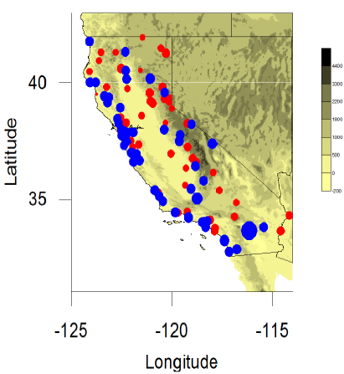
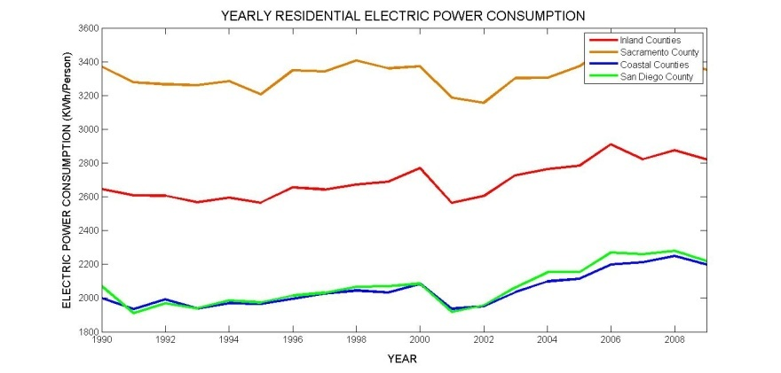
AMS 3rd Conference on Weather, Climate, and the New Energy Economy
Impacts of Summertime Climate Change on Energy Demands in California
Yanelly Molina, CREST, CCNY
California Temperature Trends
  Summertime Coastal Cooling
  Summertime Inland Warming
California Electric Power Trends
  Coastal peak hourly demand decreasing at specific sites
    Coastal consumption smaller at county level
    – Inland peak hourly demand
    increasing at specific sites
    Inland consumption larger at
    county level
Future Work
  Additional peak hourly demand studies
  Detailed county consumption studies
Source: Sequera, P., O. Rhone, J.E. González, R. Bornstein,
and B. Lebassi, 2011: Impacts of Climate Changes in the
Northern Pacific Coast on Related Regional Scale Energy
Demands, 2011 International Conference on Energy Sustainability.
Source: California Energy Commission and U.S. Census Bureau

Slide 11

PATHFINDER OF R2O
William B. Rossow, City College of New York
KEY CHARACTERISTICS OF PROCESSING SYSTEM:
Script Controlled Chain of Procedures, Multiple Re-entry Points, Option Available for Every Outcome, Design for Re-processing, Design for Aging of Computer Properties, Expert Human Involvement Required to Monitor and Investigate Anomalies
KEY CHARACTERISTICS OF DATA PRODUCTS:
Approximately Uniform Space-Time Sampling, Hierarchical Multi-Purpose Product Design, Indicators of Branching, Version Control, Document What Was Done & Why

Slide 12
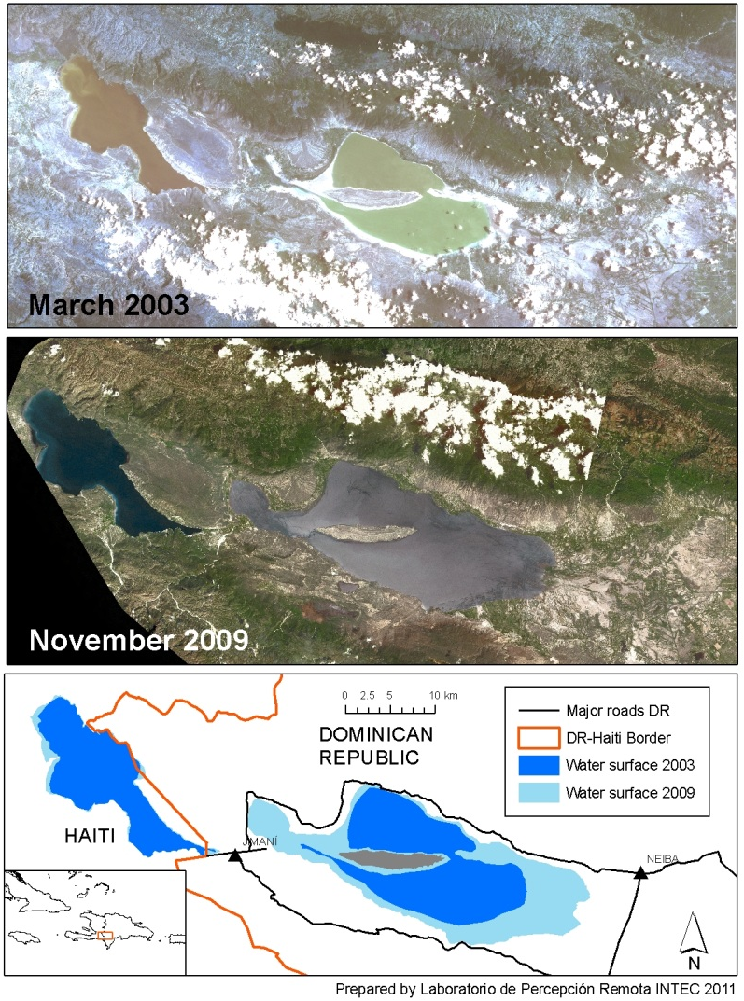
24th Conference on Climate Variability and Change:
“On the Hydro-Meteorological and Social Response of a Tropical Lake Basin, Lakes Enriquillo and Sumatra
(La Hispaniola) to Changes in Regional Climate and Land Cover”
D.E. Comarazamy, J E. González, R. González, and D.R. Brito
Lakes in the Enriquillo Basin have experienced significant surface area growth over ~15yrs
  Lake Enriquillo surface area coverage has nearly doubled since 2004
  The situation has reached critical levels affecting communities, biodiversity, international trade, and the local economy
  Regional climate changes are believed to play a key role in this phenomenon
A hydro-met hypothesis
  Increased SSTs -> Increased moisture -> Increased pcp (vertical and horizontal) and runoff -> Increase in lake area
  No significant LCLU changes were found

Slide 13
Satellite Climate Studies Branch and CICS-MD
Devaraj
Ferraro
Folmer (2)
Hernandez
Li (2)
Moradi
Vila
Wang (2)
Xu

Slide 14
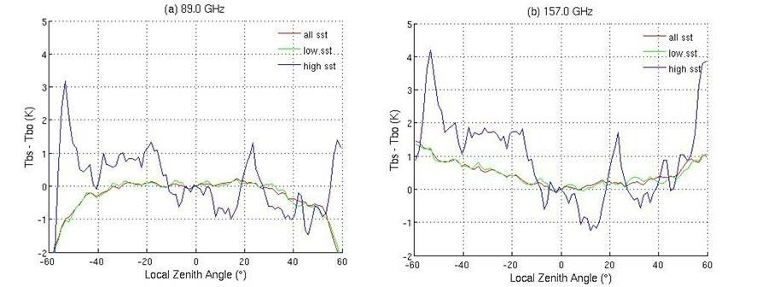
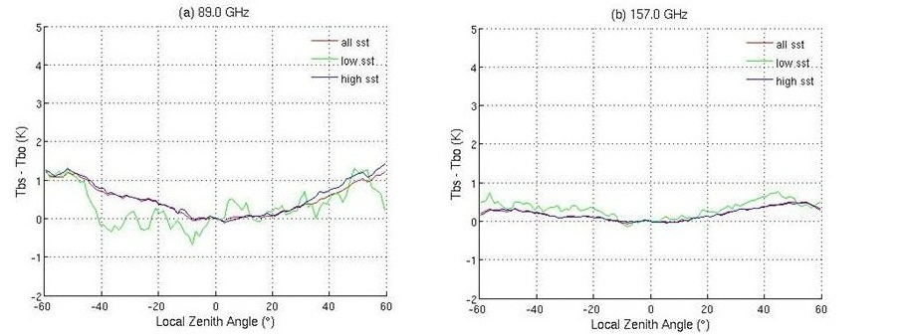
18th Conference on Satellite Meteorology, Oceanography and Climatology:
Poster – “The Development of AMSU-B/MHS Fundamental CDR's”
Chabitha Devaraj, Huan Meng, Ralph Ferraro, Wenze Yang and Isaac Moradi
Characterizing scan asymmetry for AMSU-B/ MHS window channels using CRTM
Stratification of different environmental conditions
  Low wind speed and low/high humidity stratification case over tropical/subtropical ocean under clear-sky
  89 GHz is sensitive to surface parameters,157 GHz is sensitive to atmospheric humidity
  Develop different approaches to characterize these two channels
Mean bias observed in 2008 NOAA-18 MHS channels for low wind speed and low humidity stratification case are shown in top row and for low wind speed and high humidity stratification case are shown in bottom row.

Slide 15


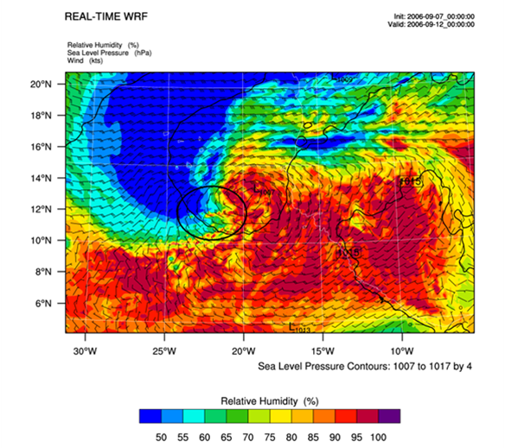
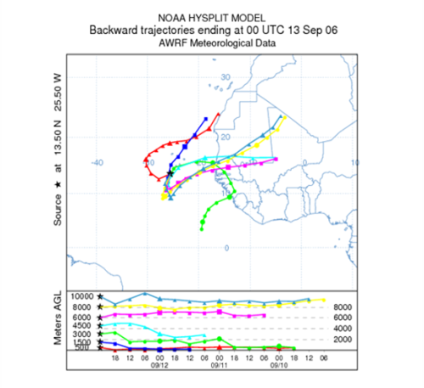
Fourth Symposium on Aerosol-Cloud-Climate Interactions
Poster – “The Impact of the Saharan Air Layer on the Development of
Eastern Atlantic Tropical Cyclones”
Michael J. Folmer¹, R.W. Pasken², T. Eichler², G. Chen³, J. Dunion⁴, and J. Halverson⁵
¹University of Maryland – ESSIC, CICS, ²Department of Earth and Atmospheric Sciences Saint Louis University, ³NASA Langley Research Center, ⁴NOAA AOML/HRD, ⁵University of Maryland – Baltimore County
Dust impact on two African Easterly Waves (AEWs) in 2006, one non-developer and one that develops
  WRF used with assimilated dropsondes
  Performed analysis to decipher what has bigger impact – dust or synoptic environment.
HySPLIT backward trajectories confirm source origin of air parcels
  Many parcels originate in Sahara and become entrained into the developing and non-developing AEW
  The SAL and associated dust appear to have a negative impact and acts as a catalyst to start the weakening process in an AEW.
  Lays the foundation for studying the aerosol impacts using WRF-Chem.
Two sample figures of Wave 7 (Helene): (top) 700 hPa RH, (bottom) HySPLIT backward trajectories

Slide 16
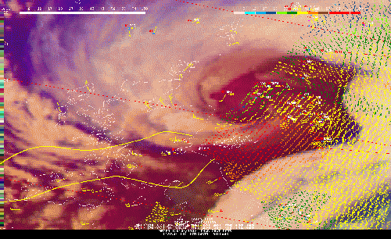
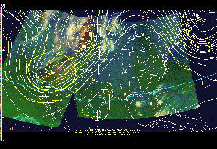
Eighth Annual Symposium on Future Operational Environmental Satellite Systems
Poster – “The 2011 HPC/OPC/SAB GOES-R Proving Ground Demonstration”
Michael J. Folmer¹, B. Reed², S. Goodman³, J. M. Sienkiewicz⁴, E. Danaher⁵,
D. R. Novak⁵ and J. Kibler⁶
¹University of Maryland – ESSIC, CICS, ²General Dynamics Information Technology, ³GOES-R Program Office,
⁴NOAA/NWS/OPC, ⁵NOAA/NWS/HPC, ⁶NOAA/NESDIS/SAB
GOES-R products are being ingested and evaluated at HPC, OPC, and SAB.
  The first product to be evaluated is the RGB Airmass product (NASA SPoRT, CIRA).
  Additional products in the queue include:
    WRF-simulated ABI imagery (Bands 08-16) – CIMSS
    Enhanced-V / Overshooting Top – CIMSS
    Lightning Detection – Rudlosky (STAR)
    Convective Initiation – UAH
    Volcanic Ash – NESDIS/STAR
    Additional products to be added later
  Training has begun at all agencies with evaluations to begin in February after forecasters/analysts have had time to use the product in daily operations.
  Additional coordination has begun to help with a workshop in Brazil and with NASA SPoRT for development of training modules on the RGB products.
Two sample images of the RGB Airmass product: (top) “sting jet” case in Scotland, (bottom) model diagnostics example in Southwest U.S.

Slide 17
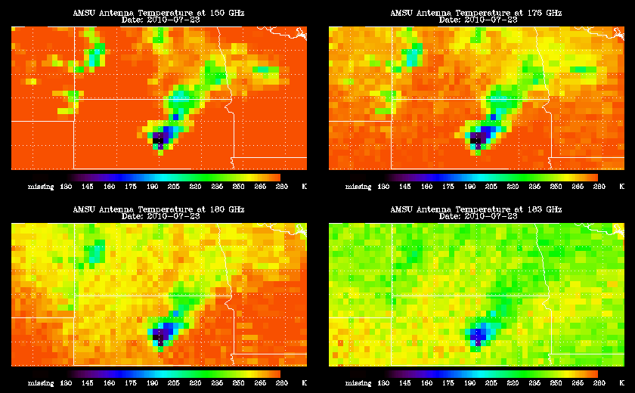
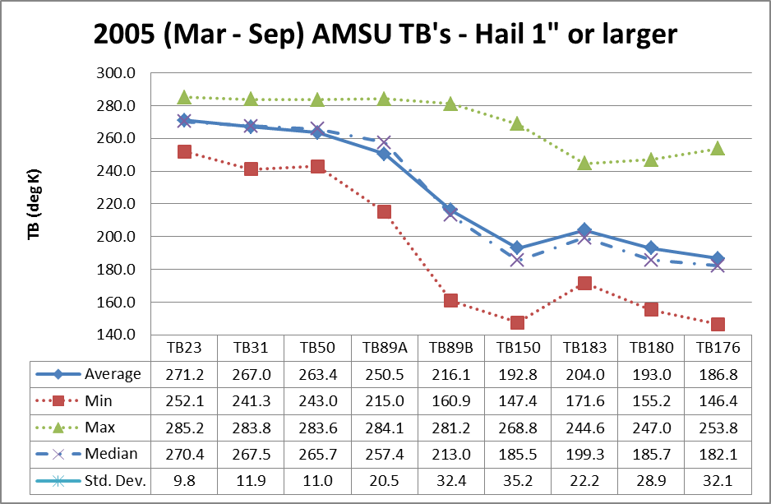
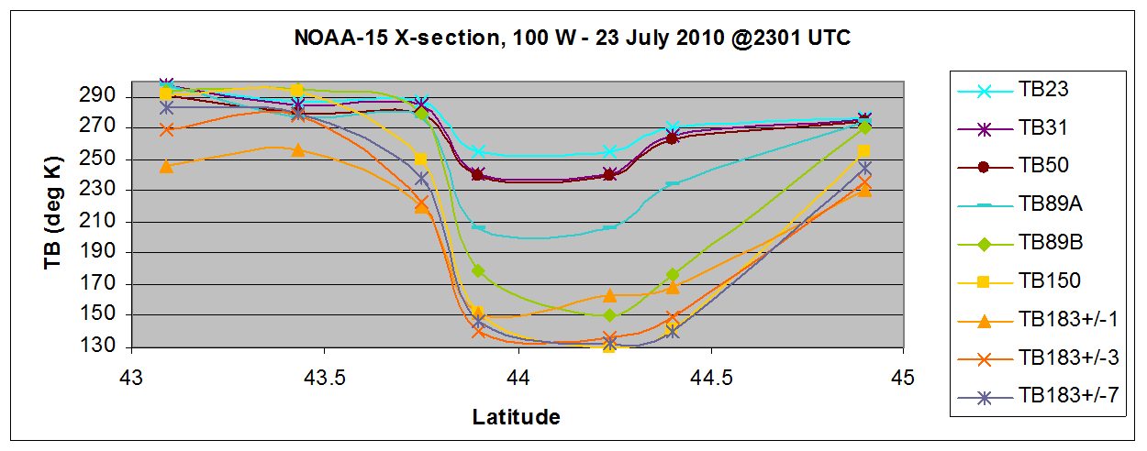
18th Conference on Satellite Meteorology and Oceanography
Severe Storm Identification with the Advanced Microwave Sounding Unit(AMSU)
Ralph Ferraro, Chi Quinn (NOAA Summer Intern), Dan Cecil (Univ. Alabama – Huntsville)
Previous studies
  Spencer – SMMR, SSMI
  Cecil – TMI, AMSR-E
Physical Basis
  Large ice/Mie Scattering
    AMSU-B/MHS, H2O bands
Encouraging results
  1”+ hail can be identified
  Excellent comparisons with surface hail reports

Slide 18
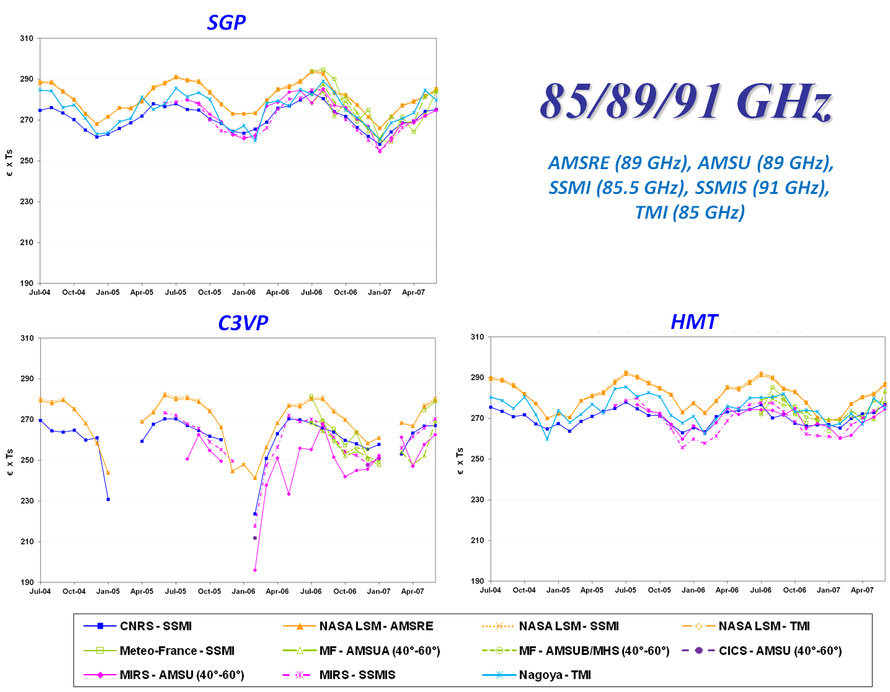
Joint Conference between the 18th Conference on Satellite Meteorology, Oceanography and Climatology/
First Joint AMS-Asia Satellite Meteorology Conference; and the 26th Conference on Hydrology
Oral – “An Evaluation of Microwave Land Surface Emissivities for Use in Precipitation Algorithms”
C. Hernandez, R. Ferraro, C. Peters-Lidard and members of the PMM Land Surface Working Group
Objectives
  Assess the current state of land surface emissivity models/retrieval
  Inter compare models to study its differences and similarities
Results
  Three different sites were compared
  Differences in the treatment of surface temperature, therefore ϵ*T_{s} was used
  Differences between models during periods of rain, or snow on the ground
  Similar seasonal variation between models

Slide 19
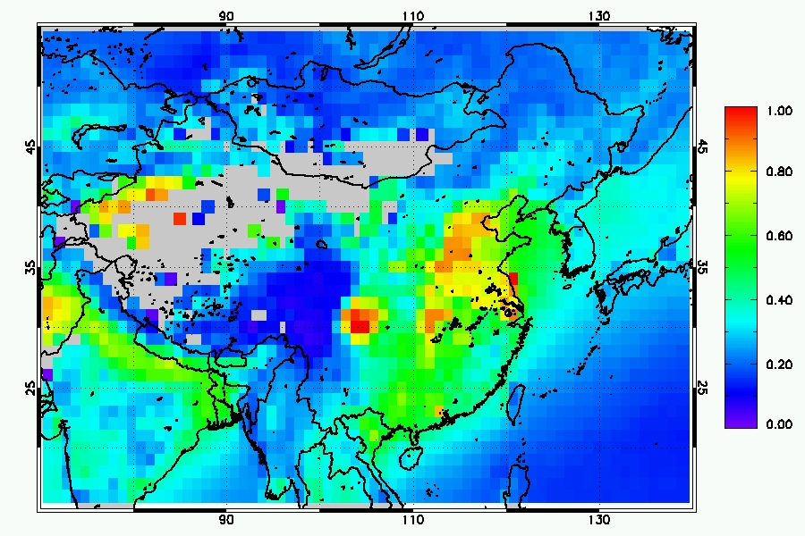
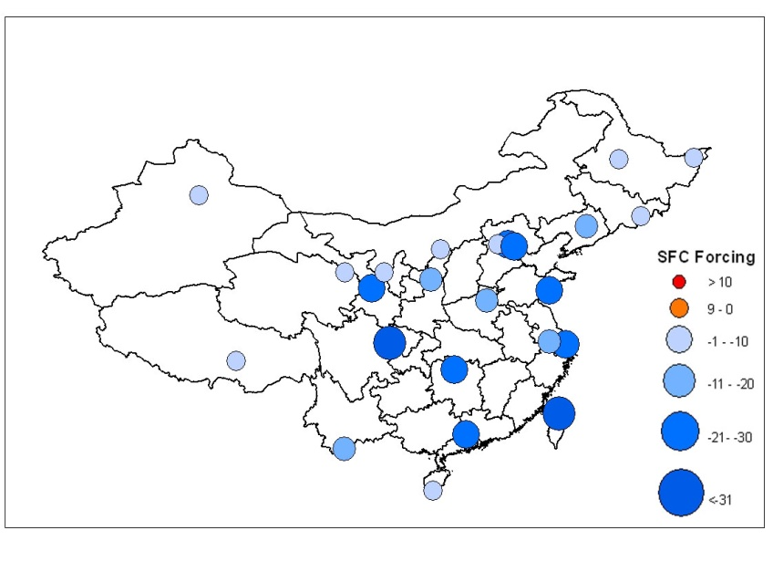
18th Conference on Satellite Meteorology, Oceanography and Climatology /
First Joint AMS-Asia Satellite Meteorology Conference & 4th Sym. on Aerosol-Cloud-Climate Interaction
Z. Li invited talk– “Use of A-Train Satellite and ARM Ground Measurements to Study the Impact of Aerosols on Cloud and Precipitation”
Aerosol loading & its changes in China are large
Aerosol raditiave effect may account for some changes in the temperature trend
Aerosol indirect effects may account for some changes in the rainfall trends.
Aerosol optical depth
Aerosol radiative forcing

Slide 20
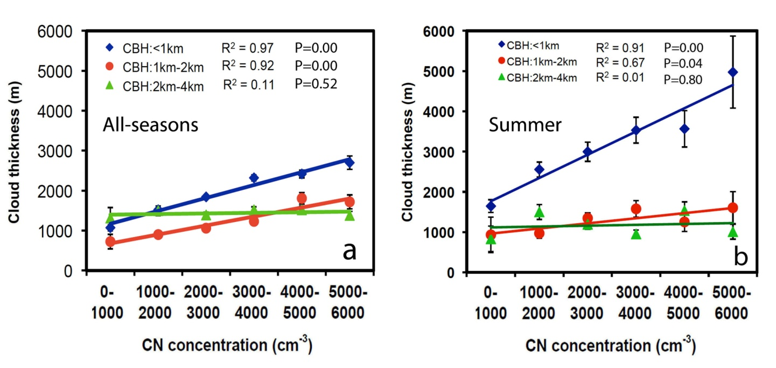



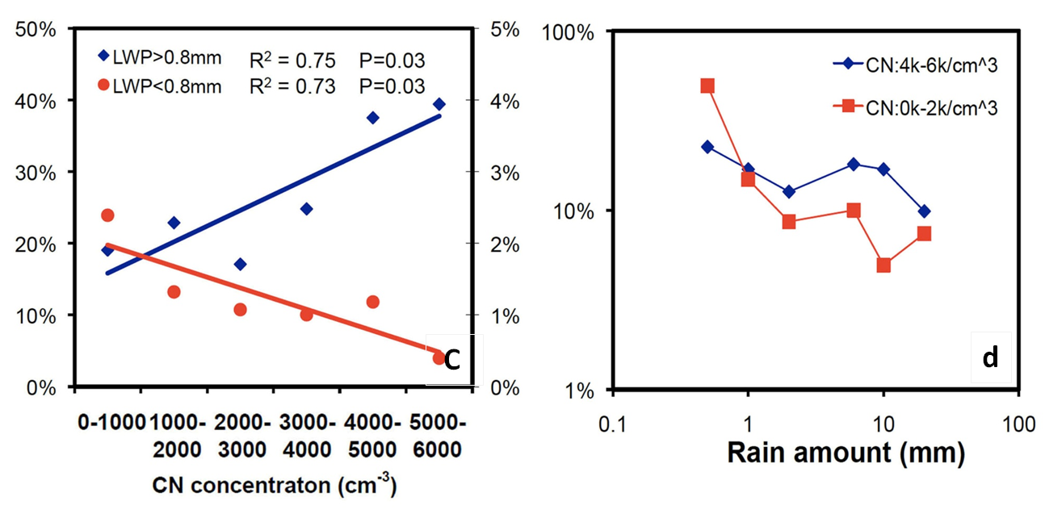
18th Conference on Satellite Meteorology, Oceanography and Climatology /
First Joint AMS-Asia Satellite Meteorology Conference :
Z. Li invited talk– “Use of A-Train Satellite and ARM Ground Measurements to Study the Impact of Aerosols on Cloud and Precipitation”
Aerosols can increase cloud top height and thickness drastically for mixed-phase clouds
Aerosols suppress rainfall for warm clouds but enhance it for mixed-phase clouds
The aerosol indirect effects depend on cloud geometry and cloud phase, convective strength, etc.

Slide 21
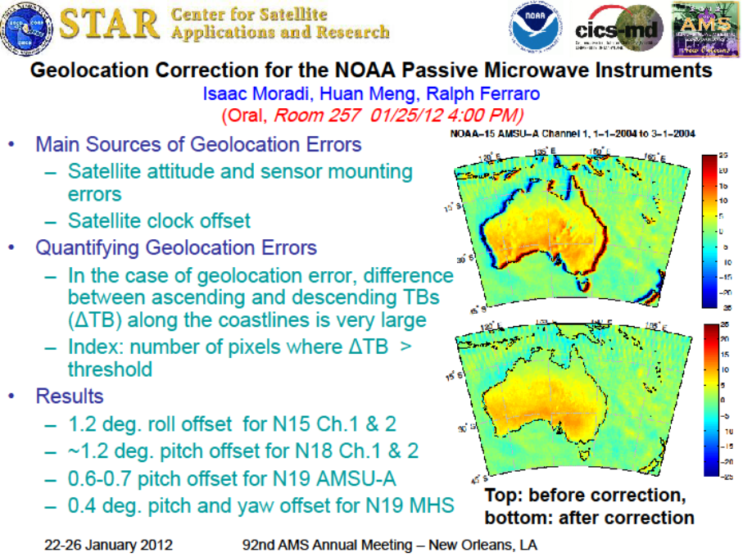

Slide 22
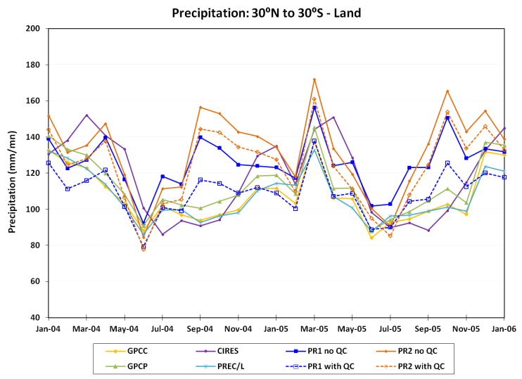
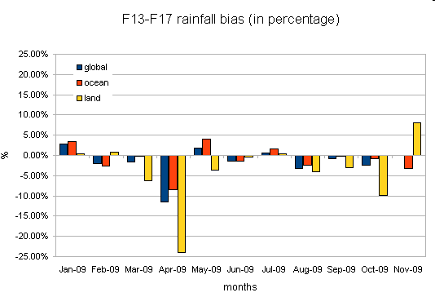
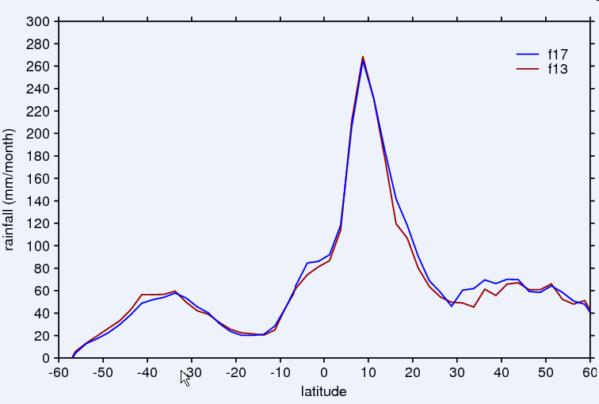
18th Conference on Satellite Meteorology, Oceanography and Climatology:
Oral – “The Performance of Hydrological Monthly Products using SSMI–SSMI/S sensors”
Daniel Vila, C. Hernandez, R. Ferraro and H. Semunegus
Objectives
  Apply an improved QC scheme to historical antenna temperature of SSM/I sensor since 1987 to 2008 and measure the impact on different hydrological products.
  Develop an improved strategy to extend the SSM/I time series into the SSMIS era, starting with data in 2009.
Results – 2nd objective
  Look-up tables (LUTs) for every channel stratified for surface type (land & ocean) using an histogram matching technique were created using global 1/3 degree global daily grids for January - July 2009.
  The monthly rainfall bias between F13 and F17 is below 10% for all cases with exception of April 2009 over land.
  The computed global rainfall mean for both satellites during August 2009 (not used for creating LUT) is in good agreement.
Results – 1st objective
  Improvement of precipitation estimates using the QC scheme, especially over land.

Slide 23
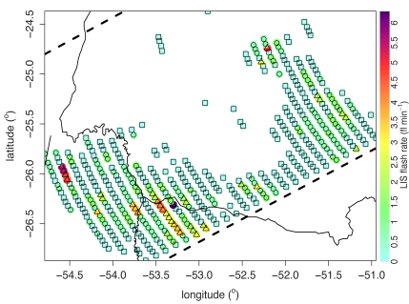
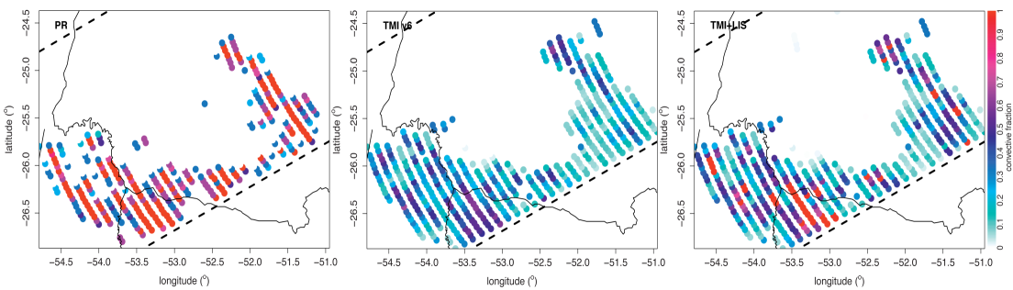
Satellite Meteorology Conference: Satellite-based algorithm developments
Oral – “Improving Precipitation Retrieval Using Total Lightning Data:
A Multi-sensor, Multi-platform Synergy between GOES-R and GPM ”
N-Y Wang, K. Gopalan, R. Albrecht
Multi-sensor Synergy on Precipitation Retrieval
  Lightning
  Microwave
Using Lightning to refine microwave’s Convective Identification
    Lightning flash occurrence and rate
    Microwave TB, ice scattering signals
Improve highly convective region
Lightning makes a difference
on the microwave
convection classification, particularly
on strong convection
microwave + lightning
radar
microwave

Slide 24
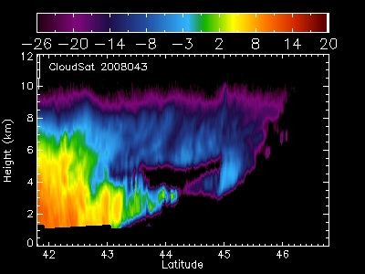
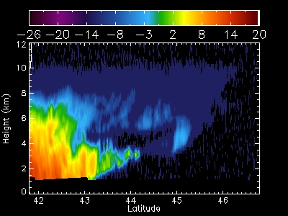
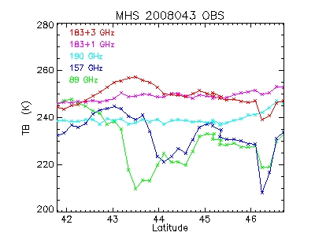
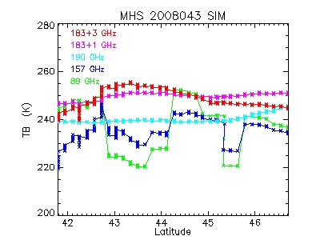
Satellite Meteorology Conference on Hydrometeorologocal Appl GPM 2:
Oral – “Developing Winter Precipitation Algorithm over C3VP”
N.-Y. Wang, K Gopalan, R. Ferraro, and J. Turk
Snowfall retrieval over land: Challenges
  weak microwave snowfall signals against strong land surface background
  uncertain snow scattering from various snow shapes
Satellite overpasses
    AMSU-B/MHS
    CloudSat
Can we model the satellite observations of snowfall reasonably well?
CloudSat
Reflectivity
observations
CloudSat
reflectivity
simulations
MHS TB
Observations
MHS TB
Simulations

Slide 25
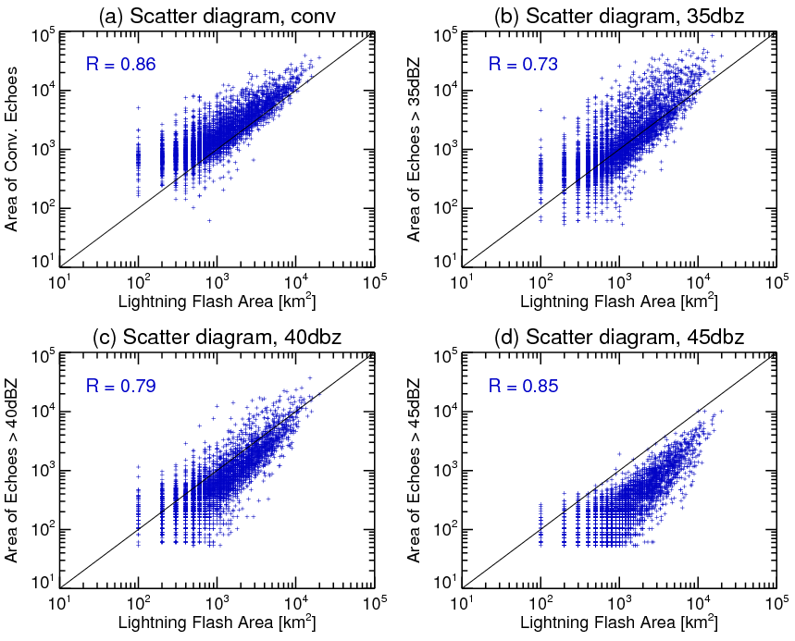
Oral – “Improving Geostationary Satellite Rainfall Estimates
Using Lightning Information”
Weixin Xu, Robert F. Adler, Nai-Yu Wang
Objectives
- Remove false IR-defined
intense convection;
- Identify convective cores
  and their size;
- Define correct rain-rate.
Results
- Lightning can discriminate
intense and weak storms;
- Lightning and conv. rain are
well correlated on storm scale;
- Linear pixel-scale lightning-
rainrate relationships are not found;

Slide 26
NESDIS STAR
Bayler
Cao
Divakarla
Flynn (2)
Kuligowski (2)
Liu
Nali (3)
Pisut
Pryor
Reale (2)
Wu (2)

Slide 27
      Joint Session (Oral): 2nd Conference on Transition of Research to Operations
      18th Conference on Satellite Meteorology, Oceanography and Climatology
      1st Joint AMS-Asia Satellite Meteorology Conference
      The Application of Satellite SSS Observations to Operational Passive Microwave Radiometry
Surface Brightness Temperature (Tb₀)
  Tb₀ = SST ∗ ε_{sfc}
  Assumed: Flat sea, no wind, 55° viewing angle, vertical polarization
Tb₀ difference due near-real-time SSS vs climatology at operationally-representative frequencies
  Data
    NOAA/NODC World Ocean Atlas 2009 SSS
    SMOS Barcelona Expert Centre Level-3 SSS
  Frequencies
    6, 11, 19, 23, 37 GHz
IMPACT: Passive Microwave Retrievals
  SSS affects surface emissivity term
  Near-real-time SSS improves accuracy vs climatological SSS values
    SSS climatologies notably sparse in space and time
  Will reduce biases and uncertainty due to non-representative climatological values
June 2010
December 2010
Data provided by ESA and SMOS-BEC

Slide 28
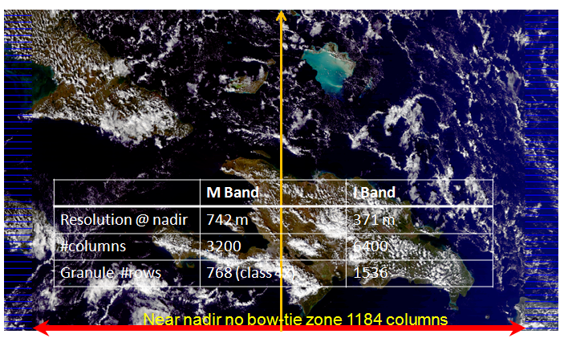
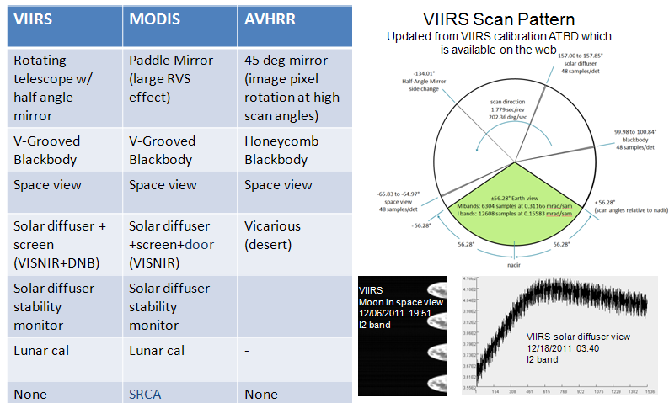
18th Conference on Satellite Meteorology, Oceanography and Climatology/
First Joint AMS-Asia Satellite Meteorology Conference Conference
Oral – “NPP VIIRS SDR Postlaunch Calibration/Validation”
C. Cao, Q. Liu, S. Blonski, et al.
Intensive Cal/Val started when VIIRS Nadir Door Opened on 11/21/2011.
  57 cal/val tasks by five organizations
  VIIRS producing excellent images
  Channel gain degradation in some channels is under investigation
VIIRS comprehensive calibration approach
  Onboard calibration similar to MODIS
  SNO and SNOx method essential
    Polar vs. Tropical SNOs
    Both radiometric and geolocation verification
SWIR and LWIR channels will be available soon.
  The VIIRS SDR team is working hard to ensure the SDR quality.
  More information available at STAR VIIRS website: http://www.star.nesdis.noaa.gov/jpss/VIIRS/

Slide 29
Eighth Annual Symposium on Future Operational Environmental Satellite Systems
Oral - “Pre-Launch to Post-Launch Transition and Evaluation of CrIMSS EDR Algorithm and Products”
Murty Divakarla, C.D. Barnet, M. Goldberg D. Gu, X. Liu, Tom King,
W. Blackwell, X. Xiong, E. Maddy , N.R. Nalli, A. Gambacorta, G. Guo, X.L. Ma, S. Kizer, H.Xie, and K. Zhang
  Evaluate CrIMSS EDR Algorithm for Launch Ready Performance
EDR Product Generation Using Proxy CrIS/ATMS - SDRs (derived from IASI/AMSU-A/MHS) - > Assessment with Matched Collocations of RAOBs/ECMWF and IASI EDRs.
Functional Testing of Operational Data Flow GRAVITE/IDPS JPSS-Rehearsal-II (P-72 Data Sets) - Consistency in CrIMSS EDR Code Implementations (Science code, IDPS-OPS, Off-line)
  The CrIMSS algorithm shows Reasonable Ability for a Post-Launch Performance.
Evaluation of CrIMSS EDRs with ECMWF and IASI Retrievals

Slide 30
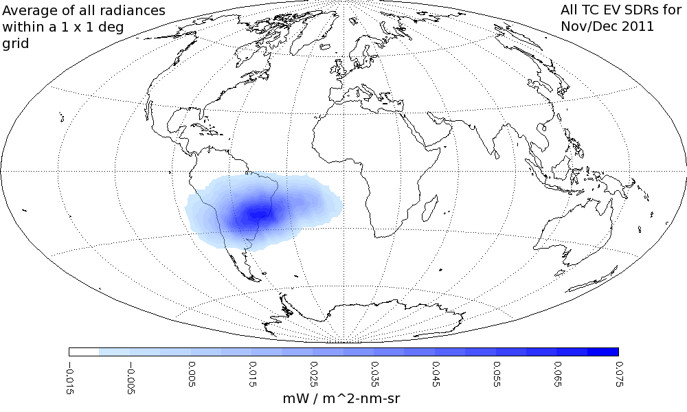
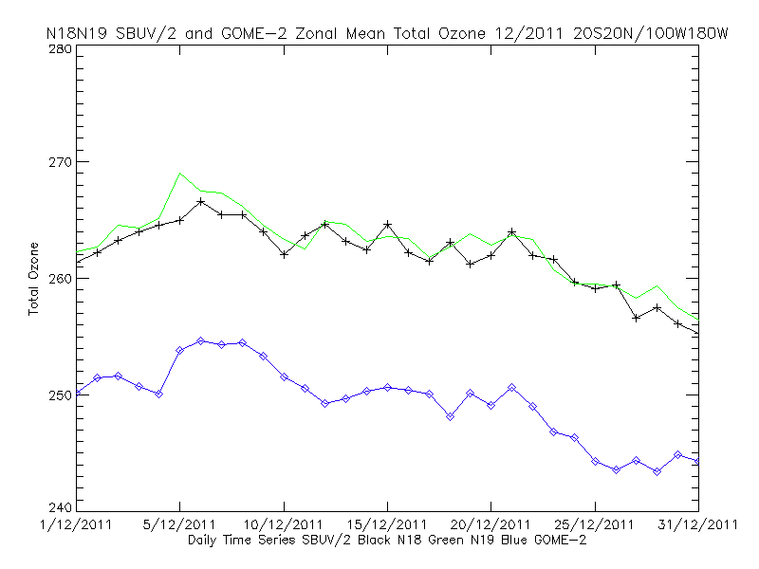
8th Annual Symposium on Future Operational Environmental Satellite Systems
Poster: “NPP Product Validation for the Ozone Mapping and Profiler Suite (OMPS)”
L. Flynn, I. Petropavlovskikh, D. Swales, J. Niu, E. Beach, W. Yu, C. Seftor, C. Long
Internal Calibration as expected
  Dark, Nonlinearity, Noise, Hot Pixels
  SAA effects present
Starting Solar Diffuser Measurements
Validation sets/analysis ready
  Other Satellites
  Ground-based Dobson and Brewer stations

Slide 31

18th conference on satellite meteorology, oceanography and climatology:
Oral: “Operational Ozone Sensors and Beyond”
L. Flynn, D. Loyola, F. Huang, W. Wang, D. Rault, T. Beck, C. Long, S. Kondragunta
R2O is working
  New AC Products
  NPP Science Team
Climate Data Records
  Stable systems
  DOAS and Multiple Diffusers
OMPS Limb Profiler
  Good global coverage
  Expected performance compared to Occultation
Institutes Satellites | Instruments Spectra | Launch Dates | Products
NOAA POES | SBUV/2 250-400 nm | N-18 2005 N-19 2009 | Total &Profile Ozone
NOAA NPP & JPSS | OMPS 250-310 nm 300-380 nm 290-1000 nm | NPP 2011 J1 2016 J2 2021 | Total &Profile Ozone, SO2, Aerosol Index
EuMetSat Metop | GOME-2 240-790 nm | M-A 2006 M-B 2012 M-C 2017 | Total &Profile Ozone, NO2, BrO, SO2, Aerosol Index
CMA FY-3 | TOU & SBUS 308-360 nm 250-400 nm | FY-3A 2009 FY-3B 2011 | Total &Profile Ozone, Aerosol Index

Slide 32

18th Conference on Satellite Meteorology and Oceanography:
Oral– “Application of TRMM Data to
Multisatellite Rainfall Estimation and Hydrologic Forecasting”
R. J. Kuligowski, Y. Li, Y. Zhang, H. Lee, D. Kitzmiller, and D.-J. Seo
TRMM data are not ideal for operational hydrologic forecasting due to data latency and sampling
Solution: incorporate into a multisensor satellite rainfall algorithm (SCaMPR); evaluate results against gauges and in a hydrologic model
Results:
  Adding TRMM improves SCaMPR performance, particularly over the western US; also improves flood forecast peak & timing
  However, SCaMPR outperforms gauge-only analysis only for areas with sparse gauge coverage (1 gauge / 7,000km²)

Slide 33


26th Conference on Hydrology:
Oral– “The GOES-R Probability of Rainfall Algorithm”
R. Barnhill and R. J. Kuligowski
Statistical algorithm for predicting probability of ≥ 1 mm of rainfall during the next 3 h at the full GOES space / time resolution
Inputs derived from forecasts of rainfall rate at 15-min intervals from the GOES-R Rainfall Potential algorithm
Developed on SEVIRI data (proxy for GOES-R ABI)
Validation against Nimrod radar over Western Europe shows skill but some bias.

Slide 34





92nd AMS Annual Meeting - 26th Conference on Hydrology:
Poster – “NOAA Soil Moisture Operational Product System (SMOPS) and Its Soil Moisture Retrieval From AMSR-E”
Jicheng Liu, I.M. Systems Group at NOAA/NESDIS, Camp Springs, MD; and X. Zhan, L. Zhao, K. A. Jensen, and X. Wang
Why SMOPS?
  Quality needs to be improved.
  Better spatial coverage.
  Higher temporal resolution.
  Operational production.
How?
  Single Channel Retrieval (SCR) algorithm is used to retrieve soil moisture from AMSR-E.
  SMOS and ASCAT soil moisture products are used to generate the blended product.
  CDFs are used to match SMOS, ASCAT and AMSR-E products before blending.
Results
  Improved retrieval quality.
  Improved spatial coverage: Complete daily global coverage.
  Improved temporal resolution: 6-hour product will be produced.
  SMOPS soil moisture product will be operationally produced at NOAA.

Slide 35

16th Symposium on Meteorological Observation and Instrumentation:
Oral – “On the Angular Effect of Residual Clouds/
Aerosols in Clear-Sky IR Window Radiance Observations”
Nicholas R. Nalli, and C. D. Barnet, A. Gambacorta, E. Maddy, W. L. Smith
Accurate satellite observations and calculations of top-of-atmosphere IR spectral radiances are required for the accurate retrieval of geophysical state parameters such as atmospheric vertical temperature and water vapor profiles
Ideally, it is desired that systematic differences between OBS and CALC under well-characterized conditions be minimal over the scanning range zenith angles
A fundamental problem with clear-sky analyses of CALC − OBS is the assumption of “clear-sky” OBS, when in reality we only have access to cloud-masked or cloud-cleared OBS, themselves being the products of algorithms, both of which are subject to errors and not designed to mask aerosols
This presentation summarizes work (Nalli et al. 2012, in prep for JGR) investigating the impact of the “clear-sky” OBS commonly used in such analyses, which include “cloud-masked” data, as is typical from imagers, as well as “cloud-cleared radiances,” as is typical from hyper/ultraspectral sounders
  Analyses of hyperspectral microwindow observations against forward calculations suggests that contamination by residual clouds and/or aerosols within clear-sky observations can have a measurable concave-up impact on the angular agreement of OBS with CALC

Slide 36


8th Annual Symposium on Future Operational Environmental Satellite Systems:
Oral – “Joint Polar Satellite System (JPSS) Cross-Track Infrared Microwave Sounding Suite (CrIMSS) Environmental Data Record Validation Status”
Nicholas R. Nalli, C. D. Barnet, M. Divakarla, L. Zhou,
X. Xiong, G. Guo T. Reale, et al.
The Joint Polar Satellite System (JPSS) mission is to provide environmental data records (EDRs) to NOAA’s users. To ensure the data products comply with the requirements of the sponsoring agencies, a calibration/validation (cal/val) plan was devised in advance of the launch of the preparatory NPP satellite launched on 28 October 2011.
The cal/val plan establishes science and user community leadership and participation, and demonstrated, cost-effective approaches under four distinct phases: (1) Pre-Launch, (2) Early-Orbit Checkout (EOC), (3) Intensive Cal/Val (ICV) and (4) Long-Term Monitoring (LTM).
This presentation provides a review of validation activities for the NPP Cross-track Infrared Microwave Sounding Suite (CrIMSS). CrIMSS measures upwelling IR and MW radiances to provide three EDRs, namely the atmospheric vertical temperature, moisture and pressure profiles (AVTP, AVMP and AVPP, respectively), with the lower tropospheric AVTP and AVMP being JPSS Key Performance Parameters (KPPs).
Focus is given to the NPP CrIMSS EDR validation activities that took place during the Pre-Launch Phase, as well as a preview of current and planned efforts for the EOC–ICV Phases.
Focus Day Proxy Data
NOAA AEROSE Matchups in NPROVS

Slide 37






8th Annual Symposium on Future Operational Environmental Satellite Systems:
Poster – “NOAA Aerosols and Ocean Science Expeditions (AEROSE) for Cal/Val of CrIMSS EDRs”
Nicholas R. Nalli, C. D. Barnet, E. Joseph, V. R. Morris, D. Wolfe, M. Divakarla,
T. King, H. Xie, A. Gambacorta, P. Minnett, T. Reale, et al.
This presentation provides an overview of dedicated soundings acquired from ozonesondes and radiosondes launched over the tropical Atlantic Ocean during the ongoing NOAA Aerosols and Ocean Science Expedition (AEROSE) campaigns conducted in partnership with the PIRATA Northeast Extension (PNE) project onboard the NOAA Ship Ronald H. Brown.
The AEROSE data complement is one of the most extensive collections of in situ measurements over the tropical Atlantic Ocean, conducted during boreal spring and summer over multiple years (2004, 2006-2011, and potentially beyond).
Ship based sonde launches have been timed to coincide with Aqua AIRS and MetOp IASI satellite overpass times, thereby providing dedicated radiosonde observations (RAOBs) as correlative data for developments of proxy datasets to be used for pre-launch NPP/JPSS CrIMSS environmental data record (EDR).
Among other things, the AEROSE data are unique in their range of marine meteorological phenomena germane to the satellite missions in question, including dust and smoke outflows from Africa, the Saharan air layer (SAL) and tropical water vapor distribution, and tropospheric ozone dynamics.
In the current work, data from the most recent 2011 AEROSE campaign are highlighted.
RAOB RH – W-E Transect (20–32°N)
Aged Air / Hadley Subsidence
SAL
IASI RH – W-E Transect (20–32°N)
Aged Air / Hadley Subsidence
SAL

Slide 38


NOAA Exhibit Booth
The Big Picture
Dan Pisut
VisLab and NOAA Communications are conducting interviews with NOAA scientists at the NOAA AMS exhibit booth
Tell the story about your science/research in under 2 minutes.
Videos are green screened and edited on site, distributed on NOAA web and social media sites.
Several STAR/CI staff are already involved: Felix Kogan, Ivan Csiszar, Tim Schmit, Bob Kuligowski, Steve Ackerman
Volunteers still needed. Filming is going on each day during exhibit hours. Will take approximately 30 minutes of your time to complete.
For more information:

Slide 39



18th Conference on Satellite Meteorology:
Poster – “Microburst nowcasting applications of GOES”
Kenneth L. Pryor
Composite microburst image development
  GOES sounder Microburst Windspeed Potential Index (MWPI), GOES imager brightness temperature difference (BTD), and radar imagery can be combined with McIDAS-V.
  Demonstrated effectiveness for a severe downburst storm over S.E. Virginia in May 2011.
Overshooting top intercomparison study
  Close correspondence between the location of overshooting tops, proximate MWPI values, and the location of observed downburst winds.

Slide 40




18th Conference on SatMet … Poster (Monday PM; 169):
Satellite and Upper Air Weather Product Inter-comparisons
Using the NOAA Products Validation System (NPROVS)
Reale (STAR)
Sun, Pettey, Tilley (IMSG)
NPROVS
  Runs every day
  Centralized Inter-comparison
Long Term Monitor (NARCS)
  Independent Samples
  Seasonal, System Change Impacts
    IASI, MIRS
    IASI EU
Shorter Term Monitoring (PDISP)
  Common Samples
  Yield
NPROVS schematic
NARCS … independent sampling
PDISP … common sampling
Demo at NOAA Exhibit !

Slide 41



8th Symposium on Future Sat. Systems … Post / Oral: (Wed/Thurs PM)
Satellite Product Inter-comparisons Using (NPROVS) and Plans for NPP Sounding Cal/val Support
Reale (STAR)
Sun, Pettey, Tilley, Divakarla (IMSG)
Expansion for NPP
  IDPS, NUCAPS, MiRS …
  First guess, ATMS only …
Issues
  42 levels (IPDS) vs 100 levels (NUCAPS)
  averaging strategy over 1km layers
  Quality Control … new rules !
  Meeting spec (clear vs cloudy, T vs H20 …)
GCOS Reference Upper Air Network (GRUAN)
  Uncertainty; product, mismatch… (Sun 509)
  Site Atmospheric State Best Estimate (SASBE) at NPP overpass … Dave Tobin (CIMSS), John Dykema (Harvard)
  ICM-4, Marc, Japan
NPROVS schematic
Oct
Dec
PDISP … common sampling
Demo at NOAA Exhibit !

Slide 42


Target Characterization for Vicarious Calibration of
Visible Channels of NOAA Satellite Instruments (Oral)
Xiangqian Wu, H. Qian and F. Yu
Calibration accuracy of the vicarious calibration relies on the accurate target characterization
  Spatial: homogeneous
  Temporal: long-term stable
  Spectral: stable
    Important for sensor inter-calibration and absolute calibration
Spectral calibration of deep convective cloud (DCC) with GOME-2
  DCC available at the tropical regions over the world
  Relatively stable spectral reflectance
  Slight scene dependent reflectance difference
  Using Aqua MODIS Band 1 as reference, calibration uncertainty caused by the SRF difference of GOES12 Imager Ch1 is less than 1%.

Slide 43


(Oral) Time-dependent GSICS Calibration Correction for the three-axis stabilized GEO satellite IR channels
Fangfang Yu, Xiangqian Wu and Haifeng Qian
All the current 3-axis stabilized GEO IR channels experience midnight calibration anomaly
  Mainly caused by the blackbody (BB) reflectance of excessive background flux to the detectors in the BB calibration event
  Last 6-8 hours, centered around the satellite midnight
A remedial algorithm, midnight blackbody calibration correction (MBCC) is applied, yet with calibration residual
  Residual dependent on the implementation duration and frequency
  Change with time (season and long-term) and channels
Empirical correction to IASI standard with the GSICS GEO-LEO collocation data
  linear regression at half-hour bins with monthly data

Slide 44
Advanced Satellite Products Branch and CIMSS
J. Feltz
Huang (2)
Lee
J. Li (2)
Z. Li
Pavolonis (2)
Schmit
Zhang
Zheng

Slide 45



GOES-R Proving Ground Aviation Weather Products Displayed in McIDAS-V
Joleen Feltz, Tim Schmit*, Kaba Bah,
Tom Rink, Tom Achtor
Cooperative Institute for Meteorological Satellite Studies (CIMSS) University of Wisconsin-Madison
*NOAA/NESDIS/Satellite Applications and Research
Advanced Satellite Products Branch (ASPB)
Notes:
The 3D capabilities of McIDAS-V can be used along with easy layer manipulation and data projection sharing to efficiently and effectively evaluate products.

Slide 46


Eighth Annual Symposium on
Future Operational Environmental Satellite Systems:
Oral – Community Satellite Processing Package (CSPP)
Proposal accepted by JPSS project in fall 2011.
VIIRS, CrIS & ATMS RDR to SDR S/W released to Beta testers on 21 December, 2011
VIIRS, CrIS, & ATMS SDR and EDR algorithms to the Direct Broadcast community in Jan 2012 (NPP DB starts on Jan 11).
Will also release CLAVR-X from Andy Heidinger for AVHRR Level-2 products (future version will support MODIS and VIIRS).
Will also release IASI retrieval algorithm from Bill Smith and Elisabeth Weisz.
Potential CSPP Users (>1000 IMAPP users in 65 countries)
CLAVR-X Cloud Effective Radius from NOAA-19 AVHRR
46

Slide 47


16th Symposium on Integrated Observing and Assimilation Systems for the Atmosphere, Oceans, and Land Surface (IOAS-AOLS)
Progress and Plan for the Development of a Research-to-Operation
High-Performance and Low-Cost GPU-Based Satellite Data Processing and Application Enabling Technology

Slide 48




Validation of GOES-R LAP algorithm with GOES-13 Sounder
and Validation Tool with deep dive capability
Yong-Keun Lee, Zhenglong Li, and Jun Li
CIMSS, UW-Madison
P.319
GOES-R LAP algorithm application
on GOES-13 measurement
Validation Tool of GOES-R LAP algorithm
with deep dive capability
Deep dive capability is available in Validation Tool. Deep dive capability is shown in Time series of 1-dimensional variables, TPW and 5 stability indices.
Time series of 1-demnsional variable will provide the sizes of the data, and their statistical values (bias, rms, std) compared to the truth.
Once “Time series” and one of six 1-dimensional variables are selected, Validation Tool will show the time series figure and ask if the user wants to see the atmospheric environment for any specific time (upto 3 specific times). If the user decide to see the detail of any specific time, Validation Tool will show skew-T diagram of temperature and dewpoint temperature at corresponding time.
Statistical values (BIAS, RMSE, and STD) of GFS (FCST, blue), regressed profiles (REG, red) and retrieved profiles (PHY, black) from GOES-R LAP algorithm compared to radiosonde measurement.
Upper panel: Temperature, Lower panel: Relative humidity

Slide 49

5.2
Improving high impact weather forecasts through assimilating the satellite advanced infrared soundings in regional NWP models
Jun Li (CIMSS), Jinlong Li (CIMSS), Hui Liu (NCAR), Jing Zheng (CIMSS), and Tim Schmit (STAR)
AIRS single FOV soundings in clear skies are used. WRF/3DVAR forecasting and assimilation system with 12 km resolution is used. Assimilation is done every 6 hours. 0-h is from analysis, others are forecasts.

Slide 50

TJ16.2
Evaluation and application of JPSS products through assimilation in regional NWP models
Jun Li (CIMSS), Mitch Goldberg (JPSS), Jinlong Li (CIMSS), Jing Zheng (CIMSS),
Chris Barnet (STAR), Lihang Zhou (STAR), and Tim Schmit (STAR)
CrIMSS provides not only the high vertical resolution information but also good spatial information. In-situ measurements (e.g., radiosondes) provide less spatial information that is also needed for validation purposes. An impact study through assimilating NPP/JPSS soundings in regional NWP models can help the evaluation of both the spatial and vertical information, as well as evaluation of the soundings over the ocean and areas where in-situ measurements are rare. AIRS soundings are used as proxy at this moment.
Hurricane Ike (2008) 48 – hour track forecasts (left) and track error (right). The conventional data (GTS), atmospheric temperatures between 200 – 700 hPa (A1T27), 300 – 700 hPa (A1T37), 500 – 700 hPa (A1T57) from AIRS are assimilated, respectively. Temperatures between 200 – 700 hPa provide best track forecast in this case. The GTS data are always included when AIRS soundings are assimilated.

Slide 51


A fast physical algorithm for hyperspectral sounding retrieval
P. 316
Zhenglong Li#, Jun Li#, Timothy J. Schmit@ and M. Paul Menzel#
#Cooperative Institute for Meteorological Satellite Studies (CIMSS), University of Wisconsin-Madison
@Center for Satellite Applications and Research, NESDIS
Email: zhenglong.li@ssec.wisc.edu
A new fast physical algorithm to simultaneously retrieve T/Q/O3/ε/T_{s} using hyperspectral infrared (HIR) radiance measurements is developed by performing retrieval in Eigenvector space of radiances
The new algorithm reduces the computation by 83 %
The new algorithm could improve the moisture retrieval quality.
Figure 1. Time to process the IASI granule of 20080901003559 using the old and the new techniques.
Figure 2. AIRS TPW retrievals validated using ECMWF of Granule 176 on Sep 6 2008.
51

Slide 52
New Quantitative Volcanic Cloud and Fog Products for GOES-R
M. Pavolonis (NOAA/NESDIS/STAR), C. Calvert (CIMSS), and J. Sieglaff (CIMSS)
This talk will feature examples on how satellites (GOES-R in particular) can be used to quantitatively characterize hazards such as volcanic clouds and low cloud/fog
Topics: automated volcanic cloud alerts, quantifying volcanic cloud properties, assessing the probability of low cloud ceilings
Automated Volcanic Cloud Alerts
Identifying Low cloud Ceilings
Notes:
-M. Pavolonis
Talked to be presented at the “From Sensors to Data Products II” session of the Symposium on Future Operational Environmental Satellite Systems (Wed. Jan 25, 2012, 9:00AM)

Slide 53

Satellite Retrievals of Volcanic Ash Cloud Properties:
Evaluation of near Real Time Results and Suggestions
for Improving Operational Satellite Products
M. Pavolonis (NOAA/NESDIS/STAR) and J. Sieglaff (CIMSS)
Overview of satellite-based volcanic cloud products produced in near real-time
Validation efforts
Working towards improving satellite-based volcanic ash products
Notes:
-M. Pavolonis
Talked to be presented at the Special International Applications Session: The Impact and Meteorological Challenges of Volcanic Eruptions Part I at the IIPS conference (Wed. Jan 25, 2012, 9:45AM)

Slide 54
8th Annual Symposium on
Future Operational Environmental Satellite Systems:
Oral – “The ABI on GOES-R”
Tim Schmit and colleagues
Instrument Noise
  Comparable
  With finer resolutions
Image Navigation
  ~ 2 times improved
Spectral
  ~ 3 times improved
Spatial
  4 times improved
Temporal
  5 times improved
ABI Band | Freq (um) | Spec (K) | Worst Case Estimate* | GOES-12 Band | Freq (um) | Spec (K) | Measured (PLT)
7 | 3.9 | 0.1 | 0.10 | 2 | 3.9 | 1.4 | 0.13
8 | 6.185 | 0.1 | 0.06
9 | 6.95 | 0.1 | 0.09 | 3 | 6.5 | 1.0 | 0.15
10 | 7.34 | 0.1 | 0.11
11 | 8.5 | 0.1 | 0.04
12 | 9.61 | 0.1 | 0.04
13 | 10.35 | 0.1 | 0.05
14 | 11.2 | 0.1 | 0.04 | 4 | 10.7 | 0.35 | 0.11
15 | 12.3 | 0.1 | 0.05 | 5 | 12.0 | 0.35 | -
16 | 13.3 | 0.3 | 0.14 | 6 | 13.3 | 0.32 | 0.19
Notes:
NEdT is 300K for all bands, but the Water vapor bands are 240K for ABI and 230K for GOES!

Slide 55


8th Annual Symposium on Future Operational Environmental Satellite Systems:
Poster – “GRAFIIR: An Efficient End-to-End GOES-R ABI Product Performance Analysis,
Implementation, and Validation System”
UW-Madison/CIMSS: Hong Zhang, Mat Gunshor, Allen Huang, Eva Schiffer, William Straka…
ABI Waiver analysis
  Impact of instrument effects on products and their ability to meet reqs.
ABI Instrument Effects
  Simulating effects in data
    (noise, nav., cal.,…)
“Connecting the dots”
    Product algorithms, proxy data, frameworks,…
GOES-R ABI Validation
  Clouds, soundings, winds, etc; implementation
HTML
Report
GRAFIIR Responds to ABI Waivers:

Slide 56

Assimilating AIRS Soundings with WRF/3DVAR for Hurricane Forecast Improvement
16th Symposium on Integrated Observing and Assimilation Systems
for the Atmosphere, Oceans, and Land Surface (IOAS-AOLS)
5.4
Jing Zheng¹, Jun Li¹, Jinlong Li¹, Timothy J. Schmit², Zhiquan Liu³
¹Cooperative Institute for Meteorological Satellite Studies (CIMSS), University of Wisconsin—Madison
²Center for Satellite Applications and Research, NESDIS/NOAA
³National Center for Atmospheric Research (NCAR)
Satellite products, such as T and Q, can be directly assimilated in the NWP models to capture the initial conditions, thus to improve the forecasts.
Quality control is the essential step to start with.
Results from the experiments with AIRS profiles from single field-of-view (SFOV) research product show some positive impacts and encouraging improvements on the HT, SLP and SPD forecasts for Hurricane Ike (2008).
HT SLP SPD
Figure 1. Observed and simulated 48-hour hurricane track (HT), minimum sea level pressure (SLP), maximum low-level wind speed (SPD) and their biases.

Slide 57
Regional and Mesoscale Modelling Branch and CIRA
DeMaria
Hillger (2)
Lindsey (2)

Slide 58

8th Symposium on Future Operational Satellite Systems:
Oral Presentation – Applications of ATMS/CrIS Soundings to
Tropical Cyclone Analysis and Forecasting
Mark DeMaria and John Knaff (NOAA/STAR)
Andrea Schumacher, Jack Dostalek, Robert DeMaria, Dan Welsh (CIRA/CSU)
Hurricane Applications of ATMS/CrIS soundings
Conversion of operational hurricane products from AMSU
  Intensity/structure estimates
New applications for intensity forecasting
AMSU examples from Hurricane Irene
Caption: r-z cross section of hurricane warm core
from model simulation and AMSU (blue) and
ATMS (red) footprint size near nadir

Slide 59

18th Conference on Satellite Meteorology, Oceanography, and Climatology:
Oral – “GOES Science Tests: Results of the last two of the current GOES series”
Don Hillger and Tim Schmit
NOAA Technical Report NESDIS 141 released http://rammb.cira.colostate.edu/projects/goes-p/
Hillger, D.W., and T.J. Schmit, 2011: Imager and Sounder Radiance and Product Validation for the GOES-15 Science Test, NOAA Technical Report, NESDIS 141, (November), 101 pp.
Report contributors are noted on the inside cover page
The Science Test part of Post Launch Testing for GOES-15 occurred in Aug/Sep 2010
Science Test coordination involved CIRA, CIMSS, NASA/MSFC, SAB, and OSPO (and others)
Several GOES-15 instrument-related issues were addressed
Data flow was tested to the AWIPS/NWS level
Comparisons with AIRS and IASI have found a bias of Imager bands 3 and 6; subsequently mitigated
Unique 1-minute rapid scan imagery acquired
GOES-15 went operational on 6 December 2011
Recommendation for a one-year checkout of GOES-R Advanced Baseline Imager (ABI)
NOAA Technical Report NESDIS 141
Significance: The NOAA Science test is a critical function to ensure the GOES-P/15 Imager and Sounder are ultimately operational. There are many goals of the Science Test, including to assess the GOES-15 data, generate products, investigate instrument changes, and collect unique rapid-scan imagery.

Slide 60


8th Symposium on Future Operational Satellite Systems:
Oral – “First images and products from VIIRS on NPP”
Don Hillger (NOAA/STAR) and Tom Kopp (Aerospace)
VIIRS EDR Imagery and Visualization Team (includes scientists as several sites: CIRA, CIMSS, NRL, NGDC, NIC, Aerospace, AFWA, and Northrop Grumman)
VIIRS includes:
  5 high-resolution (375 m) “I” bands
  16 lower-resolution (750 m) “M” bands
  1 day-night band (375 m)
Checkout of NPP VIIRS Imagery (qualitatively and quantitatively)
  Visible/reflective imagery
  Infrared/thermal imagery
  Day Night Band (DNB), aka near-constant contrast (NCC) imagery
First imagery examples, including true-color imagery of interesting phenomena
True-color (RGB) of Hurricane Kenneth from 22 November 2011
True-color (RGB) of smog south of the Himalayas from 14 December 2011

Slide 61

8th Annual Symposium on Future Operational Environmental Satellite Systems:
Oral Presentation – “The 10.35 µm Band: A More Appropriate Window Band for the GOES-R ABI Than 11.2 µm?”
D. Lindsey, W. MacKenzie, Jr., C. Jewett, T. Schmit, M. Gunshor, L. Grasso
The ABI will have 2 window IR bands: 10.35 and 11.2 µm
  What are the relative advantages of each?
The 11.2 µm band has more water vapor absorption, but 10.35 µm has a little ozone and CO₂ absorption
In this talk, we argue that GOES-R algorithms should actually use both bands

Slide 62

8th Annual Symposium on Future Operational Environmental Satellite Systems:
Poster Presentation – “Predicting Where Convective Clouds Will Form with the GOES-R ABI”
Dan Lindsey and Louie Grasso
The split window difference (10.35-12.3 µm) is tracked with time to identify areas of deepening low level moisture
These regions often pinpoint where convective clouds, and sometimes storms, will form hours in advance
This work is part of a larger multi-group project to improve Convective Initiation forecasts 1-6 hours in advance
  See the Mecikalski et al. poster (299) in the same session

Slide 63


17th Conference on Air Pollution Meteorology with the A&WMA
Oral– “PM2.5 Retrieval Improvements Over Urban Scenes by Refining Surface Albedo Model”
A. Picon, B. Madhavan, B. Gross, F. Moshary, S. Ahmed, R. Levy, I. Laslzo
MODIS C005 algorithm often overestimates AOD over urban areas
  A regional model based on surface retrievals using combined MODIS and AERONET data improves accuracy and resolution
Current algorithm cannot distinguish between bright urban and soils
  Consistent with direct spectral mixing models between vegetation and urban materials
Removal of AOD Bias based on regional tuning can remove difficulties with PM2.5 estimates and remove incorrect exceedances
Removal of biases makes
False exceedences go away
Regional Tuning improves AOD retrieval and resolution

Slide 64


17th Conference on Air Pollution Meteorology with the A&WMA
Oral– “Application of Active Optical Sensors to Probe the Vertical Structure of the Urban Boundary Layer and Assess Anomalies in Air Quality Model PM2.5 Forecasts”
Chuen-Meei Gan, B. Gross, Y. Wu, B. Madhavan, F. Moshary, M. Ku
The WRF model (12km x 12km) coupled with the CMAQ model for the urban New York City area shows strong biases that need to be explained
  We show that vertical sounding measurements from lidar / ceilometer can explain the root issues of these anomolies.
Boundary Layer Height Dynamics is shown to be well modeled during the intense mid day period where convective forces dominate
On the other hand, prior to onset of convection, CMAQ model forecasts do not properly distribute pollutants vertically through the boundary layer
  This finding is the central cause of model overestimates of PM2.5
Pre/dawn – Post Sunset Anomalies in Model

Slide 65


Fourth Symposium on Aerosol-Cloud-Climate Interactions
Oral– “Quantifying the Aerosol-Cloud Interaction From Ground Based Observations”
L.Bomidi, J. He, N. Pujols, B. Gross, F. Moshary, S. Ahmed, Q. Min, G. Feingold
Indirect aerosol cloud mechanisms are hard to quantify and uncertainty arising in these mechanisms result in largest uncertainty in Earth’s radiation budget for climate studies.
We focus on combining ground based measurements from different instruments to provide simultaneous measurements of aerosol and cloud properties.
  We verify COD retrieval algorithms against several models using SGP Data
  Results for COD for CCNY consistent with the matchups.
  Biases in matchups consistent with sub-pixel variability.
Preliminary Matchups of COD
Consistent with SGP matchups

Slide 66

Eighth Annual Symposium on Future Operational Environmental Satellite System
Poster- Potential Difficulties for GOES-R to Extract Aerosol Optical Depth and Surface PM2.5
in An Urban Environment
Yuzhe He, A. Picon, L. Cordero, B. Madhavan, B. Gross, F. Moshary, P. Ciren
The GOES-R aerosol retrieval over land surface heavily relies on the heritage of MODIS retrieval algorithm since the ABI of GOES-R are similar to MODIS bands.
  The MODIS algorithm has shown difficulties in retrieving AOD in urban regions because of the bright surface.
  AOD often overestimated due to poor surface estimation and possible aloft plumes
  The PM2.5 estimation from GOES-R may be affected too.
Preliminary assessment with operational retrieval shows good correlations for summer months
  Regional models were applied but regional aerosol model close to operational in the VIS band so corrections for summer were found to be small
Ignore Winter months since satellite data is almost totally unavailable
IDEA 60ug
~ 1 AOD Line
22-26 January 2012
92nd AMS Annual Meeting – New Orleans, LA
Notes:
66

Slide 67
17th Conference on Air Pollution Meteorology with the A&WMA
Oral– “Smoke plume optical properties and transport observed by a multi-wavelength lidar, sunphotometer and satellite”
Lina Cordero, Yonghua Wu , Barry Gross , Fred Moshary ,Sam Ahmed
Local Air Quality Can be affected by long scale smoke plume transport
  Multiwavelength lidar , sun radiometers and satellite imagery identify the events unambiguously
  Consistent Optical Properties across different instruments obtained
Lidar shows clear smoke intrusions into PBL
  Local PM2.5 spikes are observed to occur with the intrusions
PM2.5 estimates connected to column AOD’s strongly affected by plumes
  Lidar filtering and compensation is needed.
Three plume layers
Lowest layer mixed into PBL

