Slide 1

AMS Talk Summaries from STAR & CIs
Compiled by Ralph Ferraro, STAR/CoRP/SCSB & Deb Baker, CICS-MD

Slide 2
STAR
Connelly, Ryan
Das, Bigyani
Ferraro, Ralph
Han, Yong
Hillger, Donald W.
Iturbide-Sanchez, Flavio
Meng, Huan
Nalli, N.R.
Schmit, Timothy J.
Smith, Jonathon
Wrotny, Jonathan
Xu, Deyong
Yu, Yunyue

Slide 3
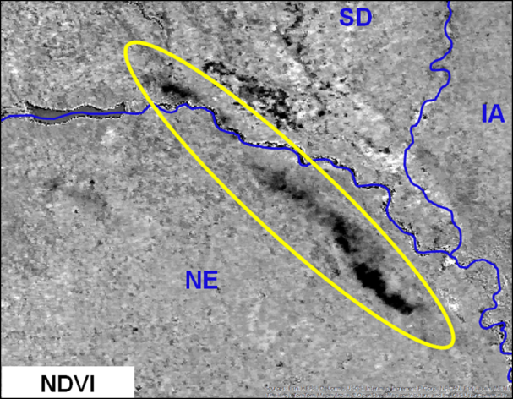
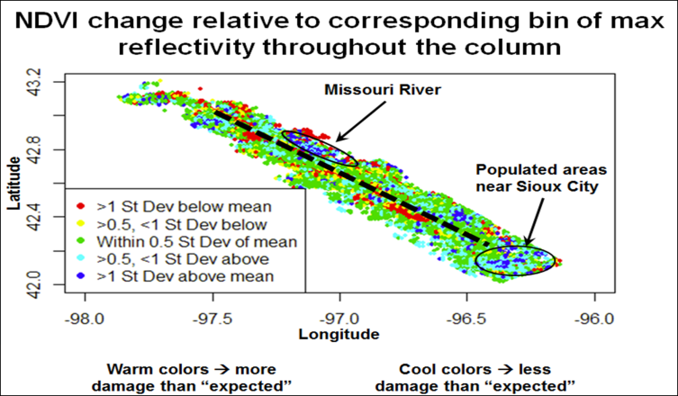
Use of NDVI Satellite Data to Identify and Document Destructive Hail Swaths
RYAN CONNELLY, Valparaiso University; PHILIP SCHUMACHER NOAA/NWS Forecast Office, Sioux Falls, SD; and KEVIN GALLO NOAA/NESDIS/STAR, USGS EROS Center, Sioux Falls, SD
AMS 14th Annual Student Conference
Simulated GOES-R ABI NDVI examined for hail events
  NDVI change between pre- and post-storm events can be used to document hail swaths (Figure 1).
  NDVI change corresponds to greater crop damage, as documented by photos, compared to radar reflectivity (Figure 2) or Maximum Expected Size of Hail (MESH) product values.
Additional hail events being evaluated
  NDVI derived from VIIRS, as well as GOES-R ABI, planned for future analysis.
Figure 1. NDVI pre- and post-storm difference for hail event of 18 August 2011 in northeast Nebraska and southeast South Dakota (simulated GOES-R ABI).
Figure 2. Spatial plot of NDVI change for each square 1 km, relative to the mean NDVI change for each point’s corresponding composite reflectivity bin, where reflectivity is binned every 2 dBZ.

Slide 4
Poster: Testing, Troubleshooting and Integrating Changes to Joint Polar Satellite Systems (JPSS) Algorithms using Algorithm Development Library (ADL)
Bigyani Das, Weizhong Chen, Marina Tsidulko, Yunhui Zhao, Valerie Mikles, Kristina Sprietzer, Vipuli Dharmawardane, Walter Wolf
20th Conference on Satellite Meteorology and Oceanography
Eight Step Process in Algorithm Integration
  Obtain ADL version from Raytheon CM
  Integrate this in STAR AIT CM
  Create a Test Stream
  Work with the Test Stream
  Create Future Emulation Scenario
  Select the Golden Days
  Collect the Input Files
  Build ADL and Run the Executables
Four Step Quality Check
  ADL Version Check
  Science Check
  Document Check
  Algorithm Package Check
Life Cycle Reviews
  Technical Interchange Meeting (TIM)
  Critical Design Review (CDR)
  Unit Test Readiness Review (UTRR)
  Delivery to DPES (DTD)
  Algorithm Readiness Review (ARR)
Life Cycle Reviews
TIM
Candidate algorithm design is discussed to ensure it meets all scientific and operational requirements
CDR
STAR AIT and science team describe the chosen algorithm
Implementation Concept and Software Architecture are discussed
UTRR
Present test plan, procedures, and results
DTD
The algorithm is delivered to DPES for implementation into G-ADA
ARR
Demonstrate that all data products are meeting requirements
Tests must demonstrate that software is meeting its functional requirements
AIT: Algorithm Integration Team
DPES: Data Products Engineering Services

Slide 5
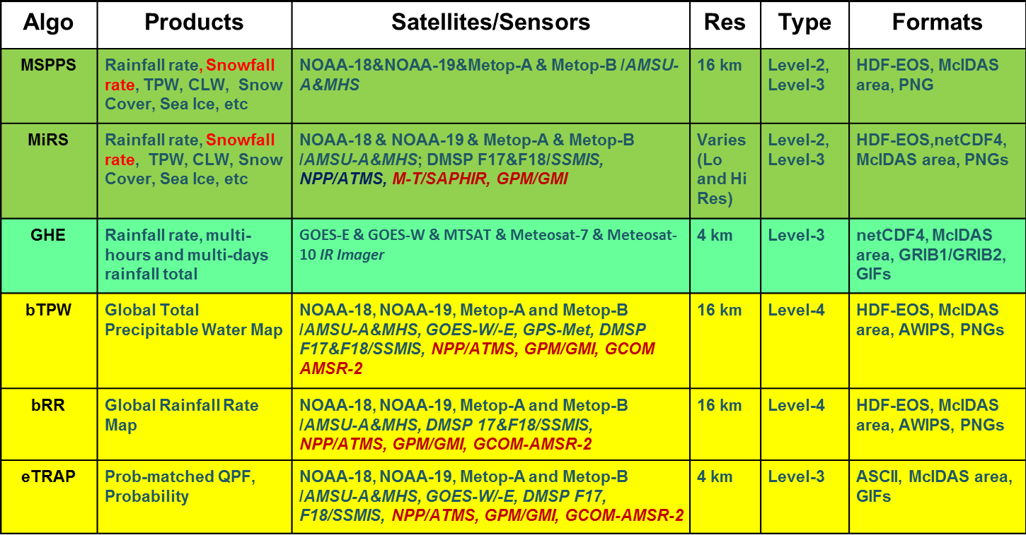
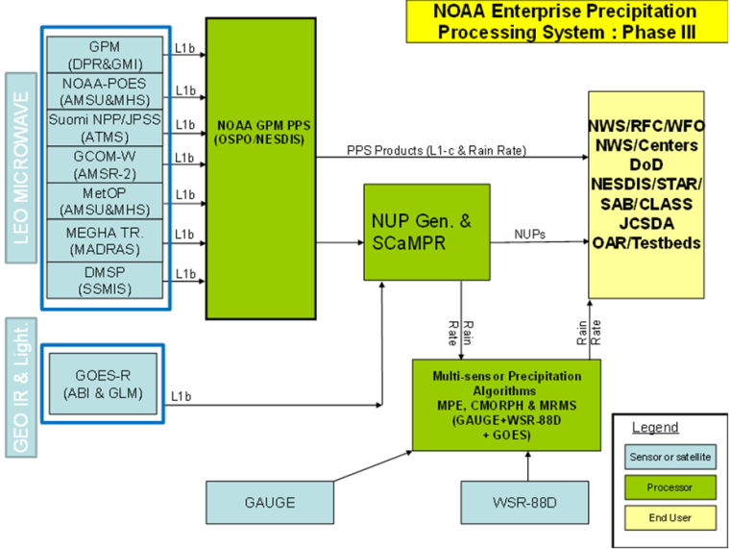
Current Status and Future Outlook for NOAA/NESDIS Operational Precipitation Products
Ralph Ferraro, NOAA/NESDIS
Limin Zhao, Stan Kidder, Chandra Kondragunta, Bob Kuligowski, Huan Meng, Patrick Meyers, Brian Nelson, Nai-Yu Wang, Jerry Zhan
J12.1
20th AMS Conference on Satellite
Meteorology and Oceanography
Several product systems that generated operational precipitation products
  POES specific
  GOES specific
  Emerging blended products
Future goal is to consolidate into a unified systems called GEARS
  Challenge is to meet all user requirements, including latency
    Direct broadcast can be exploited for POES and JPSS
  New sensors offer new capabilities to develop fused products
    GOES-R (ABI, GLM)
    JPSS (VIIRS, ATMS)
    Non-NOAA (GPM, GCOM)
A NOAA-wide “Roadmap toward a One-NOAA Precipitation Product Enterprise” is being developed
Primary NESDIS Operational Precipitation Products/Systems
Put in graphics on this side of the slide
A concept for a future precipitation processing system at NOAA that optimizes satellite and ground assets, yet, reduces the number of systems

Slide 6
S-NPP CrIS Full Spectral Resolution SDR Processing and Quality Assessment
Yong Han, Yong Chen, Xiaozhen Xiong, Xin Jin, Likun Wang and Denis Tremblay
NOAA Center for Satellite Application and Research, College Park, MD
11th Annual Symposium on New Generation Operational Environmental Satellite System
Oral presentation
NOAA/STAR Full Spectral Resolution (FSR) processing system
  On Dec 4, 2014, S-NPP CrIS was turned into FSR mode
  While the NOAA Operational processing system (IDPS) continues to provide normal resolution radiance spectra, the STAR FSR processing system provides the FSR radiance spectra to the public
FSR SDR data quality assessment
  The spectral and radiometric calibrations meet specifications
  Noise performance is characterized and results are presented
Full spectral resolution
CH₄
CO
CO₂
Normal resolution

Slide 7
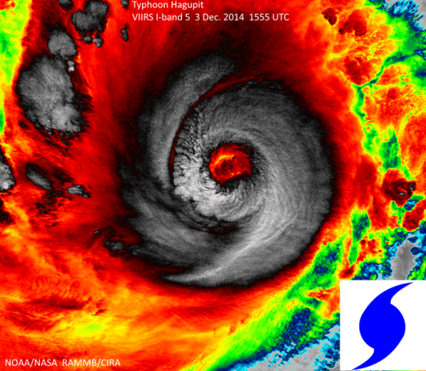
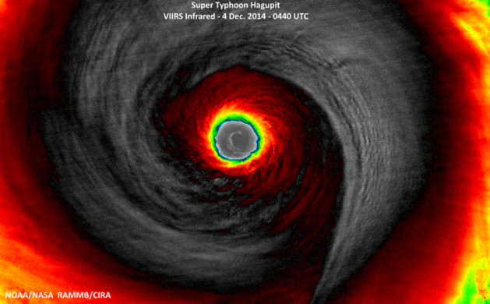
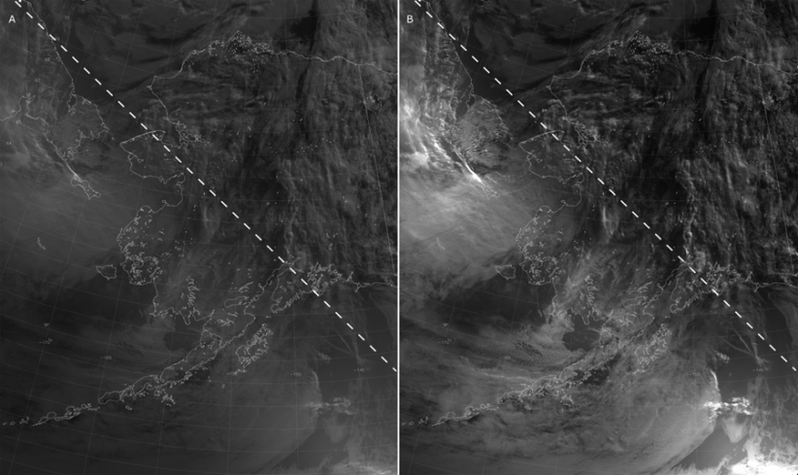
Suomi-NPP VIIRS Imagery Update
Donald W. Hillger, NOAA/NESDIS, Fort Collins, CO; and C. J. Seaman, S. D. Miller, T. J. Kopp, R. Williams, and G. Mineart
11th Annual Symposium on New Generation Operational Environmental Satellite Systems
VIIRS Imagery is excellent:
  The I-bands provide high-resolution imagery of tropical storms, thunderstorms, RGB imagery, etc., depicting details in cloud formations or features on the ground which were not seen before (as noted in many of the VIIRS Blogs and VIIRS Imagery websites).
Users especially like DNB and/or NCC.
Some Improvements in VIIRS Imagery are possible:
  Additional (all 16) M-band EDRs desired (currently only 6 M bands)
  Improved “erf-dynamic scaling” (EDS) DNB
Data latency is main realtime usage issue (6 hour delay is not user friendly).
VIIRS I-band-5 Image of Typhoon Hagupit: rapidly-intensifying 1555 UTC on 3 Dec 2014, maximum intensify 0440 UTC on 4 Dec 2014.
VIIRS DNB and NCC images of a twilight scene on the night following a last quarter moon (13:23 UTC 19 July 2014). A) DNB image produced using the EDS method. B) NCC image. The dashed lines in (A) and (B) represent the 89° solar zenith angle contour with daylight in the upper right corner and night in the lower left corner.

Slide 8
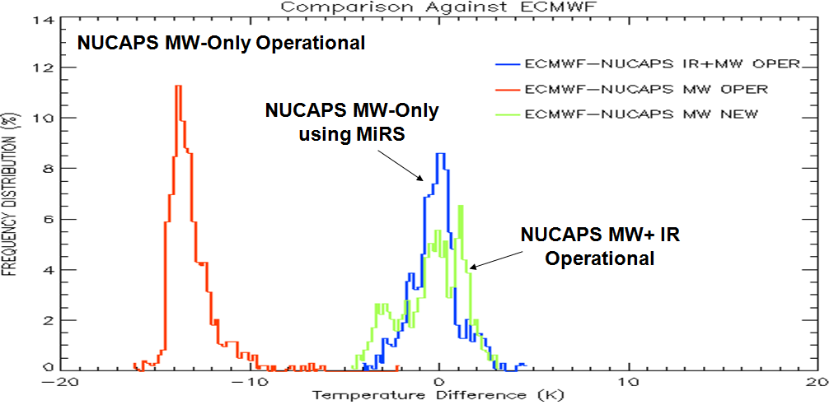
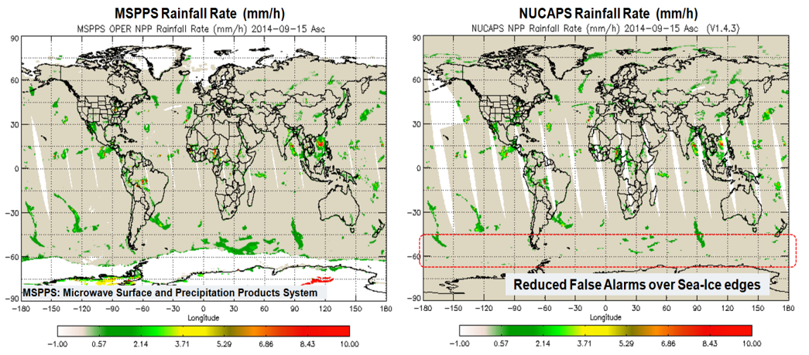
Improvement of the Satellite-Based Microwave Physical Retrieval of Temperature and Water Vapor in NUCAPS
Flavio Iturbide-Sanchez¹, Antonia Gambacorta³, Quanhua Liu², Anthony Reale², Nicholas R. Nalli¹, Changyi Tan¹, and Bomin Sun¹
1. I.M. Systems Group at NOAA/NESDIS/Center for Satellite Applications and Research, College Park, MD 20740.
2. NOAA/NESDIS/Center for Satellite Applications and Research, College Park, MD 20740.
3. Science and Technology Corporation, Columbia, MD 21046.
This work presents the performance evaluation and initial improvements of the Microwave-only physical retrieval algorithm of the National Oceanic and Atmospheric Administration (NOAA) Unique CrIS/ATMS Processing System (NUCAPS).
Figure 1 presents an improvement in the temperature retrieved by NUCAPS (blue histogram) after using a modified version of MiRS as the NUCAPS Microwave-only algorithm. This result is particular of a polar vortex case developed during January 2014 over the United States. For comparison purposes, the red line represents the actual performance of the NUCAPS Microwave-only algorithm.
A new NUCAPS ocean/land rainfall rate algorithm based on the MSPPS precipitation algorithm was implemented and evaluated. Figure 2 shows a comparison between the MSPPS (left) and the NUCAPS (right) rainfall rate. Reduced number of false alarms over the sea-ice edge are observed for the NUCAPS case.
Major problems in the quality of the NUCAPS Microwave-Only retrieval algorithm have been identified and initial efforts for their solution are in progress.
Figure 1. Histogram of the NUCAPS retrieved temperature minus ECMWF temperature over a winter polar vortex case.
Figure 2. Rainfall rate estimated by the MSPPS (left) and NUCAPS(right) precipitation algorithms.

Slide 9
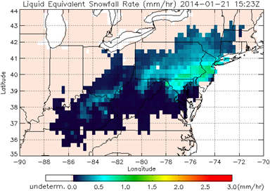
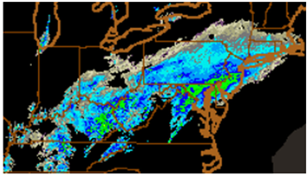
Snowfall Rate Retrieval using Passive Microwave Measurements and
Its Applications in Weather Forecast and Hydrology
Huan Meng^{1,2}, Ralph Ferraro^{1,2}, Cezar Kongoli², Banghua Yan^{1,2}, Bradley Zavodsky³, Limin Zhao^{1,2}, Jun Dong², Nai-Yu Wang^{1,4}
¹NOAA/NESDIS, College Park, MD; ²ESSIC/CICS-MD, University of Maryland, College Park, MD
³NASA/SPoRT, Huntsville, AL; ⁴IMSG, Inc., Rockville, MD
20th Conference on Satellite Meteorology and Oceanography
Developed ATMS Snowfall Rate (SFR) algorithm
  More advanced algorithm than the operational MHS SFR product
  Snowfall detection employs principal component analysis and logistic regression model
  Cold air extension greatly improved snowfall detection
Applications
  Two-year product assessment at WFOs and SAB; feedback helps product improvement
  Global blended precipitation analysis such as CMORPH-Snow
Retrieved Snowfall Rate
NEXRAD Composite Reflectivity

Slide 10
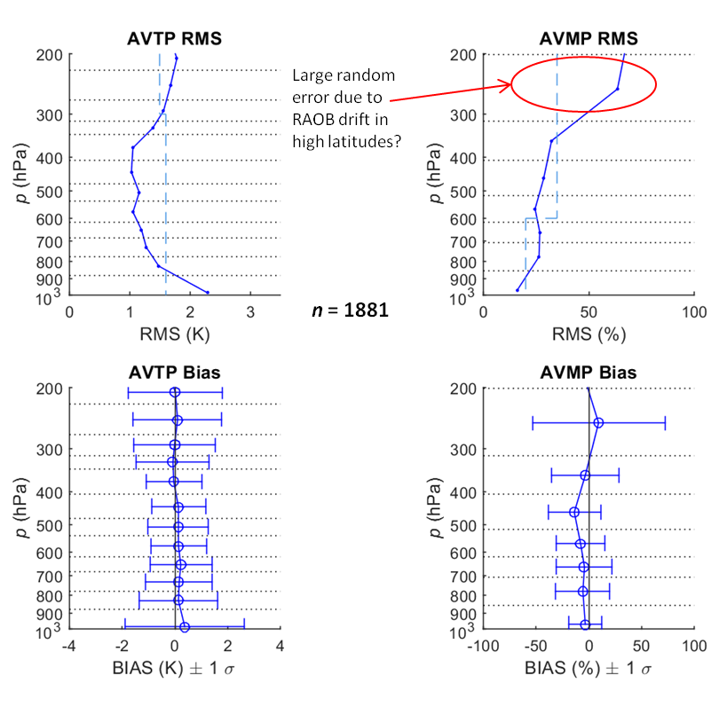
Validation of the JPSS NOAA-Unique CrIS/ATMS Processing System (NUCAPS) Operational EDR
N. R. Nalli, A. Gambacorta, C. Barnet, Q. Liu, T. Reale, C. Tan, F. Iturbide-Sanchez, B. Sun, L. Borg, D. Tobin, E. Joseph, V. R. Morris, A. K. Mollner, T. King, W. W. Wolf, J. W. Smith, F. Tilley, D. Wolfe
11th Annual Symposium on New Generation Operational Environmental Satellite Systems
An overview was given of JPSS Sounder EDR Cal/Val
  The sounder EDR validation methodology was reviewed
  The NUCAPS algorithm and validation datasets were summarized
The current status of the NUCAPS operational EDR product validation was presented
  Temperature, moisture profiles
  Ozone profiles and trace gases
  Long-Term Monitoring (LTM)

Slide 11
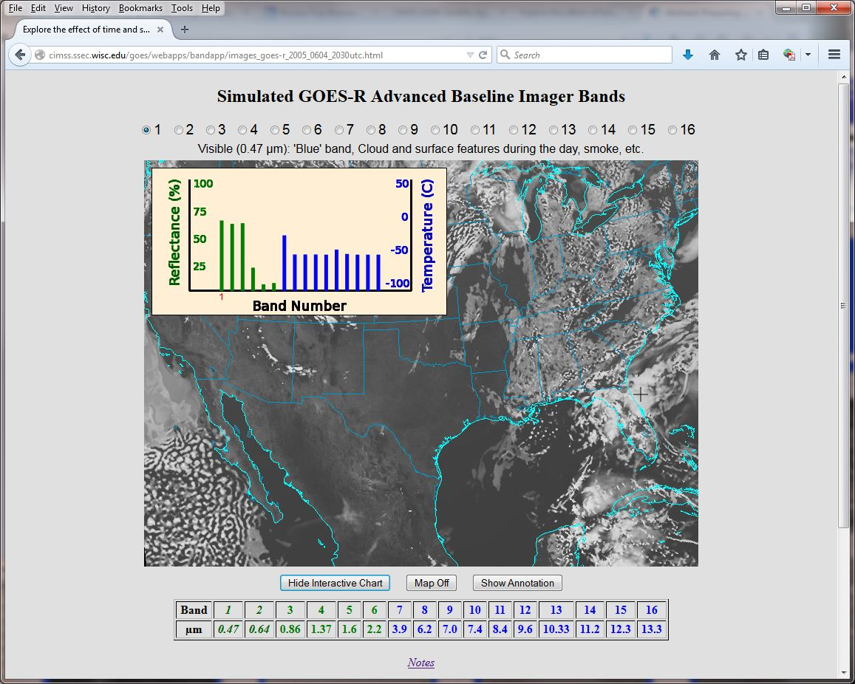
Preparing Users for the ABI on GOES-R
Timothy J. Schmit, 11th Annual Symposium on New Generation Operational Environmental Satellite Systems
Methods for preparing for the Advanced Baseline Imager (ABI)
  Simulations
    Triplet datasets
    WRF Chem
  Education
    webapps
  Training
  Other sensors
    MAS
    AHI
    SRSOR (Rapid Scans)
Sample interactive “Bandapp” educational webapp:
http://cimss.ssec.wisc.edu/goes/webapps/bandapp/
Notes:
https://ams.confex.com/ams/95Annual/webprogram/Paper265203.html

Slide 12
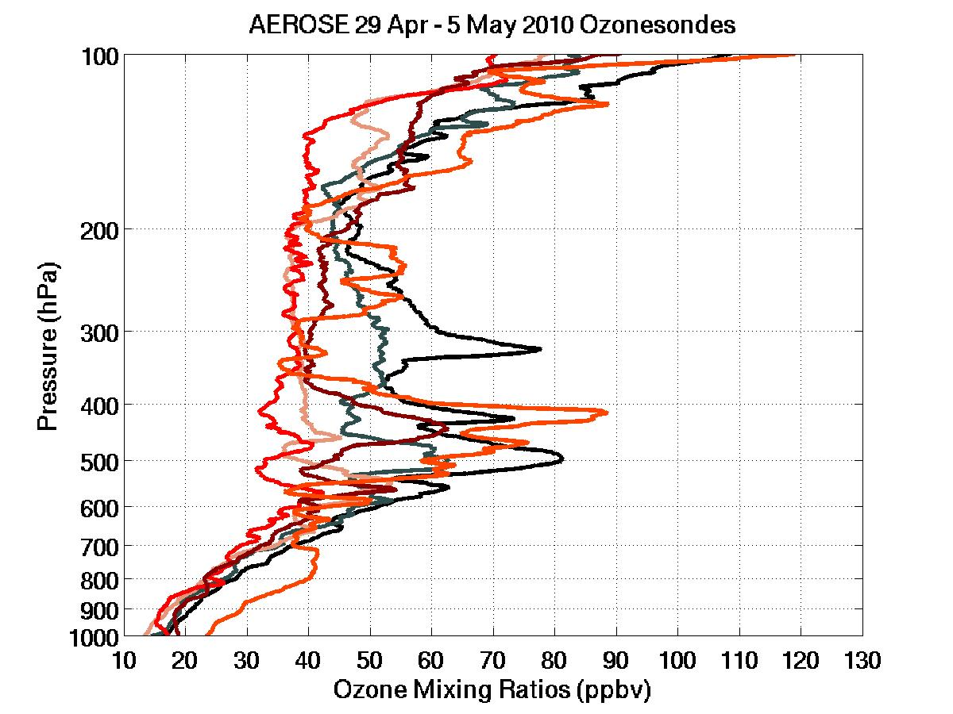
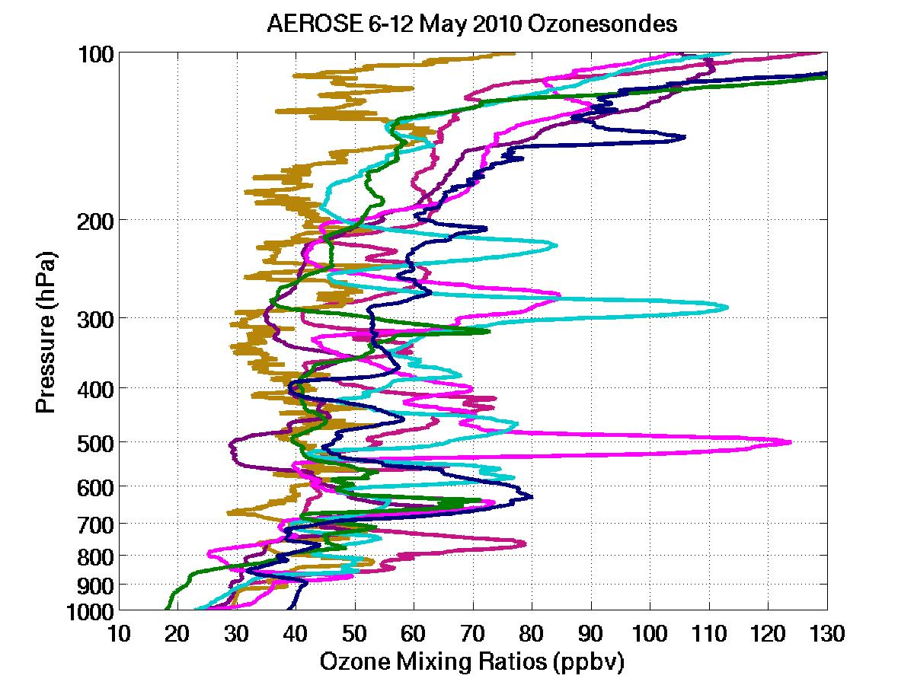
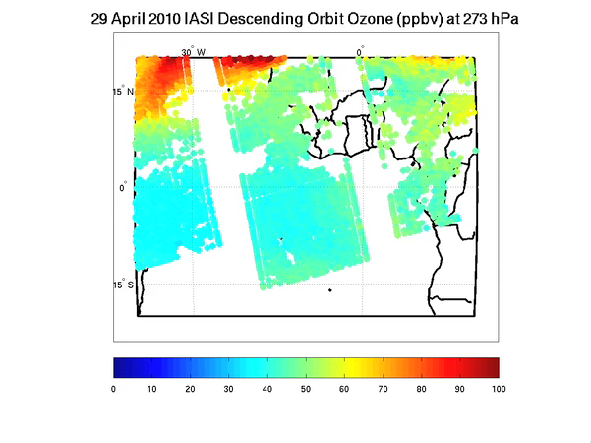
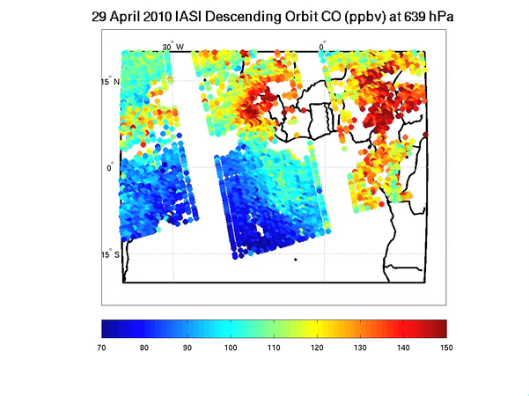
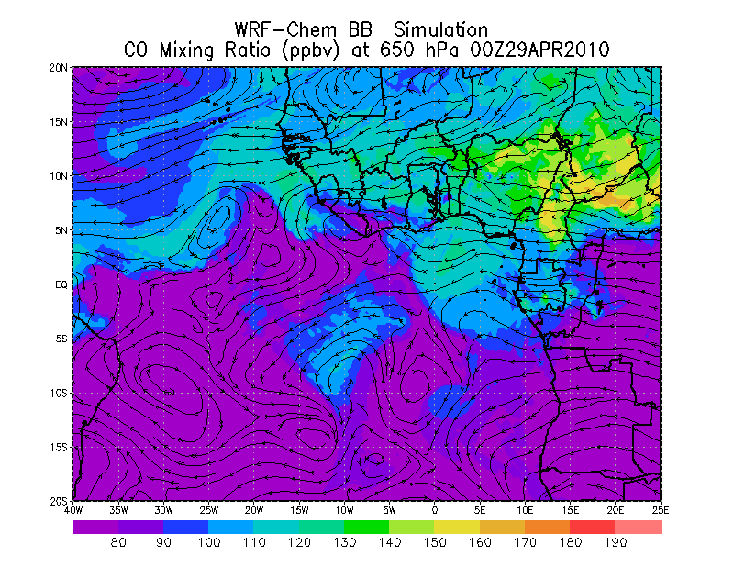
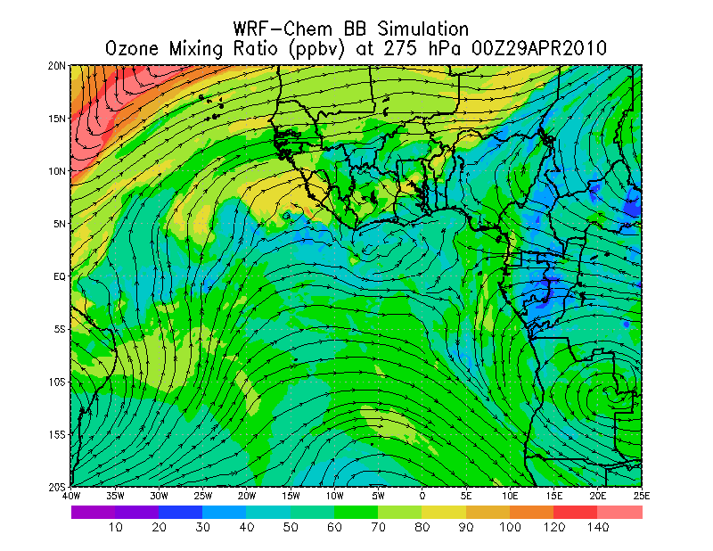
Sounder observations and WRF-Chem Model simulations: Impact study on tropospheric ozone increases observed during the 2010 AEROSE Campaign
17th Conference on Atmospheric Chemistry
Jonathan W. Smith, Ph D., National Academies/National Research Council Associateship STAR/SMCD, and Nicholas R. Nalli, Ph D., STAR/SMCD
IASI and WRF-Chem Model ozone are comparable quantitatively and spatially
  110-130 ppbv at 650 across the Sahel of Africa
  Plumes emerge of the coast of Guinea and Gabon/Cameroon
  Likely from convective transport
IASI, AEROSE ozonesonde, and WRF-Chem Model ozone are comparable
  50-60 ppbv at 275 hPa across the Sahel early in period then a decrease to 30-40 ppbv

Slide 13
GOES-R AIT: Development of Standard Test Data Sets for Routine Testing
Jonathan Wrotny¹, Z. Zhang¹, S. Sampson¹, W Wolf², and W. Straka³
¹IMSG, College Park, MD 20740, USA
²NOAA/NESDIS/STAR, College Park, MD 20740 USA
³CIMSS, Madison, WI 53706, USA
11th Annual Symposium on New Generation Operational Environmental Satellite Systems
Regression testing on all GOES-R Level 2 (L2) products is performed weekly to ensure stability of the algorithm code.
  Currently, test data is limited to a handful of test scenes such that the full science code is not being tested.
  Lack of code coverage makes it difficult to evaluate impact of code updates.
New test data sets are being assembled which ensure full code coverage of the GOES-R software.
  The standard GNU utility ‘Gcov’ is used to evaluate the code coverage for each test case.
  The individual GOES-R Algorithm Working Group science teams support the identification of test cases and help identify test data which can trigger hard to reach code decision points.
  Test cases are selected which maximize code coverage, while attempting to limit the overall number of cases.
-: 653: ! viewing zenith angle
9003969: 654: View_Zen_Ang = SatZen(Elem,Line)
-: 655: ! solar zenith angle
9003969: 656: Sol_Zen_Ang = SolZen(Elem,Line)
-: 657:
-: 658: !*** does this check need to be done in LZA rather than VZA?
-: 659: !--- check for correct sensor and solar geometry
-: 660: !IF (Local_Zen_Ang >= 65.0) THEN
9003969: 661: IF (View_Zen_Ang >= 72.0) THEN
#####: 662: Num_Pix_Cycle=Num_Pix_Cycle+1
-: 663: !*** does this check need to be done in LZA rather than VZA
-: 664: !--- quality flag set for "Local Zenith Angle >= 72.0“
#####: 665: Quality_Flag(Elem,Line) = 1
#####: 666: CYCLE
-: 667: END IF
-: 668:
A section of source code for the GOES-R Nighttime Cloud Microphysical Properties algorithm from a ‘Gcov’ code coverage file generated by running the algorithm with a scene of MSG-SEVIRI data from 0600 UTC on 1/29/2012. The green line show a non-executable line of code; the blue line shows an executable line of code and the number of times (9003969) it was executed; and the red line shows an executable line of code that was not executed.

Slide 14
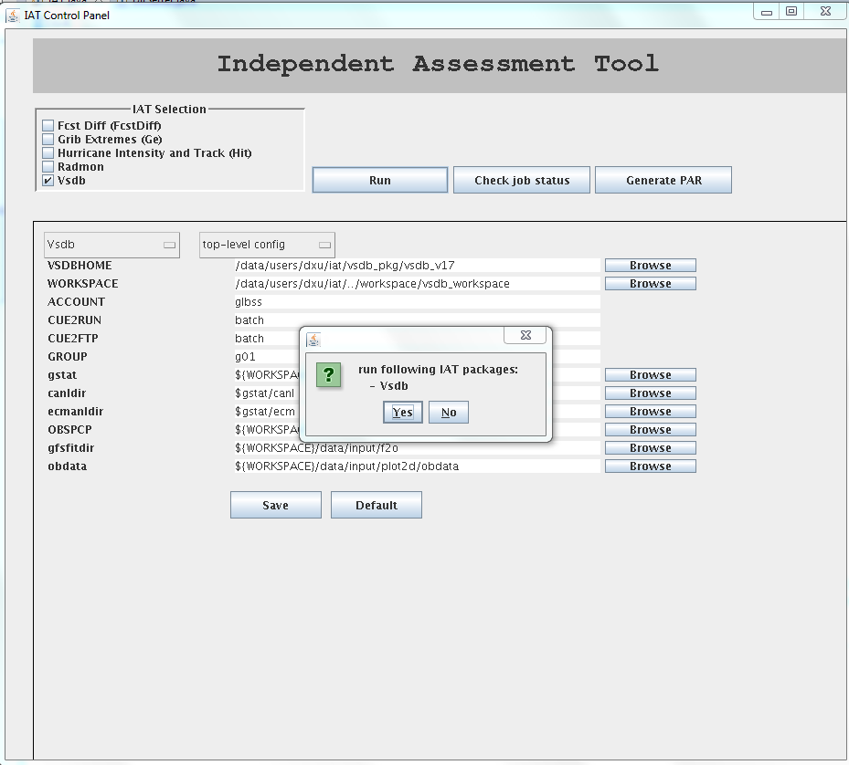
Development of Independent Assessment Tool (IAT) at NOAA/NESDIS/STAR/JCSDA
Deyong Xu, V. Krishna Kumar, and Sid Boukabara
RTi @ NOAA/NESDIS/STAR/JCSDA
The third Symposium on the Joint Center for Satellite Data Assimilation
Development of Independent Assessment Tool (IAT) at NOAA/NESDIS/STAR/JCSDA
  Integrate multiple existing validation tools into one place (IAT) and migrate them to various system such as ZEUS.
  Standardize the configuration of each IAT package, including I/O, utilities, compiler, etc. to facilitate the usage of IAT packages.
  Develop Java GUI to run these IAT packages to relieve the burden of setting these IAT packages from researchers.

Slide 15
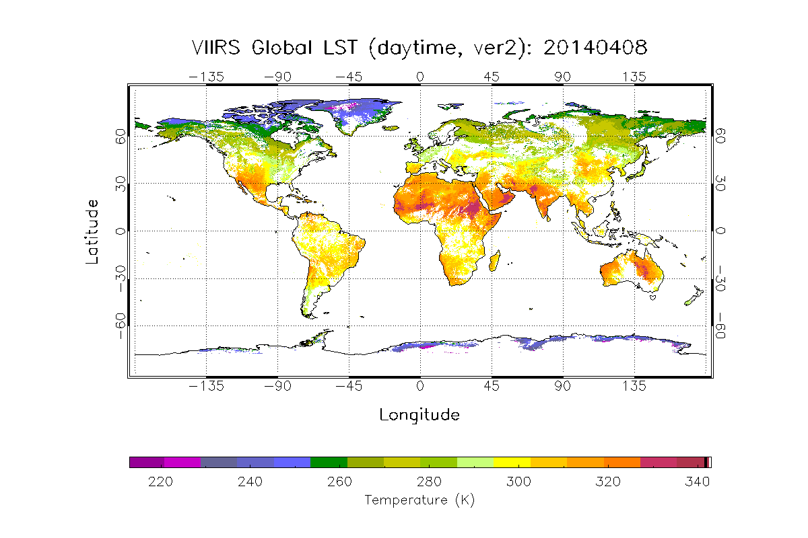
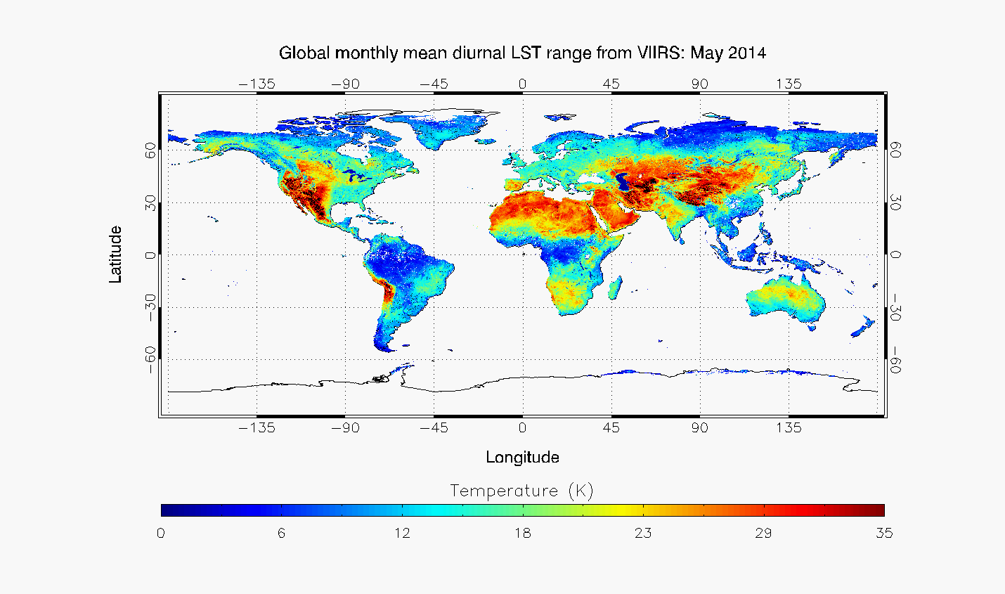
Issues in Developing and Validating Satellite Land Surface Temperature Product
Yunyue Yu, Ivan Csiszar, NOAA/NESDIS/STAR
Yuling Liu, Peng yu, Zhuo Wang, UMD/ESSIC/CICS
Presentation in the American Meteorological Society’s 11th Annual Symposium on New Generation Operational Environmental Satellite Systems
  Issues in LST Algorithm Development
    Emissivity sensitivity
    Spatial heterogeneity
    Temporal variation
    Atmospheric difference
    Cloud contamination
  Issues in LST Product Validation
  In-situ validation
    Spatial heterogeneity: spot-pixel difference
    Temporal variation: time match restriction
    In-situ LST estimation: data quality, emissivity issue
  Cross-satellite comparison
    Data gridding: aggregation process
    Time match
    BRDF impact

Slide 16
CICS-MD
Bitzer, Phillip
Casey, Sean
Chen, Yong (2)
Folmer, Michael
Kenney, Melissa (2)
Liu, Yuling
Lukens, Katherine
Moradi, Isaac
O’Brien, Katherine
Wang, Likun
Yang, Wenze
Yoo, Hyelim

Slide 17
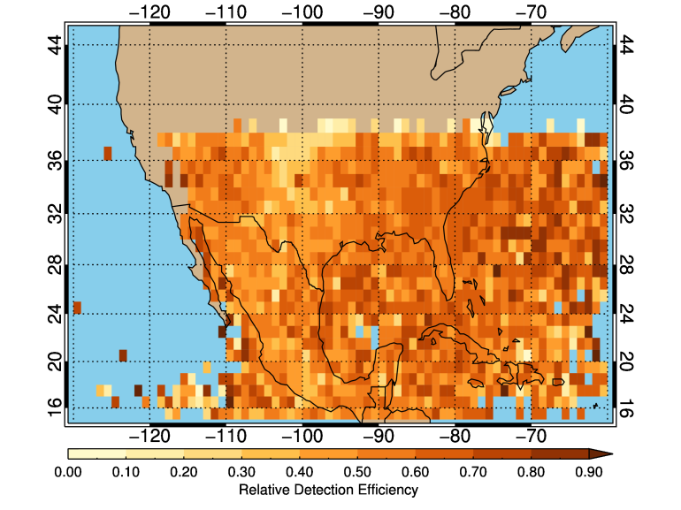
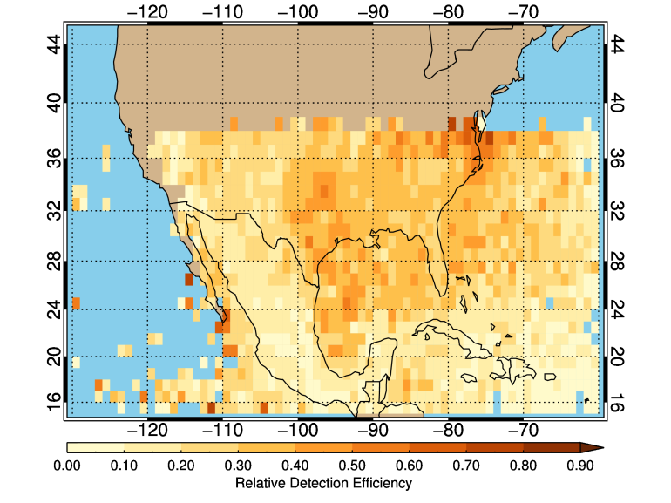
Determination of Detection Efficiency of Lightning Detection Systems using Bayesian Analysis
Phillip Bitzer, Jeff Burchfield, Hugh Christian U. of Alabama in Huntsville
LIS detects 53% of ENTLN lightning discharges
  uniform in space and time
ENTLN detects 6% of LIS lightning discharges globally
  27% near North America
Of all lightning discharges in North America in 2013, LIS detects 81%, ENTLN 41%
Space based instruments to detect lightning outperform ground based instruments

Slide 18
Initial Validation of a New OSSE Capability
Sean PF Casey^{1,2,3}, Hongli Wang^{4,5}, Robert Atlas⁶, Ross N Hoffman⁷, Sid-Ahmed Boukabara^{2,3}, Yuanfu Xie⁵, Zoltan Toth⁵, and John S Woollen^{2,8}
¹CICS-MD ²JCSDA ³NOAA/NESDIS/STAR ⁴CIRA-CSU ⁵NOAA/ESRL ⁶NOAA/AOML ⁷AER ⁸NOAA/NCEP/EMC
19th Conference on Integrated Observing and Assimilation Systems for the Atmosphere, Oceans, and Land Surface
New GEOS-5 7-km Nature Run (G5NR) different enough from GDAS/GFS to allow for OSSE experiments to be run
  Lower RMSE noted for mid-range forecasts compared to real observations
  AC scores similar between real, simulated atmosphere
New simulated observations with added errors more closely resemble real observations
  Transition between OSE, OSSE shows non-significant variance differences between real, simulated observations (right)
  Work ongoing to add reasonable variances to all assimilated observations

Slide 19
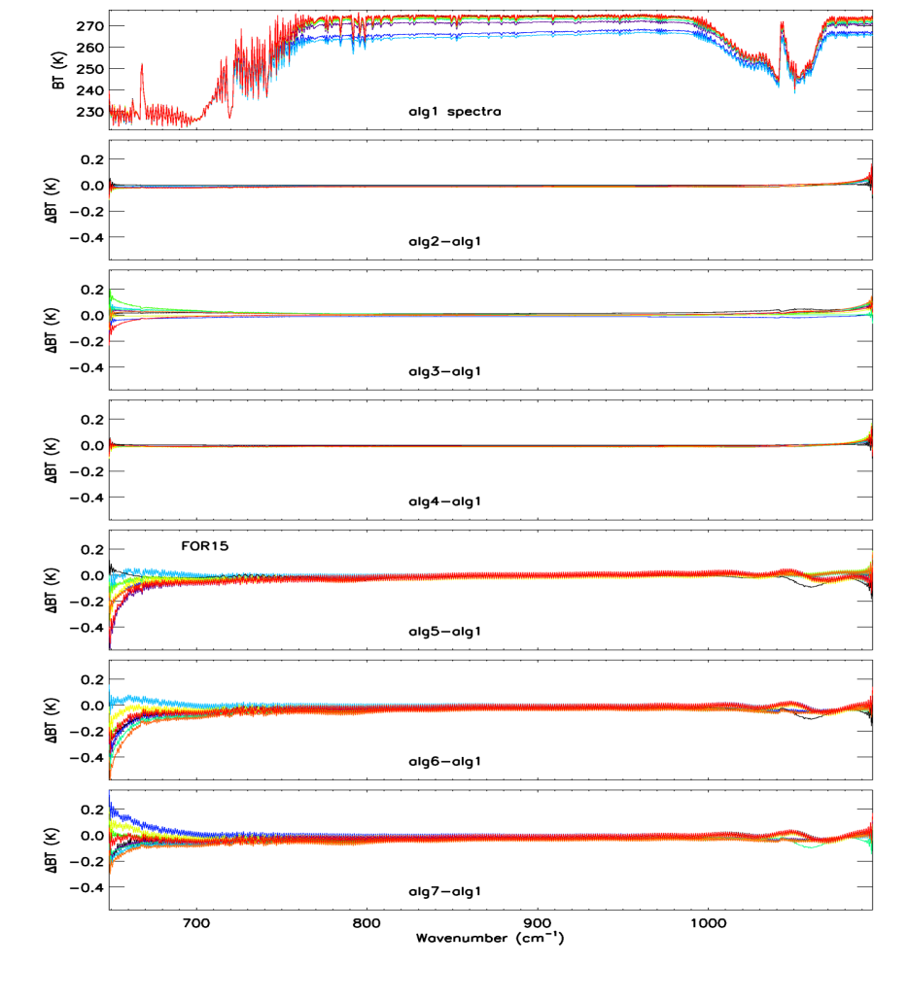
Comparison of Different Calibration Approaches in S-NPP
CrIS Full Spectral Resolution Processing
Yong Chen¹, Yong Han², Likun Wang¹ , Denis Tremblay³, Xin Jin⁴, Xiaozhen Xiong⁴, and Fuzhong Weng²
¹CICS/ESSIC ²NOAA/NESDIS/STAR ³Science Data Processing Inc. ⁴ERT
We have implemented different calibration approaches in the CrIS full resolution SDR code in order to study the ringing effect observed in CrIS unapodized spectra and to support to select the best calibration algorithm for J1
Preliminary results show significant ringing artifacts among different calibration approaches and their order in the calibration process
The CrIS SDR Science team has been working to improve SDR calibration algorithm to reduce ringing artifacts, and we will implement and test the improved calibration algorithms for J1
Envelope of Ringing among different Algorithm

Slide 20
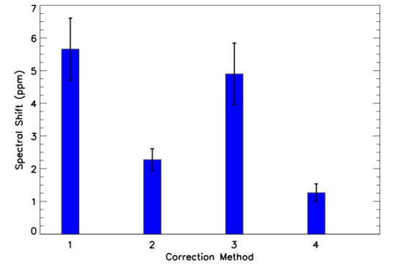
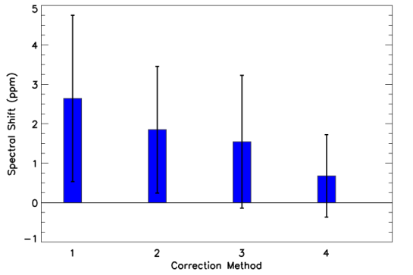
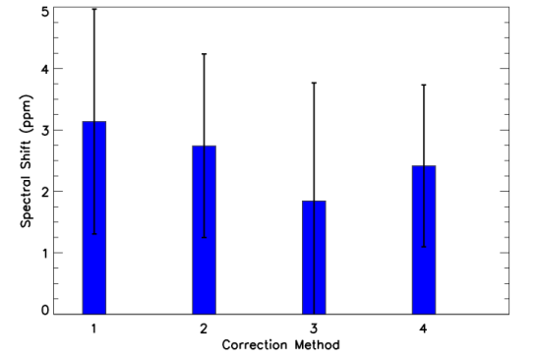
Assessment of Hyper-Spectral Infrared Sensors CrIS and IASI
Spectral Accuracy Using Community Radiative Transfer Model
Yong Chen¹, Yong Han², and Fuzhong Weng²
¹CICS/ESSIC ²NOAA/NESDIS/STAR
In this study, CRTM is used to systematically evaluate the spectral accuracy of CrIS and IASI at different spectral ranges for all three bands
Based on these results, the best spectral ranges are 710-760 cm⁻¹ , 1340-1390 cm⁻¹ , and 2310-2370 cm⁻¹ for CrIS three bands, respectively
Results show that increasing the simulated spectral resolution (for example CRTM simulated IASI spectra) then convert to back to the original resolution (IASI2CrIS) can improve the absolute spectral shift uncertainty for CrIS
LWIR
Correlation Method
CrIS_apod | 1
CrIS_unapod | 2
IASI2CrIS_apod | 3
IASI2CrIS_unapod | 4
Frequency used: 710-760 cm⁻¹
SWIR
MWIR
Frequency used: 1340-1390 cm⁻¹
Frequency used: 2310-2370 cm⁻¹
Spectral shift between CRTM and Obs. for CrIS full resolution SDR at nadir FOV5

Slide 21
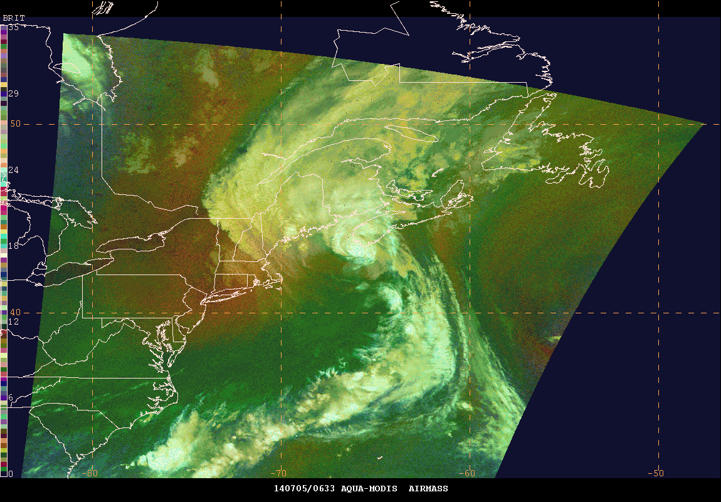
The ‘Unusual’ Evolution of Hurricane Arthur 2014:
A GOES-R and JPSS Satellite Proving Ground Perspective
Michael J. Folmer (UMD/ESSIC/CICS), John Cangialosi (NHC), Jeffrey Halverson (UMBC),
Emily Berndt (SPoRT), Steven Goodman (GOES-R), and Mitch Goldberg (JPSS)
11th Annual Symposium on New Generation Operational Environmental Satellite Systems:
Satellite Testbeds and Proving Ground Activities
Multiple GOES-R/JPSS products were available to forecasters to assist in diagnosing the complex evolution of Arthur.
The RGB Air Mass coupled with the Ozone products revealed the stratospheric intrusion leading to the extratropical transition.

Slide 22
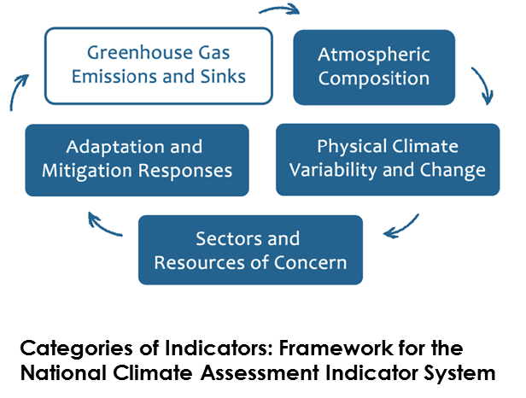
Indicators for the National Climate Assessment (Invited)
Melissa A. Kenney, Ph.D., University of Maryland, Earth System Science Interdisciplinary Center and Cooperative Institute for Climate and Satellites-MD, USGCRP National Climate Indicator System
A system of physical, ecological, and societal indicators that communicate key aspects of the climate changes, impacts, vulnerabilities, and preparedness
  Provide meaningful, authoritative climate-relevant measures about the status, rates, and trends of key physical, ecological, and societal variables and values
  Inform decisions at multiple scales
  Identify climate-related conditions and impacts
  Provide analytical tools by which user communities can derive their own indicators for particular purposes

Slide 23
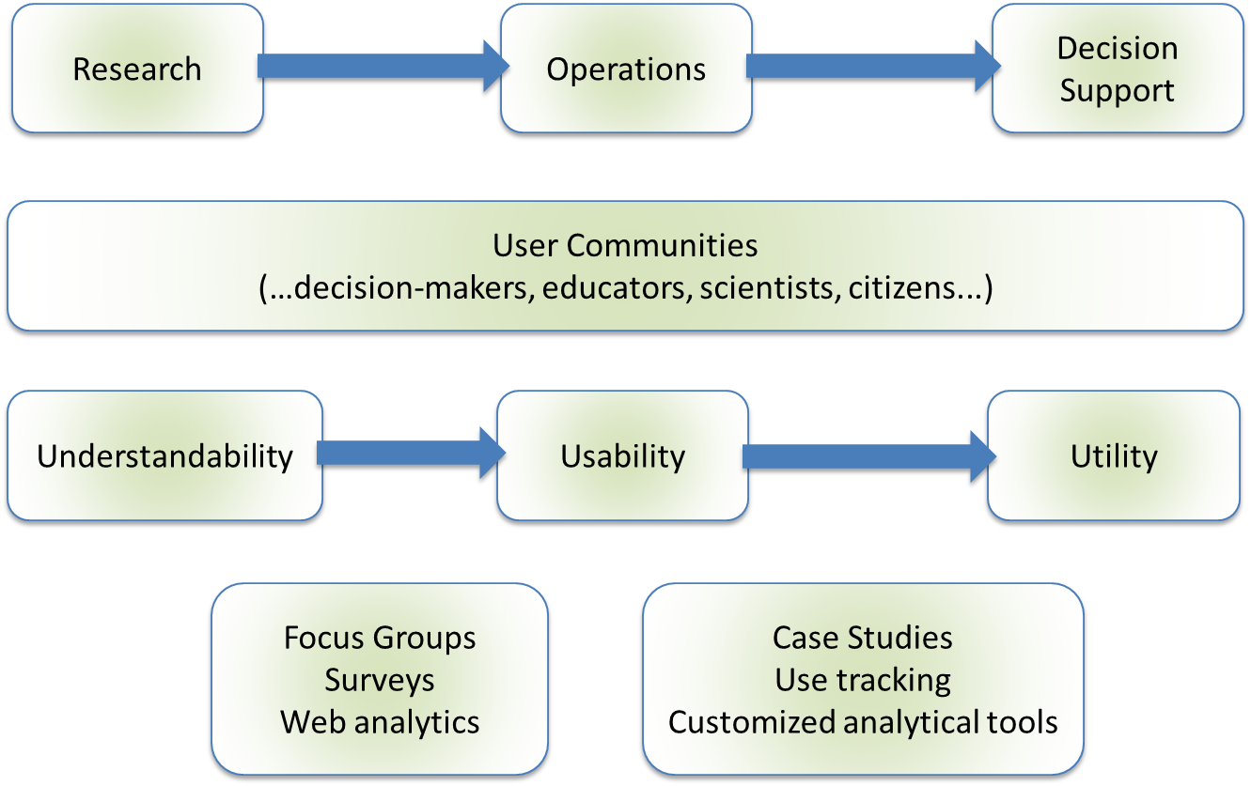
National Climate Indicators System:
Utility of Information of Indicators
Melissa A. Kenney, Ph.D., University of Maryland, Earth System Science Interdisciplinary Center and Cooperative Institute for Climate and Satellites-MD, USGCRP National Climate Indicator System
Ella Clarke, University of Maryland, USGCRP National Climate Indicator System
Pilot Indicators
  Indicators that are already developed, scientifically vetted,
  and proven to be useful
Iterative user-focused design and development with a variety of user communities in mind
  Scientific assessments of understandability and usability (e.g. through surveys and focus groups)
  Scientific assessments of utility (at a later point in the process, e.g. through case studies and evaluation of customized analytical tools developed by users)

Slide 24
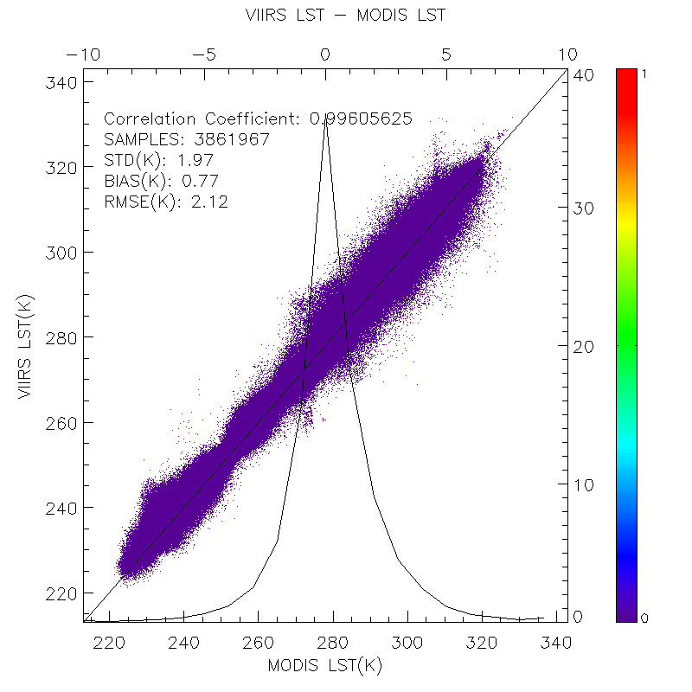
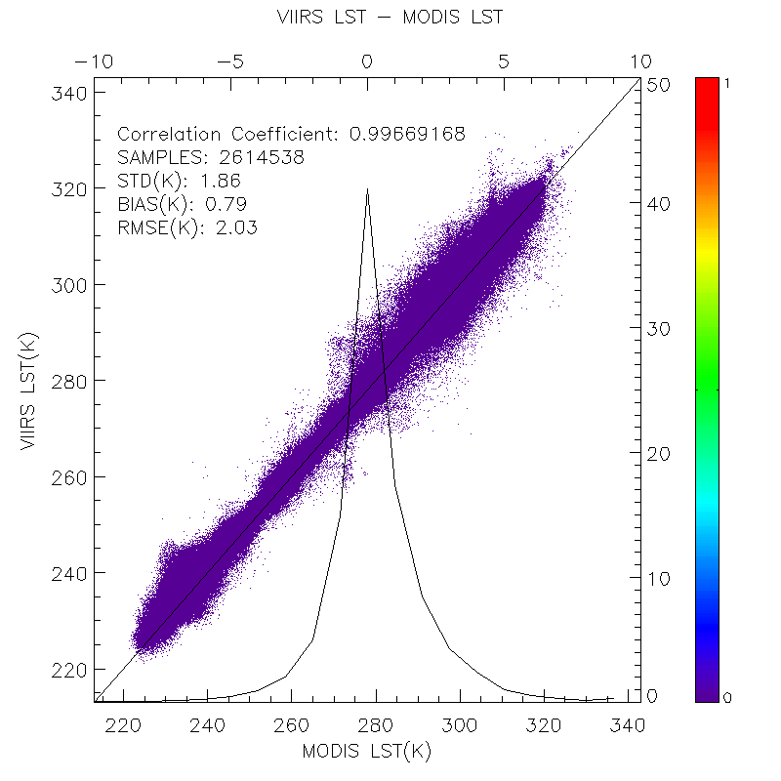
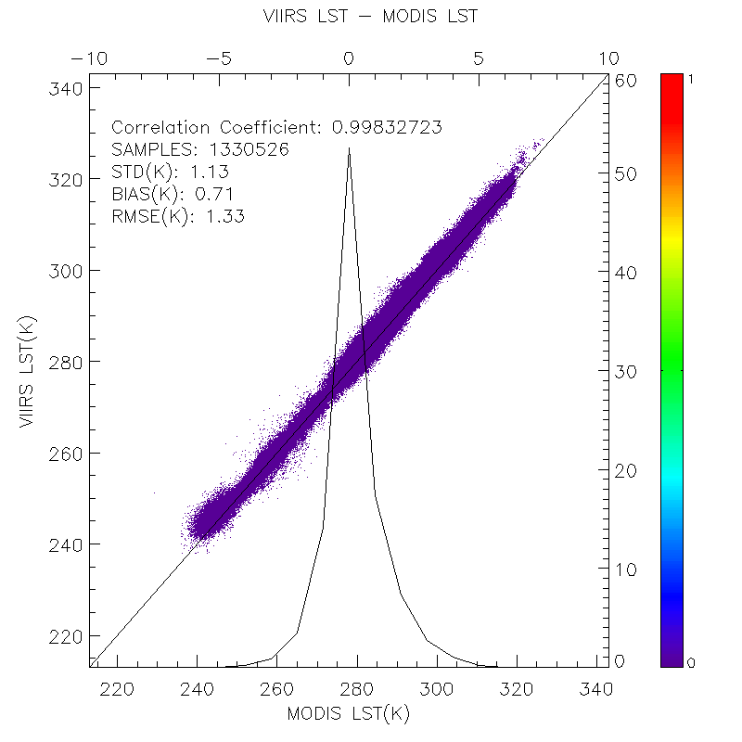
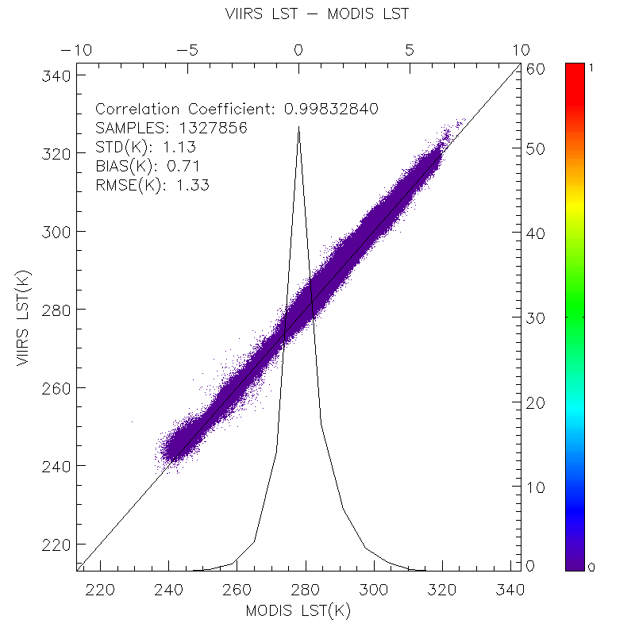
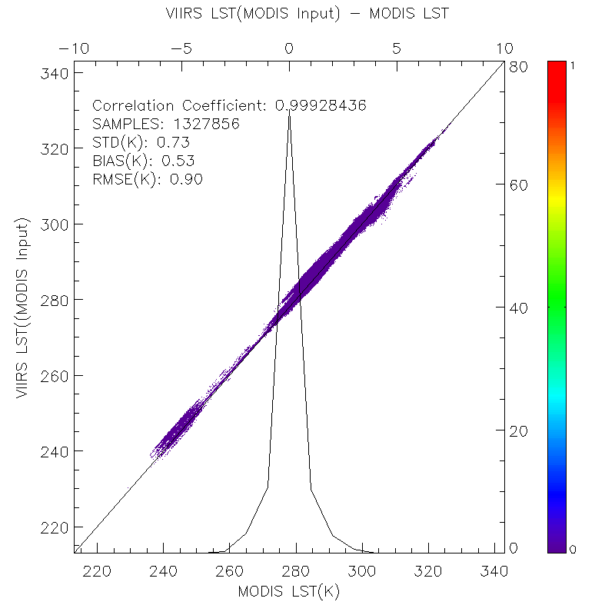
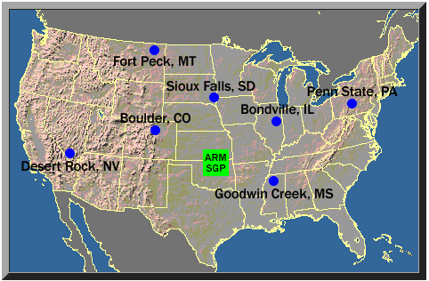
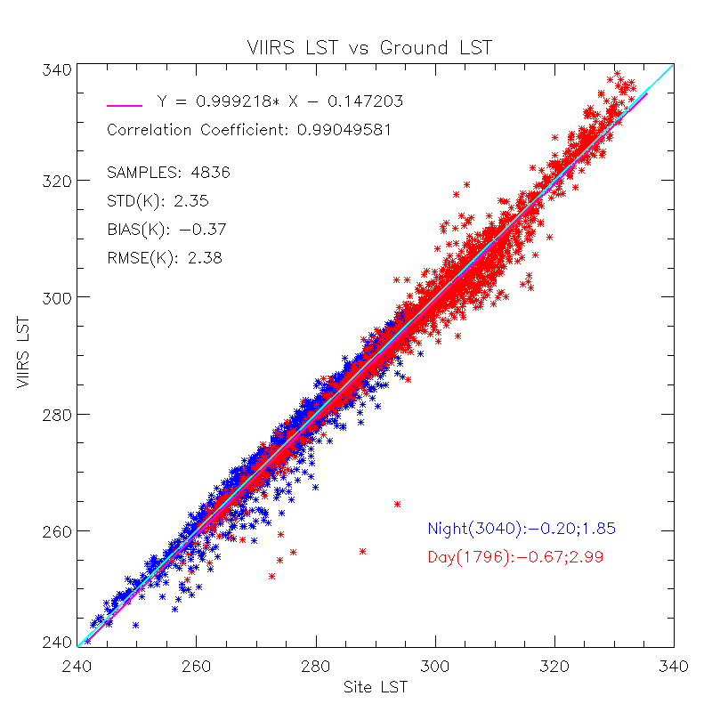
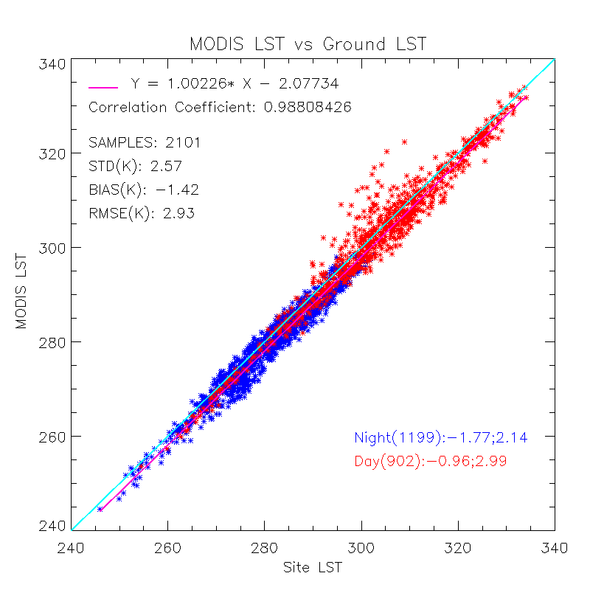
Concerns on cross comparison of satellite land surface temperature retrievals, a case study between VIIRS and MODIS LST product
Concerns on cross comparison of satellite land surface temperature retrievals,
a case study between VIIRS and MODIS LST product
Yuling Liu¹², Yunyue Yu² , Peng Yu¹² , Zhuo Wang¹²
¹CICS, University of Maryland, College Park; ² STAR/NESDIS/NOAA
The cross-comparison of LST products from different satellites or sensors is widely used to evaluate one LST product with reference to the other, particularly between heritage satellite products. As the VIIRS LST is expected to replace MODIS LST in the future, the inter-comparison between VIIRS LST and MODIS LST will provide the evaluation of VIIRS LST performance with respect to difference characterization, i.e. spatial pattern, systematic error budget, which may reflect the algorithm difference, limitations or errors. Cautions need to be taken in the whole chain of cross-comparisons, i.e. data selection for comparison, data processing procedures and results analysis. This study will focus on cautions regarding temporal differences, composite process, and angular differences. Some comparison cases are discussed and a guideline is provided for each of them in the cross satellite LST comparison.
Cross Satellite Comparison Flow Chart
Data Preparation
SNO Predictions
Nadia distance control
Overpass Time Control
VIIRS Scene
MODIS Scene
LST, Geolocation, BT, Geometry, Surface type
Cross Comparison at granule Level
Comparison Process
Swath to Grid
Grid to grid match up
Composite Procedure
e
a
b
c
d
e
Data Selection Criteria
Data quality control
Comparison results from Simultaneous Nadir Overpass (SNO) between VIIRS and AQUA in 2012, 2013 and early 2014 over US, polar and low latitude areas. The matchups are quality controlled using the quality flags in each product.
a) all comparison results under cloud clear condition ; b) based on a, the satellite zenith angle difference between VIIRS and MODIS is constrained within 10 degrees; c) based on a, spatial variation tests are added ; d) based on c, angle difference is added ; e) based on d, VIIRS LST is calculated using MODIS data as input and then compare to MODIS LST
LST intention
Angle Difference
Optimal weather conditions
Cloud screening
SURFRAD data in US

Slide 25
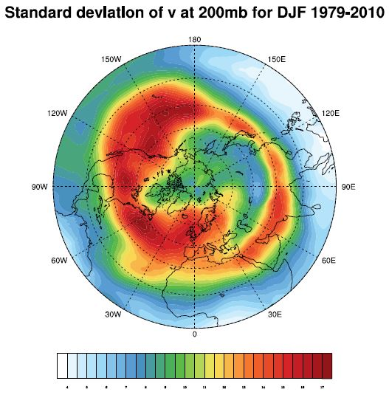
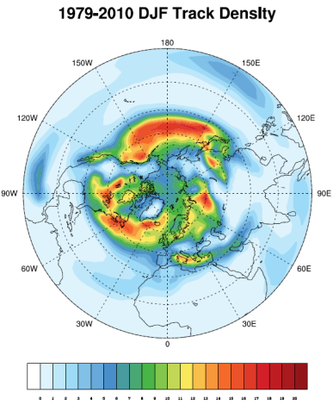
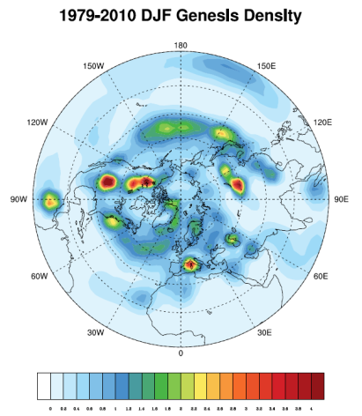
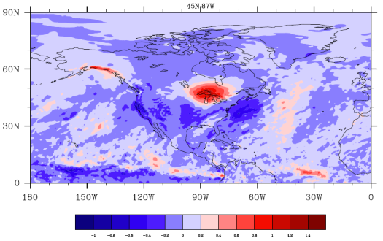
On the Relation Between North American Winter Precipitation and Storm Tracks
Katherine E. Lukens* and E. Hugo Berbery*
ESSIC/CICS-MD
*University of Maryland, College Park, MD
27th Conference on Climate Variability and Change
The track density (Fig. 2) from the Lagrangian method highlights the Northern Hemisphere winter storm tracks with greater detail than the traditional Eulerian method (Fig. 1).
  - The Lagrangian track density captures the extensions into the lower latitudes of the Mediterranean and Pacific storm tracks.
Applying low-level vorticity to the Lagrangian approach allows for storms to be identified earlier in their life cycles.
  - Storm genesis regions are typically small in scale, and only the vorticity field exposes these regions.
  - The Lagrangian genesis density (Fig. 3) highlights regions of cyclogenesis.
Regressions of the Lagrangian vorticity on surface precipitation (Fig. 4) reveal detailed small-scale features, contrasting regressions using Eulerian variables.
Fig. 1: Eulerian storm track patterns represented as standard deviations of meridional wind at 200 hPa in units of m/s.
Fig. 2: Lagrangian statistical representations of storm tracks from single estimation points for each track.
1979-2010 DJF regression of vorticity on surface precipitation
Fig. 3: Lagrangian statistical representations of cyclogenesis from the starting points of each track.
Fig. 4: Regression of Lagrangian filtered vorticity on surface precipitation on lag 0 with a base point of 45°N, 87°W.

Slide 26
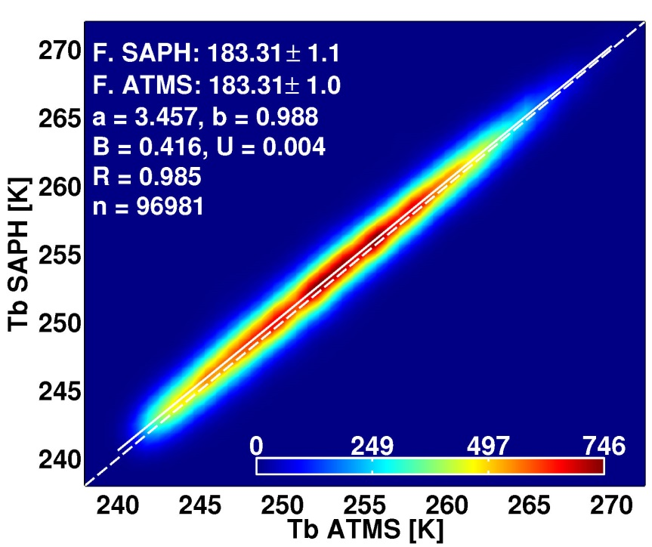
Inter-calibration and validation of observations from ATMS and SAPHIR microwave sounders
Isaac Moradi (JCSDA/UMD) and Ralph Ferrao (STAR) – Isaac Moradi (CICS-MD/UMD/JCSDA), Ralph Ferraro (NOAA)
SAPHIR and ATMS water vapor channels very consistent
The difference between sonde simulated and observed Tb’s were less than 1 K after taking into account sonde biases
ATMS sounding channels show only a small difference versus GPS-RO simulated Tb’s

Slide 27
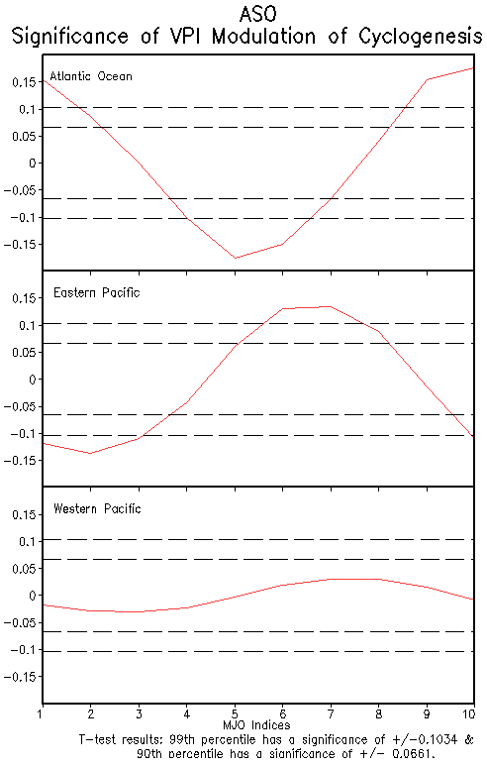
Toward Using the CPC’s MJO Index for Tropical Cyclone Prediction
By: Katherine O’Brien and Crystal Oudit, Advisor: Stephen Baxter, CPC
Climate Prediction Center/CICS-MD
The CPC derived an MJO index (with 10 indices) using velocity potential.
Using this index, we noted that the MJO can modulate cyclogenesis in the
  Atlantic and Eastern Pacific
  But, NO significance determined for the Western Pacific.
Results were analyzed further by looking at wind shear and sea level pressure anomalies in each index of the MJO.

Slide 28
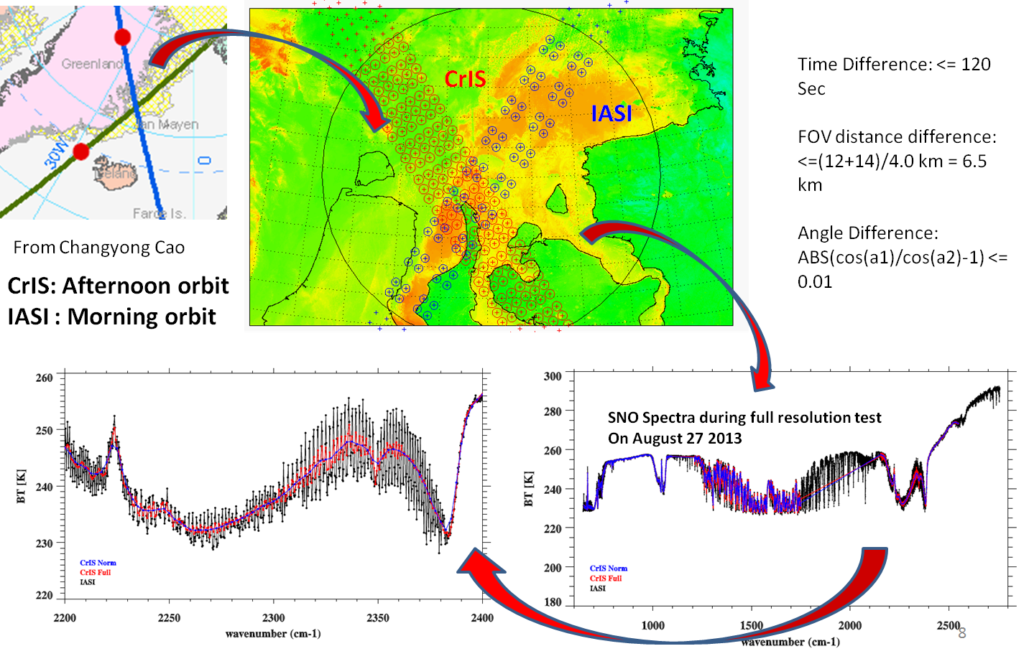
Inter-Comparison of Suomi NPP CrIS Radiances with AIRS and IASI toward Infrared Hyperspectral Benchmark Radiance Measurements
Likun Wang, Yong Han, Xin Jin, Yong Chen, and Denis A. Tremblay
Poster for 20th Conference on Satellite Meteorology and Oceanography
Radiometric and spectral consistency of four IR hyperspectral sounders is fundamental for inter-calibration and climate application.
Inter-comparison of CrIS with IASI/Metop-A, IASI/Metop-B, and AIRS have been made for one year’s of SNO observations in 2013.
CrIS vs. IASI
  IASI spectra are converted into CrIS spectral grid and the comparison is along CrIS spectral grid.
  CrIS and IASI well agree each other at LWIR and MWIR bands with 0.1-0.2K differences
CrIS vs. AIRS
  CrIS and AIRS are integrated within 25 spectral regions.
  CrIS and AIRS agree each other at LWIR and MWIR bands with the differences of 0.1-0.2 K .
  At SWIR band, the differences is less than 0.3K.
Wang, L, Y, Han, X. Jin, Y. Chen, and D. A. Tremblay, 2014: Inter-Comparison of Suomi NPP CrIS Radiances with AIRS and IASI toward Infrared Hyperspectral Benchmark Radiance Measurements, Journal of Atmospheric and Oceanic Technology (submitted).

Slide 29
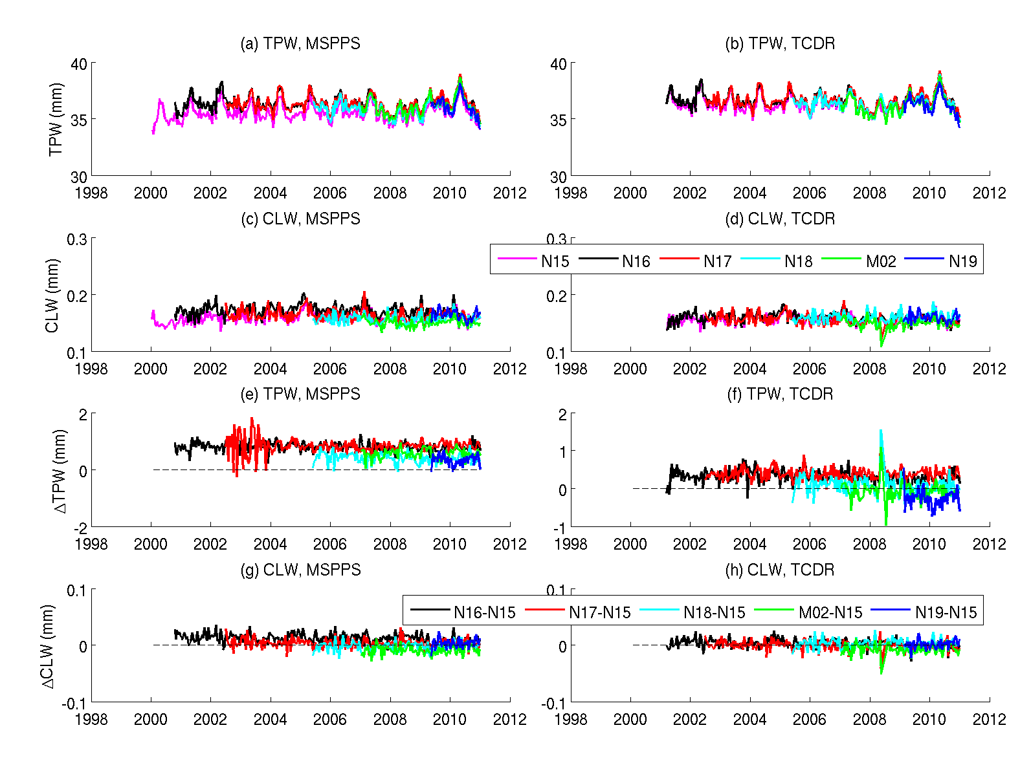
An Improved Microwave Satellite Data Set for Hydrological and Climate Applications
Wenze Yang (CICS-MD), Huan Meng and Ralph Ferraro (NOAA/NESDIS)
CDR’s for AMSU window channels and hydrological products are vital for the climate community
Our accomplishments to date include
  Completed AMSU geolocation
  Completed AMSU-A scan bias corrections and intersatellite calibration
  Developed β-FCDR for AMSU-A window channels, which include aforementioned corrections
  Developed β-TCDR for AMSU-A data sets
Put in graphics on this side of the slide

Slide 30
Long-term cloud cover trends over the U.S. from ground-based data and satellite products
Hye Lim Yoo¹², Melissa Free¹, Bomin Sun³⁴
¹ NOAA Air Resources Laboratory, College Park, MD
² Cooperative Institute for Climate and Satellites, University of Maryland, College Park, MD, USA
³ NOAA/NESDIS/Center for Satellite Applications and Research
⁴ I. M. Systems Group Inc., Rockville, MD, USA
Improvement of surface data
  Homogeneity-adjusted weather observations reduce trends in US total cloud cover than those in original dataset and increases the agreement between the cloud cover time series and those of physically related climate variables such as DTR and precipitation days.
  Comparison with satellite products
  Trends for 1984-2007 are all negative in both adjusted-station and satellite products but satellite products are more negative than those from station data.
  Overall we find good agreement between inter-annual variability in most of the satellite data and that in our station data, with PATMOS -x products showing the best match and less well with ISCCP.

Slide 31
CIMSS
Cintineo, R.
Feltz, Michelle
Gerth, Jordan J.
Knuteson, Robert
Letterly, Aaron
Li, Jinlong
Li, Jun
Li, Zhenglong
Lim, Agnes
Lindstrom, Scott S.
Menzel, W. P.
Mooney, Margaret
Otkin, Jason
Strabala, Kathleen I.
Straka III, William
Terborg, Amanda M.
Tobin, David C.
Walther, Andi
Wang, Pei
Wanzong, Steve

Slide 32
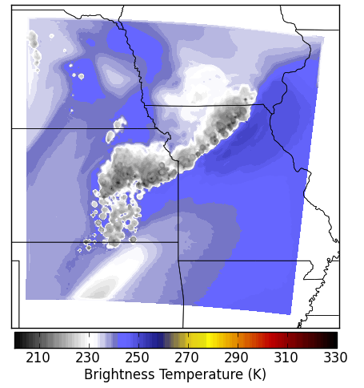
Assimilation of GOES-R ABI satellite and WSR-88D radar observations during a convection-resolving Observing System Simulation Experiment
R. Cintineo¹, J. Otkin¹, T. Jones², S. Koch³, L. Wicker³, and D. Stensrud⁴
¹UW-CIMSS, ²OU-CIMMS, ³NSSL, ⁴Penn State Univ.
19th Conference on Integrated Observing and Assimilation Systems for the Atmosphere, Oceans, and Land Surface (IOAS-AOLS)
Better results from radar reflectivity and radial velocity assimilation than GOES-R ABI assimilation in idealized experiments
  GOES-R ABI overproduces cloud cover, possibly due to problems with idealized truth simulation
Ongoing real data experiments producing better results than idealized experiments
  GOES-R ABI assimilation improves analysis over no assimilation
  Radar assimilation results still more accurate
Synthetic GOES-R ABI 6.19 μm observations from the truth simulation

Slide 33
Assessment of Vertical Resolution’s Effect in the Intercomparison of Temperature Profiles from Hyperspectral Infrared Sounders and GPS Radio Occultation
Michelle Feltz, Robert Knuteson, and Steve Ackerman
University of Wisconsin-Madison Cooperative Institute for Meteorological Satellite Studies
Raypath validation method published
  Sounder AVTP vs GPRO dry temp.
  Feltz et al. (2014) JGR
  Example shows four way coincident validation at Madison, WI between AIRS, CrIS, COSMIC, and radiosonde.
Sounder Inter-comparison
  AIRS/CrIMSS/IASI Soundings are inter-compared using COSMIC as a common reference.
  Published in Feltz et al. (2014) AMT
  Discovered bias errors in COSMIC data leading to UCAR reprocessing ( from COSMIC v2010 to v2013).

Slide 34
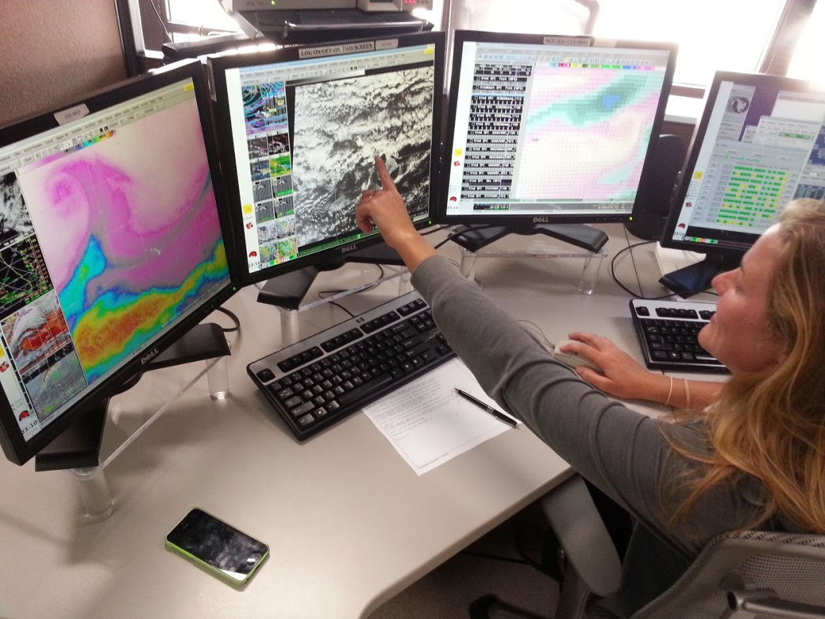
R2-Whoa
Challenges and solutions for executing best practices in transferring NOAA's research to NWS operations
Jordan J. Gerth, CIMSS/Univ. of Wisconsin, Madison, WI
Fifth Conference on Transition of Research to Operations
Oversight and Strategic Direction
  Appoint a coordinator of activities
  Joint governance
Operational Demonstrations
  Employ satellite liaisons to work with operations
  Hire technical liaisons to develop plug-ins for the Advanced Weather Interactive Processing System (AWIPS)
Research Proposals
  Hold technical interchange meetings with both operational and research participants
  Use proxy and simulated imagery from existing instruments and/or numerical models

Slide 35
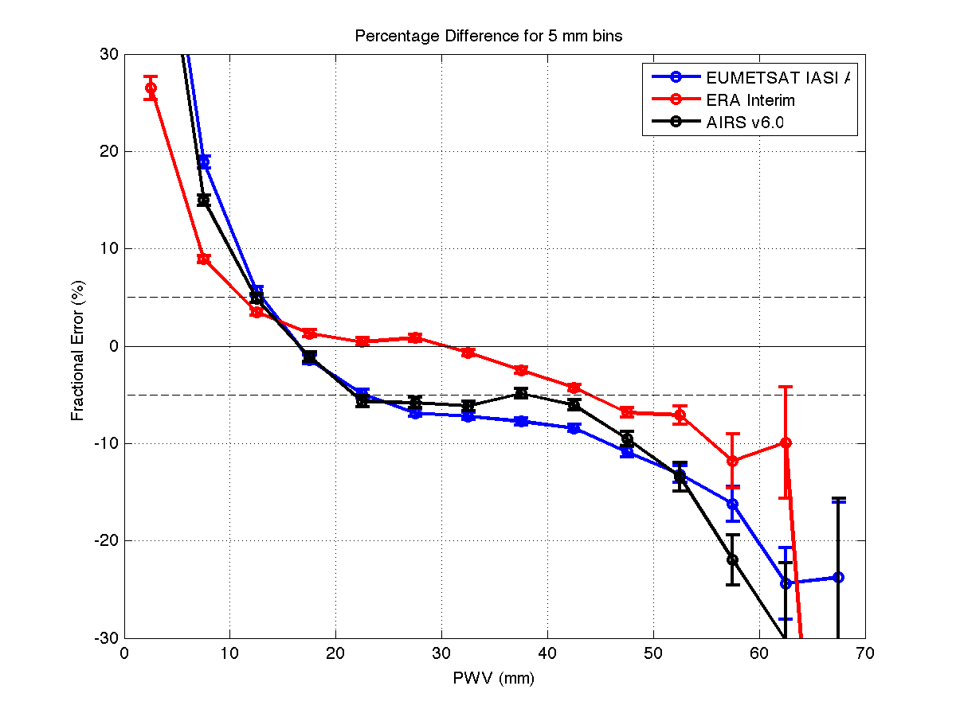
Validation of Level 2 Temperature and Water Vapor Profiles from JPSS and EUMETSAT Operational Polar Satellites using DOE ARM, SuomiNet, and COSMIC Datasets
Robert Knuteson, Michelle Feltz, Jacola Roman, Steve Ackerman, Hank Revercomb, Dave Tobin, Lori Borg, Dan DeSlover, Thomas August*, Tim Hultberg*, Tony Reale⁺
Cooperative Institute for Meteorological Satellite Studies (CIMSS), University of Wisconsin-Madison, * EUMETSAT, +NOAA
Sounder Water Vapor Validation
  ARM site and SuomiNet sites
  Period 2007 – 2014 (seven years)
  Product dry bias (-5 to -10 %)
  Products miss extreme wet events
Requirement for Climate
  Detection of Mean PWV trends within 15 years requires better than 3% accuracy as published in Roman et al. (2014), J.Climate.
  Detection of shift in extreme PWV events requires better than 3% accuracy. (Roman et al, J. Climate, submitted)
PWV Fractional Error (%)
GPS PWV (mm)

Slide 36

Wintertime Cloud Cover on Arctic Sea Ice Variability, Aaron Letterly, UW-Madison CIMSS
27th Conference on Climate Variability and Change
Winter cloud forcing varies inversely with summer ice concentration
  Marginal ice areas show high dependency on clouds to refreeze each year
Cloud forcing over Beaufort Sea serves as indicator for much of Arctic sea ice loss
  Beaufort Gyre advects ice anomalies from one region to another

Slide 37


A near real time regional satellite data assimilation system for high impact weather research and application
Jinlong Li@, Jun Li@, Pei Wang@, HyoJin Han@, Tim Schmit&, Mitch Goldberg#, and Steven Goodman*
@CIMSS, &SaTellite Applications and Research (STAR), #JPSS Program Office, *GOES-R Program Office
A near realtime satellite data assimilation for tropical cyclone (SDAT) system has been developed at CIMSS.
Researches have been conducted on GOES/GOES-R data impacts, handling clouds for advanced IR sounder radiance assimilation, assimilation strategies, etc.
The system has been running in near realtime since August 2013. The preliminary validations are encouraging.
Through joint effort among CIMSS, CIRA and NHC, the CIMSS SDAT products have been delivered since September 2014 in near real-time to the Automated Tropical Cyclone Forecast (ATCF) system that NHC are using now.
Example of simulated 72-hour forecast of GOES 6.5 µm BT image from SDAT webpage.
Hurricane Cristobal (2015) forecasts from SDAT system along with observed best track (red line) .

Slide 38



Assimilation of thermodynamic information in cloudy regions from advanced IR sounder for tropical cyclone forecasts
Jun Li@, Mitch Goldberg#, Pei Wang@, Hyo-Jin Han@, Tim Schmit&, Agnes Lim@, Zhenglong Li@, and Jinlong Li@
@CIMSS, &SaTellite Applications and Research (STAR), # JPSS Program Office
Combing imager/sounder could improve assimilation of thermodynamic information in cloudy region
  Imager/IR sounder cloud-clearing is a feasible alterative approach for assimilating thermodynamic information in partially cloudy skies
At least one H2O (6.7 um) and one CO2 (13.4 um) absorption bands for future VIIRS are needed in order to have high quality CrIS/VIIRS cloud-cleared radiances (CCR) for assimilation
The RMSE of the hurricane track from AIRS (MOD cld-clr) is the smallest among the three experiments for the whole process, especially after the 18-hour forecasts:
AIRS (GSI clr), AIRS radiances from GSI clear detection
AIRS (MOD clr), AIRS raddiances from MODIS clear detection
AIRS (MOD cld-clr), AIRS radiances from MODIS clear detection plus cloud-cleared radiances
The standard deviation (STD) of AIRS cloud-cleared radiances with MODIS 9 bands (red) , MODIS IR window bands only (blue in middle panel, VIIRS like), and MODIS IR window bands plus 1 CO2 and 1 H2O absorption bands (VIIRS like + 1 CO2 + 1 H2O) , compared with MODIS clear radiance observations at 9 spectral bands for Hurricane Sandy (2012) case..
STD (K)
STD (K)

Slide 39

Applications of future GEO advanced IR sounder for high impact weather forecasting – demonstration with regional OSSE
Zhenglong Li@, Jun Li@, Feng Zhu@*, Pei Wang@*, Agnes Lim@, Tim Schmit&, Robert Atlas#, Ross Hoffman#
@CIMSS/SSEC, University of Wisconsin-Madison, * AOS, University of Wisconsin-Madison, &Center for Satellite Applications and Research, NESDIS, NOAA, Madison, %AOML, OAR/NOAA
Synthetic observations from ECMWF T1279
Synthetic GEO AIRS observations simulated and validated from ECMWF T1279 NR and G5NR
  ECMWF T1279
    Large scale features are reasonably simulated, even for 108-h forecast
    Small scale features are less reasonable, especially small convective clouds over Amazon River.
    Ice clouds are too cold
  G5NR
    Impact from initialization is not evident after 1 month. May consider free atmosphere.
    Too many clouds, both high and low clouds; coverage too large
    Individual convective cells are not well characterized, shape looks artificial
    Cloud edges are too cold
Preliminary results show improved impact from GEO AIRS over LEO AIRS on Hurricane Sandy track forecasts
Positive impacts from
  Cycling
  Hyperspectral sounder over current GOES sounder
  Doubling observational error (retrieval)
GEO AIRS has more usable observations
Better coverage
Better refresh rate
UWRTM: SARTA + cloudy model
RAOB: vertical correlative errors considered
Assimilate sounding retrievals of T/Q

Slide 40






Impact Analysis of LEO Hyperspectral Sensor IFOV size on the next generation NWP model forecast performance
Agnes Lim¹, James Jung¹, Allen Huang¹, Zhenglong Li¹, Jack Woollen², Greg Quinn¹, Fred Nagle¹, Jason Otkin¹ and Mitch Goldberg³
1. Cooperative Institute for Meteorological Satellite Studies
2. IMSG/NOAA/NCEP/EMC
3. NOAA/JPSS Program Science Office Joint Polar Satellite System National Oceanic and Atmospheric Administration
To assess the impact obtained from assimilation of next generation CrIS observations with increased spatial resolution in a high resolution global mode.
G5NR, OSSE, GFS T1534
Conventional data – surface observations, rawinsondes, aircraft and GPSRO
Satellite radiances from current observing system
  Flying satellites in the simulated atmosphere
  Orbit simulator developed - Generate sensor geometry use in radiance simulation for any given set of start and end time. See Figure 1 for comparison between real and simulation.
OSSE Progress in Figure 2
NOAA-15 AMSU-A
NOAA-18 MHS
METOP-A IASI
S-NPP ATMS
S-NPP CrIS
AQUA AIRS
Figure 1 Comparison of Simulated satellite orbits (red) and real satellite orbits (blue) valid for the same start and end time
Figure 2 OSSE Progress

Slide 41


The use of Blogs, Twitter and YouTube for outreach at CIMSS
Scott S. Lindstrom and A. Scott Bachmeier
Blogging aligns with CIMSS’ goal of outreach/education
  Demonstrate the utility of satellite data in understanding the atmosphere
  Demonstrate the utility of CIMSS-produced Satellite products
Blogging and Tweeting are complementary
  Tweet about the presence of a new blog post
  Tweet if there’s not enough information for a full-blown blog post
This tweet takes you to the blog post above

Slide 42


Recalibrating HIRS Sensors to Produce 30 years of Radiance Measurements Useful for Cloud and Moisture Trend Analysis
W. P. Menzel, E. Borbas , R. Frey, C. Cao, R. Chen, N. Bearson, and B. Baum
Session 1B: Satellite Climate Data Records and Applications I
Recalibration
  Recalibration using IASI and SNOs offers new opportunity for climate worthy record
H2O Trends
  Separation into day before & after noon and night before & after midnight mitigates effects of orbit drift on trends
  Seasonal TPW cycle is strongest in northern mid-latitudes and weakest in tropics
  La Nina decrease in tropical TPW evident in all sensor trends
2008 La Nina
Blue - Tropics
Green – Northern Midlat
Red – Southern Midlat

Slide 43


GOES-R Education Proving Ground
Margaret Mooney, CIMSS/Univ. of Wisconsin, Madison, WI; and T. J. Schmit and S. Ackerman
GOES-R Education Proving Oral Presentation (M. Mooney)
  https://ams.confex.com/ams/95Annual/webprogram/Paper267662.htmlSub result 2
SOS video
  Debuted at AMS 2015
  Distributed to the entire SOS Network via CIMSS EarthNow Blog (OED grant) http://sphere.ssec.wisc.edu/goes-r/
New 90-second
GOES-R video
for Science On
a Sphere (SOS)
shown on NOAA
SOS at AMS 2015

Slide 44

Temporal changes in drought indices used to provide early warning of drought development over sub-seasonal time scales
Jason Otkin (UW/CIMSS), Martha Anderson, Chris Hain, and Mark Svoboda
USDM
Soil
Moisture
Crop
Condition
ESI-
RCI
> 1 CAT
4 weeks
> 2 CAT
8 weeks
Use GOES thermal infrared data and a land surface energy balance model to identify areas experiencing moisture stress conditions
Use changes in the Evaporative Stress Index (ESI) to compute a Rapid Change Index (RCI)
Compute probabilities of drought development over different time periods based on the RCI value
Large RCI and probabilities across South Dakota on June 3rd -- drought spread into that region during June
Elongated area of large drought probabilities on July 1st – drought intensified across the region during July
03 June
17 June
01 July
15 July
29 July
12 August
Notes:
We use GOES thermal infrared temperatures and the ALEXI land surface energy balance model to identify areas experiencing moisture stress conditions. We use ALEXI-derived estimates of evapotranspiration to compute the Evaporative Stress Index (ESI), which depicts standardized anomalies in the evaporative fraction. Because the ESI anomalies can change rapidly during extreme conditions, we next compute a Rapid Change Index (RCI) that depicts the accumulated magnitude of weekly changes in the ESI occurring over a longer time period. We then use a simple linear method to convert the RCI into drought intensification probabilistic forecasts. This is what is shown in the two columns on the right. They show the probability of a 1-category increase in the USDM drought severity over a 4-week period and 2-category increase over an 8 week period. This slide shows an example from 2003. In the top row, you can see that there is a large area of negative RCI values (4th column) and drought intensification probabilities across South Dakota. Indeed, drought conditions rapidly spread northward into this region during the next four weeks (circled area in the third row)

Slide 45

CSPP: Direct Broadcast Software for Operational Environmental Forecasters
Kathleen I. Strabala, CIMSS/SSEC/Univ. of Wisconsin, Madison, WI; and L. E. Gumley, H. L. Huang, D. Hoese, S. Mindock, G. Martin, R. Garcia, J. Gerth, E. Weisz, W. L. Smith Jr., N. Smith and Brad Pierce
AMS Session: Direct broadcast capabilities for polar-orbiting and geostationary satellites
CSPP Software Facilitating the Use of Polar Orbiter Satellites
  > 800 CSPP Registrants
  Users on all 7 Continents
Suomi-NPP DB data Supports Operational Forecasters
  US NWS Forecasters
  US Air Quality Forecasters
Put in graphics on this side of the slide
CLAVRx used at Taiwan Central Weather Bureau
CLAVRx used at Taiwan Central Weather Bureau

Slide 46


Routine Validation of the GOES-R Multi-Satellite Processing System Framework
William Straka III¹, S. Sampson³, R. Kuehn¹, G. Quinn¹, E. Schiffer¹, R. Garcia¹, G. Martin¹, R. Holz¹, T. Yu³, A. Li³, R. Rollins³, W. Wolf² and J. Daniels²
¹CIMSS/SSEC, University of Wisconsin-Madison, ²NOAA/NESDIS/STAR, Camp Springs, MD 20746 USA,
³IMSG, Kensington, MD 20895, USA
Product Visualization
  McIDAS-V can visualize output from the GOES-R GS as well as testing framwork
  McIDAS-V can be used to provide interactive comparisons between various products and satellites
Product Verification
  “Glance” tool can be used to compare output from various frameworks to verify proper integration
  “Glance” output provides a variety of statistics and visual comparisons
Real-time collocation and verification
  Web interface that provides quick looks and validation products
  Also provides as physically collocated quantitative performance information searchable by day or month averages.
Example Glance output
Links can be selected to provide a more detailed report of a given variable, along with the various statistics, such as how many missing pixels were in each file, the correlation between the two datasets, the mean/max/min difference, etc., as well as plots of the area of difference, a histogram of the distribution of the differences and plot of the differences

Slide 47

Advances and innovation in Aviation Forecasting: Using Next Generation
Satellite Data at the Air Traffic Control Systems Command Center
Amanda M. Terborg, CIMSS/Univ. of Wisconsin, Kansas City, MO; and M. T. Eckert and B. A. Smith
17th Conference on Aviation, Range, and Aerospace Meteorology
National Aviation Meteorologists were posted to the FAA Command Center
  Provide briefings directly to TFMs
  Real-time TFM met watch responsibilities
GOES-R products have been tested/utilized in their operations:
  Fog and Low Stratus
  NearCast model
  CI and CTC
  Simulated Imagery
  ACHA cloud heights

Slide 48

Suomi-NPP Cross-track Infrared Sounder (CrIS): Radiometric Calibration and Validation, David C. Tobin, H. Revercomb, R. Knuteson, J. Taylor, L. Borg, D. H. DeSlover, G. Martin, A. Merrelli, and T. Greenwald,
CIMSS/SSEC/UW-Madison
Joint session of the 11th Annual Symposium on New Generation Operational Environmental Satellite Systems and the 20th Conference on Satellite Meteorology and Oceanography
Radiometric Calibration Uncertainty (RU) of CrIS is very good.
  Overall, RU is <0.3K (LW), <0.15K (MW), <0.15K (SW)
  Better than spec by approximately a factor of 4.
Various post-launch validation analyses confirm these RU estimates
  Clear sky obs-calc
  Simultaneous Nadir Overpasses (SNOs)
  Internal consistency analyses
Example validation result: SNOs of AIRS, IASI and CrIS should small biases and excellent stability

Slide 49


Nighttime Cloud Microphysical Products with the VIIRS DNB
Andi Walther (CIMSS), Steven Miller (CIRA), Andrew Heidinger (NOAA)
HIGHLIGHTS
Development of a lunar down-welling irradiance predictor which enables us to compute DNB lunar reflectance.
Development of a new nighttime cloud property retrieval NLCOMP
NLCOMP closes nighttime observation gap of cloud optical thickness (COD) and effective radius (REF)
NLCOMP is part of CLAVR-x processing scheme.
Can be used for derived nighttime products, such as precipitation or icing threat
Left: Global composite of lunar DNB reflectance
Close the nighttime gap: Left and right image show COD of daytime retrieval. Small inset the state-of-the-art nighttime IR result: no information of thick clouds due to saturation. Middle image shows NLCOMP COD at night.

Slide 50



Improving assimilation of advanced IR sounder radiances in NWP with cloud detection from collocated imager cloud mask
Pei Wang@#, Jun Li@, Jinlong Li@, Zhenglong Li@, Tim Schmit&, Hyo-Jin Han@,
@CIMSS, &SaTellite Applications and Research (STAR), # AOS, UW-Madison
AIRS stand-alone
MODIS cloud detection
AIRS 11.3μm BT[K]
AIRS sub-pixel cloud detection with MODIS
Hurricane Sandy (2012) forecast RMSE
AIRS stand-alone cloud detection and AIRS sub-pixel cloud detection with MODIS high spatial resolution cloud mask product are compared
  There are some mismatched areas that the stand-alone cloud detection failed to reject and assimilated as clear radiances.
  The stand-alone cloud detection allows more cloud contaminated radiances into GSI, causing a cold bias in temperature field and a wet bias in moisture field.
The 72 h forecasts of Hurricane Sandy (2012) indicate that both hurricane track and intensity forecasts are improved when the collocated high spatial resolution MODIS cloud mask product is used for the AIRS sub-pixel cloud detection.

Slide 51


Historical GOES AMV Reprocessing
Steve Wanzong¹, David Santek¹, Christopher Velden¹, Jaime Daniels², Dave Stettner¹, Wayne Bresky³, and Andrew Bailey³
¹ University of Wisconsin – Madison/SSEC/CIMSS
² NOAA/NESIS/STAR
³ IMSG
11th Annual Symposium on New Generation Operational Environmental Satellite Systems
GOES-East/West AMV Reprocessing
  Hourly AMVs from 1995 – mid 2013 using current operational NESDIS AMV algorithm
  AMVs will be used in planned reanalysis efforts by ECMWF, JMA, NASA-GMAO
  ~ 540,000 AMV datasets generated and available now
GOES East
07 May 2005
1500 UTC
GOES West
07 May 2005
1500 UTC

Slide 52
CIRA
Chirokova, Galina
DeMaria, Robert
Longmore, Scott
Rogers, Matt
Schumacher, Andrea (2)
Szoke, Ed
Zhu, Tong

Slide 53



Use of JPSS ATMS-MIRS Retrievals to Improve
Tropical Cyclone Intensity Forecasting
Galina Chirokova¹, Mark DeMaria², Robert DeMaria¹, Jack Dostalek¹, and Jack Beven²
¹CIRA/CSU, Fort Collins, CO ²NOAA/NWS/NCEP/National Hurricane Center, Miami, FL
20th Conference on Satellite Meteorology and Oceanography
ATMS: more realistic TC structure than AMSU
ATMS, GFS and dropsonde data are being combined to obtain best T, q sounding and Maximum Potential Intensity (MPI) estimates
Real-time ATMS MPI and ATMS-dropsondes sounding comparison are available at RAMMB-CIRA TC Real Time page http://rammb.cira.colostate.edu/products/tc_realtime/
Use of ATMS MPI in statistical models:
  LGEM and SHIPS intensity forecast: AL – worse; WP, EP – better in some cases
  Rapid Intensification (RI) forecast is slightly improved for AL, EP, and WP
ATMS, Td
Dropsonde, Td
ATMS, T
Dropsonde, T

Slide 54


Machine Learning Algorithms for Tropical Cyclone Center Fixing and Eye Detection,
Robert DeMaria¹, Galina Chirokova¹, John Knaff², and John Dostalek¹
(1) CIRA, Colorado State University, Fort Collins, CO
(2) NOAA/NESDIS/StAR, Fort Collins, CO
20th Conference on Satellite Meteorology and Oceanography
Developed system using Principle Component Analysis(PCA) with Quadratic Discriminant Analysis(QDA) that can detect if an eye is present in IR imagery of tropical cyclones.
  Average probability of detection: ~78%
  Further analysis/adding additional data sources may improve accuracy
Developed system using QDA that can locate a tropical cyclone center in real-time from MIRS microwave retrievals.
  11% improvement over baseline of extrapolating from real-time positions
  May be combined with system described above.
Eigenvector of storm data produced by eye detection system.
Probability field of possible storm center locations produced by center-fixing system.

Slide 55



"An Automated Mobile Phone Photo Relay and Display Concept Applicable to Operational Severe Weather Monitoring”
Scott Longmore¹, Steve Miller¹, Dan Bikos¹, Dan Lindsey²,Ed Szoke¹, Debra Molenar², Don Hillger², Renate Brummer¹, John Knaff²
31st Conference on Environmental Information Processing Technologies Session: Crowdsourcing Data and Data Portals - Part I
Thursday, January 8, 2015: 08:30 AM - 09:45 AM, Phoenix CC, 132AB
Photo Report (PR) social media interactions with NWS forecasters
  Liked geo-located PRs
  Social media has limitations
Direct PR system concept
  Mobile phone application
  Processing/distribution servers
  Advanced Weather Interactive Processing System (AWIPS II)
  ingest and display
Mobile phone application
Processing/distribution servers
Advanced Weather Interactive Processing System (AWIPS II)
ingest and display
¹Cooperative Institute for Research in the Atmosphere, Colorado State University, Fort Collins, Colorado
²NOAA/NESDIS, Regional and Mesoscale Meteorology Branch, Fort Collins, Colorado

Slide 56



Improvements in Satellite-Derived Short Term Insolation Forecasting: Statistical Comparisons, Challenges for Advection-Based Forecasts, and New Techniques
Matt Rogers¹, Steve Miller¹, John Haynes¹, Andrew Heidinger², Sue Haupt³, Manajit Sengupta⁴
Sixth Annual Conference on Weather, Climate, and the New Energy Economy
NOAA Retrieval algorithm (PATMOS-x) used for development of satellite-derived advection technique to forecast surface GHI
Results show mean-absolute error (MAE) normalized to clear-sky of approximately 10-20%, validation against SURFRAD sites
Novel algorithm accounts for parallax errors and cloud height/shadow computation
Partnering with HRRR and WRF-Solar projects for intercomparison
  Satellite-derived forecasts may fill the initialization gap from 0-3 hours past initialization time
  Assimilation of satellite-derived products into WRF-Solar for forecast purposes
¹CIRA/CSU, ²CIMSS/UWisc, ³NCAR, ⁴NREL

Slide 57

Using Total Lightning Data to Improve Real-Time Tropical Cyclone Intensity and Genesis Forecasts
Andrea Schumacher and Robert DeMaria, CIRA/Colorado State Univ., Fort Collins, CO
Mark DeMaria, NOAA/NWS/NHC, Miami, FL
Lightning data has potential to improve tropical cyclone (TC) rapid intensification (RI) forecasts
  e.g., DeMaria et al. 2012
  Used WWLLN lightning data, mostly cloud-to-ground
In preparation for GOES-R Geostationary Lighting Mapper (GLM), this study examines role of total lightning and RI and TC genesis
Goal: update statistical TC algorithms to use total lightning data
  Rapid Intensification Index
  TC Formation Probability Product
Normalized coefficients for Atlantic experimental RII

Slide 58
Evaluating Subjective Uncertainty Information in National Hurricane Center Tropical Cyclone Discussions
Andrea Schumacher, Olivia Vila and Vanessa Vincente
CIRA/Colorado State Univ., Fort Collins, CO
Motivation
  Research shows that public wants forecast uncertainty information, makes better decisions with it
  Situational forecast uncertainty available in NHC TC Discussions, but not standardized nor verified
Conducted quantitative content analysis NHC TCDs to examine
  How often is uncertainty mentioned in TCDs? How is it expressed?
  Does uncertainty messaging change for different types of forecasts?
  How does expressed uncertainty/confidence relate to actual forecast errors?
  What types of evidence are cited (e.g., model spread, synoptic conditions) and how often?
Preliminary Results
  Uncertainty mentions >> confidence mentions
  Direct statements of uncertainty/confidence are most common for intensity and initial conditions
  Indirect statements of uncertainty/confidence are most common for track

Slide 59

CIRA Proving Ground Activities in Preparation for the GOES-R Era
Ed Szoke^{1,2}, Dan Bikos¹, Renate Brummer¹, Steve Miller¹, Deb Molenar³, Bernie Connell¹ and Mark DeMaria³
¹Cooperative Institute for Research in the Atmosphere (CIRA)
²NOAA/Earth System Research Laboratory (ESRL)/Global Systems Division (GSD)
³NOAA/National Environmental Satellite, Data, and Information Services, Center for Satellite Applications and Research (NESDIS/STAR)
GOES-R and JPSS products
  Variety of products developed
  Demonstrated to WFOs/Centers
Feedback
  Feedback has been useful
  Many forecasters are now more familiar with potential new products

Slide 60

Development and Impact Study of Community Satellite Data Thinning and Representation Optimization Tool
Tong Zhu (CIRA/CSU@NOAA/NESDIS/JCSDA) and Sid Boukabara (NOAA/NESDIS/JCSDA)
Development of CSTROT
    Developed a new satellite data thinning tool, CSTROT, with three basic thinning methods (thinning by STD, averaging and skipping), and each one can be combined with target and/or domain regions selections..
    The thinning function based on the union of selections by different channels to represent atmospheric variations at different levels.
    Analyzed satellite brightness temperatures STD, and created STD thresholds for 29 GSI currently assimilated sensors in the thinning_std.txt configuration file.
    Implement CSTROT scheme in GSI system, and performed comparison study. Compared with current GSI 145-km thinning mesh, the new CSTROT thinning can provide more data and more increment of GSI analysis in weather active regions and selected areas..
Figure. The observation points selected by CSTROT thinning scheme based on the union of AMSU-A N18 channel 2, 4 and 10 selections. Black points are the same observation points selected by all three channels. Blue, green and red points are the additional observations selected by Ch-2, 4 and 10, respectively

Slide 61
CREST
Aizenman, Hannah
Bishir, Raymond
Carroll, Brian
Daham, Farrah
Glenn, Equisha
Hosannah, Nathan
Hsu, Freddy
Karimi, Maryam
Kraatz, S.
Ramirez-Beltran, Nazario
St. Pé, Alexandra
Sullivan, J. T.
Vant-Hull, Brian
Wesloh, Daniel

Slide 62


Toolbox for Evaluating Ensembles Using an Information Gain Measure
Hannah Aizenman, Michael Grossberg, Irina Gladkova, Nir Krakauer, CREST/City College of New York
Fifth Symposium on Advances in Modeling and Analysis Using Python
Climatology variation is a good proxy for model uncertainty
Combining forecasts and climatology in predictive model improves skill
Further improve skill on land by incorporating trends:
  Add new observation to training set (online)
  computing climatology using exponential moving average
4-8 January 2015
95th AMS Annual Meeting - Phoenix, AZ
62

Slide 63




















Concurrent Multi-Instrumental Observations Of The Atmospheric Boundary Layer
ABSTRACT
Raymond Bishir¹, Ivan Valerio¹, Dr. Mark Arend², Stephen Neufeld¹, David Melecio-Vazquez¹
¹The City College of New York, ²NOAA CREST / Optical Remote Sensing Lab
A mobile Coherent Doppler LIDAR (CDL) system has been developed to measure the vertical wind speed and backscatter signal intensity at distinct heights. The CDL detects line-of-sight field measurements of backscattered atmospheric signals enabling wind to be characterized in time and space, thus providing a representation of the turbulent atmospheric conditions. This lidar technology was utilized to observe meteorological events simultaneously with a separate 1μm Direct Detection LIDAR (DDL) and Microwave Radiometer (MWR). By coordinating multi-instrumental observations of a common weather event, the retrieved profiles of vertical wind speeds, cloud cover heights, relative humidity, and atmospheric temperature can be combined to provide synergistic knowledge about the dynamic temporal evolutions of the Atmospheric Boundary Layer (ABL). It is shown that the measurements for a vertical profile from 100m to 2500m on October 31st, 2014, as observed by the CDL, agrees with the phenomena observed by the MWR and DDL, while also providing additional information undetected by the latter two instruments.
RESULTS AND CONCLUSIONS
What are Aerosols?
Aerosols are fine airborne (liquid or solid) particles present in the atmosphere. These particles are detected by the CDL through line-of-sight measurements of backscattered laser light.
The testing of our system occurred between the hours of 11 AM and 3:30 PM, on October 31st, 2014.
A consistent picture of the momentum and thermal temporal structure is detected with the mutli-instrument system in place. Starting the MWR, the conditions necessary for cloud formation and growth are present in the region near 1500m.
Relative humidity values remain nearly saturated for the entire time period in question. At the same height, the calculated virtual potential temperature lapse rate (∂θυ/∂z) shows that the near-neutral conditions, indicative of mixing, keep the thermal conditions as uniform as possible.
Looking at the results from the DDL, a high aerosol concentration at a height of ~1500m is seen in all three wavelengths. The presence of these aerosols is key to the formation of clouds. The information about the size of the aerosols at the 1500m level is also given by the DDL.
The rising and sinking motions of these aerosols are then observed with the CDL. Below the 1500m level there is significant rising motion (high values for vertical wind speed is proportional to the low intensity of the backscatter). Once at the 1500m level, high aerosol concentrations are allowed to form due to the low values of the vertical wind speeds.
Backscatter is an ‘echo’ made up of reflected of light waves traveling back to their origin.
Sources for Aerosols
SYSTEM CONFIGURATION AND METHOD
FIGURES AND GRAPHS
Microwave Radiometer (MWR)
This remote sensing device measures the vertical profiles of temperature and relative humidity.
Passive technology
Scans using RF radiation frequencies between 51 GHz and 59 GHz for temperature profiling and 22 GHz and 30 GHz for water vapor profiling.
Data is measured near-continuous coverage from the surface to 9800m.
Vertical resolution of ~100m
Direct Detection Lidar
Microwave Radiometer
CDL Schematic
CDL Mobile Unit
Coherent Doppler Lidar (CDL)
The CDL utilizes a 1545.2 nm laser to detect line-of-sight backscattered atmospheric signals
Active remote sensing device
This lidar detection device operates from a mobile lab
Measures vertical wind speed and aerosol concentrations
Coherent Doppler Lidar
MWR
CDL
Atmospheric Boundary Layer
The ABL is the lowest portion of the atmosphere (≈ 1 to 3 km deep) directly in contact with the Earth’s surface
It is the layer of atmosphere in which we live and is characterized by its responses to diurnal heat fluxes and turbulence production generated by wind shear.
Microwave Radiometer
Further develop the CDL system to allow detection of horizontal wind velocity. This can be done through the addition of a rotating top to allow the beam to travel at angles other than the zenith
Conduct additional multi-instrument campaigns to obtain a more complete view of ABL dynamics
Investigate the potential for developing a framework for coordinated multi-instrument campaigns
The Atmospheric Boundary Layer
FUTURE WORK
Direct Detection Lidar (DDL)
The DDL detects intensity of backscattered atmospheric signals @ 355nm, 532nm, and 1064nm wavelengths
Active remote sensing technology
Measures Aerosol Concentration, Cloud Top Heights
Limited availability of data
Pulse duration of 6 ns, with a repetition rate of 50 Hz
ACKNOWLEDGEMENTS
1-This project was made possible by the Research Experiences for Undergraduates in Satellite and Ground-Based Remote Sensing at CREST_2 program funded by the National Science Foundation under grant AGS-1062934. Its contents are solely the responsibility of the award recipient and do not necessarily represent the official views of the National Science Foundation.
2-This research is supported by the National Science Foundation's Research Experiences for Undergraduates (NSF REU) Grant No. AGS-1062934 under the leadership of Dr. Reginald Blake, Dr. Janet Liou-Mark, Mr. Chinedu Chukuigwe.
3- The National Oceanic and Atmospheric Administration – Cooperative Remote Sensing Science and Technology Center (NOAA-CREST) for supporting this project. NOAA CREST - Cooperative Agreement No: NA11SEC4810004.
4- The Consortium for Climate Risk in the Urban Northeast (CCRUN), Research Experience for Undergraduates (REU).
5- My irreplaceable mentors for their infinite patience and bottom-less wisdom for the duration of my research under their indelible guidance.
REFERENCES
Dr. David Santoro, “Development of an Eye Safe Coherent Doppler Wind Lidar System” PhD Thesis 2012, City College of New York
Sameh Abdelazim, “Analysis and Implementation of Signal Processing Strategies for a 3-D Doppler Lidar Wind Profiler”, PhD Thesis 2012, City College of New York
DDL
City College NYC Met Net

Slide 64


Dual Doppler Lidar Wind Profiling in the Lidar Uncertainty Measurement Experiment (LUMEX)
Brian Carroll¹, Aditya Choukulkar², Ruben Delgado³, Graham Antoszewski¹, Scott Sandberg⁴, Mike Hardesty²,
Alan Brewer⁴, Julie Lundquist⁵, Andreas Muschinski⁶
¹Atmospheric Physics Dept., UMBC; ²Cooperative Institute for Environmental Sciences, Boulder; ³Joint Center for Earth Systems Technology, UMBC; ⁴ Chemical Sciences Division, NOAA, Boulder; ⁵University of Colorado Boulder; ⁶ NorthWest Research Associates, Inc.
7th Symposium on Lidar Atmospheric Applications
Validation of Dual Doppler Lidar
  Enhance the ease and accuracy of future wind measurement experiments
Characterization of Dual Doppler Scan Parameters
  Intersection angle, dwell time
  Preferred weather conditions
tower
45º
70º
profiler
Lidar 1
Lidar 2

Slide 65


Determination of the Temporal and Spatial Variability of the Planetary Boundary Layer Height in Maryland from 915-MHz Radar Wind Profiler Measurements
Farrah Daham¹, Scott Rabenhorst², Belay Demoz^{1,2}, Ruben Delgado²
¹UMBC, ²JCET
2015 AMS Student Conference
2013 wind profiler data from Beltsville, Horn Point, and Piney Run used to investigate seasonal diurnal height variation of PBL
  Day PBLH were on average higher in the summer than winter due to instability in the atmosphere
  Summer PBLH were on average 0.144, 0.076, and 0.211 km higher than winter PBLH, respectively
Temporal and spatial variability shown between comparison sites
  Highest correlation in PBLH, R² = 0.984, shown between Beltsville and Horn Point, shortest distance of 55 miles
Figure 1. PBLH plotted for summer case study day, Sept 15, in Piney Run
Figure 2. Average 2013 daytime cycle of PBLH for comparison sites with error bars

Slide 66


Climate Change Detection in the Intra-Americas Region and Local Implications to Sensitive Eco-systems
Equisha Glenn Jorge E. Gonzalez, PhD Daniel Comarazamy, PhD
ESES Graduate Initiative Mechanical Engineering Dept., CCNY NOAA/CREST/NESDIS
NOAA-CREST NOAA-CREST STAR/SOCD
What: A 30-year analysis of high resolution SST data revealed warming trends for the Intra-Americas Region (IAR) during the 1982 – 2012 period.
  SST-Product: NOAA/Optimum interpolated sea surface temperature (OISST) with spatial resolution of 0.25 degrees.
  Observed for annual, monthly, and rainy seasons – with high statistical significance (Top-Left).
Local Implications: Water bodies in Hispaniola show a shrinking and expanding pattern since the early 1980s attributed to SST increases (Bottom-Left).
  As of 2013, Lake Enriquillo (DR) is double its minimum size observed in 2004. Lake Azuéi (Haiti) is observed to grow at similar rates.

Slide 67



Poster-809/Effects of Aerosol PSD Data Assimilation on Precipitation Prediction in Western Puerto Rico using a Cloud-Resolving Atmospheric Model
Nathan Hosannah, H. Parsiani, J. E. González, D. Comarazamy, and R. A. Armstrong
Why Puerto Rico- The distribution of aerosols in the Caribbean atmosphere has been documented to influence precipitation totals (Comarazamy et al.), and spatial precipitation distribution (Fig. below).
Modeling (RAMS). We selected a localized precipitation event (16 June 2013 to simulate 3 different PSD ingestion techniques: Run S-Simplified Unimodal PSD with only CCN. Run I-Bimodal with both CCN and GCCN. Run C-Bimodal vertically varying PSD updated in time.
Results: Radar vs RAMS results indicate that Run C captures the most intense precipitation (near Rincon) more accurately than Runs S and I. Errors in the 3 cases are 68, 57, and 43% respectively. Vertical (shaded) and U x W (barbs) along the 18.25N latitude for Run S, I, and C (Bottom Fig.), showing that 4D ingestion motivates convection, and a main cause for improved prediction.

Slide 68
Investigating the Los Angeles Urban Heat Island Using Satellites and Ground Data
Freddy Hsu¹, Tania Torres¹, Pantiwa Jarujareet¹,Steve LaDochy¹, Pedro Ramirez¹, Hengchun Ye¹, Pedro Sequera² , William Patzert³
¹Department of Geosciences & Environment, California State University, Los Angeles, California
²Department of Mechanical Engineering, The City College of New York, CUNY, New York, New York
³Jet Propulsion Laboratory, NASA, Pasadena CA
Major result 1
Downtown Los Angeles’ annual average temperature as well as Los Angeles county population trends are gradually increasing.
Major result 2
Summer and winter 2012-2013 maps reveal that the UHI shifts from near the coast at night/early morning to the inland valleys during the afternoons.
Major result 3
The diurnal patterns for summer and winter are quite complex, the UHI appears closer to the downtown area in winter throughout the day, while closer to downtown at night and shifting to the inland valleys during the day.
Major result 4
Limitations of data availability and models creates inaccuracies in the maps with unrealistic values at the extremes.
  Sub result 1
LA UHI is too complex to be clearly described with 1 year of data.
2012-2013 Summer and Winter Heat Island Maps
2am
8am
2pm
8pm

Slide 69

Impact of Environmental Factors in Variation of Temperature in Respect to Urban Heat Island, Manhattan, New York, Weather and Corresponding Surface Temperature
Maryam Karimi, Dr. Brian Vant-Hull, Dr. Rouzbeh Nazari, Dr. Reza Khanbilvardi , and Awalou Sossa
The Graduate Center, CUNY, NOAA Crest Institute, The City College of New York, and Rowan University
Field campaigns in Manhattan were used to measure spatial temperature variations within an urban setting.
Amplitude of spatial variation in temperature for each day can be predicted by regression of weather variables.
Amplitude of spatial variation in temperature is most dependent on Eastward winds and temperature.

Slide 70
Observing river ice through thin clouds (Susquehanna, MODIS-AQUA)
S. Kraatz, R. Khanbilvardi and N. Devineni
NOAA-CREST at the City College of New York (CCNY)
29th Conference on Hydrology: Hydrometeorological Extremes
Reduced revisit time (right)
  Cloud masks should not be used: strong bias towards ID as cloud during ice bearing time
  Use other bands (here, 7)
High correlation with temperature (AFDD)
  Captures midwinter thaws
  Spatial distribution/reflectance changes consistent with ground reports
Days since 11/1/13 | Cld. Mask | Algorithm
1-45 (no ice) | 9.5 (4.7,26) | 7.8 (5.8,9)
46-130 (ice) | 5.3 (16,35) | 22.9 (3.7,23)
131-171 (no ice) | 11.6 (3.5,23) | 10.6 (3.9,11)
1.0 unit = data for 1 entire river (eff. revisit [days], #days sth. retrieved)

Slide 71


An Empirical Model of High Spatial and Temporal Resolution for Radar Rainfall Nowcasting
Nazario D. Ramirez-Beltran, Luz Torres Molina, Joan M. Castro, Sandra Cruz-Pol, José G. Colom-Ustáriz and Nathan Hosannah
University of Puerto Rico, P.O. Box 9030, Mayagüez, PR 00681, U.S.A, nazario.ramirez@upr.edu
The 29th Conference on Hydrology
A short term rainfall prediction algorithm for a convective storm is introduced in this work. The algorithm uses high spatial and temporal resolution (0.06 km and 1 min) of TropiNet radar data to predict the evolving distribution of rainfall rate over western part of Puerto Rico:
  It is expected that in a short time period (~10 min) a rain cloud behaves approximately as a rigid object and the cloud rain pixels moves in a constant speed and direction. Thus, the most likely future rainfall areas can be estimated by using the advection of centroids of rain cells in consecutive images.
  The postulated rainfall nowcasting algorithm involves two major tasks: a) predicting the future location of the rain pixels, and b) predicting rainfall rate at each pixel.
The rainfall process exhibits significant changes in time and space, and it can be characterized as a non-stationary stochastic process..
  To face the non-stationary characteristic of the process, parameters are estimated at each time and spatial domain
  The stochastic characteristics of the process are represented by a nonlinear time and spatial lag model, which is an approximation to a stochastic transfer function model
The left panel shows the rainfall forecast with 10 min as a lead time and the right panel shows observations from TropiNet radar
Left panel shows the average rainfall for all rain pixels during each time interval (10 minutes). The right panel shows the accumulated precipitation for all rain pixels during 7 hours of a rainfall event that occurred on western part of Puerto Rico on March 28, 2012. The blue line represents the TropiNet data and the green line represents the forecasts at 10 minutes lead time.

Slide 72

Using Doppler Wind Lidar to Assess Meteorological Controls on Offshore Wind Power Generation
Alexandra St. Pé, Farrah Daham, Daniel Wesloh, Graham Antoszewski, Navid Goudarzi, Scott Rabenhorst, Ruben Delgado
[1]University of Maryland, Baltimore County [2] University of Maryland, College Park [3] Join Center of Earth Systems Technology
Applications of Lidar in the Energy Sector-II
Evidence suggests a microscale meteorology event lead to a localized area of increased stability & low-level wind max within turbine’s rotor layer in the MD offshore wind energy area
  More data-mining and WRF modeling needed to test hypotheses of possible drivers
Relationship between offshore stability and wind shear depends on section of rotor layer analyzed
  Given sharp nose of low-level wind max (near 100m), wind shear binned 40m-160m underestimates shear
46% greater normalized power occurs post initial increase in offshore stability
  Expected given increased wind speed throughout rotor layer

Slide 73

Tropospheric Ozone Enhancement in the Front Range Using the
GSFC TROPOZ DIAL During DISCOVER AQ 2014
J. T. Sullivan (jsull1@umbc.edu)^{1,3}, T. J. McGee ², R. M. Hoff ^{1,3}, L. Twigg⁴, and G. Sumnicht⁴
1. Department of Atmospheric Physics, University of Maryland Baltimore County (UMBC), Baltimore, MD.
2. Code 614.0, NASA GSFC, MD. 3. Joint Center for Earth Systems Technology (JCET), MD 4. Science Systems and Applications Inc, MD
Seventh Symposium on Lidar Atmospheric Applications
A Stratospheric-Tropospheric Exchange Event (STE) was characterized with the GSFC TROPOZ DIAL (top panel)
  The stratospheric air mass entered the troposphere near California’s Pacific Coast
  It was then advected to the Rocky Mountain region (bottom left)
A relationship was determined in order to quantify STE residence times and occurrence
  This implies that most STE events are rather shallow, with most of the stratospheric air dissipating in the upper troposphere over the period of the first 24 hours.

Slide 74


A Simple Statistical Model to Predict
Urban Temperature Anomalies
Brian Vant-Hull, Maryam Karimi, Awalou Sossa,
Rouzbey Nazari, Estatio Guiterrez, Reza Khanbilvardi
AMS Annual Meeting, 2015: Conference on Environment and Health
Surface temperature anomalies are modeled by multivariable linear regression against surface variables such as elevation, vegetation, building geometry;
The magnitude of the anomalies are modeled by linear regression against weather variables.
Left: measured
Right: modeled

Slide 75



Comparison of RAP Forecast Wind Data with Lidar Measurements in the
Maryland Wind Energy Area
Daniel Wesloh¹, Scott Rabenhorst¹, Ruben Delgado²
¹ Department of Physics, University of Maryland Baltimore County, 1000 Hilltop Circle, Baltimore, MD 21250
² Joint Center for Earth Systems Technology, University of Maryland Baltimore County, 1000 Hilltop Circle, Baltimore, MD 21250
2015 AMS Student Conference
Model Forecast winds were consistently slower than Lidar-observed winds
  Analysis state by 1.5 m/s, on average
  3-hour forecast by 0.8 m/s, on average
High variability in relationship between forecast and observed winds
  Standard deviation of differences between forecast and observed wind speeds of 2 m/s for the analysis state and 3 m/s for the 3-hour forecast state
  Both values increase with height
Figure : Clockwise from top right, wind roses for the RAP f00 analysis, the RAP 3-hour forecast, and the lidar observations. Wind data at all heights is combined in these plots.

