Slide 1
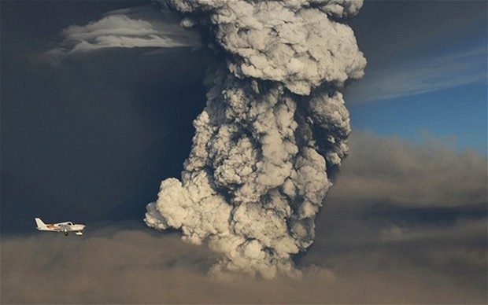
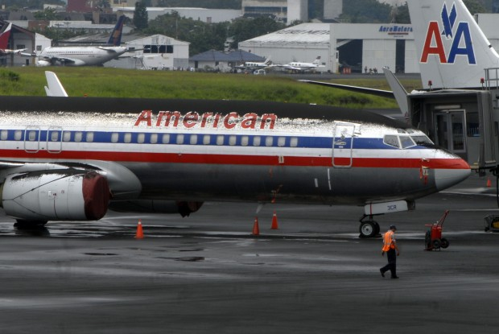
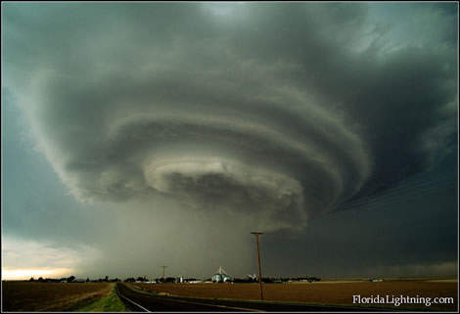
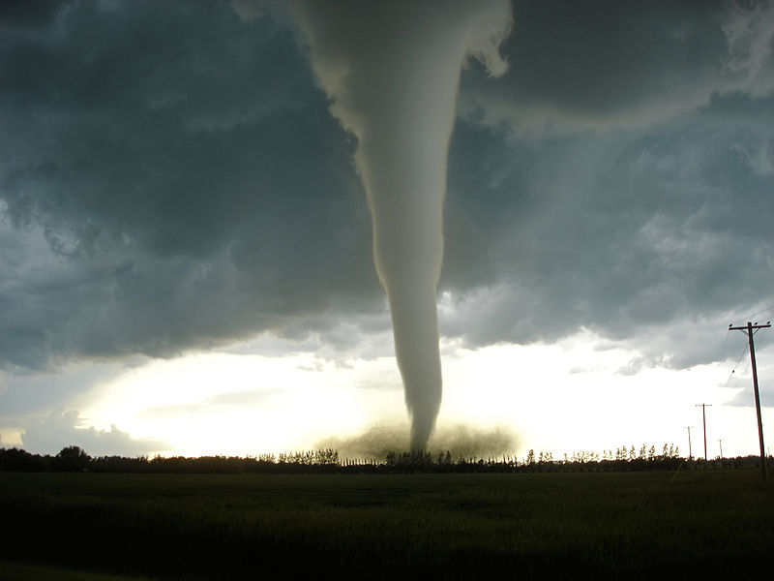


From “Big Data” to Actionable Information: Mitigation of Volcanic and Severe Weather Hazards
Reuters
Michael J. Pavolonis
Physical Scientist
National Environmental Satellite, Data, and Information Service
Center for Satellite Applications and Research
NOAA Central Library Brown Bag Seminar
Silver Spring, MD, 12 March 2015

Slide 2

Collaborative Research
Dan Lindsey (NOAA/NESDIS/STAR)
John Cintineo (UW-CIMSS)
Justin Sieglaff (UW-CIMSS)
Jordan Gerth (UW-CIMSS)
Lee Cronce (UW-CIMSS)
Eric Lokken (UW-AOS)

Slide 3
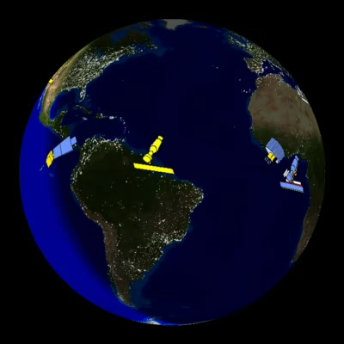
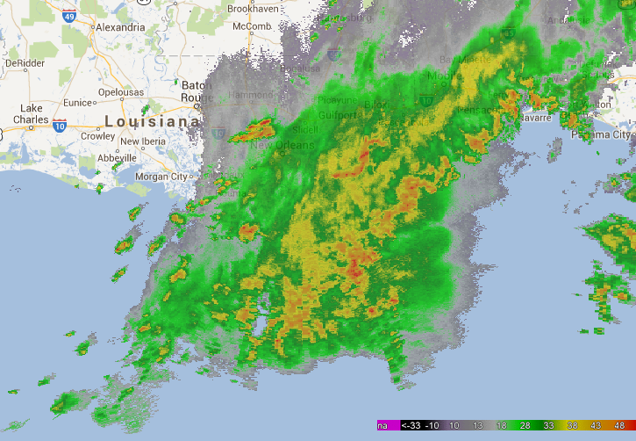
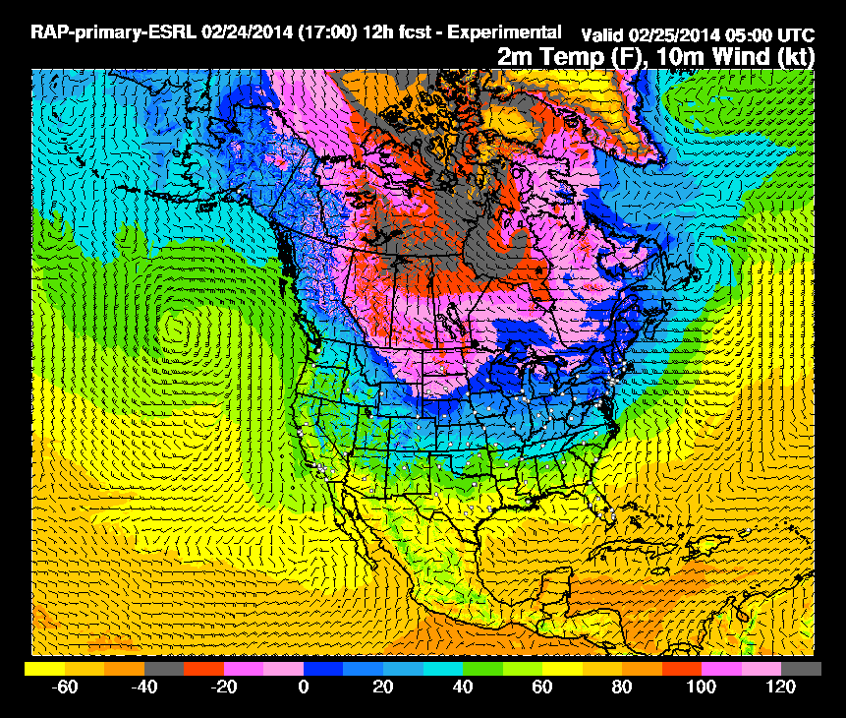
Collecting large volumes of data alone does not directly address any natural hazard problem, the data must be converted into actionable information using science and computers.
Satellite
Radar
High-res Numerical Models

Slide 4
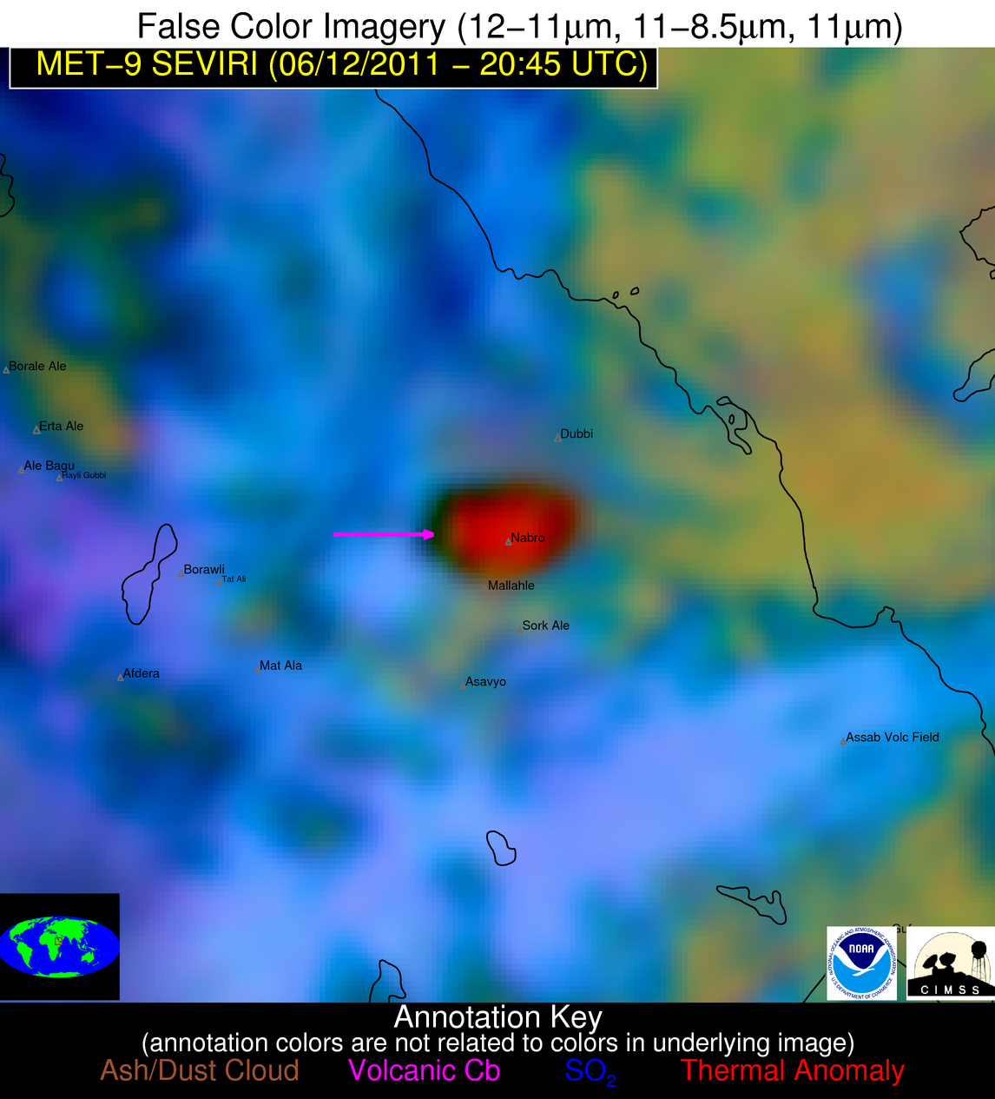

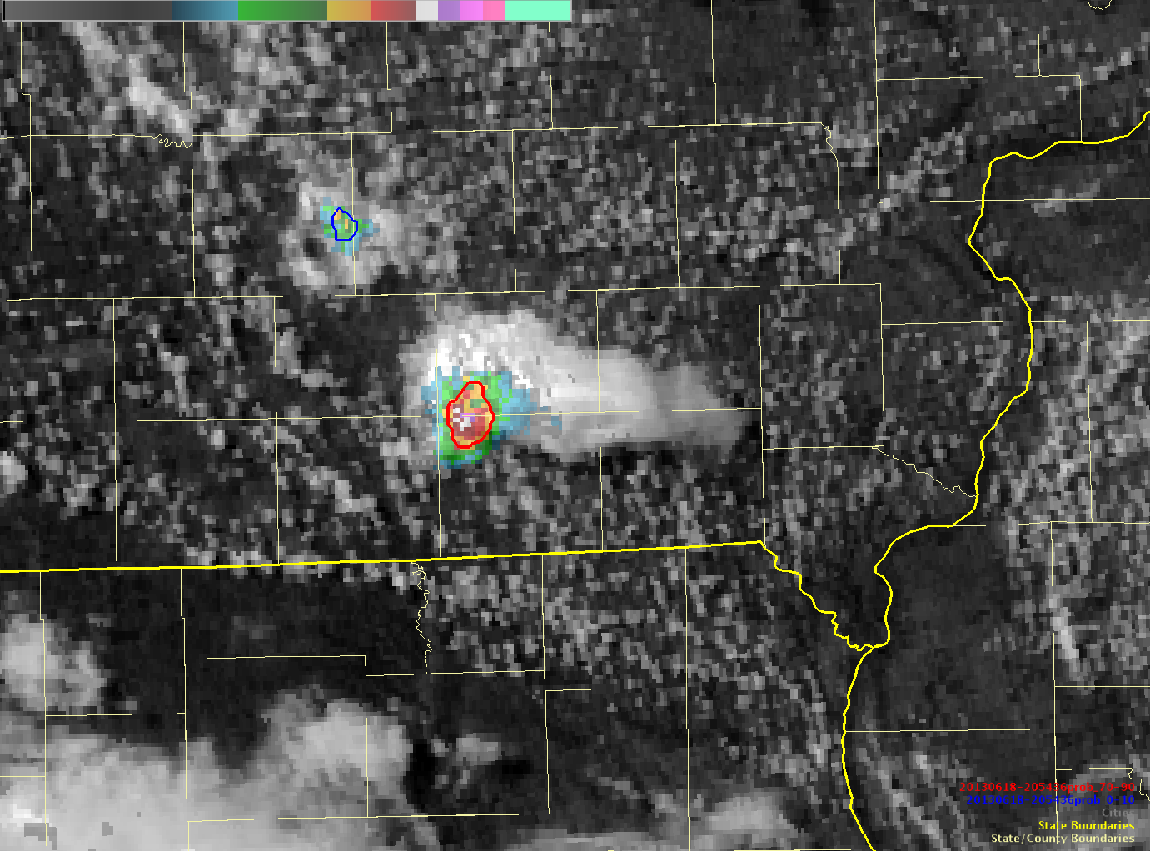
Two major natural hazards, volcanic eruptions and severe weather, are used to illustrate the need for and benefit of researching automated methods to extract timely information from “Big Data”
Alert: Volcanic eruption detected!
Probability of Severe = 73%

Slide 5
“Big Data:” Volcanic Hazard Applications
Alert: Volcanic eruption detected!

Slide 6
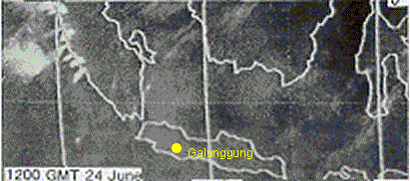
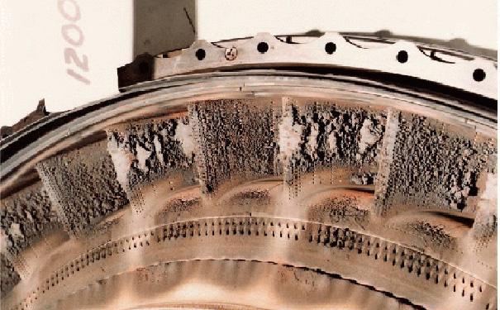
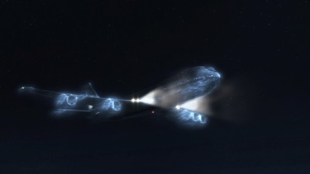
British Airways Flight 9, June 24, 1982
“Ladies and gentlemen, this is your captain speaking. We have a small problem. All four engines have stopped”
-Captain Eric Moody
Hanstrum & Watson (1983), modified by Darwin VAAC

Slide 7
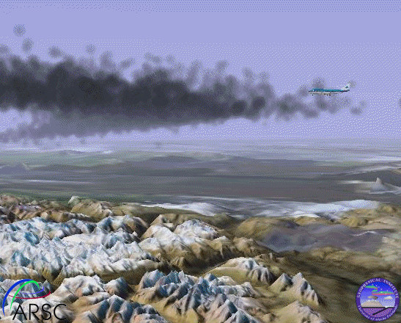
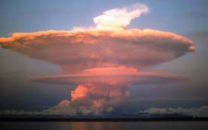
KLM Flight-867, December 15, 1989
Credit: Gary Hufford
Joyce M. Warren

Slide 8
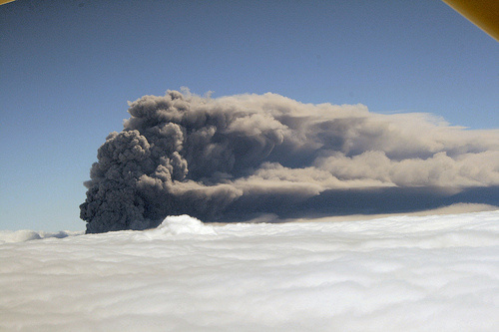
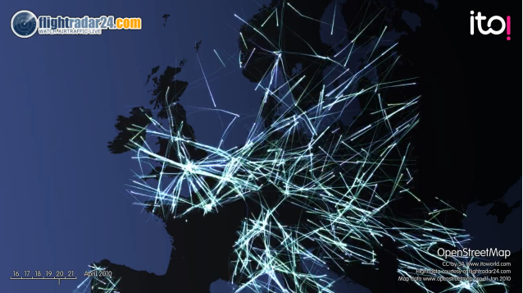
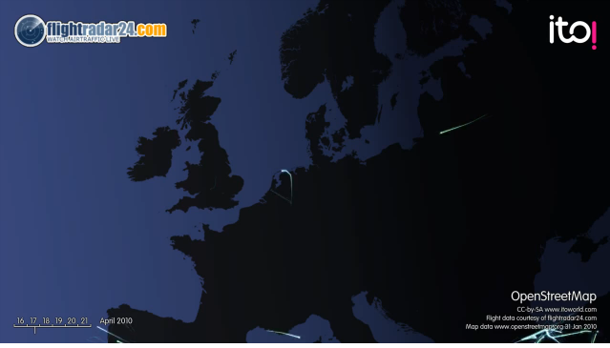
Economic Impacts of Volcanic Ash
The Eyjafjallajökull Eruption:
Nearly 100,000 canceled flights (50% of world’s air traffic!)
Airlines were losing $200 million/day
Total economic impact - $2 billion
Before Ash Event
During Ash Event

Slide 9
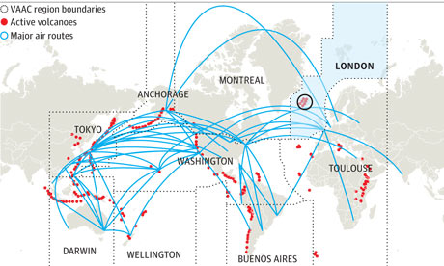
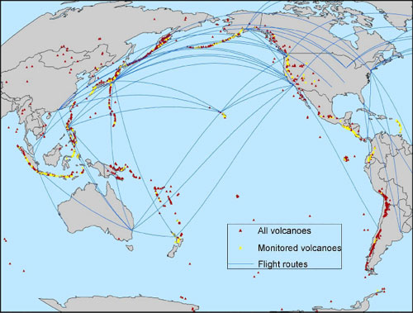
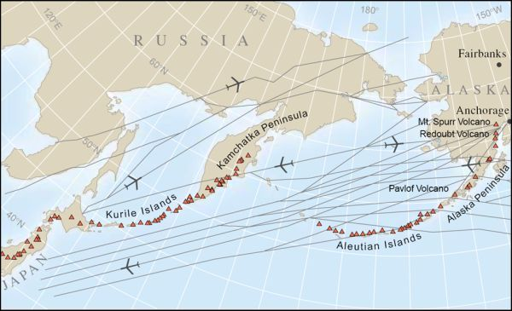
Major Flight Routes
Source: ICAO

Slide 10
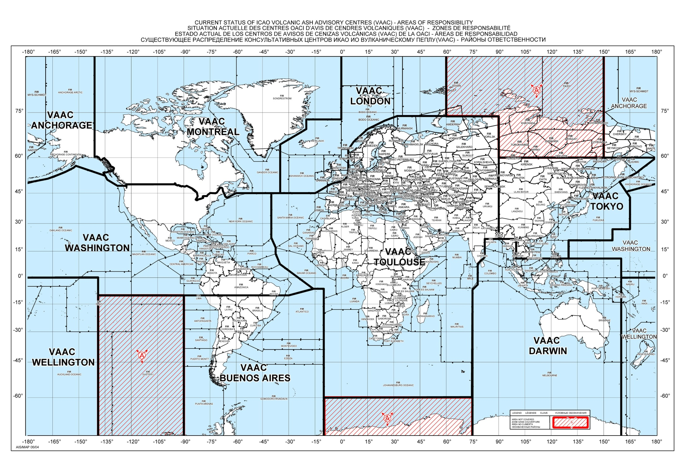


Slide 11
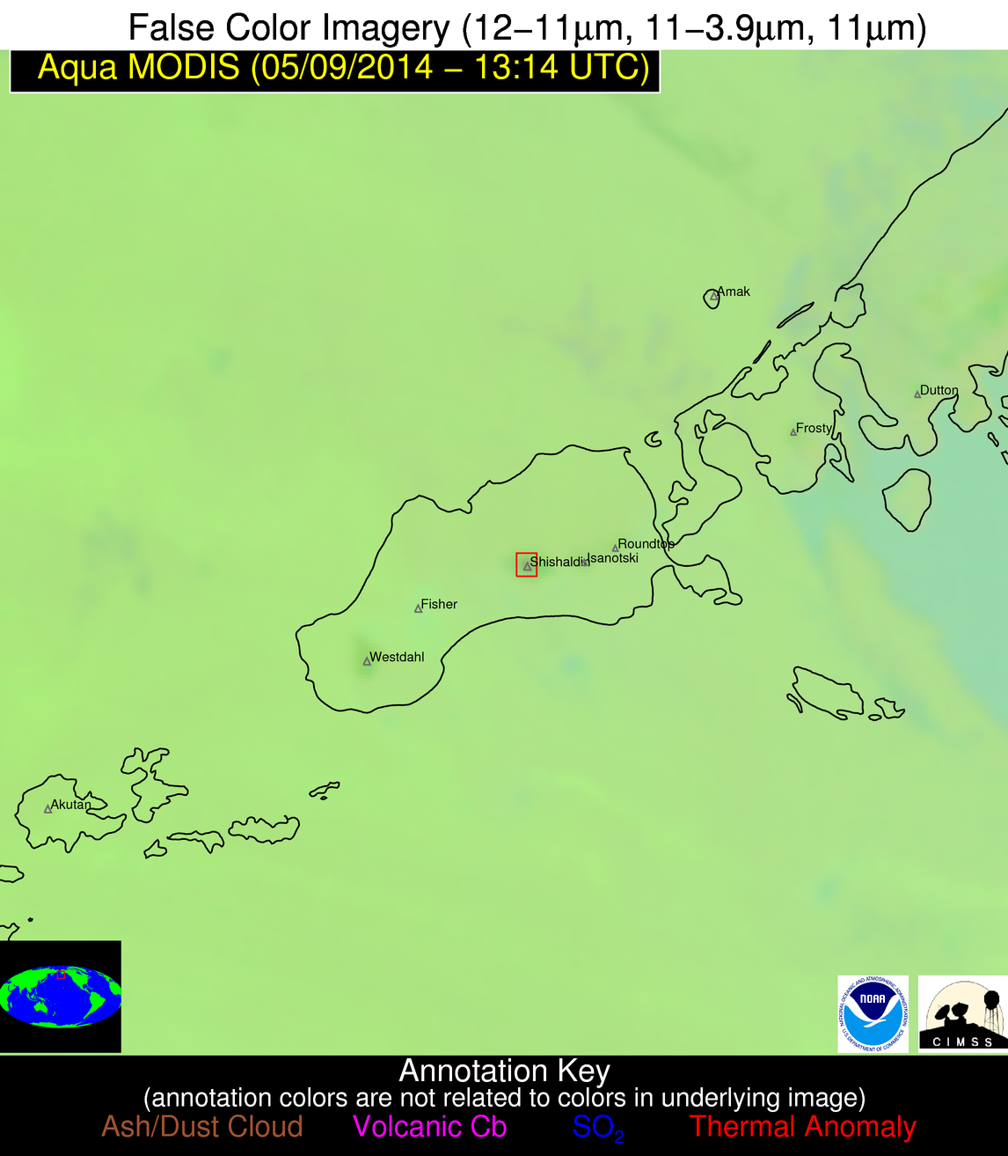
1. Identifying “restless” volcanoes
Alert: Restless Volcano Detected
Satellite measurements
Aleutian Islands, AK
Scientific computer algorithm
Identification of volcanoes that are most likely to erupt
Shishaldin Volcano
Automated alert to users

Slide 12
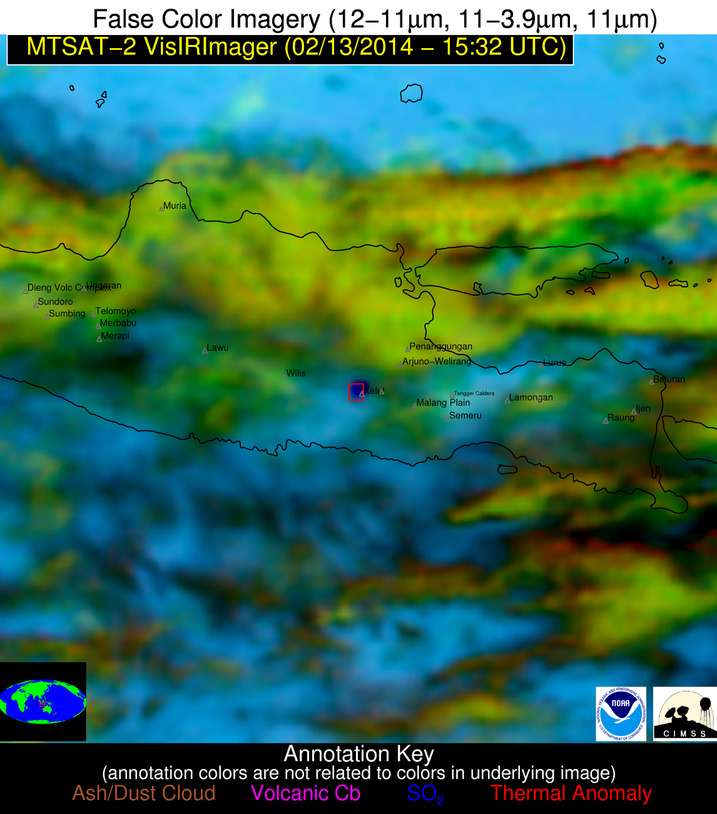
Java, Indonesia: February 13, 2014
Alert: Restless Volcano Detected
Using weather satellite data, an unusually large ground temperature was identified at Kelut volcano and an alert was automatically generated
Java, Indonesia
Kelut Volcano

Slide 13
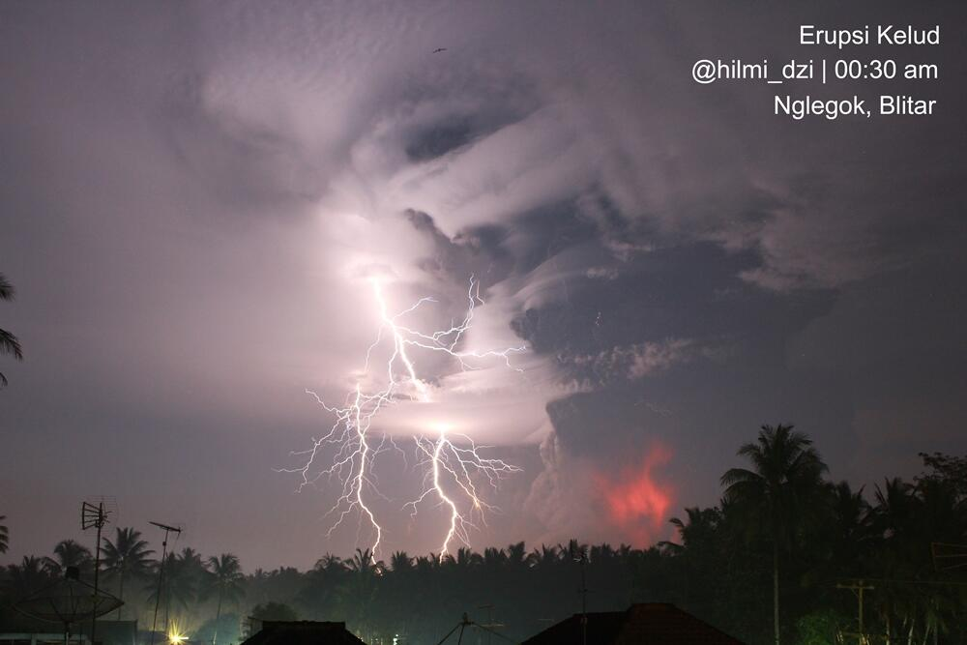
30 minutes later…

Slide 14
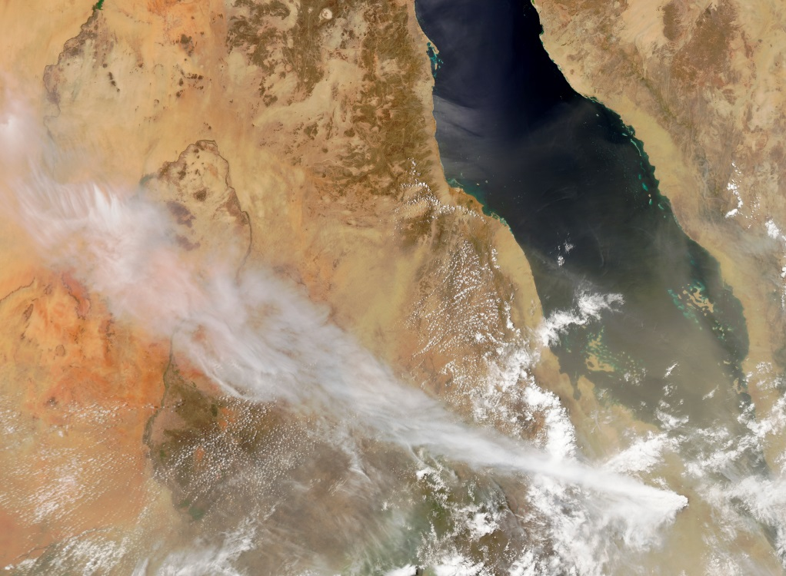
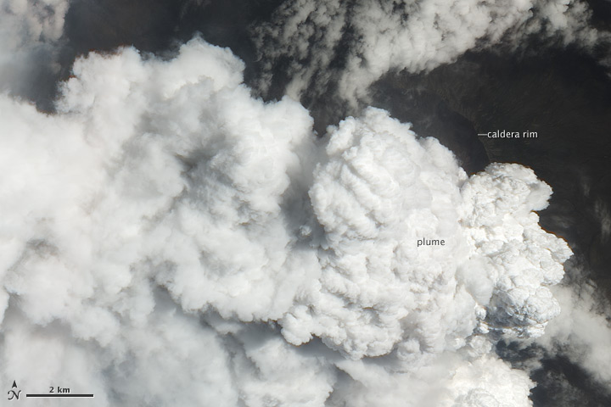
2. First detection of volcanic eruptions
Nabro volcano in Eritrea erupted explosively for the first time in recorded history on June 12, 2011
The eruption went undetected for 7.5 hours!
Nabro

Slide 16
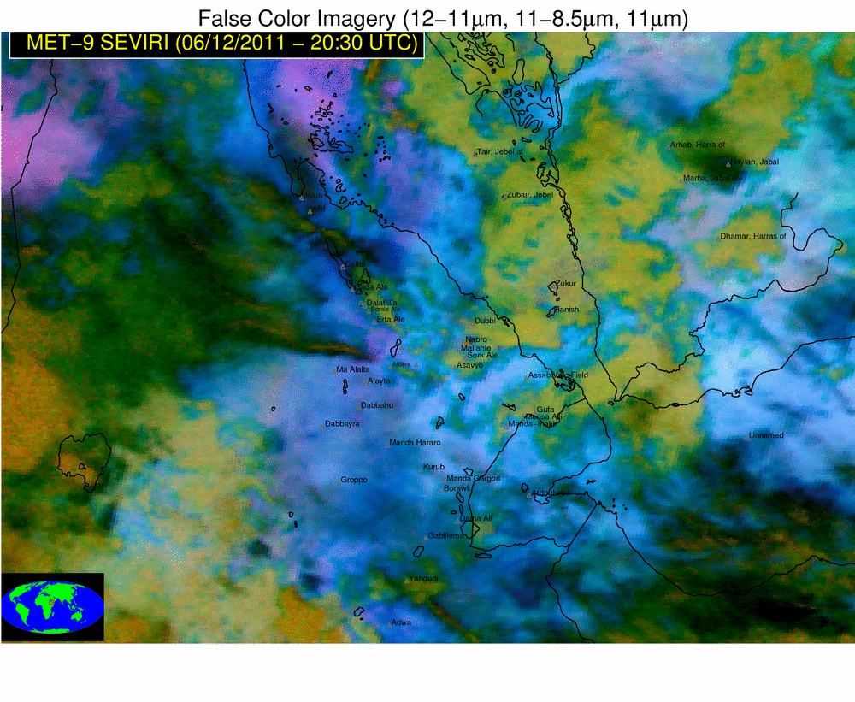
The NOAA volcanic eruption alerting tool was able to detect the eruption within 15 minutes of the start time and generate an alert

Slide 17
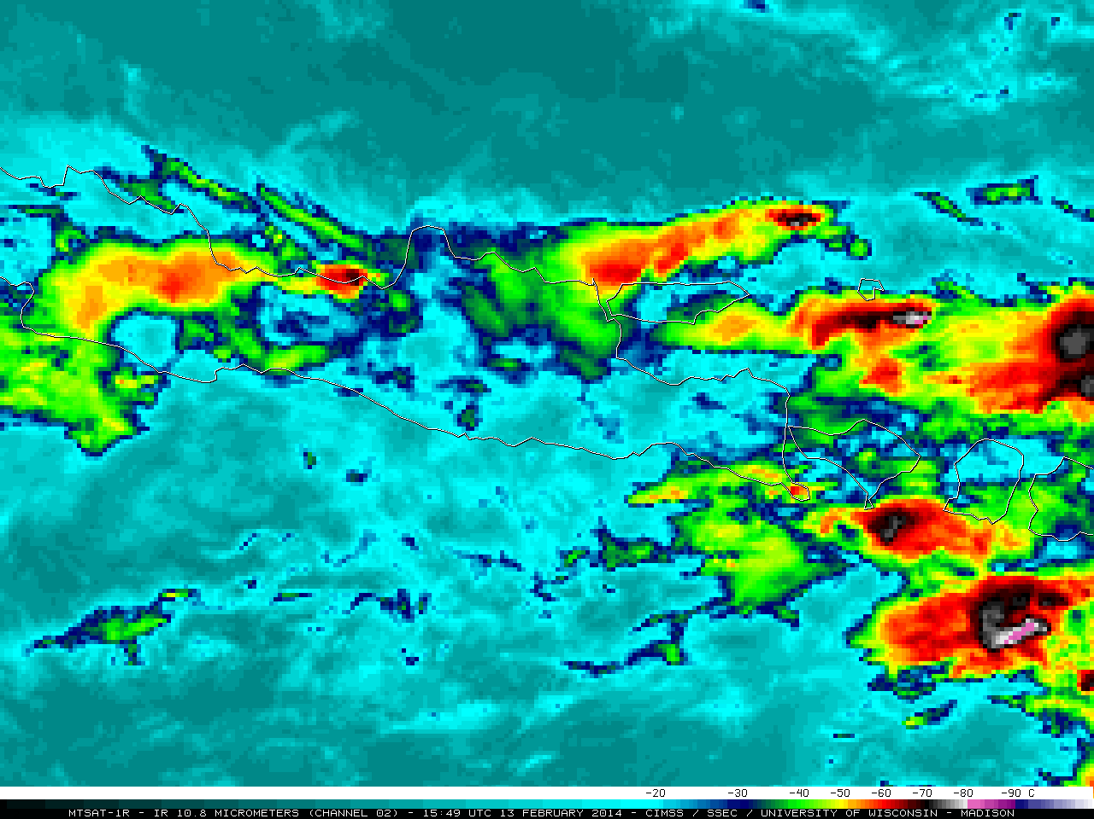
Weather or volcanic eruption?

Slide 18
Automated system is able to detect Kelut eruption about 60 minutes sooner than standard operational tools
Volcanic eruption detected!

Slide 19
NOAA automated alerting tool
Traditional tools (+ 1 hour)

Slide 20
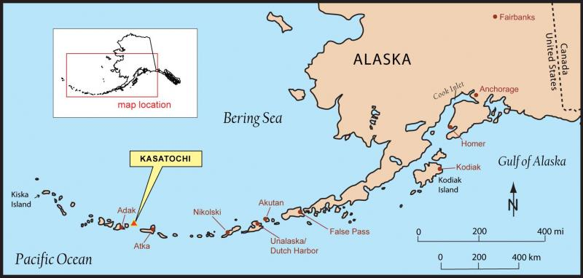
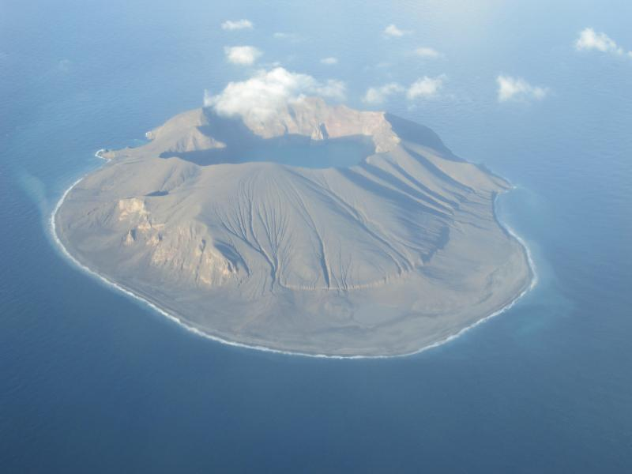
3. Tracking volcanic ash clouds
Kasatochi (Alaska) erupted explosively on August 7-8, 2008
Richard Zimmer

Slide 21
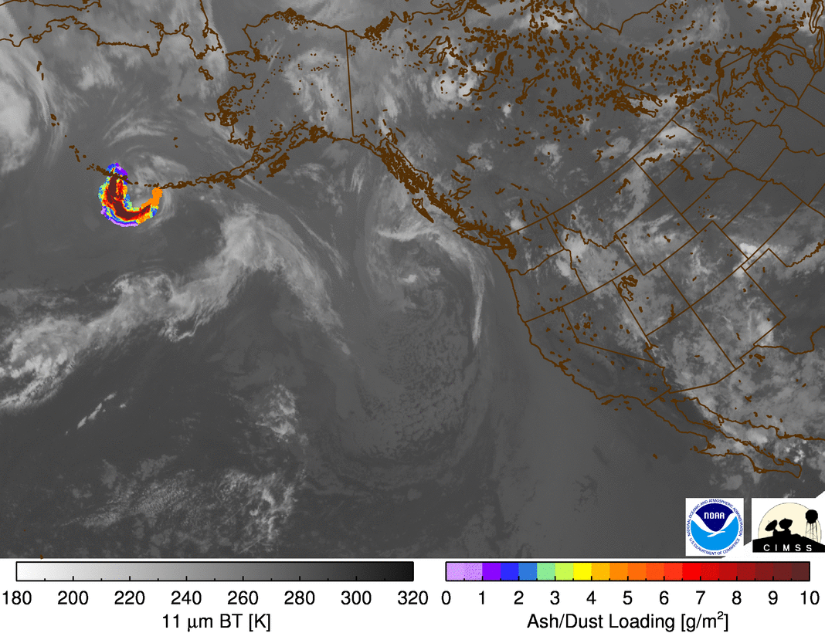

Slide 22
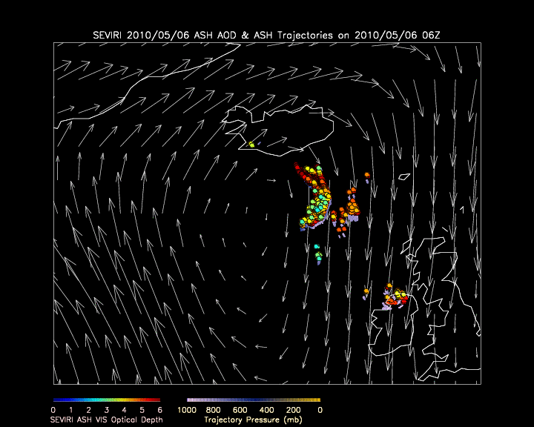
4. Improving ash cloud forecasts
Iceland
Ireland
UK

Slide 23
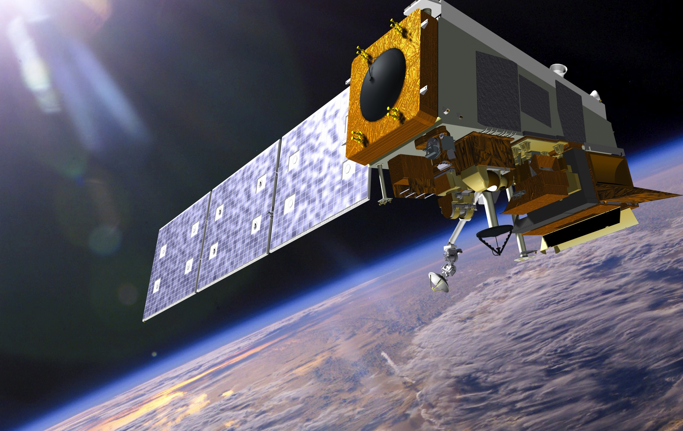
Joint Polar Satellite System
JPSS
Notes:
SNPP – the first satellite in the JPSS program is now NOAA’s primary weather low earth orbit satellite

Slide 24
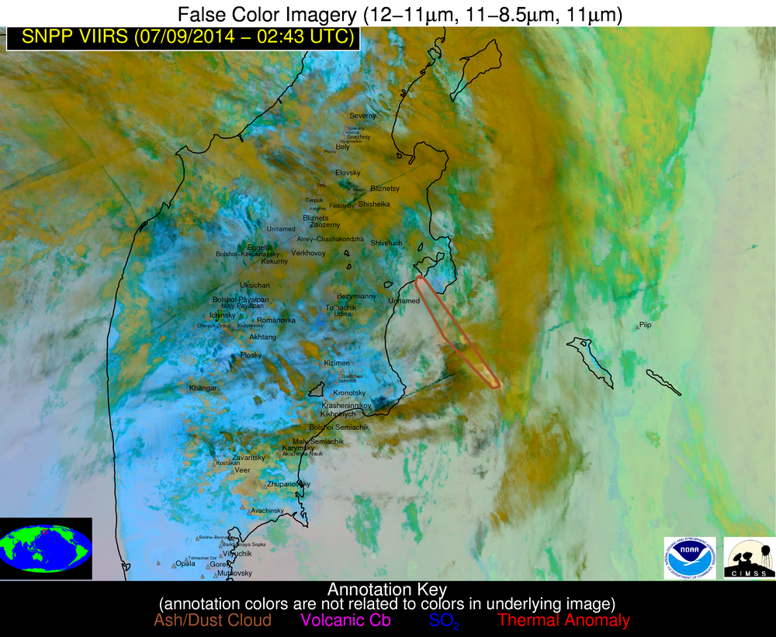

Slide 25
Jet Contrail!

Slide 26
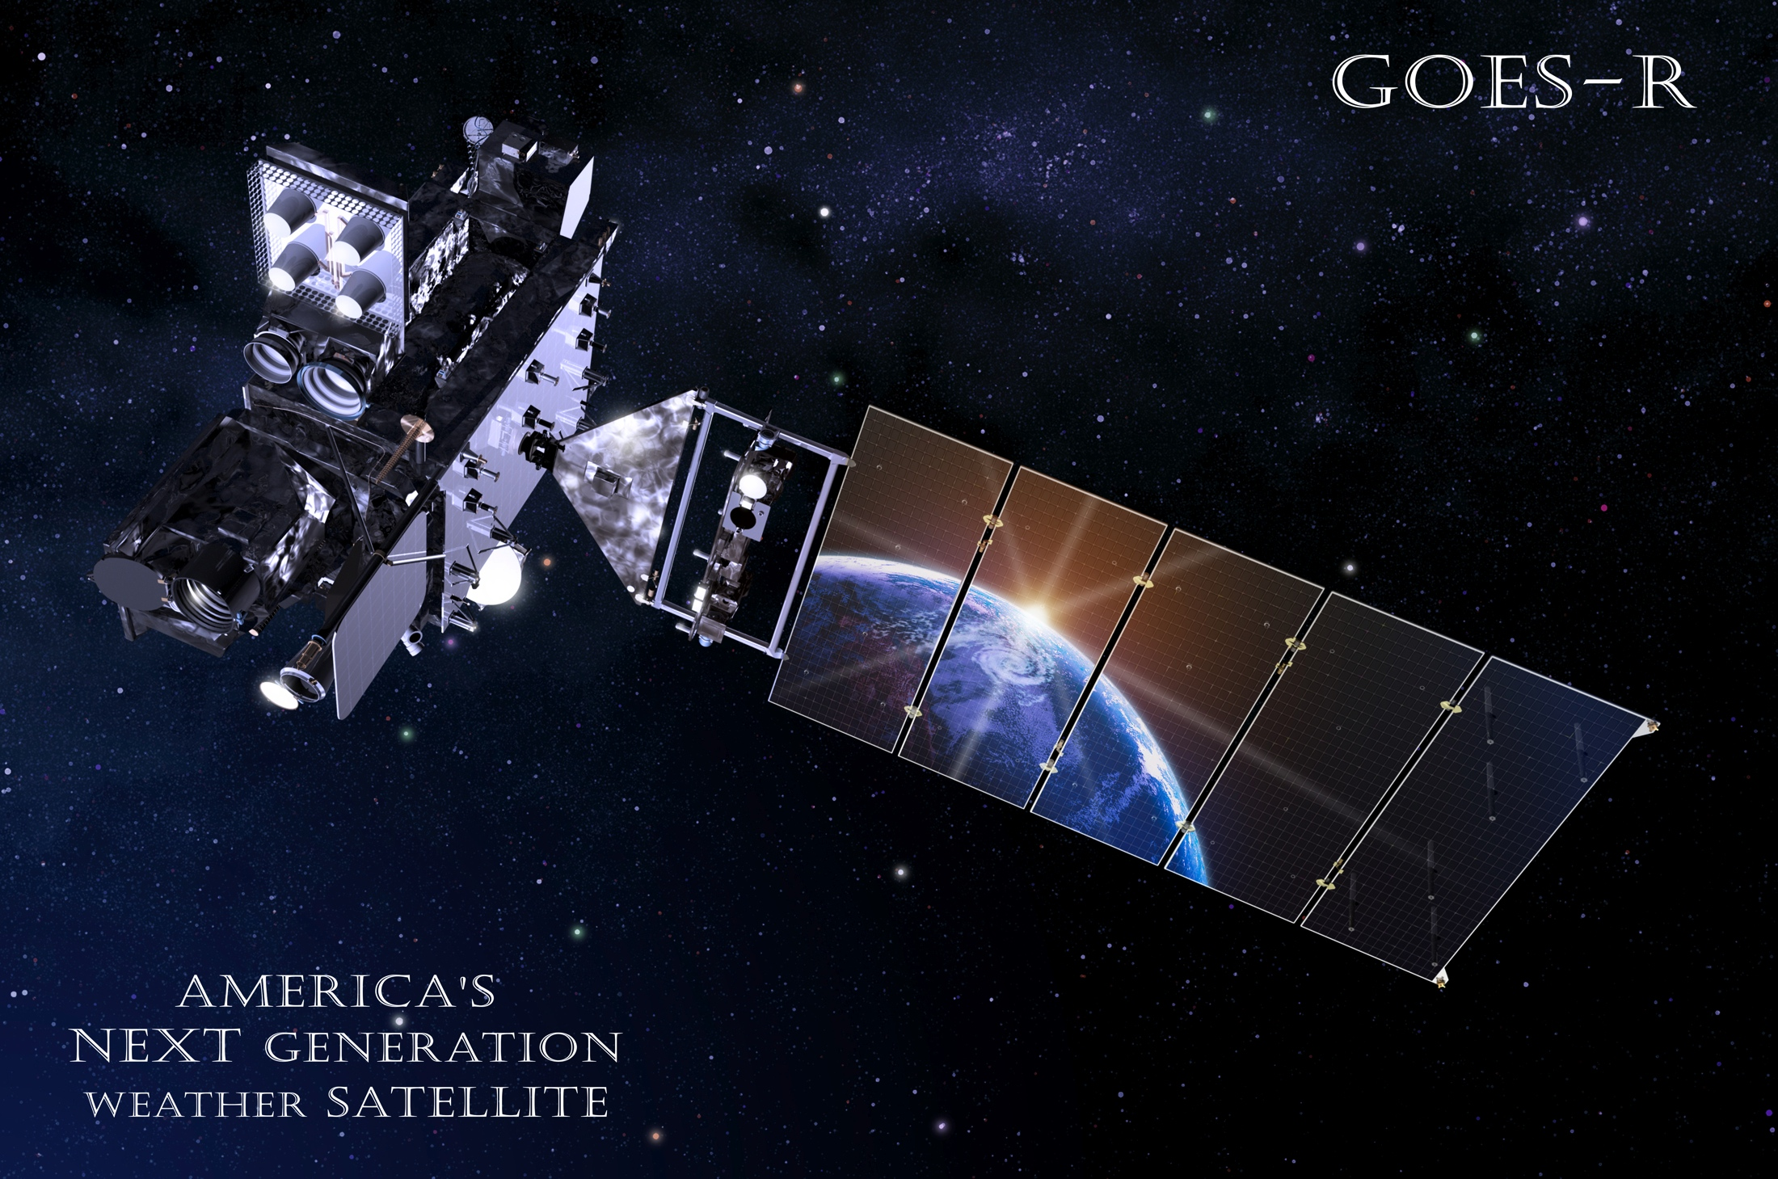
Next Generation Geostationary Operational Environmental Satellite

Slide 27
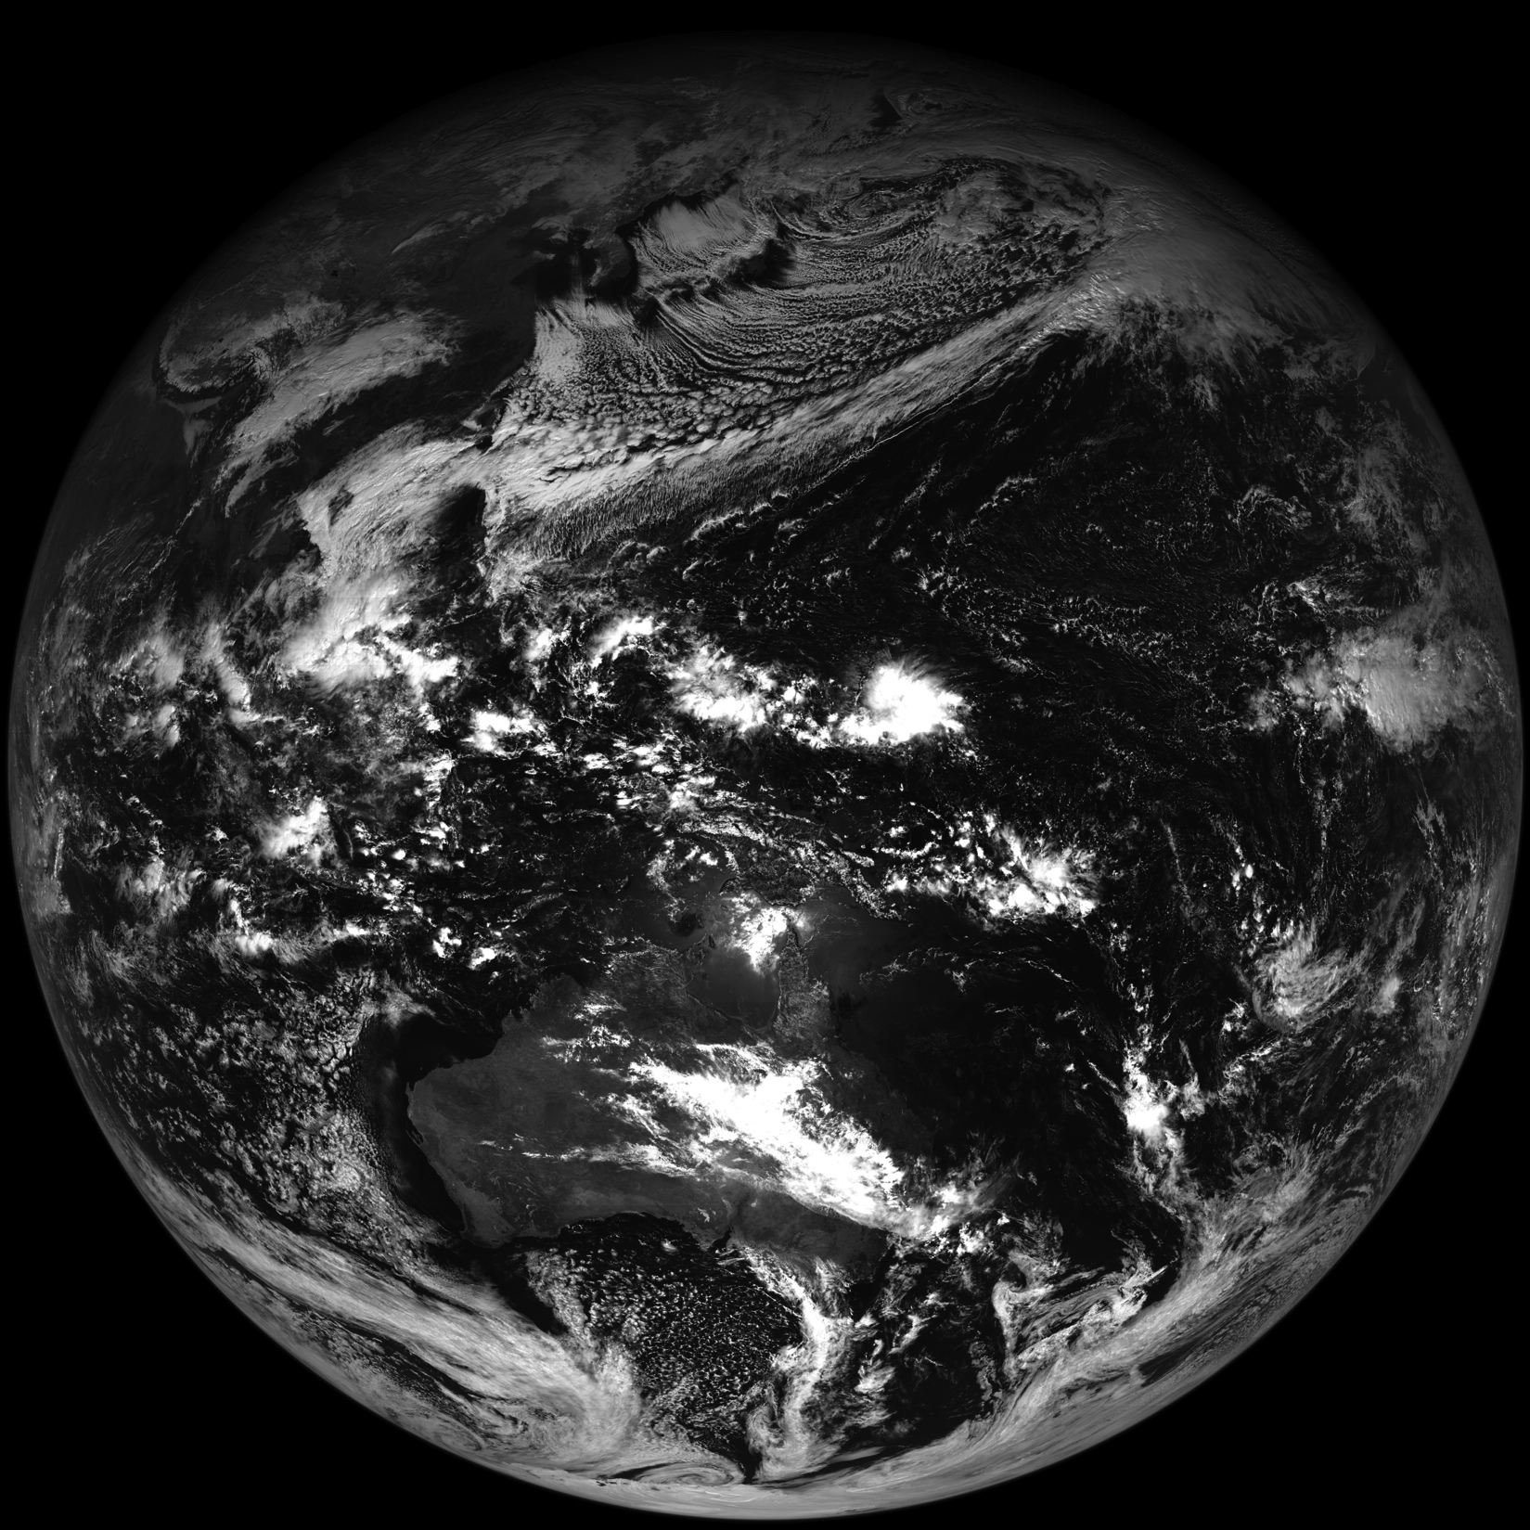
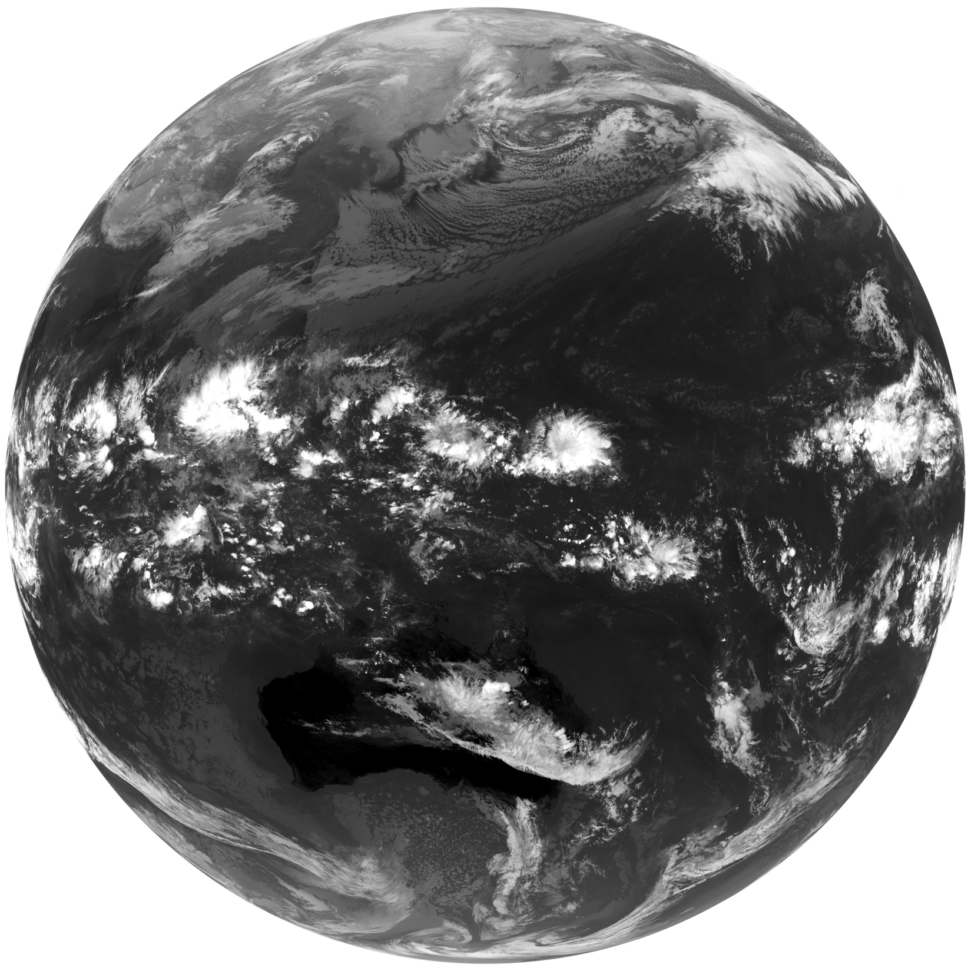
Himawari-8 (JMA)

Slide 28
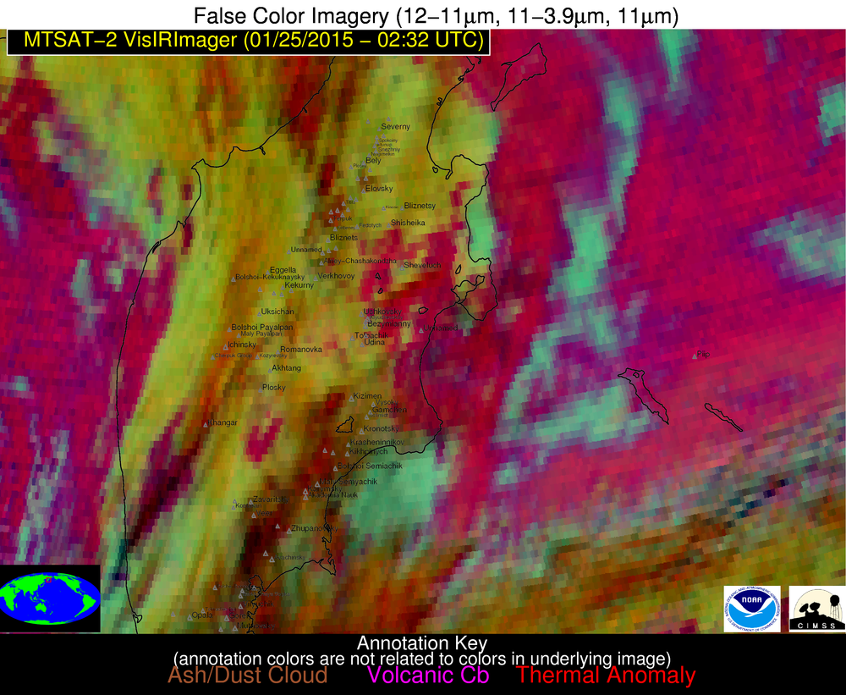
Kamchatka, Russia

Slide 29
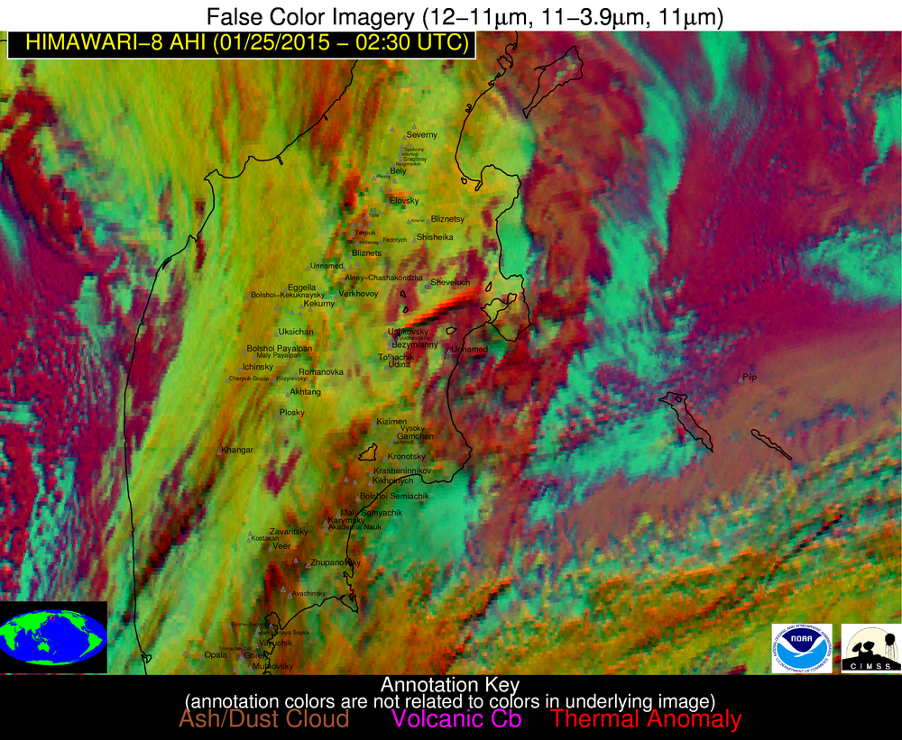
The ash plume is clearly discernable in the Himawari-8 AHI imagery constructed using similar spectral channels
Klyuchevskoy ash plume
Kamchatka, Russia
Notes:
The AHI resolution at a viewing angle of 65+ degrees is actually better than MTSAT or GOES at nadir.

Slide 30
The ash plume is not discernable in MTSAT false color imagery
Klyuchevskoy ash plume
Kamchatka, Russia

Slide 31
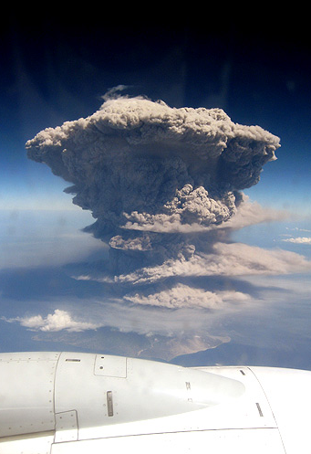

Slide 32
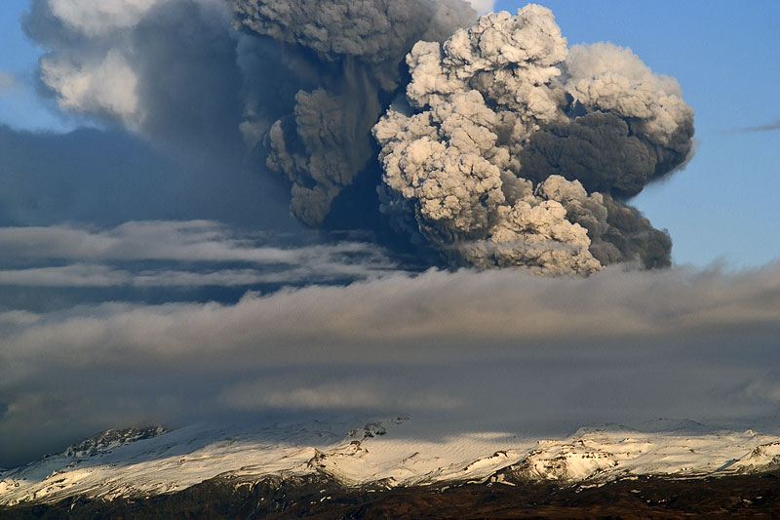
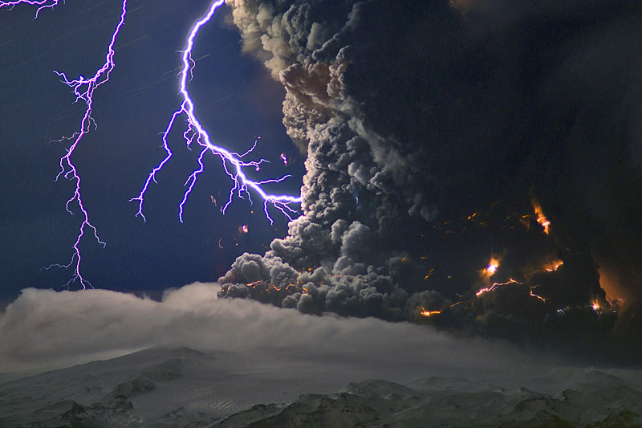
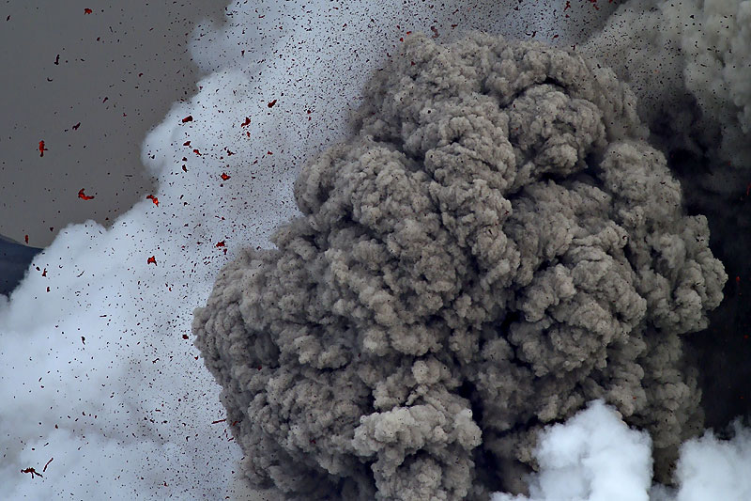
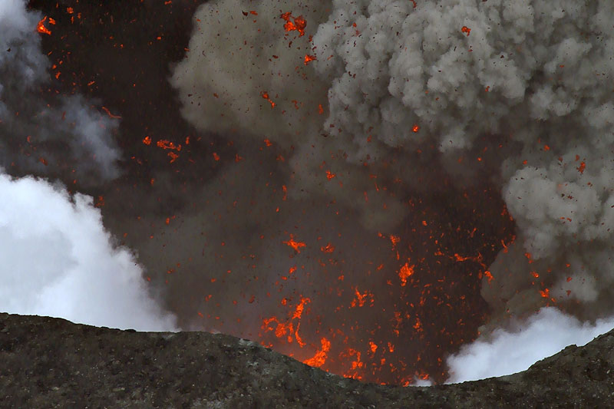
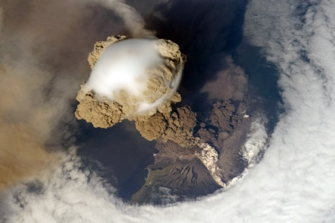
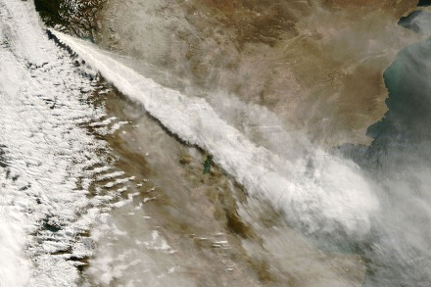

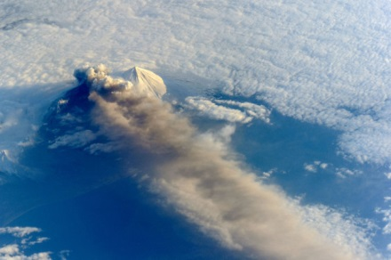
Marco Fulle - www.stromboli.net
“Big Data” Research in NOAA is:
Increasing the timeliness of volcanic ash cloud advisories to aviation customers
Improving the ability to track and characterize hazardous volcanic ash clouds
Spawning new research to improve volcanic ash cloud forecasts

Slide 34
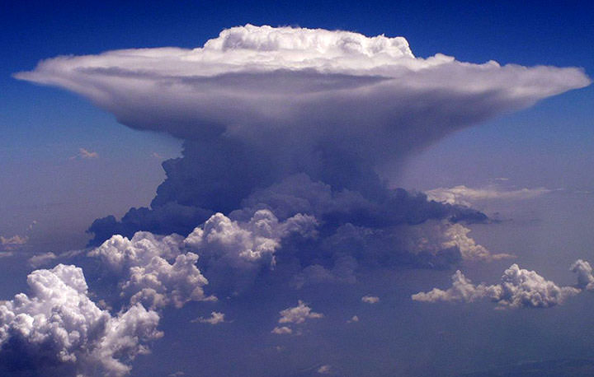

Slide 35
“Big Data:” Severe Weather Applications
Probability of Severe = 73%

Slide 36
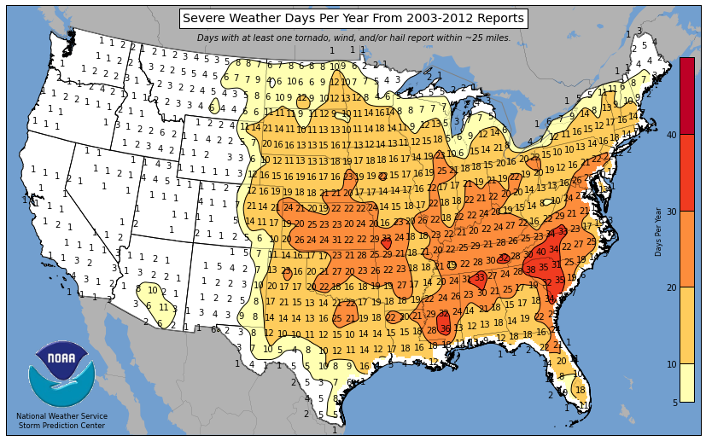
Notes:
Severe weather is common in the U.S.

Slide 37
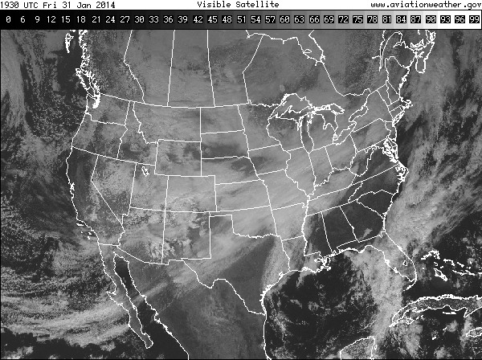
Problem: Converting “Big Data” to Information
High-res Numerical Models
Satellite
Radar
1). Storm Environment
(Energetics of atmosphere)
3). Radar Intensity
2). Development of clouds in time captured by GOES
Probability a developing thunderstorm will produce severe weather in the future (up to 60 minutes)

Slide 38

Wind gusts of 58 mph or greater or structural wind damage
NWS Duluth, MN

Slide 39

Wind gusts of 58 mph or greater or structural wind damage

Slide 40

Hail 1 inch in diameter or greater
KY3

Slide 41




NCEP
What 30 min of processing looks like…
12
ProbSevere
9
3
6
OUTPUT
Input: 0 MB
Input:138 MB
Input:142 MB
Input:145 MB
Input: 230 MB
Input: 234 MB
Input: 237 MB
Input: 322 MB
Input: 325 MB
Input: 328 MB
Input: 414 MB
Input: 417 MB
Input: 421 MB
Input: 506 MB
Input: 510 MB
Input: 513 MB
Input: 598 MB
Adding GOES-R: Input: 4450 MB
Adding GOES-R + HRRR: Input: 5754 MB
File size: 0.2 MB

Slide 42
NCEP
What 1 hour of processing looks like…
4 RAP grids
9 CONUS satellite scans
ProbSevere
Input: 1200 MB
OUTPUT
Adding GOES-R: Input: 8900 MB
Adding GOES-R + HRRR: Input: 11,500 MB
30 CONUS radar scans
File size: 0.2 MB
30 output files

Slide 43


Automated integration of information
A meteorologist sees developing storms and cloud clusters—not satellite pixels or radiances.
The same concepts apply to radar data.
Meteorologists view cells or storms—so the computer needs to identify and track radar cells and their evolution over time.

Slide 44

Customized Display for AWIPS II

Slide 45

Hazardous Weather Testbed
http://goesrhwt.blogspot.com

Slide 46
Model Evaluation (2014)
NWS:19 minutes
ProbSevere: 29 minutes
NWS:0.44
ProbSevere: 0.32
Notes:
9000 storms (860 severe) for 2014 validation
80% threshold for skill/lead-time plot (CSI: 32% model, 44% NWS)—CSI was 27% with median LT of 37 min @ 40% threshold.
May, June and July (1 August day)

Slide 47
Model Evaluation (2014)
We fully expect that the impact of the satellite component will be even greater with GOES-R (more frequent images, factor 4 improvement in spatial resolution, more spectral bands for inferring cloud properties, lightning mapping)
NWS:19 minutes
ProbSevere: 29 minutes
NWS:0.44
ProbSevere: 0.32
Notes:
9000 storms (860 severe) for 2014 validation
80% threshold for skill/lead-time plot (CSI: 32% model, 44% NWS)—CSI was 27% with median LT of 37 min @ 40% threshold.
May, June and July (1 August day)

Slide 48

ProbSevere coverts GB of input data into kB of information that can be used to help extend severe weather warning lead-times
Moore, OK tornadic storm; 8 min lead-time to first SVR warning.
Notes:
2013

Slide 49









Future Data Integration
NWP / near-storm env.
GOES-R
NEXRAD
HRRR
Super-rapid scan
Dual-pol products
MRMS products
SPC-OA
GLM
Create more refined and specific forecasts of severe weather (tornado, hail, wind)
SREF
OT detection
Images are from NOAA, NASA, UW-CIMSS, and OU-CIMMS

Slide 50

“Big Data” Research in NOAA is:
Increasing the lead time and accuracy of severe weather warnings
Supporting the NWS Weather Ready Nation initiative through provision of probabilistic storm scale forecast guidance
Spawning new research aimed at improving the prediction of specific severe weather hazards

Slide 51
Questions?

