Slide 1
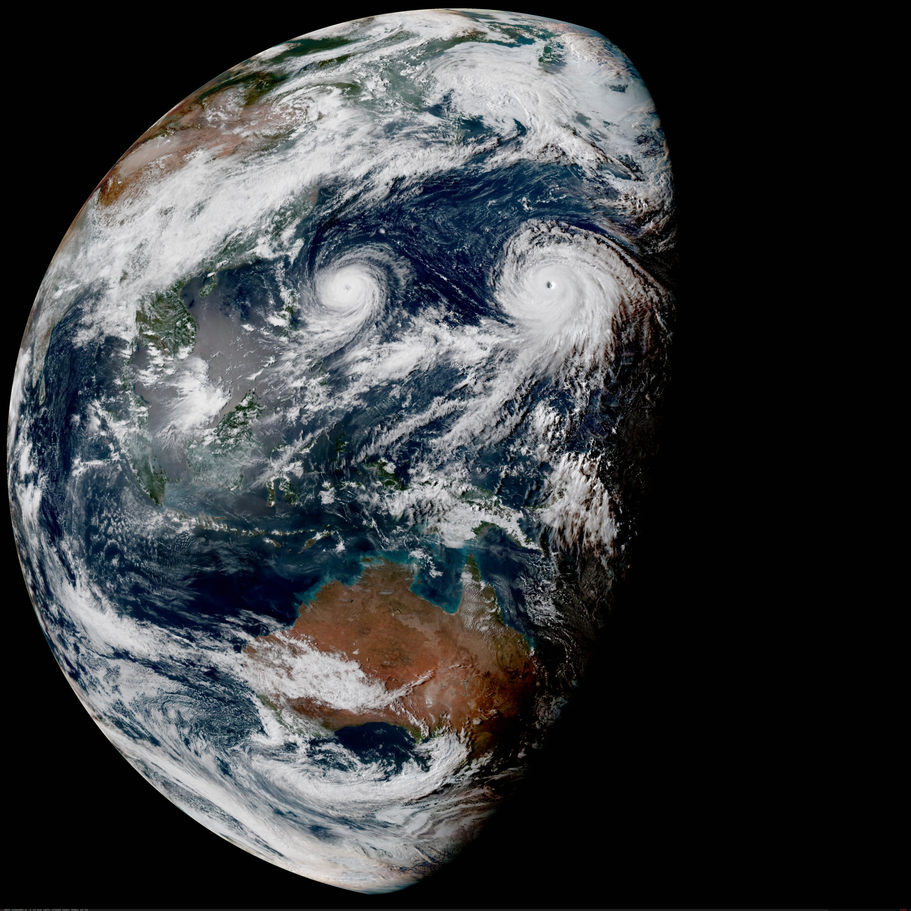




The JCSDA Community Radiative Transfer Model (CRTM):
From Development to Operations
CRTM team:
Benjamin T. Johnson (Project Lead, UCAR/JCSDA)
Patrick Stegmann (UCAR / JCSDA)
Jim Rosinski (UCAR/JCSDA)
Tom Greenwald (UW CIMSS)
Kevin Garrett (NOAA/STAR)
Tong Zhu (CIRA @ NOAA/STAR)
Ming Chen (UMD/ESSIC @ NOAA/STAR)
Thomas Auligné (Director, JCSDA) [https://www.jcsda.org/]
With essential contributions from: Barbara Scherllin-Pirscher, Quanhua Liu, Emily Liu,
Andrew Collard, Fuqing Zhang, Ping Yang, Kwo-Sen Kuo, and many others.
STAR Seminar Series, December 20, 2018

Slide 2
JCSDA Overview
What is the CRTM?
Code and Solver Optimization
Scientific Capabilities and Progress
CRTM v2.3.x and v3.0.0
Operations and Support
Education / Outreach

Slide 3
JCSDA Overview
What is the CRTM?
Code and Solver Optimization
Scientific Capabilities and Progress
CRTM v2.3.x and v3.0.0
Operations and Support
Education / Outreach

Slide 4
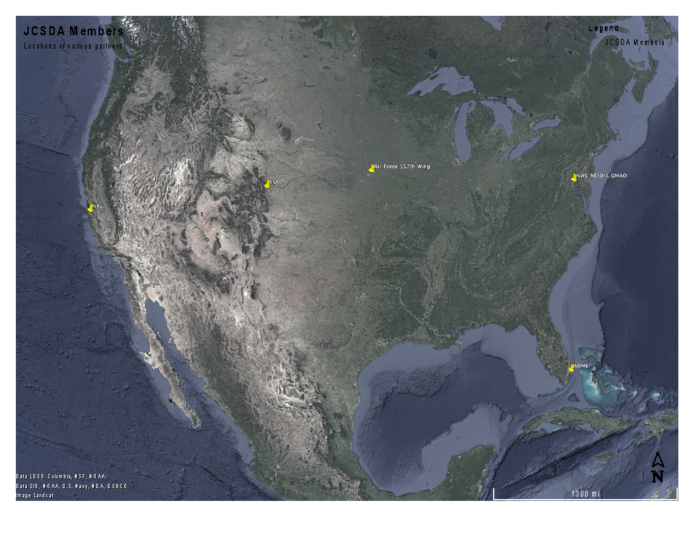
Joint Center for Satellite Data Assimilation
Vision: An interagency partnership working to become a world leader in applying satellite data and research to operational goals in environmental analysis and prediction
NASA
GSFC
U.S. Air
Force
JCSDA
NOAA
NWS
U.S.
Navy
NOAA
NESDIS
NOAA
OAR
Mission: to accelerate and improve the quantitative use of research and operational satellite data in weather, ocean, climate and environmental analysis and prediction systems.
Science priorities: Radiative Transfer Modeling (CRTM), new instruments, clouds and precipitation, land surface, ocean, atmospheric composition.

Slide 5
JCSDA Project Structure
Director
(Tom Auligné)
Director’s Office (DOF)
Community Radiative Transfer Model
(CRTM)
New & Improved Observations
(NIO)
Impact of Observing Systems
(IOS)
Sea-ice, Ocean, Coupled Analysis
(SOCA)
Joint Effort for Data assimilation Integration
(JEDI)
Accurately and efficiently simulate satellite radiances
Accelerate use of new sensors and improve use of current ones
Monitor impact of observations and provide guidance for improvements
Implement science for coupled, marine system
Next-generation data assimilation for the Nation

Slide 6
JCSDA Overview
What is the CRTM?
Code and Solver Optimization
Scientific Capabilities and Progress
CRTM v2.3.x and v3.0.0
Operations and Support
Education / Outreach

Slide 7
What is the CRTM?
CRTM is the “Community Radiative Transfer Model”
Goal: Fast and accurate community radiative transfer model to enable assimilation of satellite radiances under all weather conditions
Type: 1-D, plane-parallel, multi-stream matrix operator method, advanced method of moments solver, with specular and non-specular surface reflections.
Has aerosol (GO-CART), cloud (2 species), precipitation (4 species); with unpolarized scattering and absorption. Computes gaseous absorption/emission for 6 gaseous species (ODPS).
History: Originally developed (as CRTM) around 2004 by Paul van Delst, Yong Han, Fuzhong Weng, Quanhua Liu, Thomas J. Kleespies, Larry M. McMillin, and many others. CRTM Combines many previously developed models into a community framework, and supports forward, tangent linear, adjoint, and k-matrix modeling of emitted/reflected radiances, with code legacy going back to the mid 1970s (e.g., OPTRAN: McMillin).

Slide 8
What is the CRTM?
Written in (updated to) Fortran95/2003 (some elements of Fortran 2008).
Heavy use of language features made to ease code maintenance and reuse of common components.
Geared towards data assimilation (i.e. GSI at NCEP / JCSDA JEDI, NASA-GEOS, etc.) but used in other contexts (cal/val, satellite simulation, post-processing)
There are separate forward, tangent-linear, adjoint, and K-matrix functions.
Forward model is “built in” to the other functions so they are all stand-alone.

Slide 9
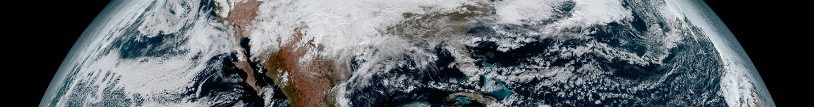

JCSDA Concept of Operations
JCSDA Executive Oversight
Agency Executives
NASA, NOAA, Departments of the Navy and Air Force
Core
FTEs
In-kind
Management Oversight Board
NASA/GSFC/Earth Sciences Division (Pawson, Chair)
NOAA / NWS / NCEP (Lapenta)
NOAA / NESDIS / STAR (Cikanek)
NOAA / OAR (Atlas)
Dept. of the Air Force / Air Force Weather (Farrar)
Dept.of the Navy / N84 and NRL (McCarren and Hansen)
Apr 2017
Oct 2018
Apr 2019
(expected)
Science Advisory Committee
Executive Team
Director (Auligné) *
Associate Directors and CAO
(Baker, Gelaro, McMillen, Benjamin, Kleist, Garrett, Yoe)
JCSDA
Core Staff
Annual Operating Plan
STAR
Staff
EMC
Staff
ESRL/AOML
Staff
GMAO
Staff
NRL
Staff
USAF/NCAR
Staff

Slide 10
CRTM Overview
CRTM 1: The first task is an umbrella for all management, external coordination/collaboration, release support, and oversight of the CRTM team activities -- covering all versions of CRTM. This specifically includes user-support, documentation, education, and outreach elements.
CRTM 2: The second task is primarily a software engineering-driven task aimed specifically at improving the computational aspects of CRTM.
CRTM 3: The third and final task aims at scientific development and testing. CRTM users require fast computations of radiances with the highest degree of accuracy and sensitivity possible, while still maintaining the operational computational resource requirements.

Slide 11
CRTM Structure
public interfaces
CRTM
Initialization
Forward Model
Tangent-Linear Model
Adjoint Model
Jacobian
Model
CRTM
Destroy
SfcOptics
(Surface Emissivity/ Reflectivity Model)
AerosolScatter
(Aerosol Absorption/
Scattering Model)
CloudScatter
(Cloud Absorption/
Scattering Model)
Molecular Scattering
AtmAbsorption
(Gaseous Absorption Model)
RTSolution
(RT Solver)
Source Functions

Slide 12
JCSDA Overview
What is the CRTM?
Code and Solver Optimization
Scientific Capabilities and Progress
CRTM v2.3.x and v3.0.0
Operations and Support
Education / Outreach

Slide 13
CRTM Optimization (J. Rosinski, JCSDA)
With OpenMP
Now CRTM scales similar to GSI using OpenMP directives. Relative load imbalance (purple) is reduced as well.

Slide 14
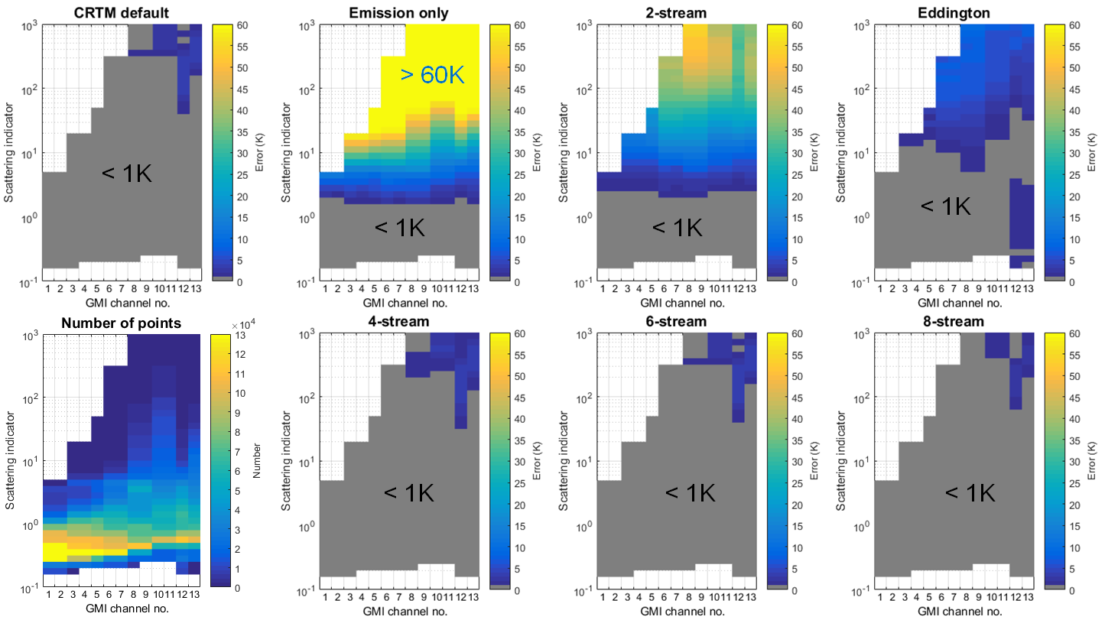
Eddington Model Benchmark Tests
Tests using WRF output show that Eddington model is only 33% slower than emission-only model and 2.8x faster than ADA two-stream model
Strong scattering: Eddington model more accurate
Weak scattering: ADA two-stream slightly more accurate
Emission-only and Eddington models provide 4x speedup over CRTM v2.3.0
16th JCSDA Technical Review Meeting & Science Workshop, 30 May-1 June, 2018
6
Slides courtesy of Tom Greenwald

Slide 15
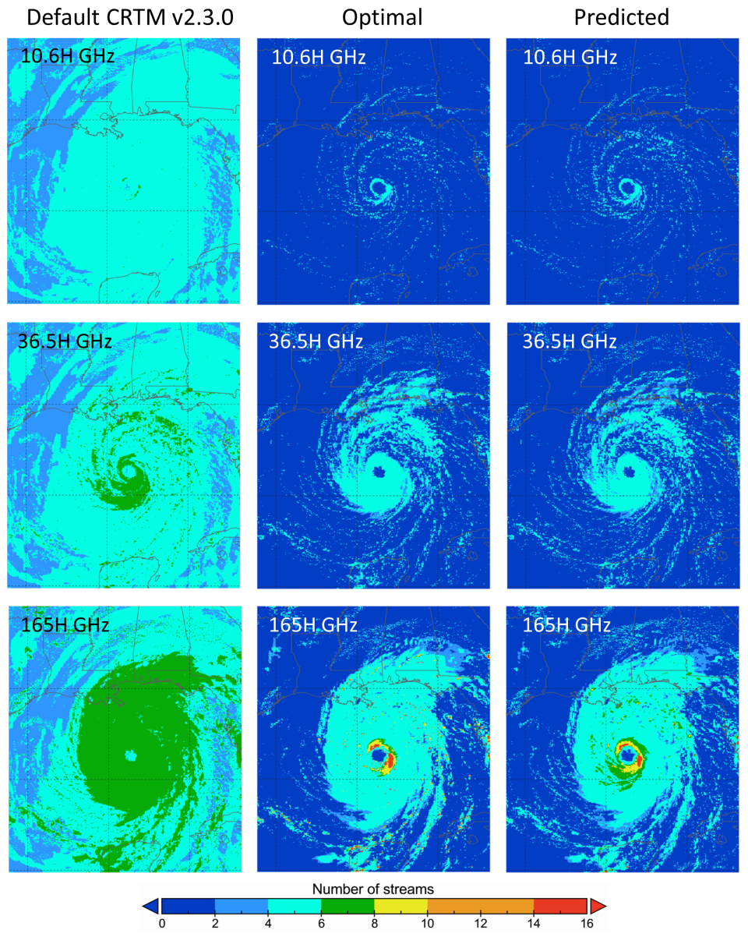
Optimization of Multi-stream Solvers
Benchmark tests used high-resolution (1.5 km) WRF model simulation of Hurricane Katrina (1800 UTC 28 Aug 2005)
For GMI channels, method correctly predicts optimal number of streams 94% of the time (assuming 0.5 K accuracy) and is 2.5x faster than CRTM v2.3.0
Coordinated effort with Min-Jeong Kim (NASA GMAO)
Slides courtesy of Tom Greenwald
16th JCSDA Technical Review Meeting & Science Workshop, 30 May-1 June, 2018
5

Slide 16
Current Status of Solver Work
Completed coding of the Eddington tangent linear and adjoint models
Completed integration of a very fast successive-order-of-scattering (SOS) model(Greenwald et al. 2005) into the CRTM
Integration of advanced vector adding-doubling (VAD)model for solar wavelengths (provided by P. Yang)
Significantly modified model code in order to properly interface with the CRTM
Future Work:
Complete testing of Eddington tangent linear and adjoint code
Complete integration of VAD model into the CRTM
Conduct a cloudy radiance data assimilation experiment using the Eddington model;
  speedups of a factor of 4 are expected over the default solver used in CRTM v2.3.0
Slides courtesy of Tom Greenwald
16th JCSDA Technical Review Meeting & Science Workshop, 30 May-1 June, 2018
5

Slide 17
JCSDA Overview
What is the CRTM?
Code and Solver Optimization
Scientific Capabilities and Progress
CRTM v2.3.x and v3.0.0
Operations and Support
Education / Outreach

Slide 18
Gaseous Absorption
The gaseous absorption algorithm is the core of the CRTM (or any “fast” model).
Regular regression model is used where frequency dependent regression coefficients, c_{i,v}, are used with atmospheric state predictors, X_{i}, to compute the channel absorption coefficients,
Two algorithms for gaseous absorption
  ODAS (Optical Depth in Absorber Space).
    A “compact” version of the OPTRAN model with H₂O, O₃ absorption only.
  ODPS (Optical Depth in Pressure Space).
    Optical depths computed on a fixed pressure grid.
    Better fitting statistics.
    More trace gases: CO₂, CH₄, N₂O.
    Enables incorporation of Zeeman model (requires fixed pressure grid).

Slide 19
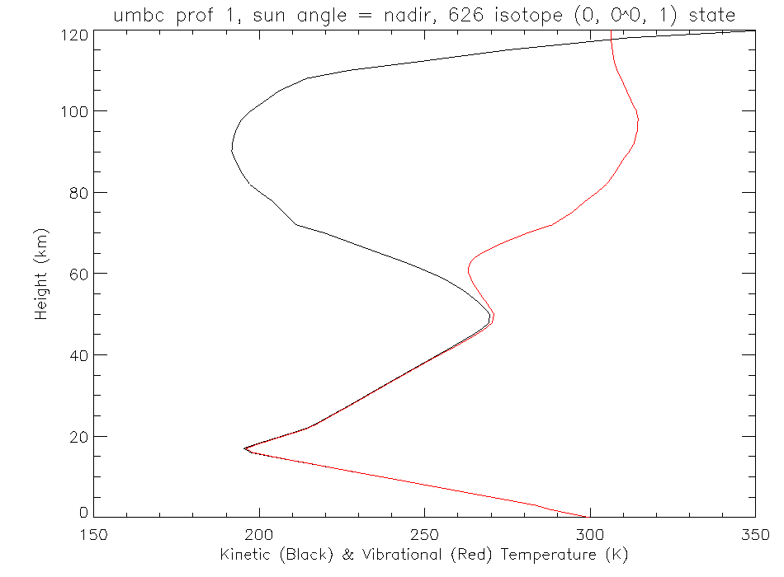
Non-LTE model (1)
At high altitudes, vibrational transitions depart from LTE.
Planck function cannot be used as a source function.
Populations of NLTE and LTE high states
NLTE and LTE absorption coefficients
Kinetic temperature
Vibrational temperature
Vibrational temperature

Slide 20
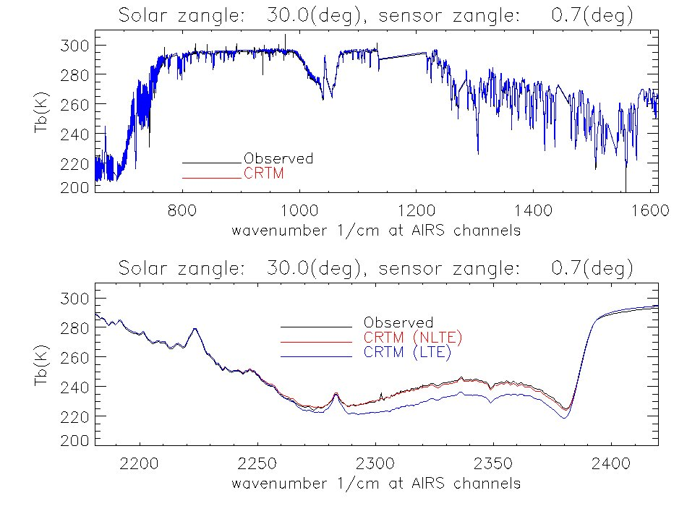
Non-LTE model (2)
Simple regression model predicts the correction to LTE radiances,
Predictors | Description
X₁ | Solar zenith angle
X₂ | Mean temperature from 0.005-0.2hPa
X₃ | Mean temperature from 0.2-52hPa
X₄ | Sensor zenith angle
Remaining differences between observations and NLTE simulations in the shortwave traced to certain CO₂ isotopologues not being present in the spectroscopic database.

Slide 21
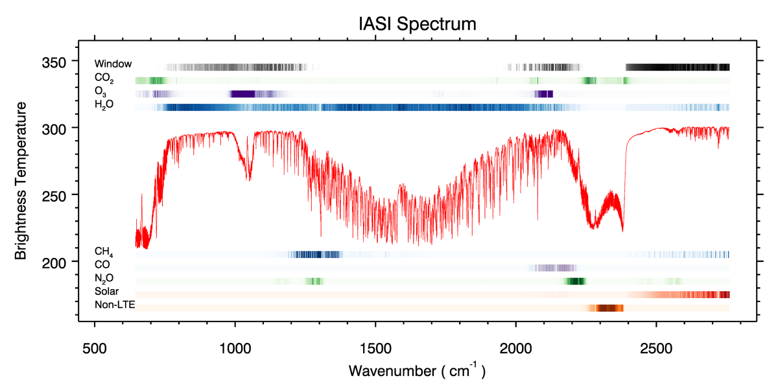
Courtesy Emily Liu

Slide 22
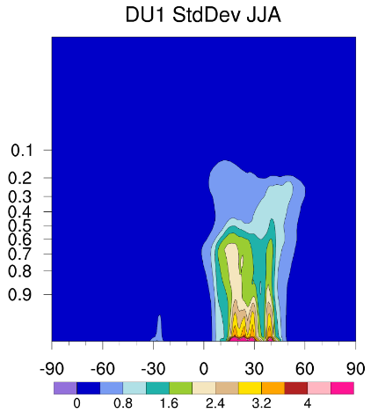
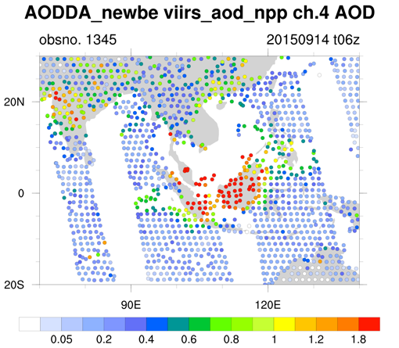
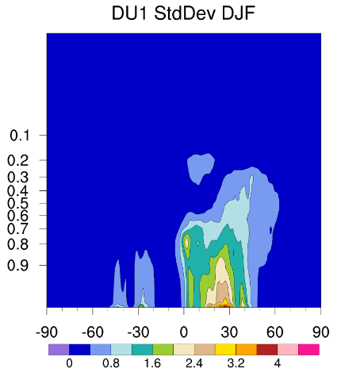
Assimilating satellite aerosol retrievals
With GSI, NCAR and ESRL assimilates MODIS AOD using WRF-CHEM as first guess. The GSI option is extended to assimilate VIIRS AOD using NGAC as first guess.
AOD DA
(GSI)
Observation operator: CRTM v2.2.3
Background Errors
Observation Inputs
(VIIRS AOD)
First guess
(NGACv2)
First global in-line aerosol forecast system at NCEP
Multi-species forecasts (dust, sulfate, sea salt, and carbonaceous aerosols) at T126 L64
Data screening and thinning, considering offset from analysis time, distance from the grid, and retrieval quality
Observation errors are determined from VIIRS versus AERONET comparisons
NMC method is used to determine BE from 12-month NGAC runs

Slide 23
Aerosols in CRTM Planning and Coordination
Goal: Implementation of the Community Multiscale Air Quality (CMAQ) aerosol specifications in CRTM, extending current GOCART model.
Ensure CMAQ speciation covers NAAPS aerosols, and confirm using intercomparisons with previous JCSDA efforts (J. Zhang) to include NAAPS aerosol.
Intercomparison of AOD/aerosol speciation operators (GoCart, NAAPS, CMAQ and NGAC)
Status: actively being worked, slow progress AOD / aerosol intercomparisons are being done at partner agencies (Ooyla/Ruston, Pagowski, Sarah Lu).
Challenges: available effort and expertise, relying on in-kind contributors completely, need to have a utility to integrate and create new aerosol scattering tables, need updated specifications (CMAQ).

Slide 24
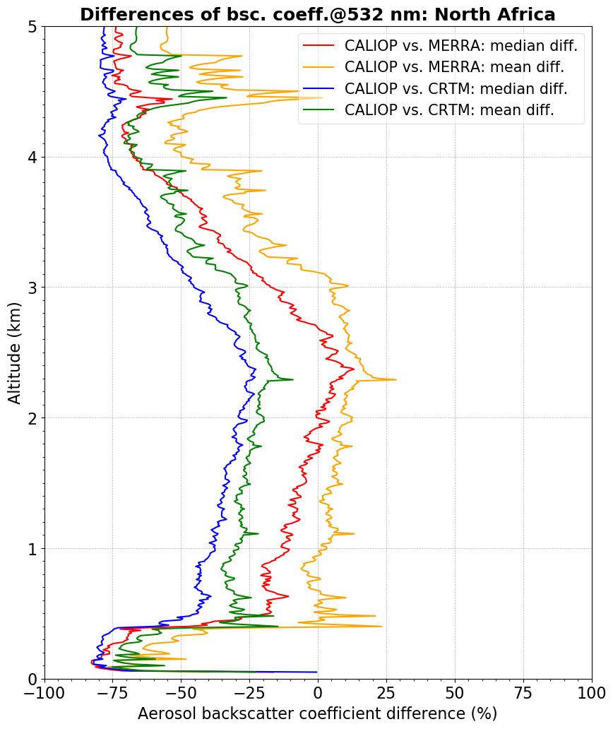
Aerosol + Lidar Work
Aerosol Backscattering Coefficient differences at 532 nm
Goal: Produce an aerosol-sensitive LIDAR forward operator for use in DA, initially focusing on CALIOP
Output: Aerosol specific AOD and LIDAR backscattering coefficient.
Status: Preliminary results (see fig.)
CRTM backscattering compared to MERRA has similar variability, but is consistently too large.
Future: update aerosol scattering tables, find source of difference.

Slide 25
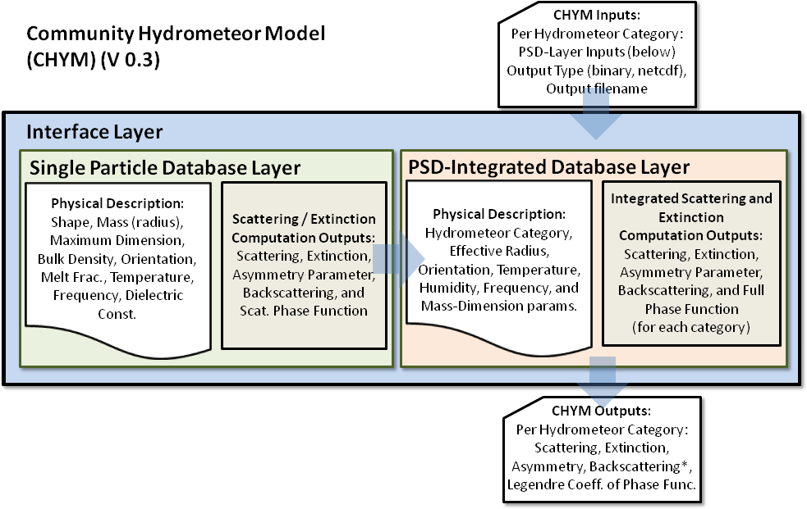
Community Hydrometeor Model CHYM
GFS or User Particle Size Distribution (PSD)
In CRTM at CRTM_CloudCoeff.f90
Processed by CRTM as standard CloudCoeff
B. Johnson (JCSDA / UCAR)

Slide 26
Community Hydrometeor Model CHYM
(1) Development of the microphysical parameters of clouds and precipitation (Lead: Emily Liu)
  Relate to the current and planned GFS microphysical assumptions.
  converting mixing ratios into particle size distributions (PSD) and habit distributions, consistent with the microphysics schemes
(2) Creating the PSD-integrated scattering properties (Lead: Ben Johnson, Patrick Stegmann).
  Extend and replace current CloudCoeff.bin lookup table, consistency with above microphysics
(3) New: Addition of Aerosols to CHYM (similar to Clouds/ Precip. in structure)

Slide 27
Field Campaign information
Expanded Set of Microphysical Data Available
IWC range: 1.E-6 to 1 g m ⁻³
Field Campaign | Year | Location | Instruments | # PSDs
ARM-IOP | 2000 | Oklahoma, USA 2000 | 2D-C, 2D-P, CPI, CVI, FSSP | 1420
TRMM-KWAJEX | 1999 | Kwajalein, Marshall Islands 1999 | 2D-C, HVPS, FSSP | 201
CRYSTAL-FACE | 2004 | SE Florida/Caribbean 2002 | CAPS (CIP, CAS), VIPS | 62
SCOUT | 2005 | Darwin, Australia 2005 | FSSP, CIP | 553
ACTIVE – Monsoons | 2005 | Darwin, Australia 2005 | CAPS (CIP, CAS) | 4268
ACTIVE- Squall Lines | 2005 | Darwin, Australia 2005 | CAPS (CIP, CAS) | 740
ACTIVE- | 2005 | Darwin, Australia 2005 | CAPS (CIP, CAS) | 2583
MidCiX | 2004 | Oklahoma, USA 2004 | CAPS (CIP, CAS), VIPS, FSSP | 2968
Pre-AVE | 2004 | Houston,Texas, USA 2004 | VIPS, CAPS | 99
MPACE | 2004 | Alaska | 2D-C | 671
TC-4 | 2006 | Costa Rica | CAPS, RIP | 877
Credit: Brian Baum’s website: http://www.ssec.wisc.edu/ice_models/microphysical_data.html

Slide 28
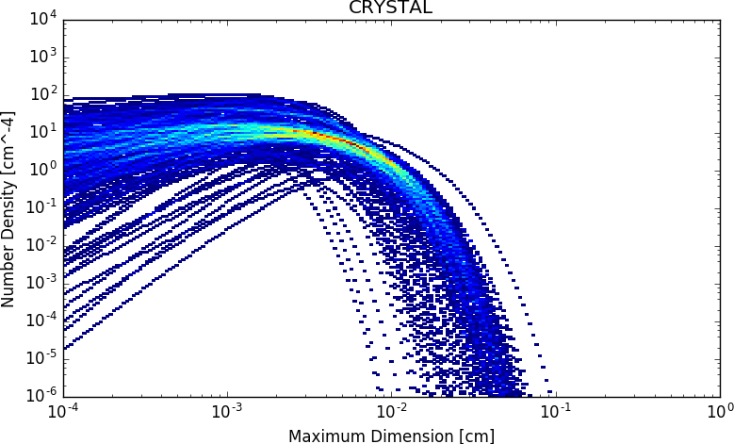
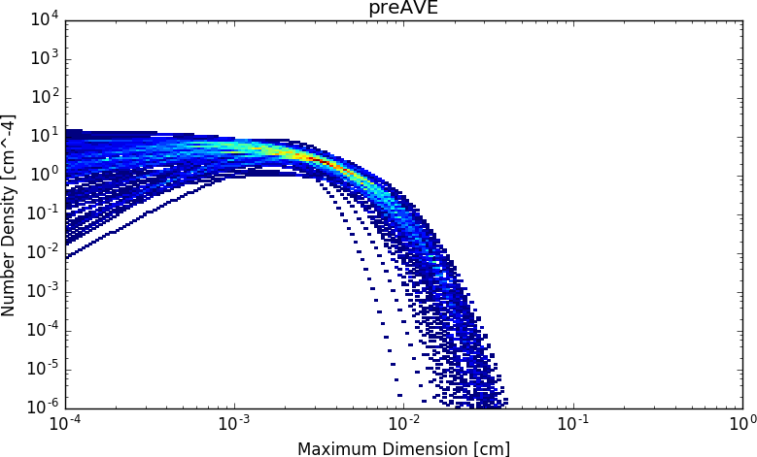
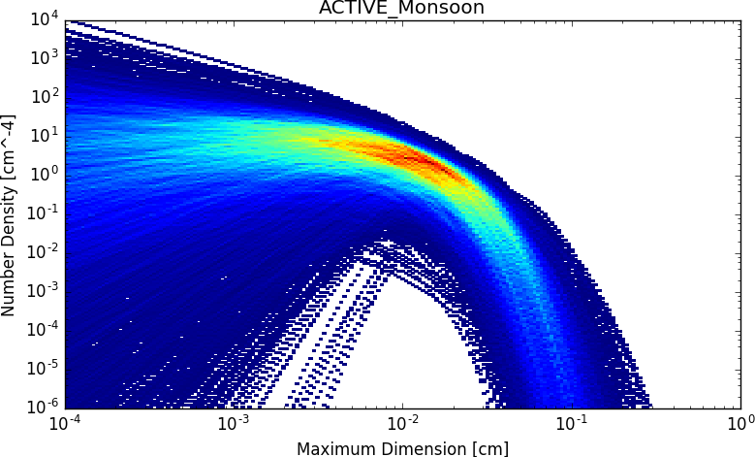
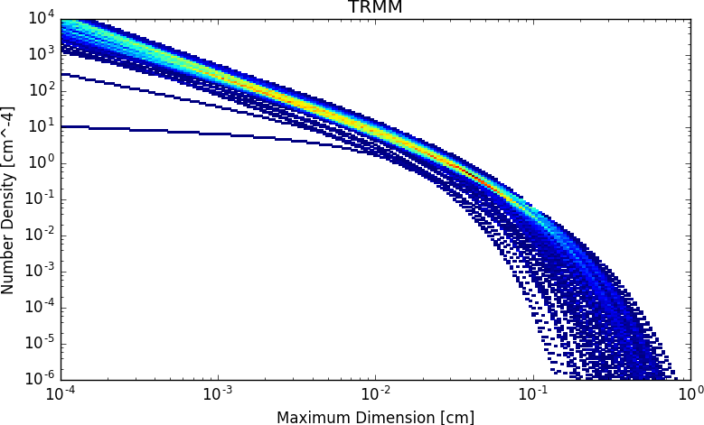
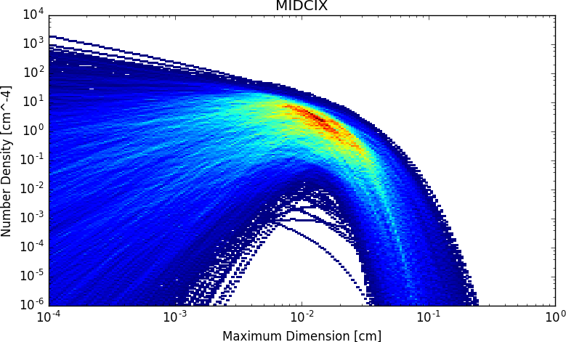
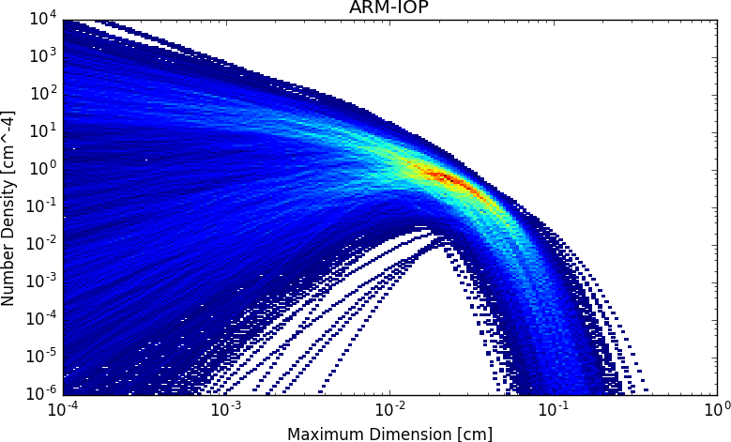
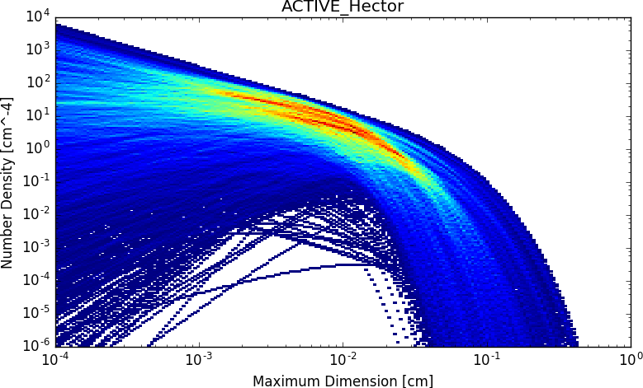
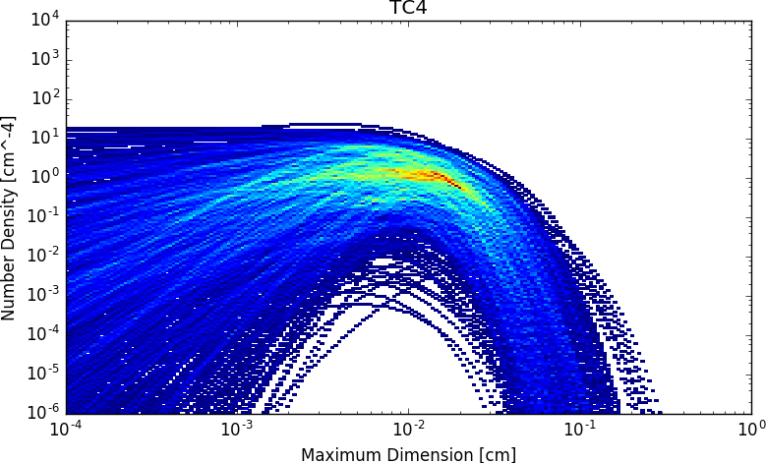
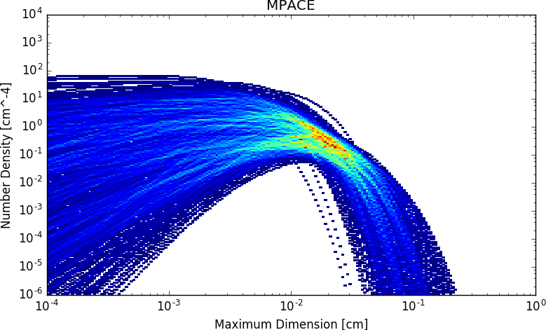
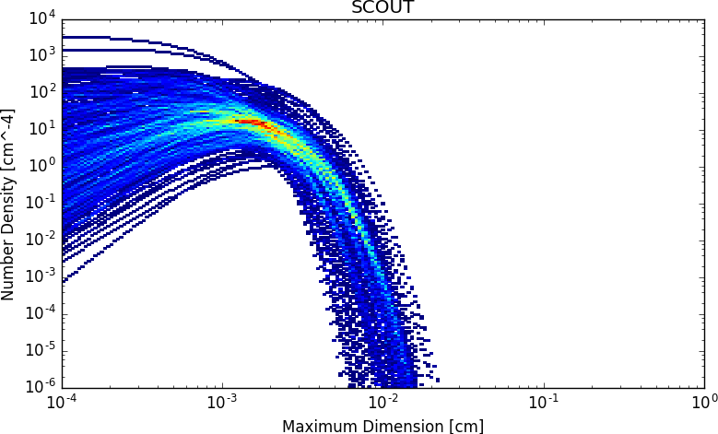
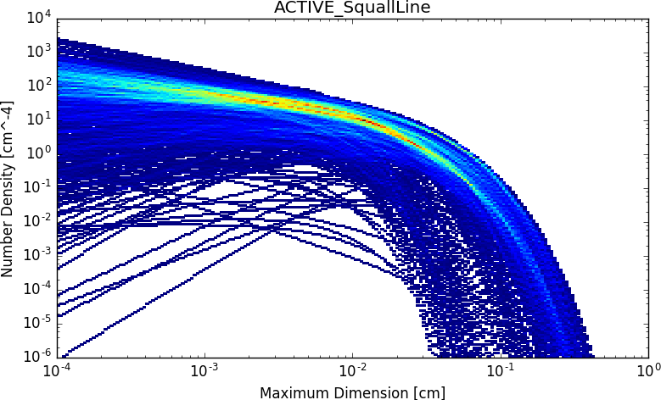
Observed Ice Particle Size Distributions
Precip
PSDs plotted using data downloaded from Brian Baum’s website: http://www.ssec.wisc.edu/ice_models/microphysical_data.htm

Slide 29
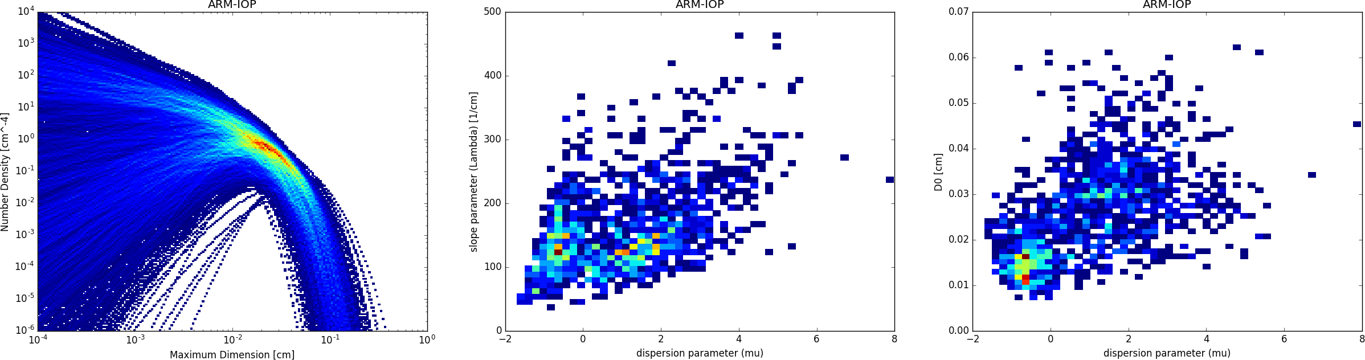
Example: ARM Intensive Observation Program
Cloud Physical Modeling (in CHYM)
N₀ (Intercept Parameter) (cm⁻⁴)
Slope Parameter (Λ)
Maximum Dimension (cm)
Dispersion Parameter (μ)

Slide 30
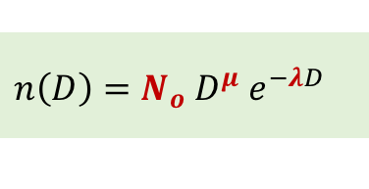
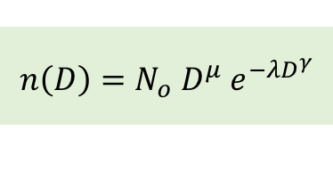

3-parameter Gamma Distribution Function
$$n\left(D\right)=N_{o}{ D}^{μ}{ e}^{−λD^{γ}}$$
General Gamma Function
3-parameter Gamma Function:
$$n\left(D\right)=N_{o}{ D}^{μ}{ e}^{−λD}$$
where $γ=1$; $λ$ is the slope, $μ$ is the dispersion, and $N_{o}$ is the intercept when $μ=0$
D is maximum dimension
Some Useful Expressions related to Gamma Function
$$M_{k}=\int_{0}^{∞}{D^{k} n\left(D\right) dD=N_{o}\int_{0}^{∞}{D^{k+μ}{ e}^{−λD} dD}=N_{o} Γ\left(μ+k+1\right) λ^{−(μ+k+1)} where Γ\left(x\right)=\left(x−1\right)! }$$
k^{th} Moment of
3-parameter Gamma Function
$$m\left(D\right)=aD^{b}$$
Mass and Max. Diameter Relationship
$${N_{t}=M}_{0}=\int_{0}^{∞}{n\left(D\right) dD=N_{o}\int_{0}^{∞}{D^{μ}{ e}^{−λD} dD}=N_{o} Γ\left(μ+1\right) λ^{−(μ+1)}}$$
Total Particle Number Concentration
$${w_{x}=ρ}_{a}q_{x}=\int_{0}^{∞}{m\left(D\right)n\left(D\right) dD=a\int_{0}^{∞}{D^{b}n\left(D\right)dD}=a M_{b}=a{ N}_{o}\int_{0}^{∞}{D^{b}{ e}^{−λD} dD}={a N}_{o} Γ\left(μ+b+1\right) λ^{−(μ+b+1)}}$$
( Hydrometeor Water Content $w_{x}$ = Density of Dry Air $ρ_{a}$ x Hydrometeor Mixing Ratio $q_{x}$ )

Slide 31

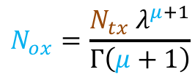
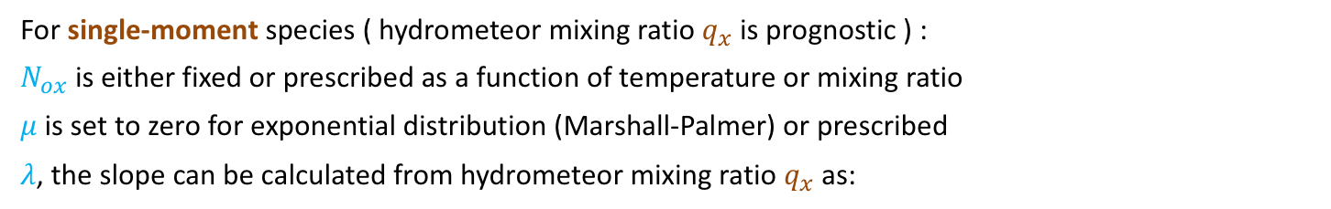
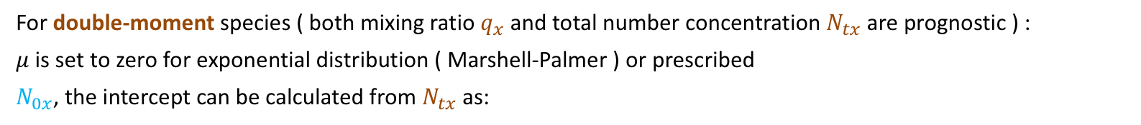
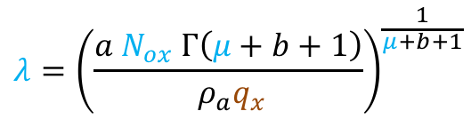
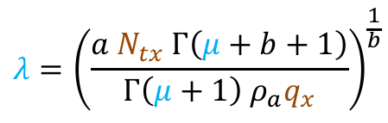
3-parameter Gamma Distribution Function
For single-moment species ( hydrometeor mixing ratio $q_{x}$ is prognostic ) :
$N_{ox}$ is either fixed or prescribed as a function of temperature or mixing ratio
$μ$ is set to zero for exponential distribution (Marshall-Palmer) or prescribed
$λ$, the slope can be calculated from hydrometeor mixing ratio $q_{x}$ as:
Single Moment
Mapping of single-
moment model
mixing ratio to PSD
parameters
$$λ={\left(\frac{a N_{ox} Γ\left(μ+b+1\right)}{ {ρ_{a}q}_{x}}\right)}^{\frac{1}{μ+b+1}}$$
$$w_{x}=ρ_{a}q_{x}={a N}_{ox} Γ\left(μ+b+1\right) λ^{−(μ+b+1)}$$
For double-moment species ( both mixing ratio $q_{x}$ and total number concentration $N_{tx}$ are prognostic ) :
$μ$ is set to zero for exponential distribution ( Marshell-Palmer ) or prescribed
$N_{0x}$, the intercept can be calculated from $N_{tx}$ as:
Double Moment
$$N_{ox}=\frac{N_{tx}{ λ}^{μ+1}}{Γ\left(μ+1\right)}$$
$$N_{tx}=N_{ox} Γ\left(μ+1\right) λ^{−(μ+1)}$$
Mapping of double-
moment concentration
and mixing ratio to PSD parameters
$λ$, the slope can be calculated from $N_{tx}$ and $q_{x}$ as:
$$λ={\left(\frac{a N_{tx} Γ\left(μ+b+1\right)}{Γ\left(μ+1\right){ ρ}_{a}q_{x}}\right)}^{\frac{1}{b}}$$
$$w_{x}=ρ_{a}q_{x}={a N}_{ox} Γ\left(μ+b+1\right) λ^{−(μ+b+1)}$$

Slide 32
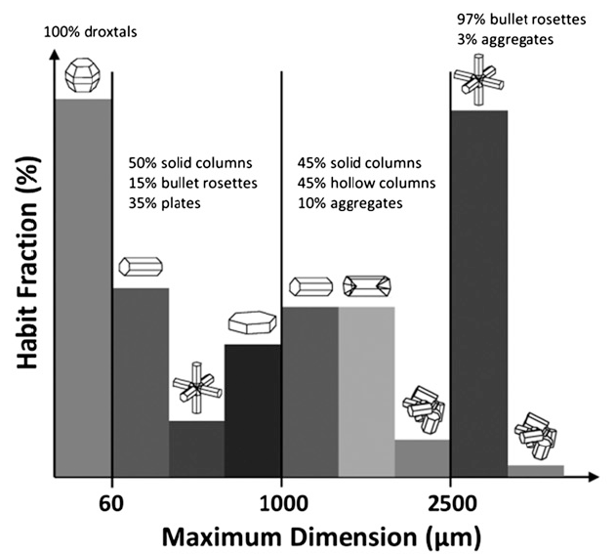
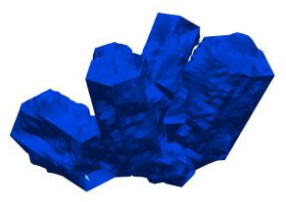
Enhancement of CRTM MODIS Collection 6 ( MC6 )
MODIS Collection 5
MODIS Collection 6
A single habit ice model
an ensemble of aggregates composed of eight severely roughened columns for ice cloud particles
Single Particle Optical Properties
Discrete Dipole Approximation (DDA) for small particles
Geometric Optics (GO) Method for larger particles
Bulk Optical Properties
Gamma size distribution
Temperatures at 160K and 230K
MODID Collection 6

Slide 33
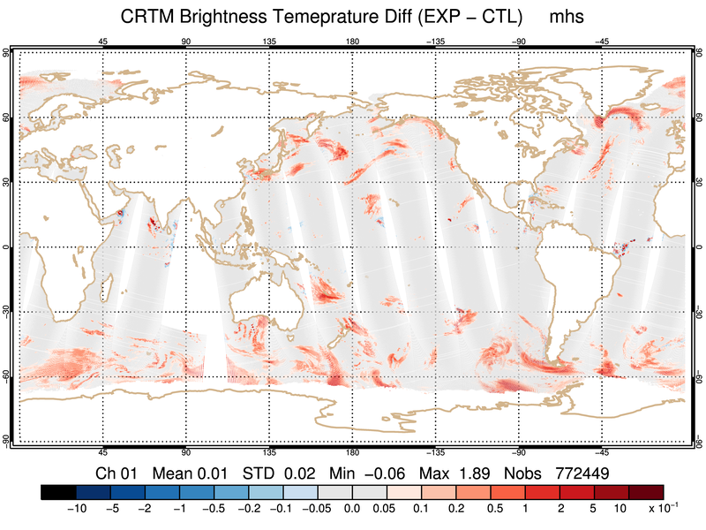
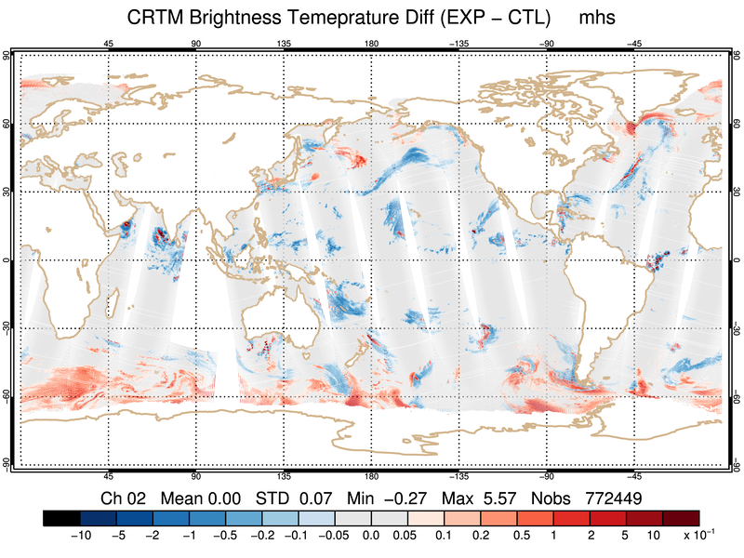
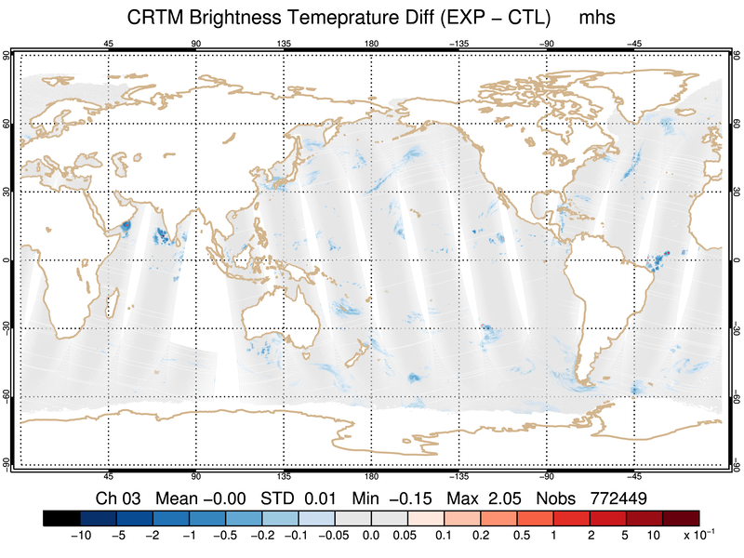
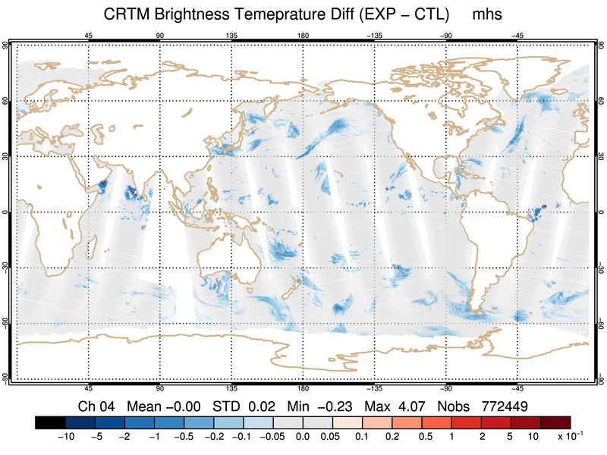
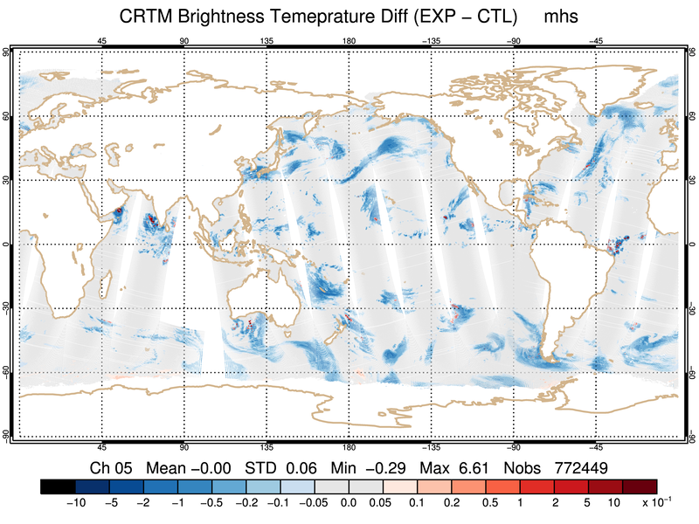
Enhancement of CRTM MC6 – Default
MC6 Optical Properties evaluated at T=230 K
Impact on AMSU-A is insignificant
MHS Metop-a

Slide 34
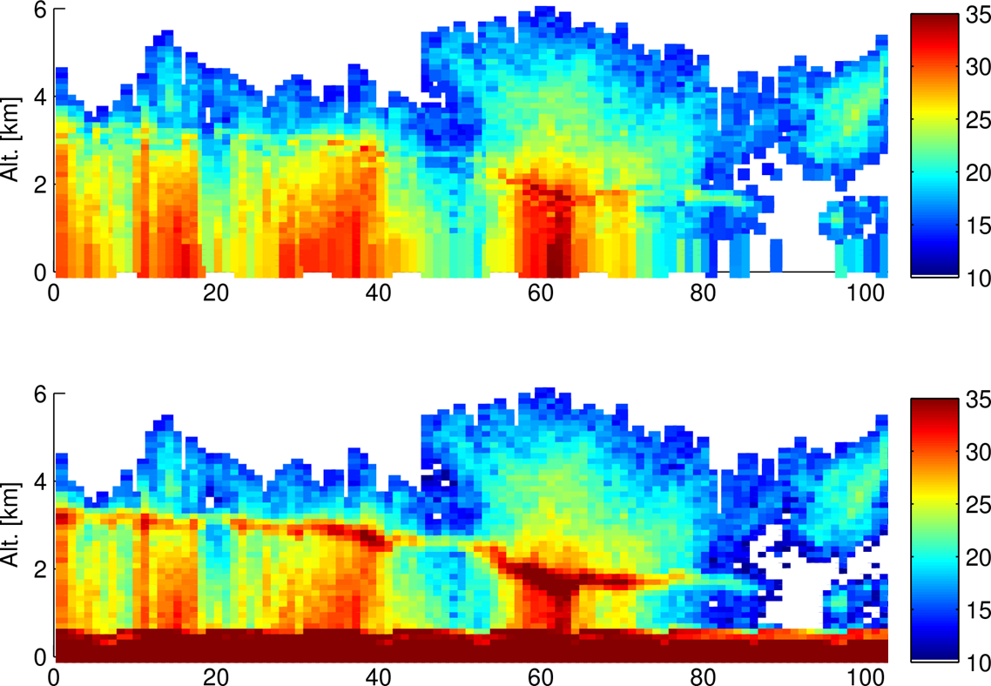
Space-based Radar Simulations (CASM)
Goal: Active Space-based Radar Simulation and Jacobians for satellite DA
Tested for Ku, Ka, and W
Output: Radar reflectivity and 2-way PIA
Status: TL and AD models under testing
Next: Melting layer model, ground-based radar, polarization
(a) CASM (Sim.) Z_{m} [dBZ] @ Ku-band (14 GHz)
CRTM Simulation
(b) GPM DPR (Obs.) Z_{m} [dBZ] @ Ku-band (14 GHz)
Observed Reflectivities

Slide 35
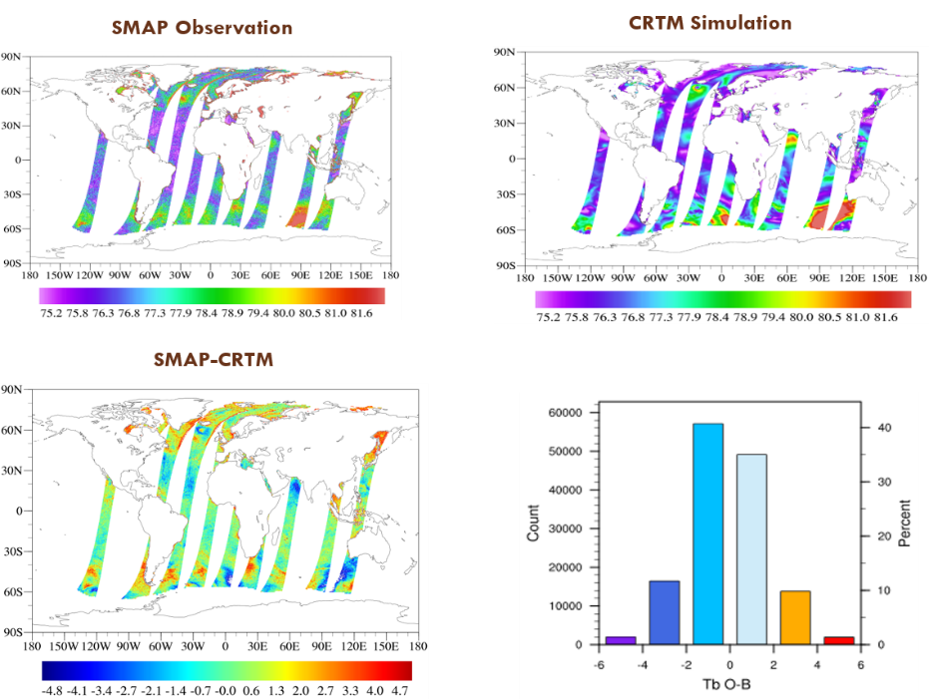
Surface Work :: CSEM (M. Chen)
Highlights:
CSEM top-down interfaces were refined to support upper-level vectorised RT solvers.
The first integrated CRTM-CSEM version was successfully implemented in ProdGSI, and passed single cycle GSI testing. More comprehensive tests will be performed in collaboration with the EMC DA group.
The tangent linear and adjoint modules of the physical MW land model were implemented and tested in the CSEM 1.0.0, which will be applied to the radiance DA, GSI QC and the emissivity retrieval data assimilation.
Implementation of L-band in CRTM has been tested with the integrated CRTM-CSEM. Since the CRTM quality of the L-band channels basically relies on the surface models, several efforts are being taken to the improve the model physics. Results are very promising toward L-band radiance DA.

Slide 36
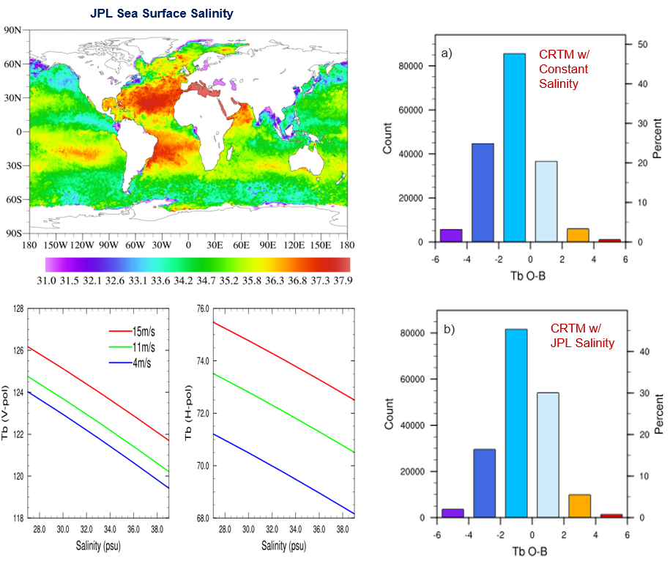
Surface Work :: CSEM (M. Chen)
The testing of CRTM-CSEM in FV3 GFS/GSI is in progress. Such testing focuses on the comparisons among different model options of the same model class (e.g., MW-LAND). While the ultimate testing analysis will target on the O-B and O-A of different model options, the ongoing testing effort is to ensure that each CSEM model component run smoothly and correctly in parallel environment with real input ingested from GSI.
Implementation of the JPL SMAP Level-3 monthly sea surface salinity (SSS) atlas into CSEM to account for the impact of SSS on the forward Tbs simulation and to improve the first guess accuracy in DA, especially for the L-band Tb. In the current FV3 GFS/GSI, a constant SSS value (33.0 PSU) is used, which may bring about ±0.5K bias from K-band (20-40GHz) to ±1.5K bias at L-band (1.4GHz). As shown in the Tb O-B, the negative bias with constant sea surface salinity may be reduced with the JPL Salinity as the model input.

Slide 37
JCSDA Overview
What is the CRTM?
Code and Solver Optimization
Scientific Capabilities and Progress
CRTM v2.3.x and v3.0.0
Operations and Support
Education / Outreach

Slide 38
CRTM REL-2.3.0 New features
1. All-Sky radiance simulation under various cloud_fraction conditions.
2. Use of all-sky transmittances in FASTEM-X reflection correction.
3. Improve surface reflectance in radiative transfer calculation for Microwave under scattering conditions.
4. Add ATMS SeaIce emissivity module.
5. Fix the simulation near 3.9 micron by adding solar contribution in ADA_Module.
6. Updates of CRTM Coefficients for ABI_GOES-R, AHI_Himawari -8.
7. Updates of CRTM antenna correction coefficients for MHS_N19/Metop-a.
8. Update AIRS coefficients for including NLTE correction.
9. Add new coefficients for: CrIS-fsrB1/B2/B3_NPP, CrIS*_N20, CrIS-fsr431_npp/n20, AHI_Himawari-9, ABI_G16, VIIRS-JPSS1, ATMS_N20, ATMS_N20-SRF, COWVR, tropics_designed_v1.
* In this release, there is a new feature for the simulation of all-sky (cloudy) radiance, which utilizes Fortran class functions. CRTM will support the new compiler with class functions, such as ifort version (14.0+, 15.0+, 16.0+, 17.0+),
gfortran version (gcc 4.8.5, 4.9, 5.4, 6.4, 7.2), pgi/17.3, ftn/2.3.0.

Slide 39
CRTM REL-2.3.1 New features
CRTM Rel-2.3.1 new features:
Integrate New/Updated Coefficients into CRTM trunk:
  Earth Observing Nanosatellite-Microwave: eon_mw.v1
  Sentinel-3A Sea and Land Surface Temperature Radiometer: slstr_sentinel3a
  Meteosat-11 SEVIRI: seviri_m11, and sent to users at NRL and OSPO
  New coefficient for ABI_G17, and updated IDs from ABI_GR to ABI_G16
  New coefficients for Metop-C sensors: AVHRR3_Metop-C, IASI(b1,b2,b3)_Metop-C, IASI300_Metop-C, IASI316_Metop-C, IASI616_Metop-C
  SMAP and SMOS for STAR Ocean and Land Teams data assimilation projects
  MI-L_COMS.v2: Update for a shifted WV band SRF
  Tempest-D_cubesat: 5 microwave bands at 87, 164, 173, 178, and 181 GHz, designed at CSU/JPL
Integrate Bug fixes:
  In CRTM_CloudCover_Define.f90, fixing “Intent(in)” to “Intent(inout)” for using gfortran compiler error
  In CRTM_CloudCover_Define.f90, when using the “Maximum-Random” scheme to calculate Total Cloud Cover
  ATMS_SnowEM_module: Comment out uninitialized (also unused) variables and calculations
  Correction to make.dependencies generation
  Corrected overflow / underflow issue with allocated arrays not being zeroed (found with gfortran 8.2.0)

Slide 40
Ongoing tasks toward CRTM 3.0
Cloudy Radiance (P. Stegmann, E. Liu, Johnson)
  Adding backscattering coefficients for CRTM active sensor capability.
  Produce (Polarized) CRTM Scattering Coefficients from BHMIE and T-Matrix spheroids in binary and NetCDF
  Start systematic investigation of “optimal” single-scattering properties for CRTM applications
Surface (M. Chen, Y. Zhu)
  Test CRTM-CSEM in GFS/GSI, focusing on the comparisons among model options.
  Analyze and document the tests of CRTM-CSEM in GFS/GSI.
  Initial implementation of MW ocean surface BRDF model.
  Continued testing of CSEM in GSI
Full Polarization Solver Capability (T. Greenwald, Q. Liu, B. Johnson, C. Cao)
  UV capable solver + polarization support under development
  Need to touch each element of CRTM to support UV capabilities – still establishing scope of effort required.
SW / IR improvements in CRTM:
  Aerosol + solar impacted IR expert needed!
Aerosols update (Johnson, Stegmann, S. Lu, M. Pagowski, B. Scherllin-Pirscher, Oyola/Ruston, others).
  Update of CHYM to work with aerosol tables (Johnson, Stegmann)
  Improved aerosol indices of refraction (via D. Turner and J. Gasteiger)
  Update toward CMAQ specifications (Team)
  Improve Lidar backscattering and attenuation calculations (Pagowski, Scherllin-Pirscher)

Slide 41
JCSDA Overview
What is the CRTM?
Code and Solver Optimization
Scientific Capabilities and Progress
CRTM v2.3.x and v3.0.0
Operations and Support
Education / Outreach

Slide 42
CRTM Role in Operations
CRTM enables satellite data assimilation
  Forward model simulates satellite radiances or brightness temperatures
  Jacobian simulates radiance sensitivity to changes in model state (dR/dx or dTB/dx)
CRTM is used in dozens of operational, reanalysis, and research models:
  NOAA, Navy, Air Force, NASA
The only other competitive model is RTTOV used by the European and other non-U.S. weather communities.
  Significant heritage shared between CRTM and RTTOV over the past decade of coordination and collaboration on scientific advancement, which continues today.
CRTM will be used in future systems, including NGGPS, and JEDI as the key driver for satellite DA.

Slide 43


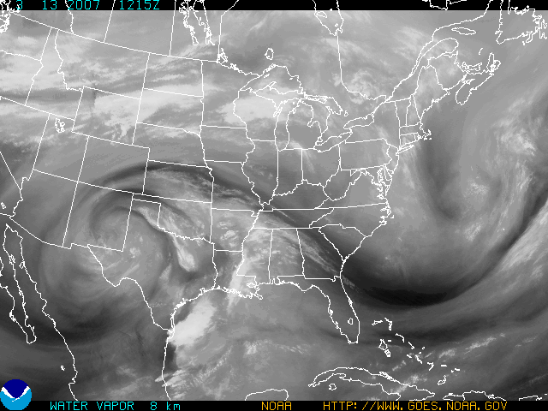
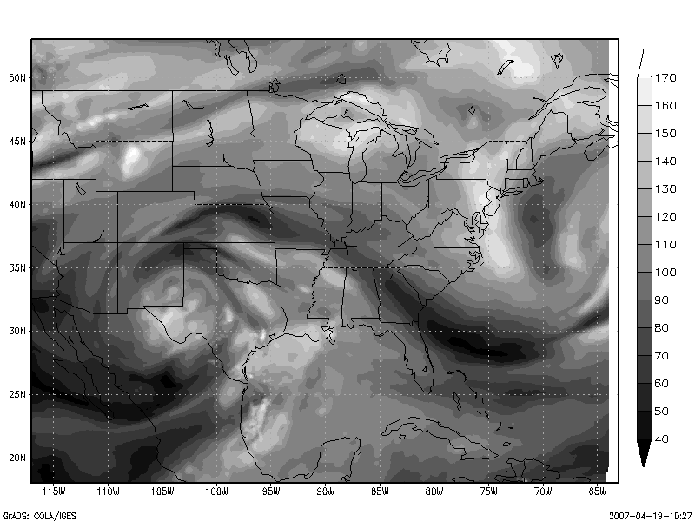
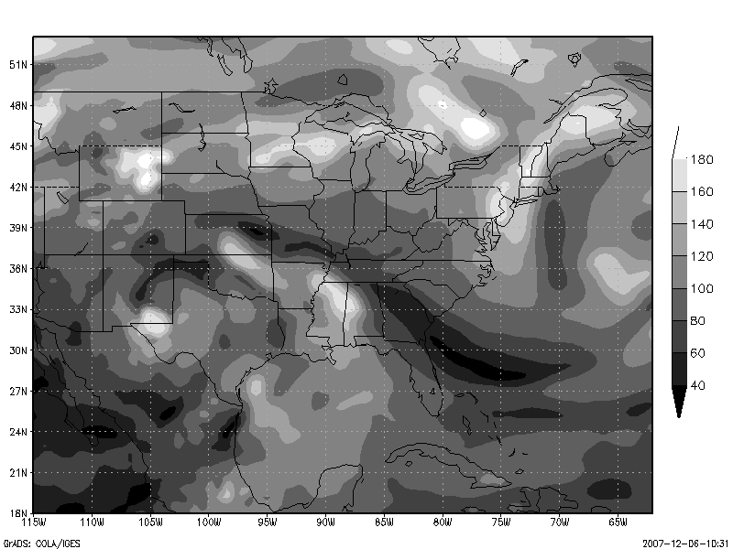
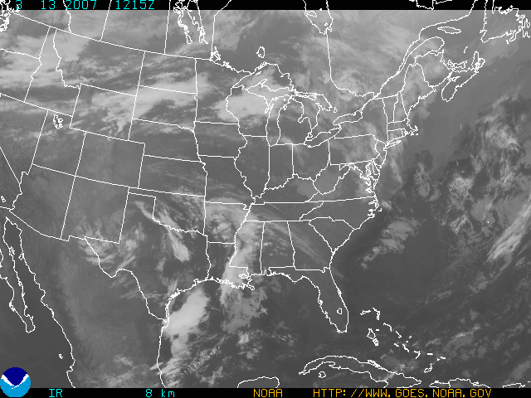
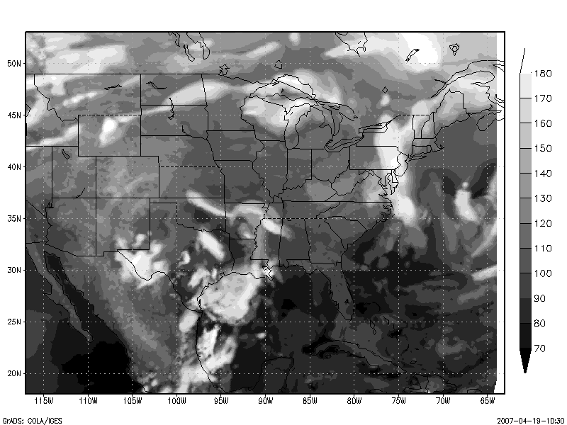
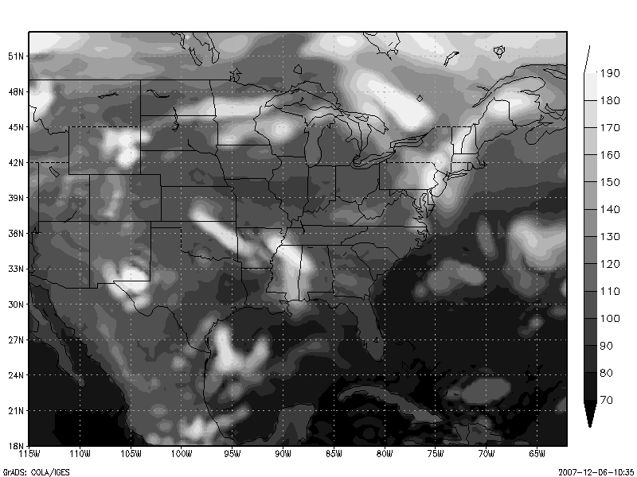
Simulated GOES Imagery vs Analysis:
Spring case. Verified at 12 UTC March 13 2007
GOES 12 Ch 3 (6.7µm)
NAM Analysis
GFS Analysis
GOES 12 Ch 4 (10.7µm)
Slide courtesy of Andrew Collard

Slide 44
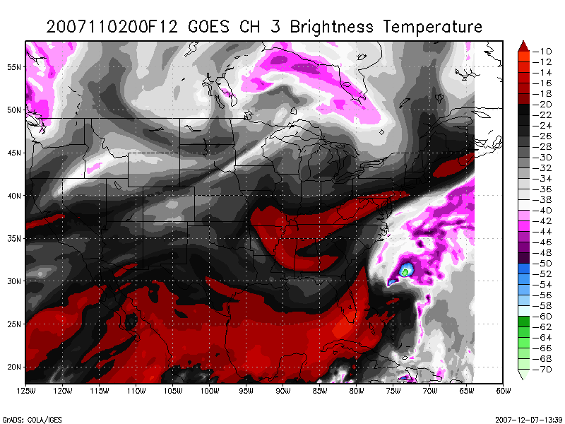
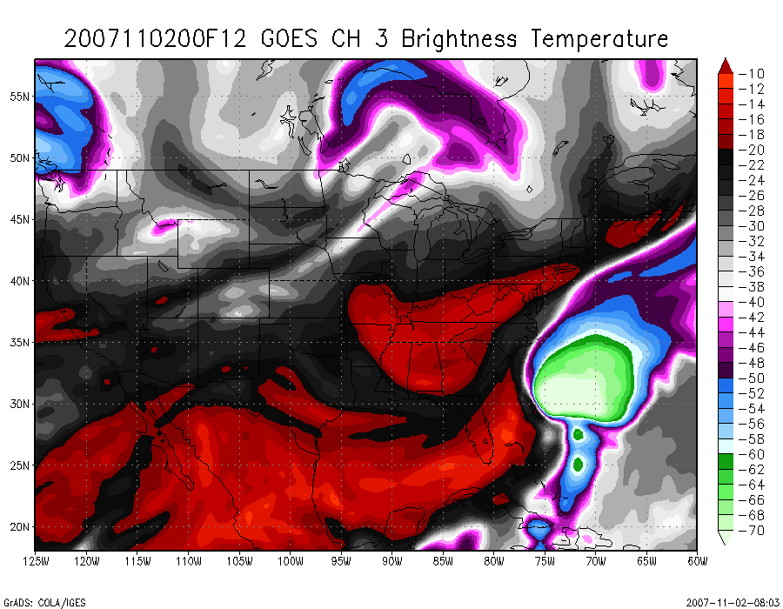




Simulated GOES Imagery vs Forecast:
Tropical Storm Noel. Verified at 12 UTC November 2 2007
GOES 12 Ch 3 (6.7µm)
NAM 12 Hr Forecast
GFS 12 Hr Forecasat
GOES 12 Ch 4 (10.7µm)
Slide courtesy of Andrew Collard

Slide 45

CRTM-JEDI Interface Forward Operator
Goal: reproduce GSI-CRTM TBs via UFO interface
806 profiles taken from GSI
Differences approximately 1e-5 K
GSI bias correction provided for reference.
Key point: UFO CRTM accurately reproduces GSI CRTM for the same physical profiles.
FV3-JEDI interface mostly completed.
Next: adding additional sensors according to priority.
Latitude
Difference: GSI – UFO [K]
Latitude
Longitude
Longitude

Slide 46
JCSDA:: Revolution in Ecosystem and Working Practices
NRL
Strong community engagement @coding level (not ‘working groups’)
Transparent and inclusive process
Continuous online discussions
+ testing
Fast-paced code development
+ reviews
EMC
JEDI core
Forks
Central repo.
Push +
Pull request
GMAO
ESRL
Community
controlled
Lab. controlled
.edu
NCAR
Community repositories on github.com/JCSDA + flexible build system + ‘graduate student test’
Improved collaborative environment (Zenhub issue tracking, Sphinx/ReadTheDocs/Doxygen, Singularity containers)
Enforce software quality (correctness, coding norms, efficiency)
Initial work toward continuous integration

Slide 47
CRTM Umbrella Repository Strategy
(Goal: complete consistency and interoperability with UFS/NGGPS/JEDI strategy)
CRTM authoritative
repositories
github.com/JCSDA/
CRTM_dev
CRTM_doc
CRTM_externals
CRTM_fix
CRTM_srf
Authoritative Master
Source Code
CRTM tech. notes
& documentation
External tools used to
create coefficient files
Coefficient files
and lookup tables
Spectral Response
Function database
Gold Master Repositories forked from CRTM_dev, reside on branch/division local repositories
STAR
EMC
NOAA Public
NRL
GMAO
Air Force
Universities
Local Working
Repositories

Slide 48
User and Developer Support
Please join our new CRTM google groups:
Announcements:
https://groups.google.com/forum/#!forum/crtm
Support:
https://groups.google.com/forum/#!forum/crtm-support
Developer Discussion:
https://groups.google.com/forum/#!forum/crtm-developers
New support email:
crtm-support@googlegroups.com
This will post to the support forum, so anything you email will be available to the members of the support group.
Email: Benjamin.T.Johnson@noaa.gov for direct support, questions, and comments
These groups replace the legacy listserv groups.

Slide 49
JCSDA Overview
What is the CRTM?
Code and Solver Optimization
Scientific Capabilities and Progress
CRTM v2.3.x and v3.0.0
Operations and Support
Education / Outreach

Slide 50
Education / Training / Outreach
The CRTM team successfully held the CRTM User/Developer’s workshop on May 16, 2017 in conjunction with the CRTM Scientific and Technical workshop (May 17 – May 19). The workshop consisted of a series of tutorials on CRTM operation and development. A particular focus was on covering the adjoint and tangent-linear programming. Also covered was spectral and transmittance coefficient generation, and regression / unit testing. There were 7 instructors more than 40 participants -- with about 16 in-person and more than 25 online. Feedback was overwhelmingly positive.

Slide 51
JCSDA Summer Colloquium on Satellite Data Assimilation
Bozeman, Montana July 22 – August 3, 2018
Objective: Foster the education of the next generation of data assimilation scientists.
Colloquium Topics:
  Data assimilation fundamentals including variational and ensemble techniques
  Satellite data observation techniques, including infrared and microwave
  Satellite data assimilation techniques
  Overview of atmospheric, ocean, land, sea-ice, wave and aerosol data assimilation
  Overview of the global observing system.
Summary Article:
  https://repository.library.noaa.gov/view/noaa/19248

Slide 52
Final Remarks about the CRTM Workflow
Conceptual leap
New and more unified approach to development, distribution, and maintenance of software
Streamlined processes and operations
  Targeted inter-dependent activities with measurable deliverables
  Annual Operating Plan improving coordination and accountability
  State-of-the-art collaborative ecosystem
Operating within a Center of excellence
Unprecedented level of collaboration at scientific/technical level
Highly skilled core staff committed to the success of JCSDA projects
Focus on transitional research
Faster, better, cheaper, safer transition between research and operations
Constantly striving to be proactive and available to operational requirements

Slide 53
Questions / Comments?
Please join our new CRTM google groups:
Announcements:
https://groups.google.com/forum/#!forum/crtm
Support:
https://groups.google.com/forum/#!forum/crtm-support
Developer Discussion:
https://groups.google.com/forum/#!forum/crtm-developers
New support email:
crtm-support@googlegroups.com
This will post to the support forum, so anything you email will be available to the members of the support group.
Email: Benjamin.T.Johnson@noaa.gov for direct support, questions, and comments
These groups replace the legacy listserv groups.

Slide 54










Field 07 Snow Particle Size Distribution
IWC
T_{c}
Mass-Dimensional Relationship
$m\left(D\right)=aD^{b}$
$$IWC=0.0931 gm^{−3}$$
$$T_{c}=−49.7 °C$$
Retrieved Particle Size Distribution
Tropics
Mid-latitude
$$a=0.0257$$
$$m\left(D\right)=aD^{2}$$
$$a=0.069$$
$$a=0.04$$
F07 PSD Parameterization
Based on 10,000 in situ PSDs
Second moment is linked to any other moment via polynomial fits to the in-cloud temperature
Any given IWC and in-cloud temperature, the original PSD can be estimated
$$\left\{\begin{aligned}x=D\frac{M_{2}}{M_{3}} \\ { Φ}_{23}\left(x\right)=N\left(D\right)\frac{M_{3}^{3}}{M_{2}^{4}}\end{aligned}\right.$$
$$N\left(D\right)=Φ_{23}\left(x\right)\frac{M_{2}^{4}}{M_{3}^{3}}$$
$$M_{n}=A\left(n\right)\exp\left[B\left(n\right)T_{c}\right]{ M}_{2}^{C\left(n\right)}$$
$$A\left(n\right)=exp\left(13.6−7.76n+0.479n^{2}\right)$$
B$\left(n\right)=−0.0361+0.0151n+0.00149n^{2}$
$$C\left(n\right)=0.807+0.00581n+0.0457n^{2}$$
Tropical Regime:
$$Φ_{23}\left(x\right)=152e^{−12.4x}+3.28x^{−0.78}e^{−1.94x}$$
Mid-latitude Regime:
$$Φ_{23}\left(x\right)=141e^{−16.8x}+102x^{2.07}e^{−4.82x}$$
$${w_{s}=ρ_{a }q_{s}=a_{s} M}_{b_{s}}→M_{b_{s}}=\frac{w_{s}}{a_{s}}=\frac{ρ_{a}{ q}_{s}}{a_{s}}$$
$M_{2}={\left( \frac{M_{b_{s}}}{A\left(b_{s}\right) exp\left[B\left(b_{s}\right)T_{c}\right]} \right) }^{\frac{1}{C\left(b_{s} \right)}} →$ ${ M}_{n} =A\left(n\right)\exp\left[B\left(n\right)T_{c}\right]{ M}_{2}^{C\left(n\right)}$

Slide 55
Thompson Cloud Scheme
WRF with modification from Ruiyu Sun

Slide 56

Liquid Hydrometeors
Variable | Habit | Density $ρ$ | Mass-Diameter $$m−D$$ | Size Distribution $N(D)$ | Distribution Parameters | Effective (Characteristic) Diameter $D_{e}$
Cloud Water $$q_{c}$$ $$w_{c}=ρ_{a}q_{c}$$ | Spherical | 1.00 | $$a_{c}D^{b_{c}}={\frac{π}{6}ρ_{c}D}^{3}$$ | Gamma $$N_{oc}{ D}^{μ_{c}}{ e}^{−λ_{c}D}$$ | $N_{tc}={10}^{8} m^{−3}$ (maritime) Prescribed $$μ_{c}=min\left( 15,\frac{{10}^{9}}{N_{tc}}+2 \right); 2<μ_{c}<=15$$ $$λ_{c}={\left( \frac{a_{c }N_{tc} Γ\left({ μ}_{c}+b_{c}+1 \right)}{ρ_{a}{ q}_{c} Γ\left({ μ}_{c}+1 \right)} \right)}^{\frac{1}{{ b}_{c}}}$$ $$N_{oc}=\frac{N_{tc}{ λ_{c}}^{μ_{c}+1}}{Γ\left({ μ}_{c}+1 \right)}$$ | $$D_{ec}=\frac{M_{3}}{M_{2}}$$ $$=\frac{\int_{0}^{∞}{D^{3}N\left(D\right)dD}}{\int_{0}^{∞}{D^{2}N\left(D\right)dD}}$$ $$=\frac{{Γ\left( μ_{c}+4 \right)λ}^{−( μ_{c}+4 )}}{{Γ\left({ μ}_{c}+3 \right)λ}^{−( μ_{c}+3 )}}$$ $$=\frac{μ_{c}+3}{λ_{c}}$$
Rain $$q_{r}$$ $$N_{tr}$$ $$w_{r}=ρ_{a}q_{r}$$ | Spherical | 1.00 | $$a_{r}D^{b_{r}}={\frac{π}{6}ρ_{r}D}^{3}$$ | Exponential $$N_{or}{ D}^{μ_{r}} e^{−λ_{r}D}$$ | $$μ_{r}=0$$ $$λ_{r}={\left(\frac{a_{r }N_{tr} Γ\left({ μ}_{r}+b_{r}+1 \right)}{{ρ_{a} q}_{r} Γ\left(μ_{r}+1\right)}\right)}^{\frac{1}{b_{r}}}$$ $$N_{or}=\frac{N_{tr}{ λ_{r}}^{μ+1}}{Γ\left( μ_{r}+1 \right)}$$ | $$D_{er}=\frac{M_{3}}{M_{2}}$$ $$=\frac{\int_{0}^{∞}{D^{3}N\left(D\right)dD}}{\int_{0}^{∞}{D^{2}N\left(D\right)dD}}$$ $$=\frac{{Γ\left({ μ}_{r}+4 \right) λ}^{−( μ_{r}+4 )}}{{Γ\left({ μ}_{r}+3 \right) λ}^{−({ μ}_{r}+3 )}}$$ $$=\frac{3}{λ_{r}}$$
All units are defined in SI units unless noted

Slide 57

Solid Hydrometeors
Variable | Habit | Density $ρ$ | Mass-Diameter $$m−D$$ | Size Distribution $N(D)$ | Distribution Parameters | Effective (Characteristic) Diameter $D_{e}$
Cloud Ice $$q_{i}$$ $$N_{ti}$$ $w_{i}=ρ_{a}q_{i}$ | Spherical | 0.89 | $$a_{i}D^{b_{i}}={\frac{π}{6}ρ_{i}D}^{3}$$ | Exponential $$N_{oi}{ D}^{μ_{i}}{ e}^{−λ_{i}D}$$ | $$μ_{i}=0$$ $$λ_{i}={\left( \frac{a_{i }N_{ti} Γ\left({ μ}_{i}+b_{i}+1 \right)}{{ρ_{a} q}_{i} Γ\left({ μ}_{i}+1 \right)} \right)}^{ \frac{1}{b_{i}}}$$ $$N_{oi}=\frac{N_{ti}{ λ_{i}}^{ μ+1}}{Γ\left( μ_{i}+1 \right)}$$ | $$D_{ei}=\frac{M_{3}}{M_{2}}$$ $$=\frac{\int_{0}^{∞}{D^{3}N\left(D\right)dD}}{\int_{0}^{∞}{D^{2}N\left(D\right)dD}}$$ $$=\frac{{Γ\left({ μ}_{i}+4 \right)λ}^{−({ μ}_{i}+4 )}}{{Γ\left({ μ}_{i}+3 \right)λ}^{−({ μ}_{i}+3 )}}$$ $$=\frac{3}{λ_{i}}$$
All units are defined in SI units unless noted

Slide 58
Solid Hydrometeors
Variable | Habit | Density $ρ$ | Mass-Diameter $$m−D$$ | Size Distribution $N(D)$ | Distribution Parameters | Effective (Characteristic) Diameter $D_{e}$
Graupel $$q_{g}$$ $$w_{g}=ρ_{a}q_{g}$$ | Spherical | 0.50 | $$a_{g}D^{b_{g}}={\frac{π}{6}ρ_{g}D}^{3}$$ | Exponential $$N_{og}{ D}^{μ_{g}}{ e}^{−λ_{g}D}$$ | $N_{o,min}={10}^{−4}$ $N_{o.max}=3×{10}^{6}$ $$x=\left\{\begin{aligned}4.01+\log_{10}\left(D_{med,r}\right) T<270.56 and{ D}_{med,r}<{10}^{−4} \\ 0.01 Otherwise \end{aligned}\right.$$ Where${ D}_{med,r}=\frac{3+μ_{0.}+0.672}{λ_{r}}$ is the median mass diameter for rain $$y=4.31+\log_{10}\left( max⁡( 5×{10}^{−5}, {ρ_{a}q}_{r }\right)$$ $$z=3.1+\frac{100}{\left[ \frac{300xy}{ \left(\frac{10}{x}+1+0.25y\right)}+30+10y \right]}$$ $$N_{o,exp}={10}^{z}$$ $N_{o,exp}=max\left(N_{o,min}, min\left(N_{o,exp},N_{o,max}\right)\right)$ $N_{o,min}=min\left(N_{o,exp}, N_{o,min}\right)$ $$N_{o,exp}{=N}_{o,min}$$ $$λ_{exp}= N_{o,exp}{\left(\frac{a_{g}Γ\left(b_{g}+1\right)}{ρ_{a}q_{g}}\right)}^{\frac{1}{b_{g}+1}}$$ $$λ_{g}=λ_{exp}{\left(\frac{Γ\left(b_{g}+μ_{g}+1\right)}{\left(b_{g}+μ_{g}+1\right)\left(μ_{g}+1\right)}\right)}^{\frac{1}{b_{g}}}$$ $N_{og}=\frac{N_{o,exp}}{\left({Γ\left(μ_{g}+1\right)λ}_{exp}\right)}{λ_{g}}^{μ_{g}+1}$ | $$D_{eg}=\frac{M_{3}}{M_{2}}$$ $$=\frac{\int_{0}^{∞}{D^{3}N\left(D\right)dD}}{\int_{0}^{∞}{D^{2}N\left(D\right)dD}}$$ $$=\frac{{Γ\left({ μ}_{g}+4 \right)λ}^{−({ μ}_{g}+4 )}}{{Γ\left({ μ}_{g}+3 \right)λ}^{−({ μ}_{g}+3 )}}$$ $$=\frac{3}{λ_{g}}$$
All units are defined in SI units unless noted

Slide 59

Solid Hydrometeors ( Field 2007 )
Variable | Habit | Density $ρ$ | Mass-Diameter $$m−D$$ | Size Distribution $N(D)$ | Distribution Parameters | Effective Diameter $D_{e}$
Snow $$q_{s}$$ $$w_{s}=ρ_{a}q_{s}$$ | Non-spherical Fractal-like aggregated crystals (Cox,1988) | Variable (?) | $$a_{s}D^{b_{s}}={0.069D}^{2}$$ | Field ( 2007 ) $$\left\{\begin{aligned}x=D\frac{M_{2}}{M_{3}} \\ { Φ}_{23}\left(x\right)=N\left(D\right)\frac{M_{3}^{3}}{M_{2}^{4}}\end{aligned}\right.$$ $$N\left(D\right)=Φ_{23}\left(x\right)\frac{M_{2}^{4}}{M_{3}^{3}}$$ | $$M_{n}=A\left(n\right)\exp\left[B\left(n\right)T_{c}\right]{ M}_{2}^{C\left(n\right)}$$ $$A\left(n\right)=exp\left(13.6−7.76n+0.479n^{2}\right)$$ B$\left(n\right)=−0.0361+0.0151n+0.00149n^{2}$ $$C\left(n\right)=0.807+0.00581n+0.0457n^{2}$$ $${w_{s}=ρ_{a }q_{s}=a_{s} M}_{b_{s}}→M_{b_{s}}=\frac{w_{s}}{a_{s}}=\frac{ρ_{a}{ q}_{s}}{a_{s}}$$ $M_{2}={\left( \frac{M_{b_{s}}}{A\left(b_{s}\right) exp\left[B\left(b_{s}\right)T_{c}\right]} \right) }^{\frac{1}{C\left(b_{s} \right)}} →$ ${ M}_{n}=A\left(n\right)\exp\left[B\left(n\right)T_{c}\right]{ M}_{2}^{C\left(n\right)}$ Tropical Regime: $$Φ_{23}\left(x\right)=152e^{−12.4x}+3.28x^{−0.78}e^{−1.94x}$$ Mid-latitude Regime: $$Φ_{23}\left(x\right)=141e^{−16.8x}+102x^{2.07}e^{−4.82x}$$ | $$D_{es}=\frac{M_{3}}{M_{2}}$$ $$=\frac{\int_{0}^{∞}{D^{3}N\left(D\right)dD}}{\int_{0}^{∞}{D^{2}N\left(D\right)dD}}$$
The effective ice-particle density is parameterized through a mass-dimension relationship
All units are defined in SI units unless noted

Slide 60
AOP 2018: Core and In-Kind Contributions
Core
In-kind
Name | In-kind FTE
NASA / GMAO | 4.25
Ron Gelaro | 0.05
Isaac Moradi | 0.10
Will McCarty | 0.30
Amal El Akkraoui | 0.10
Jing Guo | 0.50
Ricardo Todling | 0.40
Santha Akella | 0.20
David Carvalho | 0.10
ROSES External Research | 2.5
Navy / NRL | 2.3
Nancy Baker | 0.10
Bryan Karpowicz | 0.40
Benjamin Ruston | 0.30
Mayra Oyola | 0.20
Sergey Frolov | 0.20
Rolf Langland | 0.40
Sarah King | 0.20
John Michalakes | 0.20
Pedro Tsai | 0.10
Bill Campbell | 0.20
NWS / NCEP | 3.45
James G. Yoe | 0.50
Daryl Kleist | 0.05
Huichun (Emily) Liu | 0.20
Yanqiu Zhu | 0.10
Travis Sluka (NOAA / CPC) | 0.50
TBD: New Hire (EMC prepbufr) | 0.20
Stylianos Flampouris | 0.70
Yan Ho | 0.40
Rahul Mahajan | 0.40
Andrew Collard | 0.20
Hyun-Chul Lee | 0.10
Dave Groff | 0.10
OAR / ESRL (and AOML) | 2.8
Stan Benjamin | 0.05
Jim Rosinski | 0.20
Chris Harrop | 0.50
Jeff Whitaker | 0.10
Mariusz Pagowski | 0.30
Scott Gregory | 0.10
Clara Draper | 0.10
Bryan Flynt | 0.50
Ming Hu | 0.40
Anna Shlyaeva | 0.30
Lidia Cucurull (AOML) | 0.10
Eric James | 0.15
NESDIS / STAR | 4.7
Kevin Garrett | 0.45
Ling Liu | 0.25
Yingtao Ma | 0.25
Changyong Cao | 0.10
Ming Chen | 0.80
Tong Zhu | 1.00
Biljana Orescanin | 1.00
Krishna Kumar | 0.25
TBD: New Scientist | 0.50
TBD: New Scientist | 0.10
USAF / NCAR | 3.7
Jeffrey Cetola | 0.05
Dave Gill | 0.20
TBD: New Hire (USAF / NCAR) | 0.80
Gael Descombes | 0.30
BJ Jung | 0.50
Soyoung Ha | 0.25
Jake Liu | 0.10
TBD: New hire(s) | 1.00
Craig Schwartz | 0.50
Name | FTE | Funding Source
Core JCSDA | 21
Thomas Auligne | 1.00 | NASA
Whitney Robinson | 1.00 | STAR
Benjamin Johnson | 1.00 | STAR
Guillaume Vernieres | 1.00 | STAR
Hui Shao | 1.00 | STAR
Francois Vandenberghe | 1.00 | OSAAP
Yannick Tremolet | 1.00 | NGGPS
Sandra Claar | 1.00 | STAR
TBD: Executive Officer | 1.00 | NGGPS
TBD: New Software Engineer | 1.00 | NGGPS
Suryakanti Dutta | 1.00 | OSAAP
Hamideh Ebrahimi | 1.00 | NASA
Stephen Herbener | 1.00 | NGGPS
Mark Miesch | 1.00 | NGGPS
TBD: New Software Engineer | 0.50 | USAF
TBD: New Software Engineer | 0.50 | NRL
Dan Holdaway | 1.00 | NASA
Xin Zhang | 1.00 | STAR
Patrick Stegmann | 1.00 | STAR
Jim Rosinski | 0.50 | STAR

Slide 61
CRTM Management and Oversight
CRTM Core Team
  What: UCAR/JCDSA employees directly funded to support CRTM.
  Responsibilities: manage all aspects of CRTM development, implementation, testing, support, and outreach.
  Members: Benjamin Johnson, Patrick Stegmann, and Jim Rosinski (0.5 FTE)
CRTM In-Kind Contributors
  What: Researchers whose work aligns closely with the JCSDA CRTM vision and are authorized by their managers to contribute to the CRTM development.
  Responsibilities: Contribute to the CRTM development and management tasks through shared responsibility and intent. Submit quarterly reports on activities, and present relevant research / contributions at AMS.
  Members: Tong Zhu, Ming Chen, Kevin Garrett, Emily Liu, Mariusz Pagowski, Sarah Lu, Andrew Collard, Mayra Ooyla, Ben Ruston
CRTM External Contributors
  What: Externally funded contributors that have successfully proposed to and obtained funding through ROSES or NOAA FFO, or unfunded community contributors who wish to contribute to the CRTM mission.
  Responsibilities: Meet their proposed deliverables, present at conferences, and provide a quarterly report. Unfunded community members have no specific responsibilities imposed upon them.
  Members: Tom Greenwald

Slide 62
CRTM Licensing and Distribution
CRTM consists of source codes authored by over a dozen researchers over a period of 14+ years.
Most of the codes are copyrighted via the code authors.
Some of the authors were civil servants, those portions of the code, by federal law, become public domain.
Some of the codes contain Gnu Public License 2.0 with an upgrade clause. These specifically prevents the use of CRTM in any operational framework since no operational models (current or future) are conformant with GPL.
Solutions:
  (1) Remove restrictively licensed codes and replace with non-licenses or permissive licensed codes.
  (2) Get written permission from authors of GPL licensed codes to change the license for compatibility with future DA systems.

