Slide 1

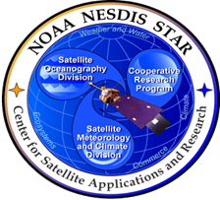




Motivation for an experiment: can we utilize the CrIS short-wave infrared channels in data assimilation?
Chris Barnet
Science and Technology Corporation, STC
STAR Seminar: Wednesday March 6, 2019
Co-Authors: Thomas S. Pagano, NASA/JPL, Sid Boukabara (STAR),
Kevin Garrett (STAR), Kayo Ide (UMD),
Erin Jones (UMD-CICS), Yingtao Ma (UMD-CICS)
Help from: Colby Francoeur, Nadia Smith, Rebekah Esmaili (all STC)
Notes:
https://www.star.nesdis.noaa.gov/star/seminars.php
Wednesday March 6, 2019, Room 2554-2555 12:00-1:00 EST
USA participants: 866-832-9297 Passcode: 6070416
Abstract:
Advanced hyperspectral sounders such as the Advanced Infrared Sounder (AIRS), Interferometric Atmospheric Infrared Sounder (IASI) and the Cross-track Infrared Sounder (CrIS) all invested heavily in providing high signal-to-noise measurements in the short-wave infrared (SWIR) spectral region (defined here as from 3.8 to 5 microns).
The use of this spectral region is complicated by the need to handle solar radiation that is both reflected from the surface and also excites molecules in the upper stratosphere and lower mesosphere into non-equilibrium emission. The AIRS Science Team demonstrated how to properly use the SWIR to derive high-quality temperature, moisture, and trace gases with the launch of Aqua/AIRS in 2002. The NOAA-Unique Combined Atmospheric Processing System (NUCAPS) operationally deployed the AIRS algorithm for the Metop-A/IASI, S-NPP/CrIS, Metop-B/IASI, and the NOAA-20/CrIS instruments since 2008, 2011, 2012, and 2018, respectively.
This presentation will focus on the lessons learned from the NUCAPS experience and discuss the advantages, and disadvantages, of using SWIR channels. The high sensitivity (at higher operating temperatures) and uniformity of detector arrays could enable lower cost and more compact concepts to be deployed in low-Earth and geostationary orbits. This has led to the following question: could the SWIR channels replace the long-wave channels currently used within numerical weather prediction? This presentation will conclude with a discussion of an experiment to help answer that question.
Biography:
Chris Barnet’s early career was a “random walk” kind of process allowed him to be involved with many interesting topics that required finding a practical solution to the problem of the day. He started as a welder at Fermilab - an accelerator for protons - and that led to working with waveguides, superconductors, holography, radio telescopes, quasi-stellar objects, array processors, observing and modeling of the outer planets, and finally Earth remote sounding. This mixture of engineering and science may be the reason why he is now interested in finding ways to transition new algorithm concepts into operational applications.

Slide 2
Topics for today
I am discussing the motivation behind an experiment to assimilate the short-wave infrared radiances (SWIR ≅ 2000-2800 cm⁻¹) from the Cross-Track Infrared Sounder (CrIS)
Topic #1: History of the SWIR instruments
Topic #2: The Pro’s and Con’s of using the SWIR
The experiment is designed to answer the following questions:
Can the SWIR add additional information?
Topic #3: Radiance vs. Brightness Temperature DA
Topic #4: Spectral Purity
Topic #5: non-LTE
Can the SWIR replace the LWIR for the next generation of sounding instruments?
Topic #6: What is the future for IR sounding instruments?

Slide 3
topic #1: A Little HIStory of hyperspectral Sounding Instruments

Slide 4
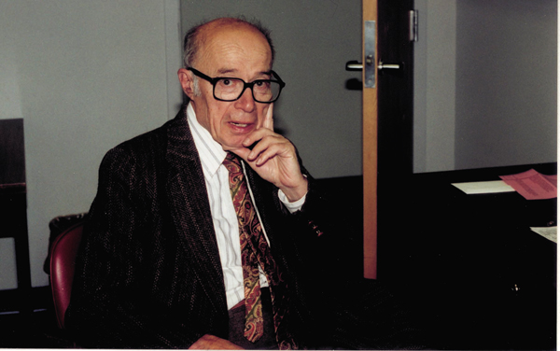
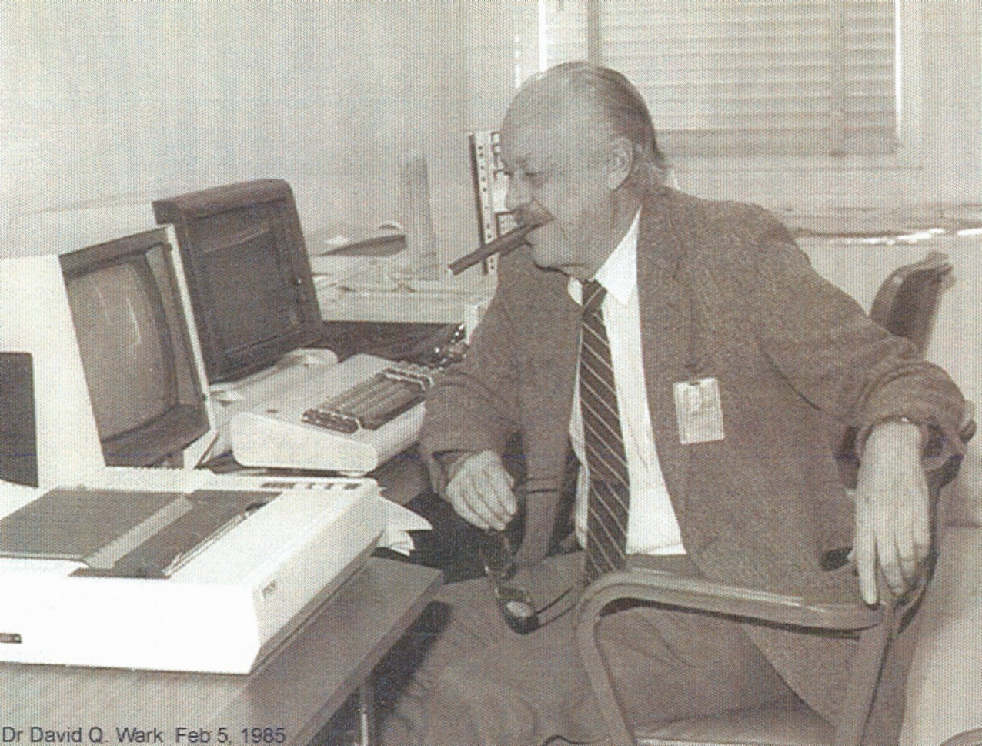
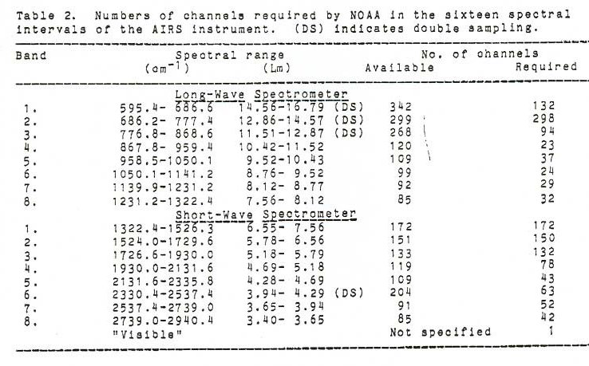
1980’s began the launch of microwave and infrared sounders for weather forecasting
1977 Lewis Kaplan published idea that SWIR (2000-2800 cm⁻¹) has unique sounding properties.
See Kaplan, Chahine, Susskind Searl 1977 Applied Optics v.16 p.322-324.
1989 Dave Wark writes the NOAA specifications for a hyperspectral infrared sounder
Makes use of Kaplan’s idea of using SWIR CO₂ band
Notes:
Kaplan, L.D., M.T. Chahine, J. Susskind and J.E. Searl 1977. Spectral band passes for a high precision satellite sounder. Applied Optics v.16 p.322-324.

Slide 5
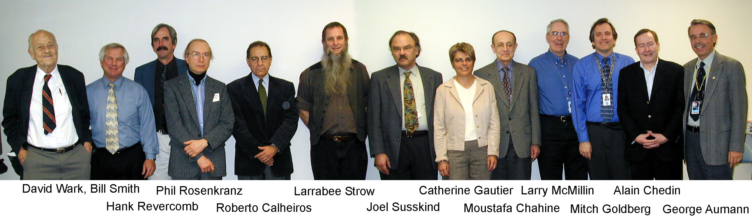
1990’s: The AIRS Science Team is formed and implements the NOAA requirements
Advanced the design of microwave + infrared advanced sounding instruments.
Developed advanced forward models for the microwave and infrared.
Major investment in low noise, high spectral resolution SWIR
Developed an algorithm approach that merged numerous concepts, including the use of the SWIR for sounding.
Notes:
Note: the AIRS algorithm incorporated the vertical resolution concepts of Backus and Gilbert as well as smoothing and concepts of Twomey, Conrath, and Rodgers. The instrument specifications were inspired by Kaplan’s

Slide 6
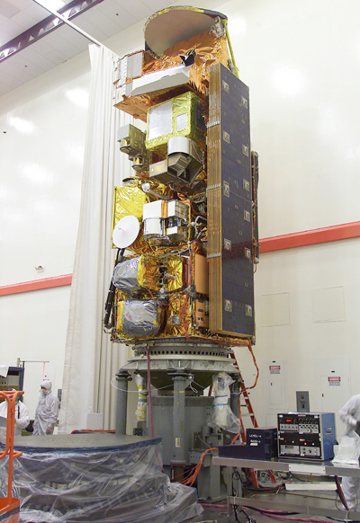
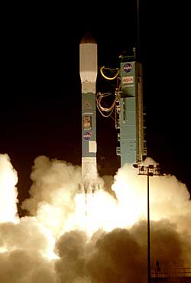
The first (and only) AIRS instrument was launched on the NASA EOS Aqua Platform May 4, 2002
AMSR-E
AMSU-A1(3-15)
MODIS
AMSU-A2(1-2)
AIRS
HSB
Delta II 7920
Aqua Acquires 325 Gb of data per day
AIRS Version.5, fully exploiting the SWIR and the basis for NUCAPS, has been operational at NASA since 2007
Notes:
NOTE: 1st AMSU was launched on NOAA-15 in 1998
HSB failed in Jan. 2003 but was a copy of the MHS instrument (that would later be launched on Metop) that Brazil donated to the Aqua program.

Slide 7
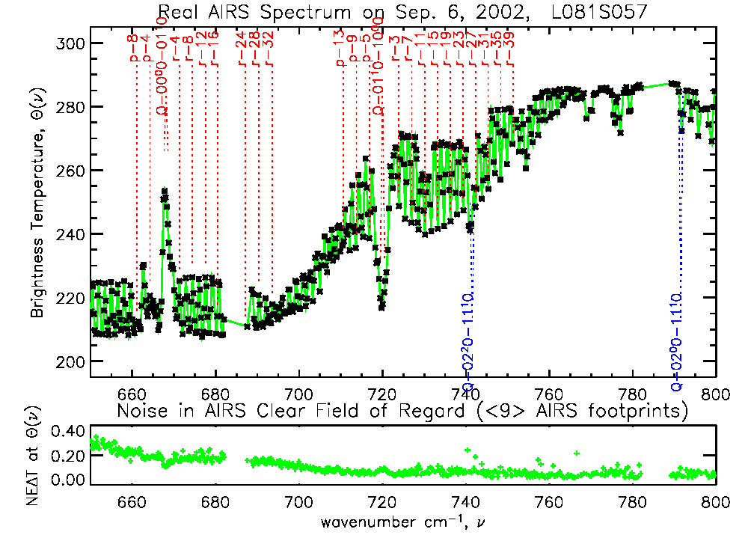
Example of 15 μm band radiance measurement from AIRS 1st operational day, Sep. 6, 2002

Slide 8
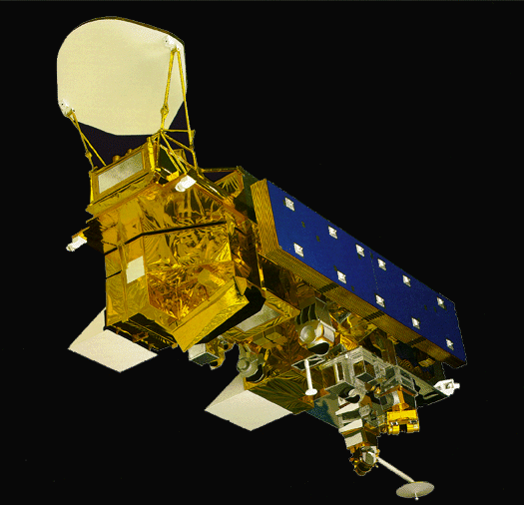
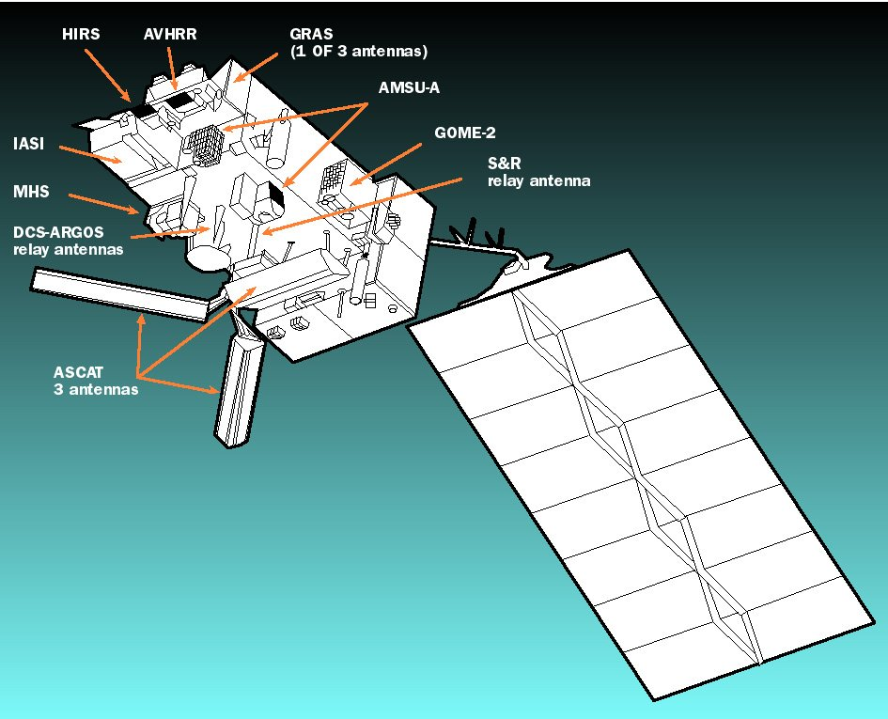
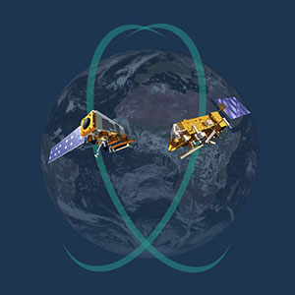
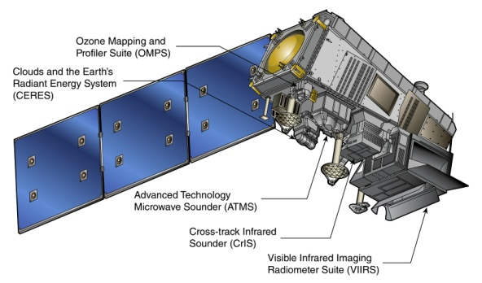
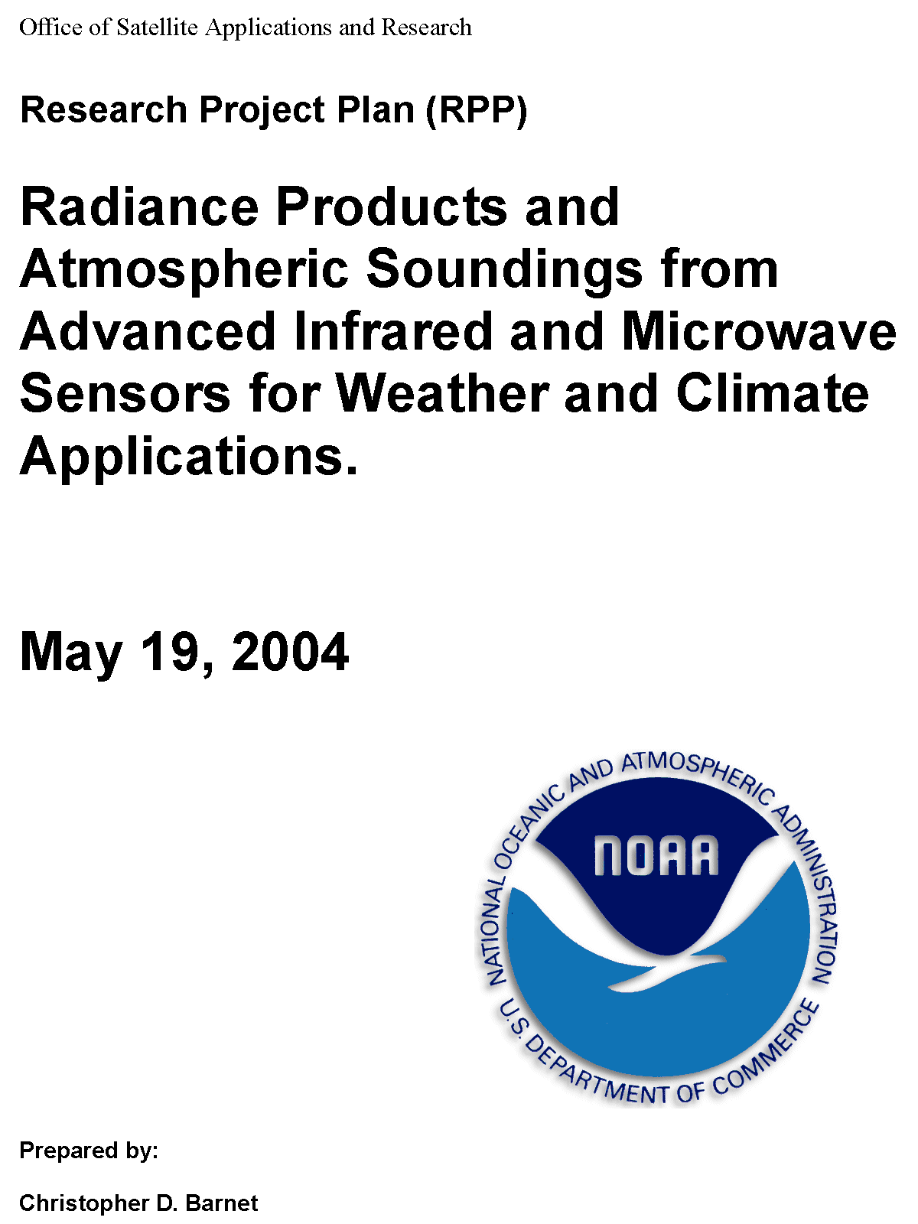
The NOAA-Unique Combined Atmospheric Processing System (NUCAPS) was envisioned in late 1990’s. NUCAPS leverages the lessons learned by NASA AIRS Team
NASA/Aqua
1:30 pm orbit
(May 4, 2002)
Suomi-NPP & JPSS
1:30 pm orbit
(Oct. 28, 2011, Nov. 18, 2017, 2021)
9:30 and 1:30 orbits provide information at critical times in the diurnal cycle
EUMETSAT/METOP-A,B, C
9:30 am orbit
(Oct. 19, 2006, Sep. 17, 2012, Nov. 7, 2018)
Discussions at 1999 ITOVS and OSA meetings led to the 2004 NOAA Research Plan to implement NUCAPS
Notes:
NUCAPS concept first described in Barnet and Susskind 1999 Tech. Proc. Int'l TOVS Study Conf. v.10 p.22-33.
Full outline of the NUCAPS plan for Aqua, Metop, and NPOESS (later to be Suomi-NPP and JPSS program) was described in the NOAA STAR Research Project Plan (May 19, 2004)
The NUCAPS science code was operational at 1st light of AIRS (June 13, 2002), IASI (early 2007) and CrIS (early 2012) demonstrating the robustness of the AIRS methodology.

Slide 9
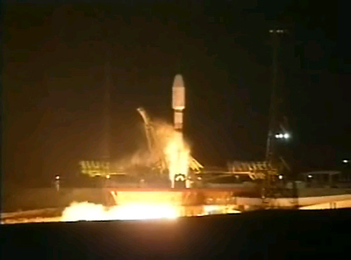
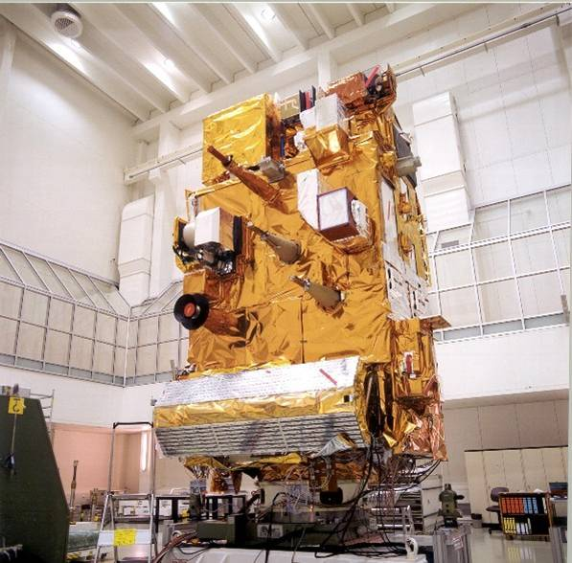
First IASI instrument was launched on the EUMETSAT MetOp-A Satellite on Oct. 19, 2006
IASI
HIRS
AVHRR
AMSU-A1
AMSU-A2
MHS
Soyuz 2/Fregat launcher,
Baikonur, Kazakhstan
ASCAT
NUCAPS, using IASI SWIR, has been operational since Dec. 2008

Slide 10
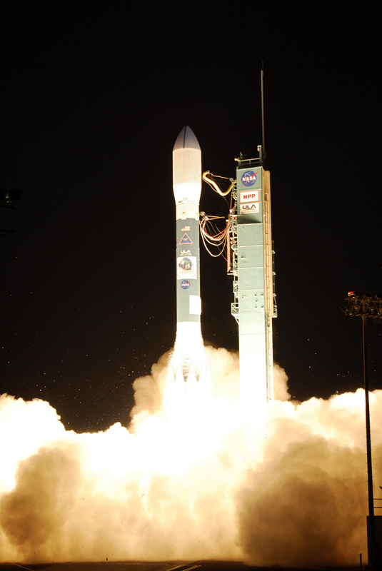
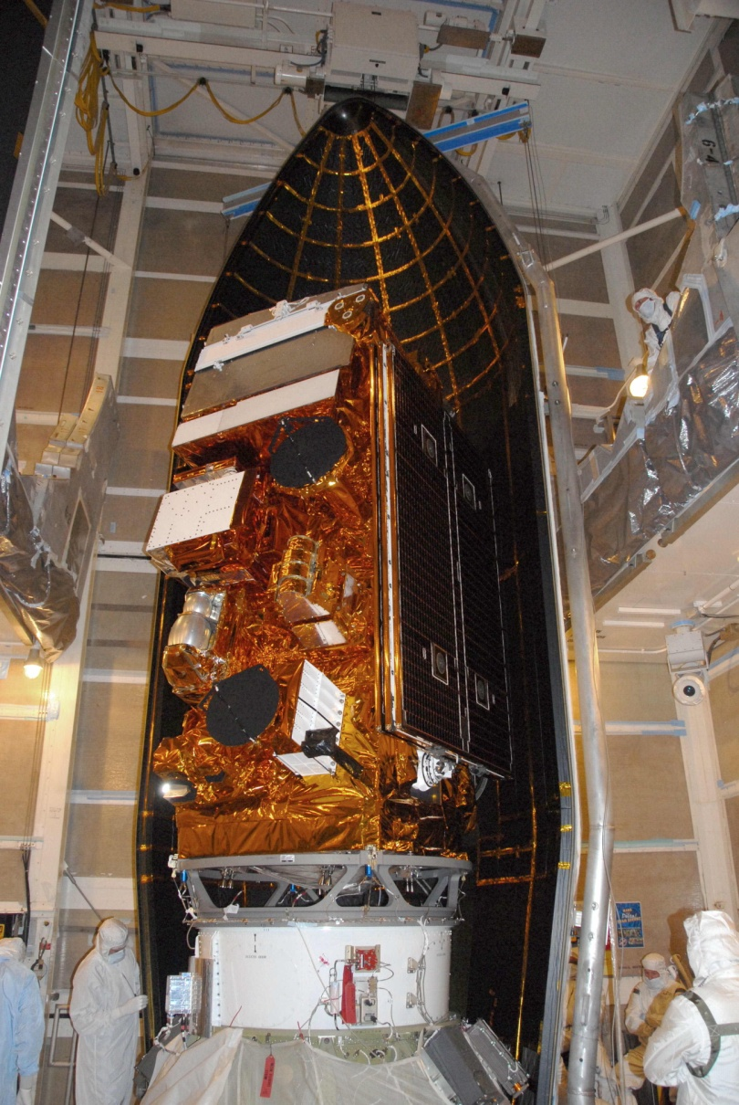
First CrIS/ATMS was launched on the NPP Satellite on Oct. 28, 2011
VIIRS
S-band C+T Antenna
CrIS
X-band DB Antenna
ATMS
CERES
OMPS Nadir, limb
X-band 300 Mb/s Antenna
OMPS (electronics)
Delta-II-7920
Vandenburg AFB

Slide 11
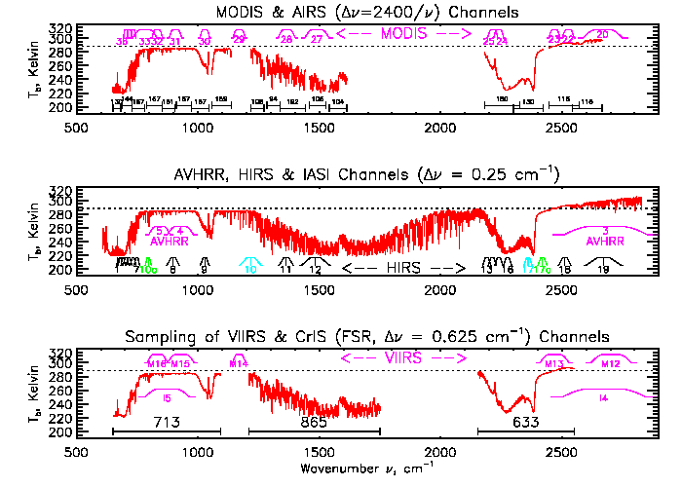
Spectral Coverage of Thermal Sounders & Imagers (Aqua, Metop-A,B,C, Suomi-NPP, NOAA-20+)
AIRS, 2378
Channels
IASI, 8461
Channels
CrIS 2211
CO₂
O₃
CH₄
H₂O
CO
CO₂

Slide 12
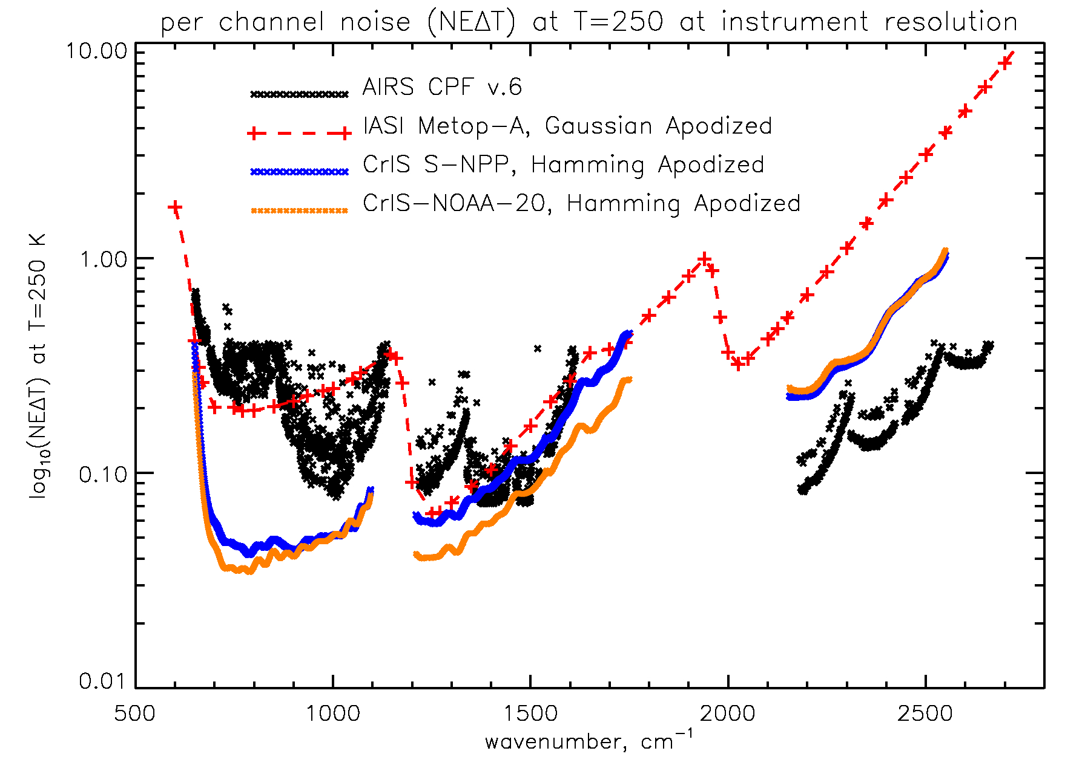
What is important for sounding is signal to noise
Per channel noise is shown as noise equivalent delta temperature (NEΔT) at a cold scene temperature (T=250 K)
NOTE: CrIS-FSR (and IASI) has higher noise in the SWIR than the LWIR
Notes:
Used Dave Tobin’s Dec. 11, 2019 NEDN(FOV)
Averaged the 9 FOV’s and divided by Hamming NRF of 1.58
AIRS is CRF v.6 and IASI is the noise used in NUCAPS operations

Slide 13
So where are we today?
It has been 42 years since Kaplan, Chahine and Susskind noted the advantage of the SWIR in sounding.
It has been 30 years since Dave Wark wrote the hyperspectral sounding requirements.
It has been 16 years since the AIRS ST demonstrated the benefits of the SWIR.
It has been 14 years NOAA laid out a plan to exploit 30+ years of hyper-spectral assets with the lessons learned from the AIRS ST.

Slide 14
TOPIC #2: So let’s talk about the Pro’s and Con’s of using the SWIR

Slide 15
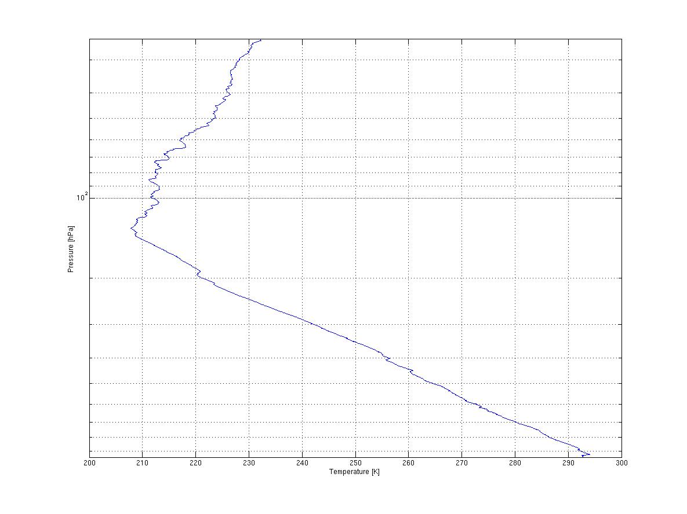
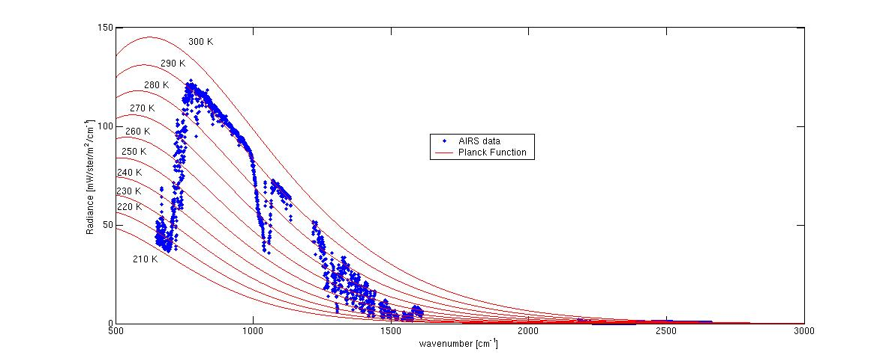
The Advantage of High Spectral Resolution is improved Vertical Resolution (selectivity)
Sounding accuracy depends on sensitivity to the vertical
temperature
gradient
Sampling over rotational bands

Slide 16
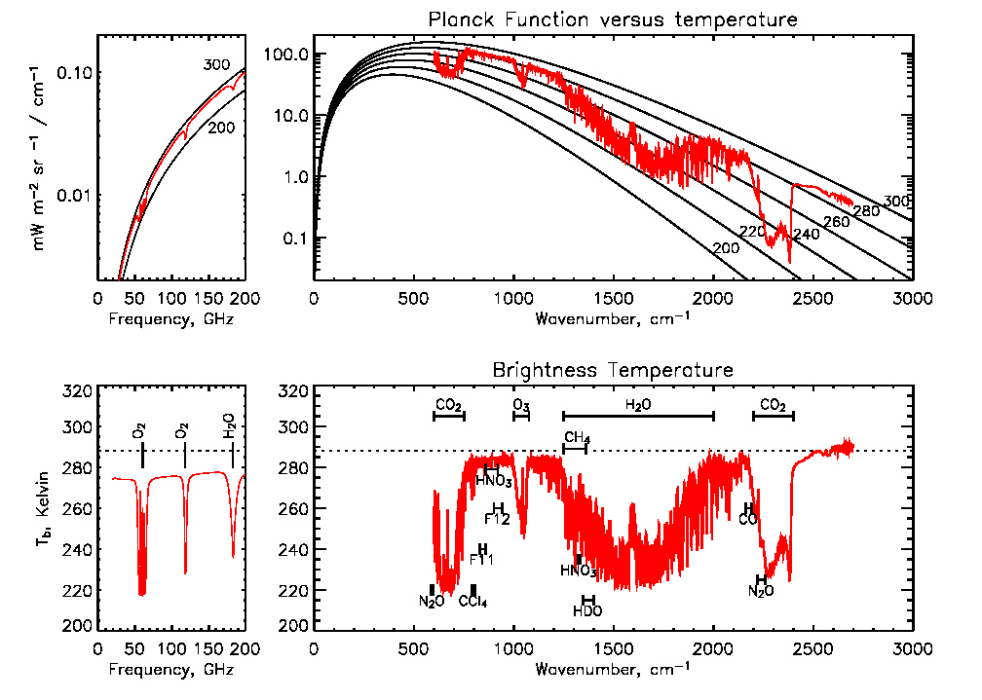
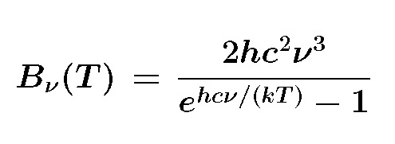
These instruments really measure radiance that is, energy/time/area/steradian/frequency-interval
Microwave
LWIR
MWIR
SWIR
This is what we really measure.
This is how we usually show it.
To Convert to Brightness Temperature ≡ Find Temperature where the Planck Function is equal to measured radiance at a given frequency.

Slide 17
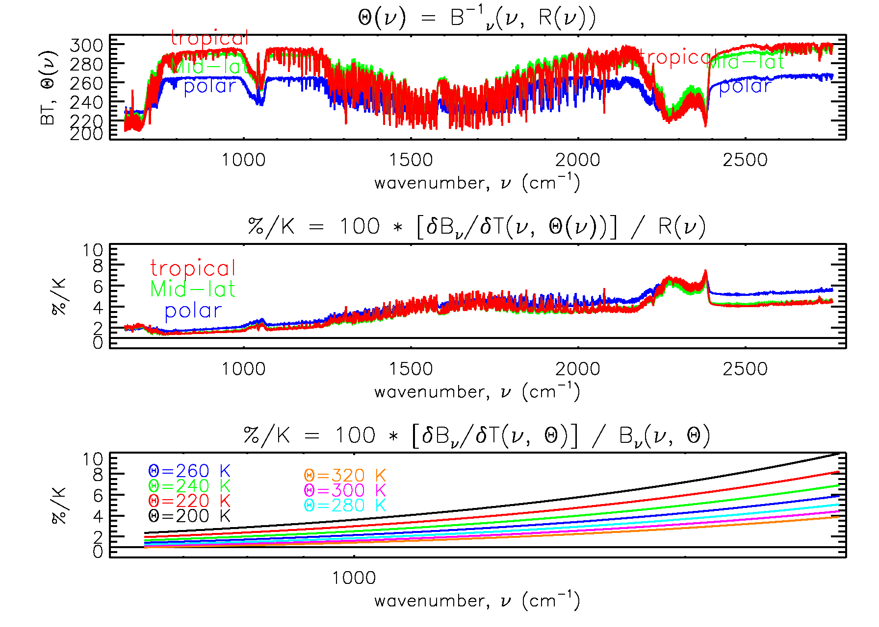
The SWIR is ~3x more sensitive due to the non-linearity of Planck function
Example Brightness Temperature for Polar, Mid-Lat, and Tropical cases
% change in radiance for a 1 K change in T
SWIR changes 4-6%/K
LWIR changes 1-2 %/K
This is due to the derivative of the Planck function
Cold scenes are significantly more sensitive.

Slide 18
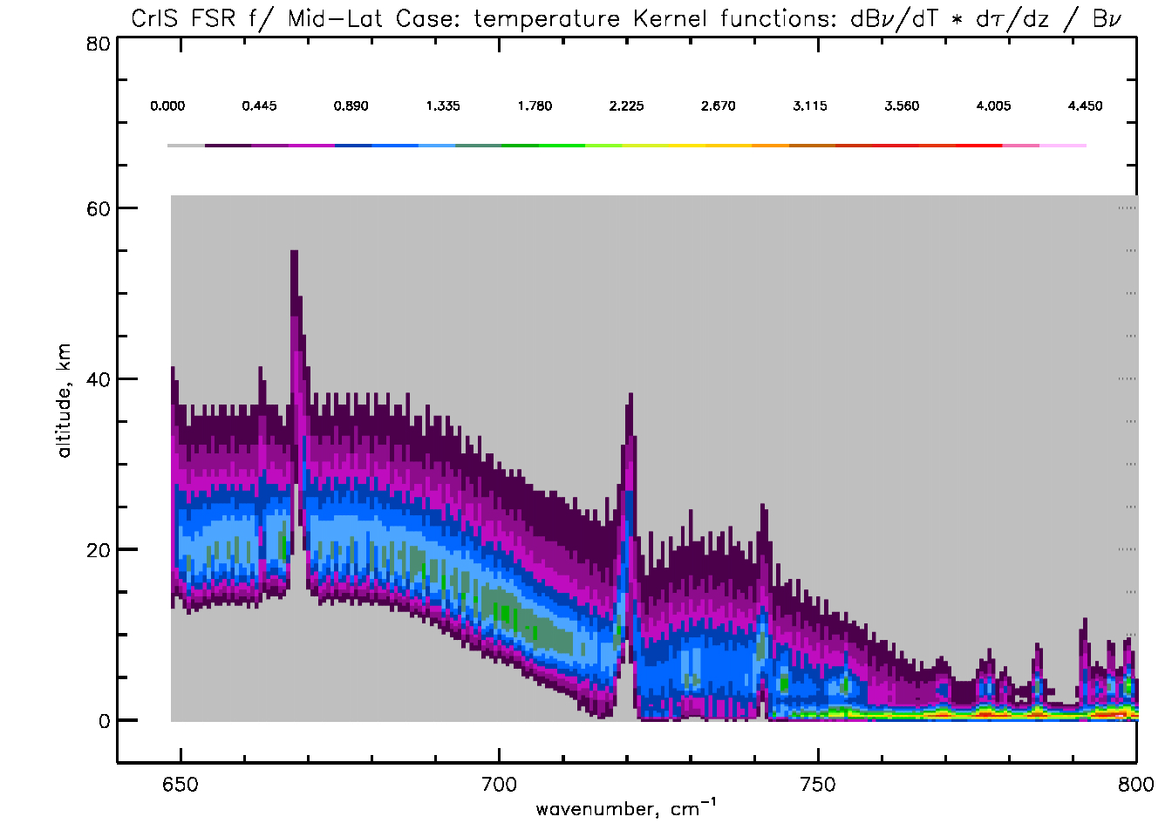
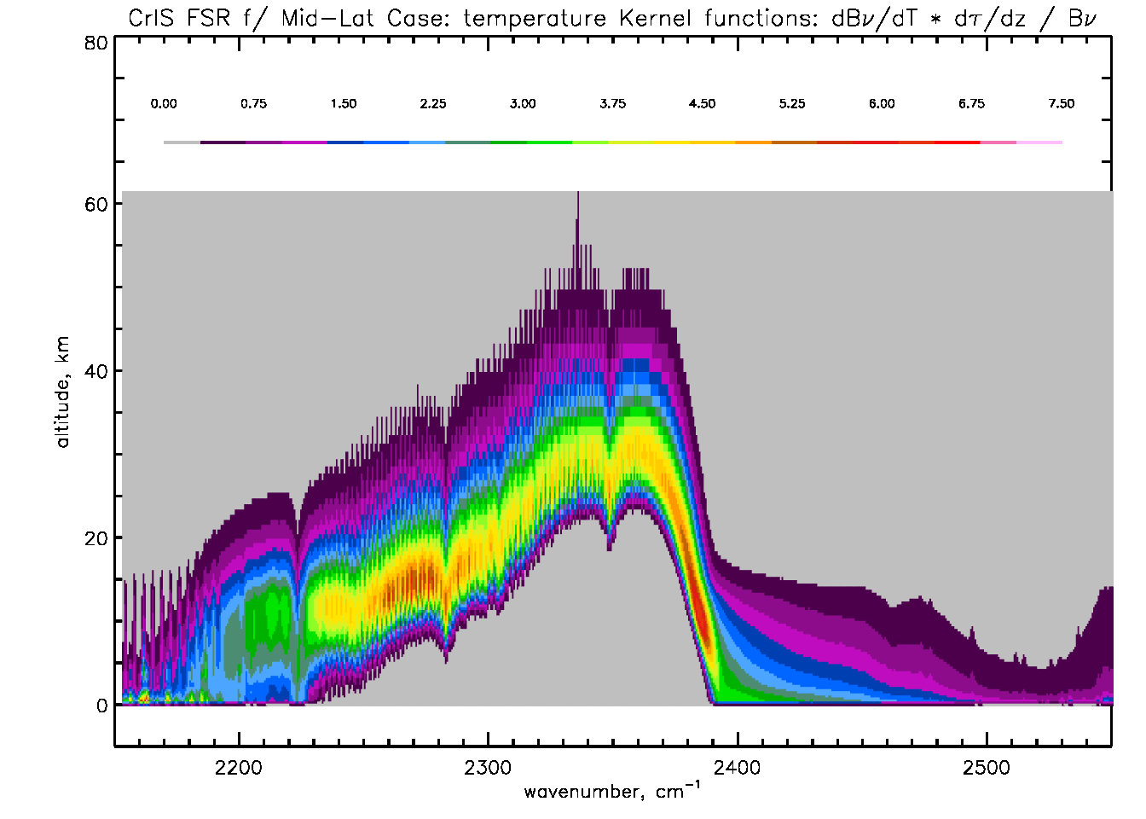
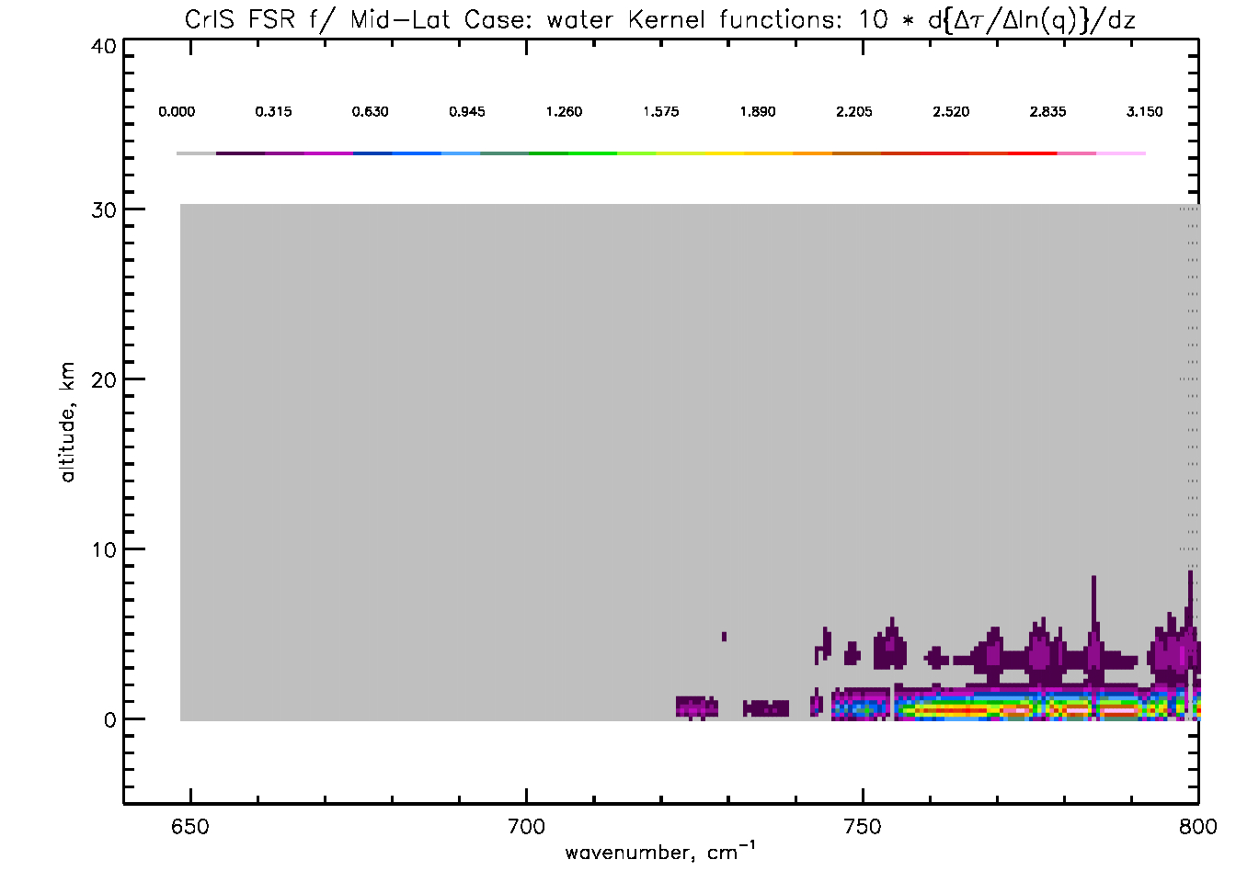
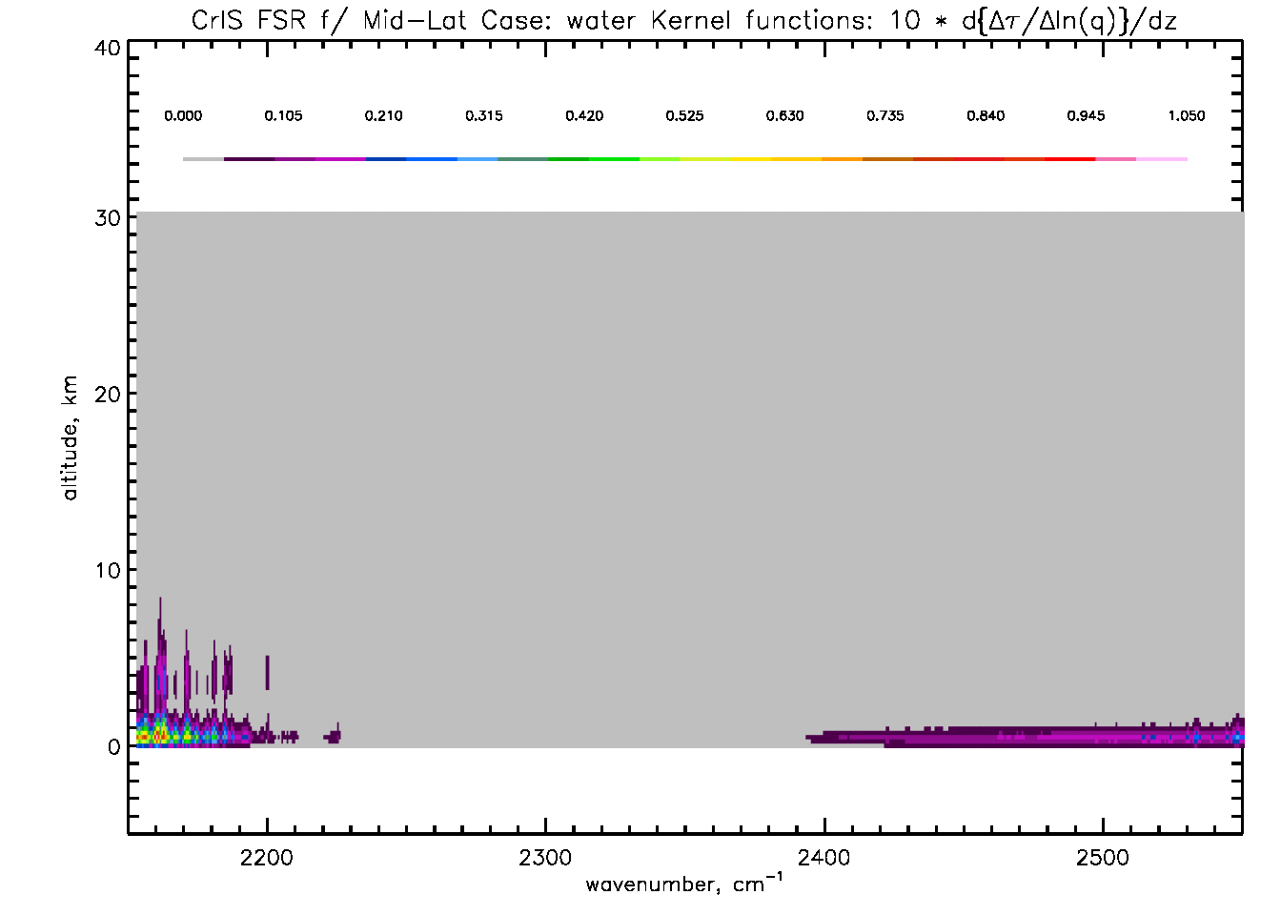
The CrIS FSR LWIR & SWIR Temperature (top) and Moisture Channel Kernel Functions
LWIR (15 μm, 650-800 cm⁻¹)
SWIR (4 μm, 2200-2700 cm⁻¹)
N2O
Sensitivity to Temperature
CO
CO2
Water affects lower sounding channels
Sensitivity to Water
Negligible water sensitivity

Slide 19
Pro’s and con’s of SWIR vs. LWIR
 | LWIR | SWIR
Interfering gases in CO2 bands | H2O, O3, HNO3 | None
Exploit the use of N2O sounding | No | YES
Vertical sounding range | 1 hPa to surface | 20 hPa to surface
Influence of solar radiation | negligible | Must handle non-LTE and surface reflection
Planck function linearity | 1st order linearity | Highly nonlinear
Instrument Noise sensitivity to scene temperature | Can Assimilate BT’s (not really true!!) | Noise is stronger function of scene T
FWHM of T(p) Kernel Fnct’s | 4 km | 2 km
Future instruments: Detector technology and optics. | Higher Power Requires Cold T’s | More COTS options
NOTE: All of the items in SWIR column been resolved by the AIRS science team & implemented in NUCAPS-IASI and NUCAPS-CrIS systems.

Slide 20
TOPIC #3: Radiance versus brightness temperature data assimilation

Slide 21
One of the biggest outcomes of this experiment might be communication
Data assimilation and retrievals are the same math, but there are many differences, for example:
Retrievals do not “inflate” the observation error.
Retrievals can explicitly add “geophysical errors.”
Retrievals never convert observations to brightness temperature because observed radiances can go negative!
Instrument noise can be difficult to characterize exactly, but it is usually more linear in radiance space.
Retrievals handle spectral correlations, noise as a function of scene temperature, and other effects.
Having retrieval, instrument, and DA folks in the same room, looking at details of how things are done, matters!

Slide 22
Simplified view of how things are done
Variable | Retrievals | Data Assimilation
Observations | Radiance, R_{obs}(n) | Brightness Temp., Θ_{obs}(n)
Forward Model | SARTA R_{calc}(n,X) X=state | CRTM R_{calc}(n,X) X=state
Conversion | G(n,X) ≡ δB_{υ}/δT(n, Θ_{calc}(n)) | Θ_{x} ≡ B_{υ}⁻¹(n, R_{x})
Signal, S | [ R_{obs}(n) - R_{calc}(n,X) ] / G(n,X) ≅ Θ_{obs}(n) - Θ_{calc}(n) | Θ_{obs}(n) - Θ_{calc}(n)
Noise, N | NEΔN(n) / G(n,X) ≅ NEΔT(n, X) | NEΔT(n)
S/N | [ Θ_{obs}(n) - Θ_{calc}(n) ] / NEΔT(n, X) | [ Θ_{obs}(n) - Θ_{calc}(n) ] / NEΔT(n)
When minimizing the cost function, we are effectively minimizing the square of S/N
Saying it is radiance assimilation is misleading, it really is brightness temperature assimilation.

Slide 23
But nothing in life is free.
The instrument NEΔT increases non-linearly for cold scene temperatures
Note that for a constant NEΔN
LWIR NEΔT varies by 3x
MWIR NEΔT varies by 16x
SWIR NEΔT varies by 100x
In the SWIR it is critical to use radiance, not brightness temperature, as the operator
Scene BT | LW NEΔN | LW NEΔT | MW NEΔN | MW NEΔT | SW NEΔN | SW NEΔT
200 K | 0.05 | 0.09 | 0.03 | 0.65 | 0.0046 | 9.7
250 K | 0.05 | 0.04 | 0.03 | 0.12 | 0.0046 | 0.5
300 K | 0.05 | 0.03 | 0.03 | 0.04 | 0.0046 | 0.07
Note: This issue has recently been raised by Larrabee Strow & CrIS SDR Team
Notes:
LWIR is using 181211tobin_nedn_snpp.dat and Hamming Apodization at 800 cm-1
SWIR is using 181211tobin_nedn_snpp.dat and Hamming Apodization at 2390 cm-1

Slide 24
TOPIC #4: Spectral PuritY

Slide 25



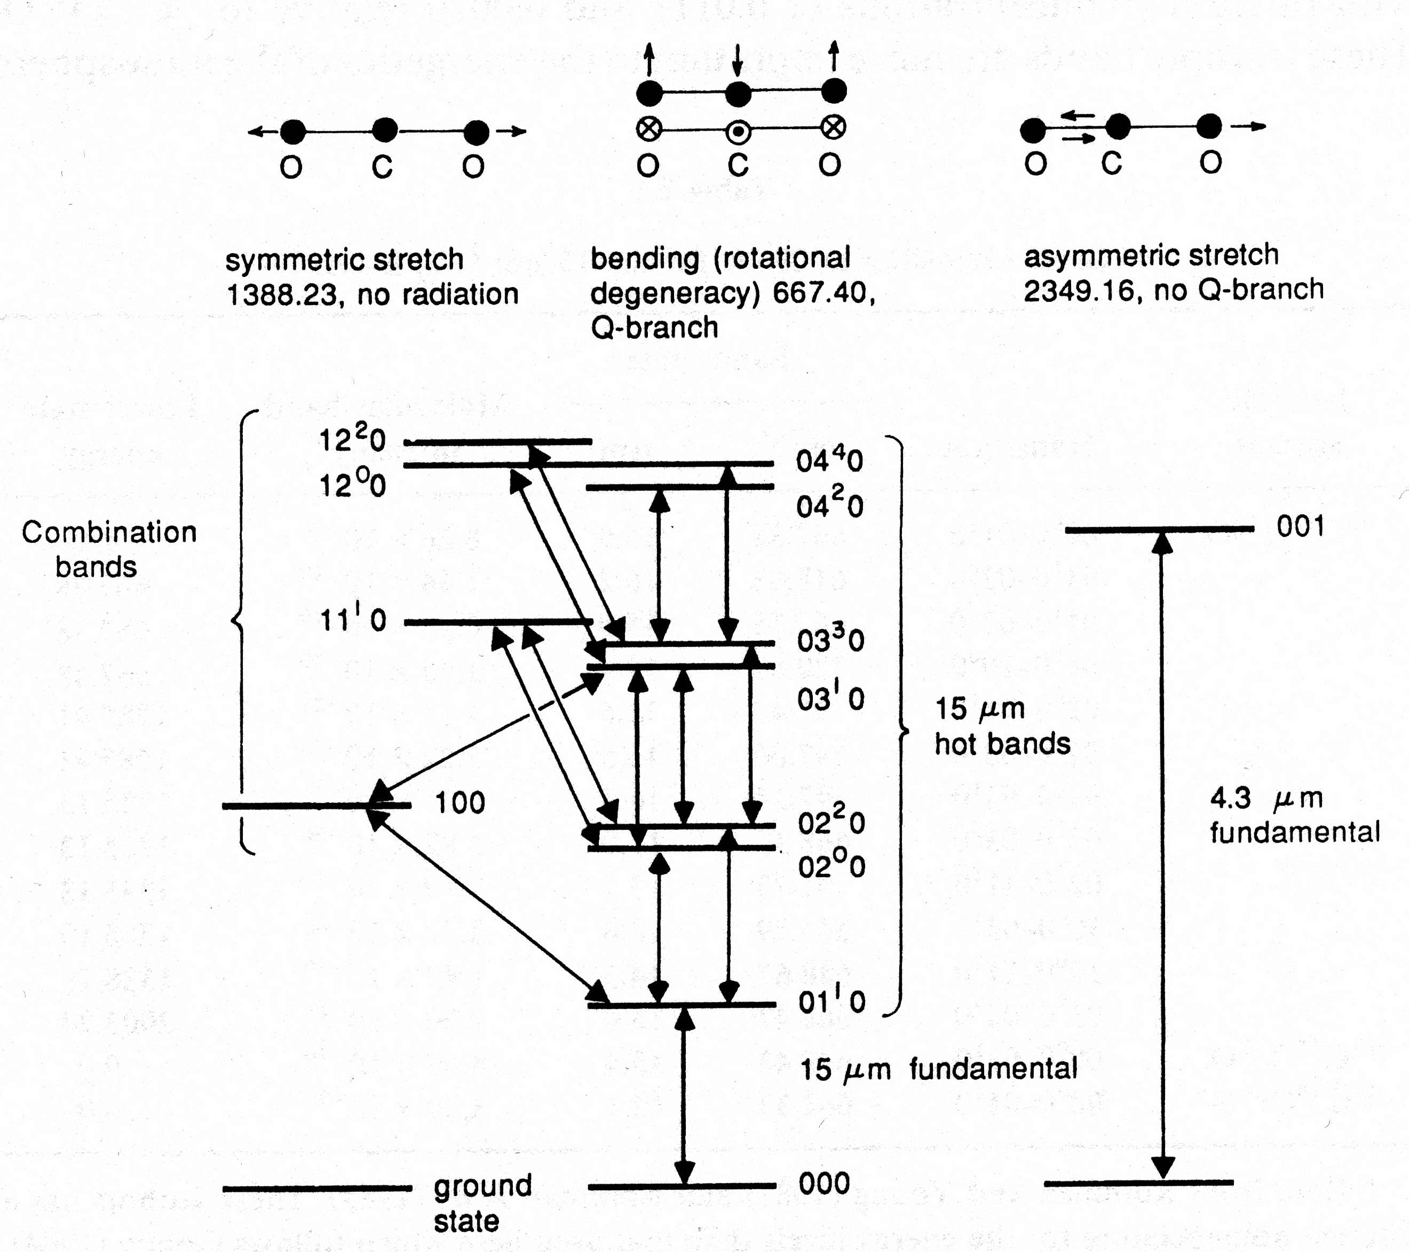
Molecular Vibrational Modes (Example: CO₂)
CO₂ has 4 modes of vibration. Each is quantized.
ν₁ is symmetric stretch (not active in infrared due to lack of dipole moment) but does interact via Fermi resonance with υ₂
ν₂ is a bending that is doubly degenerate
ν₃ is an asymmetric stretch
Energy of vibrational mode is given by
E_{vib} = Σ hc·ν_{k}·(i_{k}+ ½) for i_{k} = 0, 1, 2, …
Isotope | transition | band | S | d
¹²C¹⁶O¹⁶O | 00⁰0 → 01¹0 | 667.38 | 194 | 1.56
 | 01¹0 → 02²0 | 667.75 | 15 | 0.78
 | 01¹0 → 10⁰0 | 720.81 | 5 | 1.56
 | 01¹0 → 00⁰0 | 618.03 | 4 | 1.56
 | 02²0 → 03³0 | 688.11 | 0.85 | 0.78
 | 10⁰0 → 11¹0 | 647.06 | 0.7 | 1.56
¹³C¹⁶O¹⁶O | 00⁰0 → 01¹0 | 648.48 | 2.01 | 1.56
¹²C¹⁸O¹⁶O | 00⁰0 → 01¹0 | 662.37 | 0.77 | 1.56
Notes:
CO2 energy levels from Middle Atmosphere Dynamics, D.G. Andrews, J.R. Holton, C.B. Leovy 1987 p.43
Table is from CO2 15μm band parameters, (Kiehl+Ramanathan, 1983

Slide 26
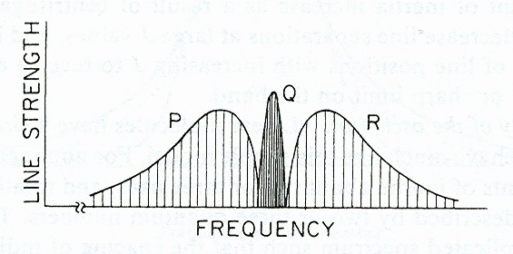
Rotational Modes
The energy of rotation is quantized and given by
E_{rot} = hc·B·j·(j+1), j = 0, 1, 2, 3, …
But as the molecule rotates it also has centrifugal forces
E_{rot} = hc·(B·j·(j+1) - D·j²·(j+1)²
P-branch lines form when Δj = +1
Q-branch lines form when Δj = 0
R-branch lines form when Δj = -1

Slide 27
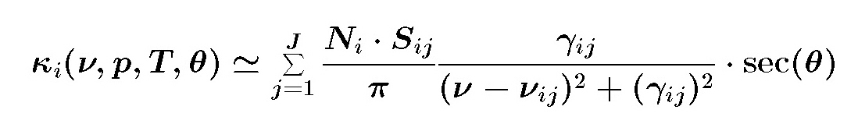
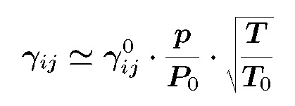
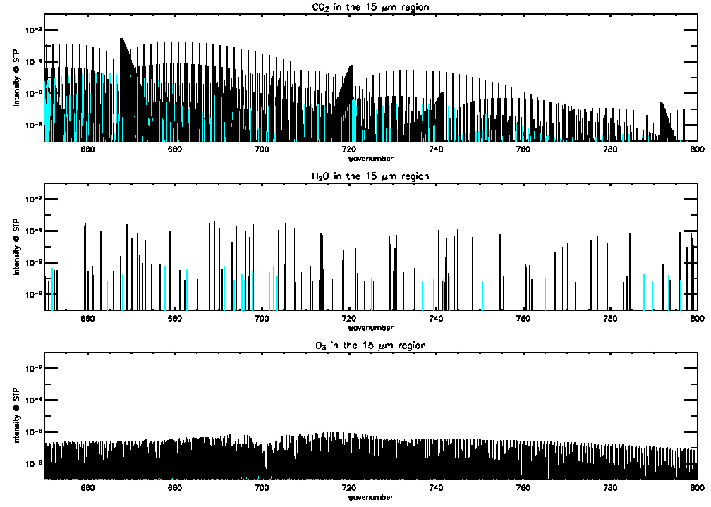
All the Physics is Contained in a quantity called the Absorption Coefficient
The absorption coefficient is a complicated and highly non-linear function of molecule i and line j
Line Strengths, S_{ij}, result from many molecular vibrational-rotational transitions of different molecular species and isotopes of those species(blue).
Where width of line, γ_{ij}, is a function of the molecule structure (natural broadening), temperature (doppler broadening) and pressure (collisional broadening)
Line strength (at T=300K) of CO2, H2O, and O3 in the 15 μm band.
Line strength, S, is also a function of temperature
(1-EXP(1-1.439ν/T))³
S(T) = S(T₀)·(T/T₀)·------------------------------
(1-EXP(1-1.439ν/T₀))³

Slide 28
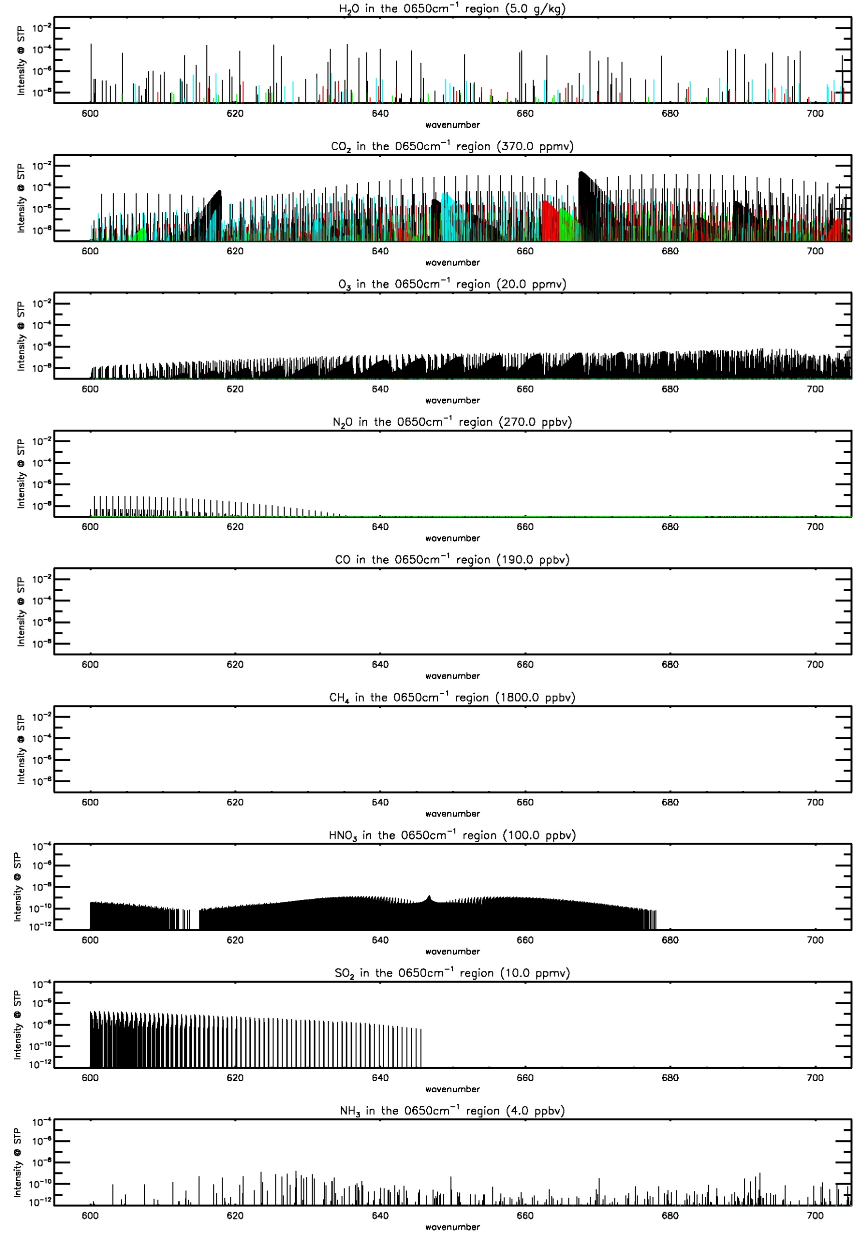
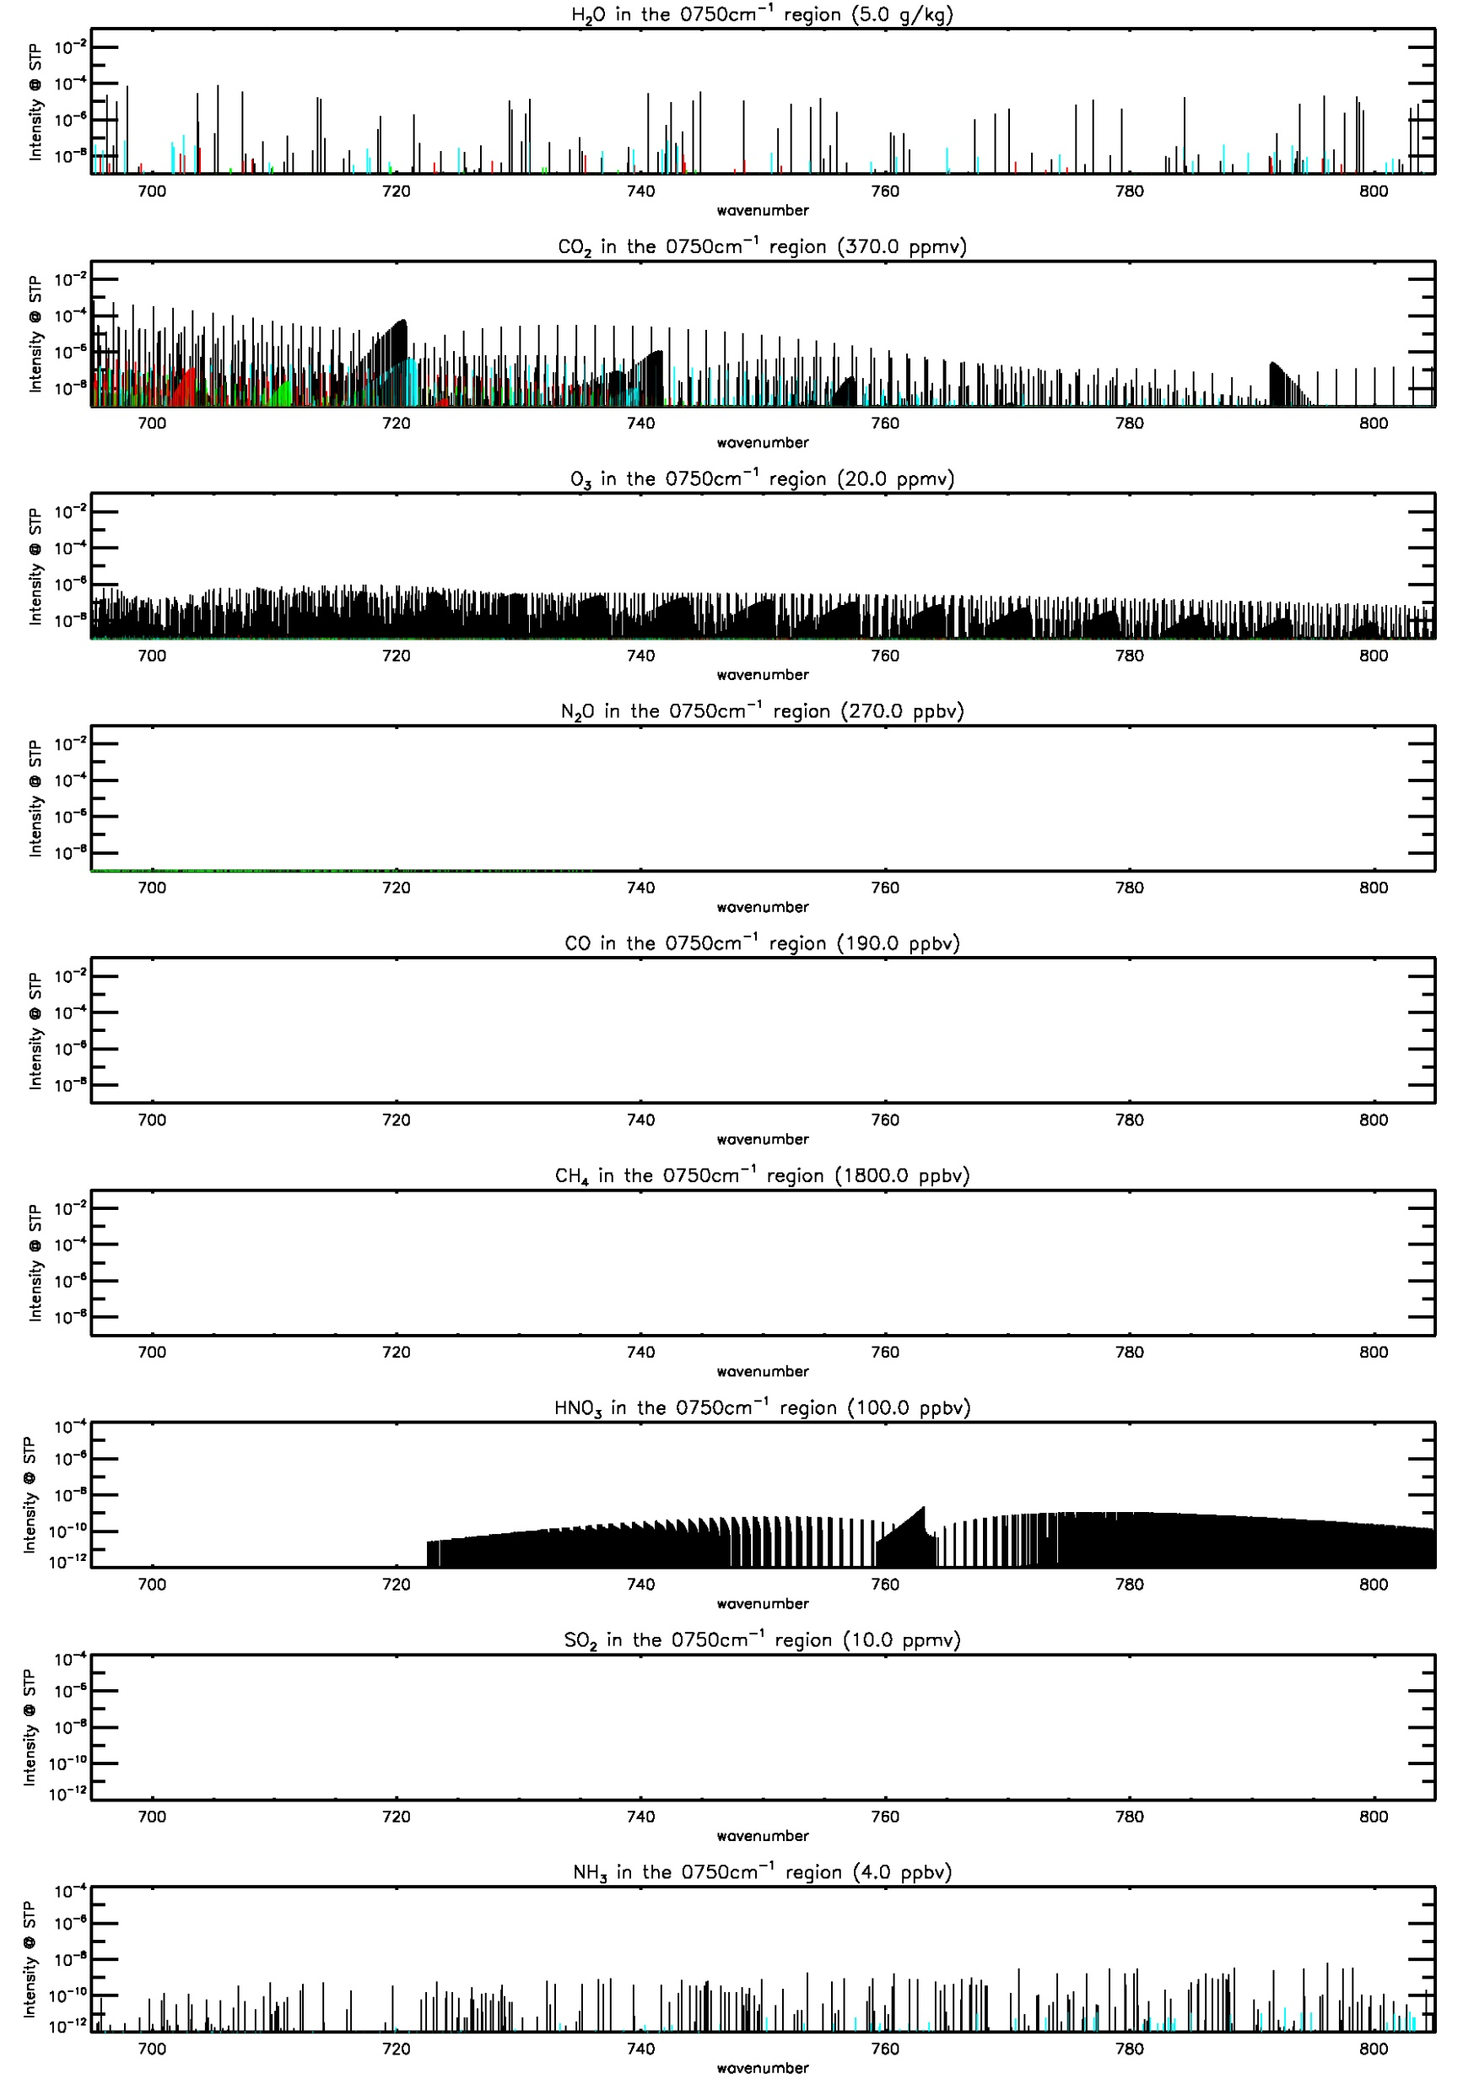
Example of vibration rotational line strengths in 15 μm band region
600 to 700 cm⁻¹
700 to 800 cm⁻¹
H2O
CO2
O3
N2O
CO
CH4
HNO3
SO2
NH3

Slide 29
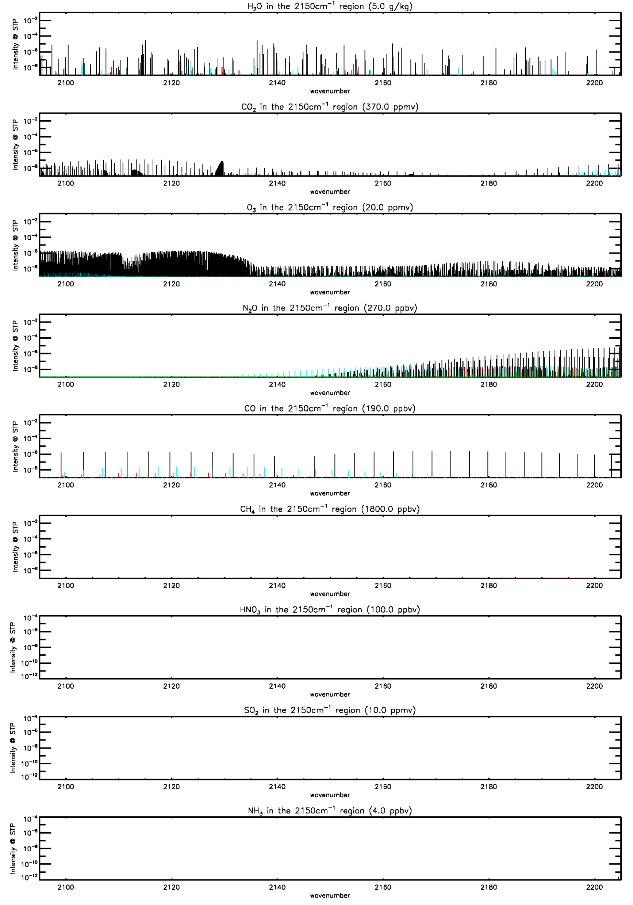
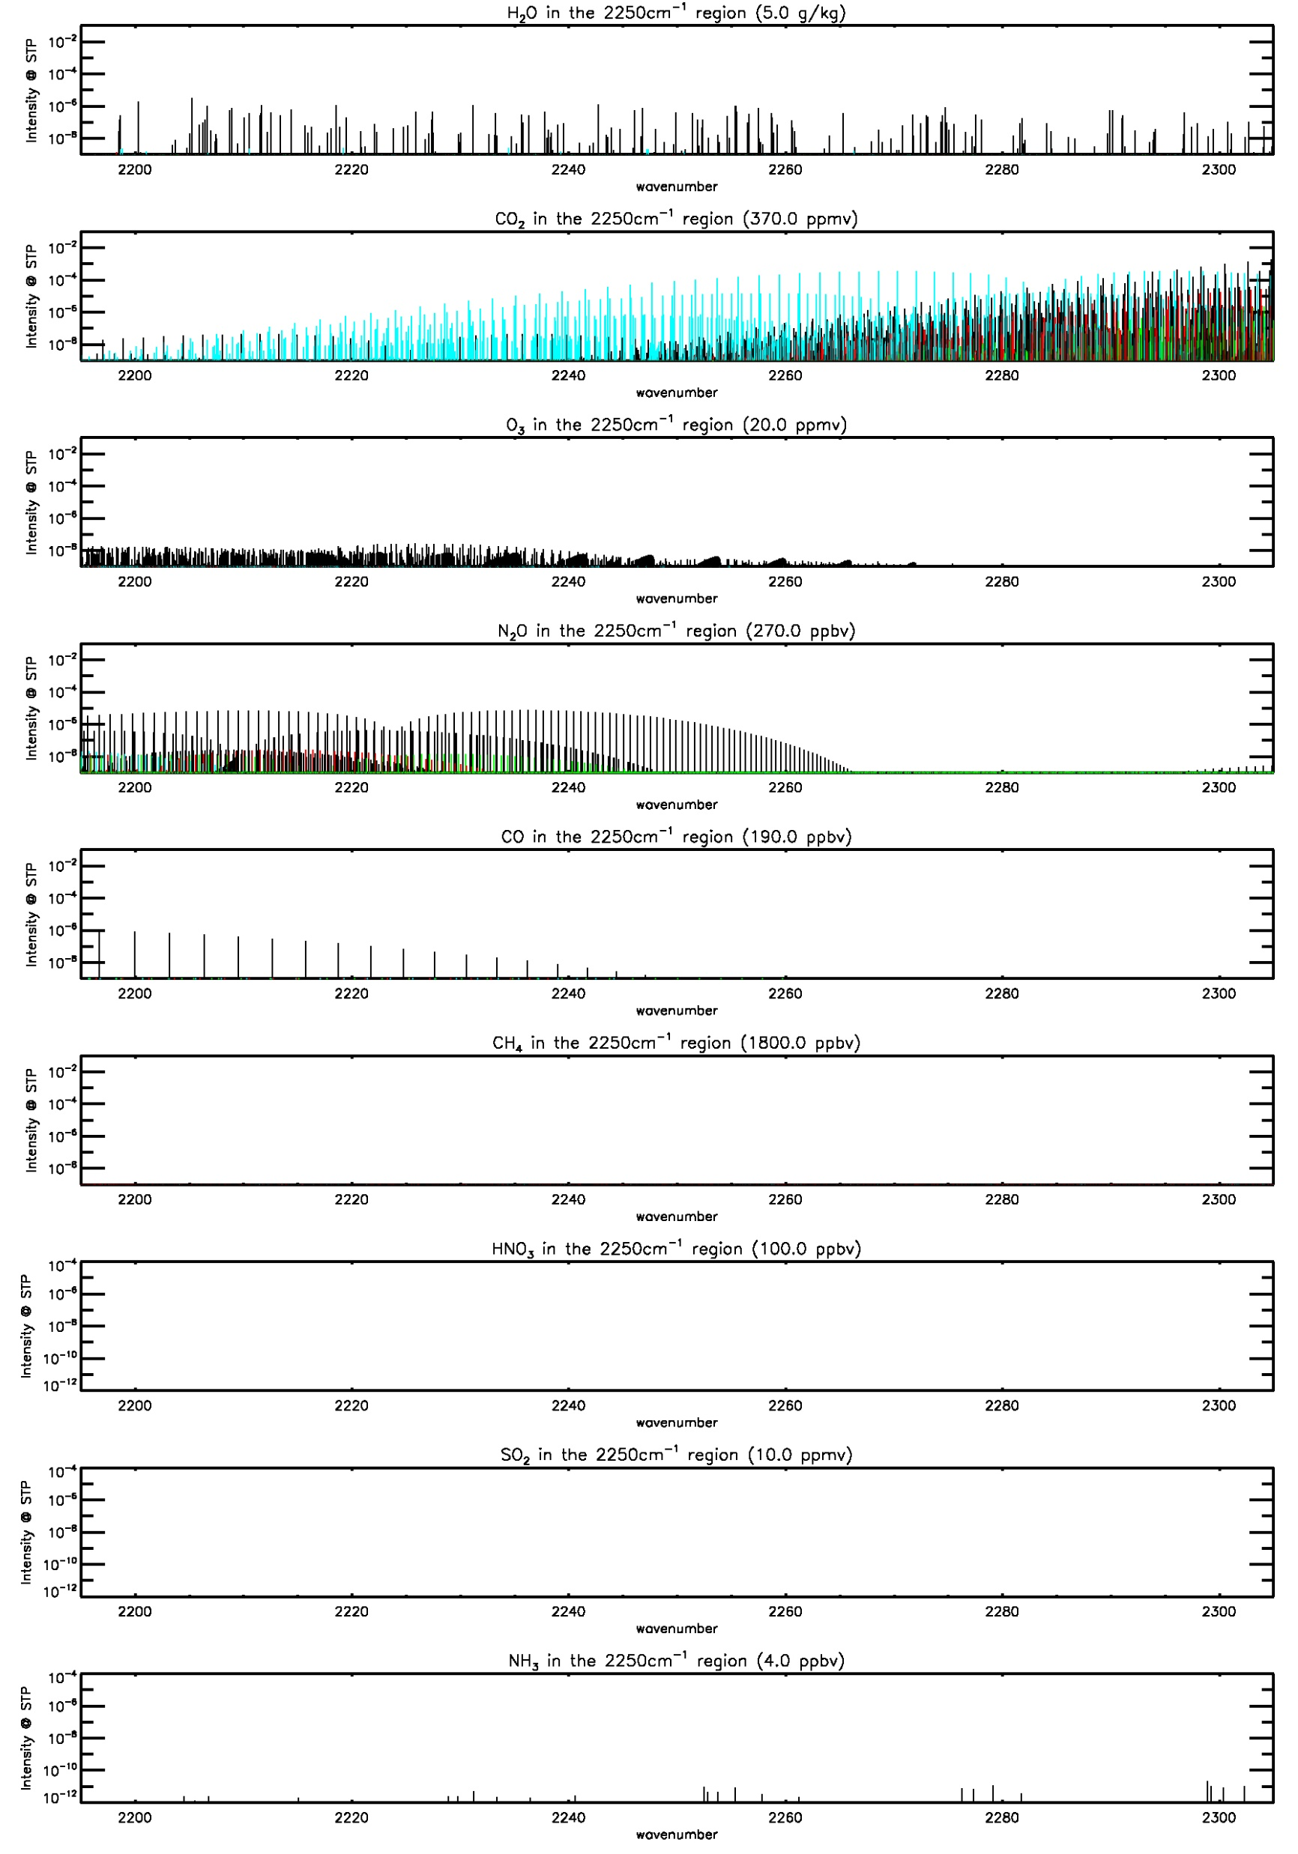
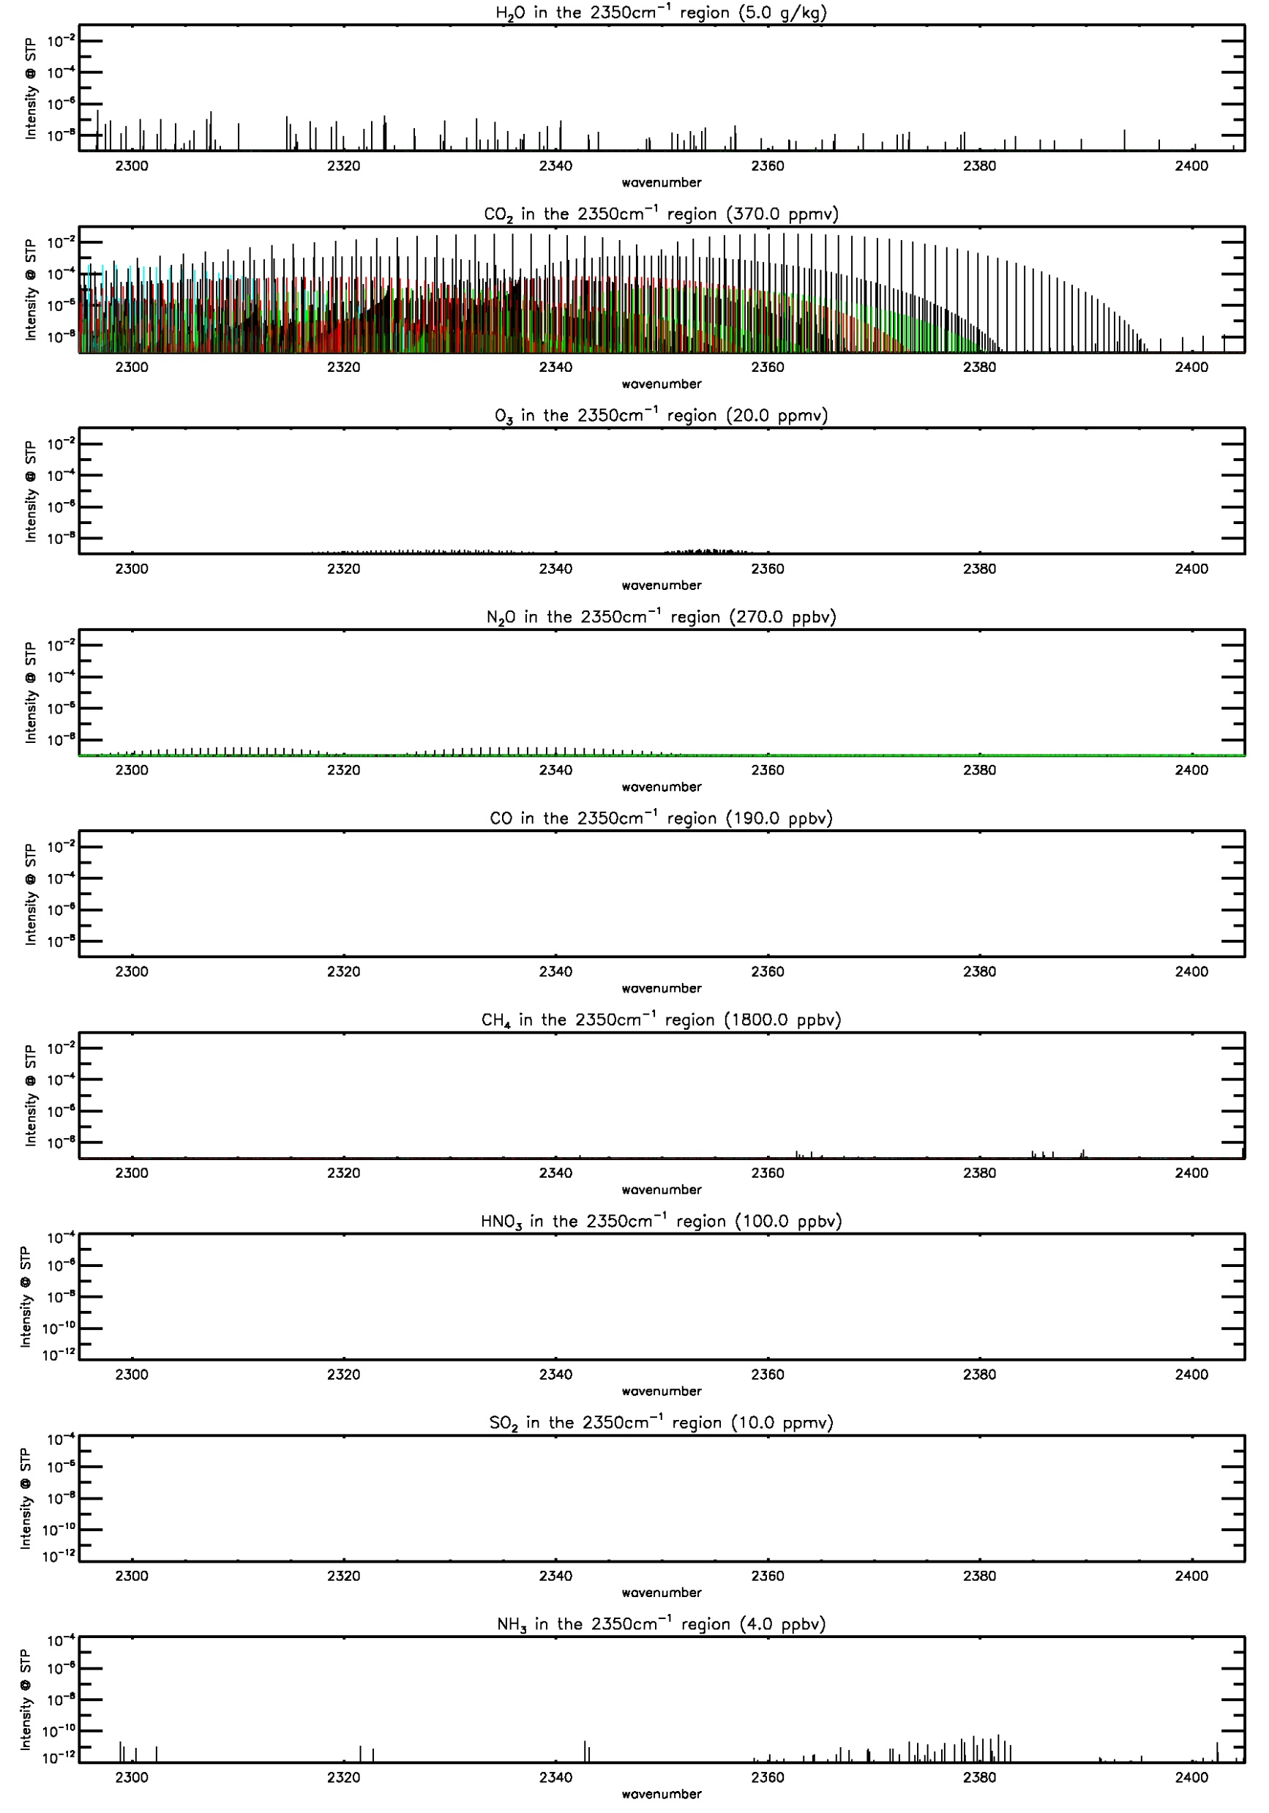
Example of vibration rotational line strengths in 4 μm band region
2100 to 2200 cm⁻¹
2200 to 2300 cm⁻¹
2300 to 2400 cm⁻¹
H2O
CO2
O3
N2O
CO
CH4
HNO3
SO2
NH3

Slide 30
topic #5: non-LTE

Slide 31
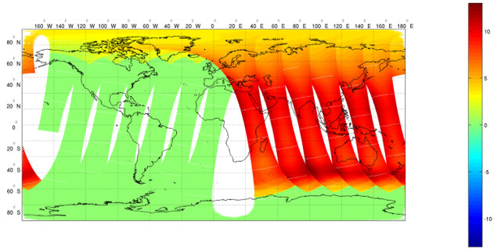
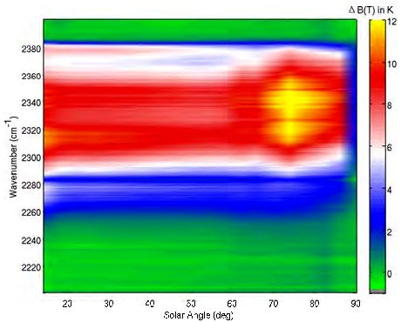
How big is the non-LTE effect?
CRTM simulation of a channel pair difference
SWIR 2336.25 cm-1 minus LWIR 667.50
Non-LTE effect is ~5 to ~10 K in daytime
Bias in AIRS SWIR region for daytime radiances versus solar zenith angle
Need to correct for non-LTE from 2255 to 2383 cm-1
This figure stolen from Zhenglong Li (CIMSS)
From DeSouza-Machado 2007 GRL, Fig. 3
Notes:
Zhenglong’s Oct. 31, 2018 discussion page 12
CRTM Simulated Non-LTE for 2336.25 cm-1
On 7/17/2017 0000-1200 UTC

Slide 32
We know how to correct for non-LTE.
The use of the Planck function assumes a Boltzmann distribution in the population of energy states – called thermodynamic equilibrium or LTE
Channels sensitive to high altitudes do not have enough molecular collisions to achieve equilibrium – called non-LTE
AIRS Science Team dealt with this issue and employed an algorithm to correct for non-LTE effects (DeSouza-Machado 2007 GRL)
NASA/AIRS ST and NOAA NUCAPS Teams have demonstrated that the SWIR + LWIR can be used for both day and night without introducing day-night artifacts.
Non-LTE correction is in the CRTM (Chen 2013 JAOT)
Notes:
Chen, Y., Y. Han, P. Van Delst and F. Weng 2013. Assessment of shortwave infrared sea surface reflection and nonlocal thermodynamic
equilibrium effects in the Community Radiative Transfer Model using IASI data. J. Atmos. Oceanic Tech. v.30 p.2152-2160.
DeSouza-Machado, S.G., L.L. Strow, S.E. Hannon, H.E. Motteler, M. Lopez-Puertas, B. Funke and D.P. Edwards 2007. Fast forward radiative transfer modeling of 4.3 um nonlocal thermodynamic equilibrium effects for infrared temperature sounders. Geophys. Res. Lett. v.34 L01802 doi:10.1029/2006GL026684, 5 pgs.

Slide 33
topic #6: What is The future of Infrared hyperspectral

Slide 34




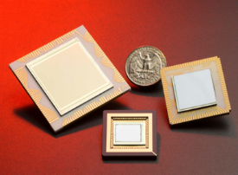
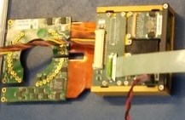
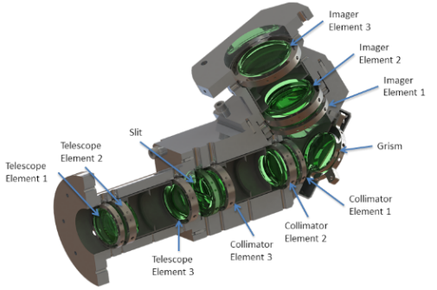
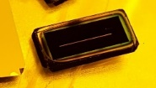
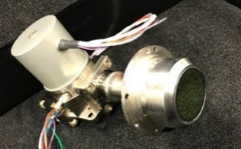
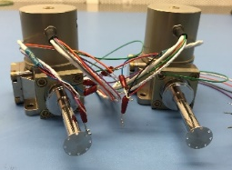
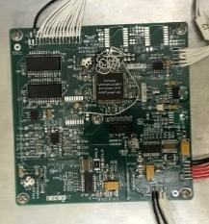
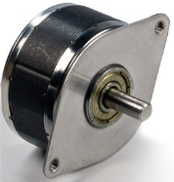
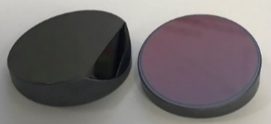
Example of technologies enabled by using SWIR: A NASA/JPL CubeSat Instrument called CIRAS
Spacecraft
(BCT)
FPA
HOTBIRD
(JPL)
Camera Electronics (IR Cameras)
Optics Assembly
(Ball)
Slit (JPL)
Dewar (IDCA)
(IR Cameras)
Payload Electronics
Stepper Motor + Mirror
(Lin Eng )
Blackbody Assembly
Black Silicon
Immersion Grating (JPL)
Cryocoolers + Electronics (Ricor K508N )
Entire satellite can fit in 6U (60x10x10 cm) enclosure!

Slide 35
Advantage of the SWIR might be most important for future instruments
 | Size (cm) | Mass (kg) | Power (W)
AIRS | 116 x 159 x 95 | 177 | 200
IASI | 120 x 110 x 130 | 236 | 210
CrIS | 80 x 47 x 66 | 147 | 106
CIRAS | 10 x 20 x 30 | 4 | 29
Low power {and lower noise} detectors can drive the entire design of instruments and satellites.
Low mass, power, and size will have significant implications for schedule and launch of these instruments.
Notes:
CIRS was a NASA/INVEST proposal in 2015

Slide 36
Summary of the experiment
NOAA/OPPA has funded a study to study the impact of the CrIS SWIR in DA
We will account for non-LTE, solar surface reflection, scene dependent noise, etc.
My NOAA co-authors will perform an OSSE.
The CrIS instrument is being used as a proxy for future instrument concepts, such as CIRAS.
CrIS-FSR is also operationally relevant to NCEP.
We will develop QC, thinning, and bias correction schemes suitable for SWIR.
We will also evaluate radiance data assimilation versus brightness temperature data assimilation.

Slide 37
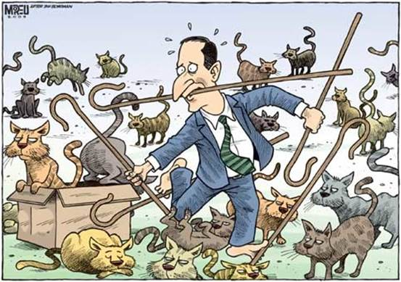
Questions?

Slide 38
Documents available
cell: (301)-789-6934 email: chrisdbarnet@gmail.com
Google drive short link: http://goo.gl/twuRtW
NOTES from UMBC classes, theory of remote sounding (PHYS741) and numerical methods documentation (PHYS 640)
rs_notes.pdf (~17.5 MB, ~650 pages)
180702_cuny_barnet.pdf (10 MB, 140 slides)
phys640_s04.pdf (~8.8 MB, 370 pages)
These are living notes, or maybe a scrapbook – they are not textbooks.
Those documents refer to other documents that are also on the google drive.

Slide 39

Apodization Alters the ILS and Spectally Correlates the Noise.
Interferometers measure interferograms (green curve) signal as a function of optical delay, δ
Performing a inverse cosine transform will yield the spectrum.
Un-apodized transforms (red) have a SINC(x)=SIN(x)/x instrument line shape (ILS).
AIRS has a Gaussian ILS (black)
Apodization can produce a ILS that is localized and has small (< 1%) side lobes. But the tradeoff is that the central lobe is wider and the signal is spectrally correlated between neighboring channels
 | Gaussian | Hamming | Blackman
FWHM / FWHM(SINC) | 1.682 | 1.5043 | 1.905
Random Noise reduction | 1.735 | 1.586 | 1.812
Maximum Side-Lobe | 0.45% | 0.73% | 0.12%
% of signal in central Lobe | 95.1% | 87.5% | 99.8%
Channel Spacing | Gaussian | Hamming | Blackman
±1 | 70.74% | 62.5% | 75.5%
±3 | 25.0% | 13.3% | 31.6%
±4 | 4.43% | - | 6.57%
±5 | 0.38% | - | 0.53%
±6 | 0.025% | - | -

