Slide 1








Lidar measured wind profiles from space
An overview of Doppler lidar technology and comparison with current and future wind measurement capabilities
Sara Tucker
Lidar Systems Engineer
Ball Aerospace, stucker@ball.com
With special thanks to the Ball Aerospace OAWL development team &
partners, including Mike Hardesty and Sunil Baidar of CU-CIRES

Slide 2
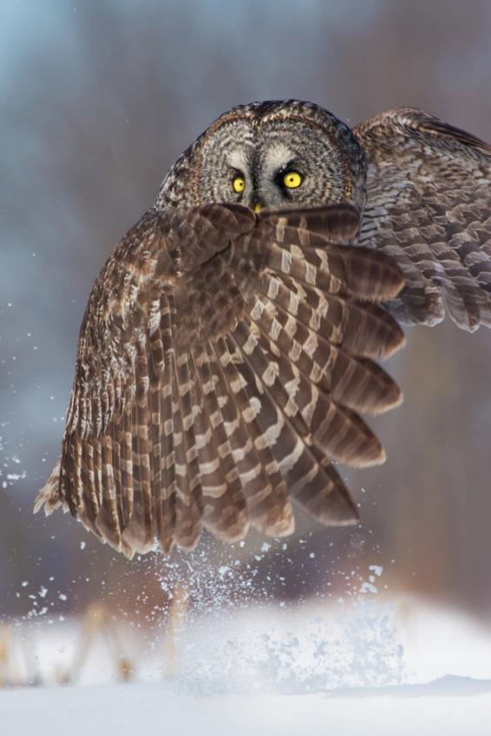
Topics
Wind Measurements
  What do we have now?
  Why a Doppler lidar from space?
  Aeolus
Doppler Wind lidar observations
  Wind lidar basics
  Wind lidar technologies (including Aeolus)
  The OAWL approach
Shaping Future Wind Missions
  Scales
  Active & Passive Synergy
  Mission concepts – building on Aeolus
Next Steps & Questions for Discussion

Slide 3
Wind Measurements

Slide 4
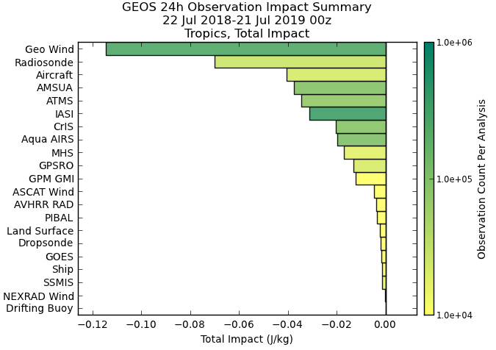
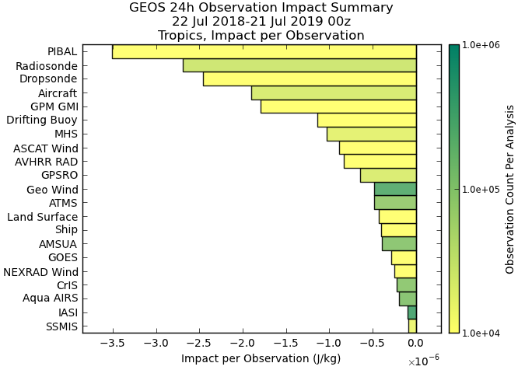
Wind observations have strong impacts on forecast
GEOS-5 Impact Summaries: July 2018-July 2019, Tropics
Observations that include winds (retrieved or measured)
Tropics, total impact
Tropics,
impact per observation
WMO: The greatest unmet observational need is still winds

Slide 5
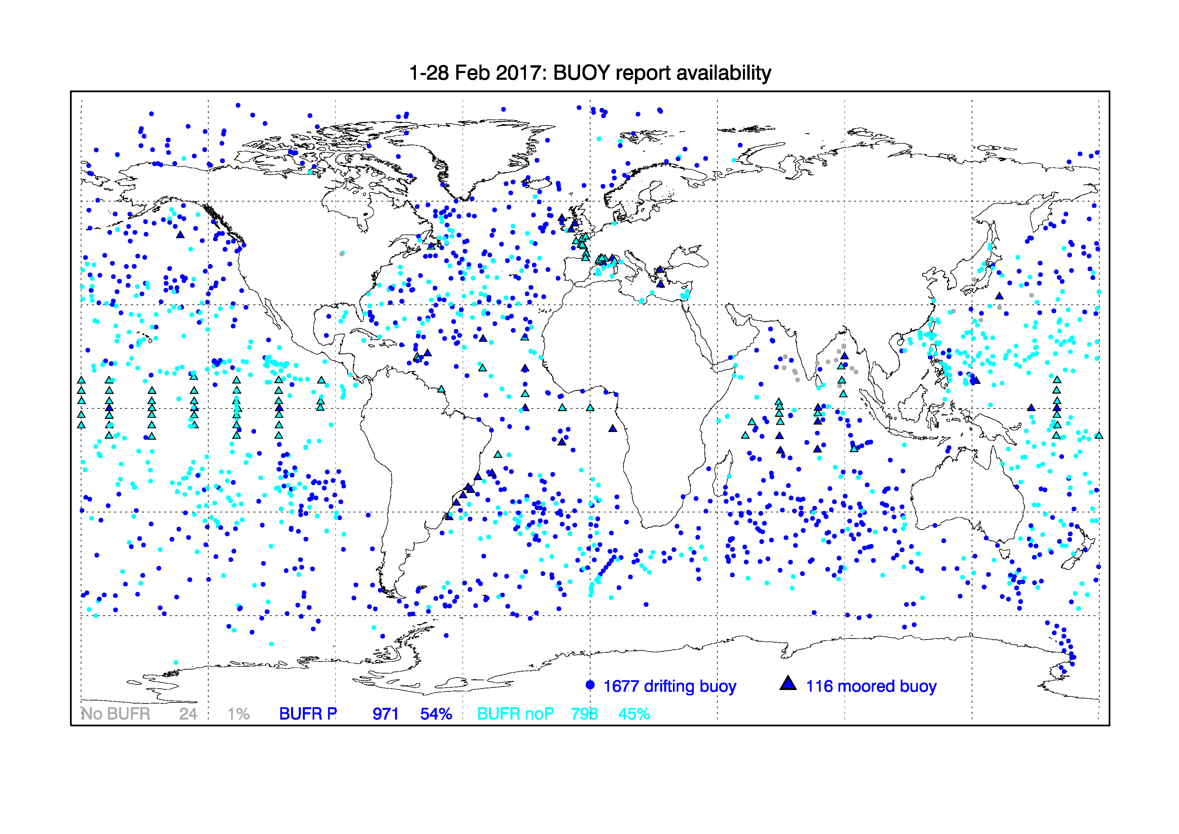
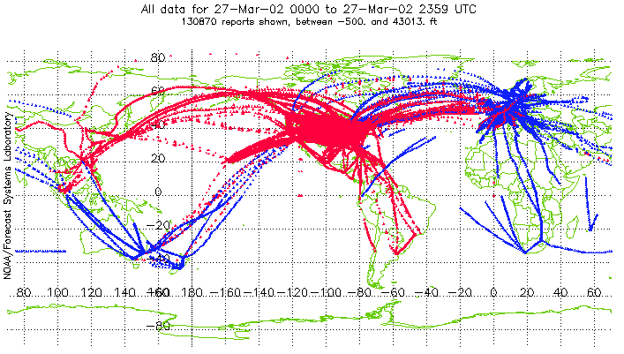
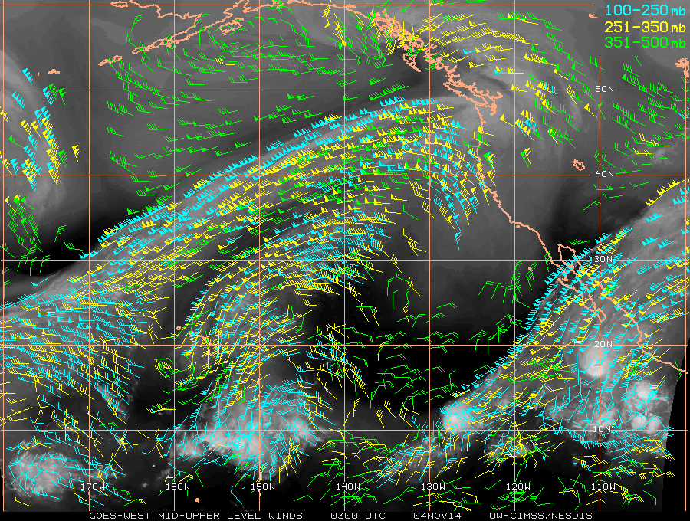
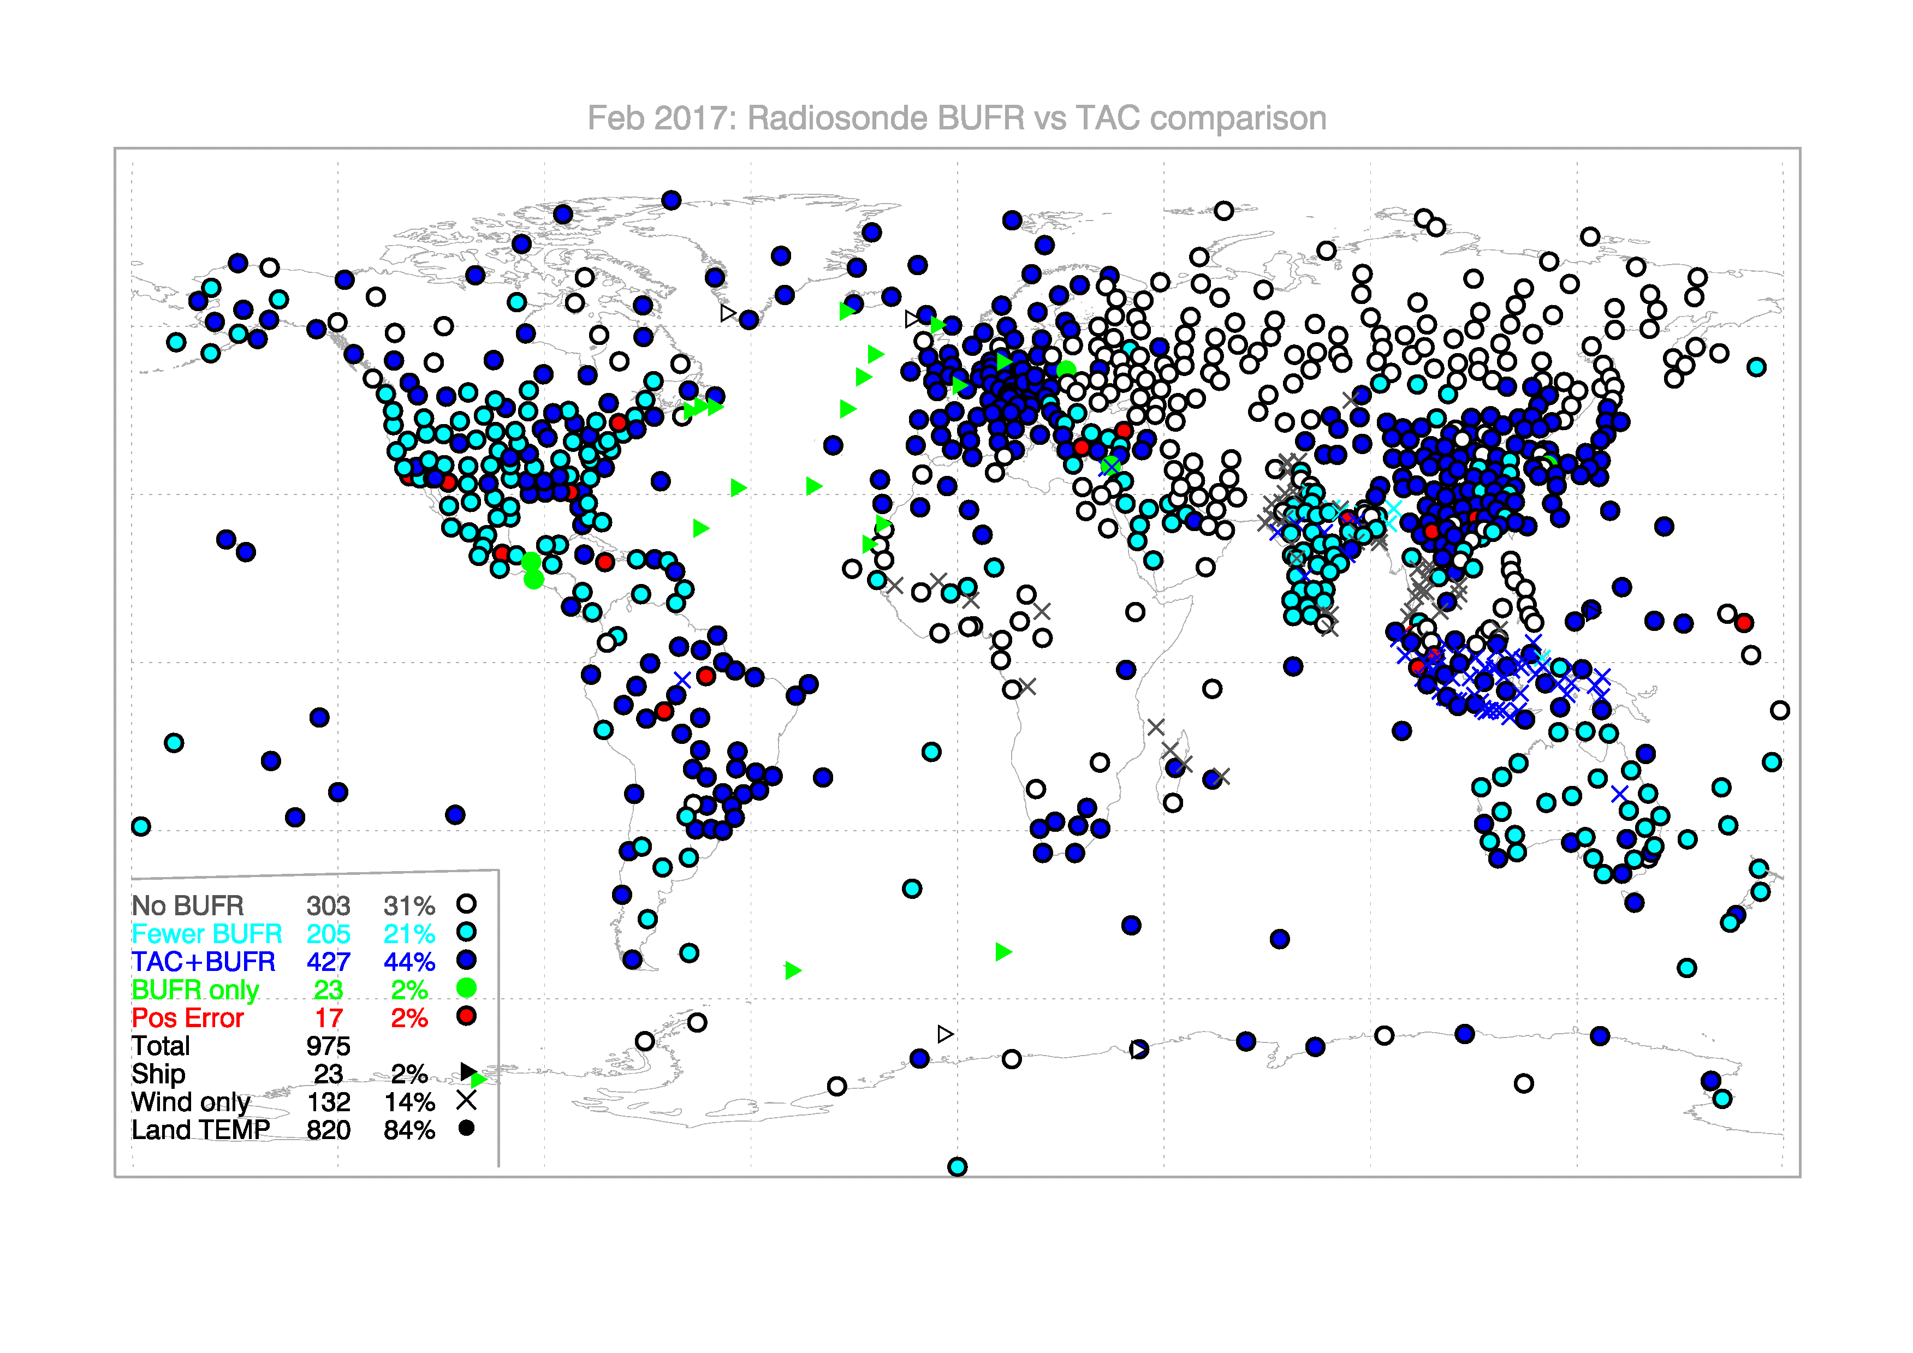
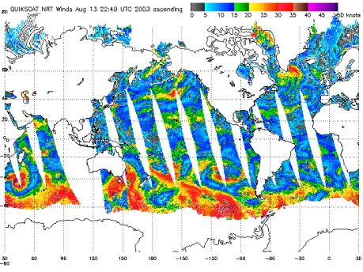
Existing global winds measurements
Surface
Motion Vector
(aerosol/cloud tracking)
In-situ Profiling
Surface Buoys
Aircraft
Radiosondes
Aircraft (in-situ)
Scatterometry
Radiosondes
Visible or water vapor channels
Requires 3 cloud images, cloud brightness temp, cloud mask, cloud height, cloud top pressure
(for Water Vapor: GFS forecast temperature profile)
Requires Cloud/WV Features

Slide 6
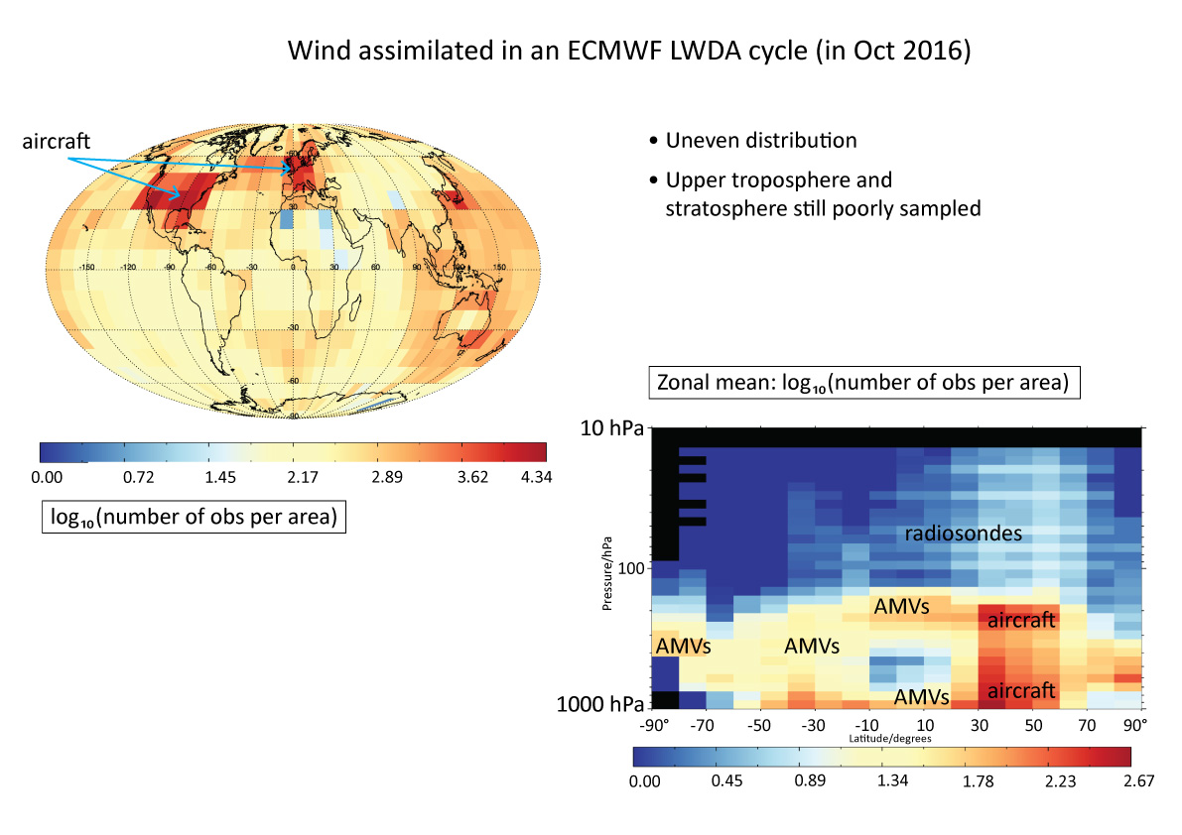
Wind assimilated in an ECMWF LWDA cycle (Oct. 2016)
Images from Lars Isaksen and Michael Rennie, ECMWF:
https://www.ecmwf.int/en/about/media-centre/science-blog/2018/improving-forecasts-new-wind-data-esas-aeolus-mission

Slide 7
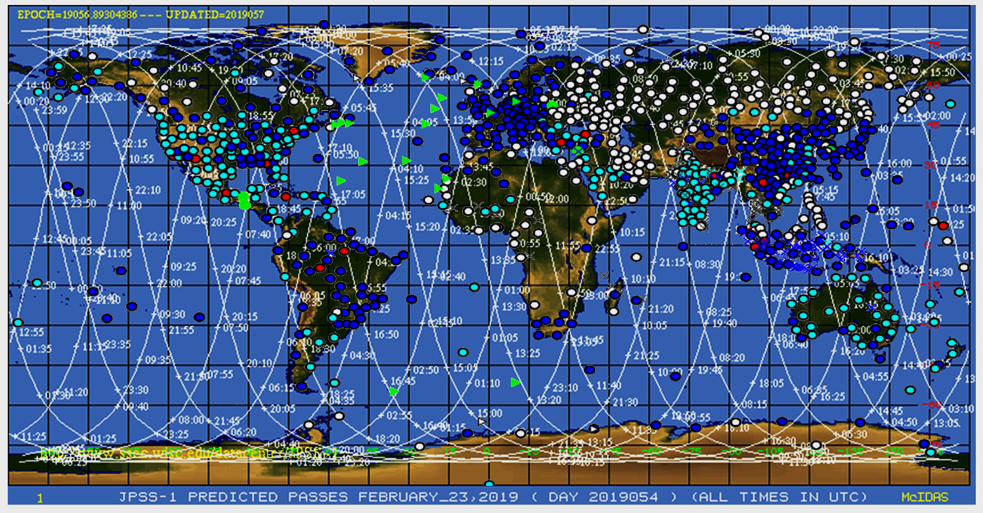
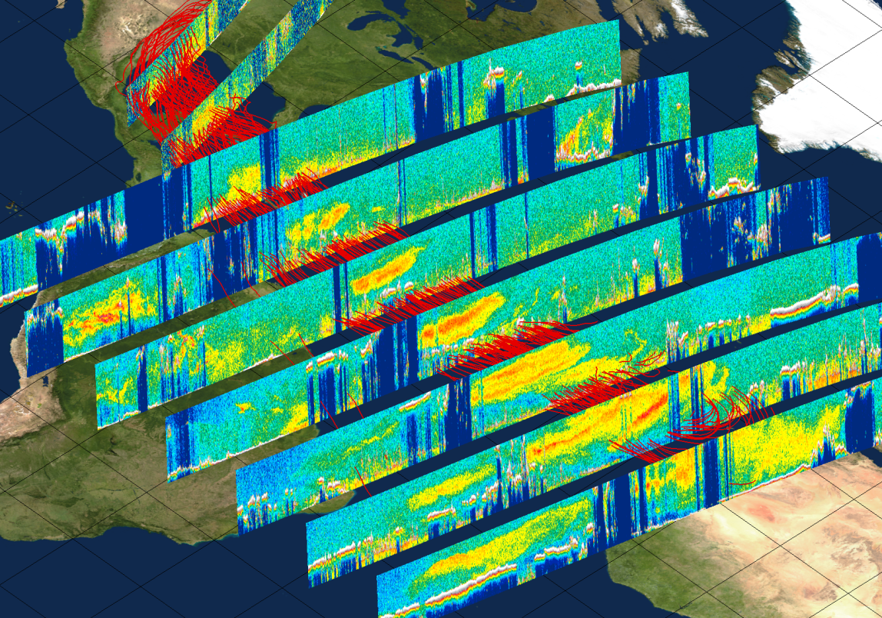
Space-based Doppler Wind Lidar builds on CALIPSO
24 hrs of JPSS orbits + radiosonde sites
CALIPSO data + wind profiles (vs. back trajectories)
Analysis greatly improved with more ocean + Southern Hemisphere wind observations
Options for UTLS
Image: Liu et al. JGR 2008

Slide 8
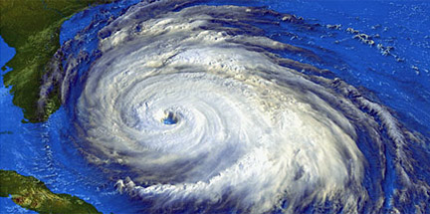
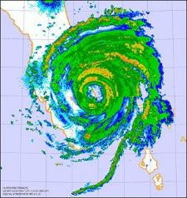
Wind lidar for operational weather
Space-based DWL can provide
  Direct measurements of altitude resolved wind profiles to
  initialize forecast models and observe large scale dynamics
  Provide Global coverage: including oceans, tropics, and SH
Multiple OSSE/OSE/etc. studies over decades show
significant predicted impact:
  Baker et al., Bulletin of the American Meteorological Society, 1995
  Marseille, et al., Proc. 5th Intl. Winds Workshop, EUM-P, 2000
  Riishojgaard et al., J. Applied Meteorology, 2004
  Stoffelen, et al., Quarterly J. of the Royal Met. Soc., 2006
  Marseille, G.J., A. Stoffelen, & J. Barkmeijer, Tellus A, 2008 (2 papers)
  Weissman & Cardinali, Quarterly J. of the Royal Met. Soc., 2007
  Atlas, et al., IEEE IGARSS, 2010
  Baker, et al., Bulletin of the American Meteorological Society, 2014
  Ma et al., Journal of Atmospheric and Oceanic Technology, 2014
  Atlas, et al. Journal of Atmospheric and Oceanic Technology, 2015
ESA’s Aeolus operating on orbit – starting to look at impact of lidar wind measurements.

Slide 9
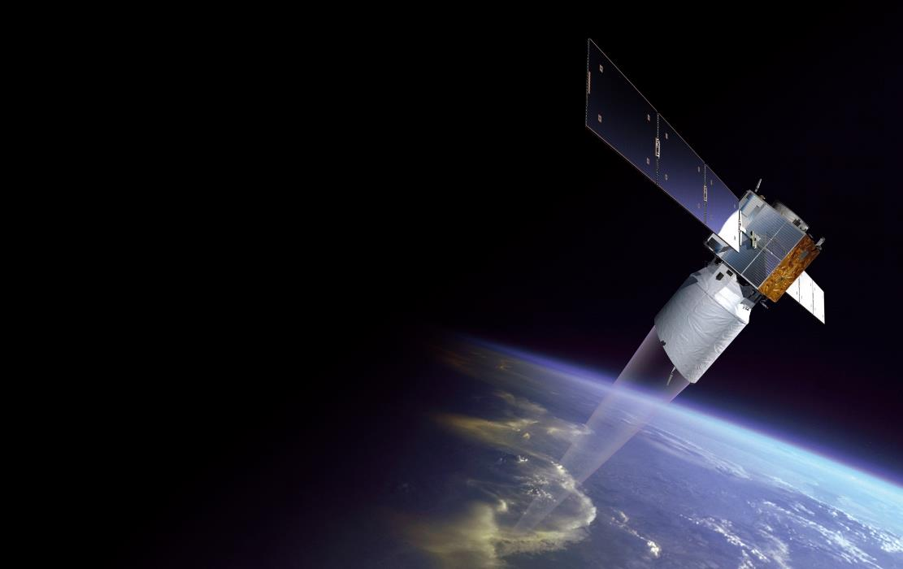
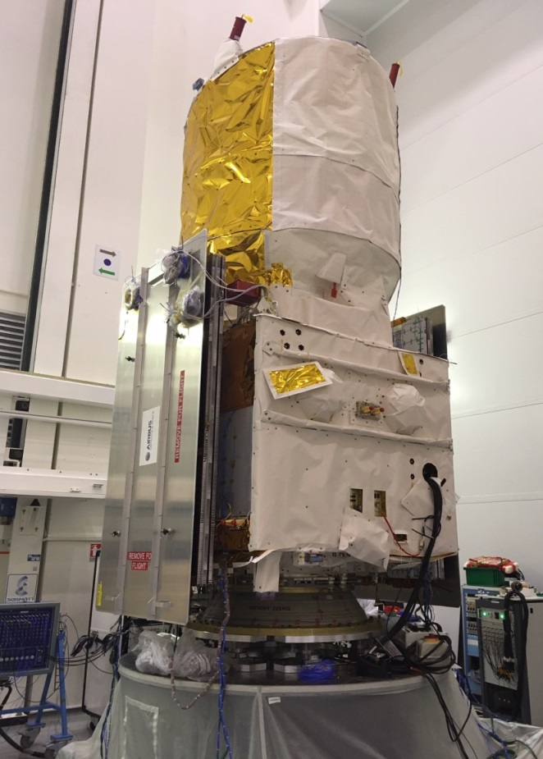
ESA’s Aeolus Mission: Atmospheric LAser Doppler Instrument (ALADIN)
Launched 22 August 2018
Single-look
(60%-70% of 2 looks)
Two Direct Detection channels: Aerosol & Molecular (full troposphere) - both at 355 nm
Sun-synchronous, dusk/dawn orbit, 320 km
3 year mission (consumables)
no planned follow-on (yet)
Courtesy Anne Grete Straume
Notes:
Aeolus Scientific objectives
To improve the quality of weather forecasts;
To advance our understanding of atmospheric dynamics and climate processes;
Explorer objectives
Demonstrate space-based Doppler Wind LIDARs potential for operational use.
Observation means:
Provide global measurements of horizontal wind profiles in the troposphere and lower stratosphere

Slide 10
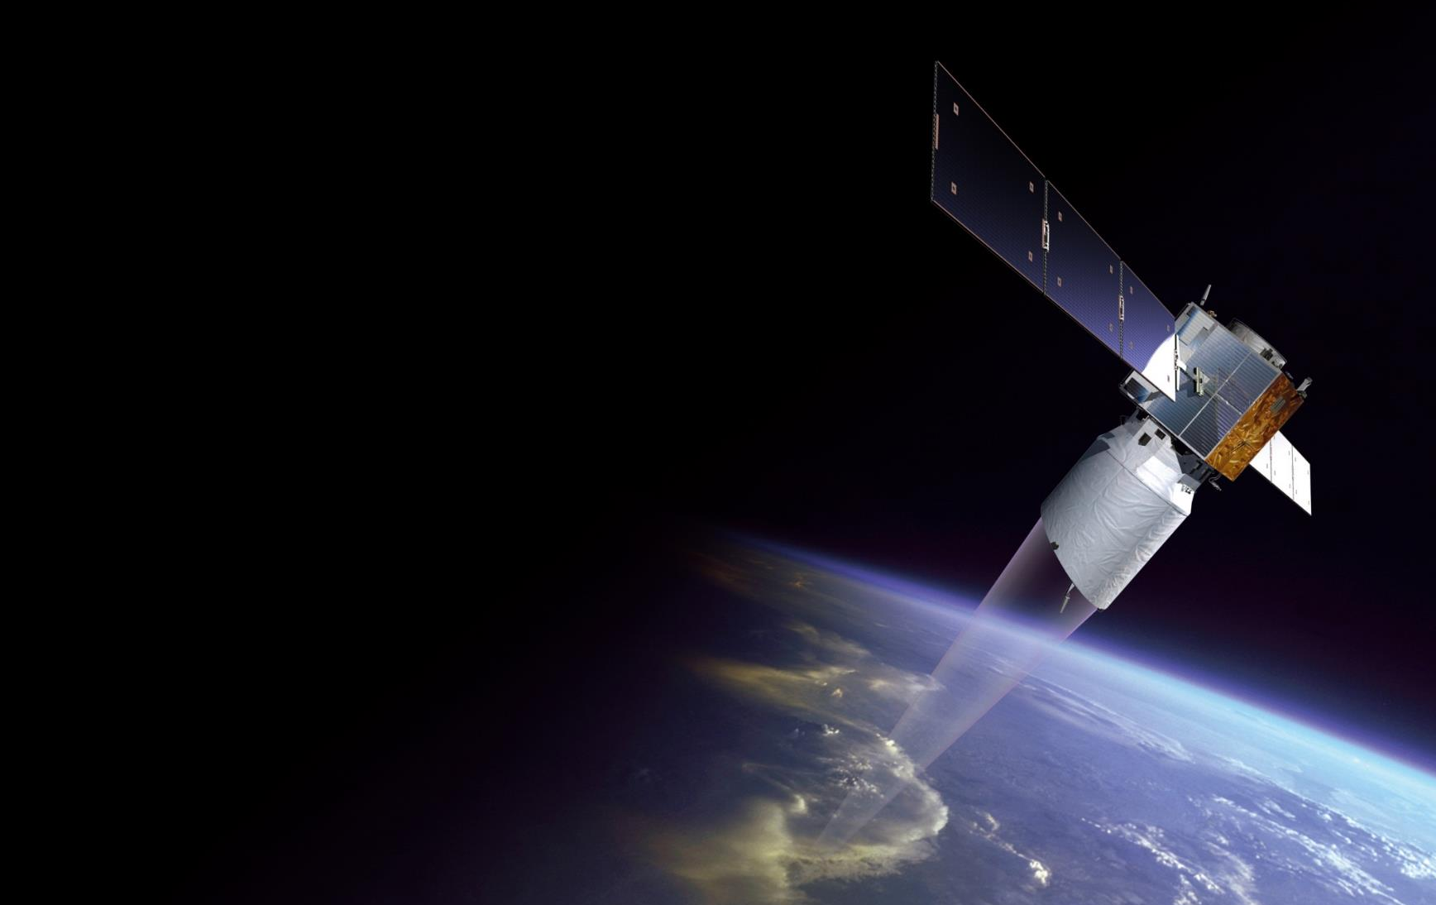
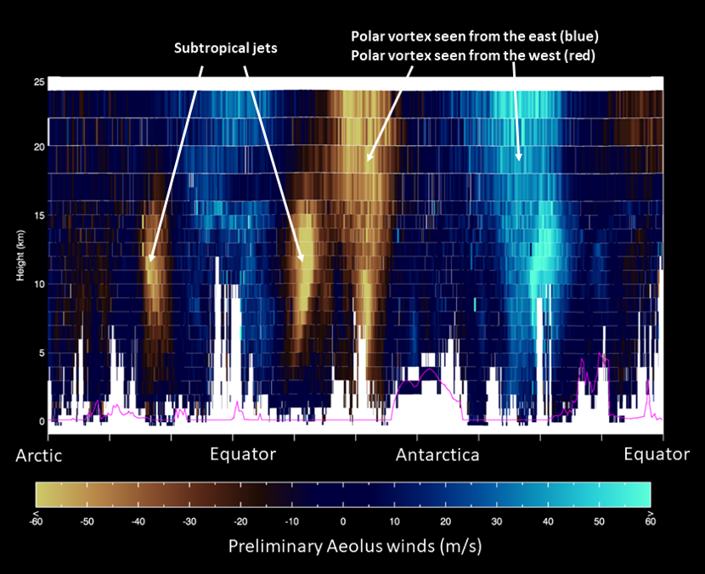
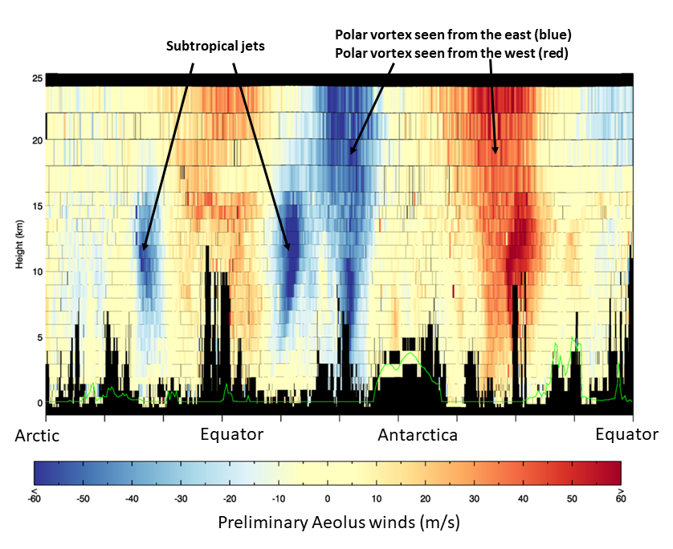
ESA’s Aeolus Mission: Atmospheric LAser Doppler Instrument (ALADIN)
Images: ESA
Notes:
Aeolus Scientific objectives
To improve the quality of weather forecasts;
To advance our understanding of atmospheric dynamics and climate processes;
Explorer objectives
Demonstrate space-based Doppler Wind LIDARs potential for operational use.
Observation means:
Provide global measurements of horizontal wind profiles in the troposphere and lower stratosphere

Slide 11
Doppler Wind Lidar OBservations

Slide 12
Principles of Doppler Wind Lidar
Laser pulse is sent into the atmosphere (10-200-5000 times per second)
The pulse scatters off the atmosphere in all directions
Part of the scattered light returns to be detected – lidar backscatter, β
If winds move the scattering targets, they impose Doppler shifts on the return light
This Doppler shift depends on wind speed angle relative to the line of sight (LOS)
V_{wind}
V_{los}

Slide 13
Distributed targets
As the pulse propagates out, continuous signals are scattered back to the telescope and detected
Time of return tells the range to each portion of the atmosphere
Process signals to calculate range-resolved Doppler shifts
Resolution depends on power, range, desired precision, etc.
Range/Space
Frequency shifts
Time

Slide 14
Doppler Wind Lidar
What it does
What it doesn’t do
Provides direct measurements of LOS wind speed profiles
  range-resolved – “sonde-like” – but averaging & accumulation along the curtain provides a more representative measurement for a grid cell than point samples
  no tracking or multiple satellites or revisit time is required
  Systems with molecular channels don’t require aerosol layers
Provides accurate & precise observation to anchor other measurements and models
Multiple looks/scans → retrieve horizontal wind speed & direction
See through thick clouds (same as CALIPSO)
From space
  Provide a horizontal swath from space– profiles provided along orbit path
  Provide frequent revisit times
    Lots of coverage over 24 hours, but observations vary in location
    A rate vs. a static variable
  Measure small scale turbulence

Slide 15

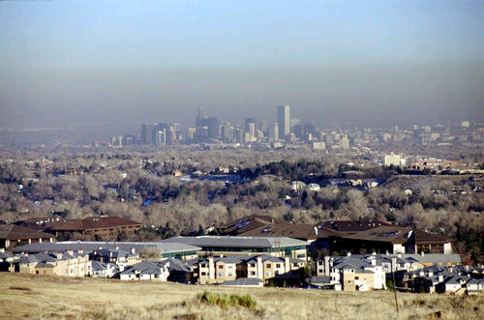
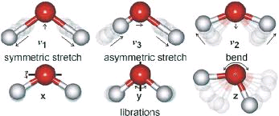
Atmospheric lidar return
Elastic scatter aerosol/cloud (“Mie”) returns – mostly lower troposphere
  Narrow bandwidth (< 100 MHz FWHM)
  Easier to resolve precise frequency shifts,
  Inconsistent opportunities – most are in the lower troposphere and cloud layers
Doppler broadened molecular (Rayleigh-Brillouin) returns
  Wide bandwidth (~1-3 GHz FWHM, based on wavelength, atmospheric temperature, pressure, and composition)
  Harder to resolve precise frequency shifts
  Molecules are consistently available (best coverage)
Low aerosol scatter (mostly molecular)
V_{wind}
V_{los}
High aerosol scatter

Slide 16
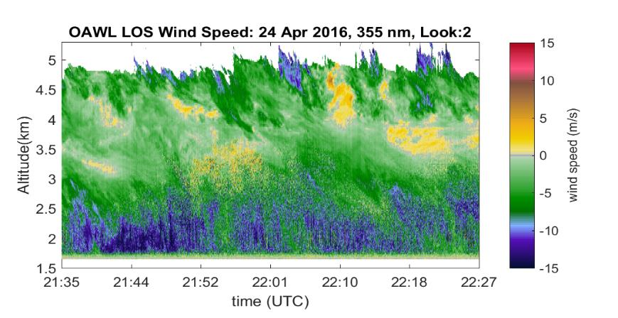
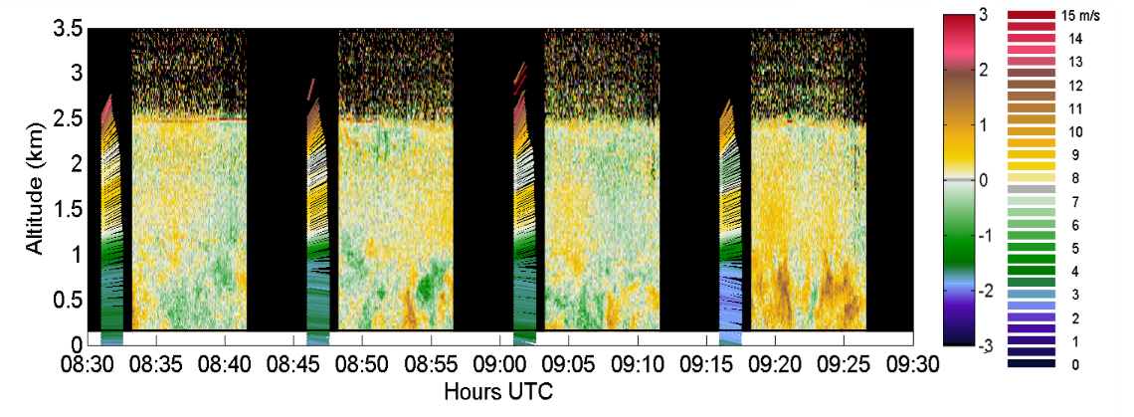
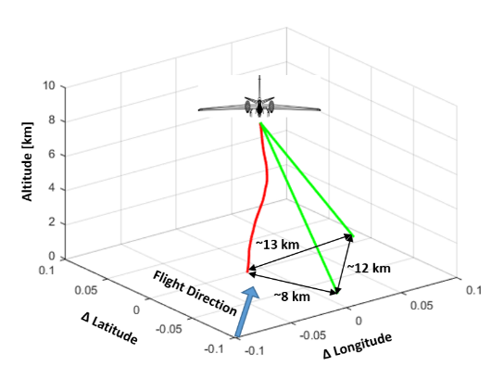
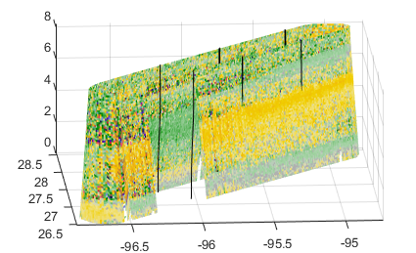
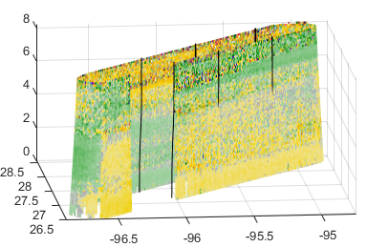
Wind Lidar data examples: Sub-orbital
NOAA ESRL CSD HRDL data, 2006
Ship ↑
Ground ↑
Aircraft ↓
Baidar et al., 2018

Slide 17
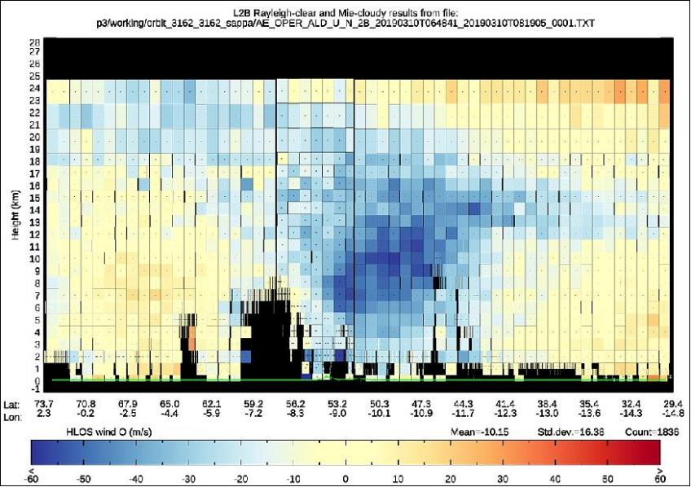
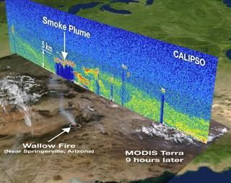
Wind lidar data: Space-based
Global curtains of wind profiles can add vertical dimensions to sounder & imager swath data
Like CALIPSO & now Aeolus, the lidar “swath” is vertical – a curtain vs. a carpet
CALIPSO data
credit: NASA
Aeolus data, credit: ESA

Slide 18
Observing Atmospheric Winds from Space
M
Molecular: UT/LS
Measure 3D Winds
A
Aerosol: LT/clouds
A
W
W
Water Vapor Features
Passive (Motion Vector, sea-state, etc.) Sounders and Imagers
Active
μ-wave
IR
MWIR
visible
Microwave
Optical Doppler Lidar
Optical (feature tracking lidar)
A
Lower troposphere/ aerosol scattering
A
Full-Troposphere & Lower Stratosphere (aerosol + molecular)
M
“Coherent” Heterodyne Detection
“Direct” Detection
1064 nm, 532 nm (CALIPSO) & 355 nm
~2 μm, (1.6 μm, ~10 μm)
LaRC
DAWN
A
Double-Edge
Fringe Imaging
Mach Zehnder
GSFC?
NOAA CSD, NOAA P-3, Halo, Leosphere,
A
M
A
M
M
A
ESA’s
Aeolus
UPMC (France)
ATHENA OAWL
Nested OAWL
Notes:
Plenty of solutions – the challenge is asking the right questions
~40 years of NASA investments in wind lidar technology
Multiple technology investments from NASA ESTO.
NASA/NOAA Working Group on Space-Based Wind Lidar (“LWG”, formerly the LAWS science team, 1989)

Slide 19
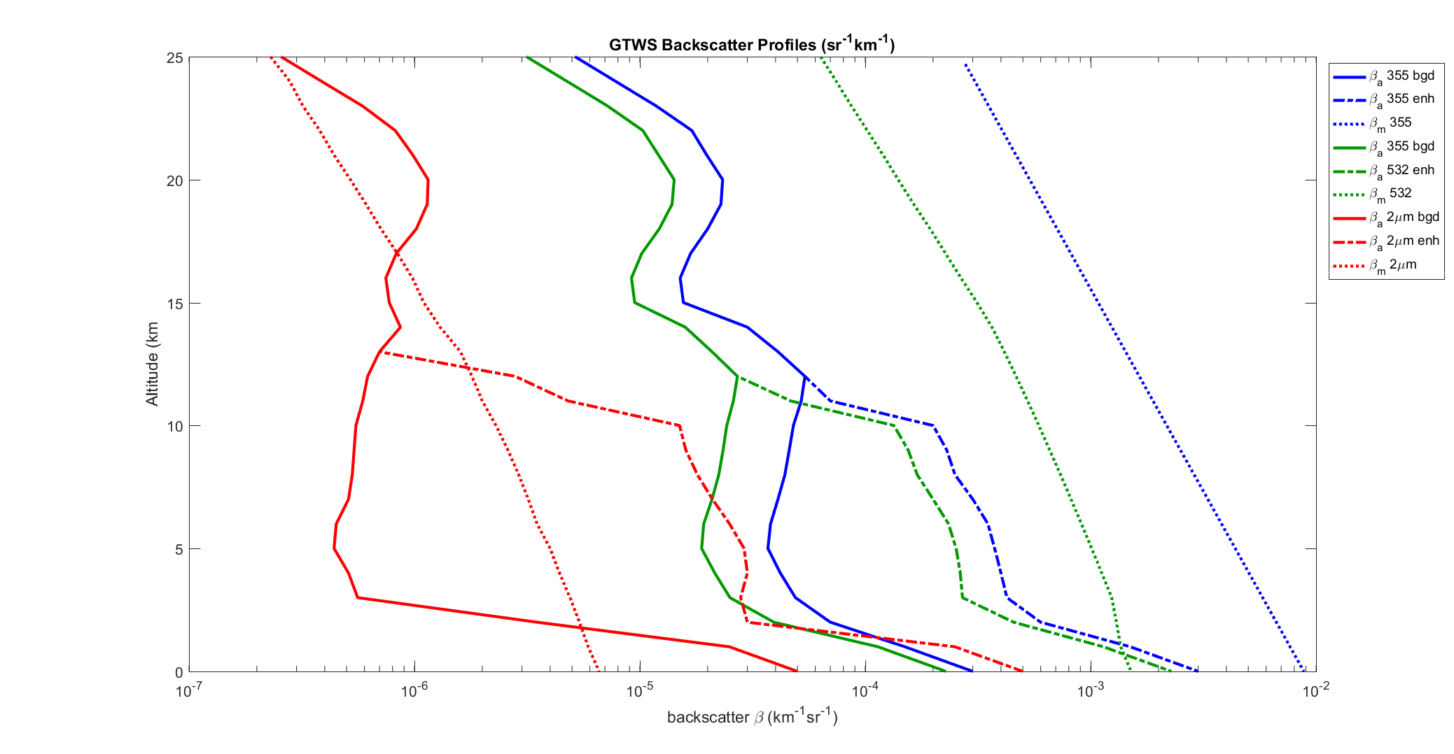




Lidar Backscatter versus Altitude (km⁻¹sr⁻¹, log scale)
From http://www.swa.com/
target-atmosphere-profiles
“Direct” Detection
Double-Edge
Fringe Imaging
Mach Zehnder
Lidar returns increase at cloud layers, with reduced returns after the cloud
returns
M
A
1064 nm, 532 nm (CALIPSO) & 355 nm (Aeolus)
A
“Coherent”
Heterodyne
Detection
A
~2 μm, (1.6 μm, ~10 μm)
A
A

Slide 20
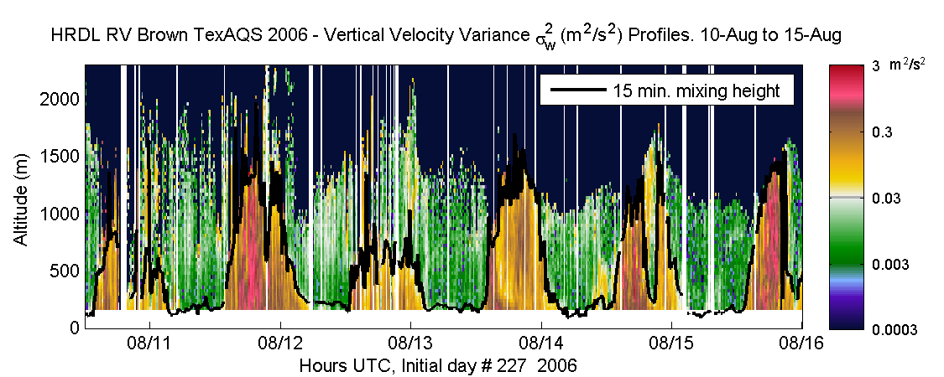
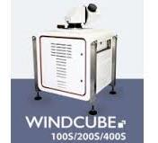
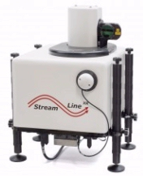
Coherent Detection Wind Lidars: used frequently in sub-orbital boundary layer/lower-troposphere research
Typically eye-safe, 1.5-10 μm wavelengths - great for PBL studies where sufficient aerosols are present
NOAA ESRL CSD: Mini-MOPA, HRDL, TEAC0, Micro-Dop
NOAA AOML: CTI Army system on P3 aircraft
Coherent Technologies Inc. (now LMCT)
  Wind Tracers (ground, airports)
  Airborne Systems: DC-8 (NASA ACLAIM), P3 (Navy & NOAA), DLR Falcon, some DoD applications.
Beyond Photonics
  Folks formerly at CTI/LMCT
  Currently working DAWN for Langley
Leosphere (Vaisala)
Halo Photonics (UK)
NASA Langley (DAWN on the NASA DC-8)

Slide 21
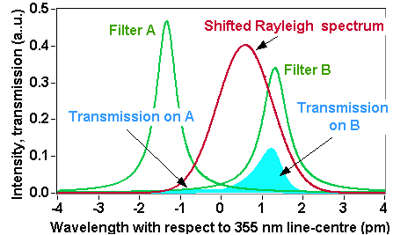
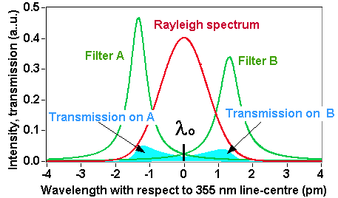
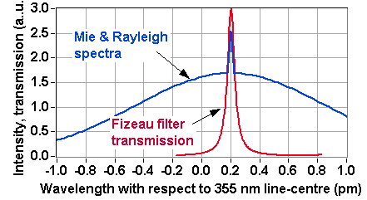
Principle of wind measurement with ESA’s Aeolus ALADIN
Atmospheric LAser Doppler INstrument
ALADIN
Direct-Detection Doppler Lidar at 355 nm
2 types of etalon spectrometers to analyse backscattered return signal
  Double edge Fabry-Perot etalon for spectrally broad molecular return (Rayleigh, like NASA GSFC’s TWiLiTE system)
  Fizeau etalon “Fringe Imaging” spectrometer narrows in on shifts in the spectrally narrow aerosol/cloud (Mie) returns
Figure from U. Paffrath

Slide 22
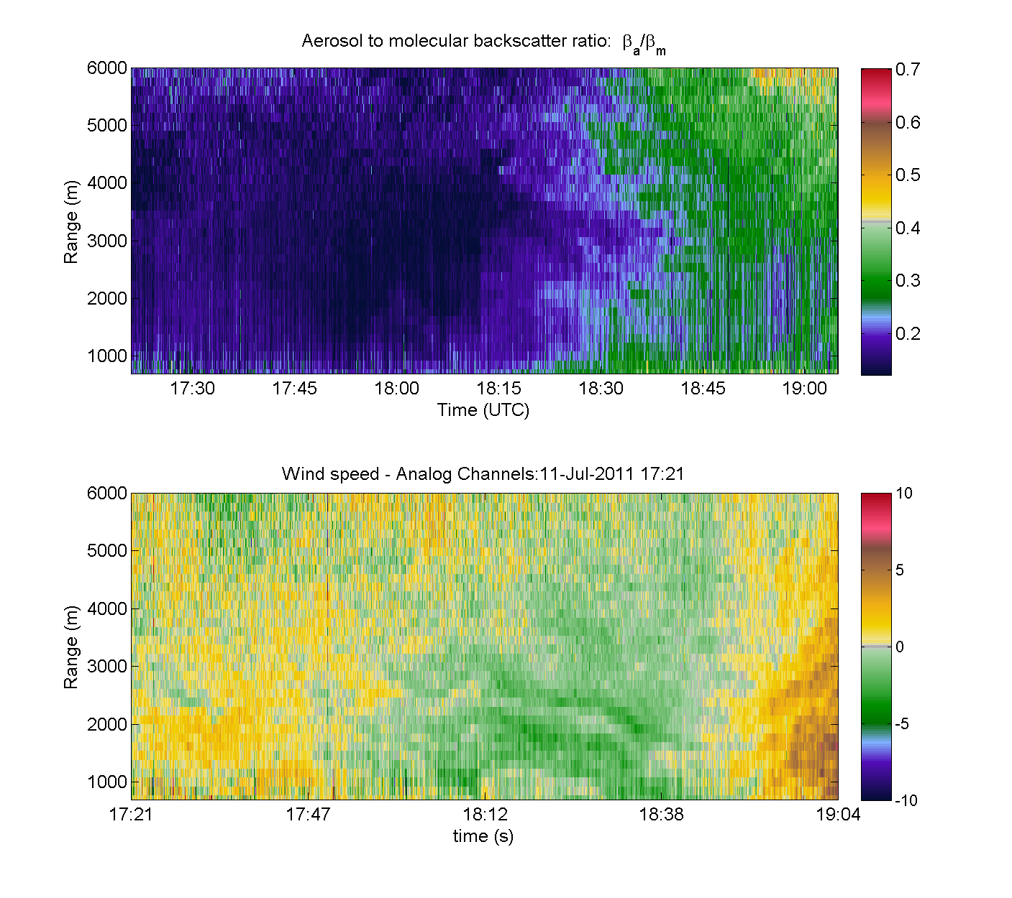
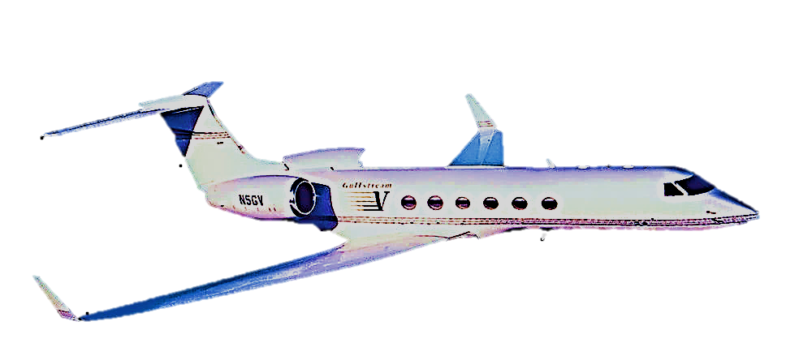
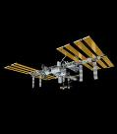
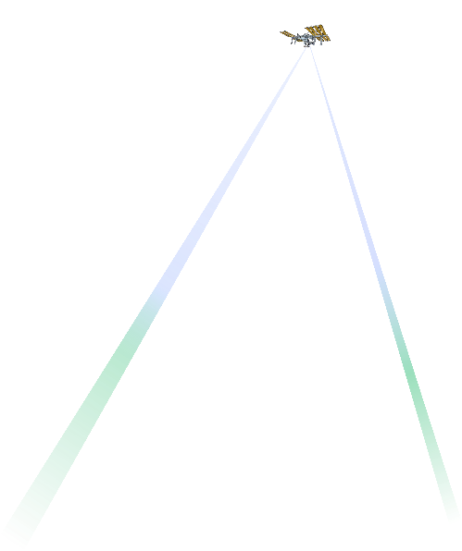
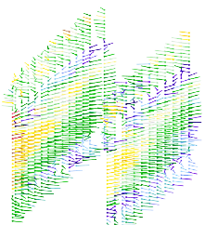

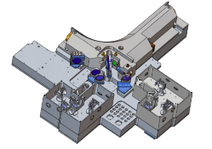
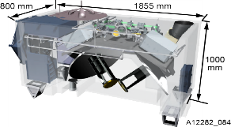
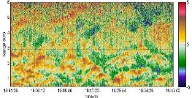

GOING BEYOND: NASA/Ball CALIPSO Lidar >13 Years on orbit!
Ball Aerospace’s Optical Autocovariance
Wind Lidar (OAWL) - Aerosol & Molecular
ESA’s ADM Aeolus (single look – 355 nm Aerosol & Molecular)
Global 3D winds
*NASA ESTO funded grants
(no profit)
NSOSA study
ESDS
 |  |  |  |  |  |  |  |  |  |  |  |  |  |  |  |  |  |  |  |  | ‘30
 |  |  |  |  |  |  |  |  |  |  |  |  |  |  |  |  |  |  |  | ‘29
 |  |  |  |  |  |  |  |  |  |  |  |  |  |  |  |  |  |  | ‘28
 |  |  |  |  |  |  |  |  |  |  |  |  |  |  |  |  |  | ‘27
 |  |  |  |  |  |  |  |  |  |  |  |  |  |  |  |  | ‘26
 |  |  |  |  |  |  |  |  |  |  |  |  |  |  |  | ’25
 |  |  |  |  |  |  |  |  |  |  |  |  |  |  | ‘24
 |  |  |  |  |  |  |  |  |  |  |  |  |  | ‘23
 |  |  |  |  |  |  |  |  |  |  |  |  | ‘22
 |  |  |  |  |  |  |  |  |  |  |  | ‘21
 |  |  |  |  |  |  |  |  |  |  | ‘20
 |  |  |  |  |  |  |  |  |  | ‘19
 |  |  |  |  |  |  |  |  | ‘18
 |  |  |  |  |  |  |  | ‘17
 |  |  |  |  |  |  | ‘16
 |  |  |  |  |  | ‘15
 |  |  |  |  | ‘14
 |  |  |  | ’13
 |  |  | ‘12
 |  | ’11
 | ’10
’09
aerosols
EVI-4 ATHENA-OAWL 532 nm Aerosol winds ISS Mission concept (TMCO rated Selectable)
Full
tropospheric operational wind lidar
winds
Operational Airborne mission development
ESA’s
Aeolus
Launch
22/08/19
Quadrature
Mach Zehnder
Interferometer
Laboratory
Prototype
OAWL Mission
concepts
On-orbit Operational Demonstration: dual lines of sight
Operational Space Demonstration Flight build
*HAWC-OAWL IIP
Nested OAWL
full troposphere
demonstration
*GrOAWL
2016 demo
*OAWL-ACTs
*OAWL-IIP
2011 demo
Notes:
OAWL IIP – First demonstration 2011
GrOAWL: the 2 LOS ATHENA Airborne Demonstrator built, flown, validated, and scaled to space
2 pubs: Journal of Atmospheric & Oceanic Technology: Tucker et al., 2018 & Baidar et al., 2018
ATHENA-OAWL: EVI-2,4 proposals
Aerosol Transport, Hurricanes, and Extra-tropical Numerical weAther using OAWL.
Mission Systems Architecture: Design-to-cost approach: based on heritage systems (CALIPSO) and
ISS hosting
EVI-4, rated Category 2 (TMCO rated Selectable
– but not selected).
HAWC-OAWL: Ground-based demonstrations of dual-wavelength wind and aerosol backscatter coefficient measurements
ESTO managed competitive grants: NO profit

Slide 23
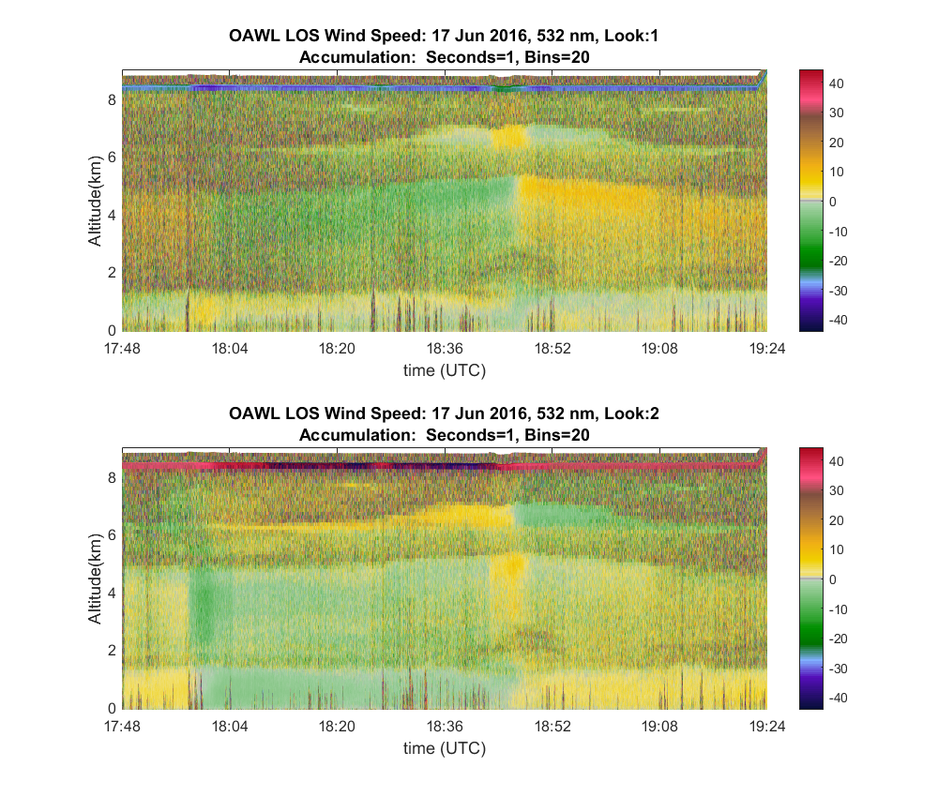
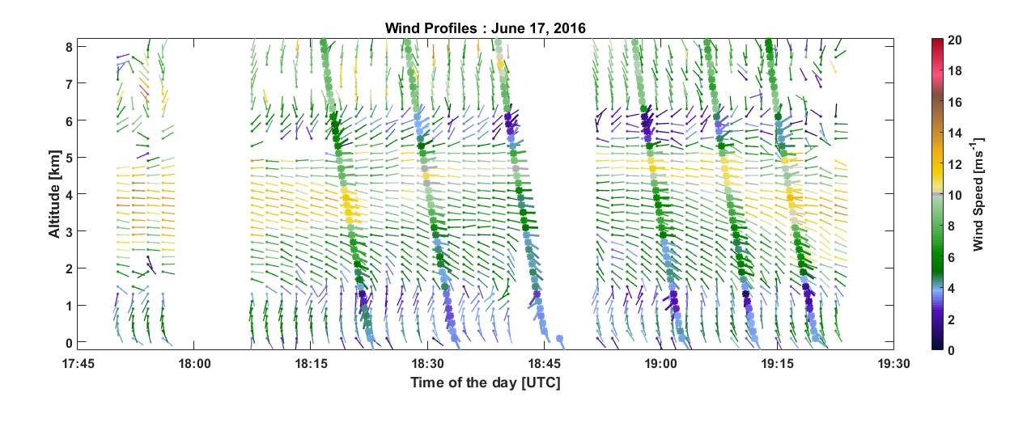
Airborne OAWL Validation: Simultaneous two-look wind profiles
17 June 2016: Forward look, 1s profiles,
<1.5 mJ/pulse (0.3 W), 532 nm
Autonomous Green OAWL (“GrOAWL”) Airborne Demonstrator built, flown (WB-57), validated, and scaled to space
Left: Dual 45° Line of Sight (LoS) wind speed data sets – can combine to get speed & direction (below)
See: Tucker et al., 2018 & Baidar et al., 2018, J. Atmos. & Ocean. Tech,
Aft look, 1s profiles

Slide 24
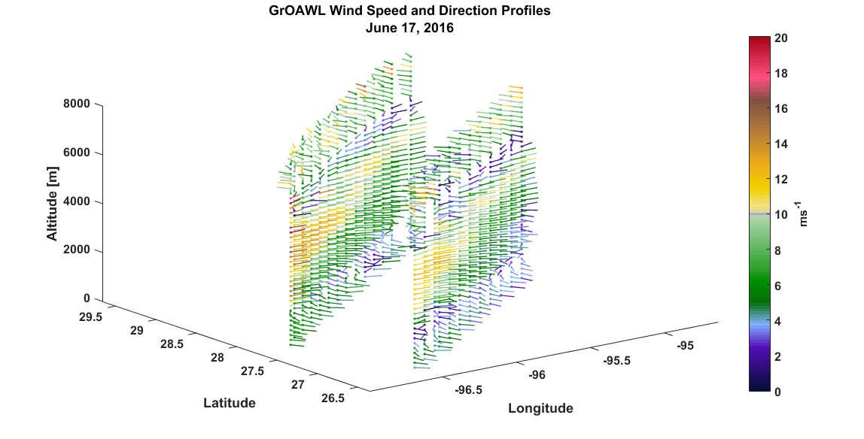
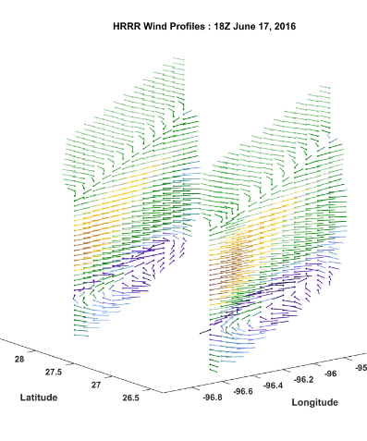
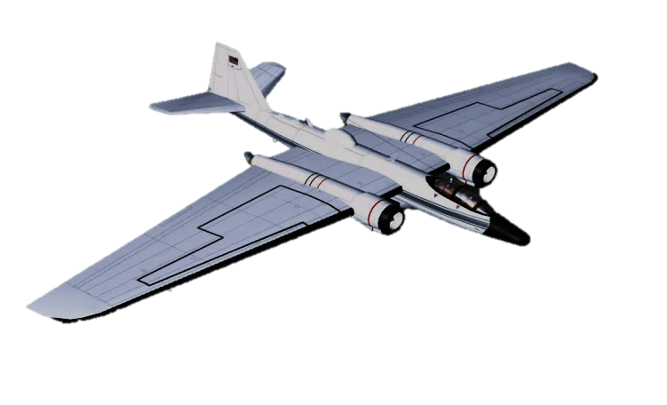
GrOAWL airborne measurements over the Gulf of Mexico captured spatial variability predicted by NOAA’s HRRR
GrOAWL Wind Speed and Direction
Profiles: 17 June 2016
HRRR Wind Profiles: 18Z 17 June 2016
Images: Sunil Baidar, CIRES/NOAA ESRL CSD

Slide 25

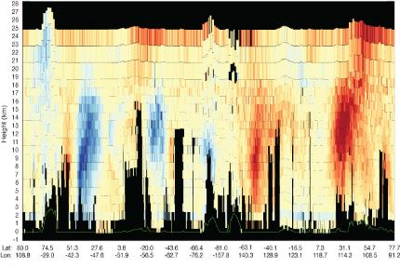
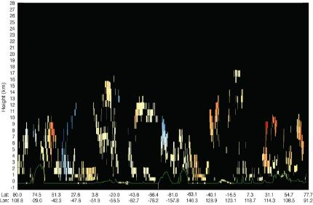
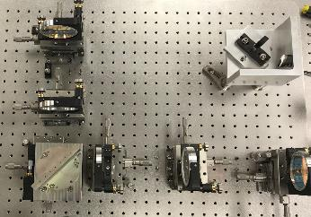

Nested-OAWL path to Full Atmospheric Wind Profiles
Current Ball IRAD demonstrating the Nested interferometer to provide Aerosol winds @ 532 nm (long OPD) and Molecular winds @ 355 nm (new short OPD)
Both wavelengths simultaneously generated in the same laser, both OPDs in the same interferometer.
DARPA-funded effort developed a UV-only short OPD OAWL interferometer
Aeolus molecular (Rayleigh) data
Aeolus aerosol (“Mie”) data
Notes:
Short (molecular) OPD is “nested” inside the long (aerosol) OPD: “Nested OAWLs”
Same detectors as used for the dual wavelength OAWL
2018 IRAD for demonstration is underway

Slide 26
Shaping Future WIND Missions

Slide 27

Scales of atmospheric processes
Space-based
Aircraft-based
Time scale
Surface-based
Modified from
Markowski and Richardson

Slide 28




Doppler Lidar Applications
Aeolus Molecular (Rayleigh)
Space: Global winds
Aircraft: Regional winds, some PBL
Ship/Ground: PBL focus, some upper troposphere
Aeolus Aerosol (“Mie”)
Images courtesy ESA/ECMWF

Slide 29
Range resolved Lidar anchors cloud heights to improve AMV results…
See Folger & Weissman, (2014 & 2016)
Lidar reveals presence of thin cirrus that (if neglected) can be detrimental to sounder retrievals
Clouds & aerosols enhance lidar precision at these layers
AMV height assignment error bars
Lidar measures convergence/divergence even where features don’t move (e.g. mountain wave clouds)
Atmospheric Motion Vector
Winds error bars

Slide 30

Possible Mission Architecture
Aerosols (including clouds) and water vapor features → AMVs
True clear air (no aerosols, low water vapor)
  Aeolus Molecular lidar winds are providing lots of previously un-measured data
AMV + molecular Doppler channel for space-based operation
  Lidar anchors AMV ←→ AMV extends lidar
Studies
  How far (swath) does the anchor hold?
  What is the overall benefit for lidar + AMV data?

Slide 31




The OAWL approach builds on Aeolus & CALIPSO
Laser - Nd:YAG doubled (CALIPSO) & tripled (AEOLUS)
High Mach Zehnder interferometer throughput efficiency enables two lines of sight for less uncertainty
Relaxed technical requirements for the laser, telescope, Tx/Rx alignment, field-of-view, etc. → less risk/costs
  No frequency locking requirement
  Wide FOV for alignment margin (like CALIPSO)
  Pressurized laser (like CALIPSO)
OAWL detectors & real-time processors → increased flexibility in processing parameters, altitude gate size, etc.
Fewer and simpler calibration requirements
No Mie contamination of the OAWL Rayleigh channel
RAM direction
Ground
Track

Slide 32
GOING BEYOND: NASA/Ball CALIPSO Lidar >13 Years on orbit!
Ball Aerospace’s Optical Autocovariance
Wind Lidar (OAWL) - Aerosol & Molecular
ESA’s ADM Aeolus (single look – 355 nm Aerosol & Molecular)
Global 3D winds
*NASA ESTO funded grants
(no profit)
NSOSA study
ESDS
 |  |  |  |  |  |  |  |  |  |  |  |  |  |  |  |  |  |  |  |  | ‘30
 |  |  |  |  |  |  |  |  |  |  |  |  |  |  |  |  |  |  |  | ‘29
 |  |  |  |  |  |  |  |  |  |  |  |  |  |  |  |  |  |  | ‘28
 |  |  |  |  |  |  |  |  |  |  |  |  |  |  |  |  |  | ‘27
 |  |  |  |  |  |  |  |  |  |  |  |  |  |  |  |  | ‘26
 |  |  |  |  |  |  |  |  |  |  |  |  |  |  |  | ’25
 |  |  |  |  |  |  |  |  |  |  |  |  |  |  | ‘24
 |  |  |  |  |  |  |  |  |  |  |  |  |  | ‘23
 |  |  |  |  |  |  |  |  |  |  |  |  | ‘22
 |  |  |  |  |  |  |  |  |  |  |  | ‘21
 |  |  |  |  |  |  |  |  |  |  | ‘20
 |  |  |  |  |  |  |  |  |  | ‘19
 |  |  |  |  |  |  |  |  | ‘18
 |  |  |  |  |  |  |  | ‘17
 |  |  |  |  |  |  | ‘16
 |  |  |  |  |  | ‘15
 |  |  |  |  | ‘14
 |  |  |  | ’13
 |  |  | ‘12
 |  | ’11
 | ’10
’09
aerosols
EVI-4 ATHENA-OAWL 532 nm Aerosol winds ISS Mission concept (TMCO rated Selectable)
Full
tropospheric operational wind lidar
winds
Operational Airborne mission development
ESA’s
Aeolus
Launch
22/08/19
Quadrature
Mach Zehnder
Interferometer
Laboratory
Prototype
OAWL Mission
concepts
On-orbit Operational Demonstration: dual lines of sight
Operational Space Demonstration Flight build
*HAWC-OAWL IIP
Nested OAWL
full troposphere
demonstration
*GrOAWL
2016 demo
*OAWL-ACTs
*OAWL-IIP
2011 demo
Notes:
OAWL IIP – First demonstration 2011
GrOAWL: the 2 LOS ATHENA Airborne Demonstrator built, flown, validated, and scaled to space
2 pubs: Journal of Atmospheric & Oceanic Technology: Tucker et al., 2018 & Baidar et al., 2018
ATHENA-OAWL: EVI-2,4 proposals
Aerosol Transport, Hurricanes, and Extra-tropical Numerical weAther using OAWL.
Mission Systems Architecture: Design-to-cost approach: based on heritage systems (CALIPSO) and
ISS hosting
EVI-4, rated Category 2 (TMCO rated Selectable
– but not selected).
HAWC-OAWL: Ground-based demonstrations of dual-wavelength wind and aerosol backscatter coefficient measurements
ESTO managed competitive grants: NO profit

Slide 33
Next Steps & Questions for Discussion

Slide 34

Research to Demonstration to Operations
Latest public Aeolus image from ESA: 23 Jul 2019
ESA/ECMWF/KNMI/DLR/etc.
  invested a lot of time and funding to advocate and
  then prepare for Aeolus
  instrument modeling, technical demonstrations, data
  processing, data assimilation, data dissemination, etc.
  Aeolus airborne demonstrator (DLR’s A2D) for the
  mission – preparation and validation
What could we all be doing to better advocate and prepare for a US mission?
Current/Next steps
  STAR: continue working with Aeolus data to understand and maximize impact
  Ball: demonstrate OAWL molecular channel to provide full tropospheric winds
  Community
    Study/understand/optimize roles for passive and active wind sensing; “Yes, AND…”
    Start shaping the next generation wind lidar mission to meet NWP needs
  Potential: OAWL Aircraft integration and flight test hours for NOAA to demonstrate observations in space-like format and test optimal configurations and data types for future architectures.

Slide 35




To think about: Shaping a future US wind lidar mission starts now
What does NOAA and, specifically, STAR & the NWP community hope to get out of a winds mission?
  Full troposphere vs. certain parts?
  Large scale global winds from orbit?
  Detailed PBL studies (from aircraft/surface obs)?
What is the maximum resolution (horizontal-along track, and vertical) that supports an operational demonstration?
  Is Aeolus resolution & performance good enough?
  What data/science improvements are desired over Aeolus?
  What are we willing to trade to keep costs down? Resolution? Duty cycle? Vertical coverage? Horizontal coverage?
How many look-angles or lines-of-sight?
  Aeolus finding (Horanyi et al. 2014): Single LOS provides 60%-70% the impact of dual-LOS on same satellite.
  Assimilation: LOS winds provides more impact than horizontal winds
  Two looks on same satellite, or two smaller satellites for double coverage?
How would you take advantage of variable/flexible sampling/processing?

Slide 36

Wind Lidar Mission Trades
Wind Speed precision (uncertainty)
Wind Speed accuracy
(bias)
Vertical coverage
Vertical resolution
Horizontal resolution
Total Coverage
Laser wavelength, power
Telescope size, quality
Type of Doppler shift
frequency discriminator*
Orbit inclination, altitude
Aerosol distribution
Risk tolerance/budget
Systems Engineering
1s processing Less vertical coverage, more uncertainty, more horizontal resolution
10s processing More vertical coverage, less uncertainty, less horizontal resolution

Slide 37

Summary – Thank you!
Potential impact of full tropospheric wind measurements (including BL winds and UTLS) from lidar has been shown through OSSEs
ESA-Aeolus’ successes and lessons benefit the whole community
  Demonstrated we can measure winds from space - the technology is available
  Aeolus data is already showing impact and ESA is providing NOAA with a fantastic resource to test wind lidar data assimilation & impact
  ESA/EUMETSAT are receptive to collaboration on a next generation winds mission. Discussions are underway in Europe. Perhaps NOAA could weigh in if interested.
For NWP, the community needs to advocate for a winds mission with full tropospheric coverage. Current NASA wind lidar investments are focused on Decadal Survey based PBL studies (incubation for next DS).
The 2016 ATHENA-OAWL Earth Venture proposal, a design to cost approach focused on extra-tropical weather and tropical cyclone research, was rated selectable - another indication of readiness of the technology
The OAWL approach provides a high TRL, reduced risk, wind lidar mission, with options for full molecular channel (follow-on to Aeolus)
Ball continues to invest in OAWL to enable wind observations through the full troposphere.
Notes:
Since 2017, NASA is only investing in coherent (2 micron) lidar systems. 2 micron system TRLs are low and still require significant development.
No NASA investment in molecular wind lidar systems since 2014

Slide 38
BACKUP/EXTRAS

Slide 39



Slide 40


Next Generation Operational LEO Weather Architecture
Based on NOAA’s Satellite Observing System Architecture (NSOSA) Study

Slide 41



Mission motives – really-simplified
NOAA Requirements: focus on improving NWP, Protecting Lives and Property
NASA Requirements: Science. Processes, Modeling, Pre-operational
Global initialization of forecast models that use tested model physics
  Global coverage
  Variable scales
  (model grids)
Research on model
physics
Research to update model physics
  Focused coverage
  Variable scales
  PBL emphasis
  ESDS driven science
A well-planned mission can provide something for everyone

Slide 42
Additional Discussion
Are NASA’s current technical investments aligned with NOAA’s priorities?
  NASA Investments – no investment in molecular/upper tropospheric observations since 2015
  Since 2017, all NASA focus is internal at Langley on heterodyne DAWN for PBL, with multiple successful Airborne demonstrations looking at lower tropospheric winds.
  TRL (Technology Readiness Levels) – no heterodyne 2 micron laser system has flown in space. Current lasers are in early developmental phase.
  Potential for Earth Explorer – lessons learned from ATHENA-OAWL

Slide 43



NASA/Ball
CALIPSO
Aerosol
Lidar
2006
ESA’s Aeolus
Wind
Lidar
2018
OAWL: Full tropospheric wind & aerosol observations

Slide 44


Advantages of OAWL approach
Wrapping fringes for removal of platform-motion-induced Doppler offsets in processing
Like Aeolus, OAWL offers a path to full atmospheric lidar wind profiles – and adds a second look
FPGA-based pulse/sample accumulation enables pulse-to-pulse phase referencing→ relaxed laser frequency and pointing stabilization requirements
Narrow range gates provide precise cloud height estimation
Nested OAWL provides aerosol & molecular channels (no cross calibration required)
No atmospheric linewidth calibrations required for OAWL Doppler measurements,
No aerosol “contamination” of molecular signal
Wide field of view receiver provides overlap margin (like on CALIOP)
The MZ Interferometer’s high throughput efficiency → enables two lines of sight
Aircraft Demonstrations/Validation

Slide 45

Lidar & Atmospheric Motion Vectors (AMVs)
Height Assignment Uncertainty
  Up to 70% of AMV error (Velden & Bedka, 2009)
Using CALIPSO to assign heights
  Folger & Weissman, (2014 & 2016): used CALIPSO cloud height measurements to anchor Meteosat-10 AMV layer heights
  Up to 15% improvement in co-located (50km, 30 min.) AMVs vectors from Metosat-10.
  lidar-based height bias adjustments (from previous days) resulted in up to 7% improvement, affecting all AMVs
Cloud Drift and WV
GEO: GOES/Himawari8/MeteoSat/etc., Visible and IR
Polar: MODIS Cloud Drift Winds (Arctic, Antarctic, Aqua, Terra), AVHRR (Arctic, MetOp-B), VIIRS (Arctic)

Slide 46

ATHENA-OAWL: path-finding science for next-generation global weather prediction and climate analysis
ATHENA-OAWL: Aerosol Transport, Hurricanes, and Extra-tropical Numerical weAther using OAWL.
Design-to-cost approach to NASA Earth Venture Instrument (EVI) based on heritage systems (mostly CALIPSO)
EVI– first proposed in 2013 was the first full US wind lidar mission concept developed, costed, and proposed in decades: Rated Category 3
Re-proposed in 2016. Announced February 2018, rated Category 2 (Selectable).
Objectives: Co-located wind and aerosol profiles to provide:
  breakthroughs in modeling and prediction of low and mid-latitude weather and climate.
  better understanding of relationships between aerosol radiative forcing, atmospheric dynamics and the genesis and lifecycle of tropical cyclones
  understanding of the impacts of long-range dust and aerosol transport on global energy and water cycles, air quality, and climate.
Notes:
Objectives: Co-located wind and aerosol profiles to provide:
better understanding of relationships between aerosol radiative forcing, atmospheric dynamics and the genesis and lifecycle of tropical cyclones
understanding of the impacts of long-range dust and aerosol transport on global energy and water cycles, air quality, and climate.
breakthroughs in modeling and prediction of low and mid-latitude weather and climate.

Slide 47


ATHENA-OAWL Earth Venture Mission for the ISS
Japanese Experimental Module: JEM-EF chosen for mass/power, cooling availability
Beams point off-nadir 40º inboard
Forward + Aft views separated by 90º (±45º from cross-track)
RAM direction
ISS Ground
Track

Slide 48








OAWL: Optical Autocovariance Wind (& Aerosol) Lidar
Since ~2003, Ball has worked in a public-private partnership with NASA, NOAA, and weather/wind lidar communities to advance space-based wind lidar technology and fill the global wind measurement gap.
1999-present: Ball designs, mission concepts, build and test of OAWL patented, field-widened, four-channel, Mach-Zehnder interferometer, mission concepts, and retrieval/processing algorithms
2013 & 2016 ATHENA-OAWL Mission Proposals
EVI4 rated selectable
Altitude MSL (m)
Altitude MSL (m)
aerosols
winds
2008-2012: OAWL IIP-07
Breadboard system
355 nm only, 4x channels
Single look 12” telescope
Ground validation with NOAA Coherent system
Autonomous flights on NASA WB-57
2012-2015: HOAWL ACT
Breadboard System
Demonstrate 532 nm wavelength channels & depolarization channels
Initial HSRL Aerosol retrieval algorithms
2015-2017: ATHENA-OAWL Venture-Tech: GrOAWL
Airborne demonstrator System (WB-57)
2-lasers = 400 Hz eff. PRF
4x 532 nm channels
2 looks, 2 telescopes to demonstrate geometry for space-based operation
2014-2017: HAWC-OAWL IIP
Dual look, dual-wavelength winds + cross-polarization system
New Invar interferometer build
DC-8 hardware design/build
2018-2019: Ball IRAD
HSRL demonstrations
Nested-OAWL: Dual-wavelength aerosol & molecular winds
Full tropospheric profiling

Slide 49
Optical Autocovariance Wind Lidar (OAWL):
Field-Widened, Quadrature Mach Zehnder Interferometer (QMZI)
…Polarization multiplexing (QWP) provides four interference points
Like a two-port Michelson, but with static OPD and…
Field-widening via cat-eye design
0.9 m OPD
Detector B = 90°
PBS
QWP = π/2
Non-Polarizing beam-splitters
Detector A = 180°
PBS
Detector C = 0° (360°)
Detector D = 270°

Slide 50

HAWC-OAWL Winds & Aerosol Backscatter
OAWL LOS Winds (m/s): 355 nm
Ground-based observations
  Pointing 30° El, 270° Az.
Dual wavelength (355 nm & 532 nm) OAWL aerosol winds & aerosol backscatter coefficients
LOS Wind Speed – m⁻¹s⁻¹
OAWL LOS Winds (m/s): 532 nm
OAWL 532 nm aerosol backscatter coefficient (km⁻¹sr⁻¹)
LOS Wind Speed – m⁻¹s⁻¹
Backscatter - km⁻¹sr⁻¹

Slide 51


Preliminary comparison: aerosol backscatter coefficient
GV-HSRL aerosol backscatter coefficient (km⁻¹sr⁻¹)
NCAR data courtesy of
Matt Hayman and Scott Spuler
OAWL aerosol backscatter coefficient (km⁻¹sr⁻¹)
Backscatter - km⁻¹sr⁻¹

Slide 52

Boresight mechanisms maintain overlap
  2 telescopes/looks couple into a single interferometer receiver
~30 cm diameter Cassegrain telescopes
Dedicated GPS/IMU (200 Hz)
  Variable 532 nm output power
New build of 2nd Fibertek OAWL Laser set up to interleave pulses with original
Refurbished OAWL IIP Fibertek Laser
Fibertek Laser Electronics
Custom Payload Controller and real-time winds processor
Direction of flight
Fiber coupled OAWL Interferometer

Slide 53


AOVT GrOAWL Airborne Flight Testing
Deployed on NASA WB-57 (N928)
Ellington Field, Houston, TX
May-June 2016
8 flights
  5 engineering
  3 validation
Remote/Co-pilot operation
Racetrack patterns over the Gulf of Mexico
  Revisit times: ~1hr/loop
  Launched dropsondes from the aircraft (48 total)

Slide 54


GrOAWL Line of Sight Wind Speed Measurement Accuracy
21 total dropsondes from 3 validation flights
Dropsonde data is considered the “True Value”
8 km spatial averaging of 10 second profiles to
better estimate the GrOAWL accuracy (1 minute)
Fit slopes of 0.98 and 1.07

Slide 55

Two look LOS wind speeds → wind profiles
Can assimilate vertically resolved winds from separate lines-of-sight → preserves the most information
Can also combine 2 look LOS winds to retrieve wind speed and direction profiles
Retrieval is based on classic radar/lidar “VAD” techniques
Wind barbs: color indicates wind speed, and line (dot at the time of the profile) line points into the wind direction

Slide 56


GrOAWL vector winds validated with YES High Definition Sounding System (HDSS) dropsondes (ONR)
June 17, 2016
June 21, 2016
Images: Sunil Baidar, CIRES/NOAA ESRL CSD

Slide 57
Atmospheric Backscatter
Backscatter scaling with wavelength:
  Aerosol scattering: scales as λ^{- 1.5-3+}
  Molecular scattering scales as λ⁻⁴
Longer wavelengths (e.g. 2 µm)
  Larger aerosols present in the PBL & aerosol/cloud layers
  Less atmospheric extinction, but less coverage
Shorter wavelengths (532 & 355 nm)
  More scattering from aerosol/cloud layers
  Scattering off of smaller particles present in Upper-troposphere/Lower-Stratosphere
  Molecular scattering
  High TRL lasers, telescopes, & detectors
These properties factor strongly into which lidars are best for a given application
Log scale
Notes:
TRL

Slide 58

CCOPE/ADLS
(Airborne)
NOAA
Mini-MOPA
NOAA TeaCO
LAWS Panel
LAWS Team
NOAA HRDL
VALIDAR
DAWN 1 IIP
DAWN 2 IIP
SPARCLE
←← DAWN Flights →→
CO2
Solid State Heterodyne
84 | 85 | 86 | 87 | 88 | 89 | 90 | 91 | 92 | 93 | 94 | 95 | 96 | 97 | 98 | 99 | 00 | 01 | 02 | 03 | 04 | 05 | 06 | 07 | 08 | 09 | 10 | 11 | 12 | 13 | 14 | 15 | 16 | 17 | 18
Direct Detection
Zephyr
← TWiLiTE Flights →
Edge Technique
GroundWinds
TWiLiTE IIP
A2D Airborne
Fringe Imaging HRDI
Fringe Imaging Lidar
GLOW Double Edge
TWiLiTE AITT
Optical Autocovariance
Decadal Survey
3D-Winds Hybrid
Aeolus Launch
GTWS
GWOS
WISSCR
ESA’s ADM Aeolus (single look – 355 nm Aerosol & Molecular)
Optical Autocovariance (OA) Wind Lidar
ATHENA-OAWL
History: A partial (34 year) timeline of space-based Doppler wind lidar
Notes:
~40 years of NASA investments in wind lidar technology
Multiple technology investments from NASA ESTO.
NASA/NOAA Working Group on Space-Based Wind Lidar (“LWG”, formerly the LAWS science team, 1989)
2007 NRC Decadal Survey “3D-Winds” mission (Tier 3): defined as a hybrid of two separate lidar systems, with two different lasers, on one spacecraft.
The past decade:
Risk tolerance at NASA has decreased significantly
Budgets have decreased as well: NASA asked to do more and more
Industry technology investments help to make missions possible
Contractor efforts are increasingly scrutinized/audited (DCAA)

Slide 59





ALADIN airborne demonstrator A2D for Aeolus
representative for the satellite ALADIN especially for spectrometers and detector ACCD; in operation at DLR since 2005 with airborne campaigns in 2009, 2015, and 2016
From Reitebuch, et al. February 2018 presentation
Lemmerz et al. (2017), Laser performance, Appl. Opt.
Lux et al. (2018), NAWDEX 2016 results, AMT Disc.
LWG – Boulder – 8 February 2018
59

Slide 60

Measuring Doppler Shifts
Backscattered laser light from moving atmosphere (wind) is Doppler frequency shifted by an amount related to the wind speed relative to the laser line of sight (V_{LOS})
Red-shift: relative/projected winds are moving toward the lidar
Blue-shift: relative/projected winds are moving away from the lidar
  f_{o}: outgoing laser pulse frequency
  λ₀: outgoing laser pulse wavelength
  c: speed of light

