Slide 1
The STAR Central Data Repository (SCDR): A Scientist’s Guide
Bob Kuligowski, STAR / SMCD / EMB
Chair, STAR ITAC (IT Advisory Committee) and DMG (Data Management Group)

Slide 2
Outline
What Is SCDR and Why Do We Have It?
How Do I Use SCDR?
How Are New Data Sets Added to SCDR?

Slide 3
What is SCDR? SCDR Facts
SCDR = STAR Central Data Repository
A 1.5-Petabyte central repository of satellite and selected ground and model data, including:
Polar operational satellites (POES, JPSS, DMSP)
Geostationary operational satellites (GOES, Meteosat, Himawari)
Non-operational, non-NOAA satellites (Terra/Aqua, GPM, Sentinel)
GFS and RAP model forecasts
Because of space limitations, generally contains a 1-year repository of L1b data and a 90 to 120-day repository of L2 data
SCDR is accessible only from the STAR LAN!
SCDR is managed by the STAR Data Management Group (DMG)

Slide 4
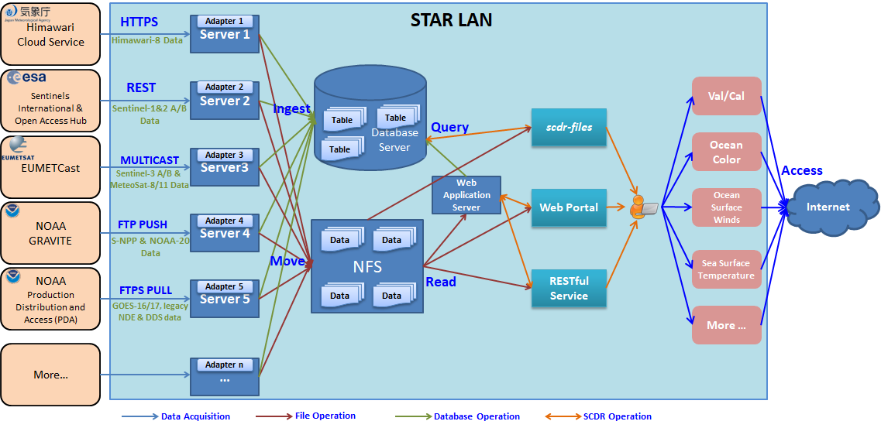
What is SCDR? SCDR Architecture

Slide 5
Why Do We Have SCDR?
Avoids wasting disk space with multiple repositories of the same dataset in multiple locations
Avoids redundant data pulls by serving as a single point of entry for datasets into STAR from e.g., PDA and GRAVITE

Slide 6
How Do I Use SCDR?
The SCDR database can be queried from a Web portal, a Linux command, or an API.
Web portal: http://rhw9120.star1.nesdis.noaa.gov/SCDRWeb/

Slide 7
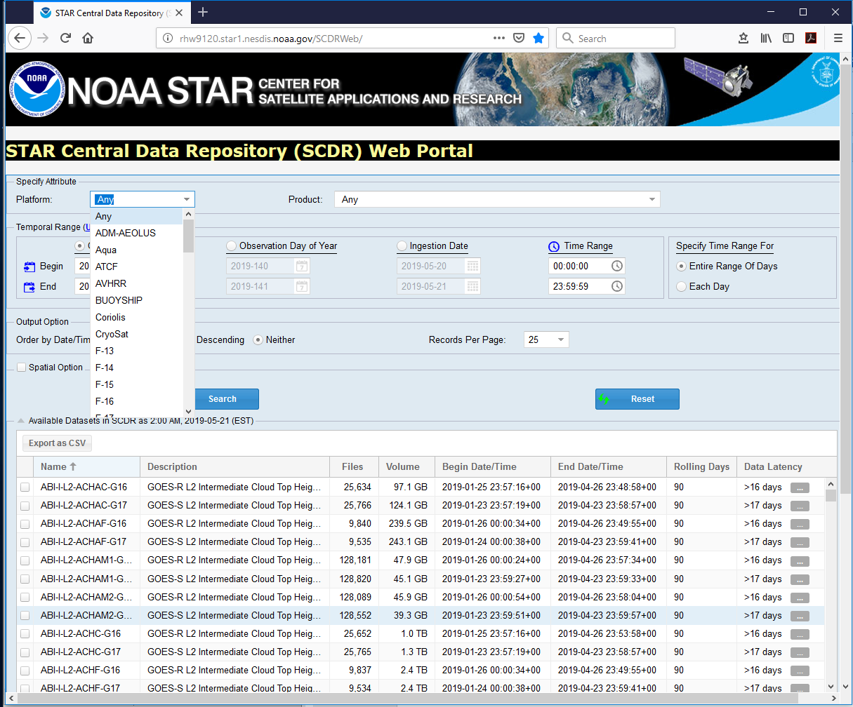
How Do I Use SCDR? (Web Portal Query)
Select the satellite platform or model you want

Slide 8
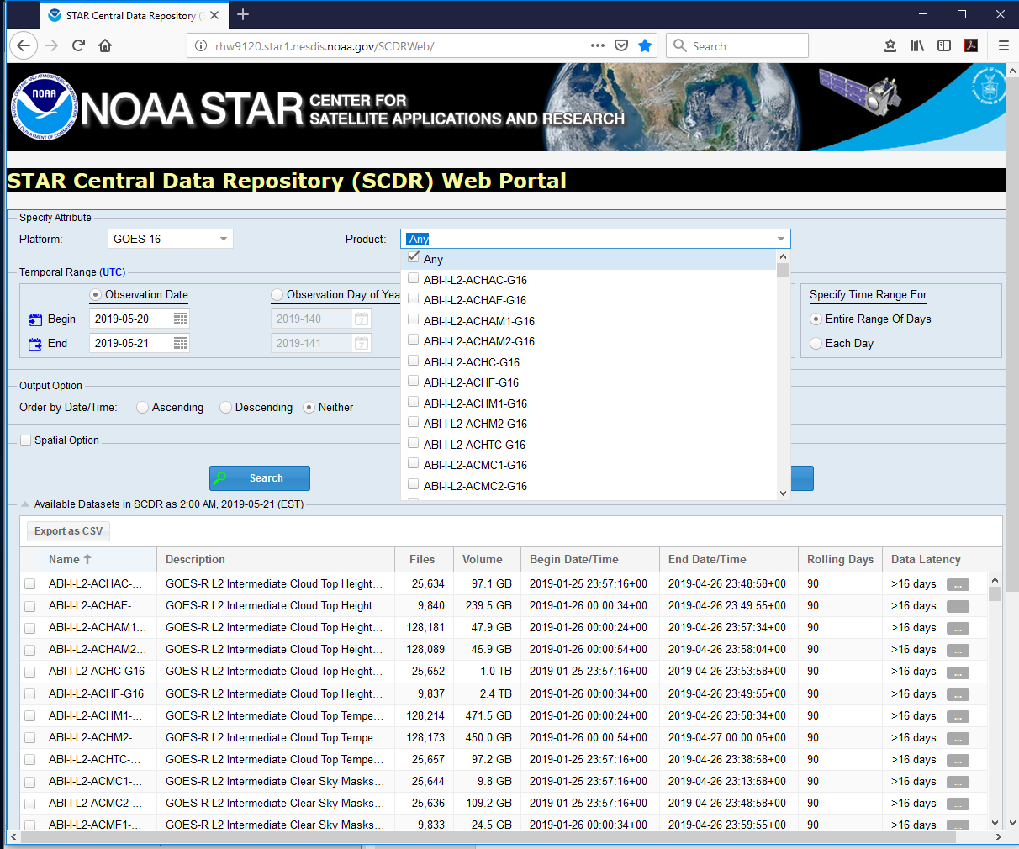
How Do I Use SCDR? (Web Portal Query)
Select the specific data set you want

Slide 9
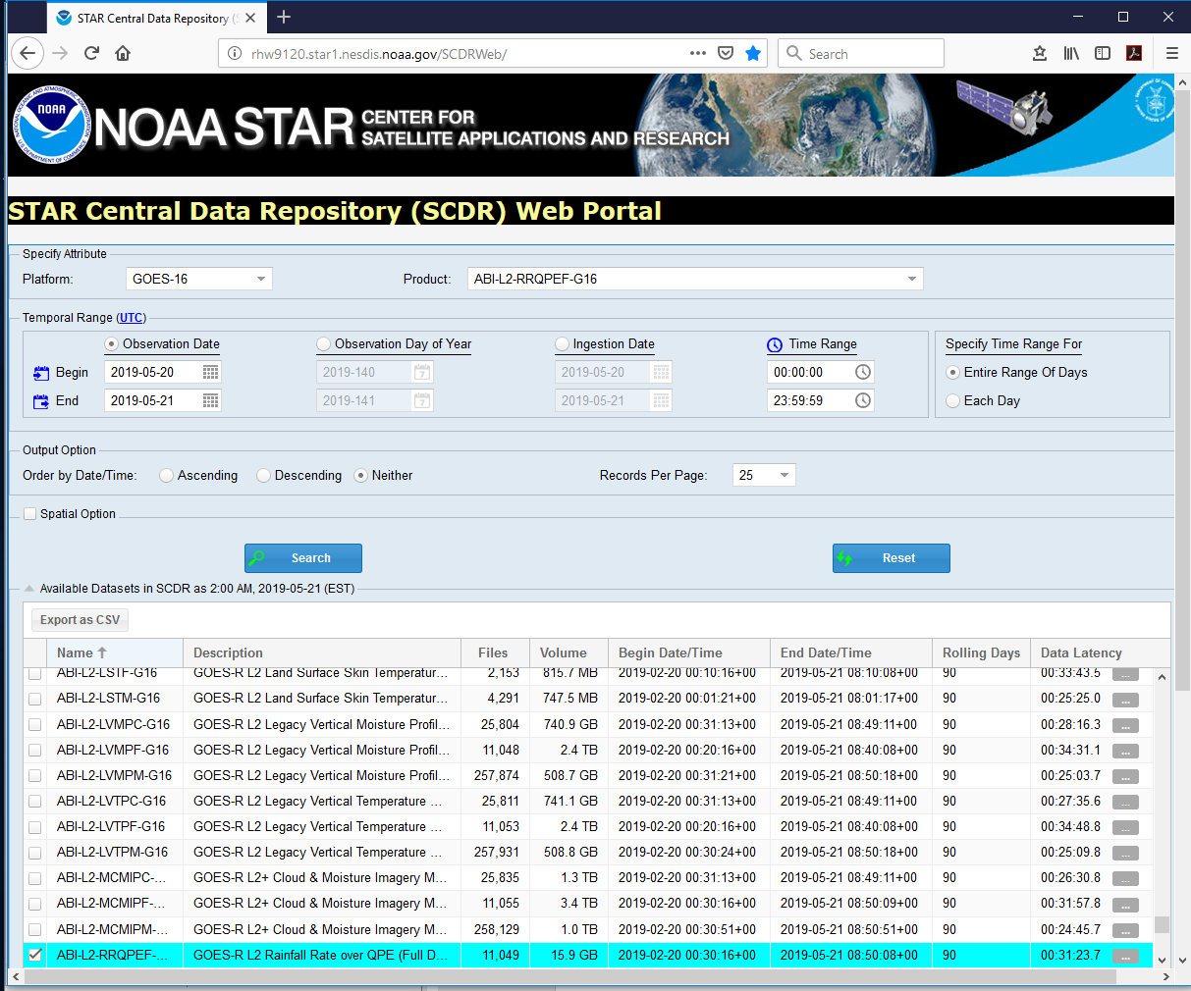
How Do I Use SCDR? (Web Portal Query)
Select the range of dates and times you want and your output options
SCDR will give the time range of the available data and the total volume

Slide 10
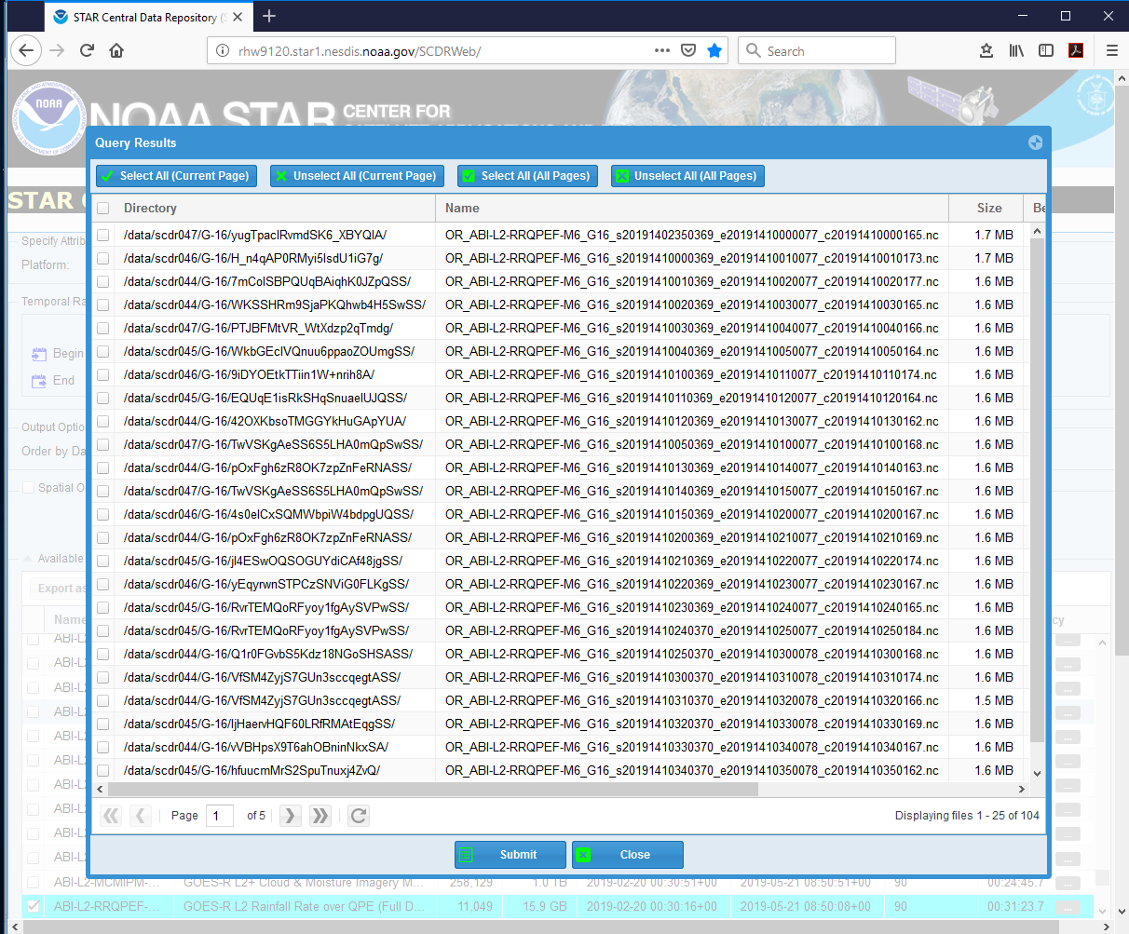
How Do I Use SCDR? (Web Portal Query)
Query returns a list of files, pathnames, sizes, and start/end times (need to scroll right to see the rest)

Slide 11
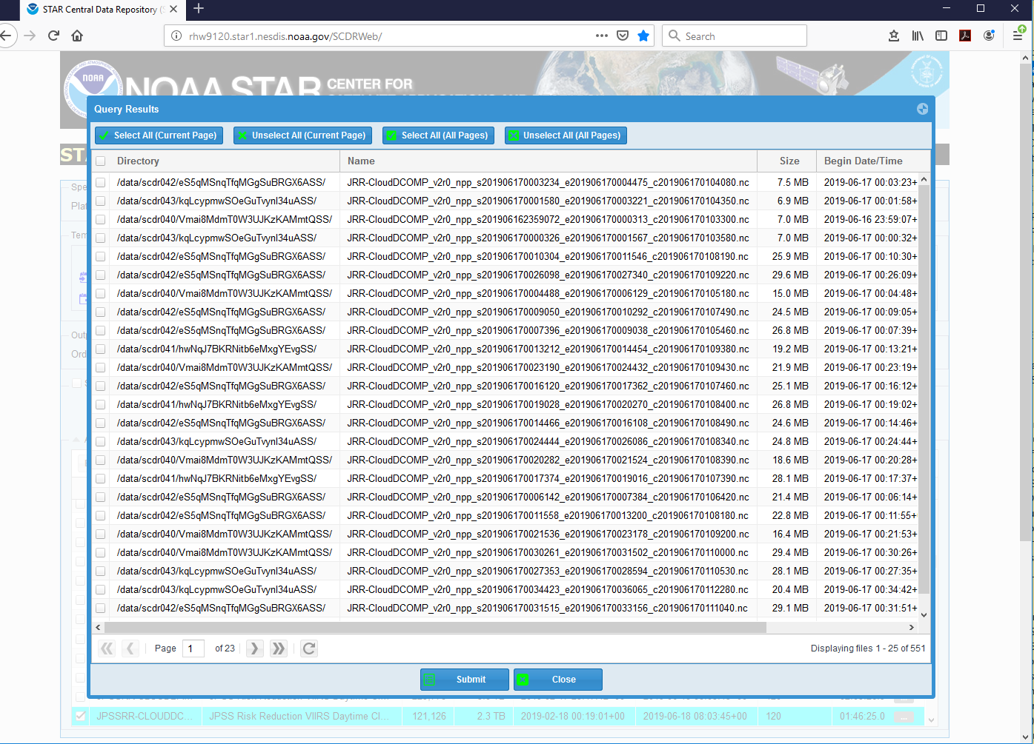
How Do I Use SCDR? (Web Portal Query)
For selected datasets, you can also search for data in a particular location by clicking the “spatial option” check box and using the tools to draw a search polygon.
For example, a search for NPP DCOMP from for all of 17 June 2019 returns 551 entries that are all over the globe:

Slide 12
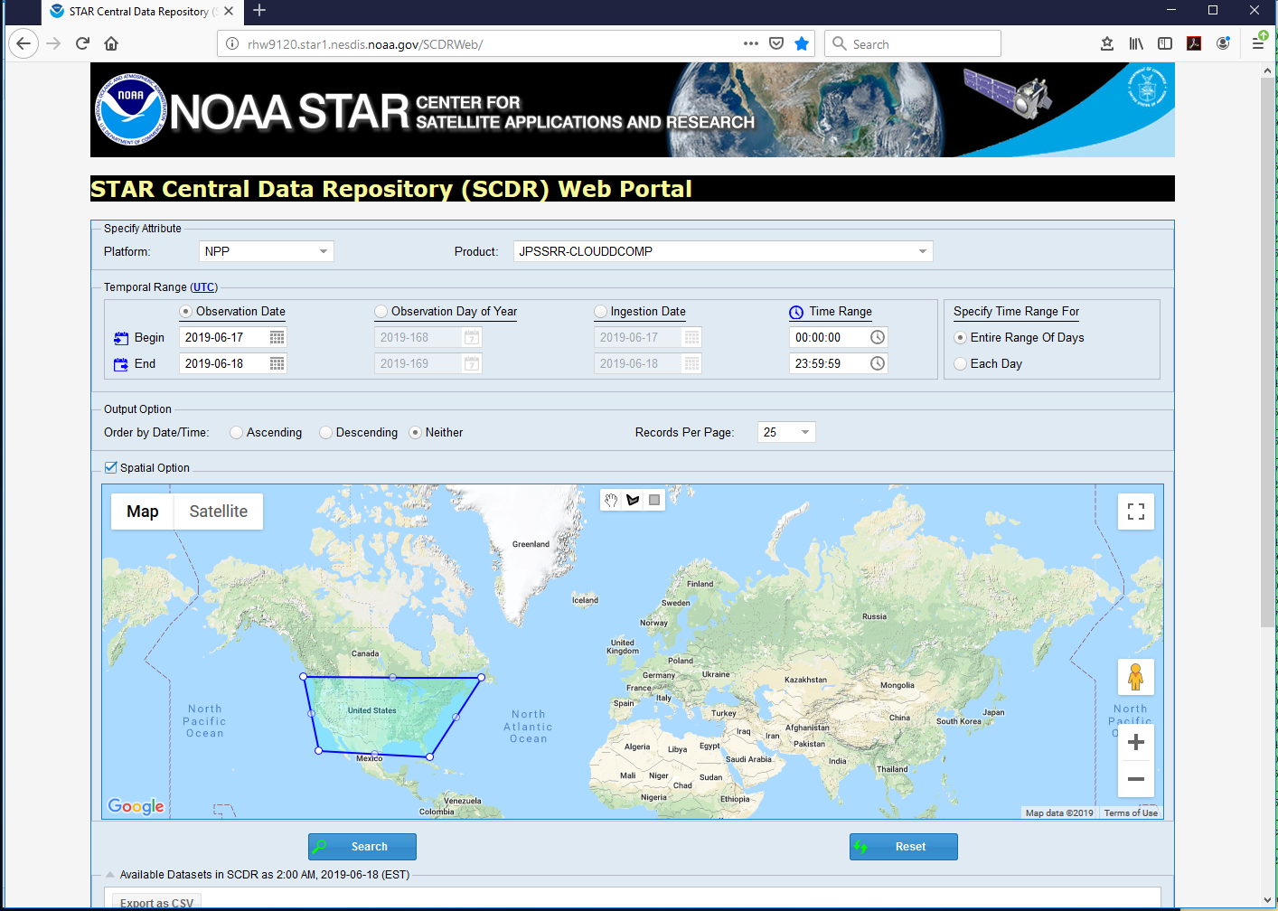
How Do I Use SCDR? (Web Portal Query)
Selecting the “Spatial Option” check box and drawing a polygon over the CONUS using the polygon tool:

Slide 13
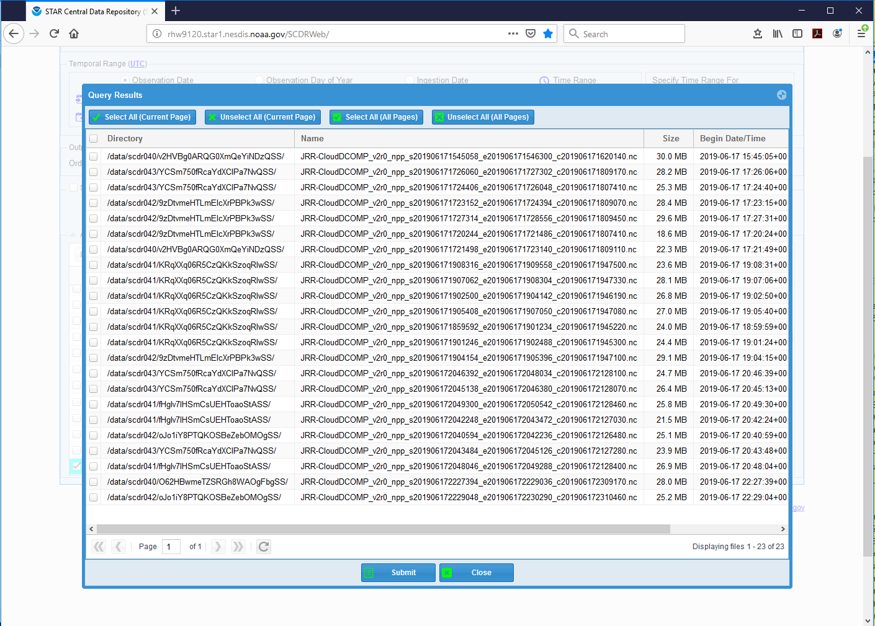
How Do I Use SCDR? (Web Portal Query)
Now only 23 granules over the CONUS are returned!

Slide 14
How Do I Use SCDR? (Linux command)
The Linux command /data/starfs1/bin/scdr-files can be used for database queries from the Linux command line or a script
/data/starfs1/bin/scdr-files -h(elp) returns documentation.
Some useful options (but not all of them):
-available ← summary report of EVERYTHING in the database
-t <type> ← collection type (from the 1st column in the summary report)
-stime “YYYY-MM-DD at HH:MM:SS UTC” ← start time of query
-etime “YYYY-MM-DD at HH:MM:SS UTC” ← end time of query
-satname “satellite name” ← satellite name
-a “POLYGON ((LAT.1 LON.1, LAT.2 LON.2, LAT.3 LON.3, …LAT.1, LON.1))” ← granules only within specified polygon

Slide 15
How Do I Use SCDR? (Linux command)
GOES-16 ABI Level 2 RRQPEF product
Search period starts at 1500 UTC 21 May 2019
/data/starfs1/bin/scdr-files -t ABI-L2-RRQPEF-G16 -stime "2019-05-21 15:00 UTC" -etime "2019-05-21 15:59 UTC"
Search period ends at 1559 UTC 21 May 2019

Slide 16
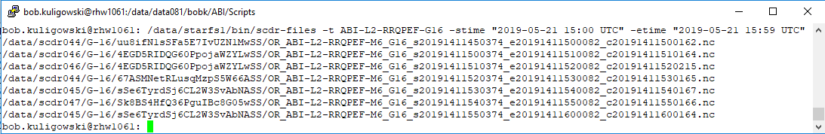
How Do I Use SCDR? (Linux command)
You can then copy the files you need to your directory (or softlink them if you’re not going to use them more than once)
To automate this, have a script make a query, dump the results to a text file, then use the text file as a file list for copying.

Slide 17
How Do I Use SCDR? (Linux command)
Search period starts at 0000 UTC 17 June 2019
JPSS Daytime DCOMP cloud properties
Data from NPP only
/data/starfs1/bin/scdr-files -t JPSSRR-CLOUDDCOMP -satname "npp" -stime "2019-06-17 00:00 UTC“
-etime "2019-06-17 23:59 UTC" -a "POLYGON ((25.0 -125.0, 49.0 -125.0, 49.0 -65.0, 25.0 -65.0, 25.0 -125.0))"
Search period starts at 2359 UTC 17 June 2019
Search for granules intersecting 25-50°N, 125-65°W.

Slide 18
How Do I Use SCDR? (API)
SCDR RESTful Web service allows wget or curl or similar command-line tools to make database queries in place of the scdr-files command
Documentation is at http://rhw9120.star1.nesdis.noaa.gov/SCDRWeb/help.html
It allows output in HTML, XML or JSON format in addition to plain text:
Content-Type: text/plain (default) ← plain text
Content-Type: text/html ← HTML
Content-Type: application/xml ← XML
Content-Type: application/json ← JSON

Slide 19
How Do I Use SCDR? (API)
The option syntax for using the API is a bit different from scdr-files:
type=<type> ←dataset name in SCDR database
stime=YYYY-MM-DDTHH:MM:SS ← start time of query
etime=YYYY-MM-DDTHH:MM:SS ← end time of query
satname=<satname> ←satellite name in SCDR database
since=YYYY-M(M)-DDTHH:MM:SS ← query from start time until now
area=POLYGON(LAT.1 LON.1, LAT.2 LON.2 LAT.3 LON.3,…LAT.1 LON.1) ← polygon encompassing search area (any granules that even partially intersect the polygon will be selected)

Slide 20
How Do I Use SCDR? (API)
Sample query of file types in SCDR using wget:
Write output to result.txt (default is to write to a file called list)
Write output as plain (ASCII) text
wget --header "Content-Type: text/plain” -O ./result.txt "http://rhw9120.star1.nesdis.noaa.gov/SCDRWeb/service/scdr-files/list"
url containing the list of SCDR file types

Slide 21
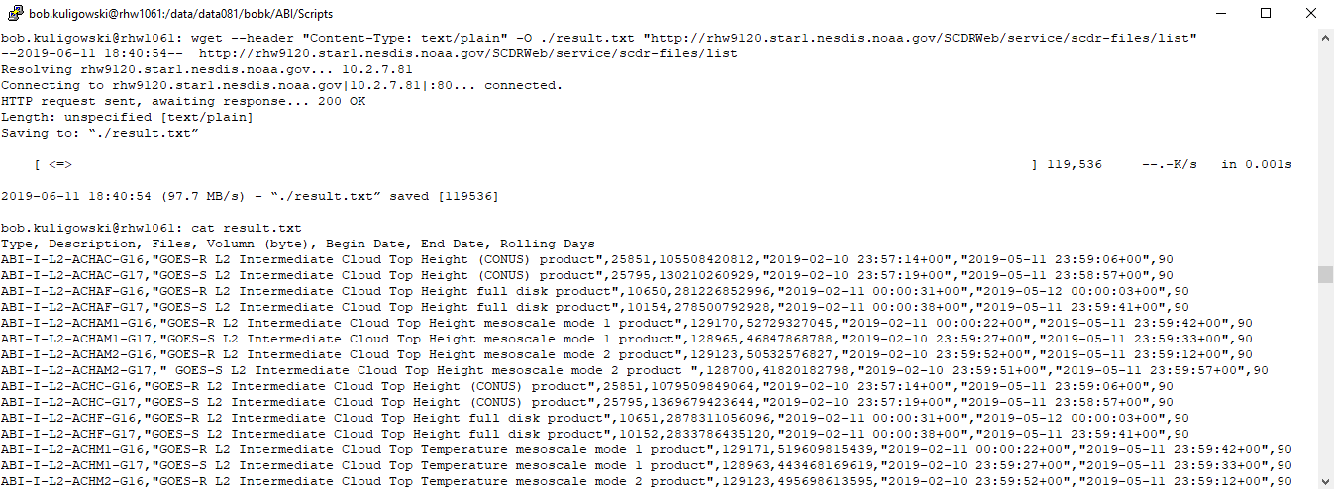
How Do I Use SCDR? (API)
Sample query of file types in SCDR using wget:

Slide 22
How Do I Use SCDR? (API)
Same GOES-16 RRQPE example as before, but using wget:
url for querying specific datasets
Write output as plain (ASCII) text
Write output to SCDRlist.txt (default is to write to a file called list)
wget --header "Content-Type: text/plain" -O ./SCDRlist.txt "http://rhw9120.star1.nesdis.noaa.gov/SCDRWeb/service/scdr-files/query?type=ABI-L2-RRQPEF-G16&stime=2019-5-21T15:00:00
&etime=2019-5-21T15:59:00"
Get G16 RRQPE files
Start query at 1500 UTC 21 May 2019
End query at 1559 UTC 21 May 2019

Slide 23
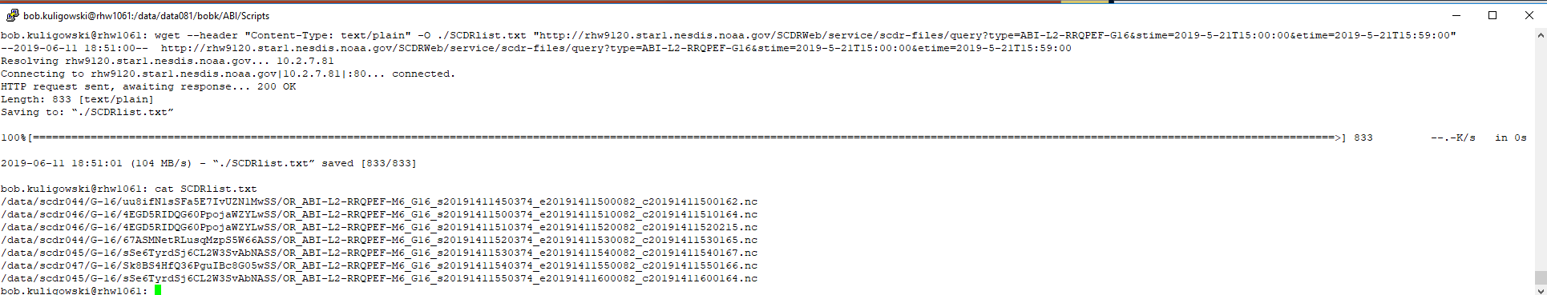
How Do I Use SCDR? (API)
Same GOES-16 RRQPE example as before, but using wget:
(Who wants to type all that, anyway? So…)

Slide 24
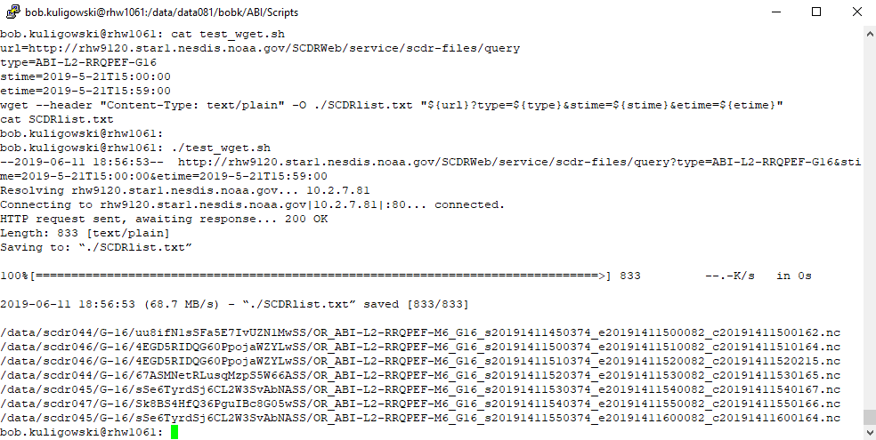
How Do I Use SCDR? (API)
Same GOES-16 RRQPE example again, but using wget in a script:

Slide 25
So Which Approach Should I Use?
scdr-files currently has more options than the RESTful API
The longer-term plan is to focus development on the RESTful API and transition scdr-files to alias to it
This avoids parallel development paths (and the resulting redundant work)
It also minimizes the need to re-work existing scripts that use scdr-files
Recommendations:
Try the RESTful API, but if it doesn’t meet your needs, feel free to use (or keep on using) scdr-files
Give feedback on what features you would like to see added!

Slide 26
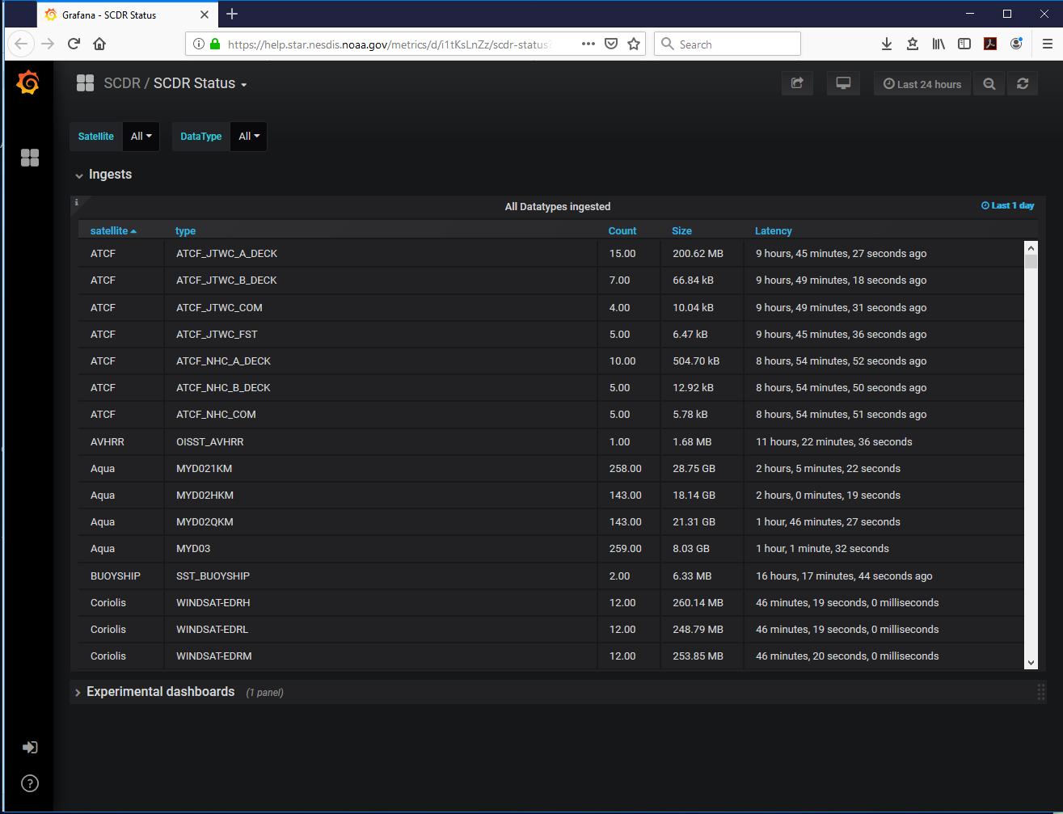
How Do I Find Out the Latency of SCDR Data?
You can use any of the methods on the previous sides to indirectly find out, but this dashboard provides a much more direct method: https://help.star.nesdis.noaa.gov/metrics/d/i1tKsLnZz/scdr-status?orgId=1

Slide 27
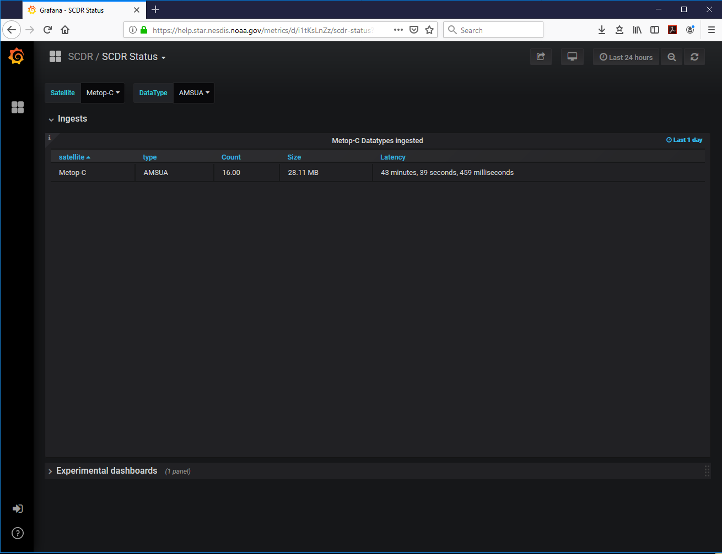
How Do I Find Out the Latency of SCDR Data?
You can also select specific satellites / data types to narrow down the list:

Slide 28
How Do I Use SCDR Politely?
Really large queries significantly degrade database performance
The scdr-files command has some built-in limits:
No requests without time bounds
Maximum time interval of 30 days
Requires specific data types (or file names, if known)
Be as specific as possible in your requests, especially automated ones!

Slide 29
How Are New Data Sets Added to SCDR?
The STAR Data Management Group (chaired by yours truly) manages SCDR ingest and storage
To add a new data set to SCDR, fill out a SCDR Data Storage Request Form (Google Survey) at least 24 hours before the DMG meeting at which it will be voted on (2nd and 4th Wednesday of every month).
Information requested includes justification for the request, expected repository duration and size, and data sources.

Slide 30
Final thoughts..
For any SCDR-related issues or questions, submit a STAR IT Help Desk Ticket or contact Weiguo Han at Weiguo.Han@noaa.gov
We’re always looking for ways to improve SCDR! I’ll be sending out a survey soon asking for your thoughts on this.

Slide 31
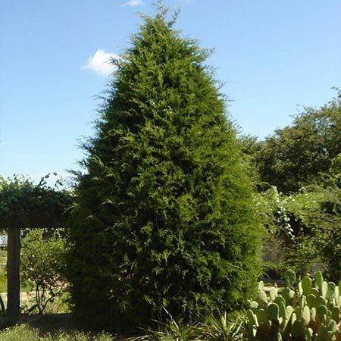
Questions?

