Slide 1
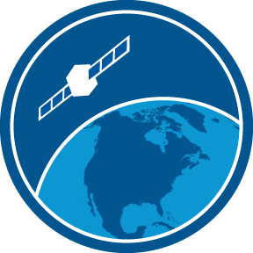
Easy data access and visualization using the ERDDAP data server
Cara Wilson & Dale Robinson
NOAA CoastWatch West Coast Node (WCN)
STAR Seminar
August 22, 2019

Slide 2
Accessing satellite data can be challenging
a short list of data servers
NOAA CoastWatch Central Operations
NOAA Center for Satellite Applications and Res.
NOAA Office of Satellite and Products
NOAA National Centers for Environmental Info.
NOAA Comprehensive Large Array-data Stewardship System (CLASS)
NASA Jet Propulsion Laboratory PO.DAAC
NASA Ocean Biology (OB.DAAC)
NASA Goddard Space Flight Center
European Space Agency
EUMETSAT
Japan Aerospace Exploration Agency
each with its own
Data products
File formats
Download protocols
Subsetting abilities
Previewing abilities

Slide 3



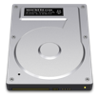




ERDDAP – designed to make data access easier
ERDDAP provides a simple, consistent way to:
Subset datasets temporally and spatially
Download data in > 30 formats
Access data within analysis tools
(R, Matlab, python…) using urls which completely define the data request
Machine-to-machine data exchange
Data Aggregation
Data Distribution
Local Storage
Internal Servers
Automated Scripts
Database
Web-Based
Applications
RAID
ERDDAP
Download
By Hand
Remote Servers
NSIDC
NCEI
Software
Applications
ERDDAP developed at SWFSC/ERD by Bob Simons
~80 ERDDAPs exist worldwide
Over a dozen different ERDDAPs in NOAA
ERDDAP is one of the recommended data servers in NOAA's Data Access Procedural Directive
JPL PO.DAAC
NESDIS STAR

Slide 4
NOAA ERDDAPs
CoastWatch-Central Ops
CoastWatch-West Coast Node (WCN)
CoastWatch-PolarWatch
CoastWatch-Caribbean/Gulf of Mexico
CoastWatch-Pacific Node
CoastWatch-Great Lakes Node
NOAA Unified Access Framework
NOAA NCEI
NOAA NCEI
NOS CO-OPS
NMFS NEFSC
OAR PMEL
NOAA Observing System Monitoring Center
NOAA IOOS Sensors
NOAA IOOS National Glider Data Assembly Center
NOAA IOOS CeNCOOS
NOAA IOOS NERACOOS
NOAA IOOS PacIOOS
NOAA IOOS SCCOOS
NOAA IOOS SECOORA

Slide 5
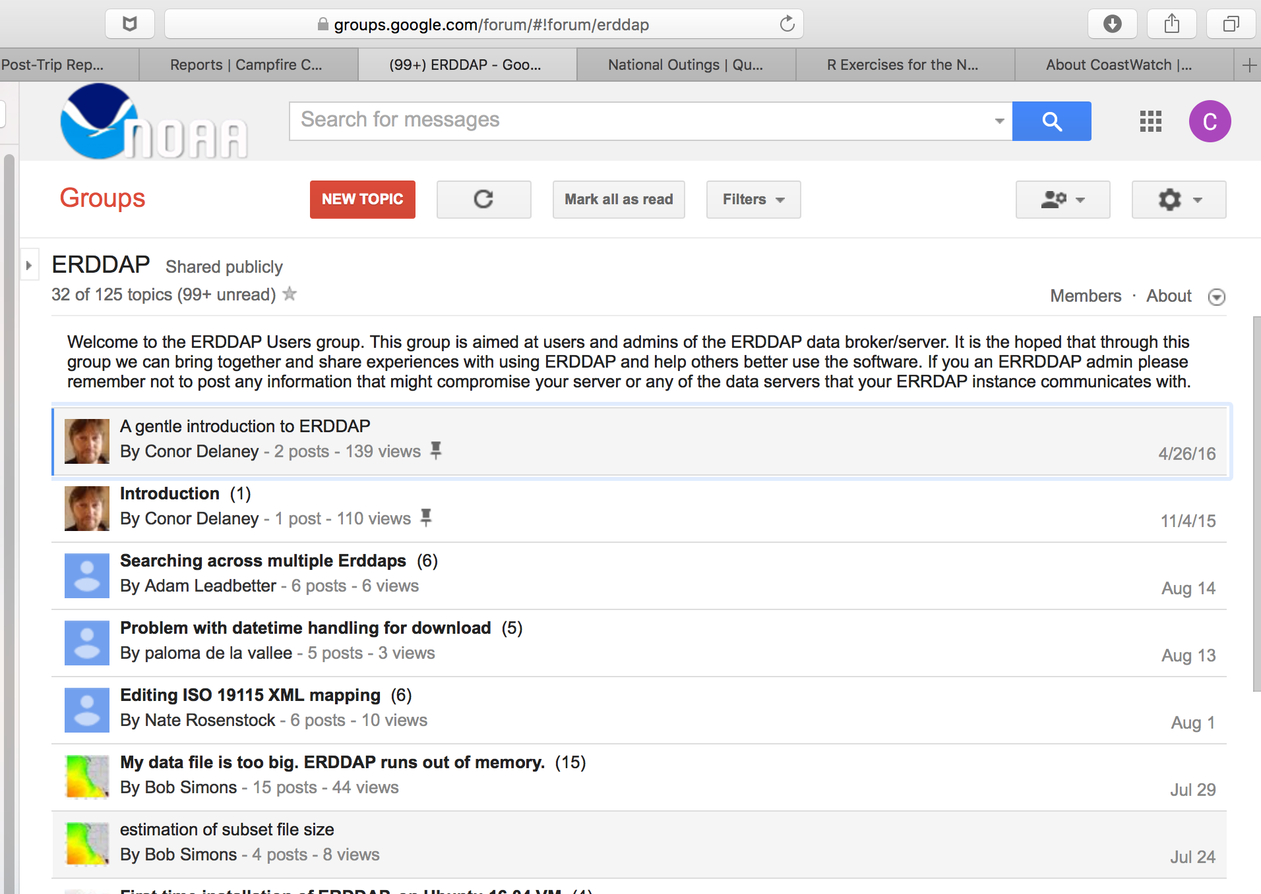
ERDDAP Google Group for Admins https://groups.google.com/forum/#!forum/erddap
Active ERDDAP user’s group
Aimed at administrators

Slide 6
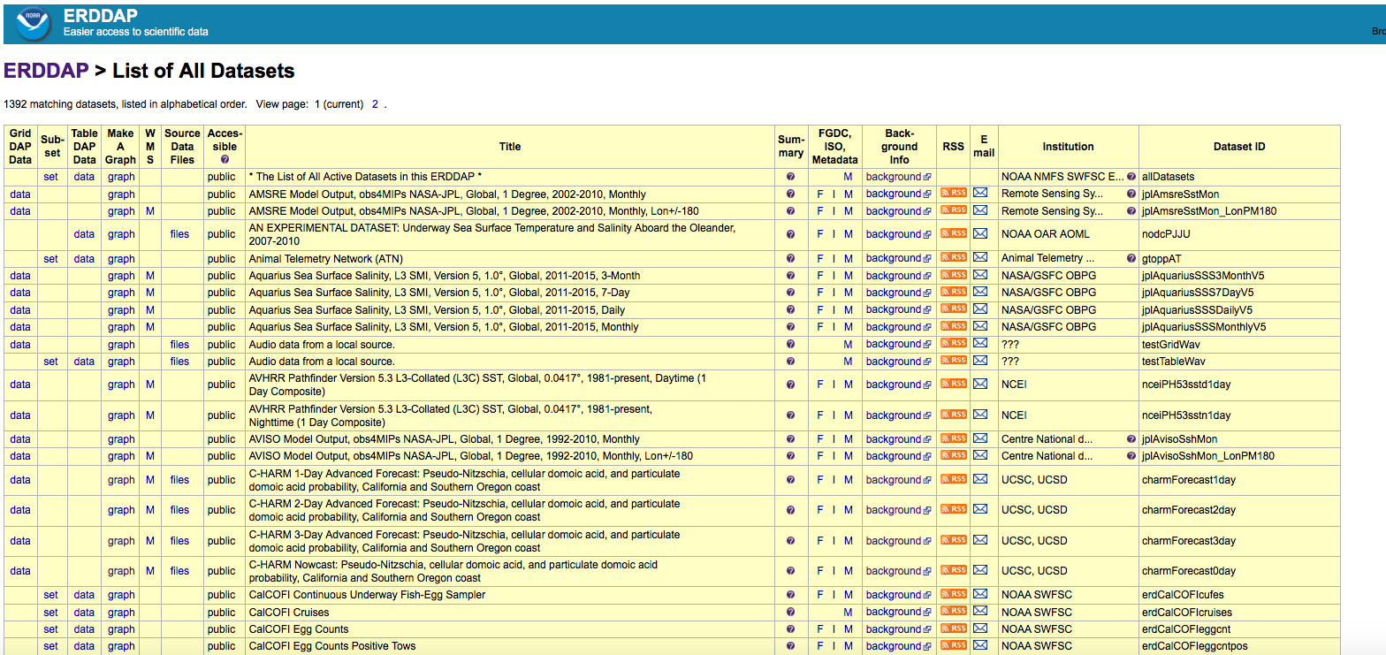
The ERDDAP interface is functional (not beautiful)

Slide 7
The ERDDAP interface is functional (not beautiful)
Two types of data:
Gridded (Acessed though GridDAP)
Tabular (Accessed through TableDAP or Subset)

Slide 8
The ERDDAP interface is functional (not beautiful)
Good metadata is crucial for data discoverability

Slide 9
The ERDDAP interface is functional (not beautiful)
Easy to serve data from other institutions. Full credit is given to the source.

Slide 10
WCN’s data catalog has ~1,000 satellite datasets
Distributed via our ERDDAP Server
ERDDAP makes it easy to get the data you need.
0.5 – 1.0 million data requests per day

Slide 11
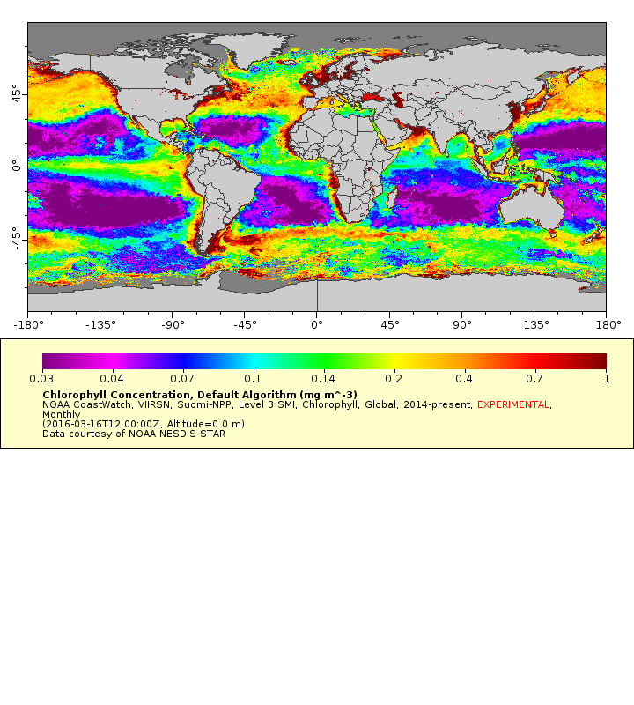
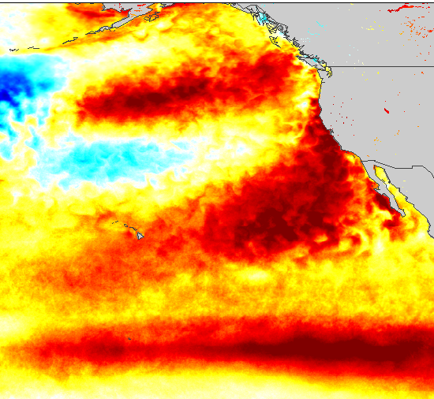
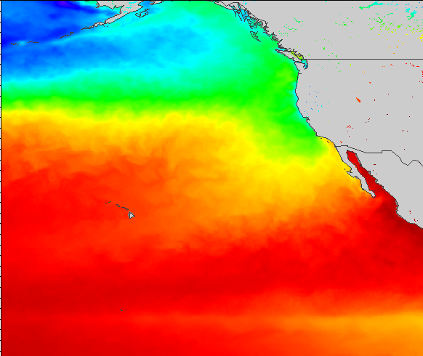
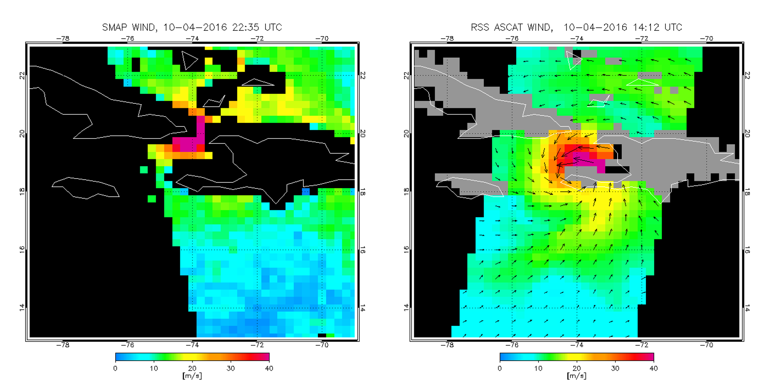
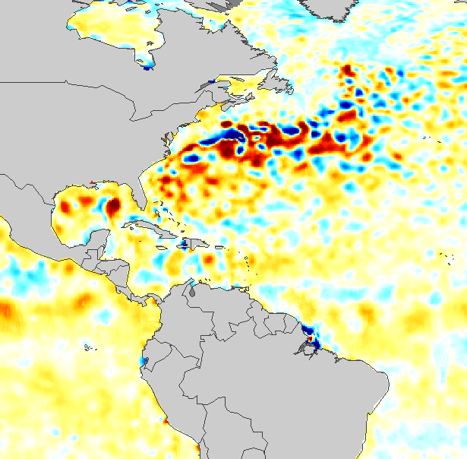
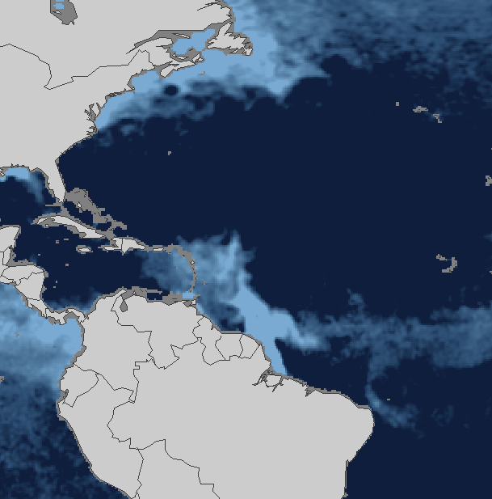
Some of our most popular data products include the following
Daily, weekly, and monthly composites
Blended products
Interpolated products
Chlorophyll
Primary Productivity
POC, PIC, Kd, nLw
SST
SST Anomaly
Surface Winds
Sea Surface Salinity
Sea Surface Height and Anomaly

Slide 12
WCN data catalog has non-satellite data (~400 datasets)
In Situ Measurements
Animal Telemetry Network
ARGO floats
TAO/TRITON, RAMA, &
PIRATA Buoys
IOOS In Situ Sensors
Glider Data
Global Temperature and Salinity Profile Programme
HF Radar Currents
GLOBEC Northeast Pacific
NOAA CO-OPS Sensors
NDBC buoys
Field Sampling
CalCOFI
California Fish Landings
Farallon Island Seabirds
NWFSC Habitat Use
SWFSC Rockfish
Underway Data
NOAA Vessels
UNOLS Vessels
Models, Climatologies
OSCAR Sea Surface Velocity
SODA Model
Models, Climatologies (cont.)
NOAA Coastal Relief Model
NOAA RTOFS Forecast Model
NOAA RTOFS Nowcast Model
NOAA World Ocean Atlas
NOAA Seafloor Topography
SWFSC Upwelling Index
Navy NAVGEM Model
Navy NOGAPS Model
NCEP/NCAR Reanalysis
USGS Topography
NASA/NOAA CCMP Wind Atlas
Navy HYCOM Model
Navy FNMOC Forecast Model

Slide 13
Allows automated processes via RESTful services
https://coastwatch.pfeg.noaa.gov/erddap/griddap/erdVHsstaWS3day.largePng?sst[(2018-11-13T12:00:00Z):1:(2018-11-13T12:00:00Z)][(0.0)][(41.75):1:(30.86)][(-128.25):1:(-114.75)]
Example of a URL data request
Base URL:
Dataset ID:
File Type:
Variable:
Time range:
Altitude:
Latitude Range:
Longitude Range:
https://coastwatch.pfeg.noaa.gov/erddap/griddap/
erdVHsstaWS3day
.largePng (.nc, .mat, .json, .geotif, .kml, .csv…)
?sst
[(2016-10-21T12:00:00Z):1:(2016-10-21T12:00:00Z)]
[0.0]
[(41.75):1:(30.86)]
[(-128.25):1:(-114.75)]

Slide 14
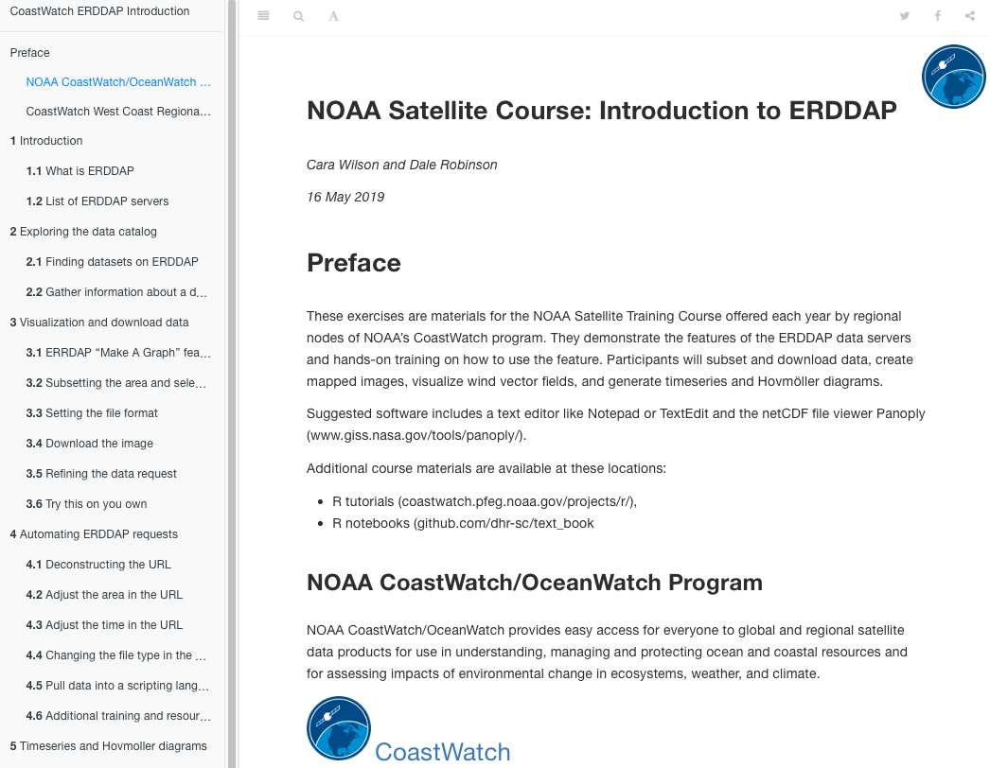
Today’s “Introduction to ERDDAP” tutorial is online
Online ERDDAP tutorial
Developed by WCN for the NOAA satellite course
Walks users through using ERDDAP
Demonstrates visualizing both gridded and tabular datasets
I will demo parts of the tutorial today
https://coastwatch.pfeg.noaa.gov/projects/erddap/

Slide 15
rerddapXtracto tools help R users extract data from ERDDAP
R package written by Roy Mendelssohn (SWFSC/ERD),
based on code originally written by Dave Foley for Matlab
Developed based on user needs identified from the NOAA satellite courses
Uses the rerddap and plotdap R packages
All packages are on cran
Three main functions are within rerddapXtracto:
  rxtracto: extracts data along xyt points (e.g. tagged animals, ship stations, etc.)
  rxtractogon: extracts data within a user-supplied polygon
  rxtracto_3D: extracts data from a 3-dimensional (latitude, longitude and time)
Will work on any dataset on any ERDDAP
https://coastwatch.pfeg.noaa.gov/xtracto
https://github.com/rmendels/rerddapXtracto

Slide 16
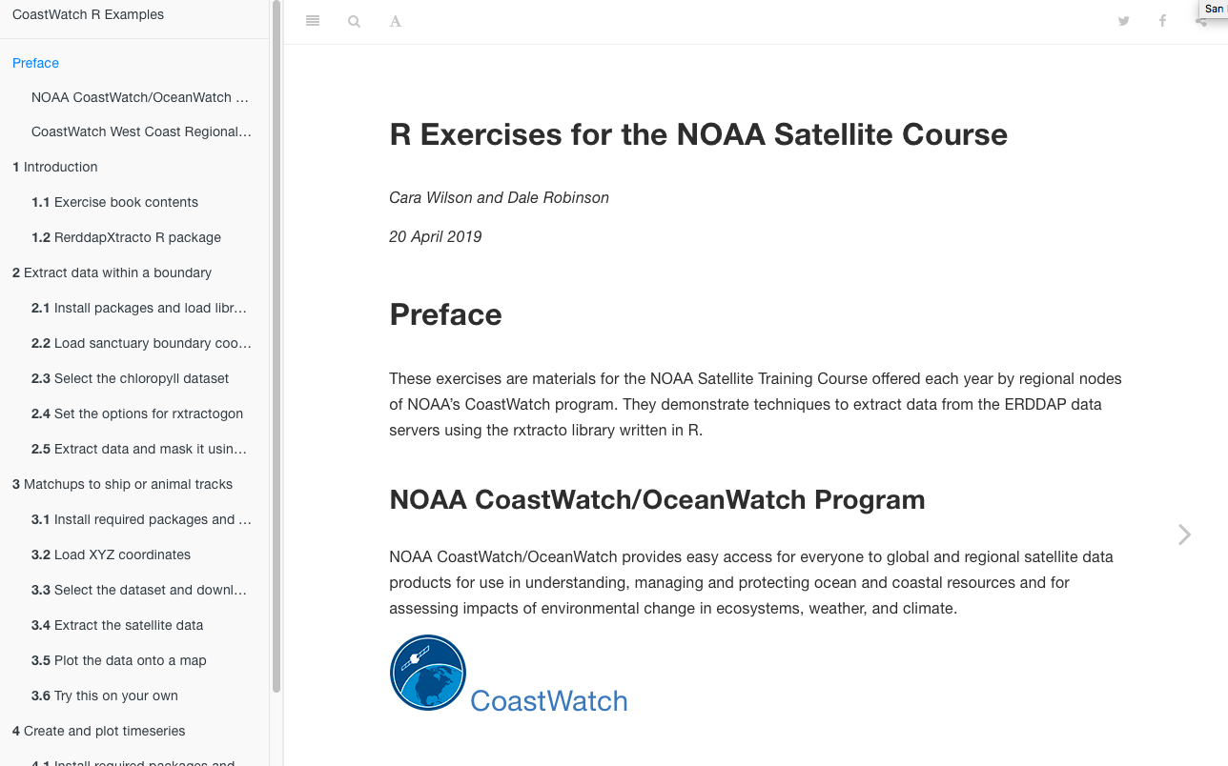
An rerddapXtracto tutorial is available online
https://coastwatch.pfeg.noaa.gov/projects/r/

Slide 17
Live Demonstration
Visualize the N. Pacific SST ‘Blob’
Visualize a N. Pacific Chlorophyll bloom
Hurricane Jose (Sept 2017)
BGC-Argo data on PolarWatch ERDDAP
Search for datasets across all ERDDAPs
https://irishmarineinstitute.github.io/search-erddaps/
https://coastwatch.pfeg.noaa.gov/erddap/download/SearchMultipleERDDAPs.html
https://coastwatch.pfeg.noaa.gov/projects/erddap/

