Slide 1
STOP Making Ugly Posters Lori K. Brown NOAA / NESDIS / STAR
Presented at the STAR Seminar Series
NOAA Center for Weather and Climate Prediction College Park, MD 5 September 2019

Slide 2
Purpose of posters?
We make posters to communicate our work to our peers
We are trying to persuade them to care, to be interested in our work.
To get viewers to engage with your content, it is critical to present that work in a visually interesting, attractive, and readable way.
You don’t have to be a graphic artist to do this. You don’t have to be a communications specialist to do this.
The purpose of this talk is to help you improve the way you make posters, so they do a better job of communicating your work.

Slide 3
Why is this presentation needed?
The posters I see at science meetings vary wildly in quality.
By quality I don’t mean, some have good science and others have terrible science.
Some posters are attractive and communicate effectively;
Surprising number of others are difficult to read or even look at, and others are straight up ugly.
GOAL:
Encourage you to consider some methods for improving the communication and presentation of your excellent science work;
To give yourself the best possible opportunity to share your work effectively.

Slide 4
Why me?
I’ve been communicating scientific and technical topics to more or less technical audiences professionally since 1992, when I started working as a senior typist producing flight simulator documentation for a defense contractor.
At one point in 2000, I figured out that I’d made more than 25,000 PowerPoint slides.
Since then, I have designed and produced charts, graphs, posters, signs, ads, logos, presentations, web sites, and web applications for law firms, defense contractors, BGE, biotech companies, and NOAA, where I’ve worked since 2006.
At NOAA / NESDIS / STAR, I’m the webmaster, research bibliographer, and occasional photographer.
I am proudest of my work with the GOES Imagery team. During Hurricane Dorian, the GOES Imagery site delivered over 350 million image downloads to the media, the storm-watching public, and our NOAA peer organizations.

Slide 5
Common poster problems
Common and debilitating poster problems include:
Titles that are mostly a long string of acronyms;
Block after block of small type;
Crowded together illustrations;
Poor contrast, too many typefaces, too many colors;
Images with bad aspect ratios, with insufficient resolution for use in print media;
Unclear reading order for the elements on the poster;
Lack of a clear thesis or conclusion
This matters because if people don’t want to look at your poster, your work isn’t going to be disseminated or recognized.

Slide 6
Topics
Think about your audience
Telling an interesting story – rhetoric of your poster
Structure / layout
Readability and typography
Color, contrast, and other fussy details that you should pay attention to
Use of images

Slide 7
Audience
Who is your poster’s audience?
While some scientific meetings are very narrowly focused to specialists in a single topic, it is far more common for your audience to be comprised of people who are technically literate in a more general sense, rather than being a specialist in your field.
When you start to draft your poster, you should start from an idea of who your audience is –
What is it reasonable for you to expect them to know?
What will be the shared knowledge and interests between you and that audience?
Are they all meteorologists? Or all physicists? Or all engineers? Or most likely, a mix of these?
And don’t forget …. Bosses.
Your boss may be at the poster session. And your boss’s boss.

Slide 8
Rhetoric
What is the definition of rhetoric? The art or study of using language effectively and persuasively.
What is your poster’s purpose?
To draw attendees to stop and learn about your work;
To highlight the value and meaning of your work.
To accomplish this, don’t just think about charts, graphs, and equations, but about how you explain and describe your work.

Slide 9
Questions
?
One very effective way to tell a compelling story is to draft your poster around questions.
Questions are dynamic.
Statements are static.
Many posters use passive statements to characterize what is being illustrated. “We did a thing”, “This is our result”, “Error values for this calculation are X”
A poster where all the headings are passive, verbless statements will struggle to capture a reader’s attention.
So, try to give your poster a title which is the thesis question for your poster.

Slide 10
Consider these questions
?
What is the purpose of your project?
What problem are you trying to solve?
What has previously not been well understood in the area you are working on?
What is interesting or valuable in what you are doing?
What is the impact of your work for society? (outside of the science itself)
What is the unique contribution of your team’s work?
What did you learn from the work?
What next steps or questions are suggested from the work you’ve done so far?
What do you want to do better or differently the next time you work on this problem?

Slide 11
Driving the narrative
?
Candor about mistakes and problems you encounter in your project is:
Inherently interesting;
Increases your credibility;
Admitting that something you tried failed, and suggesting a next approach – I will definitely read that bullet, every time!
You may not necessarily have answers to all the questions you identify – that is ok!
The way you present both the questions and the answers should be written to be clear and compelling to visitors who are not experts in your specific work area.
Ultimately, your poster needs to answer this question:
“Why should I care about this?”

Slide 12
Clarity of expression
Your poster text should be written so that it is clear and compelling to visitors who are not experts in your specific work area.
How to do that?
Focus on what is interesting about the work to others besides experts;
Minimize acronyms, and when you use them, define them. But see if you can live with as few as possible.
Use active verbs, minimize jargon, and think about explaining your work to the smartest non-scientist you know; this will push you to write clearly.
Get a non-specialist reader to review your text
After you draft the text of your poster, ask someone to read it who is as much like your expected poster audience as possible: not a specialist in your area, but a generally scientifically literate person.
Ask them if what you are writing is clear, understandable, and interesting.
If they can’t understand what you are trying to say, revise and try again

Slide 13
DRAFT before you DESIGN
Before you start building your poster, draft a simple document that outlines what you want the poster to include at a high level; a sort of design document or poster recipe
It should include:
The poster title
The major headings (Probably not more than 8 or so)
A description of what you want to include under each heading:
Bullets of text explaining the steps in an experiment;
a flow chart or diagram of an algorithm;
a photo or rendering of the parts of a satellite instrument; a product image; an equation;
Then, start populating the outline with the actual content elements you want to include
Once your outline is populated, THEN use it to start laying out the poster.

Slide 14
Why draft before you start designing?
You can review, revise, and reorganize the poster design document rapidly and repeatedly before you have to commit to dragging around bits of text in PowerPoint.
The more you do to prepare and organize your poster contents before you start assembling it in PowerPoint, the better.
Skipping straight to PowerPoint will NOT save time.
I am assuming you will be building the poster in PowerPoint; there are pros and cons to PowerPoint, and other possible tools, but its flexibility and ease of composition make it the most straightforward choice.

Slide 15
Choosing a poster layout
There are several good ways to layout the content areas of your poster.
One that you should avoid, but which is very common:
How many of you have seen posters that were clearly made from pasted together PowerPoint slides?
Why is this a terrible idea?
Your viewers can usually tell you did this and it looks unprofessional.
The level of detail is wrong for a poster; usually too heavy with text, too much repetition of content.

Slide 16
Reading order
If your poster dimension is landscape, you will in most cases want to organize the content into columns.
Key consideration – if it matters what order the poster visitor reads the poster, then your poster layout needs to CONVEY this.
A very direct way to dictate reading order is to use numbered headings.
Works, but can be clunky looking.
Alternative: add very thin vertical rules between your columns, and make sure your headings, if read separately in order, make sense.
If your content is in blocks that could be read either left to right or top to bottom, a column at a time, thin vertical rules are a good idea.

Slide 17
Layout options
It’s also possible that your poster content doesn’t require a fixed reading order, beyond the title. The GOES Imagery site poster can be read in any order, beyond the title and the main description block at the top. In such a case, you don’t have to try to convey a reading order.
If you have a great image to build your presentation around, you can consider organizing your content blocks around that image in a ‘spokes of a wheel’ configuration.
To do this, your central image has to be of very high quality (sufficient resolution, good focus, lighting, and color quality if it’s an image) and truly central to the work you’re presenting
The point is, figure out which approach makes sense for your content, and layout the poster to cue the reader accordingly.

Slide 18
SO MANY WORDS
Don’t be allergic to empty space! Don’t write so very many words!
Our sample OSOS poster had nearly 2000 words on it. There is literally no way that anyone is going to read all 2000 of those words.
A good rule for drafting your poster: keep the total number of words under 1000.
If you can’t face pruning the text as much as you should,
Consider putting the ‘long version’ of what you have to say into a handout that you give to session attendees.
There are pros and cons to using handouts at poster sessions, but when you preserve that option for yourself, it is often easier to edit the poster’s actual text aggressively enough to get to a clean, terse presentation of your most important points.

Slide 19
Pitfalls of screen captures
A central source of excessive wordiness on the OSOS poster is its reliance on screen captures
Pro:
Screen captures seem like the obvious way to incorporate examples of one’s work that reside on the web
They are easy to acquire
They are colorful, and hey, you already did all that work to make the web page in the first place!
Cons:
Web page layouts are way too small to be referenced usefully on a poster, in most cases
They include fussy unreadable details that clutter your poster’s look without adding any useful information
It’s easy to use too many of them.

Slide 20
What to do instead?
In the case of the OSOS poster
Use fewer screen captures;
Crop them to omit unreadable bits such as footers.
Original poster has 6 captures, would revise down to 3
Instead of demonstrating every feature of the two websites via screen captures:
Use the most interesting view of each of the 2 sites;
Summarize the features currently being illustrated via screen capture by creating feature tables to categorize the features, for easy comparison.

Slide 21
Contrast
Contrast matters. You can’t put light colored text on white or another light colored background.
Even placed on a dark colored background, the yellow text below should be bolded. Otherwise it is too difficult to read.
This is completely unreadable.
Even if it’s really large.
If you can’t live without yellow text (why?), you must then outline the text with a darker color – but use a THIN outline, and make the outline dark gray, not black.
This is a little less unreadable.
But usable, if you really must.

Slide 22
Color – use a color scheme
Do you like bold use of color, but find yourself overwhelmed by choices?
The Internet is here to help you.
There are online tools for selecting and creating simple attractive color schemes
Try: https://coolors.co
Now, you can consistently apply this scheme to all the type and graphical elements in your poster, without losing your mind or spending 2 days adjusting the color blue.
Why is this a good thing?
If you consistently apply a defined color scheme to your poster, it will have a tidy, visually disciplined appearance, and in the end it will allow you to focus on your content instead of managing color.

Slide 23
Applying your color scheme
Once you choose a color scheme, copy down all the color values (either RGB or hex values), and then apply them to all the elements of the poster.
PRO TIP: You can control the color values used in Excel charts, IDL, MatLab, or Python-generated graphics, using these values.
When making charts to embed in your poster, do not use the default color scheme that the charting tool supplies.
Recolor them from your COLOR SCHEME!
The consistency of using 1 color of medium blue instead of 5 different ones that are close but not quite the same will improve the appearance of your poster significantly.

Slide 24
Software defaults
All the tools you work with to make your poster – PowerPoint, Photoshop, Gimp, Python, IDL, etc. – have default settings.
Line weights, colors, typefaces, all of those configurable items.
Get in the habit of not accepting the defaults.
Example:
The default fill colors for shapes in PowerPoint are quite saturated, and make your graphics look like children’s toys. I always change filled objects to paler colors (from my color scheme!) so that it’s easier to set text on top of that filled object.
Default line weights are often too heavy. When making posters, use thin line weights for most purposes – 0.5 pt looks good for rules between columns and the borders of elements in charts.

Slide 25
Typography
Modern desktop publishing has made it possible for anyone to choose and layout type in hundreds of typefaces.
While these technologies are only a few decades old, trained typesetters have been honing best practices in laying out type for hundreds of years.
There are many things you CAN do in PowerPoint or Word that aren’t necessarily good practice, and will actively harm the readability and attractiveness of your poster.
Reference: The Non-Designer’s Type Book by Robin Williams (no, not that Robin Williams)

Slide 26
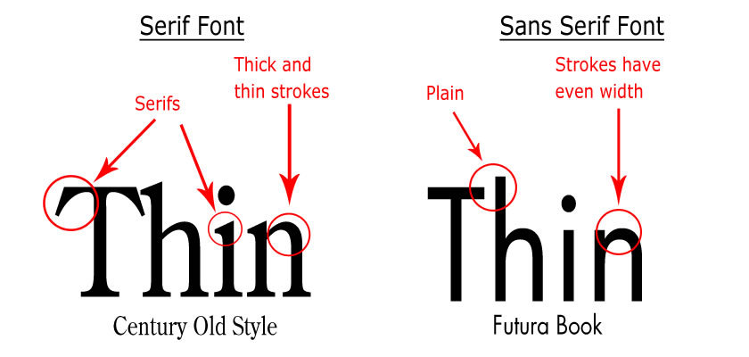
Choosing typefaces
Serif vs. Sans Serif fonts;
DO NOT USE Times New Roman or most serif typefaces for your poster.
Serif typefaces make your poster look like an English paper, and don’t have the clean, modern presentation that you want for scientific graphics.
Windows comes with a number of attractive and suitable sans serif typefaces, including: Gill Sans, Humanist, Futura, Helvetica, Optima, Calibri, Tahoma, Verdana. Arial is so generic and overused I tend to avoid it.
Two or three typefaces for a poster is probably about right; you’ll want a body type that is very readable, and a bolder type for headings. They should contrast a bit.
DON’T MAKE YOUR POSTER LOOK LIKE A RANSOM NOTE.

Slide 27
More about typography
Color and type
I almost never set type in black. For print applications like the poster, try a really dark gray, like 85% grayscale. Black type looks to me like being poked in the eye. You may not realize it, but many professionally produced print items you use do this as well.
Headings
Don’t be afraid to make a real distinction between the size of headings and body type. Make your headings bold and a different color and larger, particularly for top level headings in the poster. I don’t mean, headings are 34 pt and body type is 32 pt. But a real contrast in size and weight.
Type portability
Plan ahead if you need to print your poster away from your home computing environment; if you don’t have the right typefaces, printing will be a problem.

Slide 28
More about typography
Line lengths
It is hard for the human eye to follow a line of type that is longer than 12 words or so for extended reading. Very long lines of type, like the width of a poster, are therefore not a good idea.
This is one of the reasons that newspapers are laid out in columns, and why your poster should probably be laid out in columns.
It’s also the reason why data tables use alternating colored row backgrounds, to make it easier for your eye to follow the row of data across the page.

Slide 29
Type sizes
If you are working on a 48” x 36” poster layout, your type sizes should fall in the range of about 100 pt for the largest titles and 30 pt for bullets and paragraphs, with the various headings falling somewhere in between. Using larger type on a limited basis for titles and emphasis can be useful, but I firmly advise against using any type much smaller than 30 pt.
Your audience will need to be able to read your poster title from several feet away, and even if they are interested in reading every single word you’ve produced, they aren’t going to want to press their nose against the poster to do so!
When trying to cram more words into your poster, you will be tempted to make text smaller; resist this temptation. Edit instead.

Slide 30
Creating emphasis
Use bold, italic, and spot color changes to create emphasis
Be sparing and intentional:
If everything is emphasized, effectively nothing is, and your poster will have the effect of shouting at your reader.
Use red sparingly. Visually and historically, red is associated with hazards and warnings, and overuse of red that doesn’t respect this implicit meaning can be confusing and distracting to viewers.
Don’t set anything in red that you don’t want to be the most noticed thing on the poster.

Slide 31
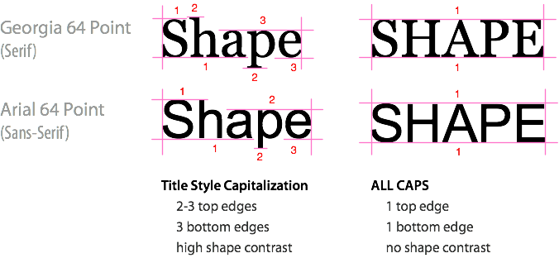
Capitalization
Full capitalization reduces the SHAPE CONTRAST, and therefore the readability, of words.
Be sparing, consistent, and intentional in your use of full capitalization
The shape of any word in all caps is a rectangle. This means that text in all caps show a parallel edge at the top and bottom of a word, giving it low shape contrast.
Compare to text in title style capitalization, or even lower case – these show multiple adjacent edges at the top and bottom, giving the words high shape contrast.
Where is full capitalization suitable? Headings, acronyms, abbreviations.
Reference: https://uxmovement.com/content/all-caps-hard-for-users-to-read/

Slide 32
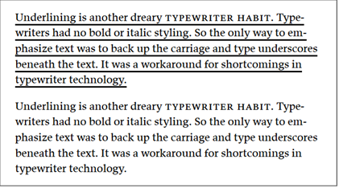
Underlining
You should not underline text for emphasis on your poster.
Why are underlines terrible?
Underlines make text less readable by chopping in half the ‘descenders’ – the parts of letters that extend below the text’s baseline. The descenders on lower case letters exist to give individual words a distinctive shape. Which is how you read them!
https://practicaltypography.com/underlining.html
Underlining for emphasis is a historical artifact of the limitations of typewriters, not a technique that was used because it was attractive or a good idea.
The only appropriate use of underlining is for web hyperlinks.

Slide 33
Bullets
Bullets are the best way to layout straight text on a poster.
Please don’t use weird or cute bullets. Stick with simple filled round or square bullets. Anything else is distracting. (example: don’t use tiny satellites)
If you find yourself writing entire paragraphs of text, consider:
Redrafting the paragraph into bullets;
A table;
A chart or diagram?
Remember:
Blocks of text are where the interestingness of your poster goes to DIE.

Slide 34
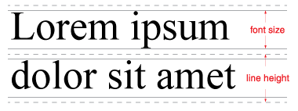
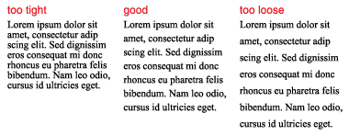
Line Height
Line height is the vertical space occupied by a line of type, plus the empty space above and below that line of type.
In order not to torture your readers, don’t crowd your type vertically.
The recommended line height is calculated as 120% of the height of the type size you are using.
Since the minimum type size on most posters should be about 30 pt, the line height for that 30 pt type should be 36 pt.
You can squish a image caption or other label text when needed, but for text longer than a line or two, use a proper line height setting. Your readers will thank you, but more importantly, they will actually read your poster.

Slide 35
Text justification
Some suggestions offered in this talk are matters of opinion and taste. Text justification is not one of these things.
Some users think fully justified text (text that is flush aligned with both the left and right margins) looks more polished and formal.
However, when produced from MS Word or PowerPoint, fully justified text is frequently less readable and professional looking.
Headings and titles can be centered, if you prefer.
DO NOT use full justification in your text formatting.

Slide 36
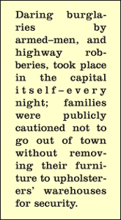
Why you shouldn’t use full justification
Rivers of white space!
Typesetting programs perform an operation called KERNING to make justified text. Kerning is the process of minutely adjusting the horizontal space inside of words and between words. When it is done well, it minimizes perceptible variation among both spacing inside of words and spacing between words.
PowerPoint and MS Word are terrible at kerning, and lack the fine controls needed to address this problem which are available in more specialized tools like InDesign or Illustrator.
References: https://www.fonts.com/content/learning/fontology/level-2/text-typography/justified-type https://opusdesign.us/blog-post/graphic-design-tip-removing-rivers-and-working-with-justified-text/

Slide 37
Line breaks
When producing for print, unlike the web, you have the ability to control line breaks, particularly in TITLES.
This matters, and can significantly improve readability
Which looks better? Monitoring of multi-sensor and multiple ocean parameters: SST, Salinity, Height, Wind and Color
Or
Monitoring of multi-sensor and multiple ocean parameters: SST, Salinity, Height, Wind and Color
Choose your line breaks in such a way as to group words logically and grammatically. It will make your poster easier to read.
Line breaks vs. paragraph breaks: not the same thing!

Slide 38
Problems with raster images
Your poster will likely incorporate photos or other raster images.
There are several common mistakes in manipulating raster images you should understand how to avoid because they are both ugly and avoidable.
Appropriate Resolution
Use at least 200 dpi, preferably 300 dpi or better.
This is challenging when the images you want to use are sourced from the web, where image dimensions are on the small side and resolutions can be as low as 72 dpi.
It is possible to use your computer monitor’s own enlargement capabilities to produce larger screen captures;
This constraint can limit you from using some web-sourced graphics in your poster.

Slide 39
Aspect ratio
When you re-size photos, it is imperative to maintain their original aspect ratio.
There is no more obvious indication of poor graphic production skills than a photograph that has been skewed to be tall and skinny or shorter and wider than its source.
It is everywhere, and it looks terrible.

Slide 40
Resizing images
Incorrect aspect ratio is typically caused by mistakes in image resizing.
In nearly all software tools, there is a single correct technique for resizing images. Learn it today, use it everywhere!
Steps:
Click to select the image;
When you see the bounding box appear, you have selected the image;
Press and hold the shift key;
Click and drag the CORNER of the image to enlarge or downsize the image as desired;
Click somewhere else in the document to ‘let go’ of the image.
Pressing the shift key before you start dragging the resizing handle on the image preserves the image’s aspect ratio.

Slide 41
Consistency
The last thing you will want to do with your poster after you have placed and edited the text, incorporated your graphics, applied your color scheme, sized the headings, etc. is to review the poster for consistency.
Are all my headings at the same level the same size, color, and typeface?
Is the spacing and line height and typeface of bullets and text the same?
Is there a balanced distribution of white space throughout the poster?
Is the poster capitalized consistently?
Paragraph / bullet text should NOT have random capitalization.
Have I applied my color scheme to all the elements in the poster?
Production consistency is the difference between a polished poster and one that falls short.

Slide 42
Conclusion
I hope these approaches and techniques give you some tools for improving your posters.
Please bring me your questions as you work on your next round of posters for meetings this fall, I’ll be very happy to assist!
Let’s make STAR’s science work stand out in the world the way that it should.
Special thanks to Prasanjit Dash for supplying my poster makeover subject and helping me prepare this talk, and the Leadership Support Team at STAR, who encouraged me to write this talk.
You can find me at: Lori.Brown@NOAA.gov, 301-683-0499

