Slide 1
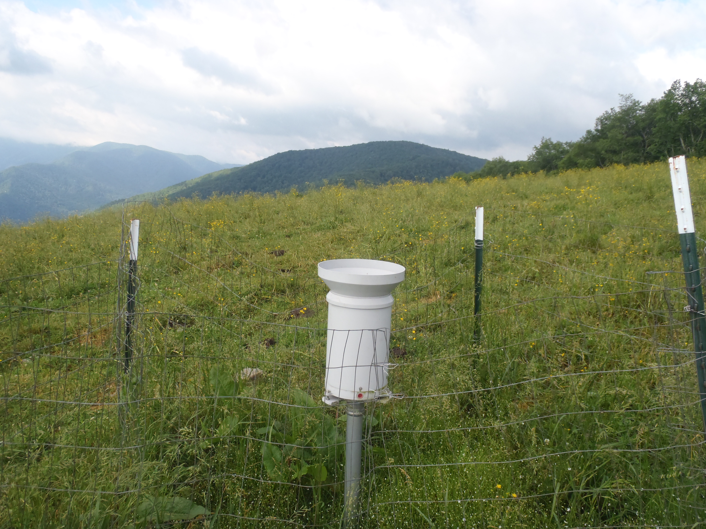


Fellowship of the Rain (Gauge Network)
Douglas Miller
Atmospheric Sciences Department
UNC Asheville
In collaboration with…
Ana Barros
Civil Engineering Department
Duke University

Slide 2
Outline
High elevation rain gauge network in the Pigeon River Basin and Great Smoky Mountains National Park (Duke GSMRGN)
Founding
Why the Pigeon River Basin?
Purpose
Installation and maintenance and challenges
Findings
Pigeon River Basin
Pigeon v. Coweeta River Basin
Future
Climate-related questions

Slide 3
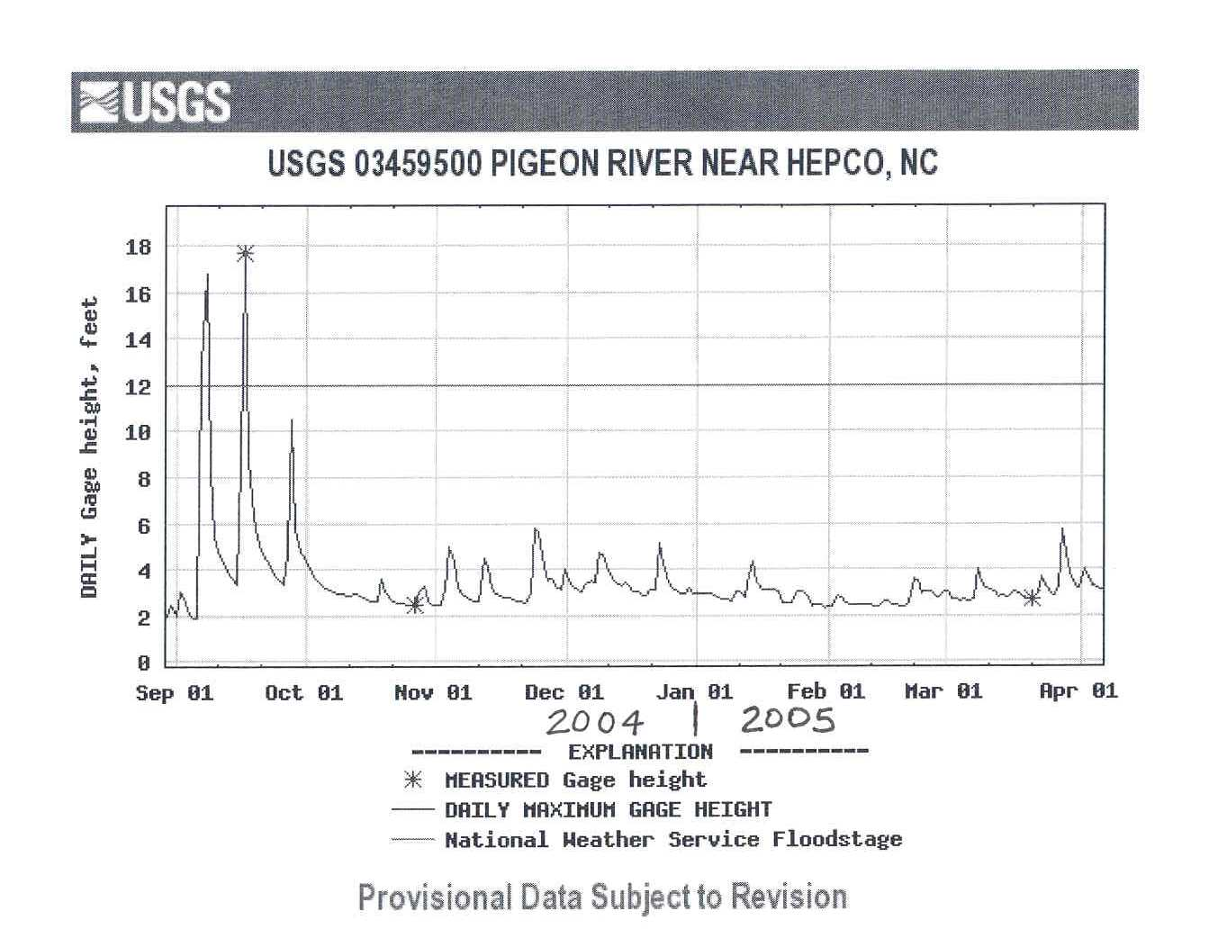
Flood Data
Hurricane Ivan
Hurricane Frances
Courtesy: John Fargher, P.E.

Slide 4

September 18, 2004
The Pigeon River
Courtesy: John Fargher, P.E.

Slide 5
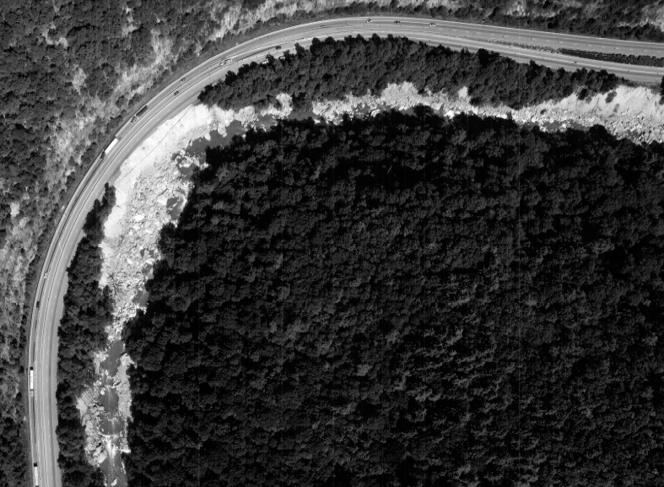
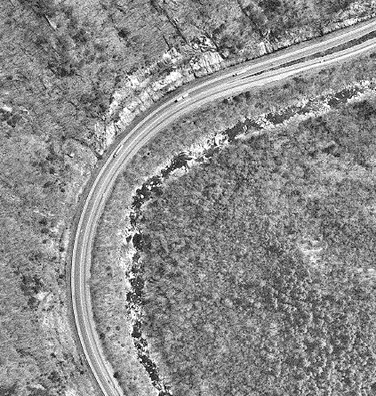
Aerial Photographs
2004
1992
Courtesy: John Fargher, P.E.

Slide 6
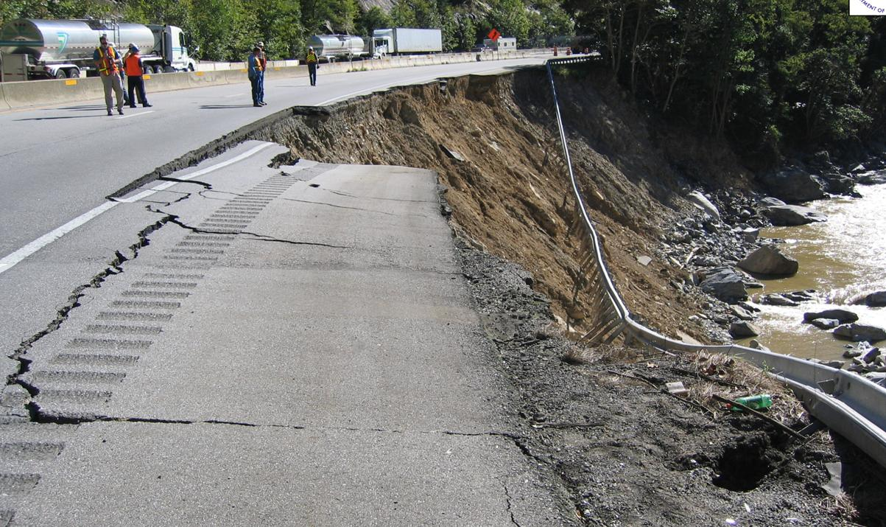
Courtesy: John Fargher, P.E.

Slide 7

Original purpose - funding
NASA
Provide ground validation (GV) at high elevation locations in the mid-latitudes for NASA’s Global Precipitation Mission (GPM)

Slide 8

GPM LAUNCH: 27 FEBRUARY 2014, 1:37 PM EST, TANEGASHIMA SPACE CENTER, JAPAN
Improves upon the capabilities of the Tropical Rainfall Measurement Mission (TRMM), a joint NASA-JAXA mission launched in 1997 and still in operation.
Expands coverage area from 40°N to 40°S (TRMM) to from the Arctic Circle to the Antarctic Circle.
Detect light rain and snowfall, a major source of available fresh water in some regions.
Collect information that unifies and improves data from an international constellation of existing and future satellites by mapping global precipitation every three hours.
http://www.nasa.gov/mission_pages/GPM/main/#.Ux9ynM65Hws
Wilson et al. (2014)
Notes:
TRMM stands for Tropical Rainfall Measurement Mission
TRMM revisits area on average once a day
8

Slide 9
GPM Ground Validation Program
Purpose
Provide ground and airborne precipitation datasets supporting physical validation of satellite-based precipitation retrieval algorithms
Determine the measurement uncertainty for GPM measurements to allow users of GPM data to interpret observations
Improve the retrieval algorithms used by GPM and future space-based precipitation measurement missions
Improve understanding of precipitation processes and the ground-based GV measurements themselves, which have historically been beset with difficulties
seek to advance our physical understanding of precipitation processes and assure consistency between this understanding and the representation of those physical processes in NASA GPM retrieval algorithms
Wilson et al. (2014)

Slide 10

Installation and Maintenance
pc: Daniel Martin

Slide 11
Duke University Great Smoky Mountain Rain Gauge Network (Duke GSMRGN)
2009
2008
2007
Miller et al. (2018)
Notes:
11

Slide 12
Methodology
Notes:
12

Slide 13
Methodology
32 gauges
6570 ft
3398 ft
Notes:
13

Slide 14
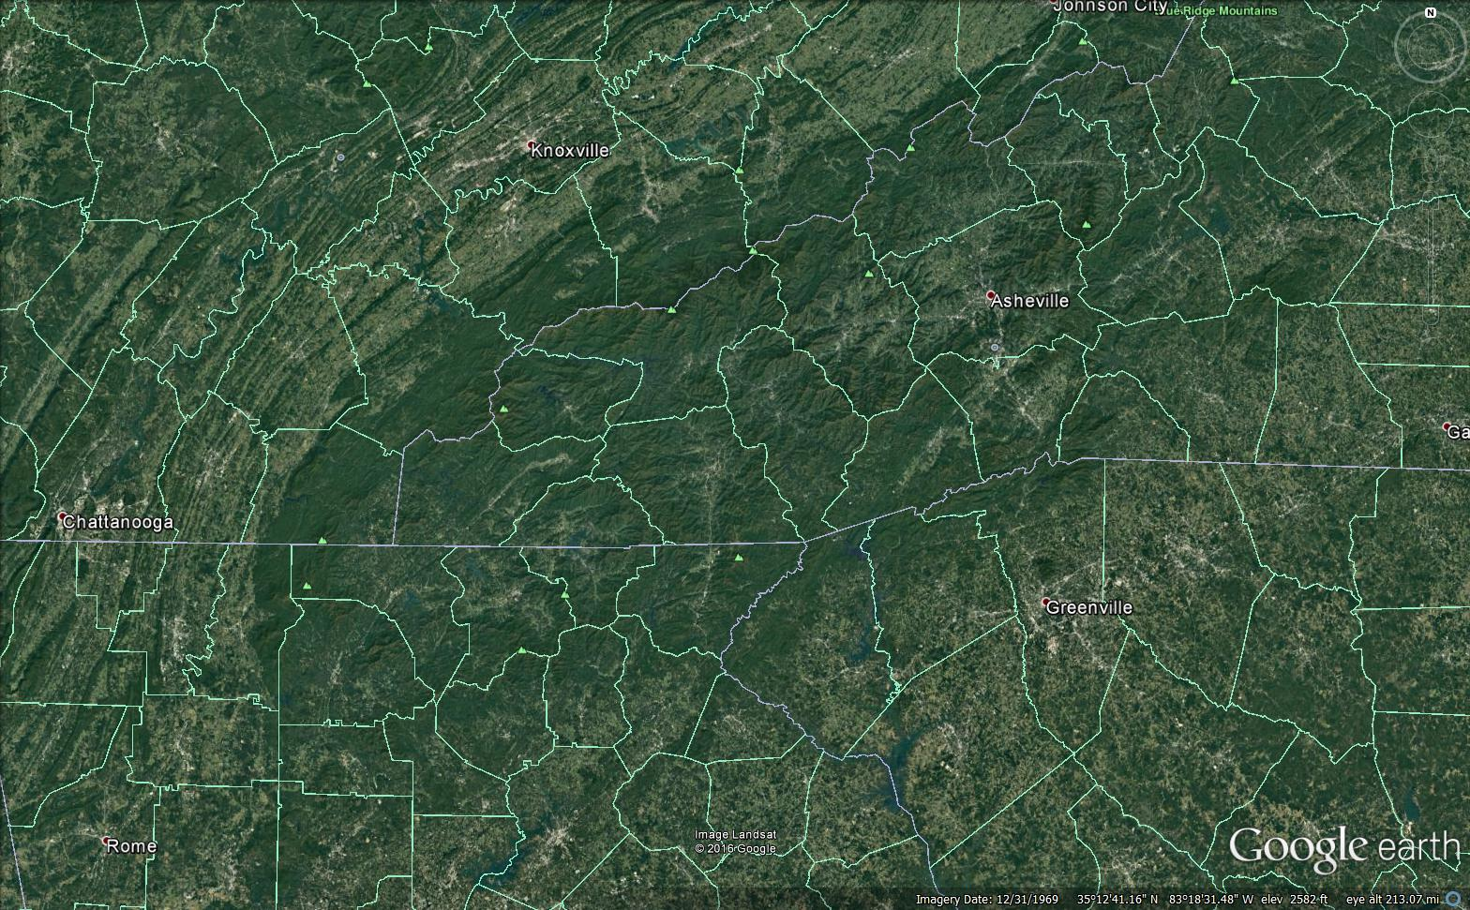
Southern Appalachians
Clingmans Dome [3]
2024 m (6643 ft)
Mt. Mitchell [1]
2037 m (6684 ft)
Mt. Guyot [4]
2018 m (6621 ft)
Pigeon River Basin (PRB)
1823 km² (704 sq mi)
Notes:
2037 m = 79130.7 Pascals (U.S. Standard Atmosphere)
Mount Craig is 2nd highest peak east of the Mississippi River
14

Slide 15
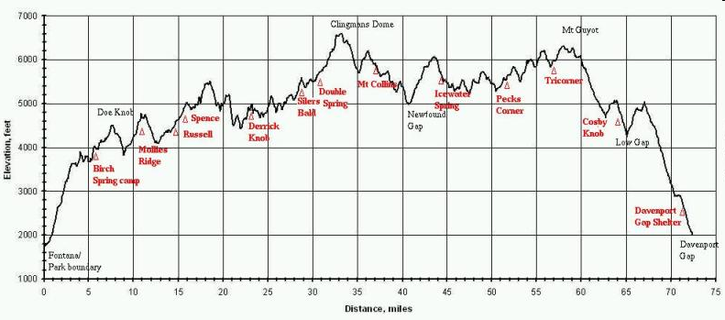
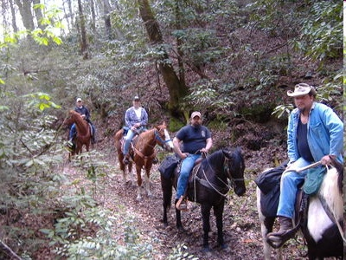
Installation
4525
2354
Backcountry Horsemen of NC
http://www.hikinginthesmokys.com/_wizardimages/at%20-%20elev%20profile.jpg

Slide 16
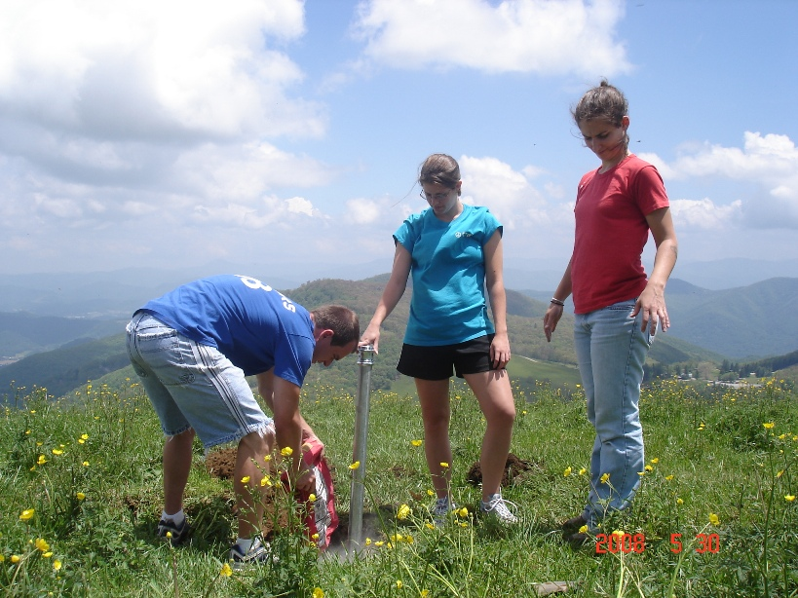
Day One

Slide 17
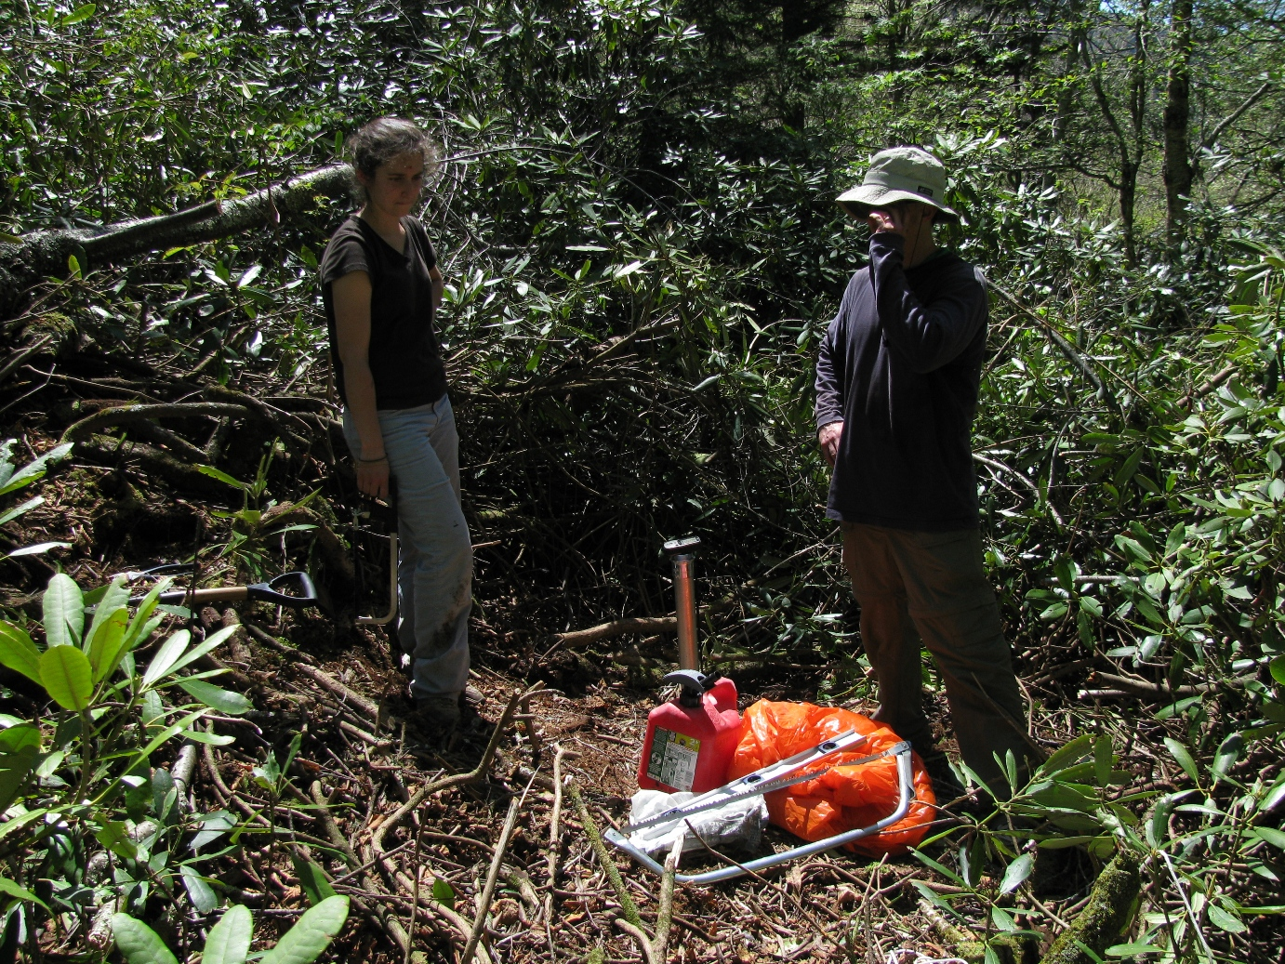
Day One
pc: Daniel Martin

Slide 18

Day Two
pc: Daniel Martin

Slide 19
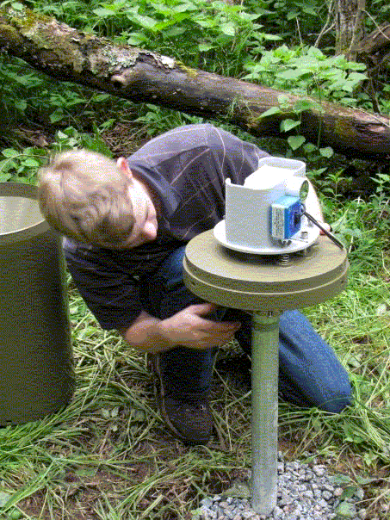
Day Two
pc: Daniel Martin

Slide 20

Final Gauge
6621
4525
2354
pc: Daniel Martin
http://www.hikinginthesmokys.com/_wizardimages/at%20-%20elev%20profile.jpg

Slide 21
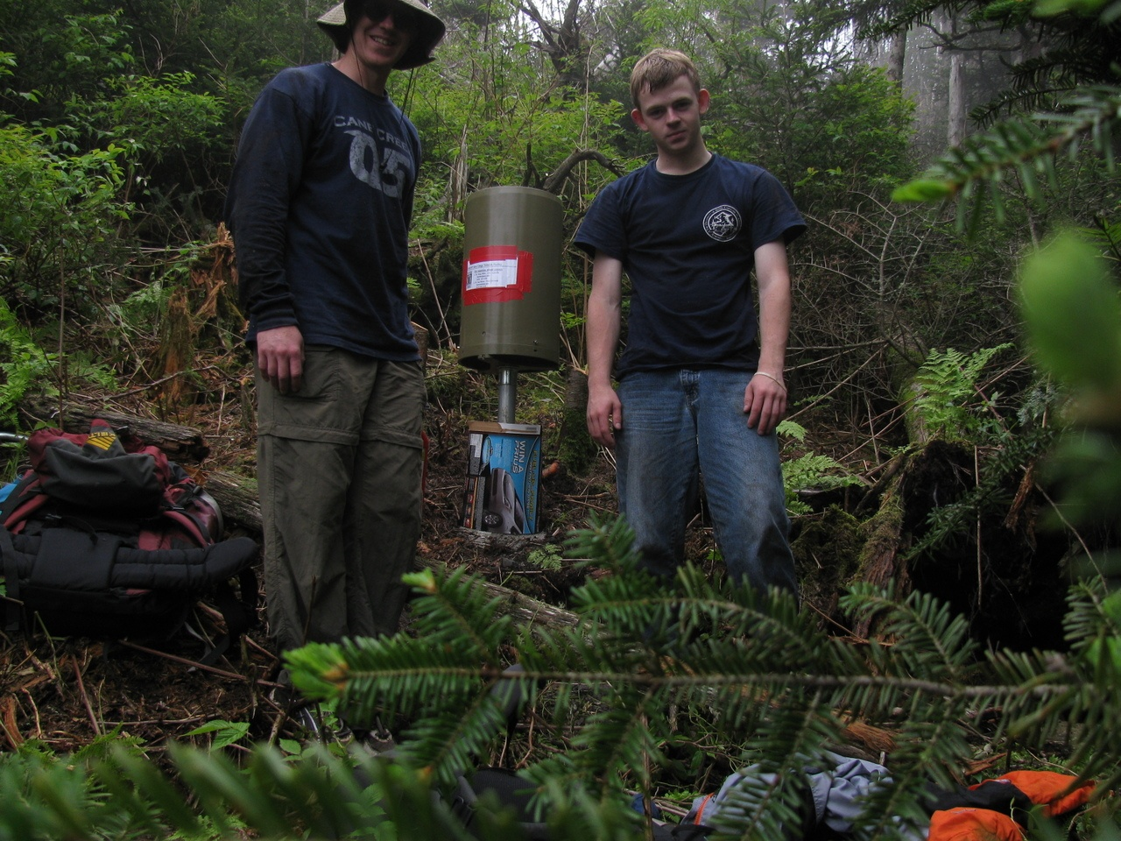
Finished!! 12 June 2009
pc: Daniel Martin

Slide 22
Maintenance
pc: Daniel Martin

Slide 23
Maintenance

Slide 24
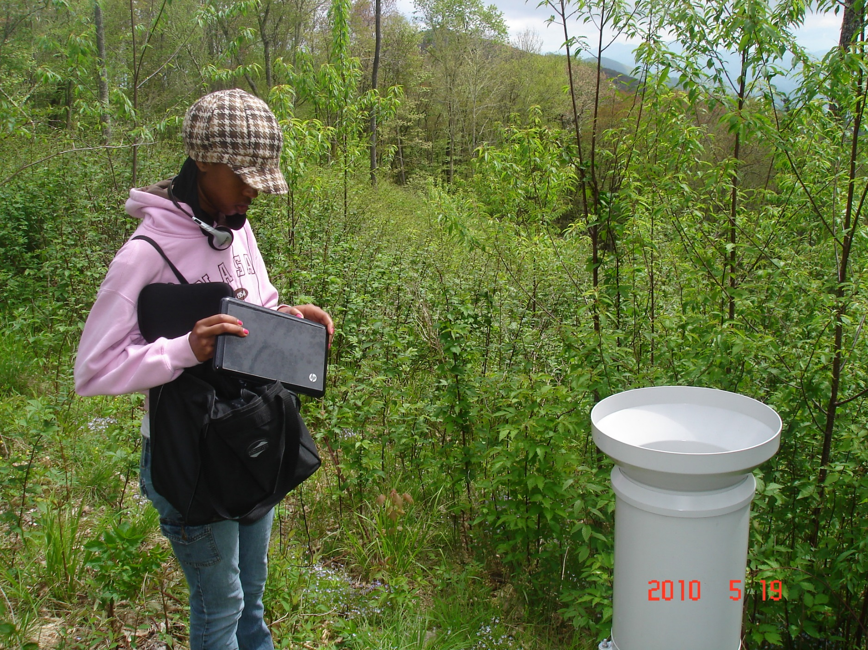
Maintenance

Slide 25
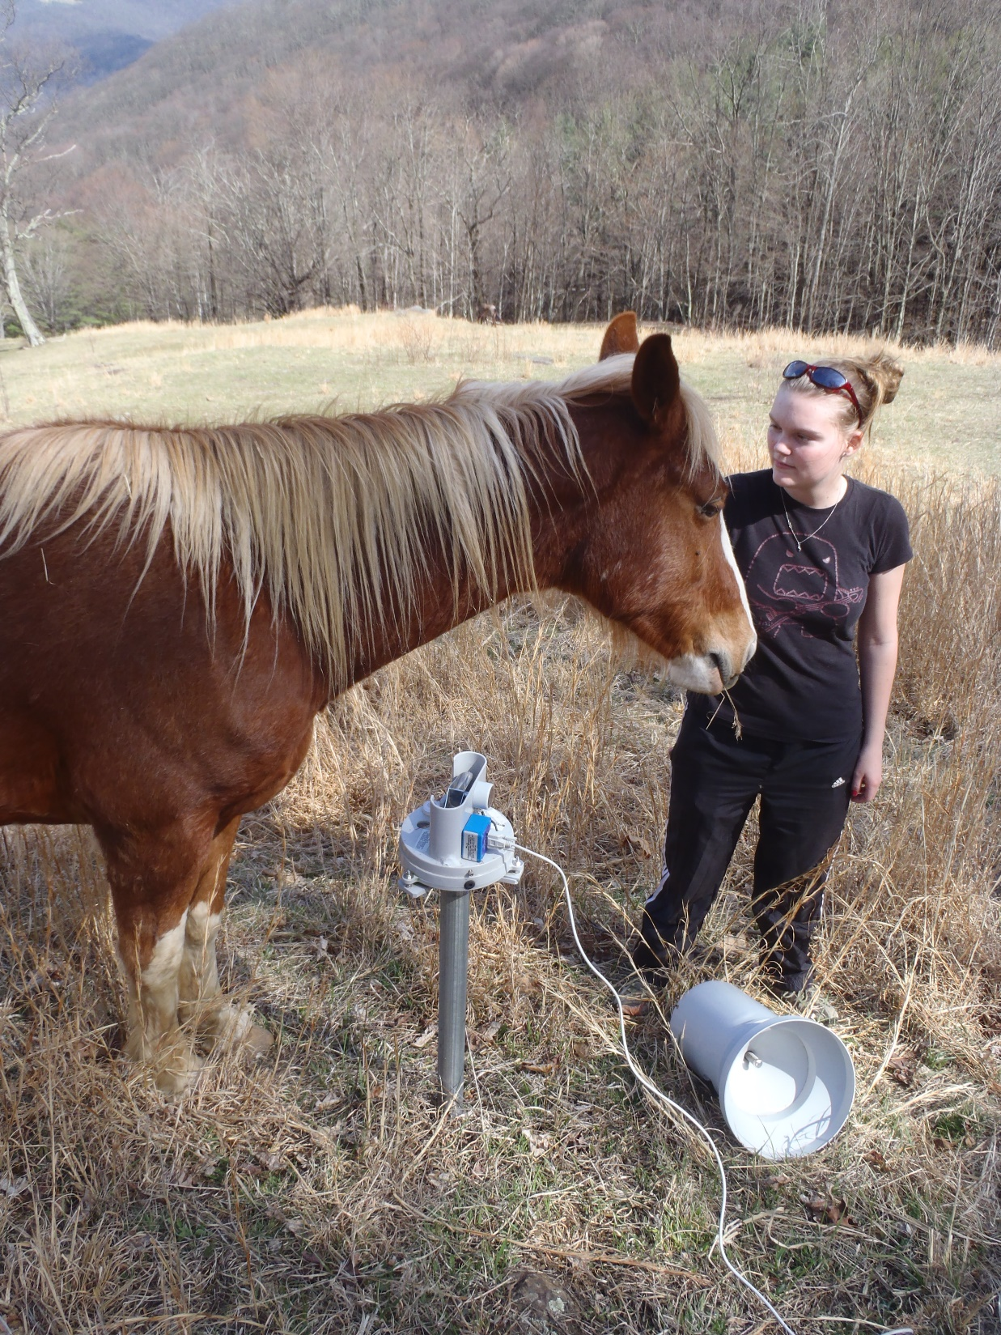
Maintenance

Slide 26
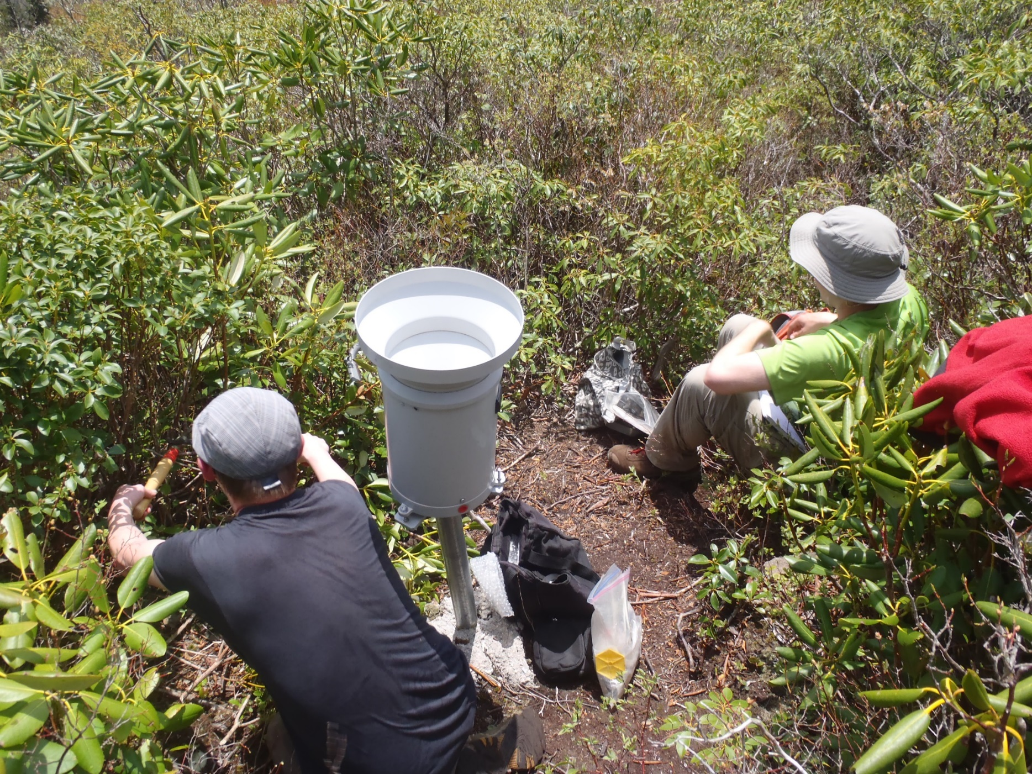
Maintenance

Slide 27
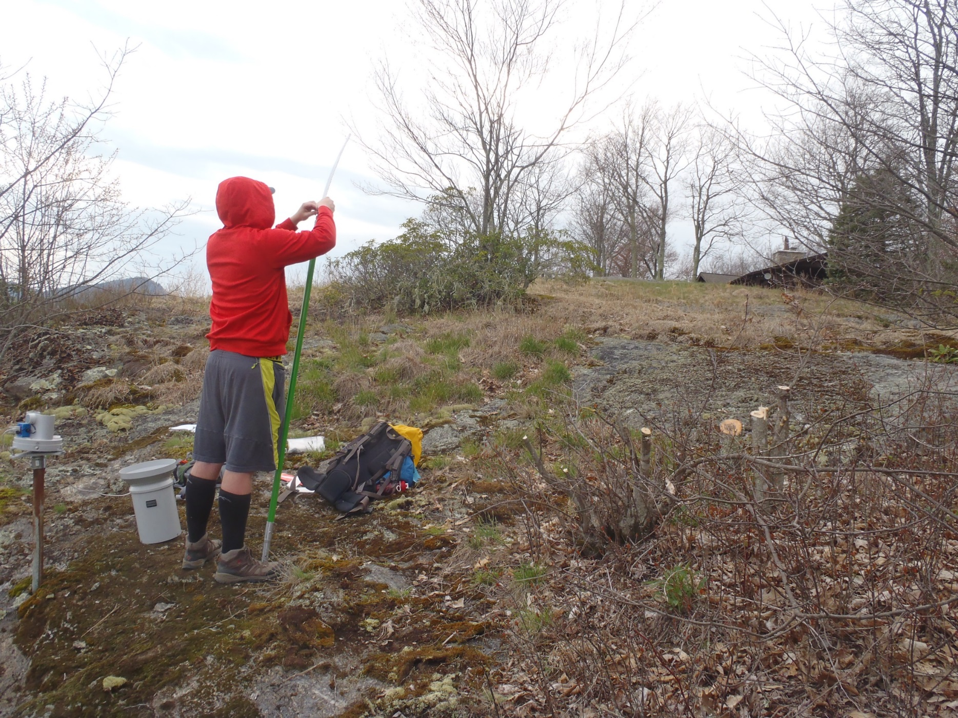
Maintenance

Slide 28
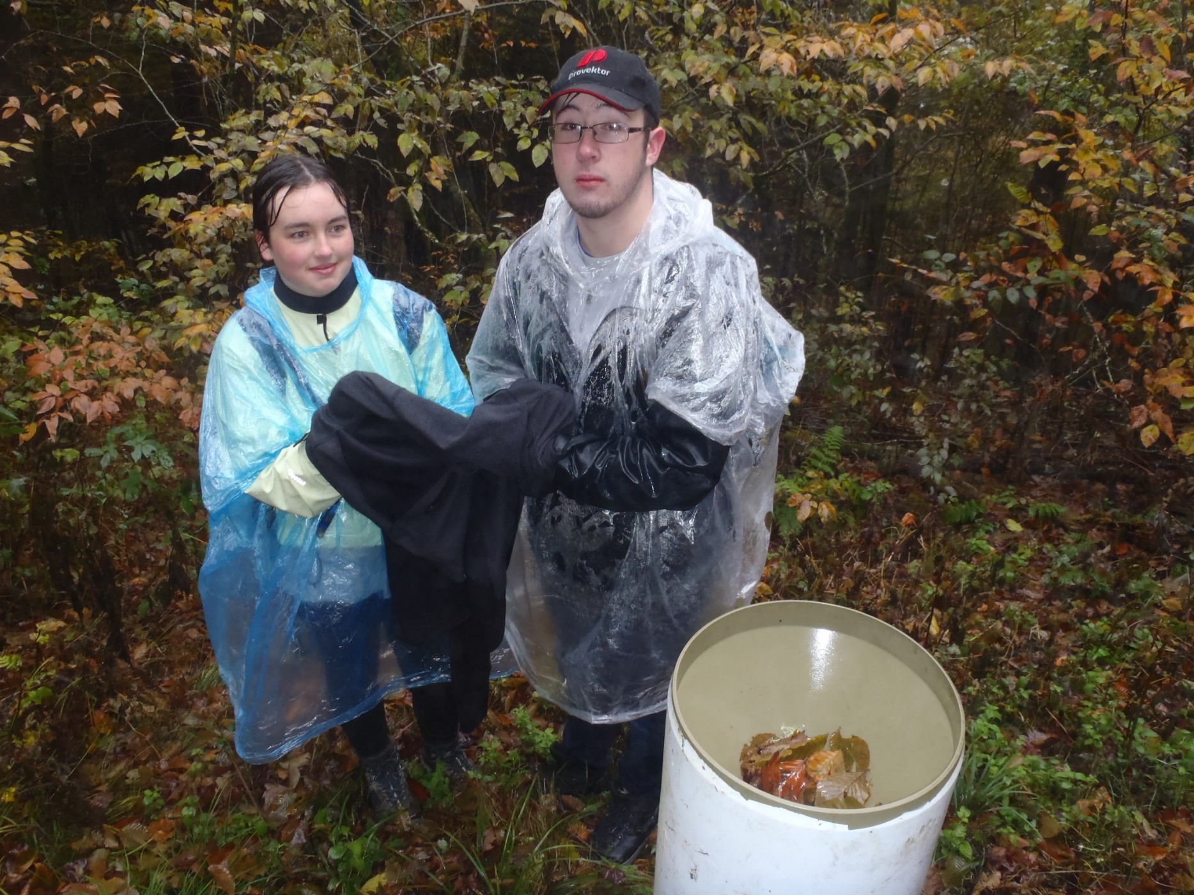
Challenges

Slide 29

Challenges

Slide 30
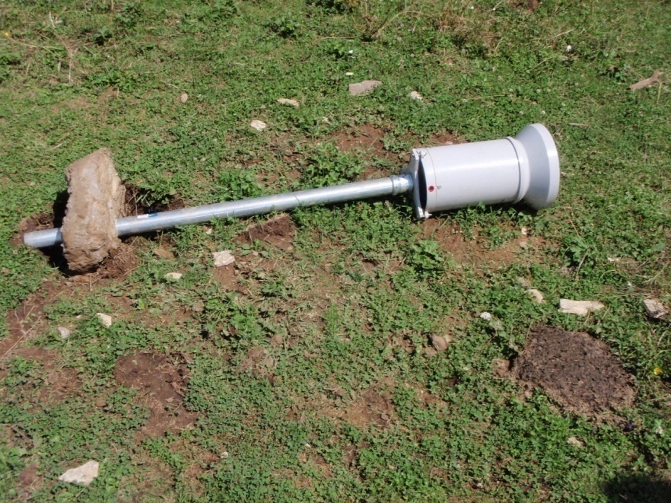
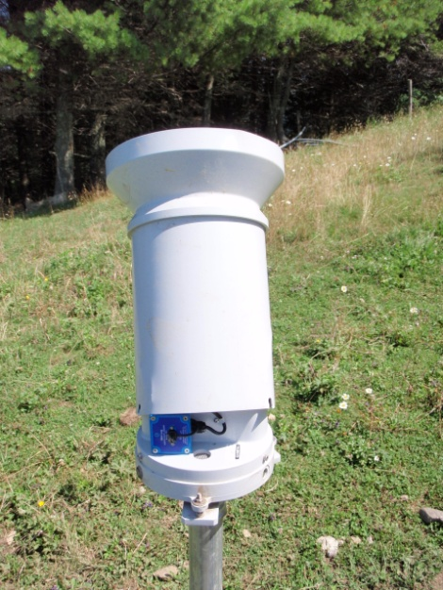
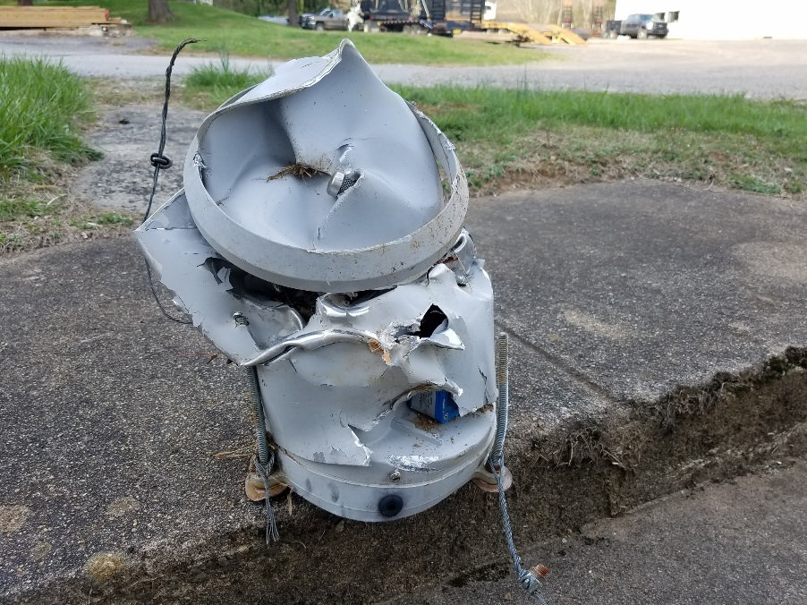
Challenges

Slide 31
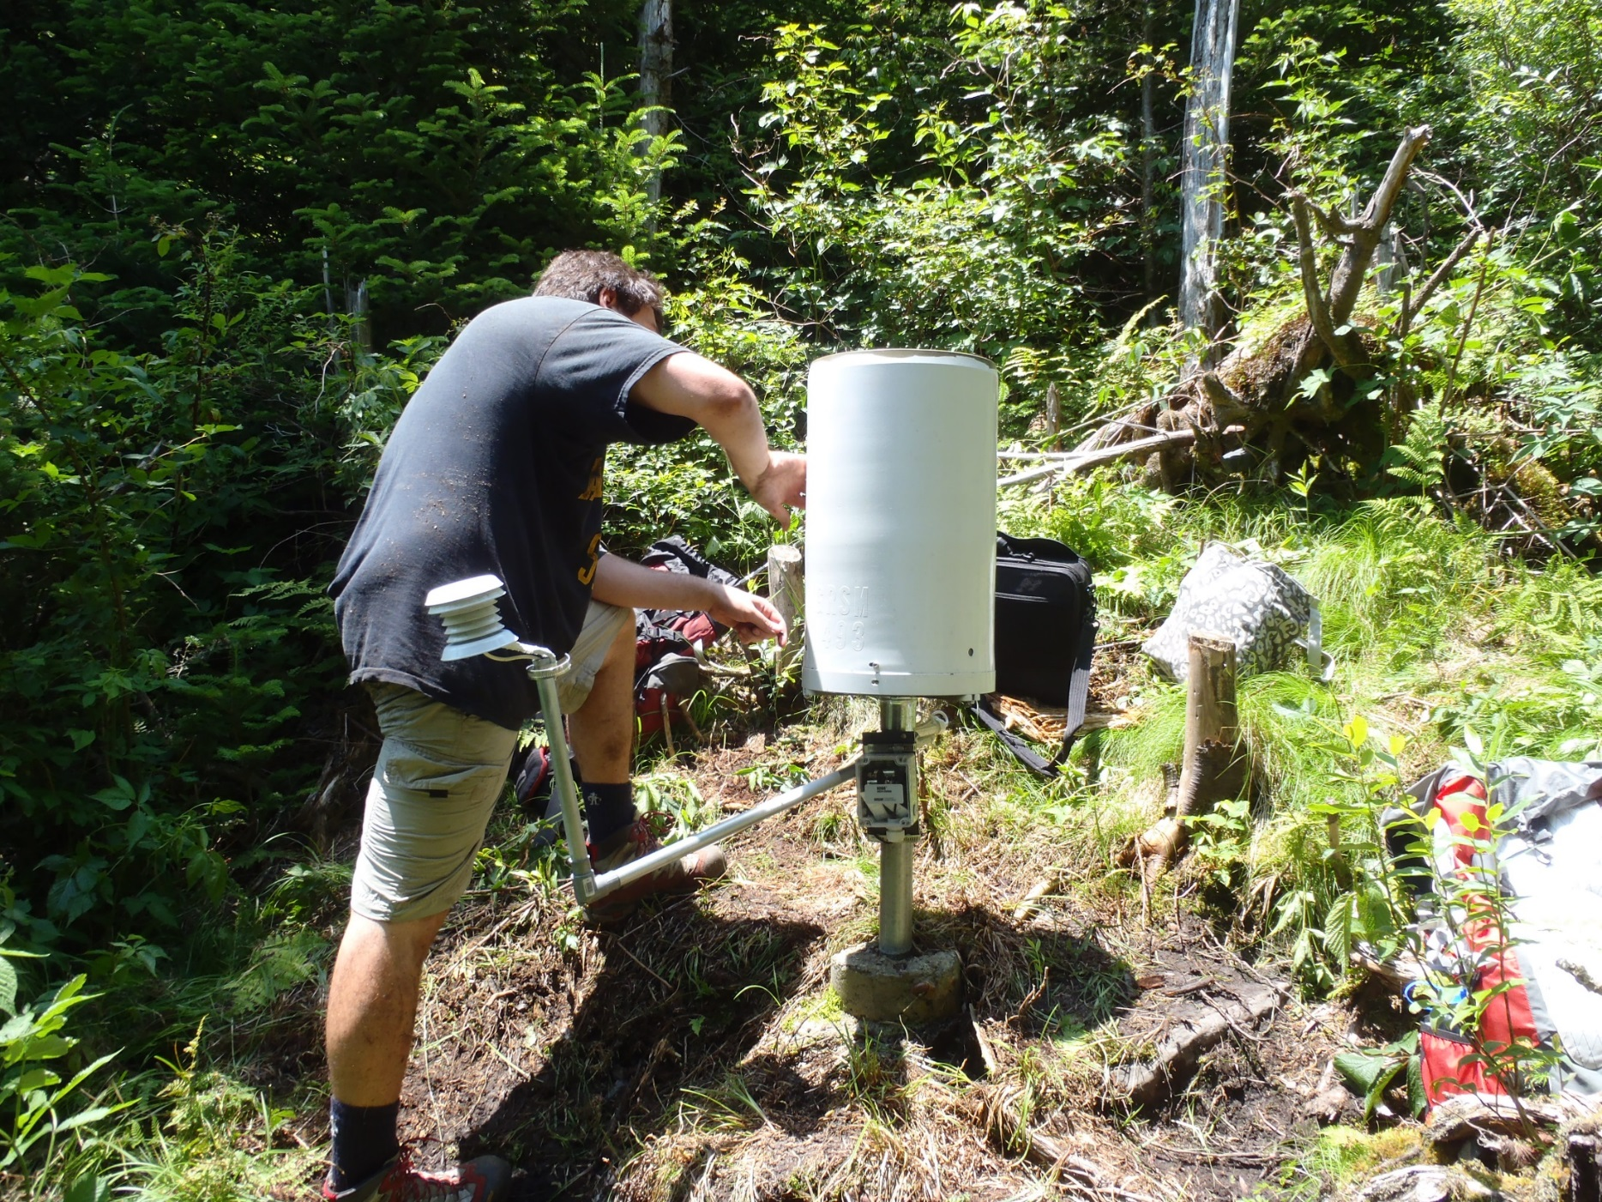
Challenges
pc: Daniel Martin

Slide 32

Challenges
https://www.hgtv.com/outdoors/gardens/animals-and-wildlife/the-gray-squirrel-411

Slide 33
Challenges
pc: Daniel Martin

Slide 34
Challenges
pc: Daniel Martin

Slide 35
Challenges
pc: Daniel Martin

Slide 36
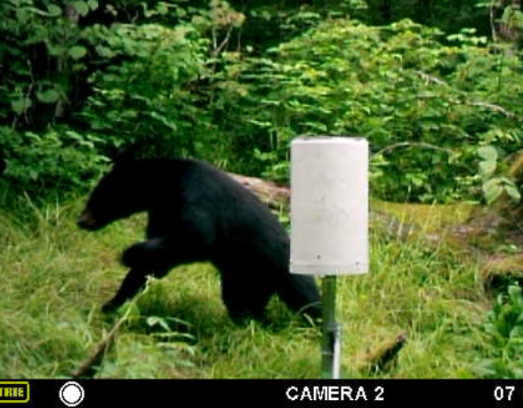
Challenges
http://blizzard.atms.unca.edu/dmiller/MFDC0135.AVI

Slide 37
Challenges
pc: Daniel Martin

Slide 38

Challenges

Slide 39
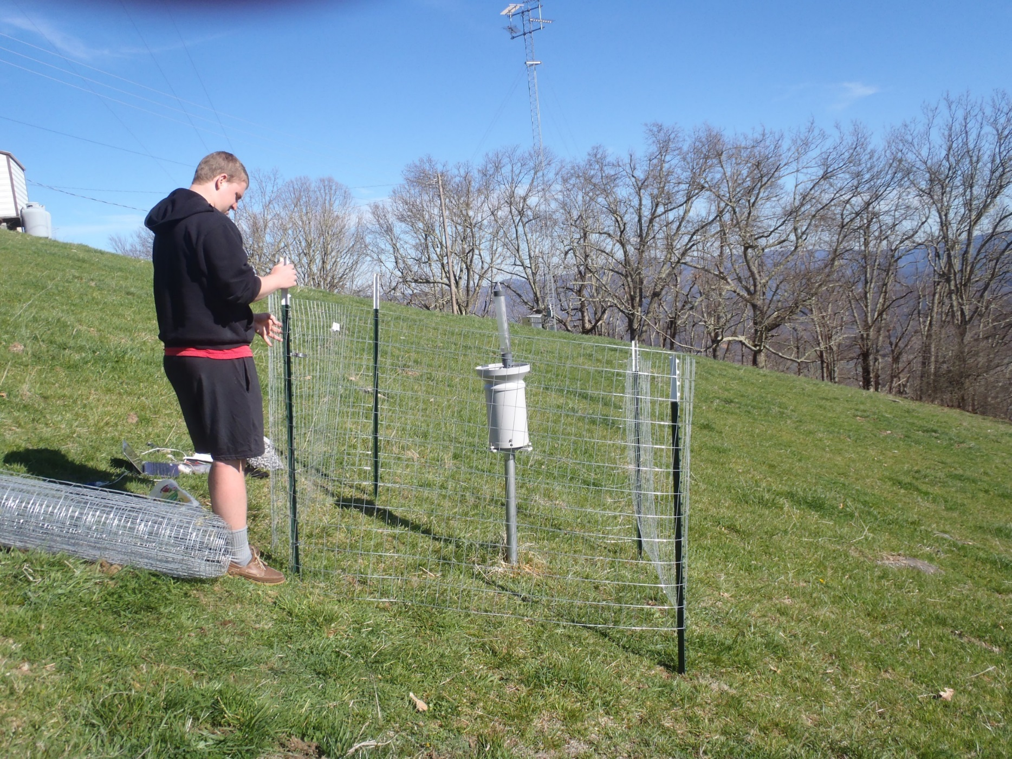
Challenges

Slide 40
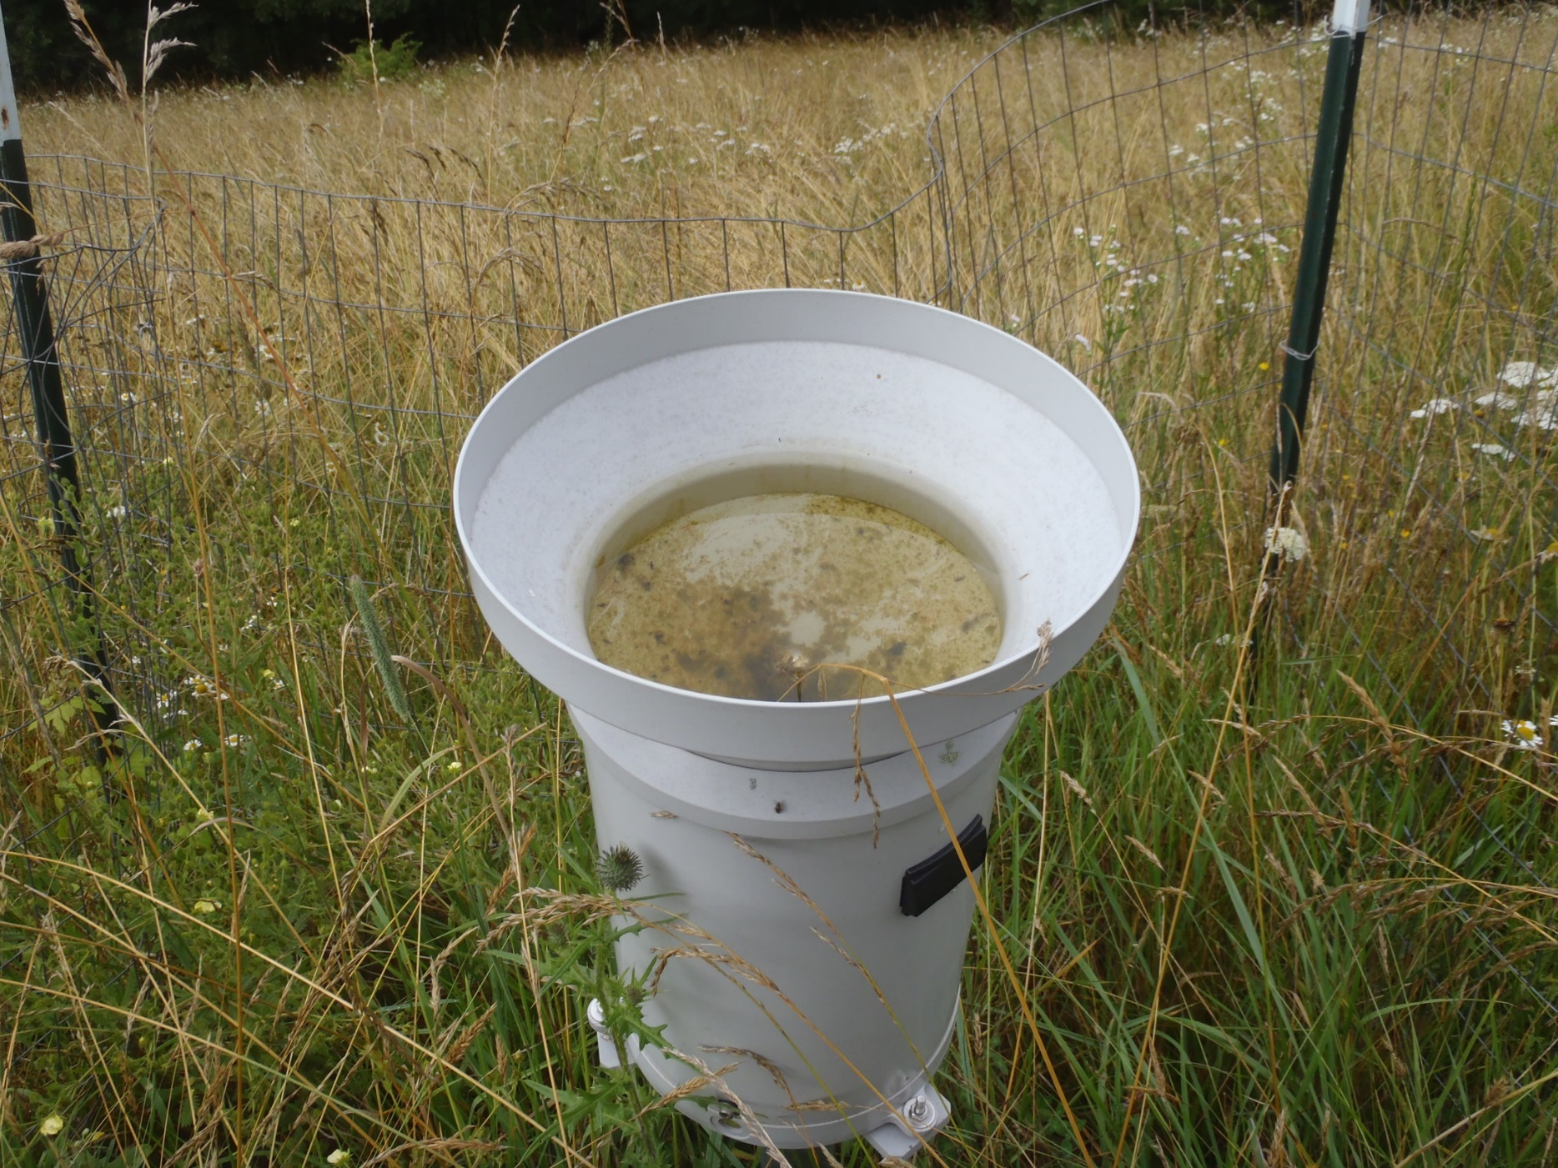
Challenges

Slide 41
Challenges

Slide 42
Local Research
Findings…

Slide 43
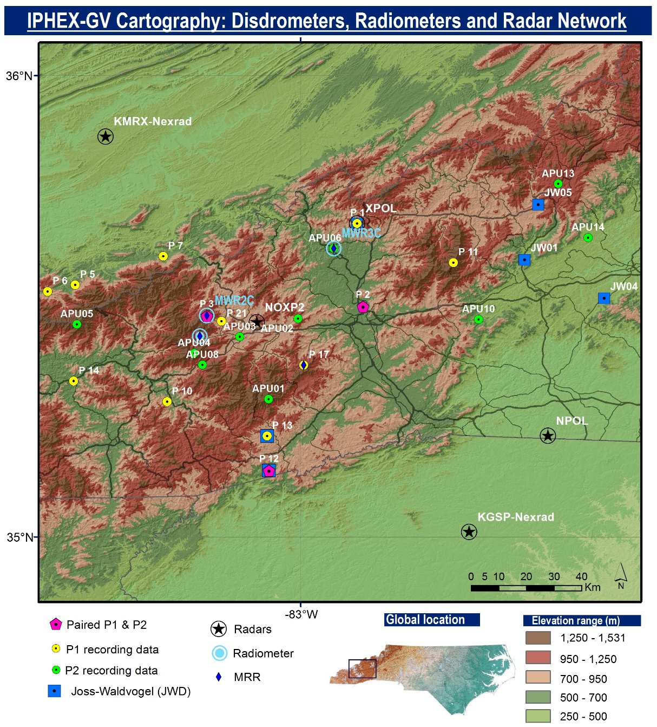

Findings
IPHEx
1 May – 15 June 2014
Wilson et al. (2014)

Slide 44
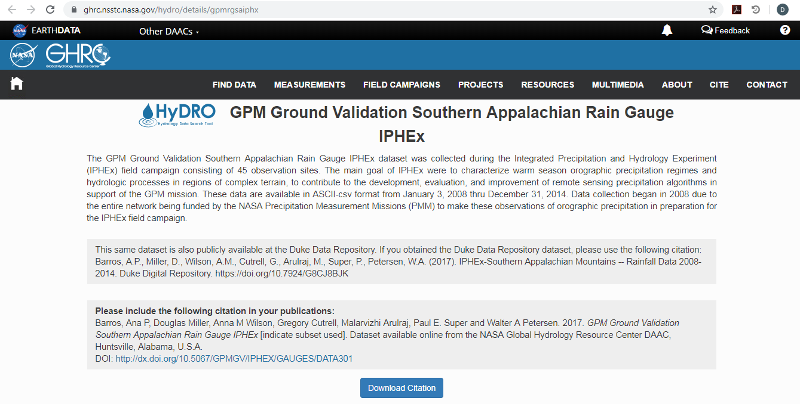
Findings
Barros, Ana P, Douglas Miller, Anna M Wilson, Gregory Cutrell, Malarvizhi Arulraj, Paul E. Super and Walter A Petersen. 2017. GPM Ground Validation Southern Appalachian Rain Gauge IPHEx [indicate subset used]. Dataset available online from the NASA Global Hydrology Resource Center DAAC, Huntsville, Alabama, U.S.A. DOI: http://dx.doi.org/10.5067/GPMGV/IPHEX/GAUGES/DATA301

Slide 45
Background on Atmospheric Rivers
In the western United States…

Slide 46
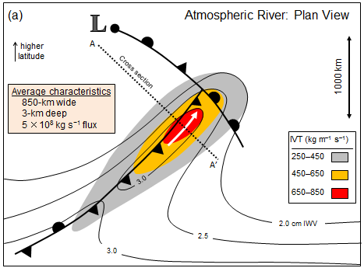
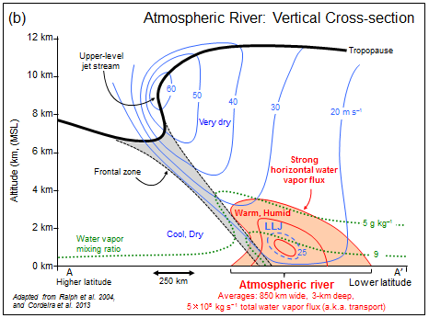
Atmospheric River
IVT = Integrated Vapor Transport
A long, narrow, and transient corridor of strong horizontal water vapor transport that is typically associated with a low-level jet stream ahead of the cold frontof an extratropical cyclone. The water vapor in atmospheric rivers is supplied by tropical and/or extratropical moisture sources…Horizontal water vapor transport in the midlatitudes occurs primarily in atmospheric rivers and is focused in the lower troposphere.
http://glossary.ametsoc.org/wiki/Atmospheric_river

Slide 47
Background on Atmospheric Rivers
In the southeastern United States…

Slide 48
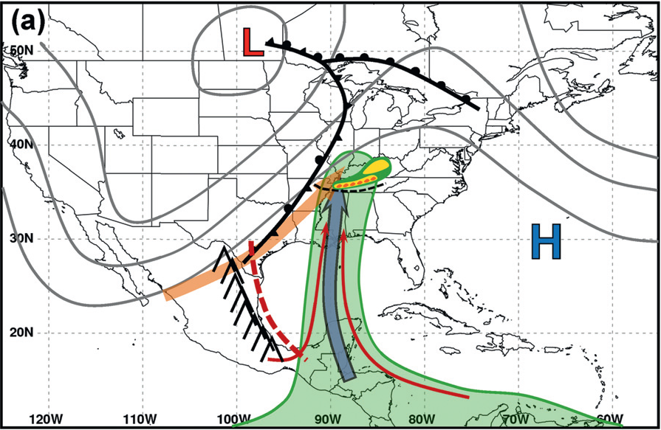
slow-moving or static supply of moisture from the tropics
1 – 2 May 2010
Moore et al. (2012)

Slide 49
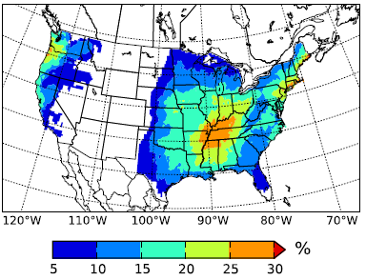
Climatology in SE U.S.
“The Appalachian Mountains are clearly visible as a low AR fraction region dividing relatively high percentages along the U.S. East Coast and the central United States.”
Lavers and Villarini (2015)

Slide 50
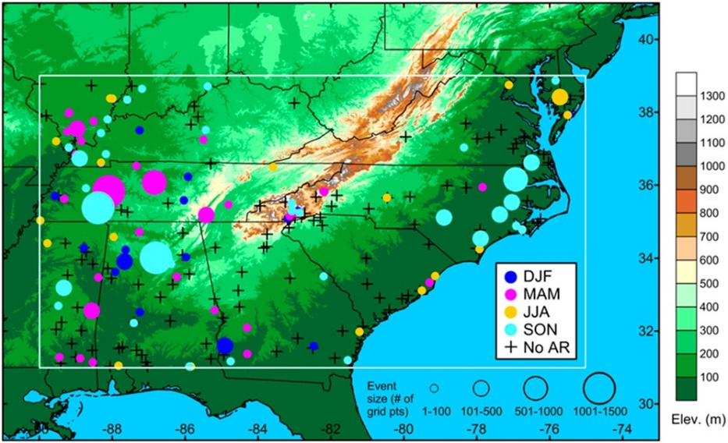
Background
S.E. U.S. (SEUS) findings…
IVT ~500 kg m⁻¹ s⁻¹ reasonable threshold for defining ARs
clear connection between ARs and heavy precipitation events in non-summer months
AR conditions in SEUS have a less direct influence on heavy precipitation relative to the U.S. west coast
Jan. 2002 – Dec. 2011
Mahoney et al. (2016)

Slide 51
Findings…
Pigeon River Basin

Slide 52
Methodology
Rainfall accumulation binned in 6-h periods
g #1
.
.
.
g #32
0000 UTC
0600 UTC
1200 UTC
1800 UTC
0000 UTC

Slide 53
Methodology
Rainfall events (observed by the Duke GSMRGN)
Rank events by event total per gauge accumulation
Extreme (top 2.5%) rainfall events
Normal (middle 33%) rainfall events

Slide 54
Methodology
Investigate systematic differences between Extreme and Normal rainfall events (“Connections”)
Atmospheric Rivers (ARs)
Observed flooding at Newport, TN river gauge
Storm event reports in TN, NC along common state border

Slide 55
Methodology
Methodology
IVT** study domain
Using 6-h GFS analysis (0.5º x 0.5º) grids and IVT study domain…
highest IVT contour meeting Mahoney et al. (2016) shape criteria (at least 1500 km long, no wider than 1500 km)
average maximum IVT value for three consecutive GFS analyses (12+ h) at least 500 kg m⁻¹ s⁻¹
IVT** = Integrated Vapor Transport (vapor movement in lowest layer)

Slide 56
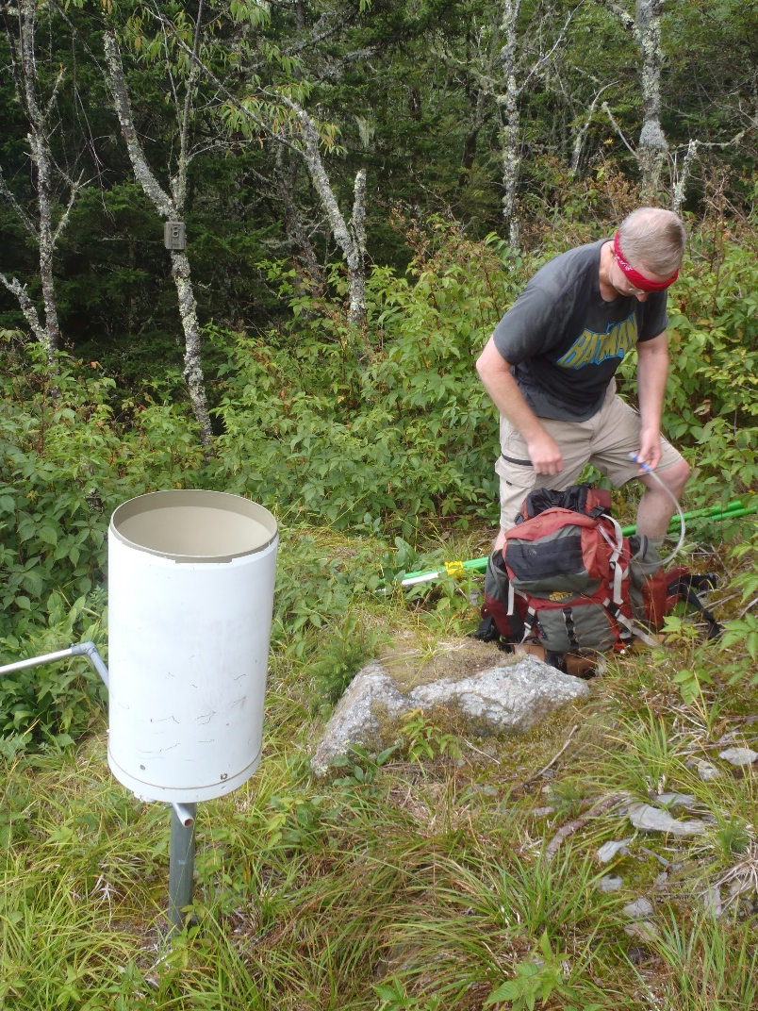
Results

Slide 57
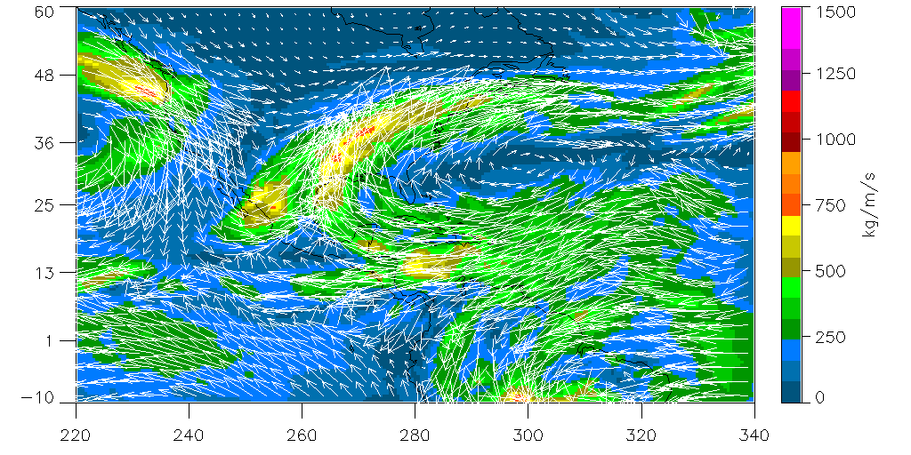
Integrated Vapor Transport
[kg m⁻¹ s⁻¹]
0000 UTC 21- 0600 UTC 24 December 2013
GFS gridded analyses
(moderate flooding)
NOAA - NOMADS

Slide 58
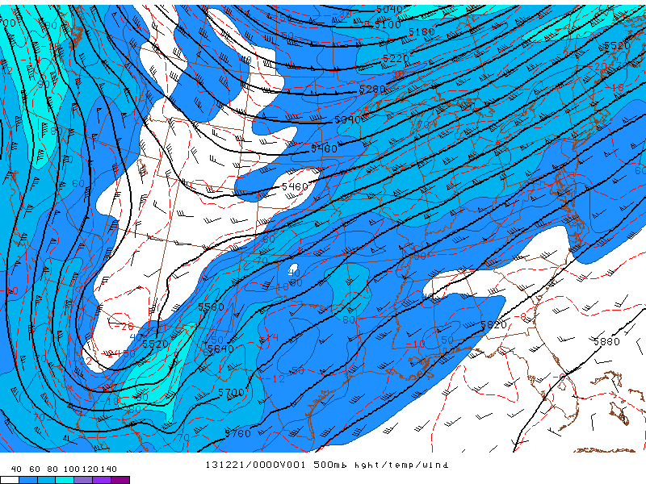
500 hPa level Geo Ht / Temp / WS
21- 24 December 2013
(moderate flooding)
NOAA - SPC

Slide 59
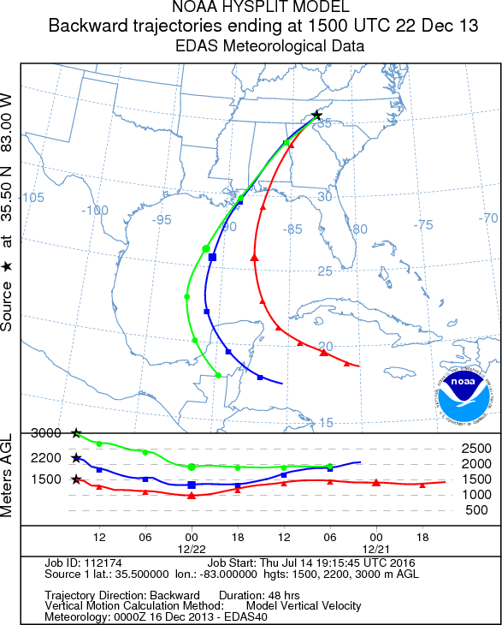

Slide 60
Findings
Do Atmospheric Rivers impact the southern Appalachians?
Half of Extreme events are AR-influenced
Most likely in cool season environments
Slow-moving high amplitude atmospheric wave
Rapidly moving humid air at low-levels (from the Gulf of Mexico)
Extreme events having no AR-influence
Most likely in warm season environments
Cut-off low level cyclone southwest of southern Appalachians
Low-level winds blow normal to mountains – orographically-enhanced precipitation

Slide 61
Findings
Do Atmospheric Rivers impact the southern Appalachians?
12-25% ARs are associated with a societal hazard (flooding, flash flooding, heavy rainfall reports)
Normal rainfall events with an AR, not associated with a societal hazard? [“non-threatening” ARs]

Slide 62
Climatology [8-yr]
Seasonal count of number of ARs impacting the IVT study domain using available 11463 GFS 6-h analysis periods of the 8-yr study (of 11688 maximum 6-h periods; 98.1% of a complete archive) [1 July 2009 – 30 June 2017].
Meteorological Season | AR Events | 6-h Periods | Avg Duration (h)
Winter (DJF) | 79 | 451 | 34.25
Spring (MAM) | 49 | 258 | 31.59
Summer (JJA) | 24 | 175 | 43.75
Autumn (SON) | 40 | 247 | 37.05
Total/avg | 192 | 1294 | 35.34
Notes:
snd_diag_look
/usr/local/www/html/arisa/data/soundings/analysis

Slide 63
Findings…
Comparison between the Pigeon River Basin (PRB) and the Coweeta River Basin (CRB)…

Slide 64
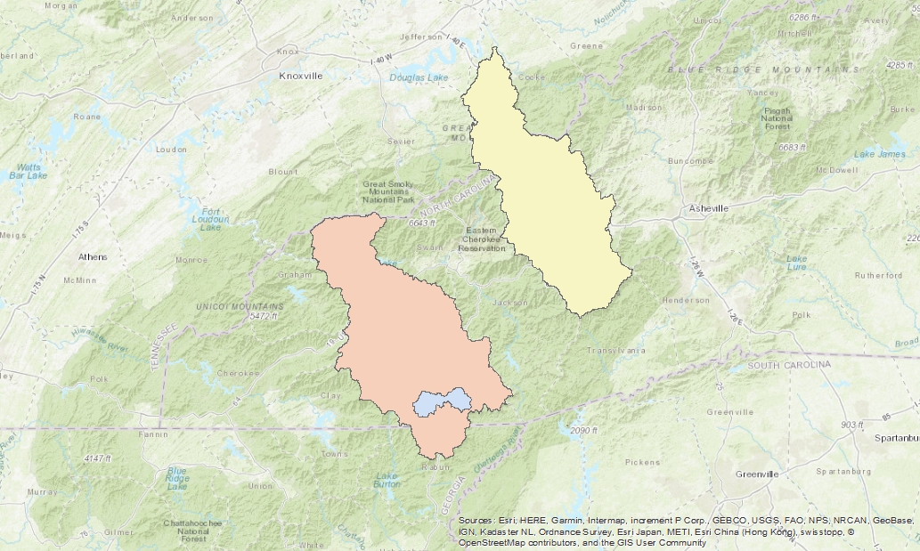
Expanded view – two river basins
Pigeon River Basin
Methodology
Map of pigeon and coweeta river basin boundaries embedded in elevation map of western NC
Upper Little Tennessee Basin
Coweeta River Basin

Slide 65
Methodology
Methodology
Pigeon River Basin – displaced north and west of the Blue Ridge escarpment
Coweeta River Basin – adjacent to the Blue Ridge escarpment

Slide 66
8-yr comparison; PRB v. CRB
Results
Number of extreme (top 2.5%) rain events of the 8-yr study [1 July 2009 – 30 June 2017].
River Basin | AR-influenced | TC-influenced | NOT AR- or TC-influenced | Total
Pigeon | 23 (53.5%) | 3 (7.0%) {Ida, Lee, Andrea} | 17 (39.5%) | 43
Coweeta | 20 (83.3%) | 2 (8.3%) {Ida, Lee} | 2 (8.3%) | 24
TC = tropical cyclone
Notes:
1464/19 = tave (PRB) = 77.05 h,
1260/18 = tave (CRB) = 70.00 h

Slide 67
8-yr comparison; PRB v. CRB
Results
Seven rainfall events qualify as extreme in the Coweeta River Basin and less-than-extreme in the Pigeon R.B.
Six events = AR influenced (5 Feb 2012, 16 Apr 2011, 28 Nov 2011, 14 Oct 2014, 18 Nov 2015, and 3 Feb 2016)
One event = squall line and severe weather (26 Oct 2010)
Examination of geopotential height and precipitable water composite means and anomalies of
six AR-influenced extreme rainfall events (CRB)
16 AR-influenced extreme rainfall events (PRB, Miller et al. 2018)

Slide 68
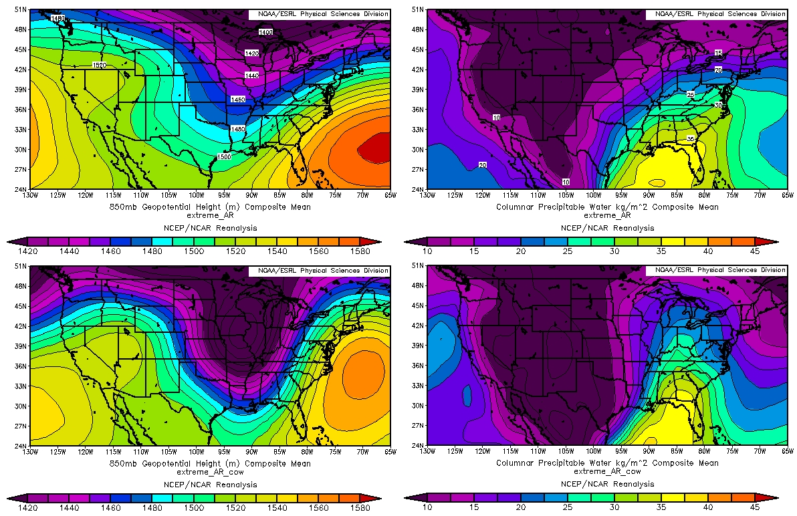
Expanded view – two river basins
Composite means
PRB, N=16
PRB
Results
Four panel 850 (a) cow AR, (c) duke AR and PW (b) cow AR, (d) duke AR geopotential composite mean
Four panel 850 (a) cow AR, (c) duke AR and PW (b) cow AR, (d) duke AR geopotential composite anom
850 hPa
P Wat
CRB, N=6
CRB
850 hPa
P Wat

Slide 69
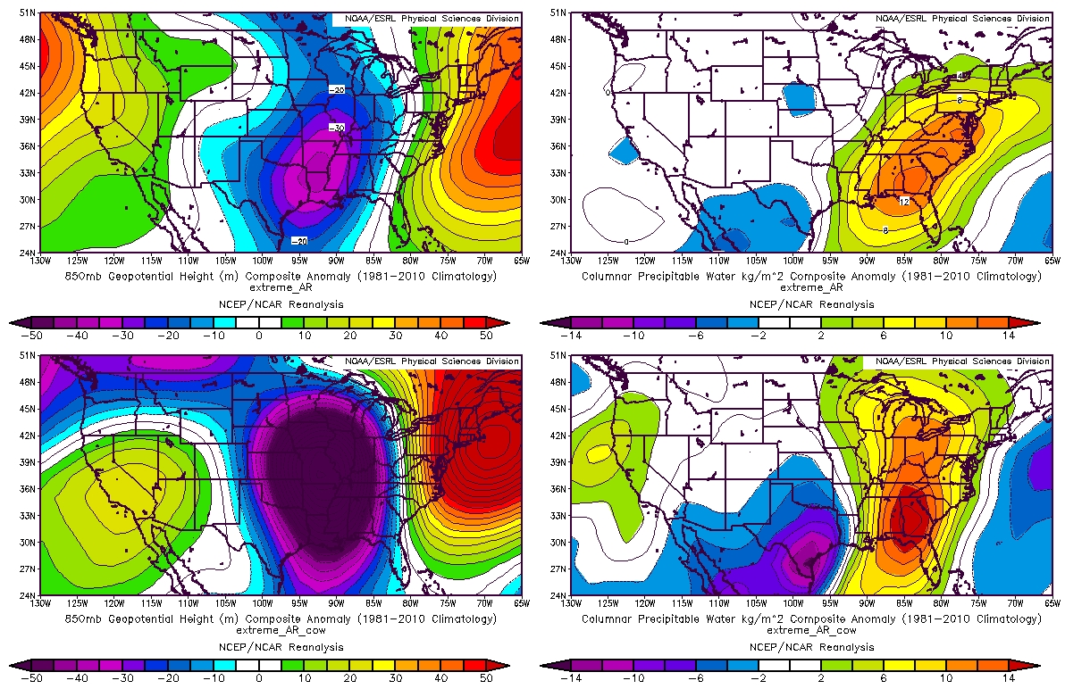
Expanded view – two river basins
Composite anomalies
PRB, N=16
PRB
Results
Four panel 850 (a) cow AR, (c) duke AR and PW (b) cow AR, (d) duke AR geopotential composite mean
Four panel 850 (a) cow AR, (c) duke AR and PW (b) cow AR, (d) duke AR geopotential composite anom
850 hPa
P Wat
CRB, N=6
CRB
850 hPa
P Wat

Slide 70
8-yr comparison; PRB v. CRB
Results
Disagreement between two river basins on ‘extreme’ events
Much smaller record (8-yr [v. 82-yr]) in the Pigeon River Basin
Difference in position relative to the Blue Ridge escarpment
Relative landform homogeneity of the Coweeta River Basin; 8-9 [32] gauges spread over 16.26 km² [1823 km², PRB]
Composite weather AR pattern differences
Southwesterly flow favors extreme events in the PRB
Southerly flow inhibits extreme events in the PRB

Slide 71
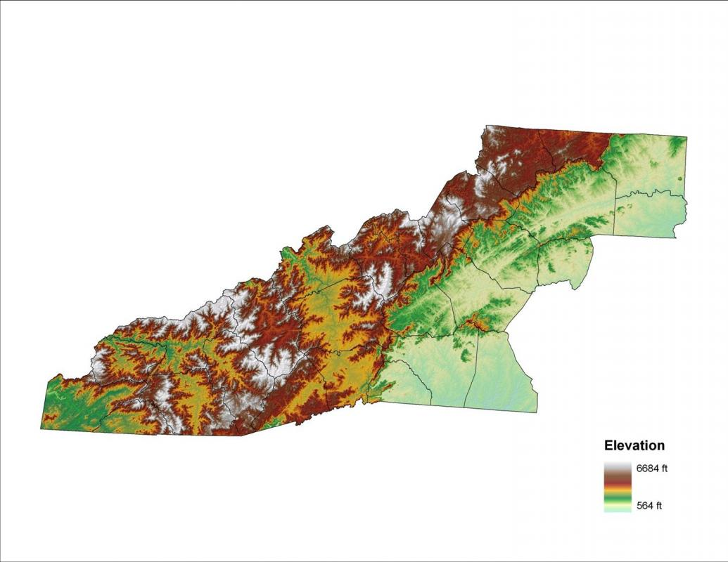
Expanded view – two river basins
Richland Balsam, 1845 m (6053 ft)
Methodology
Map of pigeon and coweeta river basin boundaries embedded in elevation map of western NC
http://www.wncvitalityindex.org/topography/mountain-topography-and-geomorphology

Slide 72
Future…
Hypothesis; another way Atmospheric Rivers can cause a disruption in the southern Appalachian Mountains…

Slide 73
Future
Methodology
Longer time-scale precipitation events; Elevated Rain Time Clusters [ERTCs]
Δt = 30-h
Notes:
N = 4733 SRTC events since 4 June 1936

Slide 74
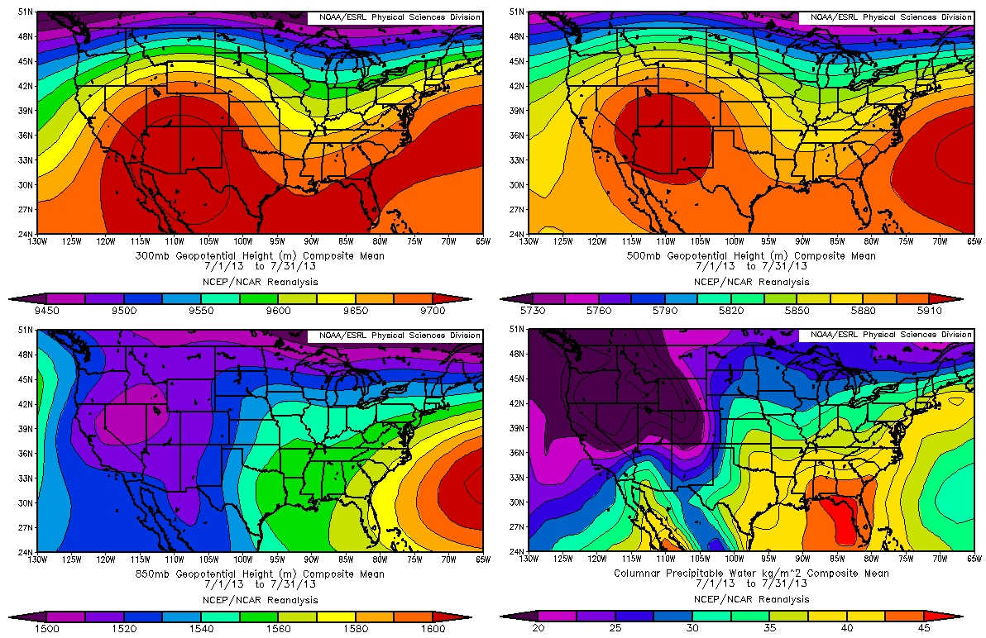
Expanded view – mud slides, debris flows
Composite means – July 2013
Results
NCEP/NCAR reanalysis composite means and anomalies of july 2013…
300 hPa
500 hPa
850 hPa
P Wat

Slide 75
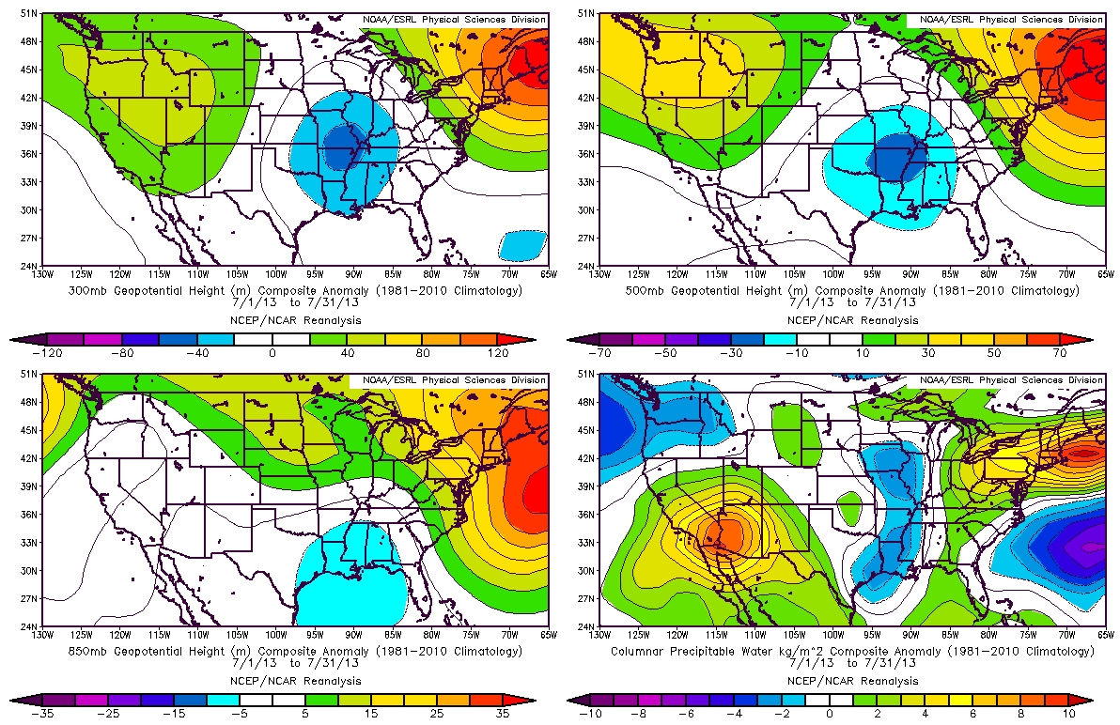
Expanded view – mud slides, debris flows
Composite anomalies – July 2013
Results
NCEP/NCAR reanalysis composite means and anomalies of july 2013…
300 hPa
500 hPa
850 hPa
P Wat

Slide 76
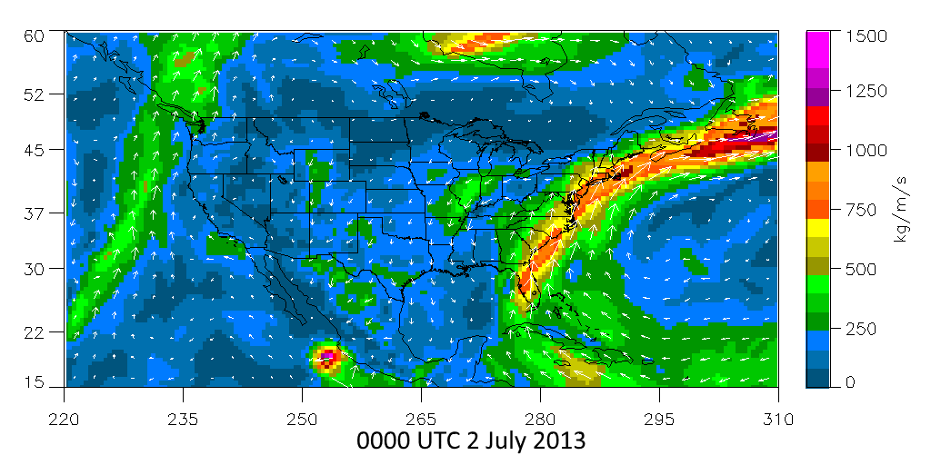
Future – mud slides, debris flows
Results
Animation of July 2013 AR
IVT – GFS 6-h analyses

Slide 77
Future…
‘Maya Corridor’ hypothesis
ridge-building provided via the diabatic process of latent heat release as the sub-tropical moisture of the ARs was converted to cloud water and precipitation
as the ridge continued to build, the large-scale weather pattern became increasingly stagnant
repeated propagation of successive ARs over the same pathway and increased ridge-building through continued latent heating
provided a mechanism for ‘training’ rainfall events over the southern Appalachian Mountains that pre-conditioned the soil and/or triggered landslides

Slide 78
Future…
Warm season studies (Duke GSMRGN is now past 10 year mark)
Regional WRF simulation of July 2013 – impact of diabatic heating – confirm/refute Maya Corridor hypothesis
Identify convection “hot spots” in the PRB with events stratified by the 850 – 700 hPa layer winds
Systematic change of the initiation time of convection in the PRB?

Slide 79
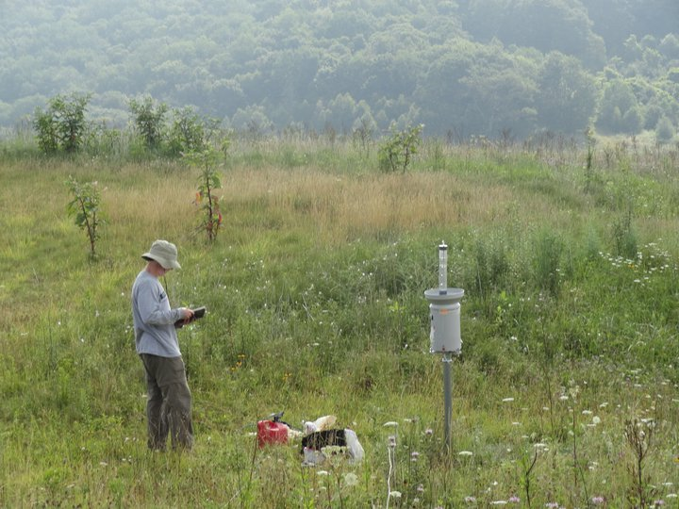
Acknowledgements
Special thanks to Paul Super, Jim Renfo, and everyone in the Great Smoky Mountains NP for your invaluable help and cooperation!
Near Purchase Knob, credit: Michael Goldsbury

Slide 80
References
Lavers, D. A., and G. Villarini, 2015: The contribution of atmospheric rivers to precipitation in Europe and the United States. J. Hydrology, 522, 382-390.
Miller, D.K., C.F. Miniat, R.M. Wooten, and A.P. Barros, 2019: An expanded investigation of atmospheric rivers in the southern Appalachian Mountains and their connection to landslides. Atmosphere, 10, 71 (DOI:10.3390/atmos10020071).
Miller, D.K., D. Hotz, J. Winton, and L. Stewart, 2018: Investigation of atmospheric rivers impacting the Pigeon River Basin of the southern Appalachian Mountains. Wea. Forecasting, 33, 283-299 (DOI:10.1175/WAF-D-17-0060.1).
Moore, B. J., P. J. Neiman, F. M. Ralph, and F. E. Barthold, 2012: Physical processes associated with heavy flooding rainfall in Nashville, Tennessee, and vicinity during 1–2 May 2010: The role of an atmospheric river and mesoscale convective systems. Mon. Wea. Rev., 140, 358-378.
Neiman, P. J., F. M. Ralph, G. A. Wick, J. D. Lundquist, and M. D. Dettinger, 2008: Meteorological characteristics and overland precipitation impacts of atmospheric rivers affecting the west coast of North America based on eight years of SSM/I satellite observations. J. of Hydrometeorology, 9, 22-47.
Mahoney, K.M., D. L. Jackson, P. Neiman, M. Hughes, L. Darby, G. Wick, A. White, E. Sukovich, R. Cifelli, 2016: Understanding the role of atmospheric rivers in heavy precipitation in the southeast United States. Mon. Wea. Rev., 144, 1617-1632.
Wilson, A. M., and A. P. Barros, 2014: An investigation of warm rainfall microphysics in the southern Appalachians: Orographic enhancement via low-level seeder–feeder interactions. J. Atmos. Sci., 71, 1783–1805, https://doi.org/10.1175/JAS-D-13-0228.1.

Slide 81
extra References
Cordeira, J. M., F. M. Ralph, and B. J. Moore, 2013: The development and evolution of two atmospheric rivers in proximity to western North Pacific tropical cyclones in October 2010. Mon. Wea. Rev., 141, 4234–4255, doi:10.1175/MWR-D-13-00019.1.
Guan, B., D. E. Waliser, and F. M. Ralph, 2018: An intercomparison between renalysis and dropsonde observations of the total water vapor transport in individual atmospheric rivers. J. Hydrometeor., 19, 321–337, doi:10.1175/JHM-D-17-0114.1.
—, and —, 2015: Detection of atmospheric rivers: Evaluation and application of an algorithm for global studies. J. Geophys. Res. Atmos., 120, 12 514–12 535, doi:10.1002/2015JD024257.
Ralph, F. M., P. J. Neiman, and G. A. Wick, 2004: Satellite and CALJET aircraft observations of atmospheric rivers over the eastern North Pacific Ocean during the winter of 1997/98. Mon. Wea. Rev., 132, 1721–1745, doi:10.1175/1520-0493(2004)132<1721:SACAOO>2.0.CO;2.
—, and Coauthors, 2017: Dropsonde observations of total water vapor transport within North Pacific atmospheric rivers. J. Hydrometeor., 18, 2577–2596, doi:10.1175/JHM-D-17-0036.
Zhu, Y., and R. E. Newell, 1998: A proposed algorithm for moisture fluxes from atmospheric rivers. Mon. Wea. Rev., 126, 725–735, doi:10.1175/1520-0493(1998)126<0725:APAFMF>2.0.CO;2.

Slide 82

Details of slides #10 – 41 are described in Chapter 11 of the book to be published in 2020…
University of California Press

