Slide 1
JPSS Cloud Data Processing Future and Machine Learning for the Weather Value Chain
Scott Kern
Emily Greene
Shawn Miller
This document does not contain technology or technical data controlled under either the U.S. International Traffic in Arms Regulations or the U.S. Export Administration Regulations.
Notes:
Text or image elements are not permitted below the copyright or takeaway bar on any slide to allow this white space for required document markings.

Slide 2
Agenda
IDPS in the Cloud for NESDIS
Optimization Plans
Cloud enabled Opportunities
Machine Learning for Operational Weather
This document does not contain technology or technical data controlled under either the U.S. International Traffic in Arms Regulations or the U.S. Export Administration Regulations.

Slide 3
Initial Implementation – Phase 1
Operational IDP Configuration
Transition to Operations in Cloud must occur NLT EOY 2020 (Lenovo HW waiver expiration)
NOAA direction to migrate current operational baseline to Cloud with minimal baseline changes
Only changes to baseline that are explicitly necessary to operate in the cloud
Moving primary IDP DB from Oracle to PostgreSQL to save Oracle licensing costs
HOT backup of primary Operations IDP
Monthly Security Patching requires transition to backup IDP
3rd IDP necessary to accommodate monthly patches and baseline upgrades while maintaining resiliency to failures
Primary change is new Common Environment :
Route data to multiple IDPS systems from a single on-prem data source
Management of security solutions
On-prem IDPS is a “user” of security solutions from the C3S segment
Leveraging DevOps Tools/Processes:
Environments 100% managed using Infrastructure-as-Code (Packer, Terraform, Chef)
Faster/Frequent algorithm releases to PRO subsystem decreases Research-to-OPS (R2O) cycle
~60 EC2 VMs and 500 TB EBS storage per Ops-capable IDPS
Database Layer (EC2 and EBS)
Oracle Dataguard installed to EC2
Backup DB instance
EBS storage attached to EC2
DMS: Data Management
PDR: Performance Data Repo
Storage Layer (EBS)
EBS SSD volumes attached to EC2 instances
GPFS/Spectrum Scale installed to EC2 to create shared file system
Data is replicated using GPFS failure groups
Processing VMs (EC2)
IDPS subsystems are very modular allowing updates to individual subsystems without impacting others
Attached to shared file system for product and common storage
This document does not contain technology or technical data controlled under either the U.S. International Traffic in Arms Regulations or the U.S. Export Administration Regulations.

Slide 4
IDPS in the Cloud Architecture Overview
This document does not contain technology or technical data controlled under either the U.S. International Traffic in Arms Regulations or the U.S. Export Administration Regulations.

Slide 5
AWS Services In Use For Initial Implementation
AWS Service | Purpose
EC2/EBS | Processing VMs, significant tuning in Task Order prototypes to define the configuration SIGNIFICANT volume of EBS storage required for GPFS, 250 TB writable data perf IDP. GPFS installed to EC2 however needs full replication for resiliency to a single EC2 failure, 500TB total storage.
PostgreSQL Relational Database Service (RDS) | Hosts primary data management database (DMS) Deployed in multi-AZ configuration for redundancy, but other IDPS components are single-AZ
Simple Storage Service (S3) | SMD and MSD archive hosted in cloud DPC Factory use for testdata and other large datastores Storage for Artifactory COTS in deployment pipeline Drop-box for algorithm changes in DP-AE
Simple Notification Service (SNS) Simple Queue Service (SQS) | Used by new Mission Data Distribution function to deliver one data source to many IDPs New SMD/MSD product arrives in S3, SNS sends message to a SQS queue assigned to each IDP, guarantees each IDP receives all SMD/MSD even when not active
CloudWatch | Monitoring and aggregation of cloud logs (from CloudTrail, VPC Flow Logs and CloudWatch agents) Delivers security relevant events to on-prem Qradar
CloudTrail | Logs API calls to AWS services
VPC Flow Logs | Logs traffic in/out of each VPC
Direct Connect Gateway (DXG) Transit Gateway (TXG) | DXG enables direct connect at NWAVE TXG routes data from DXG to each VPC
This document does not contain technology or technical data controlled under either the U.S. International Traffic in Arms Regulations or the U.S. Export Administration Regulations.

Slide 6
Optimization – Phase 2
Optimization Phase Updates the IDPS cloud design to take better advantage of cloud capabilities
Provides significant cost savings over initial-implementation
Savings for Infrastructure, COTS, O&M
Implements a better foundation for science/forecast product driven changes during Modernization Phase
Optimization | Description
Transition to Highly Available (HA) IDPS | Deploy single HA IDPS spanning 2 Availability Zones Subsystems deployed across AZs in auto-scaling groups “Live” security patching on dynamic instances to eliminate OPS/Non-OPS transitions for monthly security patching
Dynamic Allocation of Processing Capacity | Elastic processing capacity to dynamically respond to changing throughput needs in responding to anomalies
Complete migration of all databases to PDR | COTS licensing savings Reduces DBA support needs and security patching overhead
Modernize IDPS Storage Layer | Product storage moved from GPFS to cloud-native blob storage (AWS S3) Significant cost savings Initial prototyping shows satisfactory performance with minimal code modifications Common storage migrates to cloud-native shared file system (AWS Elastic File Service EFS) Provides HA without overhead required to manage large replicated storage cluster
Utilize Clustered Messaging Service | Develop HA messaging system or utilize “Messaging-as-a-Service from AWS (Amazon MQ)
Utilize Cloud-Native Monitoring and Alerting | Initial-Implementation using legacy design of monitoring agents deployed on IDPS VMs delivering messages to operations.
BLUE: Denotes successfully prototyped and demonstrated capability
This document does not contain technology or technical data controlled under either the U.S. International Traffic in Arms Regulations or the U.S. Export Administration Regulations.

Slide 7
Modernization – Phase 3
The modernization phase leverages IDPS’ proven data production platform
Provide an expanded number of enterprise data products
Decrease algorithm process overhead accelerating R2O cycle
Data Delivery capability to expanded user base while minimizing data egress costs
Prioritize Real-time products critical to NWP delivered with IDPS’ proven low-latency and stability
Non-Real-time critical products have packaging and delivery processing
Optimization | Description
Modernize Processing Subsystem using Containerized Algorithms | Science teams will directly develop algorithms and include dependencies in versioned containers Run multiple algorithm versions in parallel, dependencies reside in container Enterprise data product generation Real-time Processing: Operational algorithms generating products Off-line Processing: “Algorithm Sandbox” Evaluate updates to algorithms Executed during “back-orbits”, spot-instances or serverless Eliminates need for full IDPS dedicated for dedicated I&T and provides faster R2O cycles
Modernize Data Delivery via Cloud-based Content Delivery Network | Data products delivered to single cloud location (S3) Eliminate delivery of products through C3S facility to Mission Partners Real-Time Delivery: Products delivered to S3 location NWP products delivered in directly ingestible format (HDF, BUFR, NetCDR, etc) Consumers who need real-time products will receive notification of new products and API to pull the data directly down to their system (S3 => SNS => SQS pipeline) Off-Line Delivery: Non-Real-Time consumers will be able to request aggregation and/or packaging of products which will create a new product in S3 and notification delivered to consumer
“Lights Out” IDPS decreases reliance on dedicated operations staff | IDPS is highly stable system requiring almost no human interaction to function Decreases reliance on 24x7 dedicated operators Remove Java based GUIs and replace with simplified web GUI with APIs to drive IDP functions Significantly improves security posture
This document does not contain technology or technical data controlled under either the U.S. International Traffic in Arms Regulations or the U.S. Export Administration Regulations.

Slide 8
Cloud Enabled Opportunities
Data Delivery via Cloud Storage
Data products delivered to single cloud location (S3)
Eliminate delivery of products through C3S facility to Mission Partners
Real-Time Delivery: Products delivered to S3 location with no aggregation/packaging
Significant simplification of delivery subsystem
Consumers who need real-time products will receive notification of new products and API to pull the data directly down to their system
S3 => SNS => SQS pipeline
Off-Line Delivery:
Non-Real-Time consumers will be able to request aggregation and/or packaging of products which will create a new product in S3 and notification delivered to consumer
This document does not contain technology or technical data controlled under either the U.S. International Traffic in Arms Regulations or the U.S. Export Administration Regulations.

Slide 9
Cloud Enabled Opportunities
Containerize Processing Algorithms
Science teams will directly develop algorithms and include dependencies in versioned containers
Run multiple algorithm versions in parallel, dependencies reside in container
Real-time Processing: Operational algorithms generating products
Off-line Processing: Evaluate updates to algorithms, executed during “back-orbits” or serverless
Less capacity required than real-time
Eliminates need for full IDPS dedicated for dedicated I&T and provides faster Science-to-OPS cycles
Rapid Science Container updates
4 weeks cycles to reach Operations, 2 cycles in development at all times
SW with 2 week sprints
Extra time for Performance check and Science Quality evaluation
This document does not contain technology or technical data controlled under either the U.S. International Traffic in Arms Regulations or the U.S. Export Administration Regulations.

Slide 10



General Application of Machine Learning
SYSTEMS ENGINEERING
Where in Processing Chain should AI/ML be Applied?
Benefit vs. cost
Data availability – quality & quantity
Impact on overall system
DATA
Information that contains a signal about the event you care about. AI/ML data can be in the form of images, text or video. Training data: data that we present AI/ML algorithms to train them; Test data: data that we use to evaluate accuracy of AI/ML algorithms
DEVELOP/TRAIN MACHINE LEARNING ALGORITHMS
Select algorithm, language, framework
Establish training environment
Train neural nets, evaluate results, iterate
SOFTWARE/ ALGORITHMS
Interface, library or tool which allows developers to more easily and quickly build machine learning models, using pre-built optimized components
IMPLEMENT ALGORITHMS
Select processing approach
Integrate with existing system
HARDWARE
Specialized hardware to accelerate software which runs machine learning and deep learning applications
EVALUATE SYSTEM
Select evaluation data
Perform Verification & Validation, operational testing
This document does not contain technology or technical data controlled under either the U.S. International Traffic in Arms Regulations or the U.S. Export Administration Regulations.

Slide 11
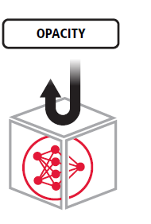
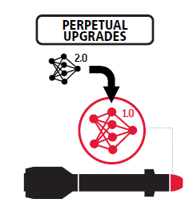
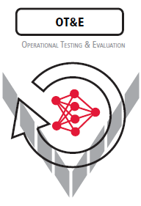
Challenges to Machine Learning
Opacity (i.e., “the black box”):
Explaining why ML got an answer is just as important as getting the answer
Perpetual Upgrades:
Evolving requirements can cause models to have a life cycle of mere seconds; key discriminator is automation
Operational Test and Evaluation:
ML models are inherently complex, non-deterministic systems; potential exists for unanticipated emergent behavior, indeterminate test results, Black Swan events (another fertile ground for innovative solutions)
This document does not contain technology or technical data controlled under either the U.S. International Traffic in Arms Regulations or the U.S. Export Administration Regulations.

Slide 12
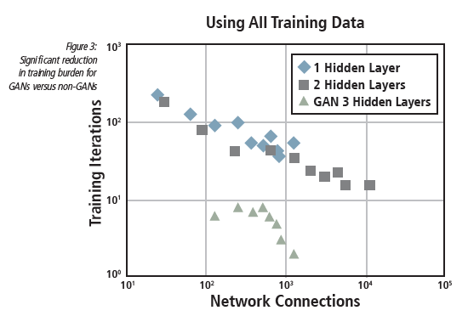
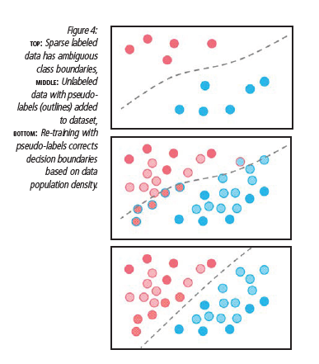
Improving Machine Learning Itself
Strategies for Rapid Prototyping Machine Learning
Difficulty in pattern recognition is the sheer volume of source data that must be analyzed – time required to acquire, label, and train the model
We have developed a number of tools and approaches to maximize training efficiency and mitigate effects of limited training exemplars, bad labels, and noisy data
Example 1: integration of Generative Adversarial Networks (GANs) into the training process (joint probability between inputs and outputs); shown in one study to reduce training iterations by factor of 10
Example 2: Pseudo-Labels (labels that are created automatically for unlabeled data using a partially trained network) can significantly improve classification accuracy without changing network architecture, based on theory known as Entropy Regularization
This document does not contain technology or technical data controlled under either the U.S. International Traffic in Arms Regulations or the U.S. Export Administration Regulations.

Slide 13
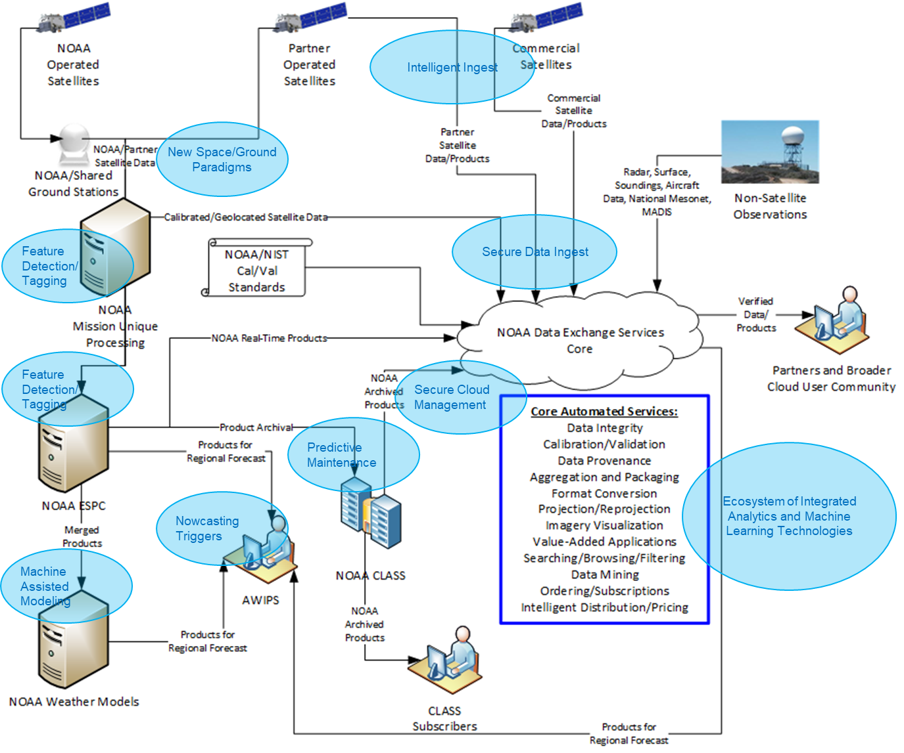
Analytics, ML, and the Weather Value Chain
Impact Area | Forecast Benefit
Accelerated Data Ingest | Commercial data available for forecast models Reduced data latency
Identify high-value data for forecast models during sensor processing | Improve initial conditions for model runs Improved Satellite Data Assimilation
Training models for weather anomalies | Increase speed and accuracy of extreme weather forecasts Provide forecaster tools to train regional datasets
Federate Weather data to process disparate data sets in the cloud | Faster R2O2R due to removal of data stovepipes “multi-int” data fusing across commercial/govt data types
Cloud technologies (massively parallel systems, GPUs, cloud computing) | ML for all classes of users, with elasticity for cost control Better collaboration across weather enterprise community
This document does not contain technology or technical data controlled under either the U.S. International Traffic in Arms Regulations or the U.S. Export Administration Regulations.

Slide 14
This document does not contain technology or technical data controlled under either the U.S. International Traffic in Arms Regulations or the U.S. Export Administration Regulations.

