Slide 2
Spectral enhancement of multispectral sensors with contra-bands
department of Biology
  Protistology & Aquatic Ecology research group
Theory and retrieval of Landsat 8 orange contra-band
NOCCG meeting
2020/04/08

Slide 3
Outline
40 to 45 min presentation
Motivation
The contra-band concept
The OLI orange contra-band:
● Algorithm development
● Noise and AC error propagation
● Generality
  ● Spaceborne and in situ validation
● Independent information content
● Case study: Lake Erie
VIIRS orange contra-band
Perspectives

Slide 4
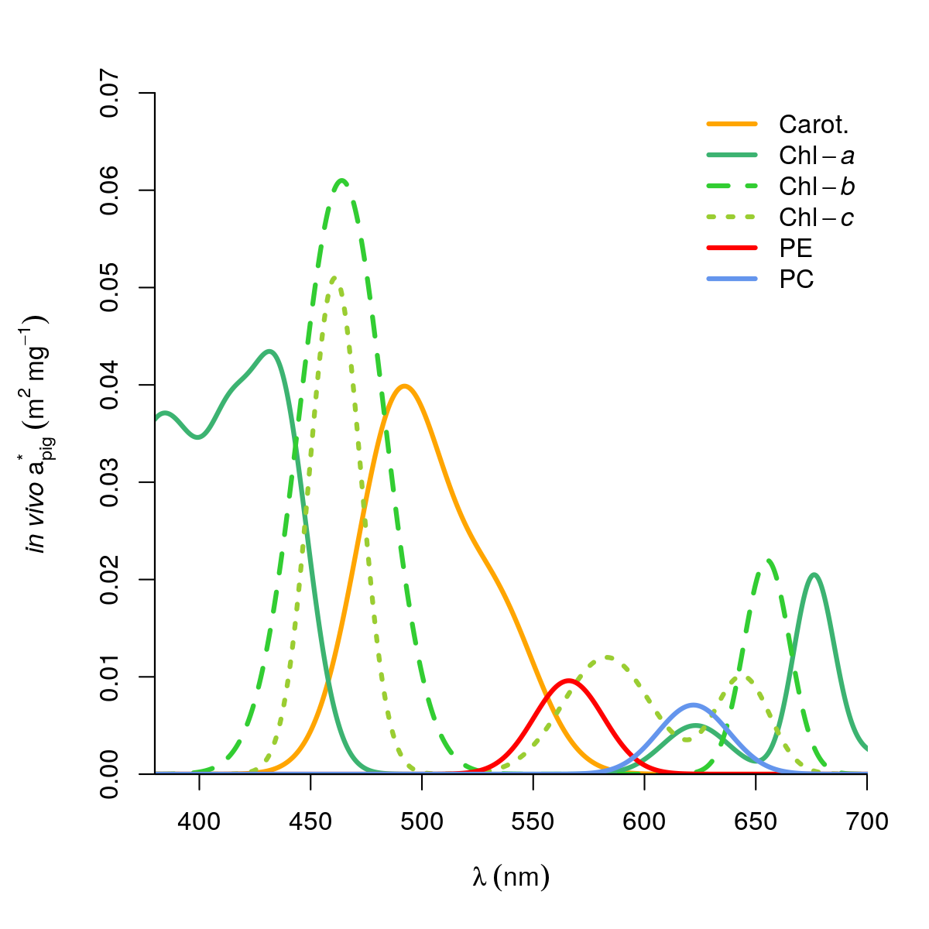
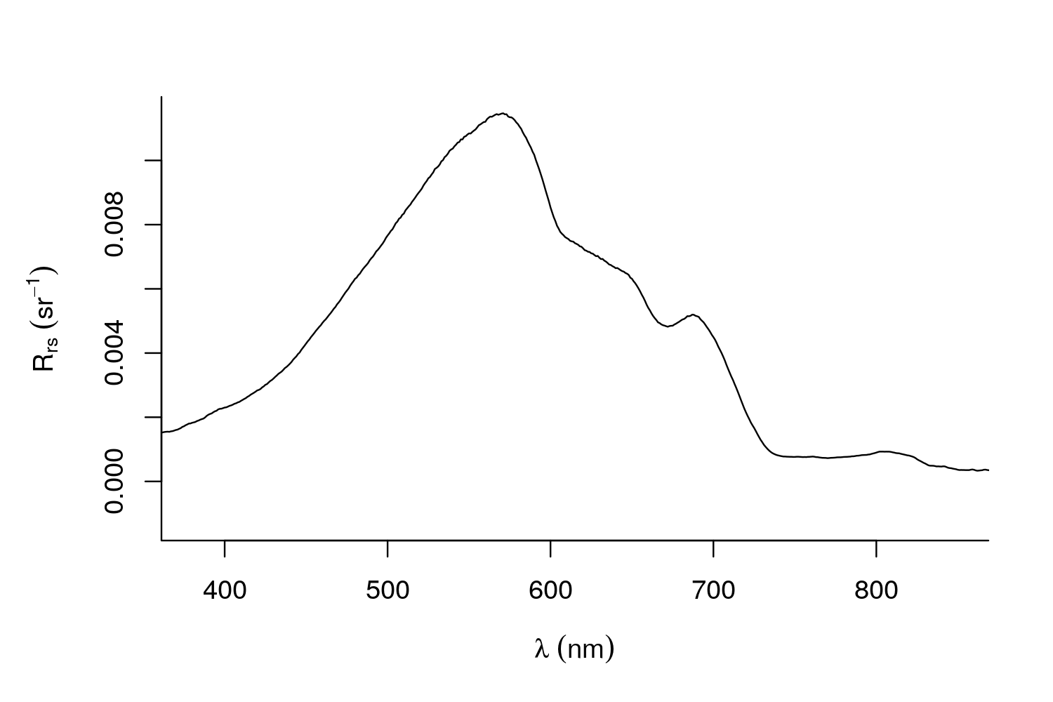
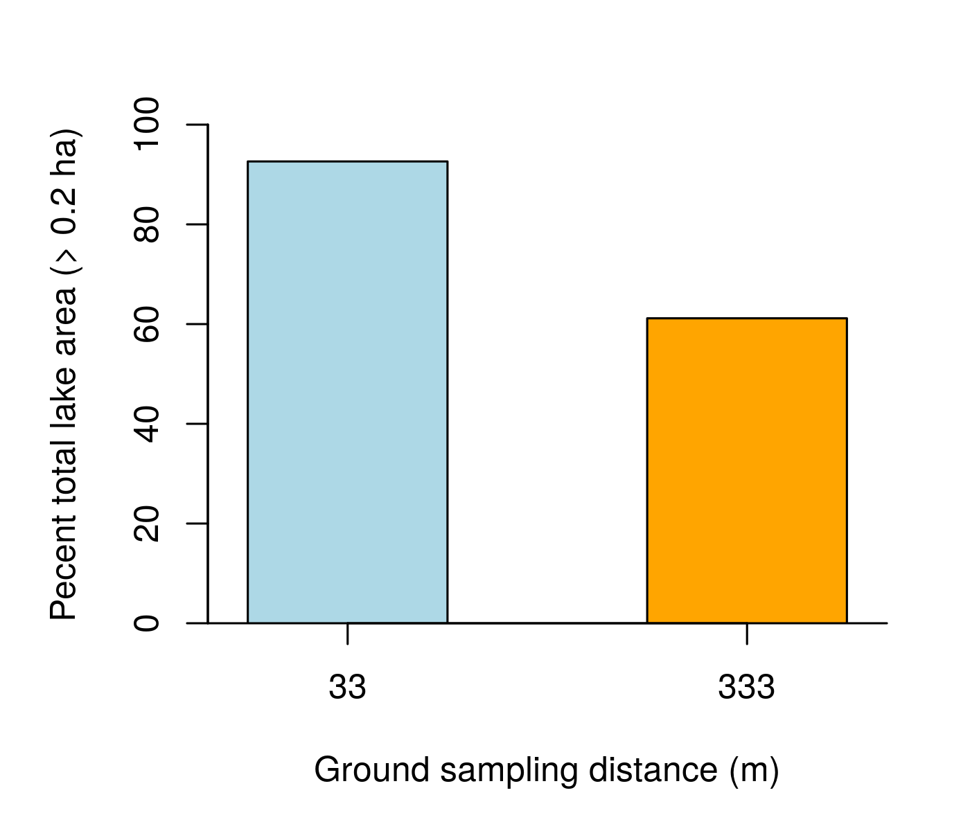
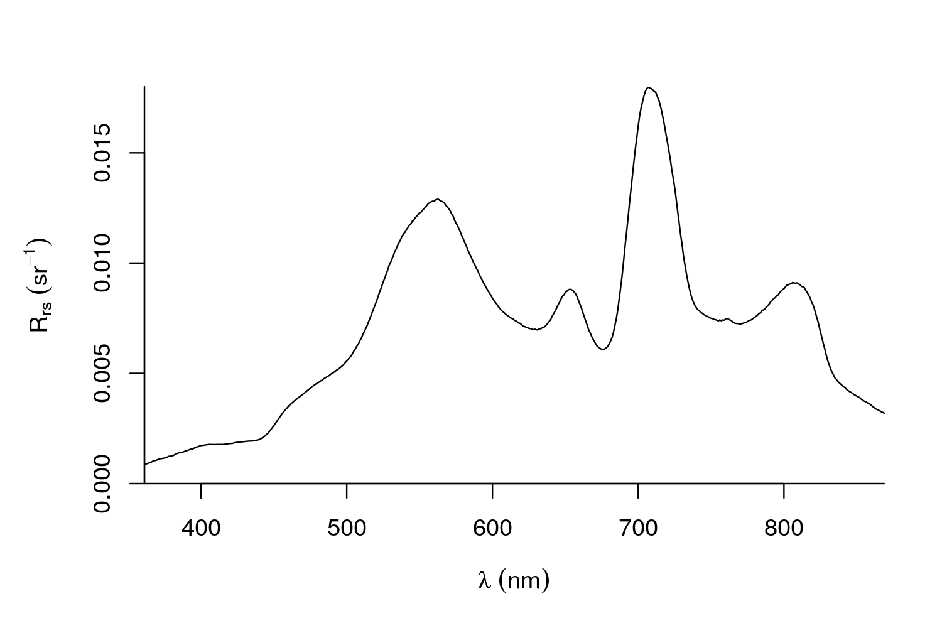
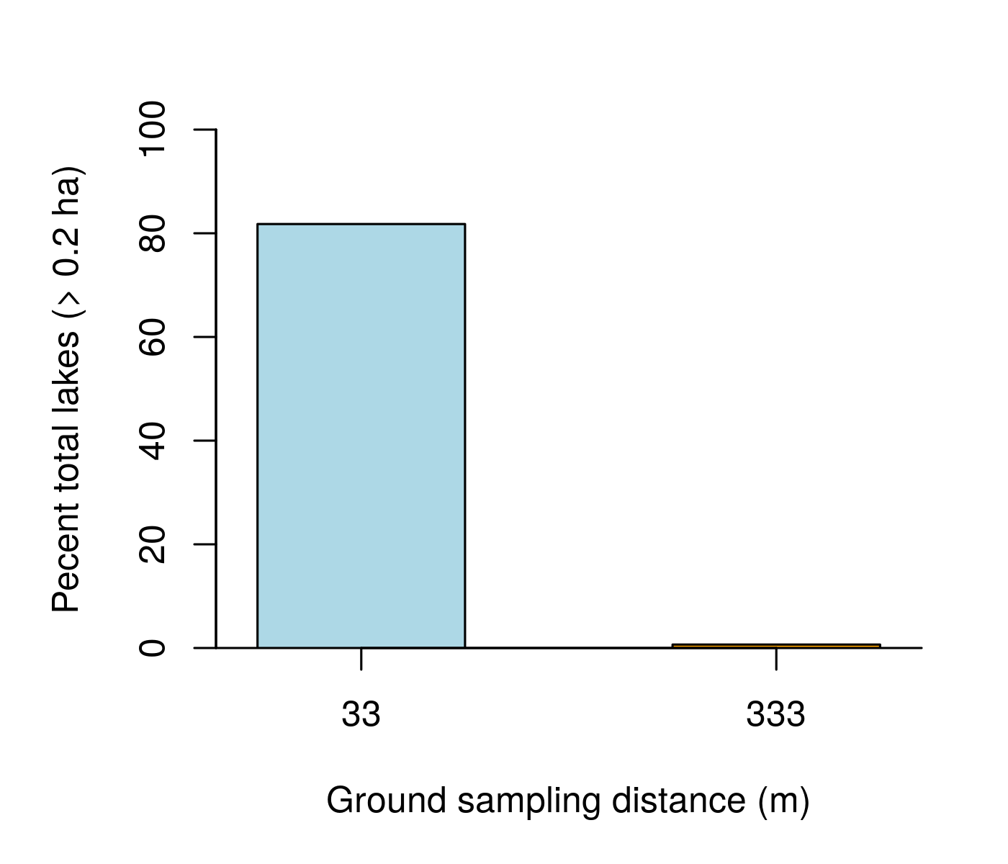
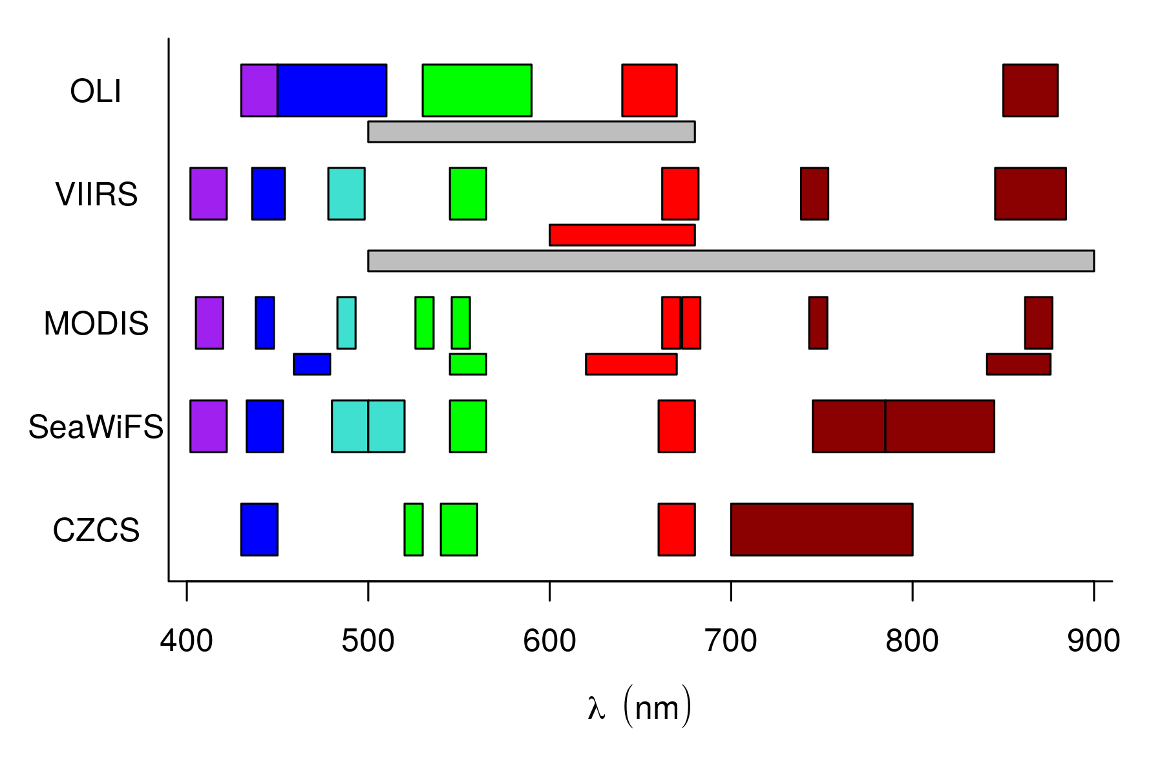
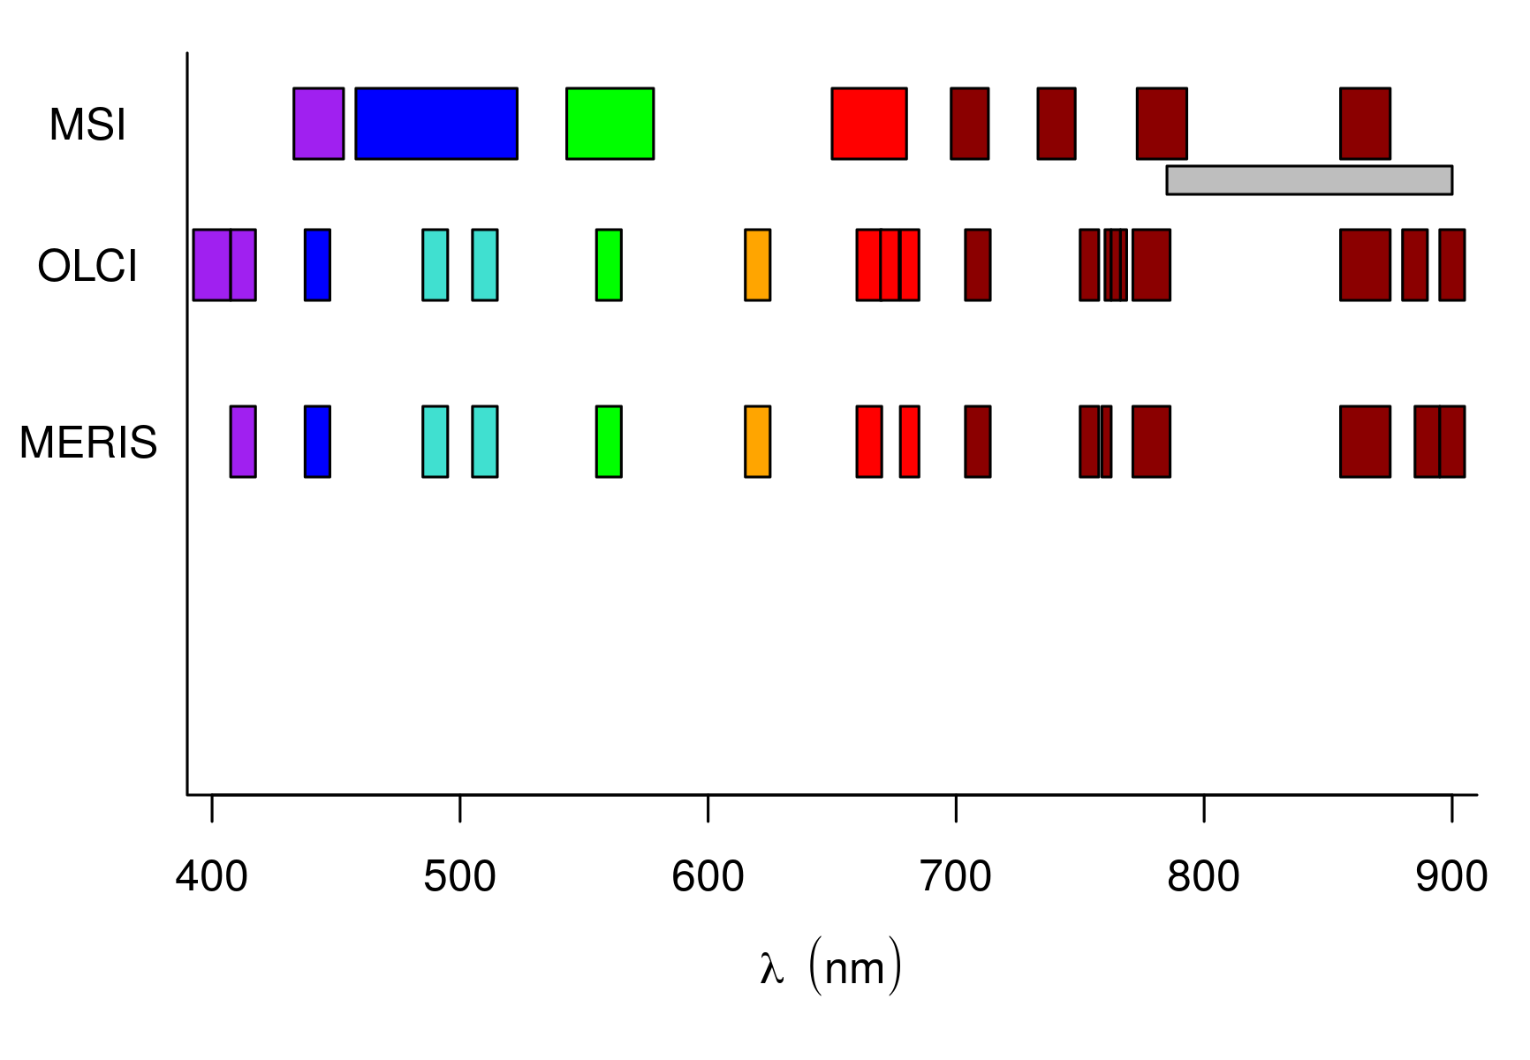
Motivation
CEOS 2018
GSD < 33 m
Objective +
Budget +
Engineering

Slide 5
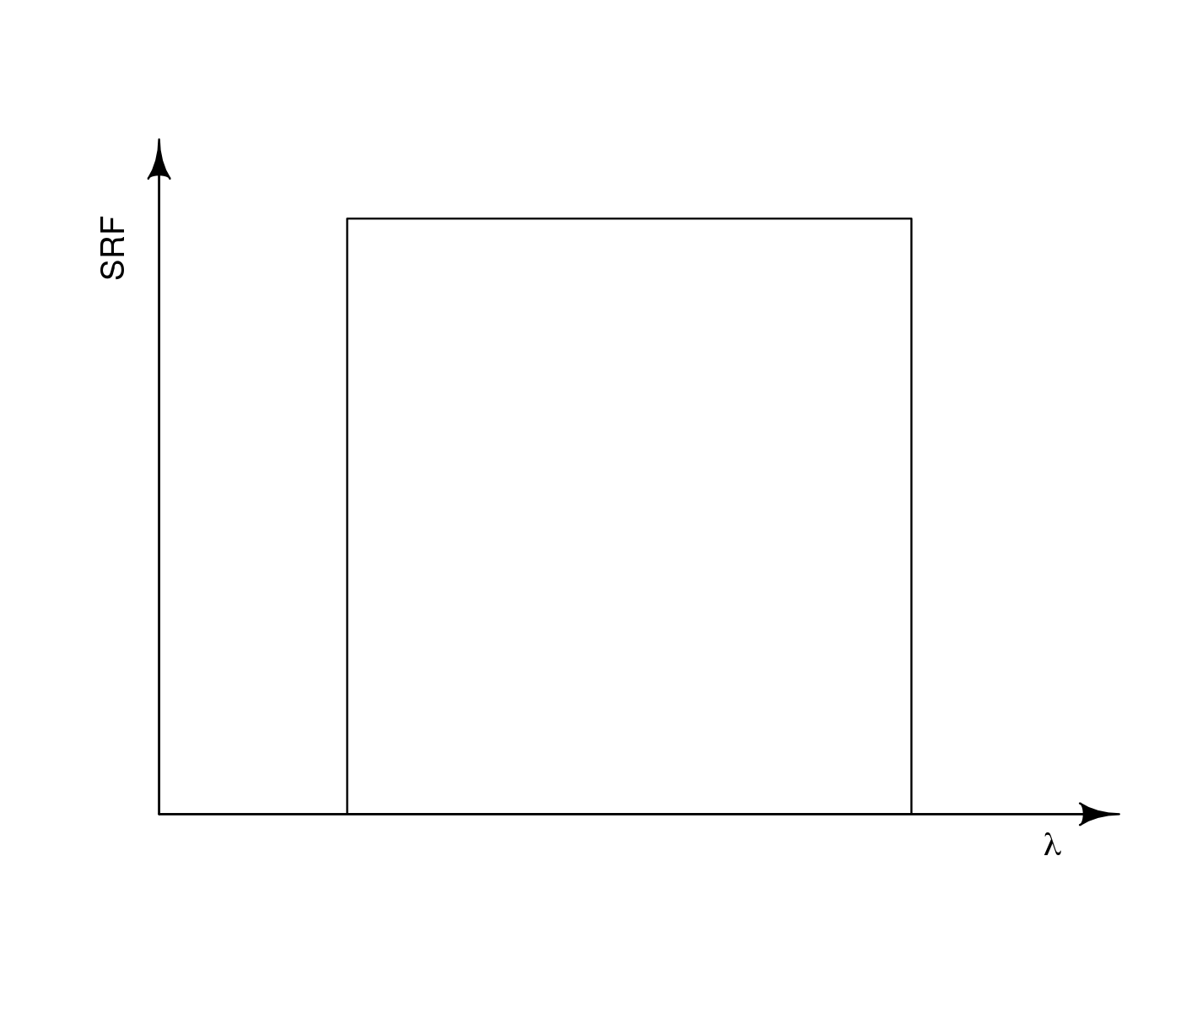
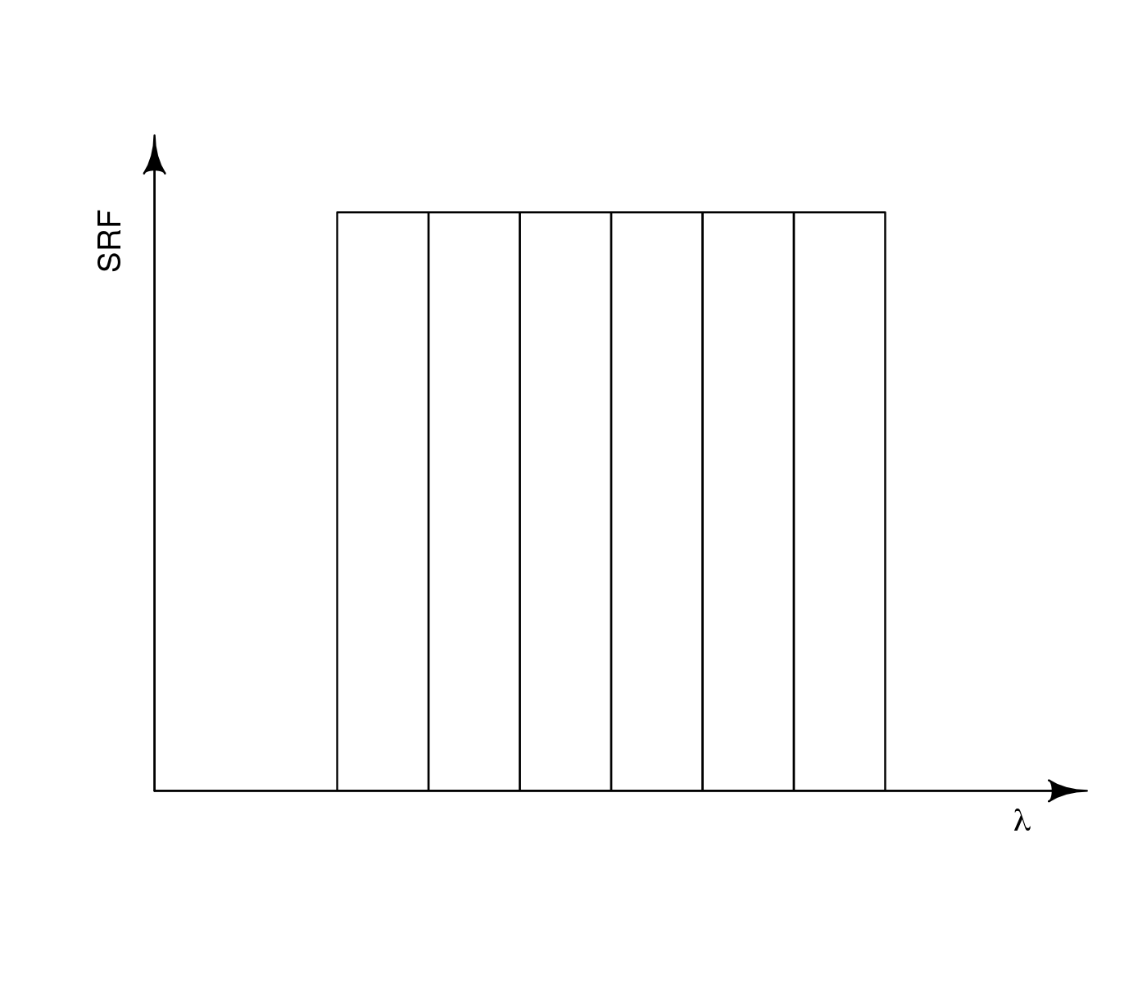
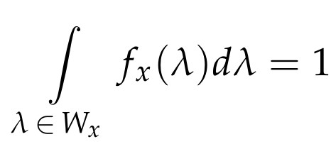
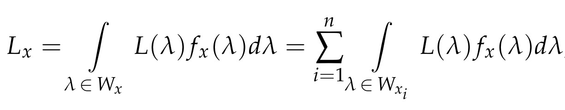

The contra-band concept
Virtual bands:
Interpolation with regression (Wernand et al., 1997);
Extrapolation with spectral matching (Wei et al., 2019);
Extraction with contra-bands (Castagna et al., 2020);

Slide 6
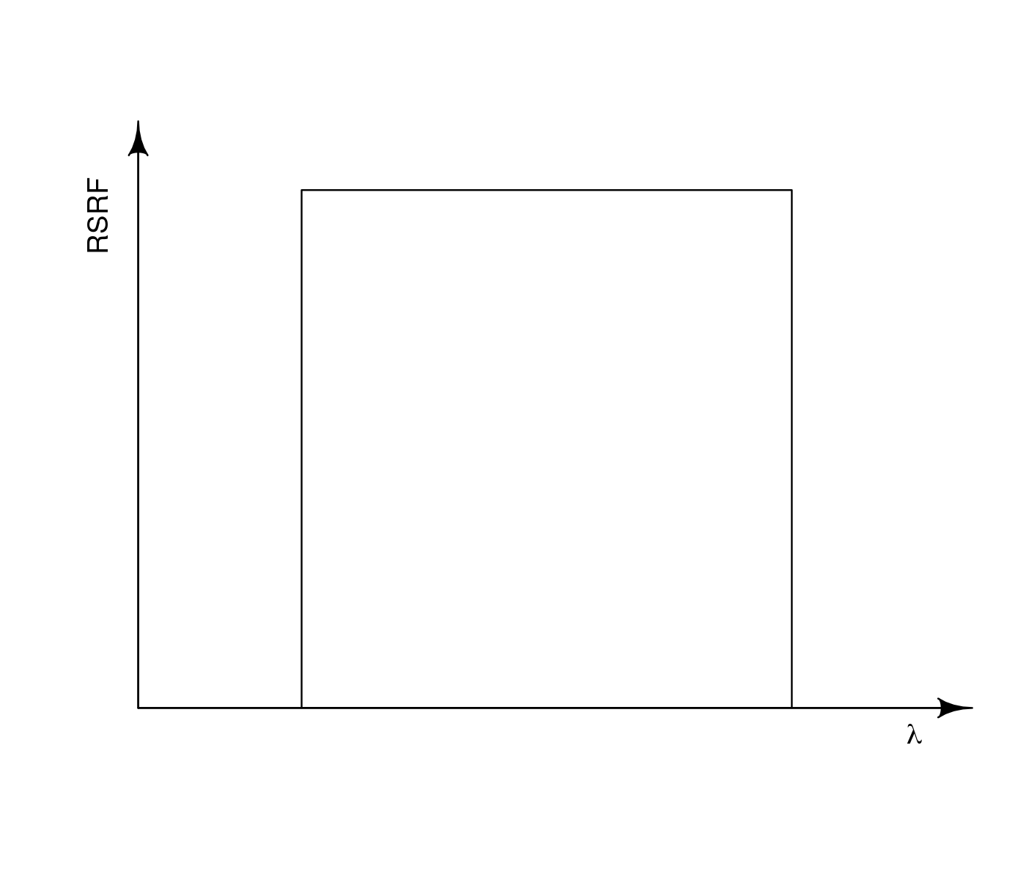
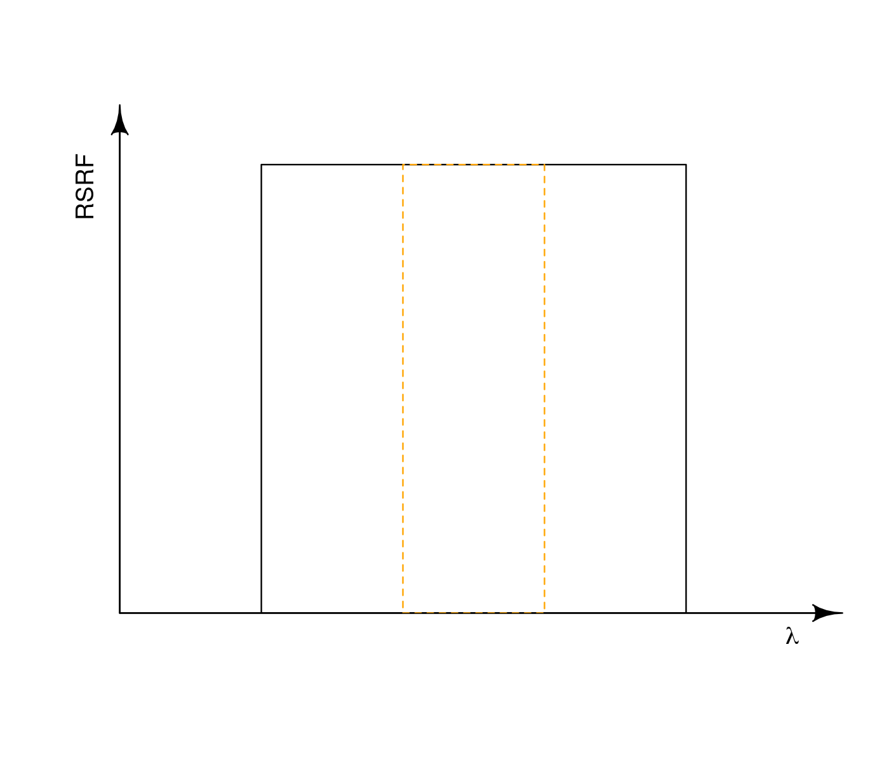
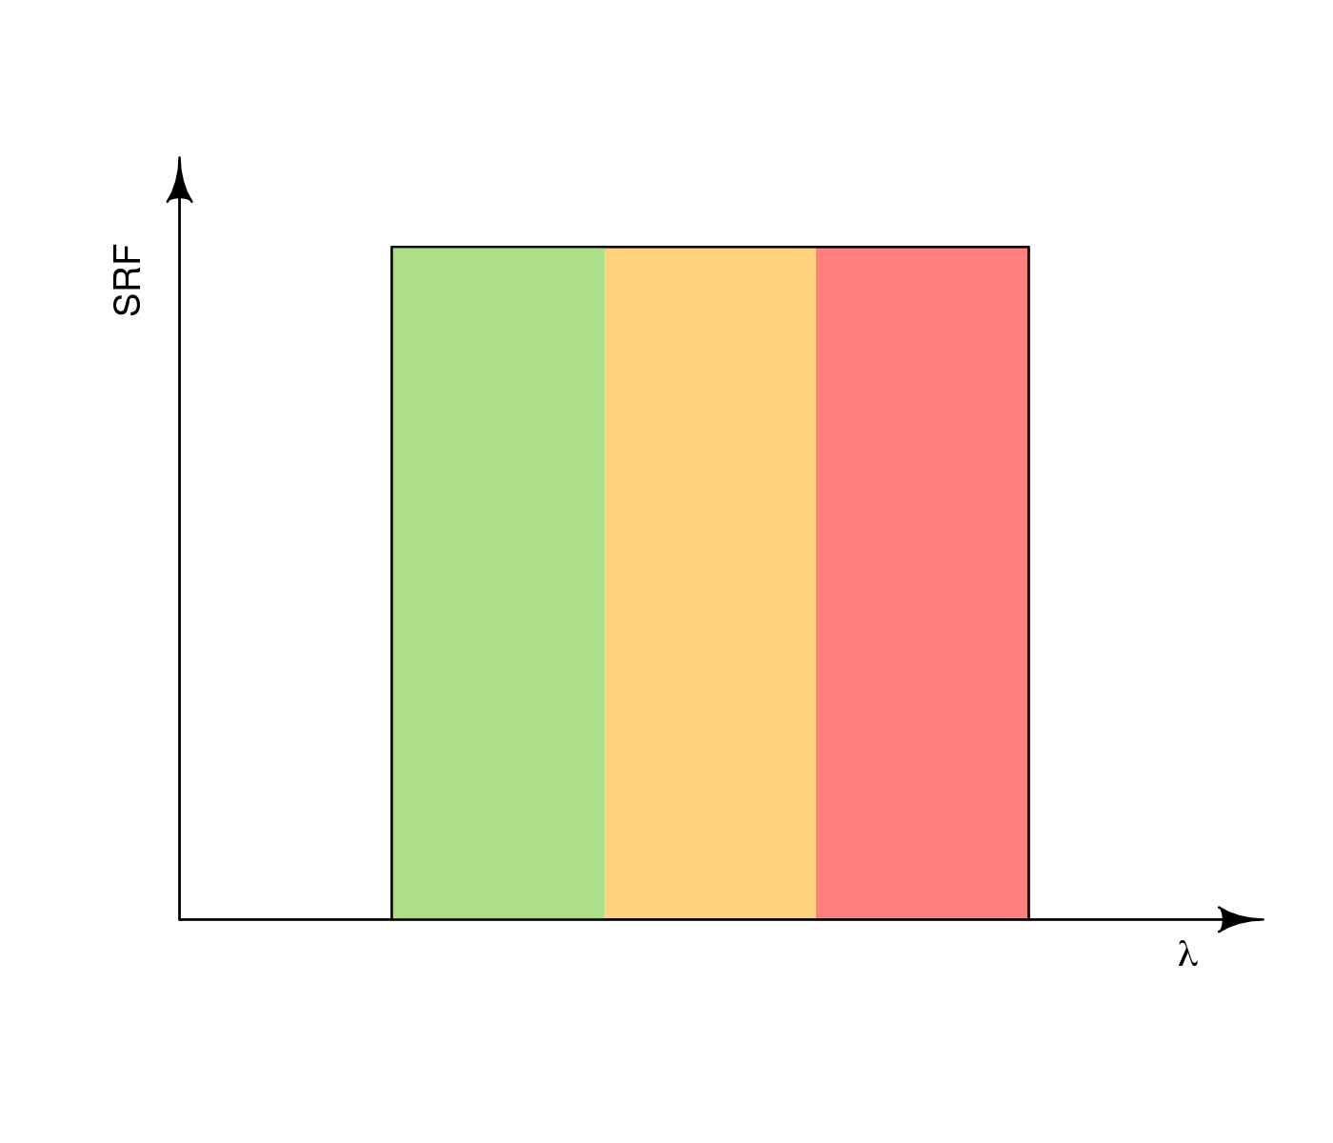
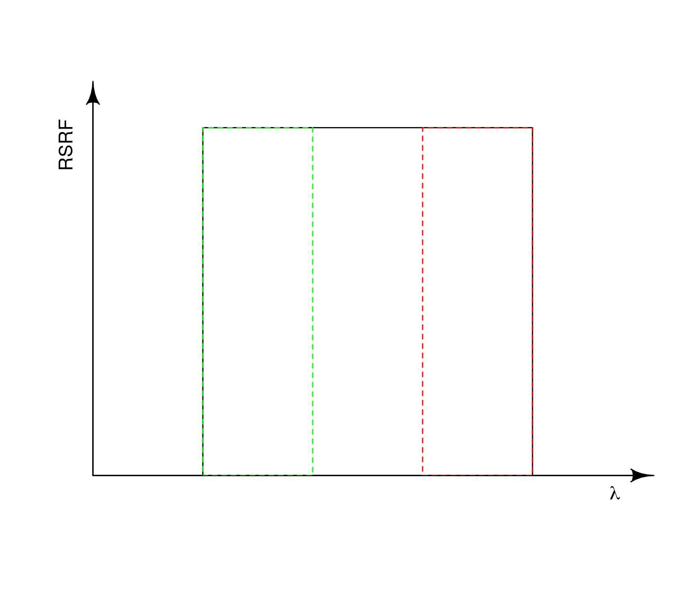
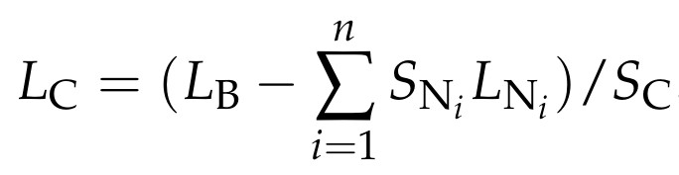
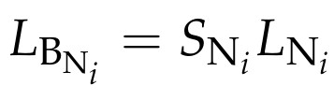

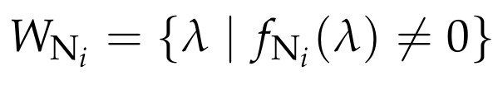
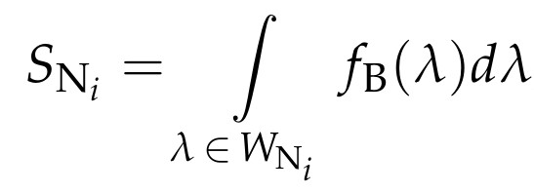
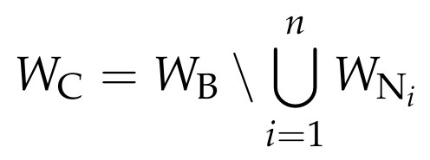
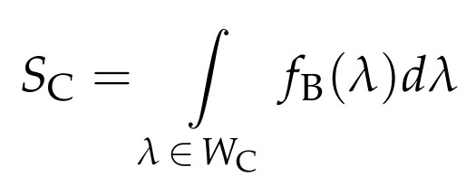
The contra-band concept
Individual bands
The analytical contra-band equation:
Regions of the broader band
0.333
0.333
0.333

Slide 7
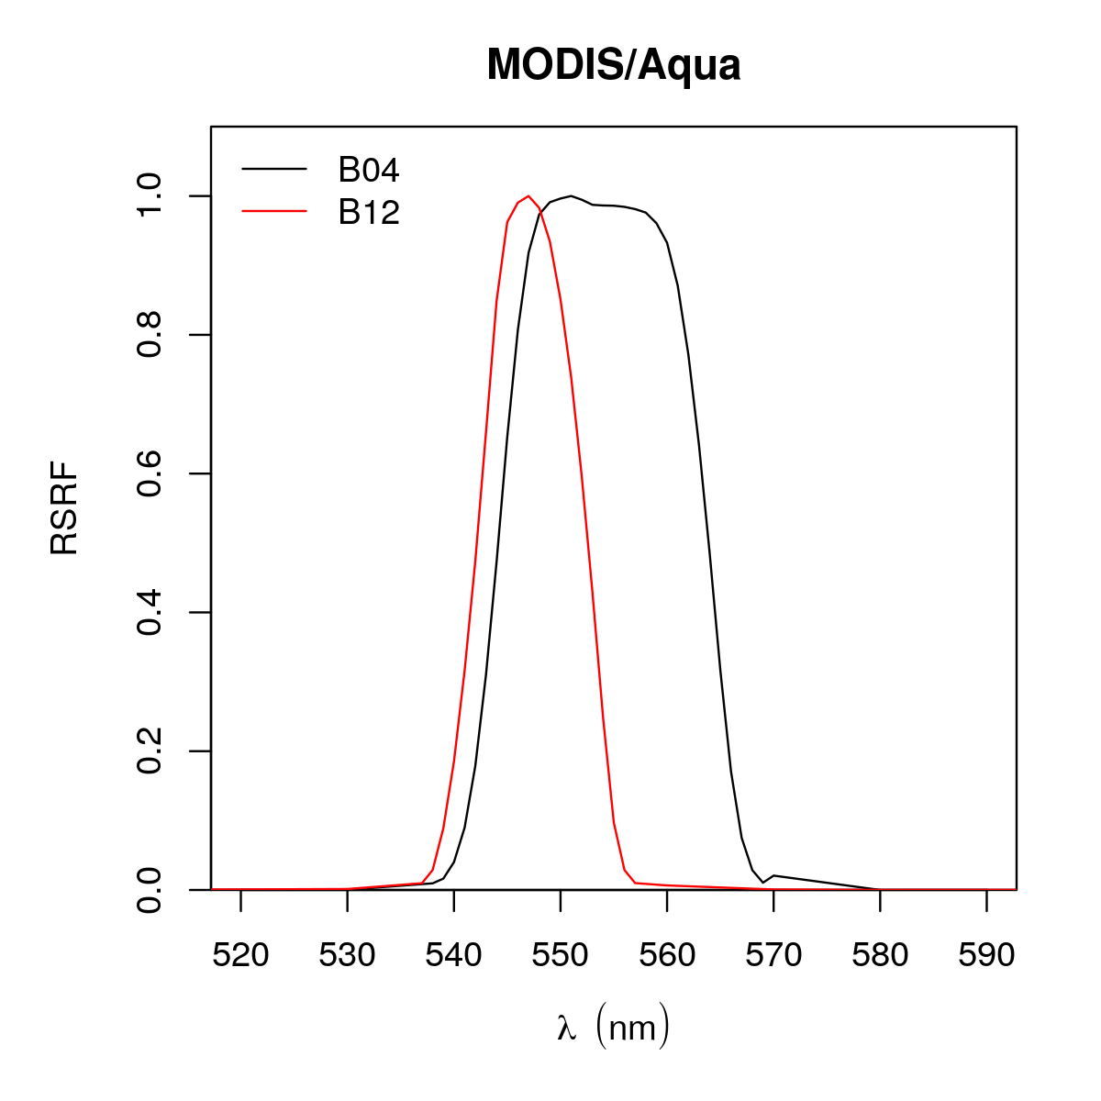
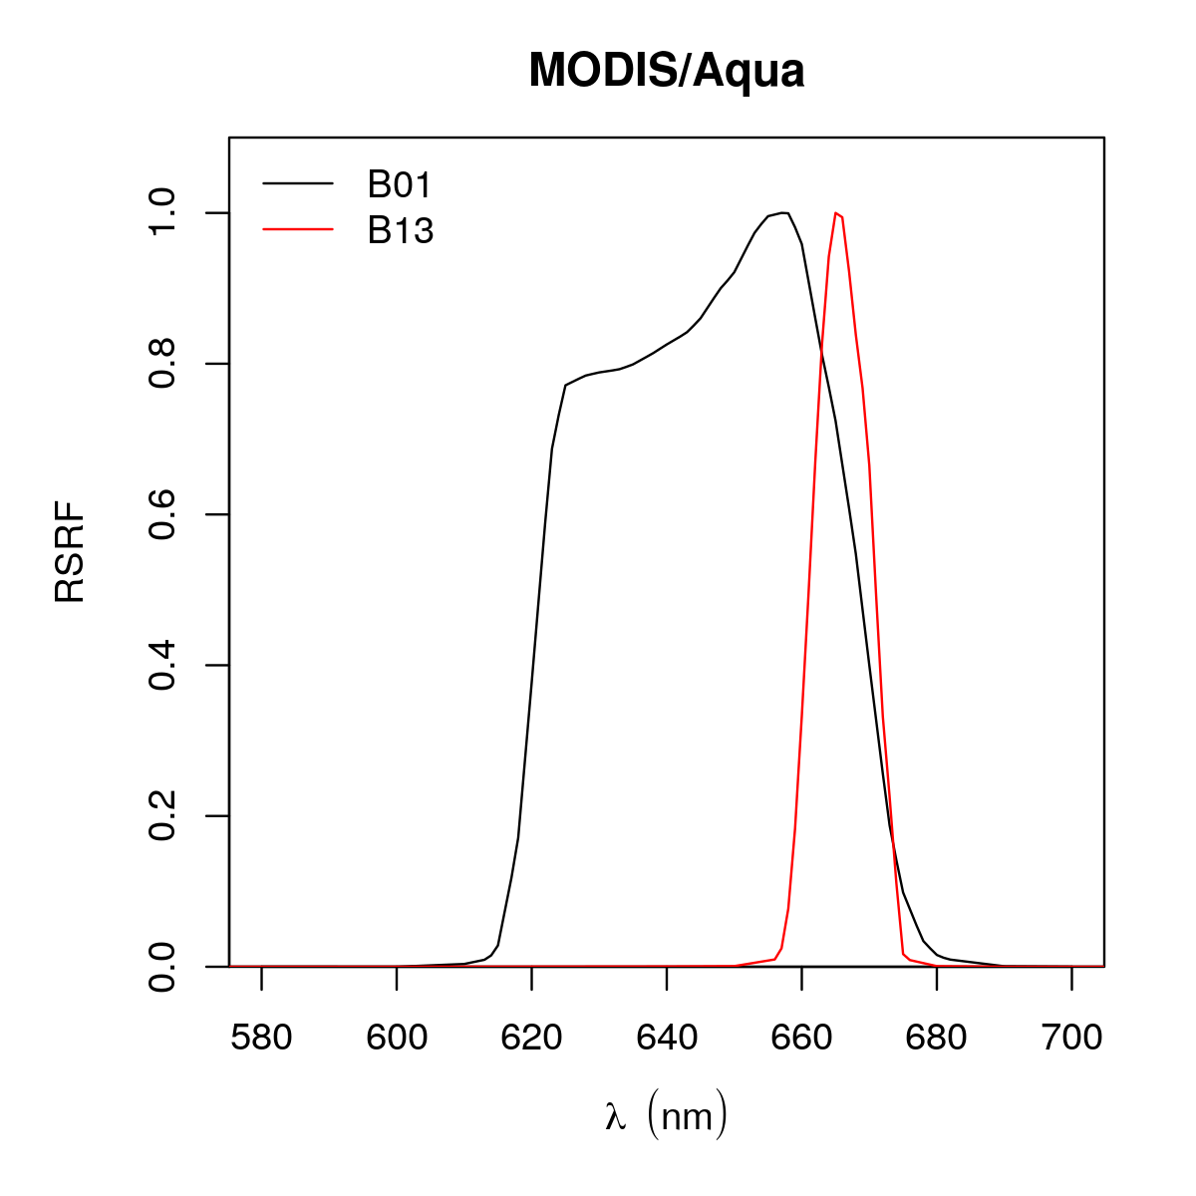
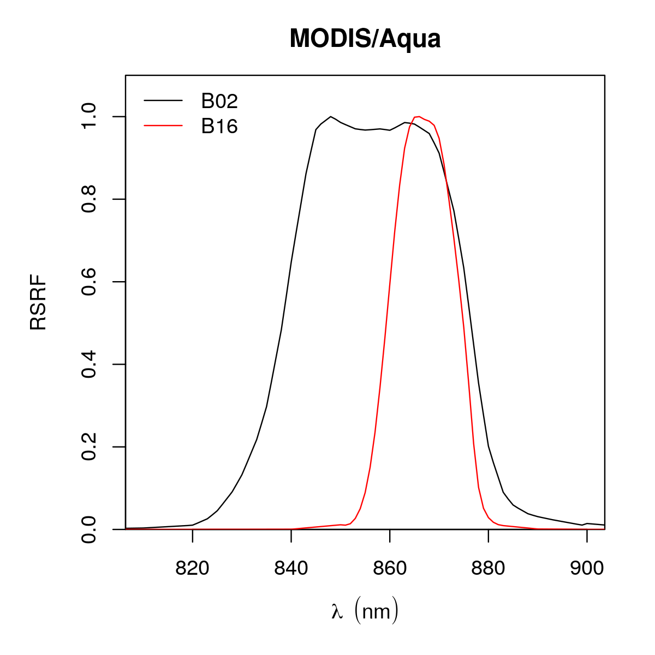
The contra-band concept
1) The relative spectral profiles of the SRFs are equivalent within their overlapping regions;
2) The spectrally narrower band(s) is(are) completely contained in the broader band;
3) There is no superposition between the narrower bands;
4) Measurements of the overlapping bands are collocated in space and time.
No real sensor completly fulfill those requirements, but the equation will be appropriate if requirements are met to a good approximation.
PE
PC
?
MODIS/Aqua bands

Slide 8
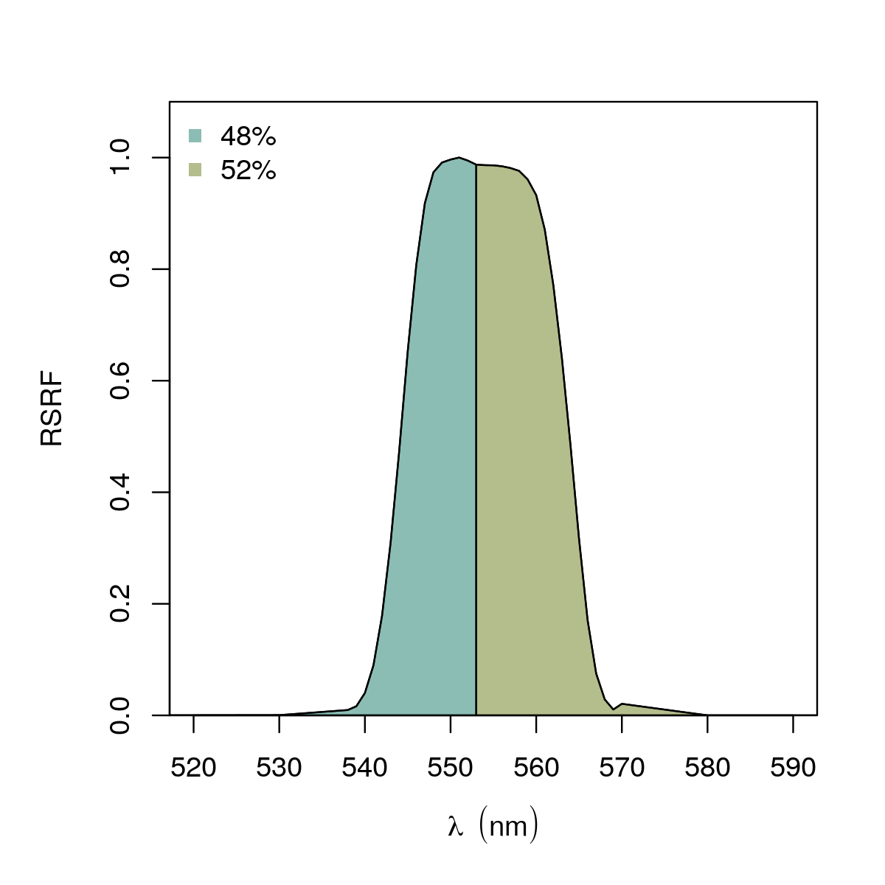
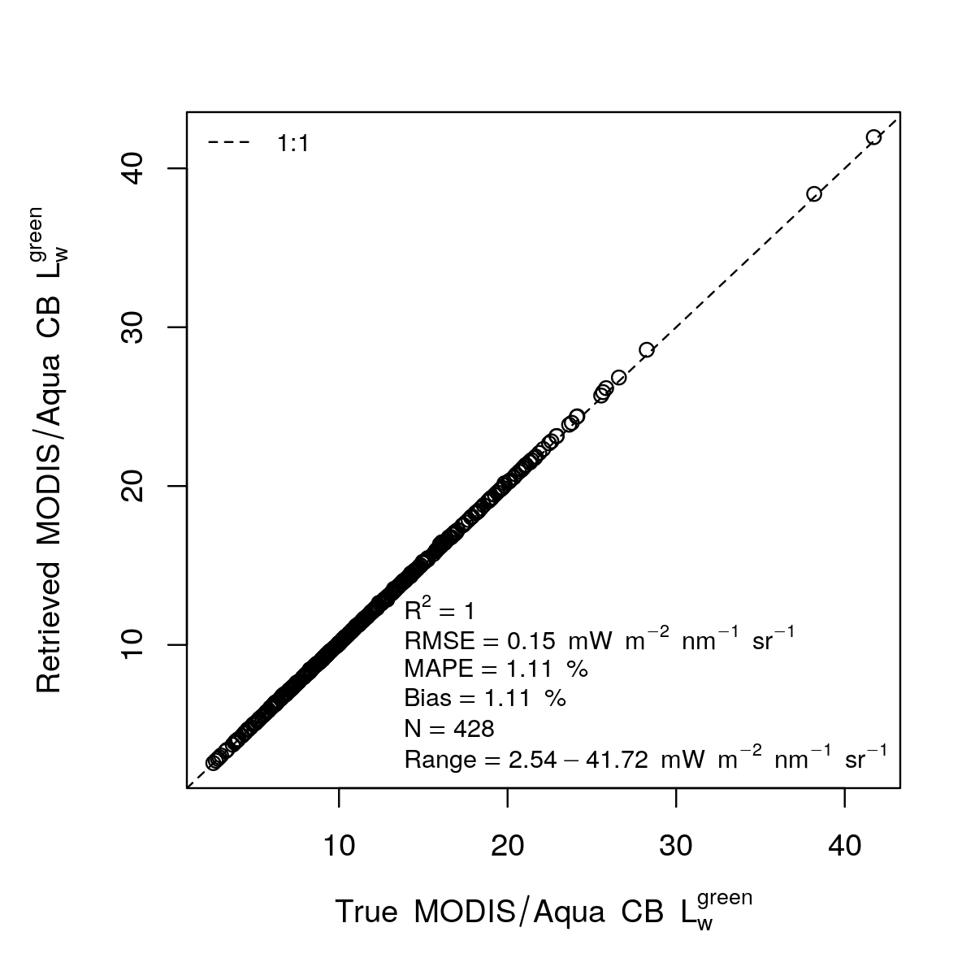
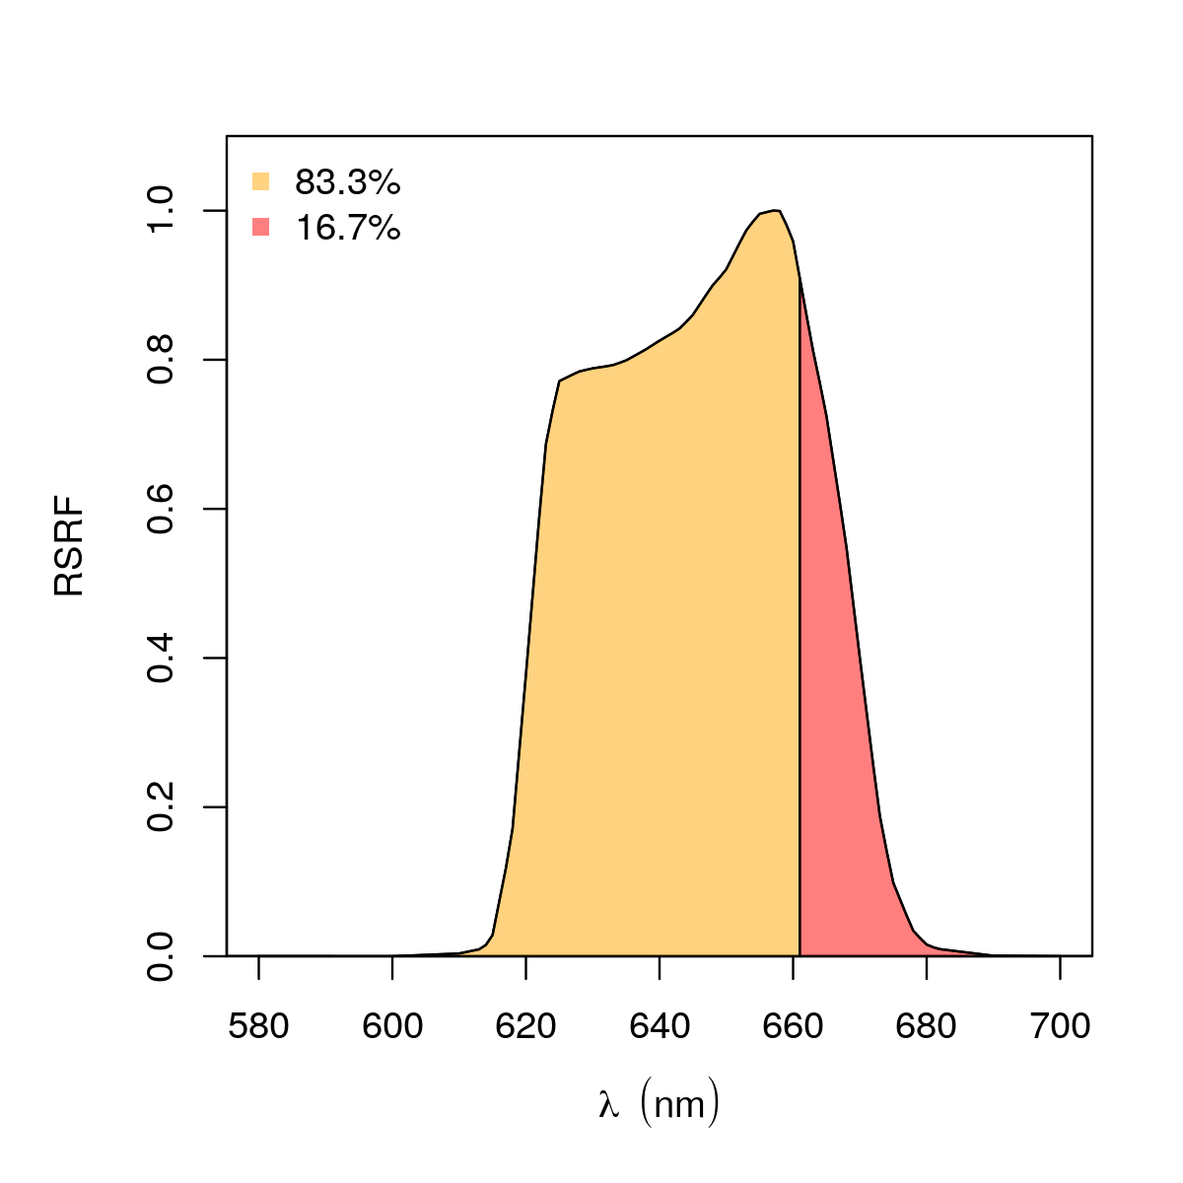
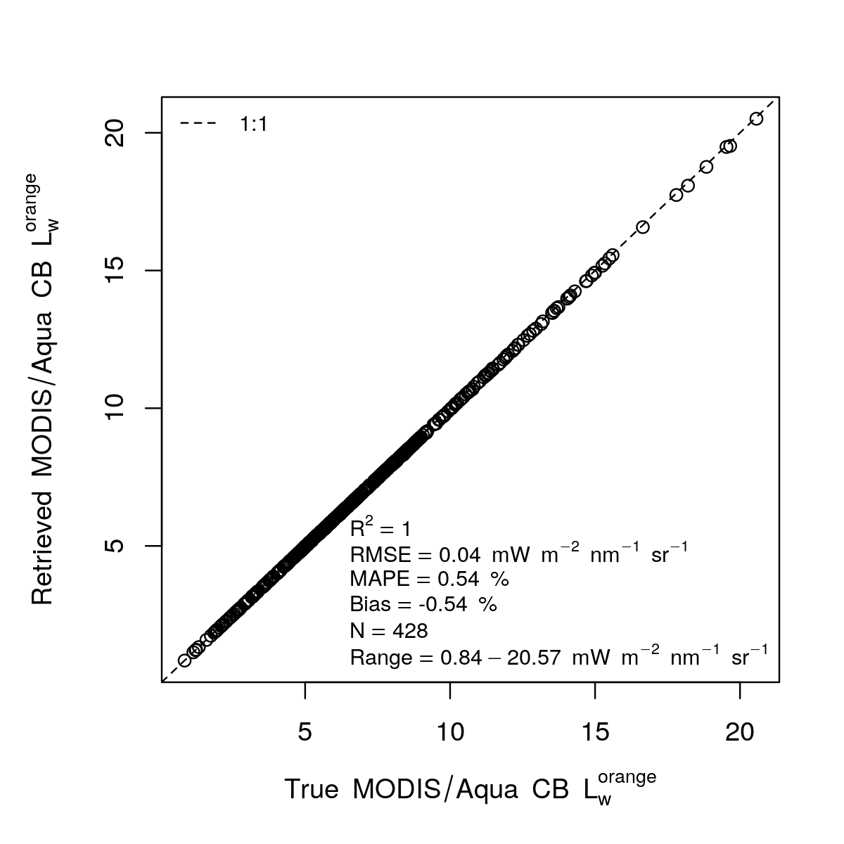
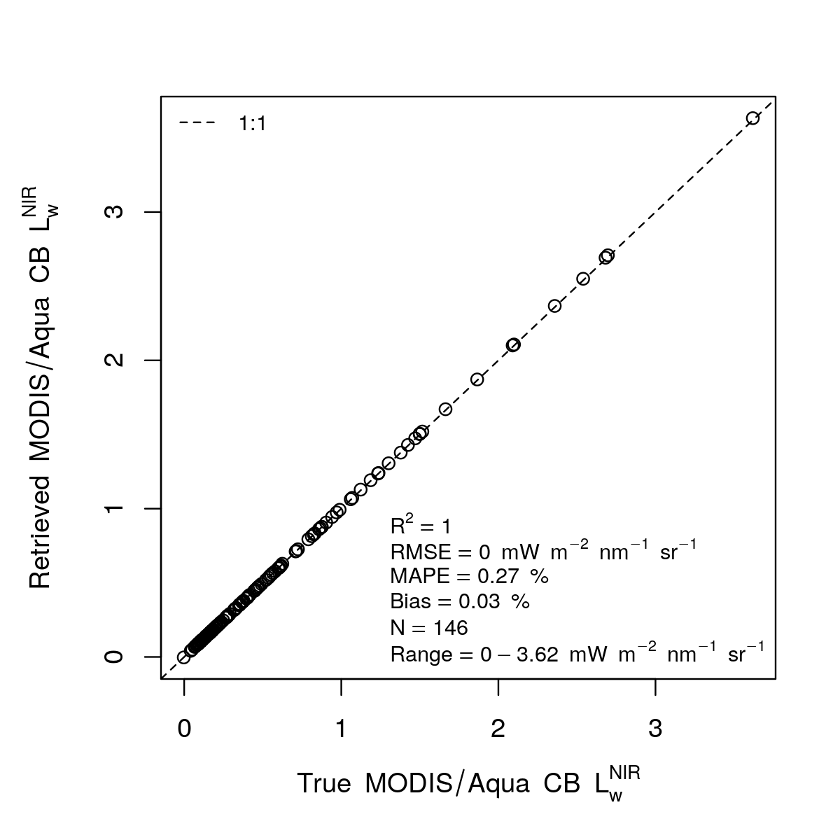
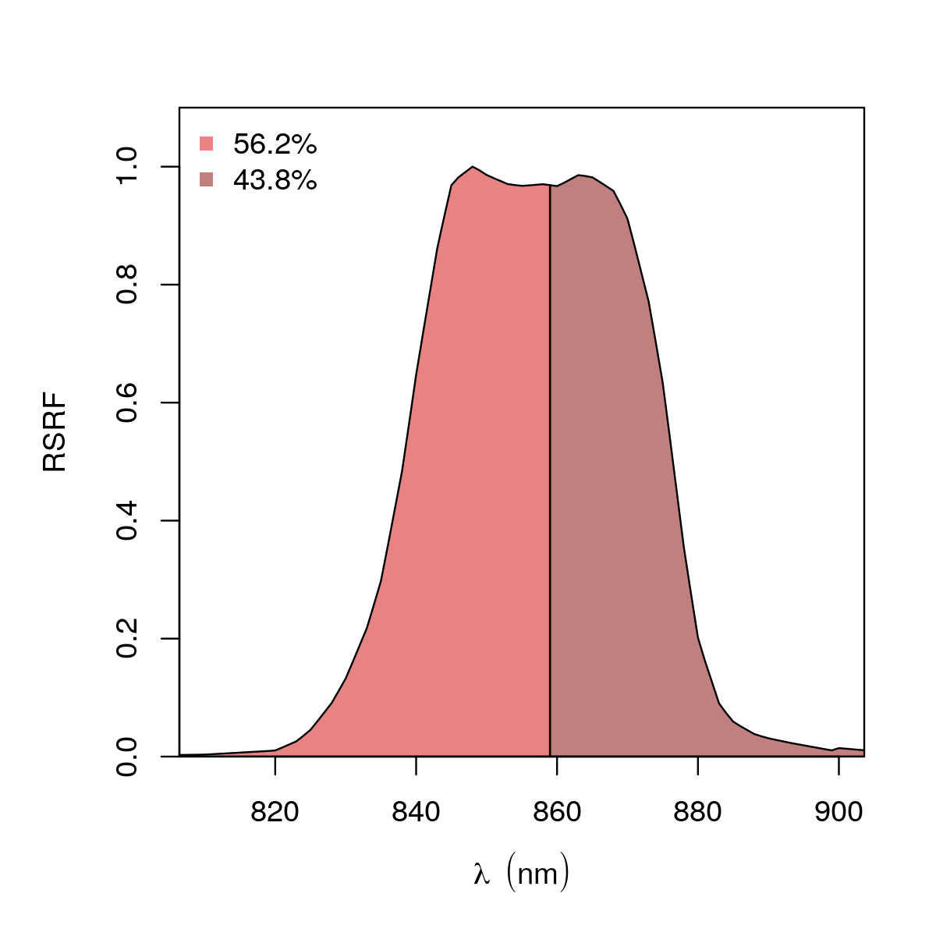
The contra-band concept
The relative spectral profiles of the SRFs are equivalent within their overlapping regions;
The spectrally narrower band(s) is(are) completely contained in the broader band;
There is no superposition between the narrower bands;
Measurements of the overlapping bands are collocated in space and time.
No real sensor completly fulfill those requirements, but the equation will be appropriate if requirements are met to a good approximation.
MODIS/Aqua bands

Slide 9
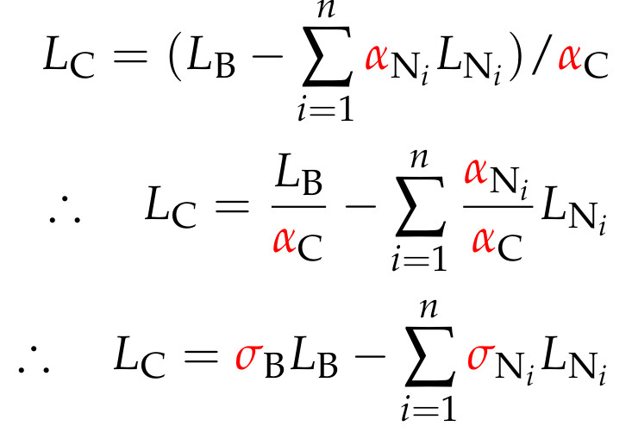
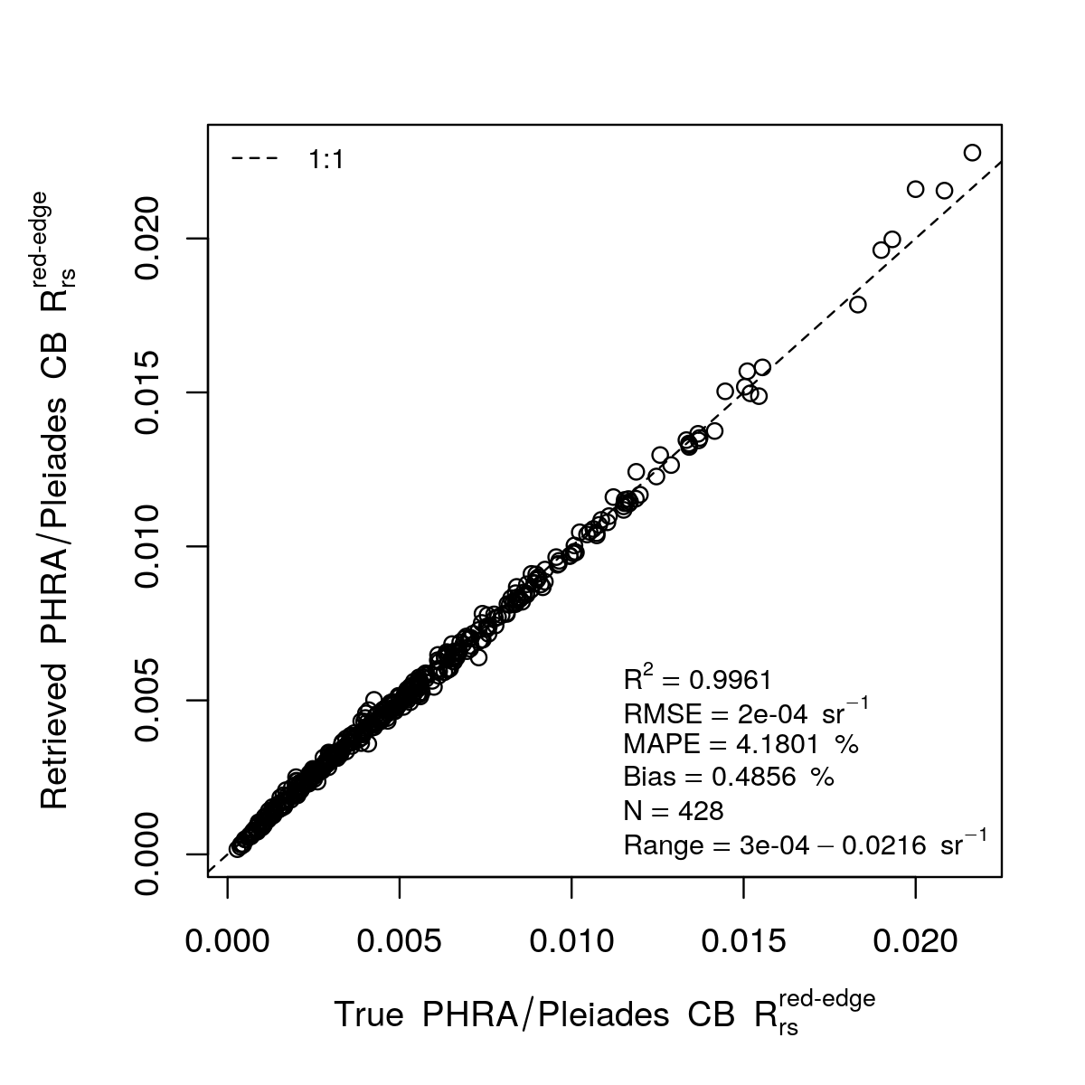
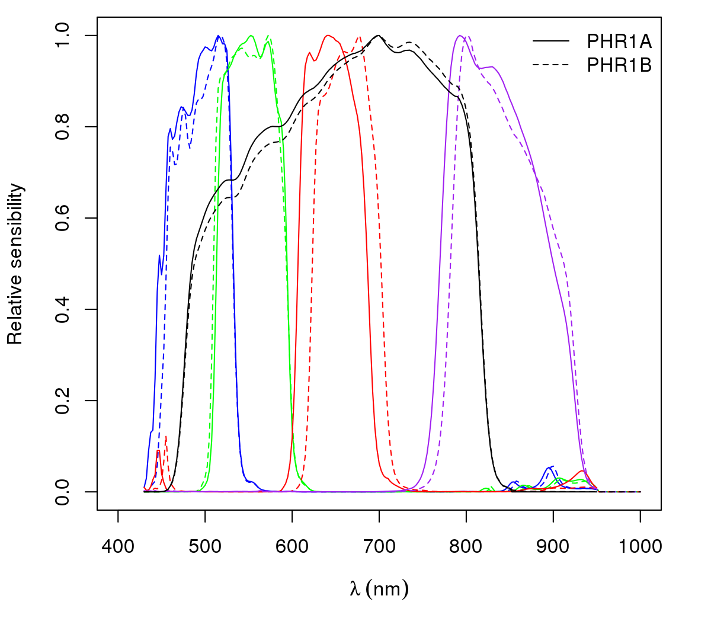
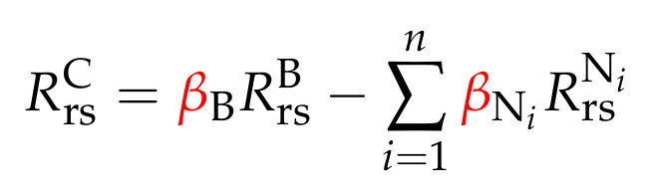
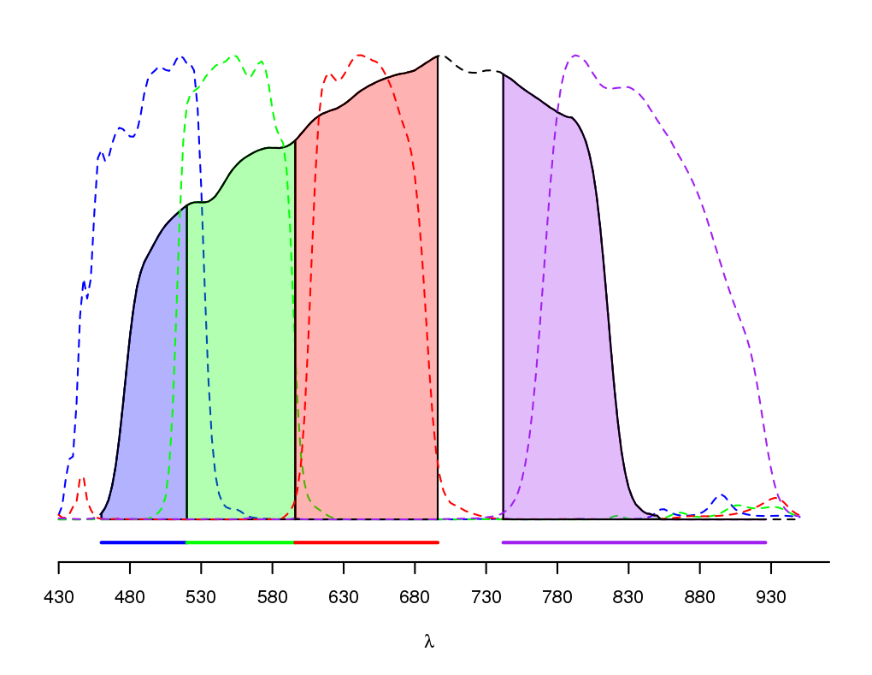
the Contra-band concept
The semi-empirical
contra-band equation:
Pleiades:
Derivation only stricly valid in radiance space, but if coefficients have to be estimated, approximate application in reflectance space will reduce the errors by increasing the covariance.
Since a regression is used, is possible to specify the subregion of the retrieval, as long as available information is representative.

Slide 10
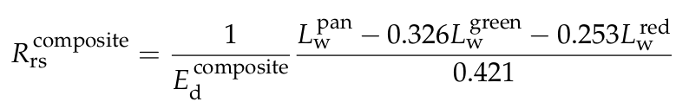
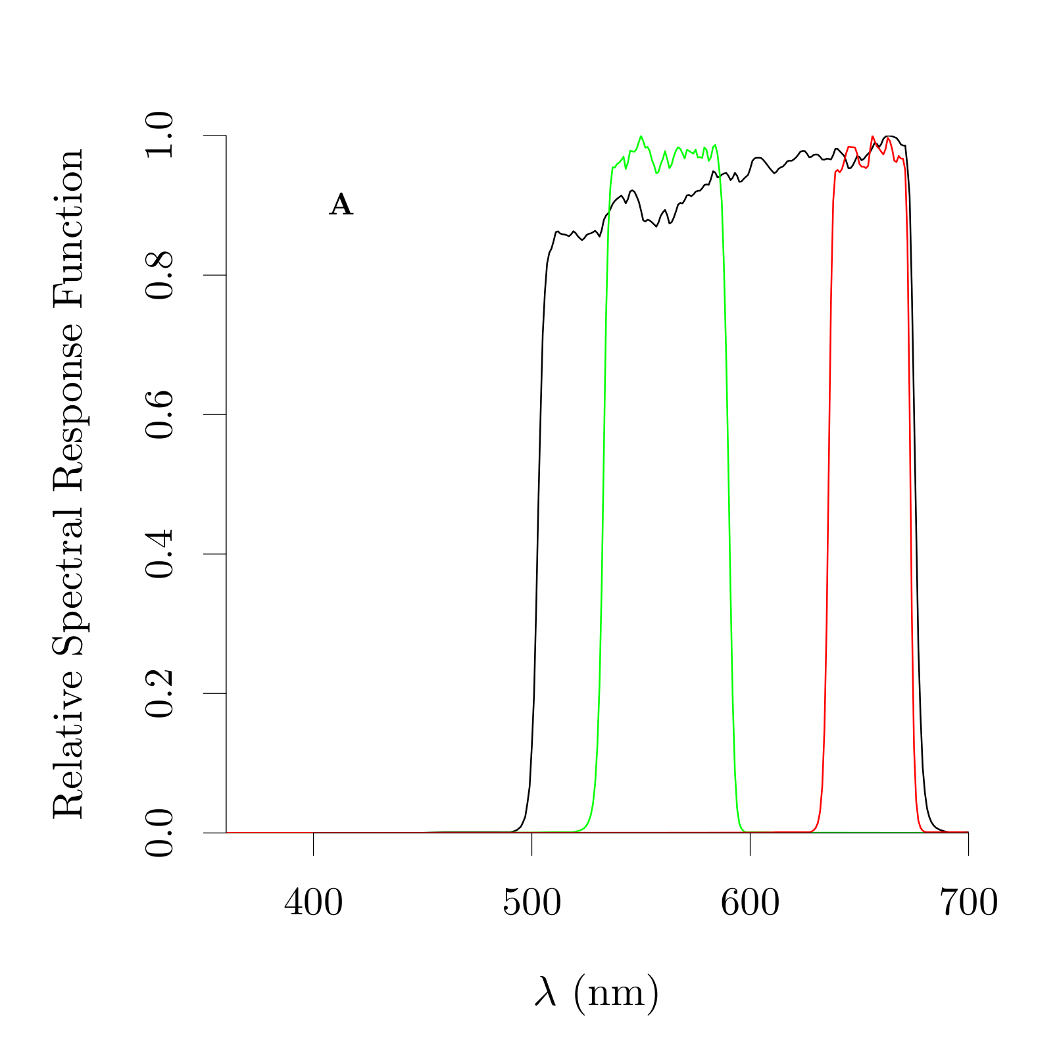
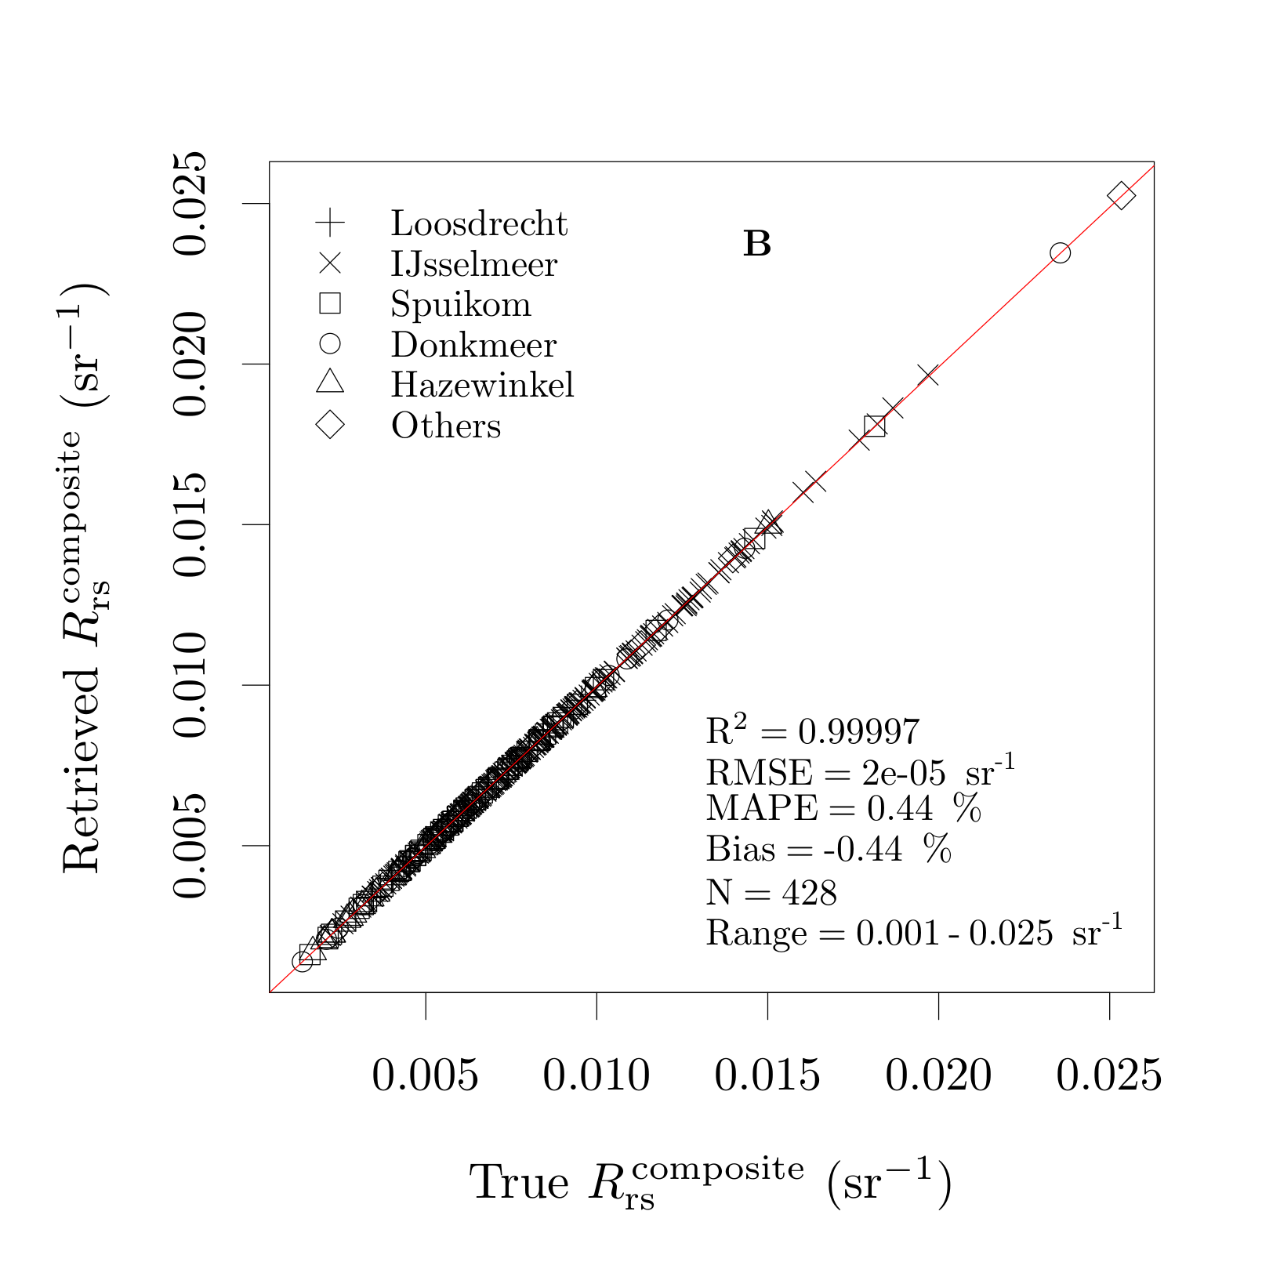
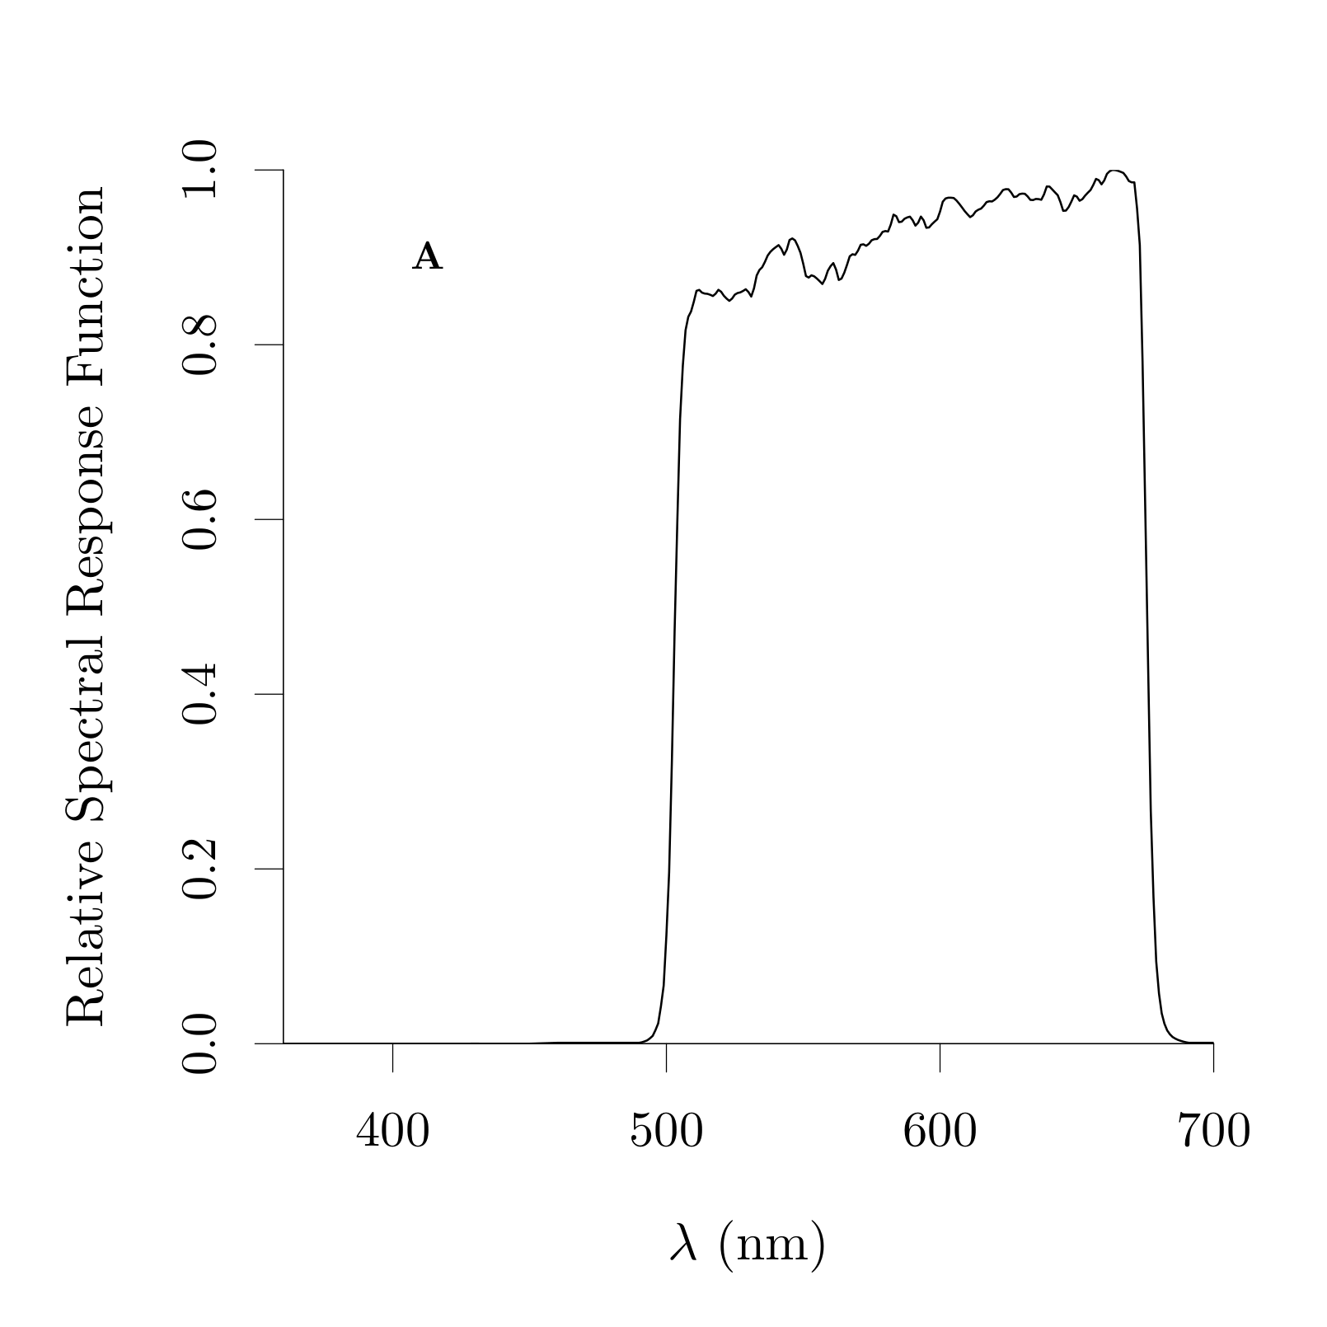
The OLI orange contra-band
Composite contra-band:
1
503-533
+
3
590-635

Slide 11
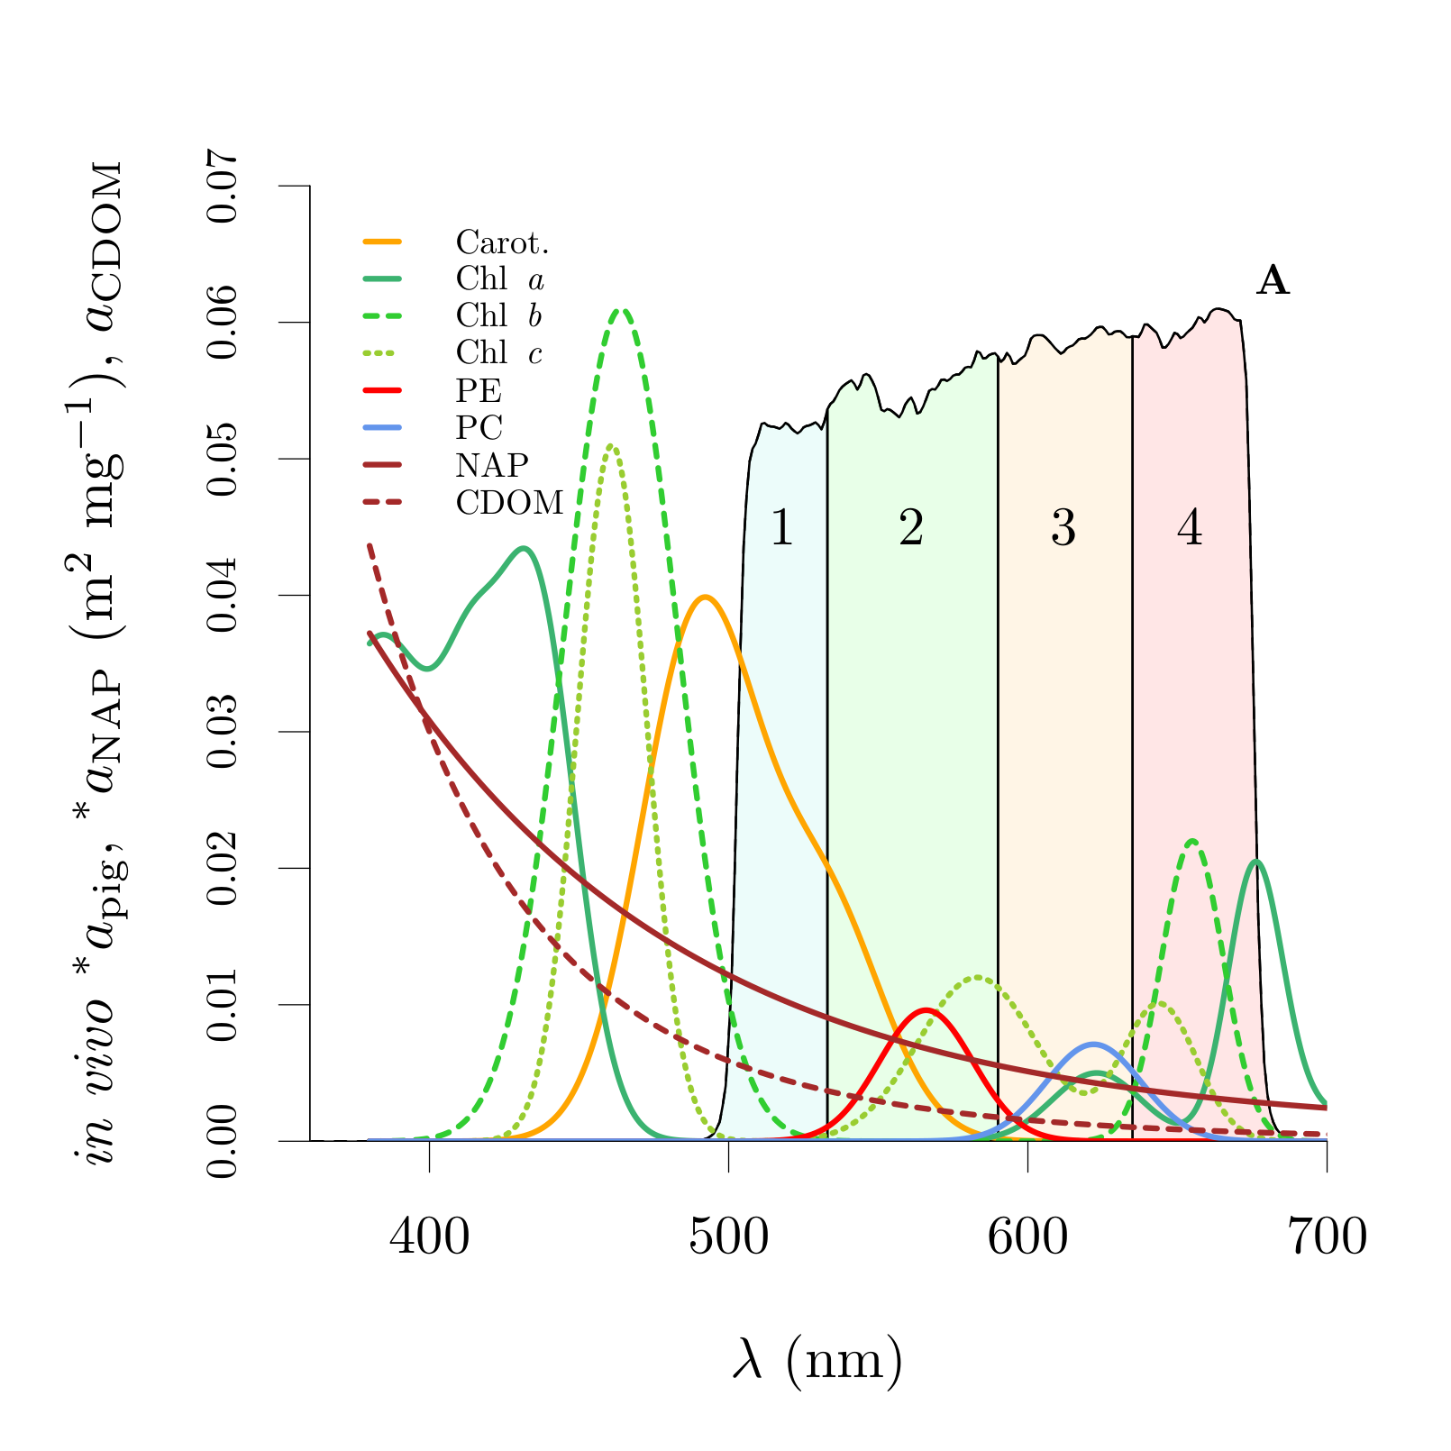
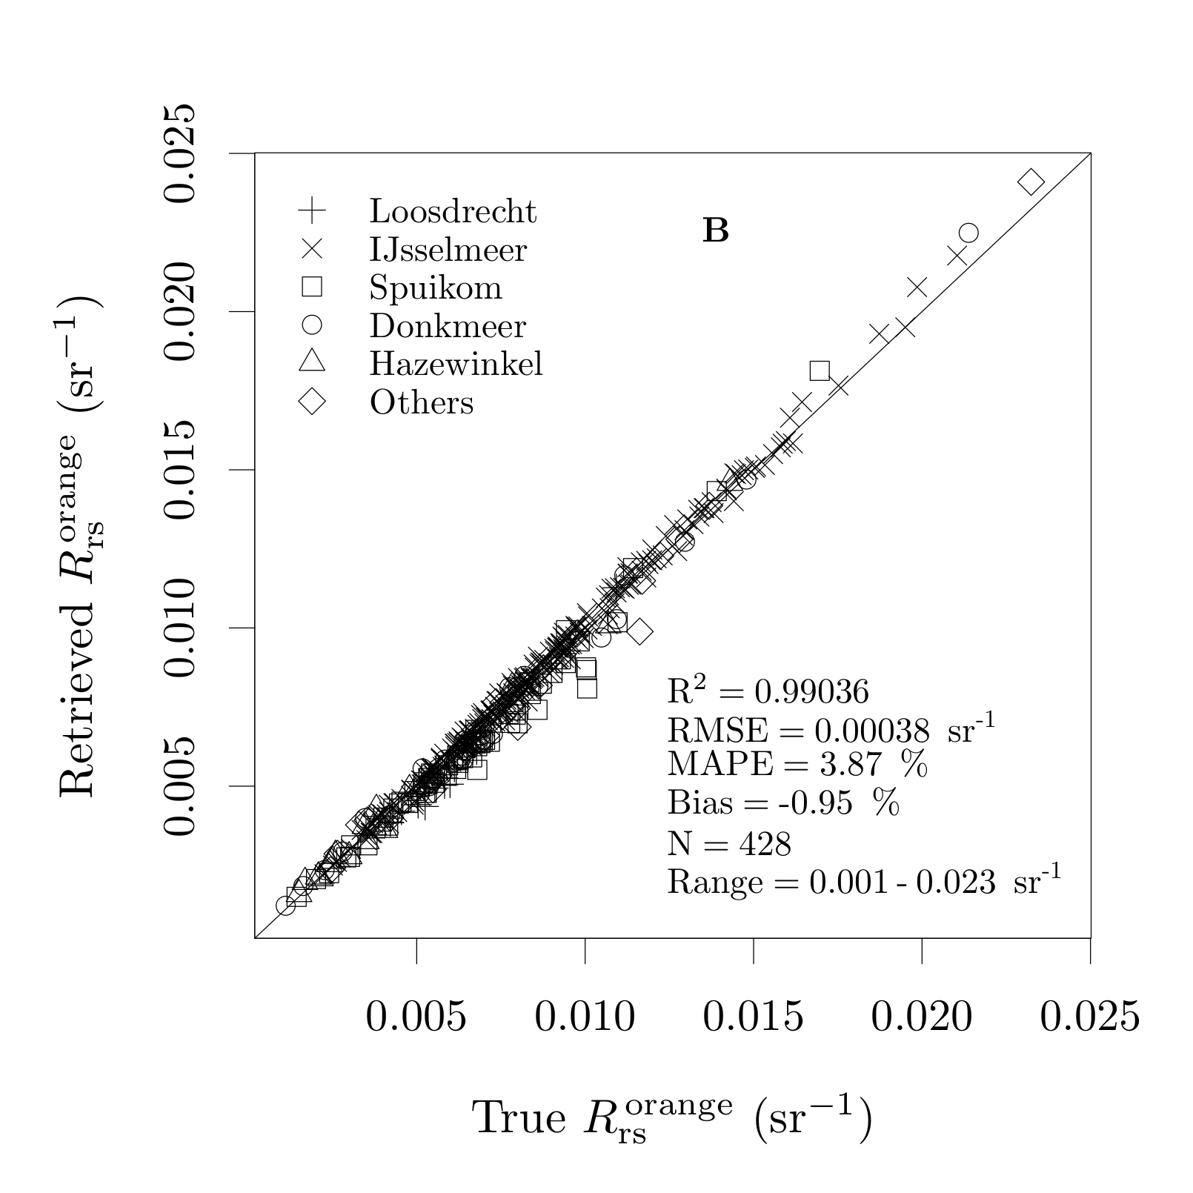
The OLI orange contra-band
Orange contra-band:
(5.7%)
(6.5%)
(36%)
Ordinary Least Squares (OLS) to random subset of half the dataset (calibration);
Performance statistics with complementary half dataset (validation);
Repeated 10,000 times.
(x300)
RMSE
MAPE
Bias
(5.8%)
(4.4%)
(52%)

Slide 12
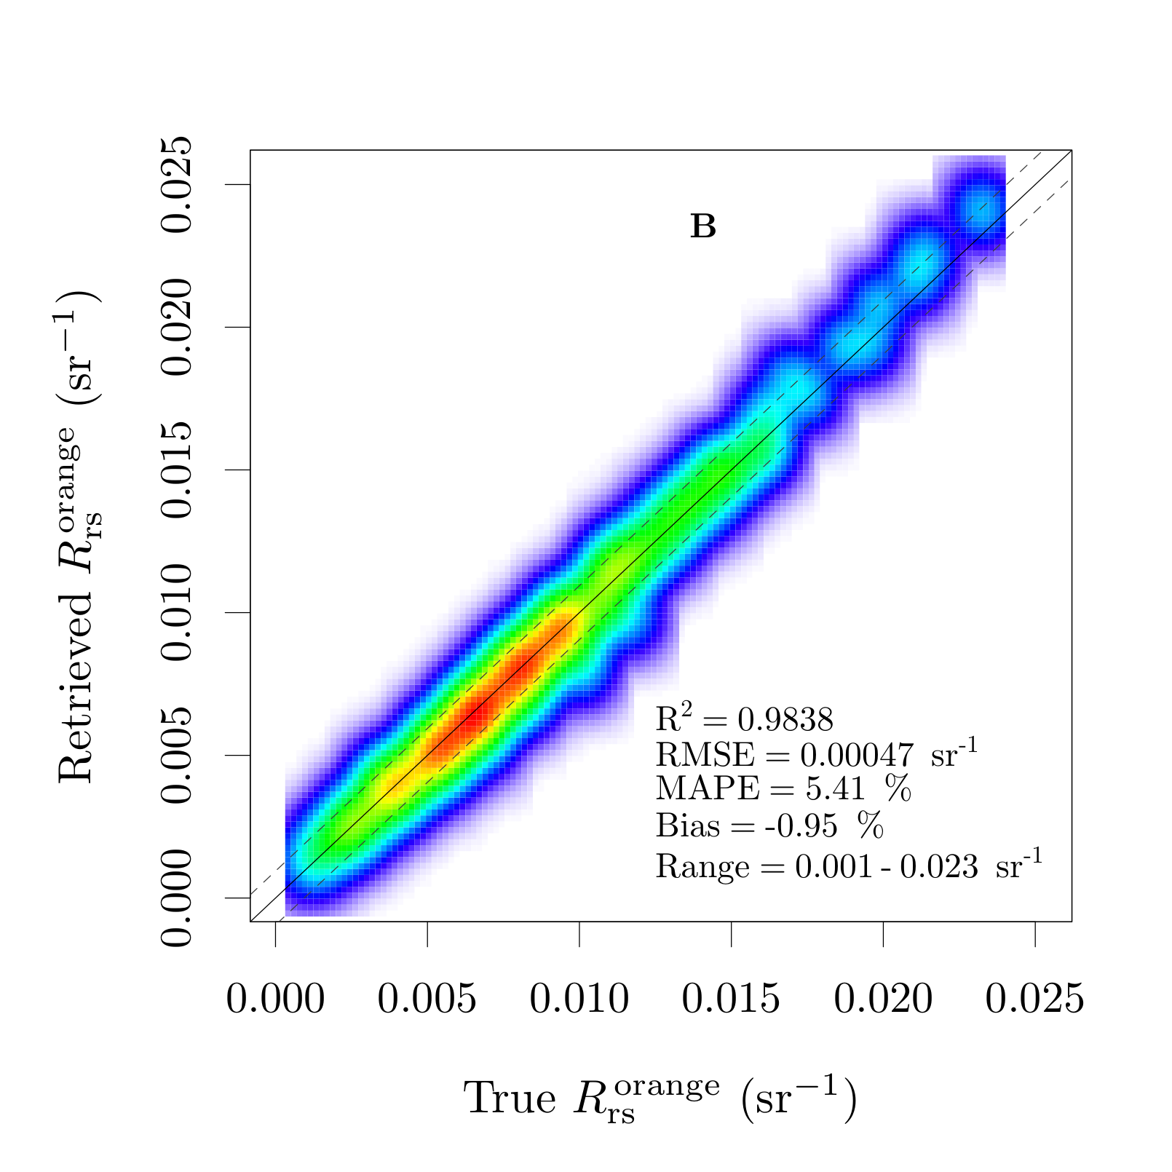
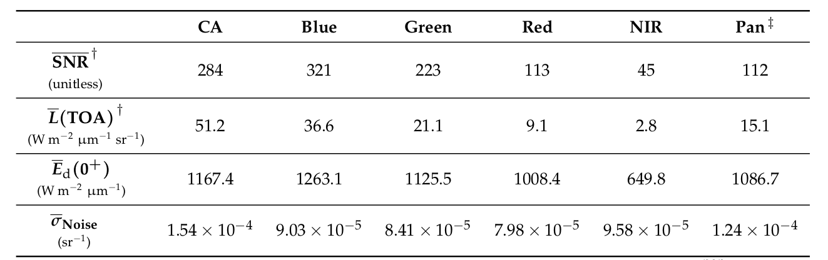
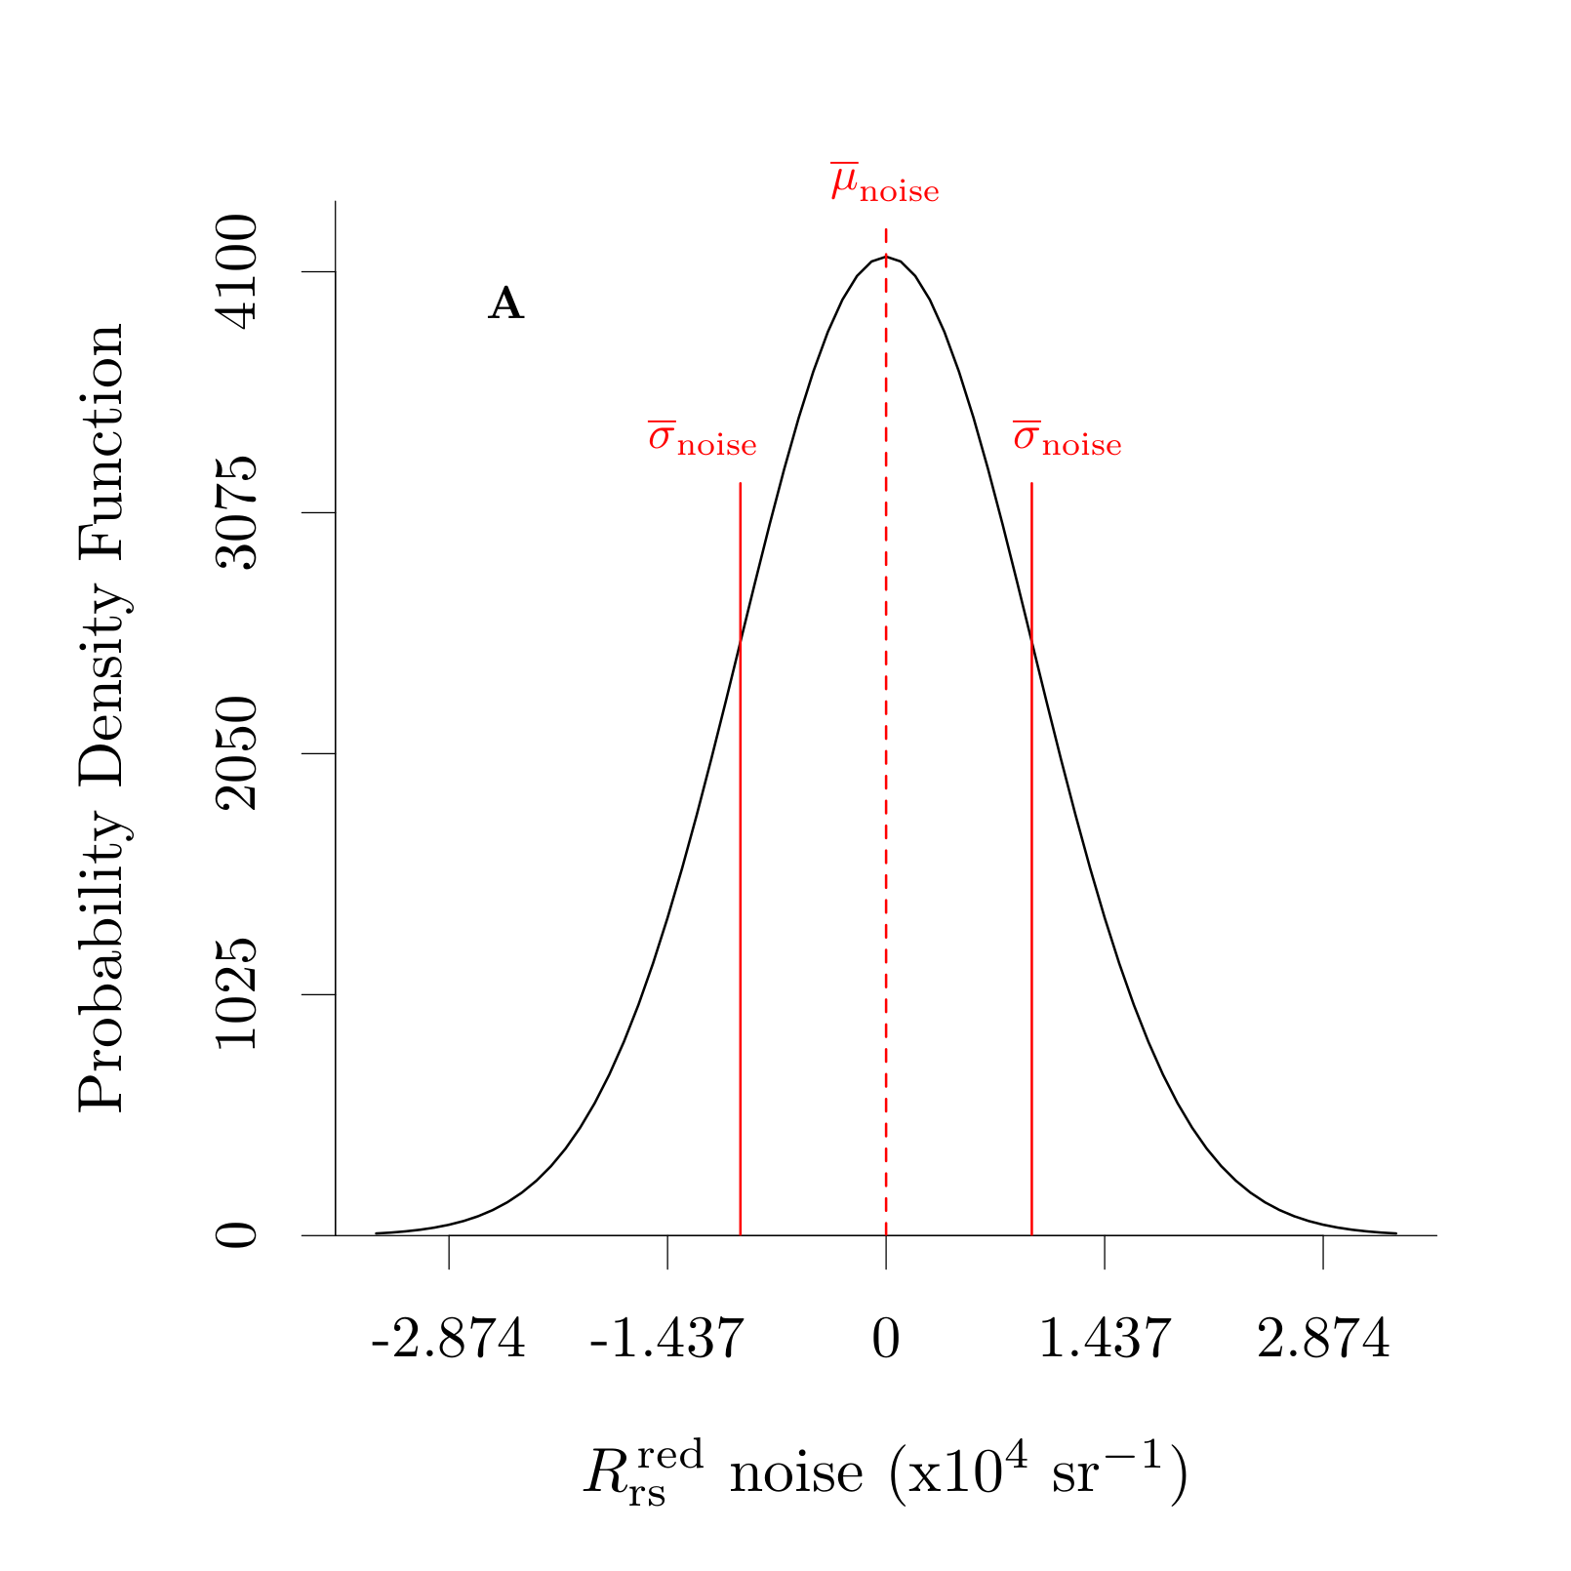
Noise propagation
Pahlevan et al. (2017)
Morfit et al. (2015)
Simulated for clear skies in the range of θ_{s} experienced by OLI scenes.
Castagna et al. (2019)

Slide 13
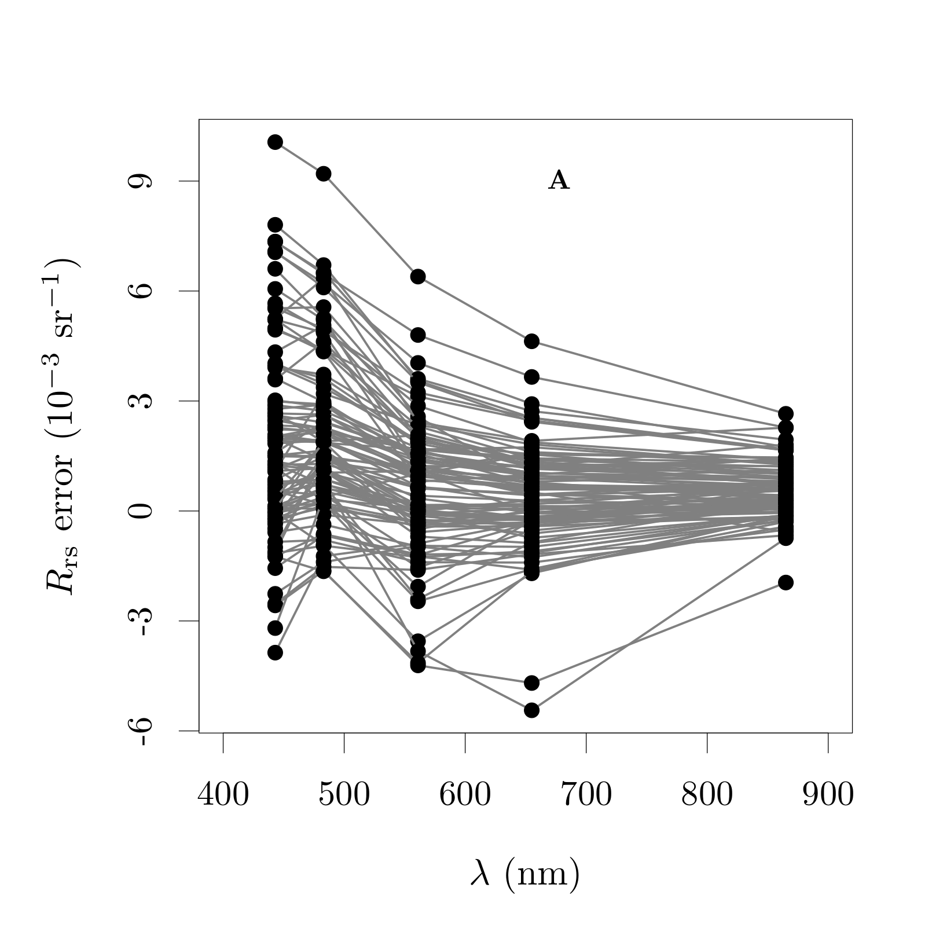
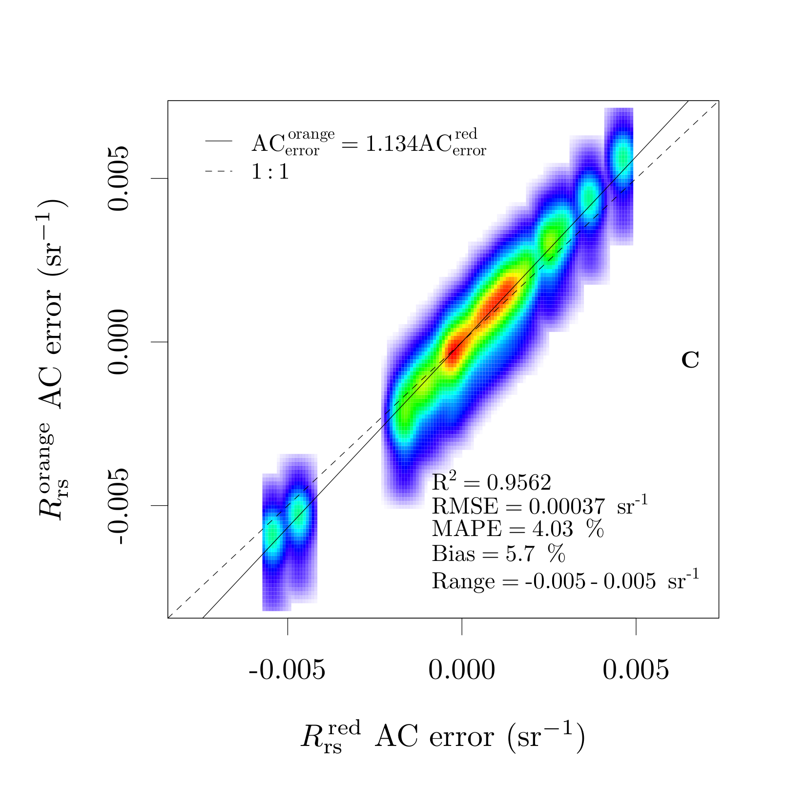
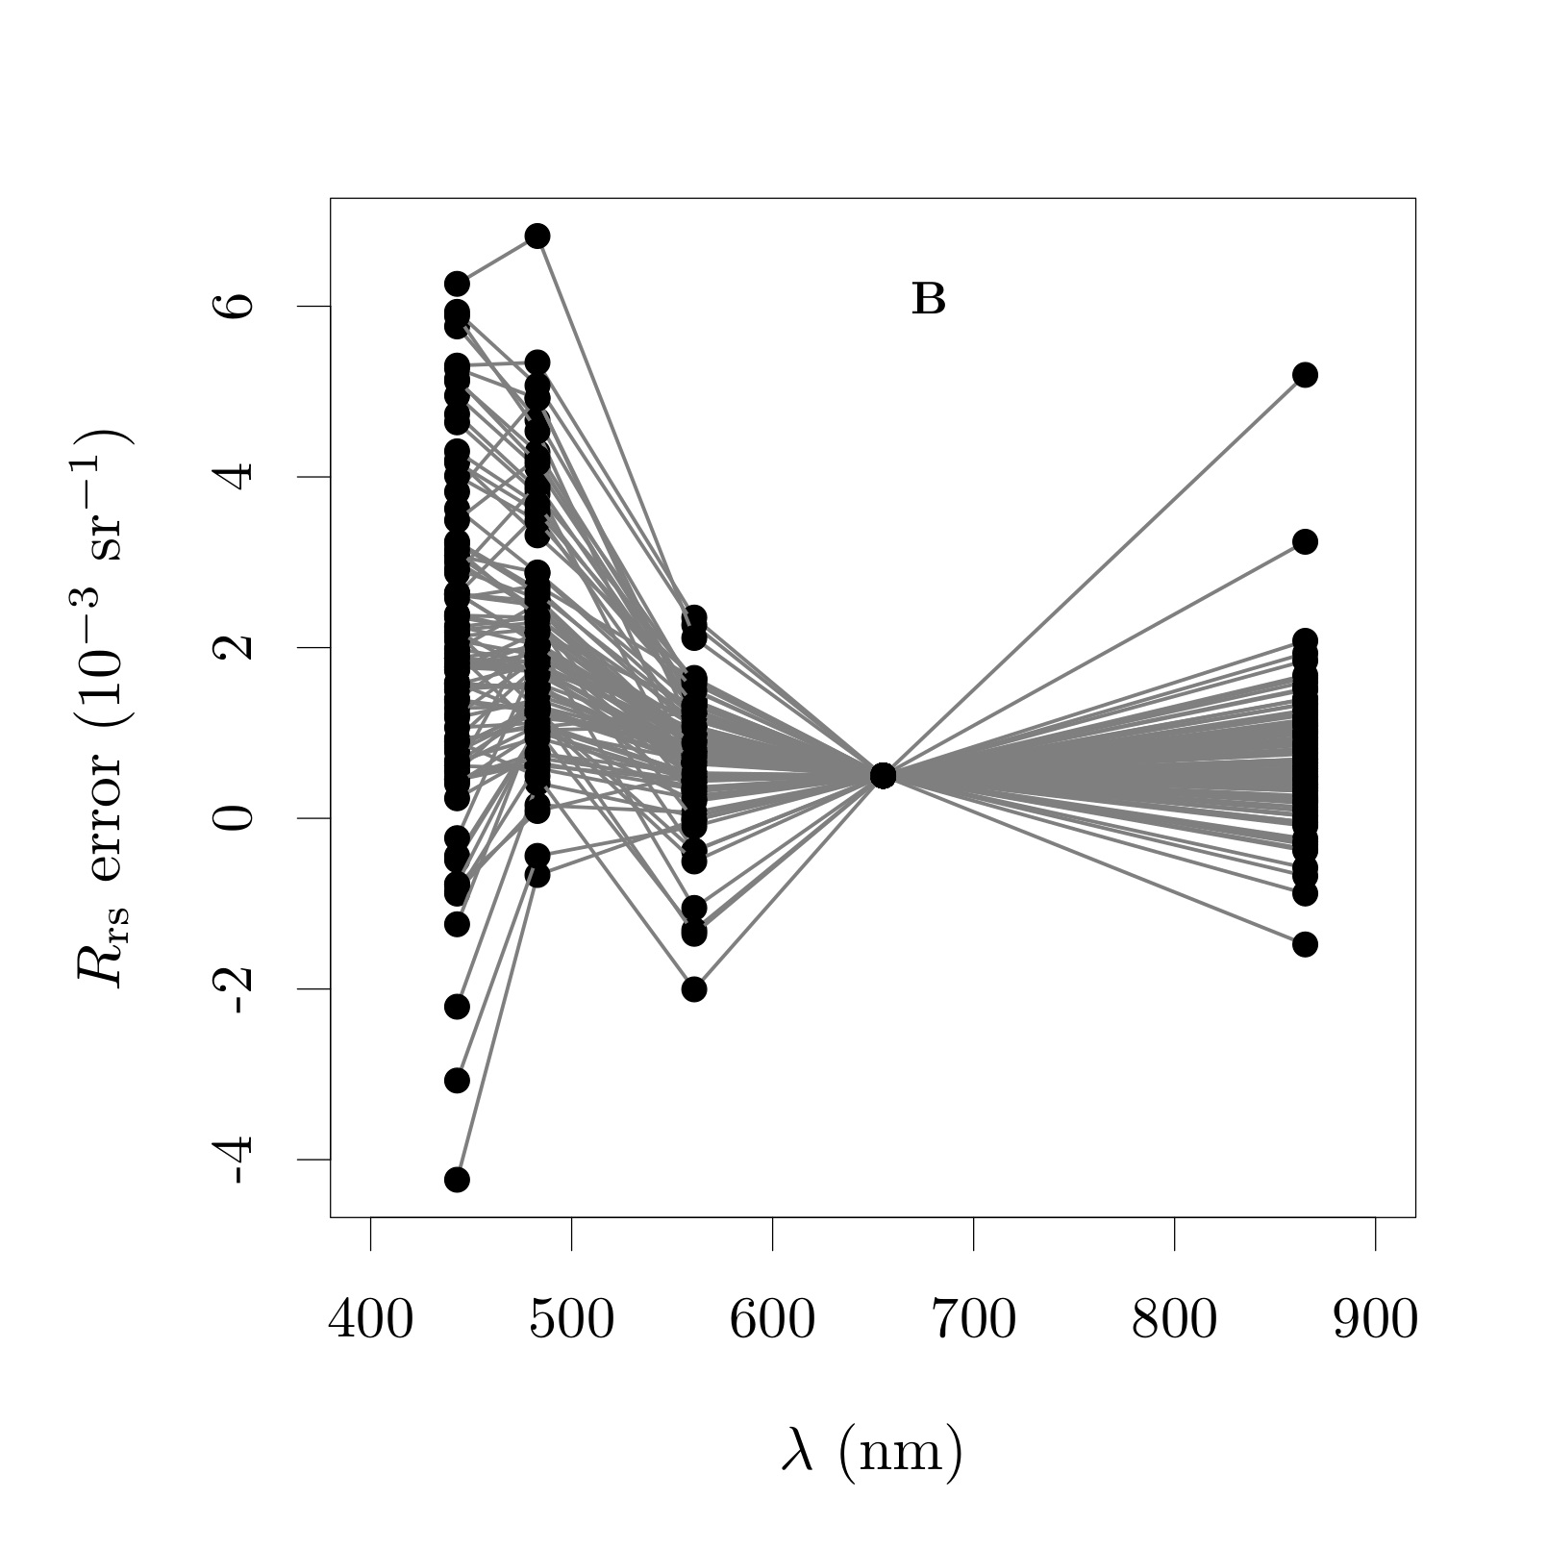
AC error propagation
98 matchups
Vanhellemont (2019)
AERONET-OC: Zibordi et al. (2009)

Slide 14
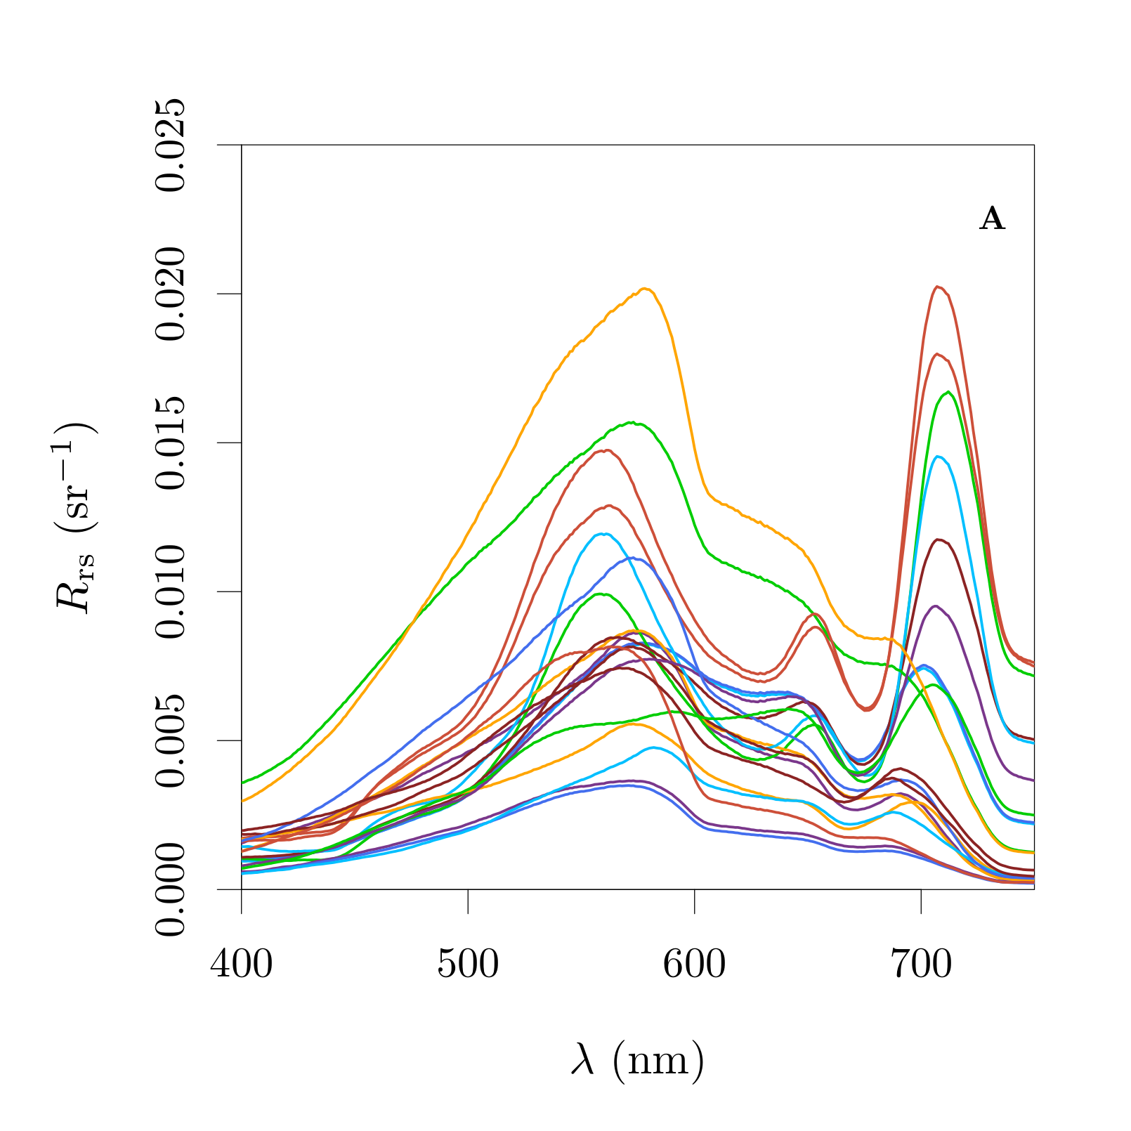
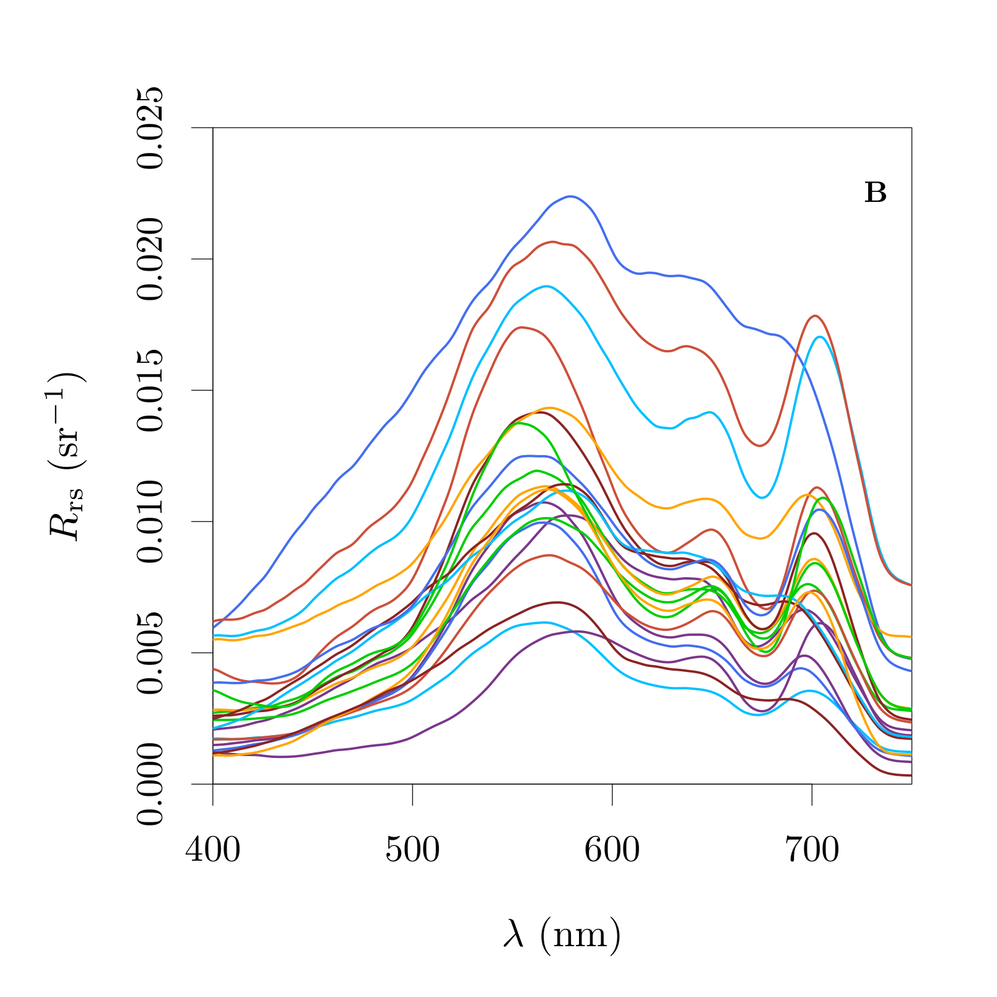
Generality of current calibration
Belgium dataset
Dutch dataset

Slide 15
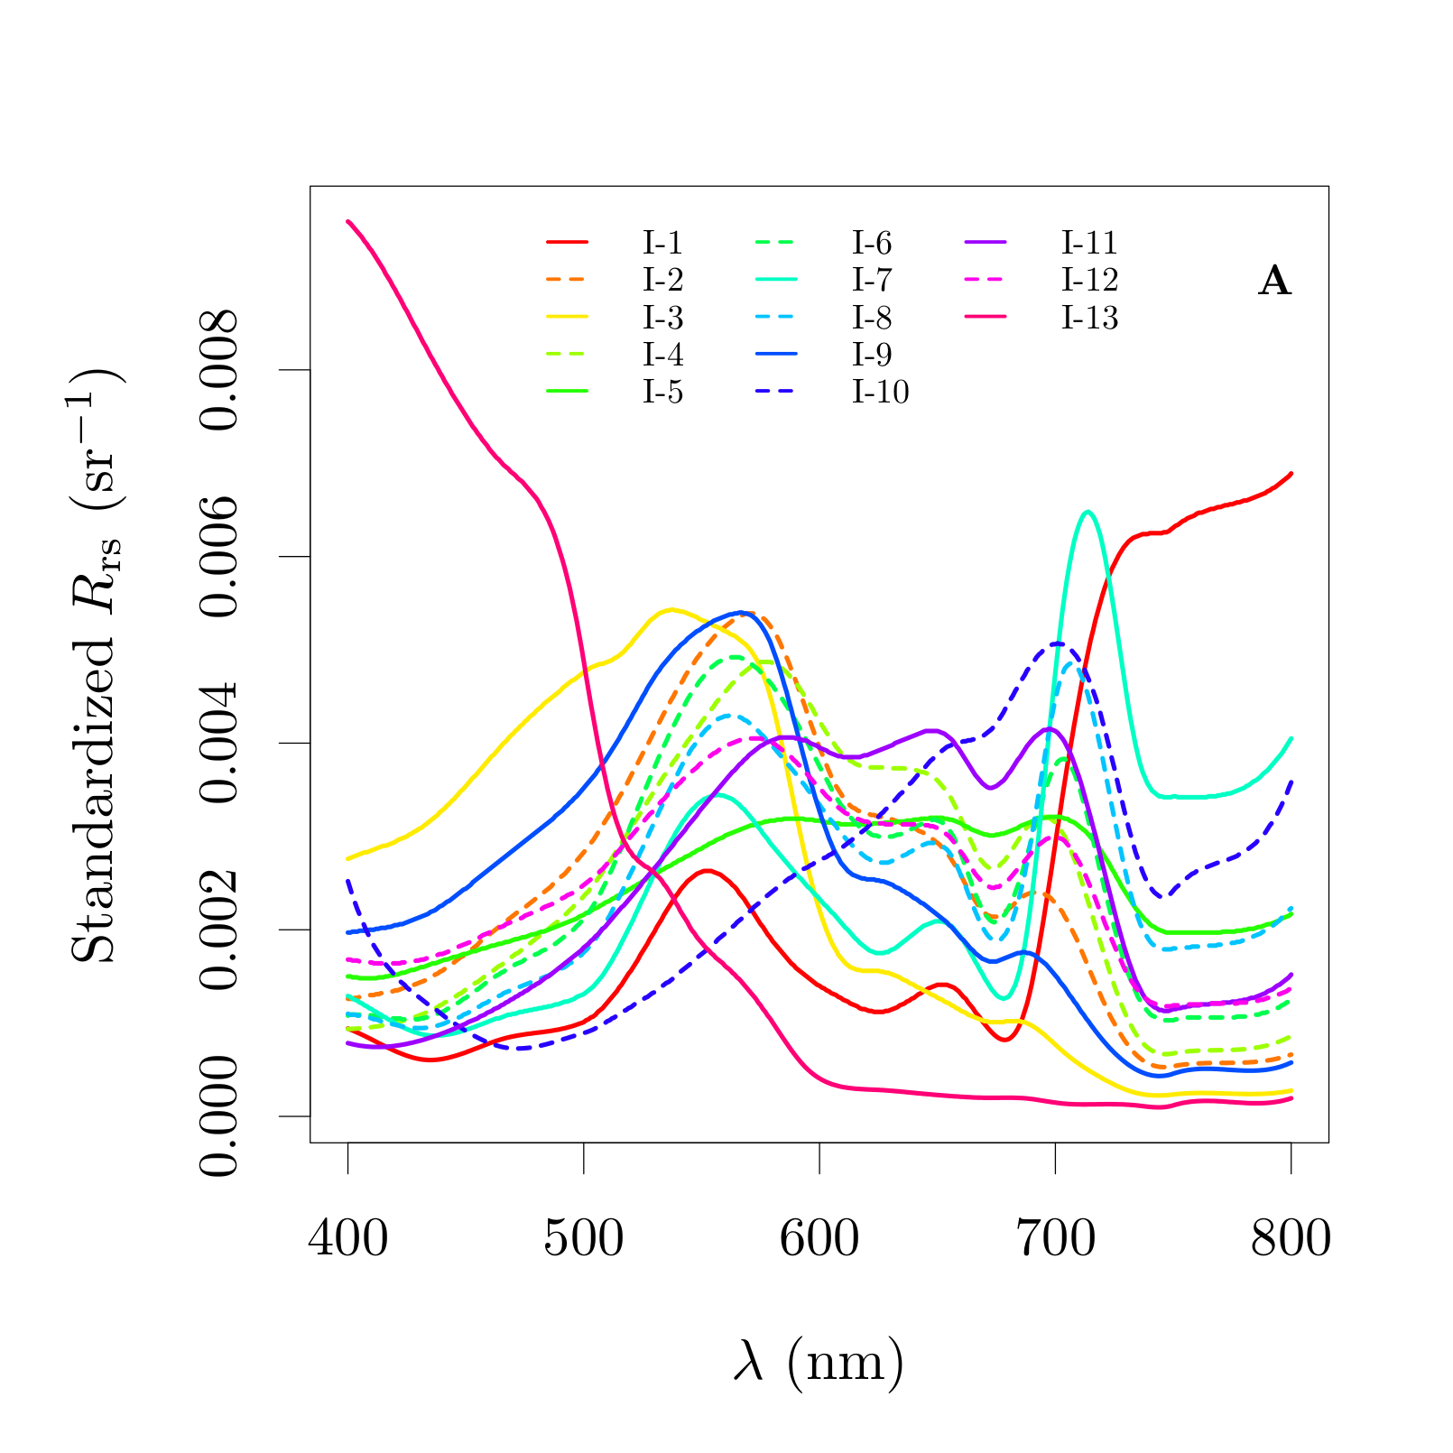

Generality of current calibration
Spyrakos et al. (2017)

Slide 16




Generality of current calibration
Inland: 11 out of 13 (85%)
Coastal: 3 out of 9 (33%)
Algorithm domain flags:

Slide 17








Validation against spaceborne data
Allows to compare over a broader spatial coverage, system types and states. However, AC errors in each sensor / scene pair is a formidable challenge to be overcomed.
Assumptions:
1) Atmosphere is horizontally constant for each sensor acquisition;
2) R_{rs} temporally constant between each sensor acquisitions;
- t_{diff} < 1 hour
- Low f_{cloud}
- θ_{s} < 65◦
Matchup only included if
≥ 10% od the pixels were valid

Slide 18











Validation against spaceborne data
Allows to compare over a broader spatial coverage, system types and states. However, AC errors in each sensor / scene pair is a formidable challenge to be overcomed.
10 globally distributed lakes over a period of 2 years.
133 matchups, with 79 valid matchups after QC.
CyanoTRACKER
Scott et al. (2016)

Slide 19




Validation against spaceborne data
AC errors equal in scene median sense
20% variability allowed in the 440 nm band:
Spatio-temporal variability and BRDF effects

Slide 20






Independent information content
Removing scattering magnitude
Removing Chl a abs.
magnitude

Slide 21




Independent information content
Assumes the information in the orange region is completly contained in the adjacenct green and red bands.

Slide 22

Case study: lake erie
Moore et al. (2017)
Orange contra-band
Spectral reconstruction

Slide 23

Case study: lake erie
Moore et al. (2017)
Orange contra-band
including the blue band

Slide 24


The VIIRS orange Contra-band
Overlap between imaging band 1 (I1, 375 m) and moderate resolution band 5 (M5, 750 m). Band M5 covers the Chl a absorption peak.
Regions of the I1 band are defined by the FWHM of band M5.

Slide 25

The VIIRS orange Contra-band
(algorithm) Analytical retrieval performance
Analytical coefficients (S_{x}) are the RSRF areas in each region.
Performance evaluated from direct convolution of CB RSRF against calculated from broad and narrow band.
No errors sources (noise, AC, etc) other than approximate coefficients.
L_{w}^{CB} = L_{w}^{I1} - S_{M5} * L_{w}^{M5}
S_{CB}
In absence of other error sources, the MAPE of the analytical algorithm retrieval is 0.69%.
This is the expected high performance possible analytical contra-bands. But to judge its utility it is necessary to know how much information it would add to the moderate resolution band set.

Slide 26


the VIIRS orange Contra-band
(pratical) Maximum independent information
The main driver of correlation is magnitude of scattering which is not necessarely related to the information we want to estimate. This effect is removed by normalizing to green.
Simulated radiance from in situ reflectance measurements:
Fixed E_{d};
Negligible noise;
No AC errors;
No absolute calibration errors;
If radiances from bands were totally correlated, residuals would be zero. Therefore, all residual variability is due to independent information content.
If VIIRS had a real orange band with same characteristics as the band M5 but centered at 620 nm, the amount of independent information to band M5, considering our dataset, would be 8.85%.

Slide 27


the VIIRS orange Contra-band
(average) Independent information
Most of that independent information to band M5 (68%) is already present in band I1 as is, amounting to 6.05%. But the possible contra-band increases the total independent information captured (81%), amounting to 7.16%.
Simulated radiance from in situ reflectance measurements:
Fixed E_{d};
Negligible noise;
No AC errors;
No absolute calibration errors;
If radiances from bands were totally correlated, residuals would be zero. Therefore, all residual variability is due to independent information content.

Slide 28
Perspectives: OLI orange contra-band
Data suggest robust retrieval over most turbid inland waters, with an uncertainty of 5.4%, including noise;
The AC error is expected to propagate with about the same magnitude as the red band;
It is show to contain independent information and improve retrievals proportional to PC;
Algorithms for PC using the orange contra-band are being developed (e.g., Kumar et al., 2020).

Slide 29
Perspectives: contra-band approach
1) When conditions are ideal (to a good approximation), use analytical coefficients in radiance space;
2) When conditions are less ideal, substitute the analytical coefficients by empirical ones, calculated through regression in reflectance space;
3) Spectrally contiguous regions, and significant SRF area overlap will increase utility of the contra-band.
Semi-empirical contra-bands may be dependent on spectral shape, since they have some dependence on the spectral correlation structure. Therefore, when designing a sensor that could take advantage of a contra-band, it will lead to a better retrieval to adapt as necessary to ensure that the conditions of the analytical retrieval are met to a good approximation.

Slide 30






Partners funding
Agency:
Alexandre Castagna
Wim Vyverman
Koen Sabbe
Stefan Simis
Projects:
Ponder
(link)
Quinten Vanhellemont
Heidi Dierssen
(link)

Slide 31
Acknowledgements
NASA OBPG funding for Heidi Dierssen through the PACE project;
Vagelis Spyrakos, Timothy Moore and Nima Pahlevan for sharing data;
Kevin Ruddick for discussions on noise;
Six anonymous reviewers for constructive comments;
The Flanders Marine Institute (VLIZ) and POM West-Flanders, for the data gathered from Panthyr at the RT1 platform;
The Italian National Research Council (CNR), for the data gathered from Panthyr at the AAOT platform.

