Slide 1


Stable machine-learning parameterization of subgrid processes for climate modeling at a range of resolutions
Janni Yuval and Paul O’Gorman
Support from Houghton-Lorenz Fellowship
MIT Environmental Solutions Initiative and the NSF

Slide 2
Outline
  Motivation: Parameterizations of small scale processes are the main cause of uncertainty in climate change temperature and precipitation projections
  Previous studies: Recent studies on machine-learning parameterization are promising (but still many problems)
  Results:
  a. Learning from a high resolution model (SAM)
  b. Example: Sub-grid tendencies are very important
  c. Offline results, conservation of energy, non-negative precipitation
  d. Online results
  e. Is there an optimal length scale for parameterization?

Slide 3
Outline
  Motivation: Parameterizations of small scale processes are the main cause of uncertainty in climate change temperature and precipitation projections
  Previous studies: Recent studies on machine-learning parameterization are promising (but still many problems)
  Results:
  a. Learning from a high resolution model (SAM)
  b. Example: Sub-grid tendencies are very important
  c. Offline results, conservation of energy, non-negative precipitation
  d. Online results
  e. Is there an optimal length scale for parameterization?

Slide 4
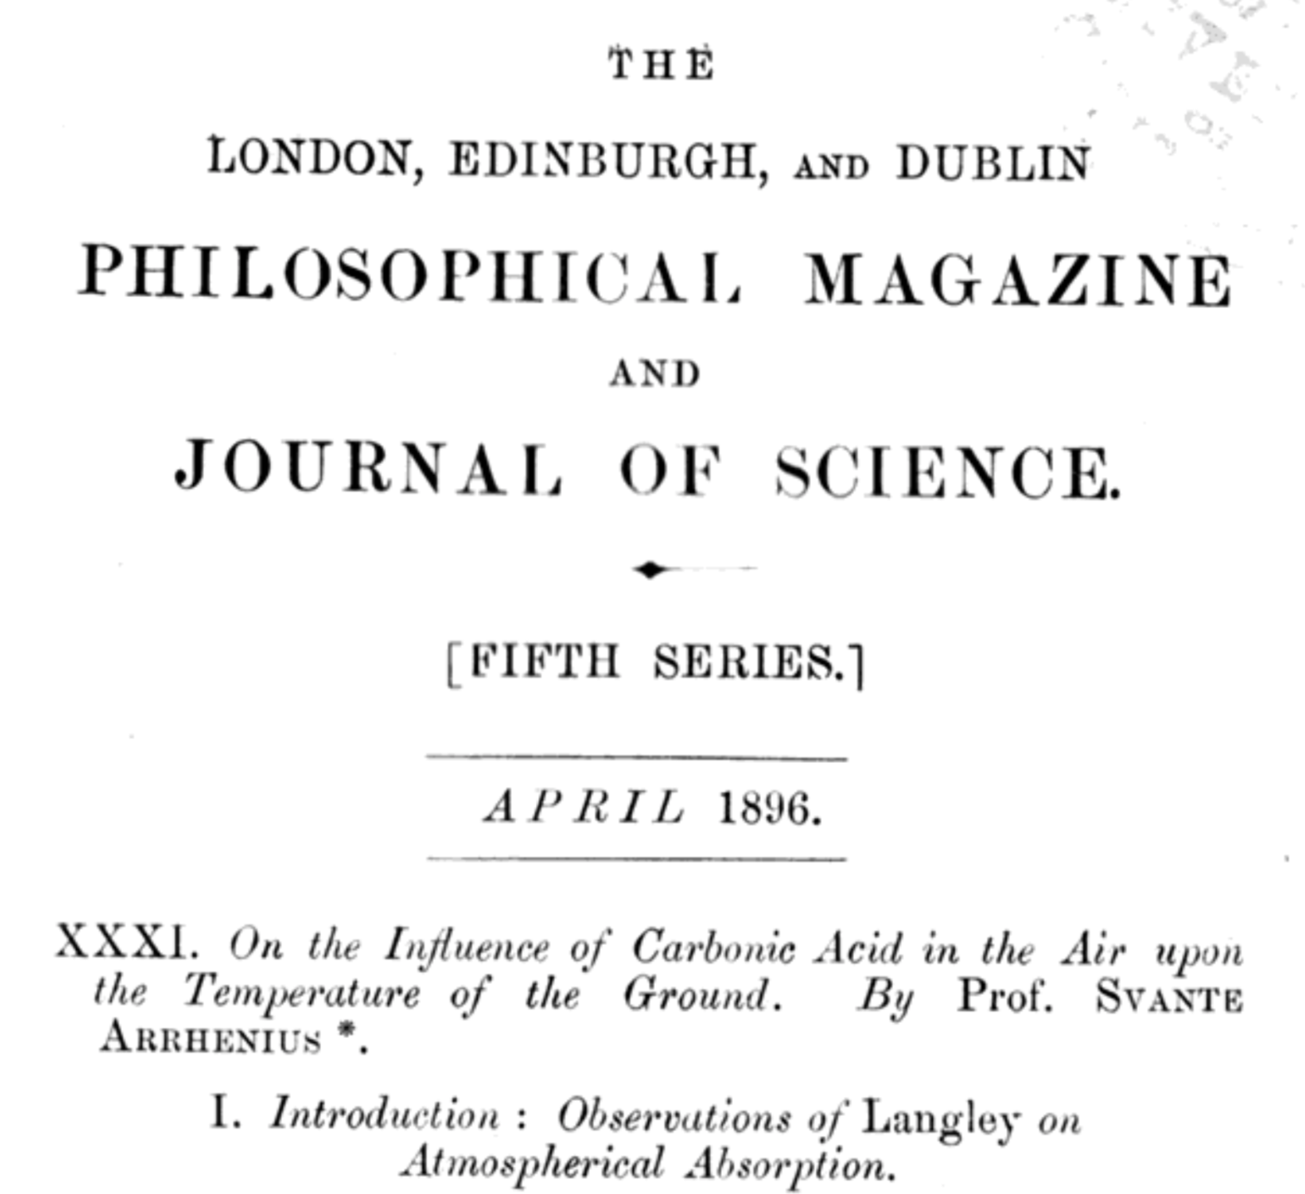

Slide 6
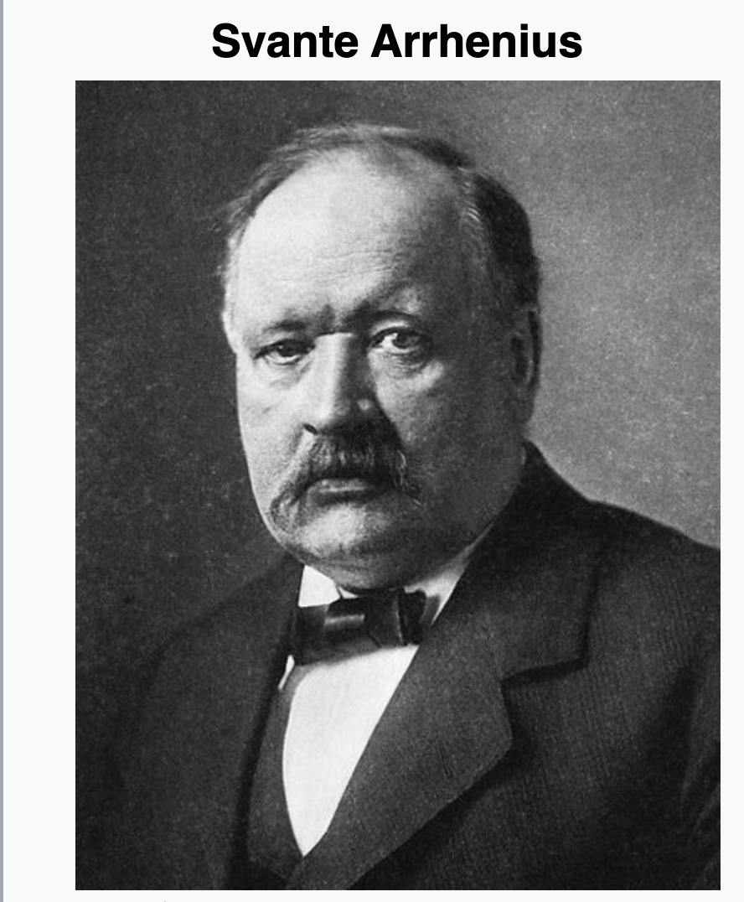
Large uncertainty in the temperature response to increased CO₂ concentrations (slow to non-existent improvement in narrowing the uncertainty)
Arrhenius (1896):
Doubling of CO₂ → global warming of ~5°C

Slide 7
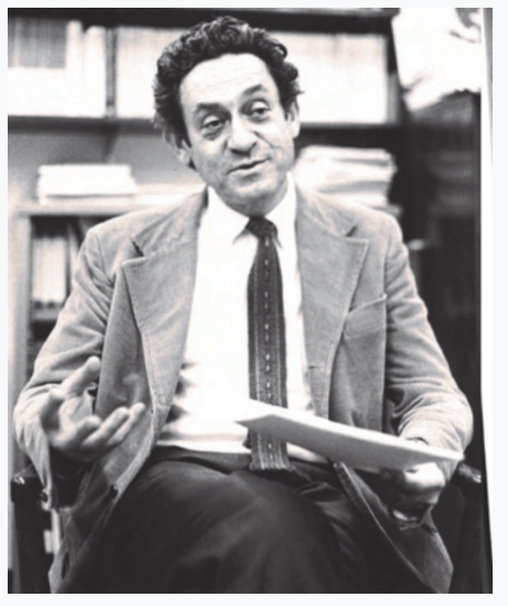
Large uncertainty in the temperature response to increased CO₂ concentrations (slow to non-existent improvement in narrowing the uncertainty)
Arrhenius (1896):
Doubling of CO₂ → global warming of ~5°C
Charney Report (1979):
“We estimate the most probable global warming for a doubling of CO₂ to be near 3°C with a probable error of ± 1.5°C”

Slide 8
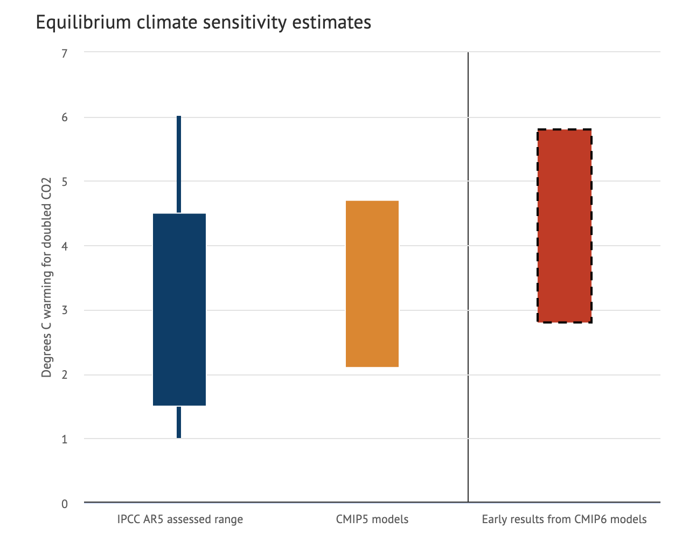
Large uncertainty in the temperature response to increased CO₂ concentrations (slow to non-existent improvement in narrowing the uncertainty)
Arrhenius (1896):
Doubling of CO₂ → global warming of ~5°C
IPCC AR5
1.5-4.5°C
Charney Report (1979):
“We estimate the most probable global warming for a doubling of CO₂ to be near 3°C with a probable error of ± 1.5°C”
IPCC report (2013):
“Estimates of the equilibrium climate sensitivity (ECS) based on observed climate change, climate models and feedback analysis, as well as paleoclimate evidence indicate that ECS is likely in the range 1.5°C to 4.5°C with high confidence, …. and very unlikely greater than 6°C (medium confidence)."

Slide 9
Large uncertainty in the temperature response to increased CO₂ concentrations (slow to non-existent improvement in narrowing the uncertainty)
Arrhenius (1896):
Doubling of CO₂ → global warming of ~5°C
IPCC AR5
1.5-4.5°C
CMIP6 early
results 2.8-5.8°C
Charney Report (1979):
“We estimate the most probable global warming for a doubling of CO₂ to be near 3°C with a probable error of ± 1.5°C”
IPCC report (2013):
“Estimates of the equilibrium climate sensitivity (ECS) based on observed climate change, climate models and feedback analysis, as well as paleoclimate evidence indicate that ECS is likely in the range 1.5°C to 4.5°C with high confidence, …. and very unlikely greater than 6°C (medium confidence)."

Slide 10
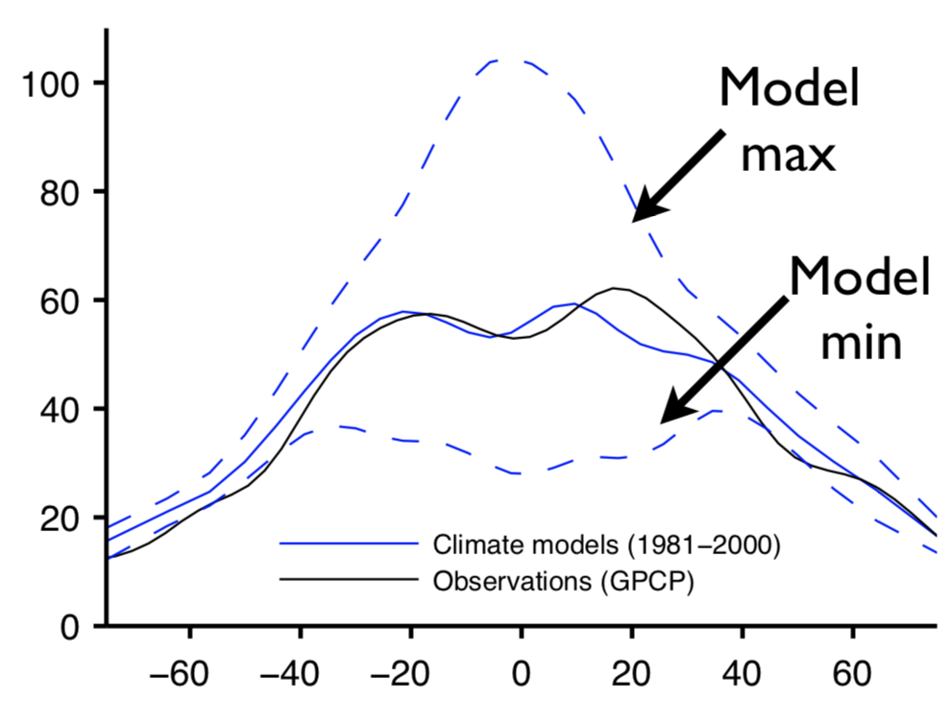
There is a large spread in the intensity of extreme precipitation events between climate models
Control climate
Extreme precipitation [mm/day]
Latitude
Latitude
Climate models from CMIP3
Figure adapted from O’Gorman and Schneider 2009

Slide 11
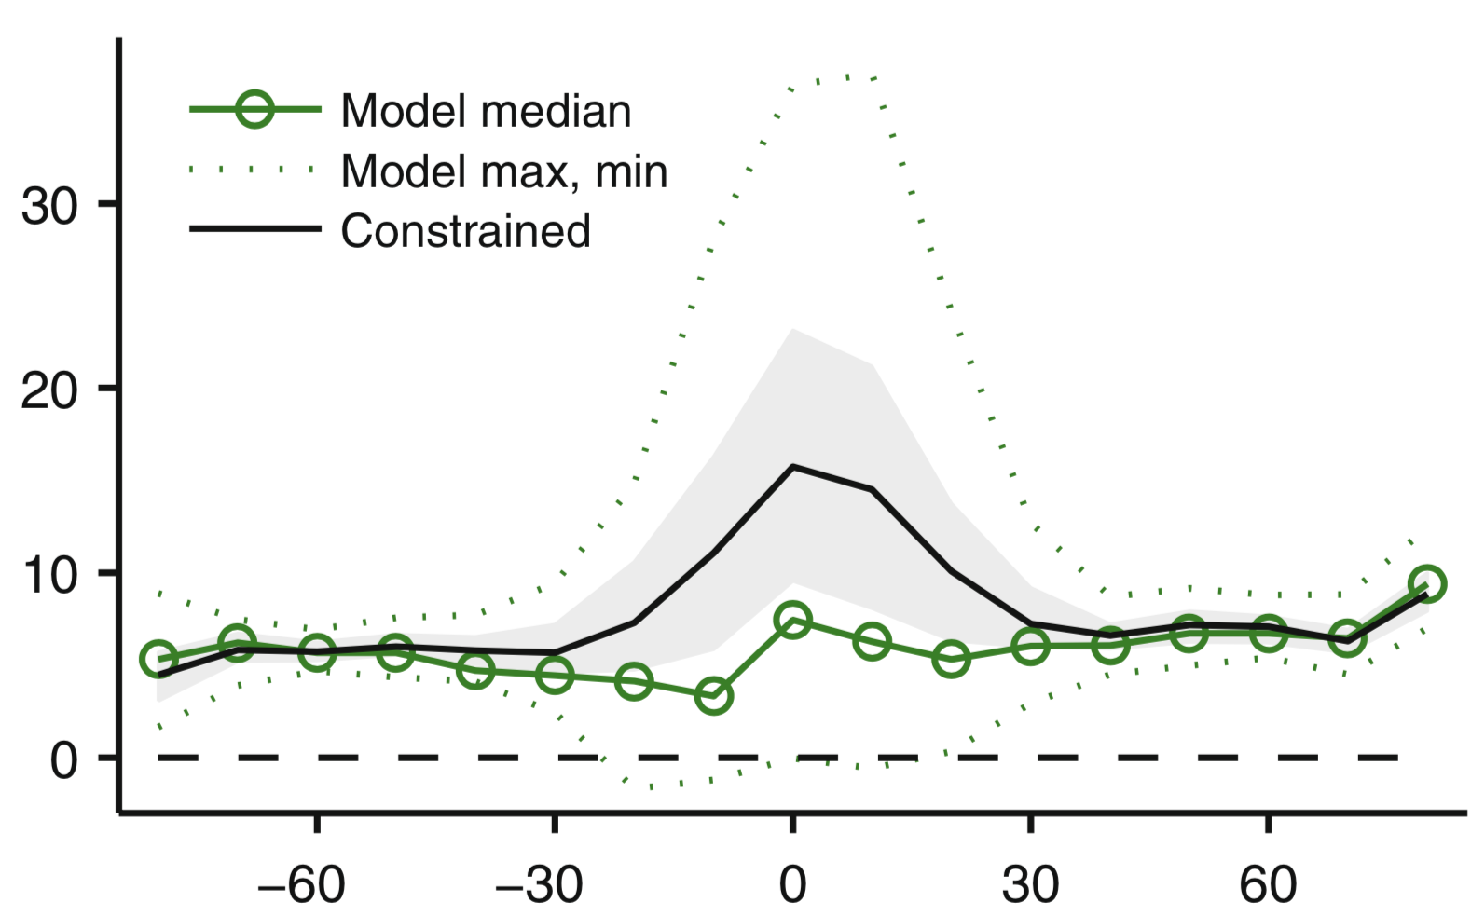
There is a large spread in the intensity of extreme precipitation response to climate change
Control climate
Climate change
Sensitivity [% K⁻¹]
Extreme precipitation [mm/day]
Latitude
Latitude
Latitude
Climate models from CMIP3
Figure adapted from O’Gorman and Schneider 2009
Climate models from CMIP5
Figure adapted from: O’Gorman 2015

Slide 12
There is a large spread in the intensity of extreme precipitation response to climate change
Control climate
Climate change
Sensitivity [% K⁻¹]
Extreme precipitation [mm/day]
Latitude
Latitude
Latitude
Climate models from CMIP3
Figure adapted from O’Gorman and Schneider 2009
Climate models from CMIP5
Figure adapted from: O’Gorman 2015

Slide 13
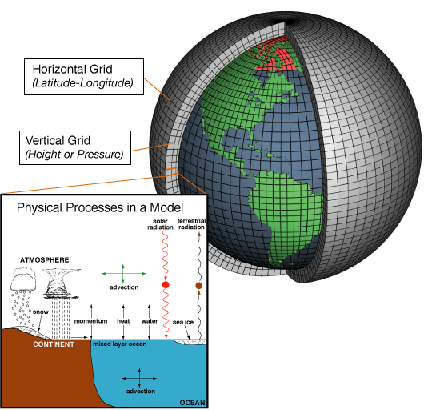
The large uncertainty in climate projections is mainly caused by (inaccurate) representation of subgrid physics
Law of physics
(e.g., fluid dynamics)
Figure credit: NOAA

Slide 14
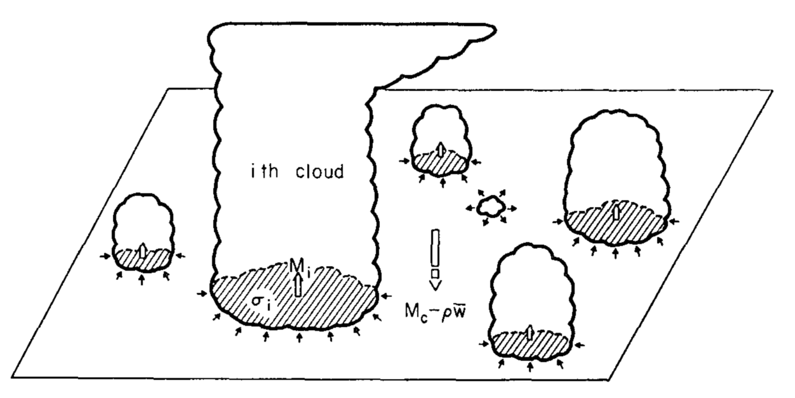
The large uncertainty in climate projections is mainly caused by (inaccurate) representation of subgrid physics
Law of physics
(e.g., fluid dynamics)
Parameterizations represented by simplified models – (e.g., convection)
Figure credit: NOAA
Arakawa and Schubert 1974

Slide 15
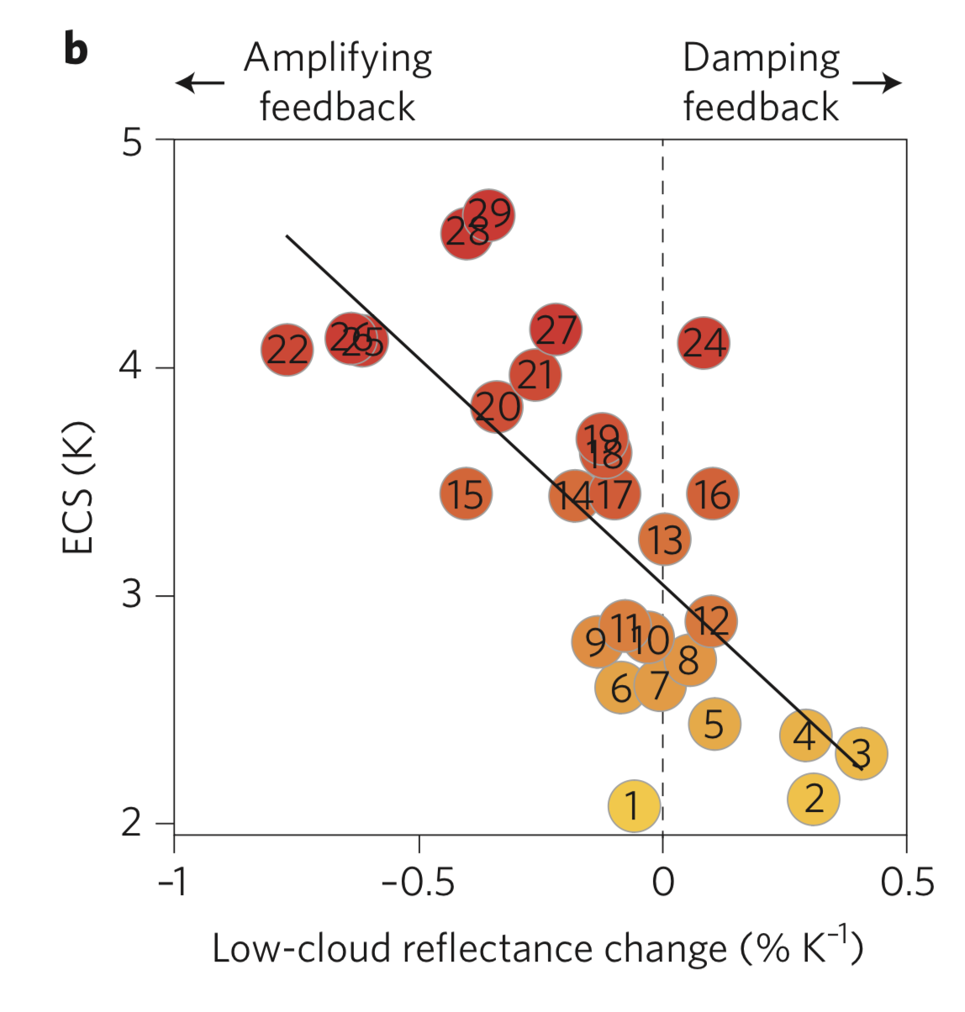
Uncertainty in low-cloud feedback leads to large uncertainty in the equilibrium climate sensitivity
Schneider et al. (2017)

Slide 16
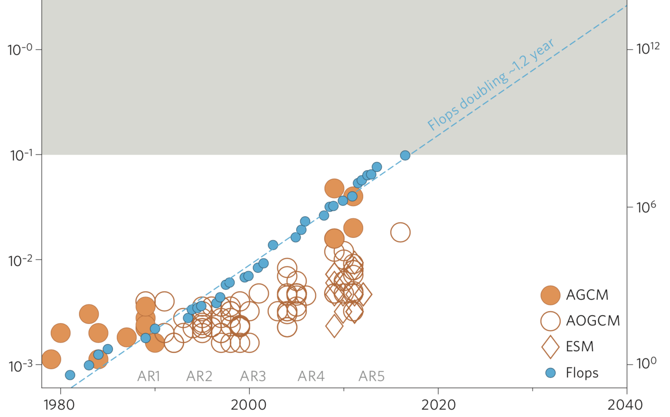
“Important” small scales will not be resolved in the foreseeable future
Climate Models
horizontal resolution [km⁻¹]
Computer performance [Gflops]
Schneider et al. (2017)
Year

Slide 17
“Important” small scales will not be resolved in the foreseeable future
Climate Models
horizontal resolution [km⁻¹]
Computer performance [Gflops]
Schneider et al. (2017)
Year

Slide 18
“Important” small scales will not be resolved in the foreseeable future
Climate Models
horizontal resolution [km⁻¹]
Computer performance [Gflops]
Schneider et al. (2017)
Year

Slide 19
“Important” small scales will not be resolved in the foreseeable future
Starting to resolve deep convection – O(10km)
Climate Models
horizontal resolution [km⁻¹]
Computer performance [Gflops]
Schneider et al. (2017)
Year

Slide 20
“Important” small scales will not be resolved in the foreseeable future
Starting to resolve deep convection – O(10km)
Resolving stratocumulus clouds O(10m) is not likely to happen in our lifetime
Climate Models
horizontal resolution [km⁻¹]
Computer performance [Gflops]
Schneider et al. (2017)
Year

Slide 21
A different approach to parameterization:
Use machine learning to create new parameterizations trained on high-resolution models
General Circulation Models
Law of physics
(e.g., fluid dynamics)
Machine learning parameterizations (where possible)
High-resolution simulations

Slide 22
Outline
  Motivation: Parameterizations of small scale processes are the main cause of uncertainty in climate change temperature and precipitation projections
  Previous studies: Recent studies on machine-learning parameterization are promising (but still many problems)
  Results:
  a. Learning from a high resolution model (SAM)
  b. Example: Sub-grid tendencies are very important
  c. Offline results, conservation of energy, non-negative precipitation
  d. Online results
  e. Is there an optimal length scale for parameterization?

Slide 23
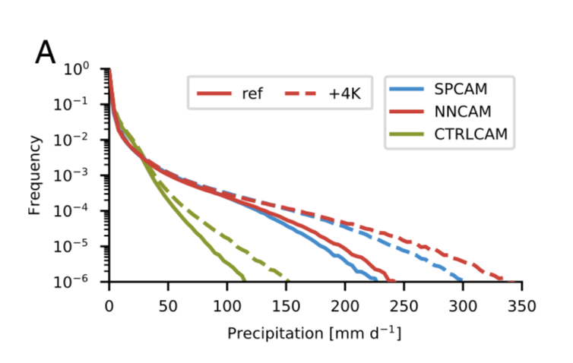
Recent attempts at machine learning parameterizations had some success but were not always stable/did not obey conservation laws/had climate drift
Neural Network to learn SP-CAM (super-parameterized model) sub-grid tendencies.
Rasp et al. (2018)

Slide 24
Recent attempts at machine learning parameterizations had some success but were not always stable/did not obey conservation laws/had climate drift
Neural Network to learn SP-CAM (super-parameterized model) sub-grid tendencies.
SP-CAM and Neural network-CAM has similar precipitation distribution
Rasp et al. (2018)

Slide 25
Recent attempts at machine learning parameterizations had some success but were not always stable/did not obey conservation laws/had climate drift
Neural Network to learn SP-CAM (super-parameterized model) sub-grid tendencies.
SP-CAM and Neural network-CAM has similar precipitation distribution
Rasp et al. (2018)

Slide 26
Recent attempts at machine learning parameterizations had some success but were not always stable/did not obey conservation laws/had climate drift
Neural Network to learn SP-CAM (super-parameterized model) sub-grid tendencies.
2D CRM with 8 gridboxes (wasn’t stable with 32 gridboxes)
Changes in the Neural Network architecture can lead to unstable simulations
No energy conservation (though see Beucler et.al. 2019)
SP-CAM and Neural network-CAM has similar precipitation distribution
Rasp et al. (2018)

Slide 27
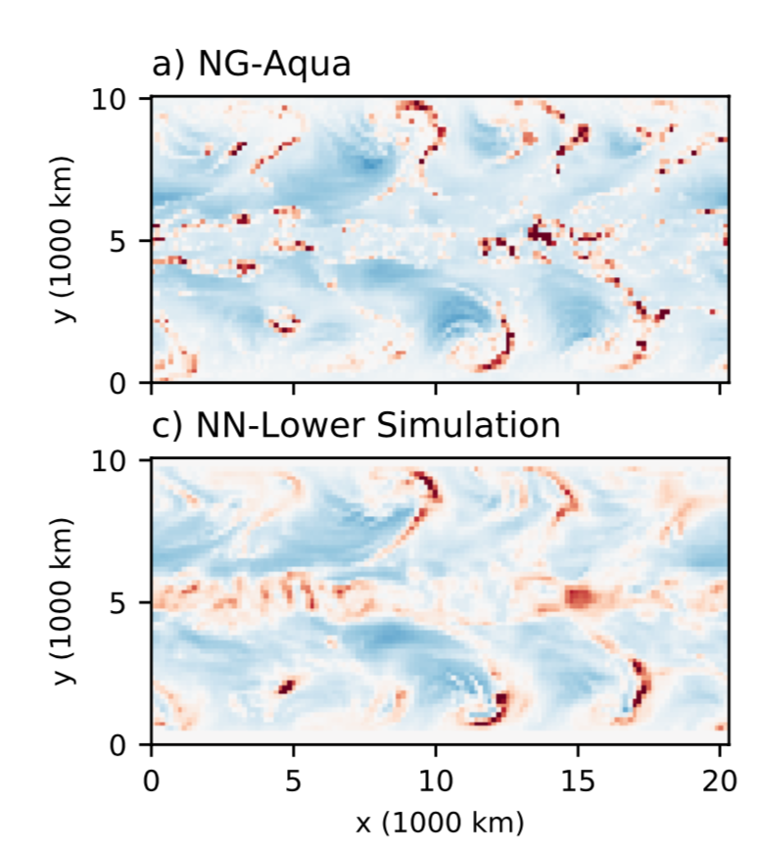
Recent attempts at machine learning parameterizations had some success but were not always stable/did not obey conservation laws/had climate drift
Neural Network to learn a 3D cloud resolving model (SAM, 4km resolution) sub-grid tendencies.
CRM (4 km resolution)
2-day precipitation forecast
Brenowitz and Bretherton (2019)

Slide 28
Recent attempts at machine learning parameterizations had some success but were not always stable/did not obey conservation laws/had climate drift
Neural Network to learn a 3D cloud resolving model (SAM, 4km resolution) sub-grid tendencies.
CRM (4 km resolution)
2-day precipitation forecast
160 km resolution + NN parameterization
Brenowitz and Bretherton (2019)

Slide 29
Recent attempts at machine learning parameterizations had some success but were not always stable/did not obey conservation laws/had climate drift
Neural Network to learn a 3D cloud resolving model (SAM, 4km resolution) sub-grid tendencies.
CRM (4 km resolution)
2-day precipitation forecast
Drift of the mean climate: only short term prediction
Challenging to make it stable
No energy conservation
160 km resolution + NN parameterization
Brenowitz and Bretherton (2019)

Slide 30
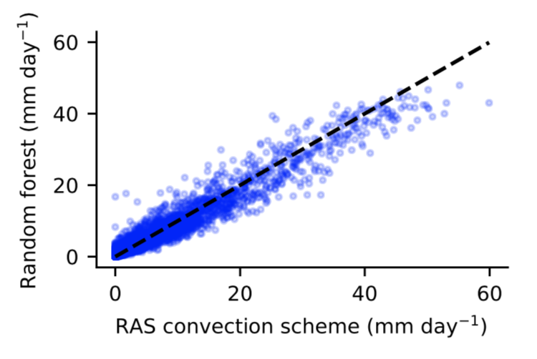
Random forests is a machine learning algorithm that can give a parameterization that obey conservation laws
Random Forest could emulate the relaxed Arakawa-Schubert (RAS) convection scheme
O’Gorman and Dwyer (2018)

Slide 31
Random forests is a machine learning algorithm that can give a parameterization that obey conservation laws
Random Forest could emulate the relaxed Arakawa-Schubert (RAS) convection scheme
Stable when coupled to GCM
Conserves energy/non-negative precipitation
O’Gorman and Dwyer (2018)

Slide 32
Goal here: to run stable and accurate climate simulations learning from a fully 3D high-resolution simulation

Slide 33
Outline
  Motivation: Parameterizations of small scale processes are the main cause of uncertainty in climate change temperature and precipitation projections
  Previous studies: Recent studies on machine-learning parameterization are promising (but still many problems)
  Results:
  a. Learning from a high resolution model (SAM)
  b. Example: Sub-grid tendencies are very important
  c. Offline results, conservation of energy, non-negative precipitation
  d. Online results
  e. Is there an optimal length scale for parameterization?

Slide 34
We learn from a quasi-global high-resolution model
SAM model with hypohydrostatic rescaling factor of 4 (grid spacing 12km), 48 vertical levels
Specified SST distribution (qobs)
Original simulation thanks to Bill Boos
Longitude
SAM: Khairoutdinov and Randall, 2003
Hypohdrostatic/DARE: e.g., Kuang et al. 2005

Slide 35
Extreme precipitation is different in high- and low-resolution simulations
High resolution (target)

Slide 36
Extreme precipitation is different in high- and low-resolution simulations
Lower resolution
High resolution (target)

Slide 37
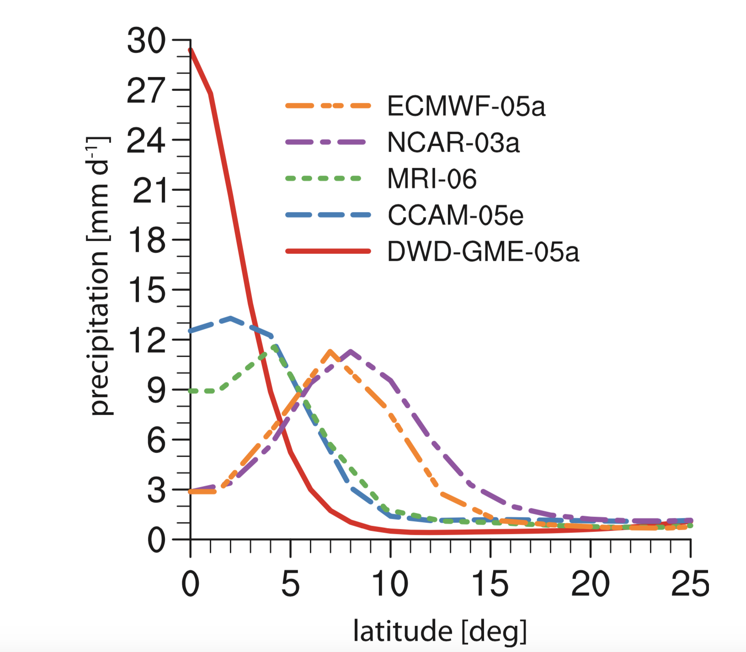
Privious studies: Aqua-planet simulations with different parameterization schemes lead to very different precipitation patterns
Mobis and Stevens 2012

Slide 38
Goal: to correct the tendencies of the thermodynamic and moisture variables due to sub-grid processes

Slide 39
Goal: to correct the tendencies of the thermodynamic and moisture variables due to sub-grid processes
Liquid
Ice

Slide 40
Goal: to correct the tendencies of the thermodynamic and moisture variables due to sub-grid processes
Liquid
Ice

Slide 41
Goal: to correct the tendencies of the thermodynamic and moisture variables due to sub-grid processes
Liquid
Ice

Slide 42
Goal: to correct the tendencies of the thermodynamic and moisture variables due to sub-grid processes

Slide 43
Goal: to correct the tendencies of the thermodynamic and moisture variables due to sub-grid processes

Slide 44
Goal: to use a Random Forest (RF) to predict the effect of subgrid processes on the resolved thermodynamic and moisture variables

Slide 45
Goal: to use a Random Forest (RF) to predict the effect of subgrid processes on the resolved thermodynamic and moisture variables

Slide 46
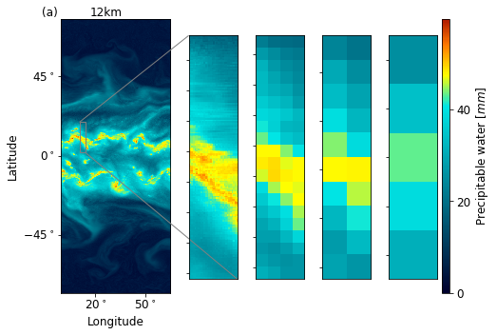
Coarse grained field = average of a field over a number of grid boxes
x8
x16
x32

Slide 47
Coarse grained field = average of a field over a number of grid boxes
x8
x16
x32

Slide 48
Coarse grained field = average of a field over a number of grid boxes
x8
x16
x32

Slide 49
Coarse grained field = average of a field over a number of grid boxes
x8
x16
x32

Slide 50
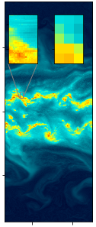
Subgrid tendency is the difference between the coarse-grained (high-res) tendency and the resolved tendency
Longitude
Coarse grained advection from high resolution simulation
Yuval & O’Gorman, Nat. Com. (in press)

Slide 51
Subgrid tendency is the difference between the coarse-grained (high-res) tendency and the resolved tendency
Longitude
Coarse grained advection from high resolution simulation
Resolved advection
Yuval & O’Gorman, Nat. Com. (in press)

Slide 52
Subgrid tendency is the difference between the coarse-grained (high-res) tendency and the resolved tendency
Longitude
Coarse grained advection from high resolution simulation
Resolved advection
Yuval & O’Gorman, Nat. Com. (in press)

Slide 53
Subgrid tendency is the difference between the coarse-grained (high-res) tendency and the resolved tendency
Longitude
Coarse grained advection from high resolution simulation
Resolved advection
Parameterization includes: microphysics, vertical advection, boundary-layer turbulence and radiation
Yuval & O’Gorman, Nat. Commun. (in press)

Slide 54
Goal: to use a Random Forest (RF) to predict the effect of subgrid processes on the resolved thermodynamic and moisture variables

Slide 55
Machine-learning algorithm for parameterization: Random-forest (Breiman 2001)
One simple tree:

Slide 56
Machine-learning algorithm for parameterization: Random-forest (Breiman 2001)
One simple tree:
Random-forest is stable and robust when implemented in a GCM
Respects physical constraints (energy conservation, non-negative precipitation)
O’Gorman & Dwyer 2018

Slide 57
RF Inputs: vertical structure of temperature and humidity
RF Outputs: vertical structure of instantaneous tendencies due to subgrid scales

Slide 58
RF Inputs: vertical structure of temperature and humidity
RF Outputs: vertical structure of instantaneous tendencies due to subgrid scales
Latitude is a proxy for SST, albedo etc.

Slide 59
RF Inputs: vertical structure of temperature and humidity
RF Outputs: vertical structure of instantaneous tendencies due to subgrid scales
Latitude is a proxy for SST, albedo etc.

Slide 60
RF Inputs: vertical structure of temperature and humidity
RF Outputs: vertical structure of instantaneous tendencies due to subgrid scales
Latitude is a proxy for SST, albedo etc.
Single diffusivity for all thermodynamic and moisture variables
Flux is always down gradient

Slide 61
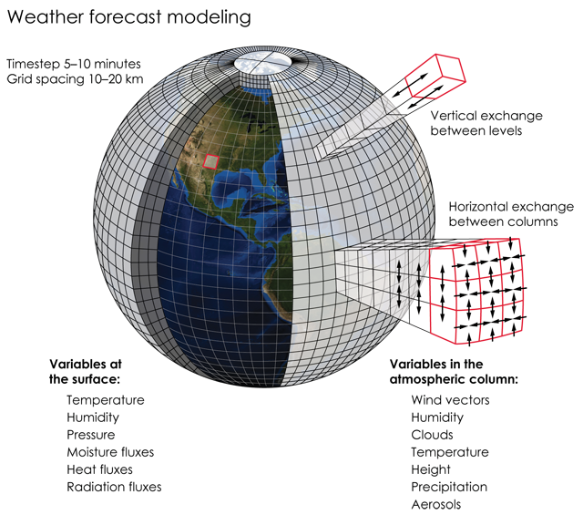
Coupling the random forest to SAM

Slide 62
Coupling the random forest to SAM

Slide 63
Coupling the random forest to SAM

Slide 64
Coupling the random forest to SAM

Slide 65
Coupling the random forest to SAM

Slide 66
Coupling the random forest to SAM
Do not correct any horizontal fluxes

Slide 67
Outline
  Motivation: Parameterizations of small scale processes are the main cause of uncertainty in climate change temperature and precipitation projections
  Previous studies: Recent studies on machine-learning parameterization are promising (but still many problems)
  Results:
  a. Learning from a high resolution model (SAM)
  b. Example: Sub-grid tendencies are very important
  c. Offline results, conservation of energy, non-negative precipitation
  d. Online results
  e. Is there an optimal length scale for parameterization?

Slide 68
Tendency of precipitating water due to conversion of cloud water/ice and due to evaporation at 3km
high resolution coarse grained
Resolved at coarse resolution
Would look the same if subgrid not important

Slide 69
Tendency of precipitating water due to conversion of cloud water/ice and due to evaporation at 3km
high resolution coarse grained
Resolved at coarse resolution
Would look the same if subgrid not important
Positive – means autoconversion (droplets grow as they collect water from clouds)

Slide 70
Tendency of precipitating water due to conversion of cloud water/ice and due to evaporation at 3km
high resolution coarse grained
Resolved at coarse resolution
Would look the same if subgrid not important
Negative – means Evaporation of precipitating water
Positive – means autoconversion (droplets grow as they collect water from clouds)

Slide 71
Outline
  Motivation: Parameterizations of small scale processes are the main cause of uncertainty in climate change temperature and precipitation projections
  Previous studies: Recent studies on machine-learning parameterization are promising (but still many problems)
  Results:
  a. Learning from a high resolution model (SAM)
  b. Example: Sub-grid tendencies are very important
  c. Offline results, conservation of energy, non-negative precipitation
  d. Online results
  e. Is there an optimal length scale for parameterization?

Slide 72
Random forest (96km horizontal grid) predicts reasonably well the subgrid tendencies in a test data set (coefficient of determination R²>0.7)
Non-precipitating subgrid tendency
R²
Yuval & O’Gorman, Nat. Commun. (in press)

Slide 73
Precipitation is a diagnostic variable (we do not predict it separately in the RF)
Yuval & O’Gorman, Nat. Commun. (in press)

Slide 74
Precipitation is a diagnostic variable (we do not predict it separately in the RF)
no negative precipitation values
Yuval & O’Gorman, Nat. Commun. (in press)

Slide 75
Random forest (almost) conserves energy in the absence of external forcing
Compared to ~92W/m² in Brenowitz and Bretherton (2019) that used neural networks (Though see Buecler et al. 2019)
Yuval & O’Gorman, Nat. Commun. (in press)

Slide 76
Outline
  Motivation: Parameterizations of small scale processes are the main cause of uncertainty in climate change temperature and precipitation projections
  Previous studies: Recent studies on machine-learning parameterization are promising (but still many problems)
  Results:
  a. Learning from a high resolution model (SAM)
  b. Example: Sub-grid tendencies are very important
  c. Offline results, conservation of energy, non-negative precipitation
  d. Online results
  e. Is there an optimal length scale for parameterization?

Slide 77
Coupling the random forest to SAM
Do not correct any horizontal fluxes

Slide 78
Random-forest parameterization brings the low-resolution model simulation much closer to the high-resolution simulation
High resolution
Coarse resolution
Yuval & O’Gorman, Nat. Commun. (in press)

Slide 79
Random-forest parameterization brings the low-resolution model simulation much closer to the high-resolution simulation
Coarse resolution with RF parameterization
High resolution
Coarse resolution
Yuval & O’Gorman, Nat. Commun. (in press)

Slide 80
Random forest parameterization leads to remarkably accurate simulation of precipitation extremes
Lower resolution
High resolution (target)
Yuval & O’Gorman, Nat. Commun. (in press)

Slide 81
Random forest parameterization leads to remarkably accurate simulation of precipitation extremes
Stable simulation
No drift
Lower resolution
Low-res + RF
High resolution (target)
Yuval & O’Gorman, Nat. Commun. (in press)

Slide 82
Outline
  Motivation: Parameterizations of small scale processes are the main cause of uncertainty in climate change temperature and precipitation projections
  Previous studies: Recent studies on machine-learning parameterization are promising (but still many problems)
  Results:
  a. Learning from a high resolution model (SAM)
  b. Example: Sub-grid tendencies are very important
  c. Offline results, conservation of energy, non-negative precipitation
  d. Online results
  e. Is there an optimal length scale for parameterization?

Slide 83
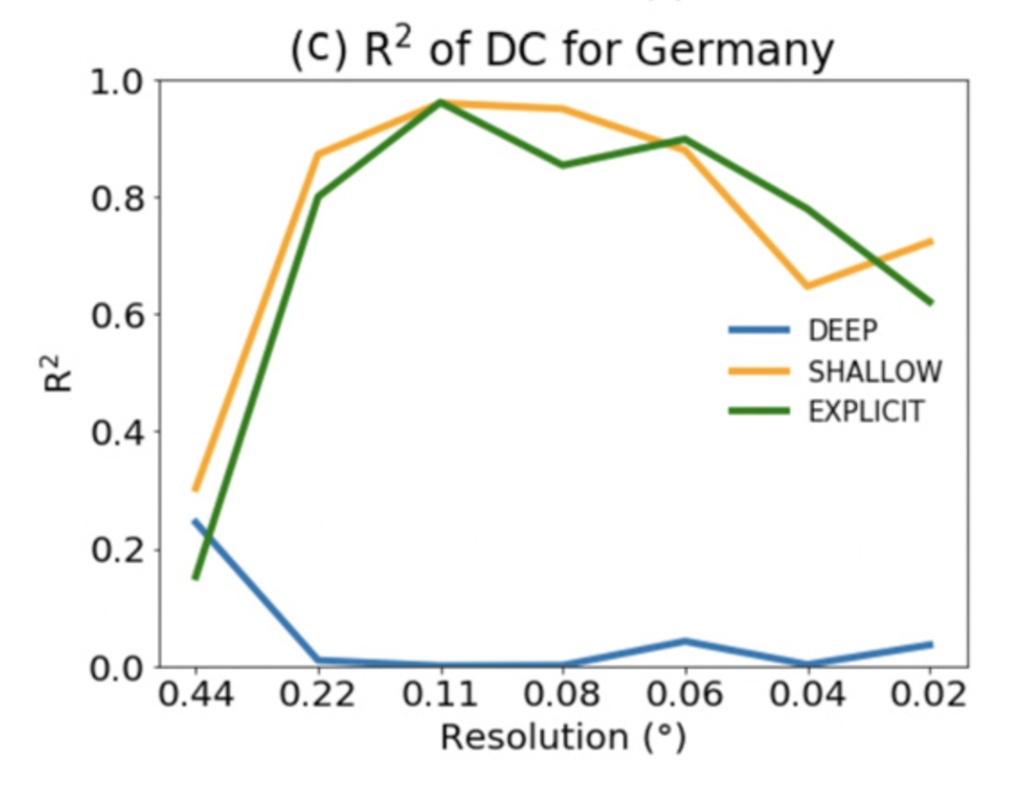
Is there an optimal length scale for parameterization?
Test score for diurnal cycle of summer precipitation (Germany)
Conventional parameterization
(non scale aware)
Vergara-Temprado et al. (2020)

Slide 84
Is there an optimal length scale for parameterization?
Test score for diurnal cycle of summer precipitation (Germany)
Conventional parameterization
(non scale aware)
”Gray zone”
Better to turn off
deep convection parameterization
Vergara-Temprado et al. (2020)

Slide 85
Is there an optimal length scale for parameterization?
x8
x16
x32
When increasing the grid spacing:
Yuval & O’Gorman, Nat. Commun. (in press)

Slide 86
Is there an optimal length scale for parameterization?
x8
x16
x32
When increasing the grid spacing:
Averaging over more cloud elements – subgrid tendencies more predictable
But more of the dynamics becomes subgrid
Yuval & O’Gorman, Nat. Commun. (in press)

Slide 87
Is there an optimal length scale for parameterization?
x8
x16
x32
When increasing the grid spacing:
Averaging over more cloud elements – subgrid tendencies more predictable
But more of the dynamics becomes subgrid
We train a different random-forest parameterization for different grid-spacing
Yuval & O’Gorman, Nat. Commun. (in press)

Slide 88
Random-forest parameterization of subgrid tendencies becomes more accurate as grid spacing becomes coarser
Offline performance
Larger coarse-graining factor makes the subgrid tendencies more predictable
Yuval & O’Gorman, Nat. Commun. (in press)
Performance is based on test dataset with-held in training

Slide 89
But accuracy of simulations improves with decreasing grid spacing
Online performance
More dynamics is resolved
Performance is measured by the mean precipitation distribution as compared to high-resolution simulation
Yuval & O’Gorman, Nat. Commun. (in press)

Slide 90
But accuracy of simulations improves with decreasing grid spacing
Online performance
ML parameterizations could be useful for
grid spacings that are quite close to that of the high-resolution model from which they are learned
More dynamics is resolved
Performance is measured by the mean precipitation distribution as compared to high-resolution simulation
Yuval & O’Gorman, Nat. Commun. (in press)

Slide 91
Why the discrepancy between offline and online performance?
Offline
Yuval & O’Gorman, Nat. Commun. (in press)

Slide 92
Why the discrepancy between offline and online performance?
Offline
Online
Yuval & O’Gorman, Nat. Commun. (in press)

Slide 93
Why the discrepancy between offline and online performance?
Offline
Online
Yuval & O’Gorman, Nat. Commun. (in press)

Slide 94
Discrepancy between offline and online performance regardless of whether consider relative or absolute measures of error
“Relative” agreement

Slide 95
Discrepancy between offline and online performance regardless of whether consider relative or absolute measures of error
“Relative” agreement
Absolute error

Slide 96
The outputs have (a) a predictable component and (b) a stochastic component
Target
Target
Longitude
Longitude
Longitude

Slide 97
The outputs have (a) a predictable component and (b) a stochastic component
Target
Target
Error
Longitude
Error

Slide 98
The outputs have (a) a predictable component and (b) a stochastic component
Target
Target
Low R² for the high resolution does not imply that it does not predict the predictable component accurately
Error
Longitude
Error

Slide 99
To compare “apples-to-apples” we coarse-grain the higher resolution parameterization
Target
Target
Longitude
Longitude
Longitude

Slide 100
To compare “apples-to-apples” we coarse-grain the higher resolution parameterization
Target
Target
Longitude
Longitude
Longitude
Coarse-grain (again!)

Slide 101
RF with smaller coarse graining performs better in an “apples-to-apples” comparison (at the same length scale)
Error
Error
Coarse-grain

Slide 102
Conclusions
Offline performance can be misleading in comparisons across length scales unless first coarse-grain to a reference length scale
ML parameterization works better as we decrease grid spacing (no evidence for optimal length scale or gray zone)

Slide 103
Main conclusions
Random-forest parameterization learned from fully 3-D high-resolution simulation gives stable and accurate simulations at climate-model resolution
Machine learning can give insights into the parameterization problem (e.g., scale dependence)
Machine learning parameterization has potential to work well in the ''gray zone" of conventional parameterizations

Slide 104
Low resolution simulations with random forest parameterizations are faster than high resolution simulations
96km-RF requires x30 times less CPU time than the high resolution simulation (12km)
192km-RF x120 less resources
Without changing the time step

Slide 105
A different approach for Random forest parameterization
Precipitating water (qp) is a variable that changes rapidly (due to precipitation falling with gravity)
Cannot significantly increase the time step when correcting qp
Want to avoid using qp as a prognostic variable

Slide 106
Want to avoid using precipitating water as a prognostic variable

Slide 107
Want to avoid using precipitating water as a prognostic variable
+ Change equation of motions in SAM

Slide 108
coarse grained + simplified RF parameterization have similar precipitation a to a high resolution simulation

