Slide 1
GEO IR Sounder Case Study: Multi-Band Retrieval Simulation and Forecast OSSE Results
Vijay Natraj and Derek Posselt
Jet Propulsion Laboratory, California Institute of Technology
NOAA STAR Seminar
March 24, 2021

Slide 2
Overview
GEO IR Sounder was developed in response to BAA-NOAA-GEO-2019, capable of NWP and atmospheric composition measurements.
GEO IR Sounder combines thermal emission and reflected solar bands (like combining CrIS and GeoCARB) in one integrated instrument package:
  Co-registered field of view in both bands
  Both bands measured at same time of day
  Reflected solar band improves sensitivity to lower troposphere and near surface
  Greater societal impact than stand-alone NWP and atmospheric composition measurements
Notes:
Imaging FTS that uses innovative large focal plane arrays and a wide wavelength band, to achieve a flexible instrument with superior performance at reduced mass and affordable cost.
JPL has unique extensive experience developing Earth-observing instruments in general and FTS instruments in particular. JPL built and successfully flew the FTS Tropospheric Emission Spectrometer (TES) instrument for more than 13 years on NASA’s Aura spacecraft. For 20 years JPL has been a leader in atmospheric sounding, with its work on AIRS. This experience informs the design of the GEO IR Sounder.

Slide 3
Overview (Continued)
Instrument system simulations flow-down from scientific requirements to measurement requirements to instrument requirements:
  Simulated different choices of instrument and operation parameters into the retrieved temperature, water vapor and trace gas profiles.
  Improved weather forecast accuracy by incorporating temperature and water vapor retrievals into regional OSSE framework.
Combined multi-band retrieval improves storm intensity, structure and track forecast accuracy, and benefits air quality and climate research.
Notes:
Instrument system simulations are an essential part of any flight mission. They guide all aspects of the mission conceptual design by helping to define the flow-down from scientific requirements to measurement requirements to instrument requirements. For these simulations, we have simulated the performance of the GEO IR Sounder in two main areas. In the first, we carry out a parametric analysis that demonstrates how choices of instrumental and operational parameters propagate into retrieved temperature, water vapor and trace gas profiles. In the second, we incorporate temperature and water vapor retrievals into a regional weather Observation System Simulation Experiment (OSSE) framework and compare the resulting forecast to data from a severe storm event, Hurricane Harvey in 2017.

Slide 4
Contributors
Simulated Retrievals
  Ming Luo, Jean-Francois Blavier, Vivienne Payne, Zhao-Cheng Zeng
Weather OSSE
  Longtao Wu, Jacola Roman
Instrument/Science/Management
  James Wu, Stan Sander, Len Dorsky

Slide 5
Definition of Spectral Ranges
Designation | Spectral Range (μm) | Spectral Range (cm⁻¹)
VLWIR | > 10 | < 1,000
LWIR | 5-10 | 1,000-2,000
MWIR | 3-5 | 2,000-3,333
SWIR | 1-3 | 3,333-10,000
NIR | 0.7-1 | 10,000-14,286
Visible | 0.38-0.7 | 14,286-26,316
UV | < 0.38 | > 26,316
TIR | > 3 | < 3,333

Slide 6
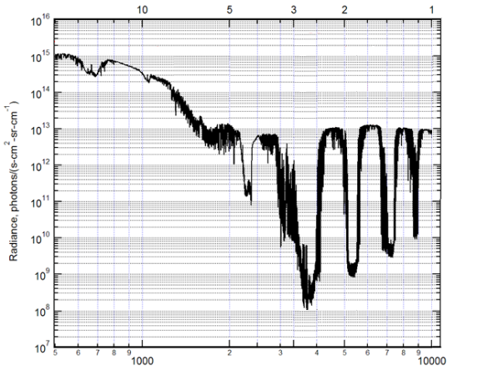
Wide Spectral Range Improves Vertical Profiling of Temperature, Water Vapor and Trace Gases
The combination of wide spectral range, megapixel chemical imaging and high spectral resolution meets and exceeds NOAA’s requirements for its next-generation geostationary sounder suite
Earth Spectrum (Tropical noon, albedo 0.8)
Wavelength (μm)
The wide spectral range of GEO IR Sounder permits operation in multiple wavebands (thermal infrared to short wave infrared).
This capability increases the information content of retrievals to improve vertical profiling.
High spectral resolution (up to 0.1 cm⁻¹) and wide spectral range (1-15.4 μm) enable simultaneous observations of reflected sunlight and thermal emission (day/night) for meteorological sounding (temperature, humidity) for NWP and trace gases (CO₂, CH₄, CO, SO₂, O₃) targeted by the NOAA AC4 program.
CO₂
O₃
CH₄
O₂
Temperature
CO
H₂O
H₂O
SO₂
FPA #2 FPA #1
V/LWIR
MWIR
SWIR
Wavenumber (cm⁻¹)

Slide 7
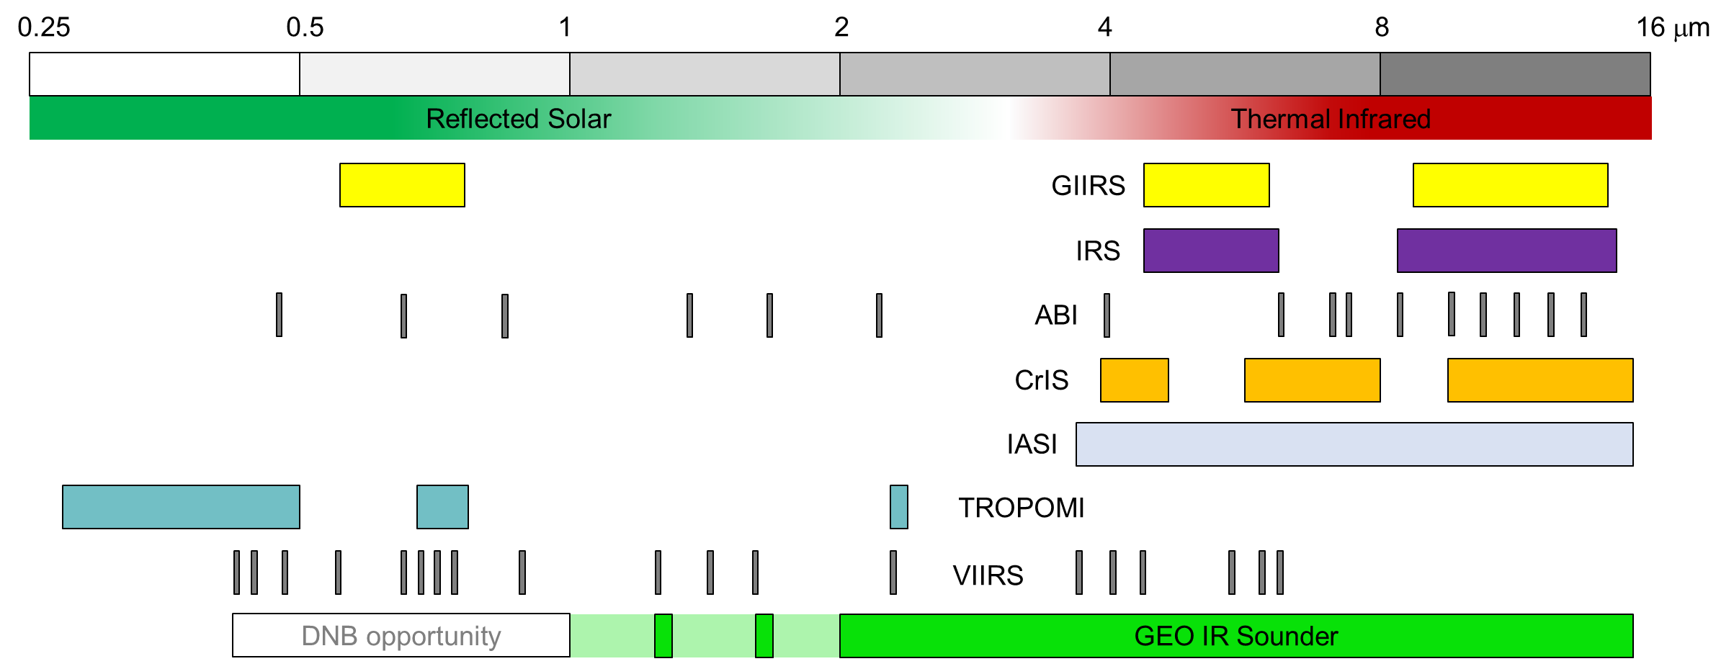
Comparisons to State-of-the-Art, Spectral Range
Optimize these bandpass filter locations and widths to optimize retrievals
FPA #1 FPA #2
Notes:
Measurements over this range can address
NWP
Currently provided by hyperspectral TIR sounders (e.g., CrIS)
Air quality / Atmospheric chemistry, carbon cycle and climate (AC4)
Currently provided by hyperspectral TIR (e.g., CrIS) and SWIR (e.g., TROPOMI)
Real-time weather imagery
Currently provided by broadband TIR and SWIR (e.g., GOES)

Slide 8
Considerations for Simulated Retrievals
The impact of satellite observations on our ability to forecast and monitor weather and air quality events depends on characteristics of the satellite products, including:
  Accuracy
  Vertical resolution
  Horizontal resolution
The characteristics of the remotely sensed products depend on the details of the instrument.
Factors to consider:
  Spectral coverage
  Spectral resolution
  Signal-to-noise

Slide 9
Approach
Multispectral: SWIR and TIR to match the 1⎼15.4 μm spectral range of the GEO-IR instrument and to maximize information content
Multispecies: Temperature, H₂O, O₃, CO, CO₂, CH₄
Radiative transfer: Two-Stream-Exact-Single-Scattering (2S-ESS) model (fast/accurate)
Retrievals: optimal estimation
Profiles obtained from WRF-Chem simulations over Houston and W. Virginia
Notes:
Multispectral measurements maximize information content by improving profile information with respect to several species. e.g. for O3 done using both simulated and real measurements.
SO₂ included in forward model but not in retrievals.

Slide 10
Inputs to the Radiative Transfer Simulations
RT
Model
Aerosol and cloud profile and optical properties
Optical depths
Flags for scattering and thermal calcs
Solar geometry
Atmospheric Profile & Surface data

Slide 11
Radiative Transfer/Retrieval Outputs
RT Model/ Retrieval
Jacobian/ sensitivity analysis
Information content assessment with band combination
Information content analysis with resolution and noise variation

Slide 12
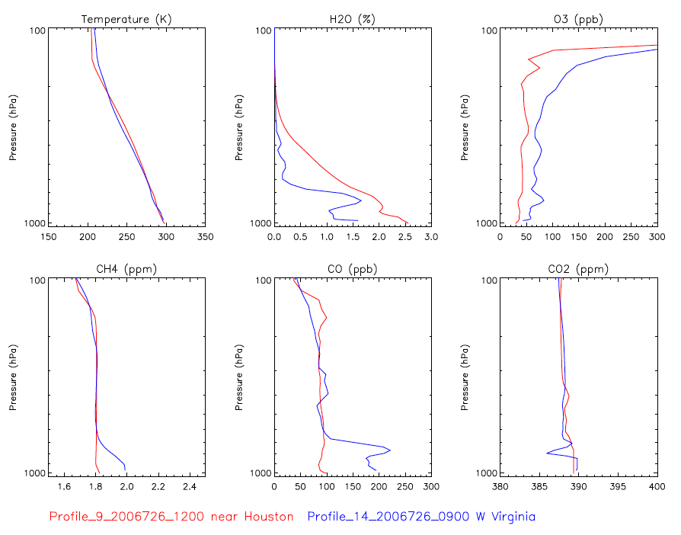
Profiles
Notes:
From our database of over 200 summer-time atmospheric profiles over the continental US, we selected two representative daytime atmospheres; one near Houston to support the OSSE analyses and the background trace gas case, and another in W Virginia that has more enhanced trace gas pollutants near the surface.

Slide 13
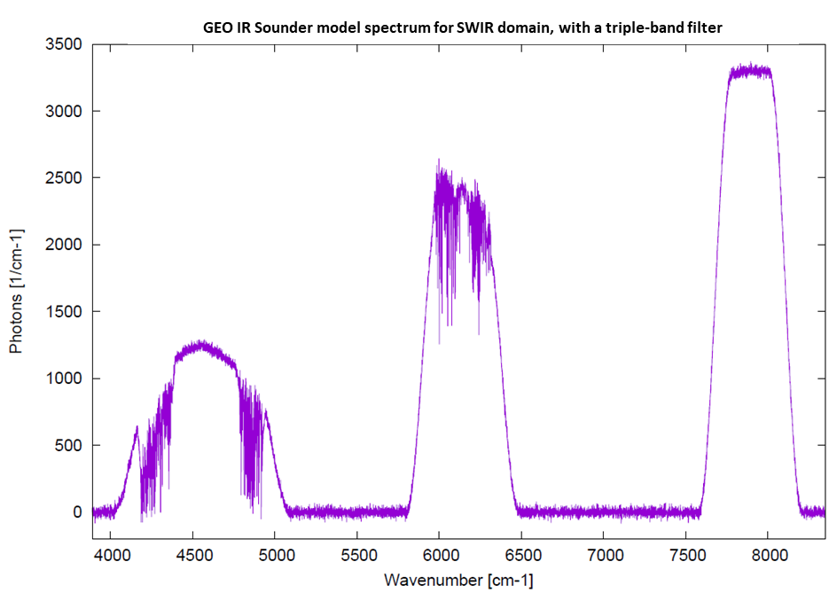
Instrument Model
Thermal IR
Shortwave IR
Note log scale.
Many more photons/cm⁻¹ in V/LWIR.
SWIR region includes spectral information that adds near-surface information for CH₄, CO₂ and CO
SWIR has been band-limited here to maximize signal-to-noise in region where radiance is low
Selected bands are configurable. Possible to include additional band, e.g., targeted for PBL H₂O
Notes:
SWIR includes spectral information that increases vertical resolution retrievals for CH₄, CO₂, CO
Why chop into bands? SWIR has been band limited so as to maximize SNR in the region where radiance is low
Selected bands are configurable. One option is to include another band for H₂O for improved PBL visibility

Slide 14
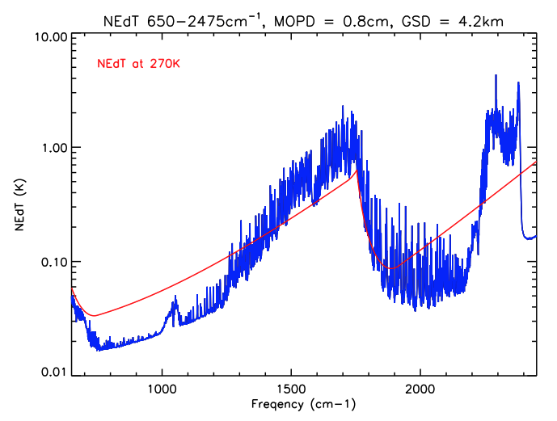
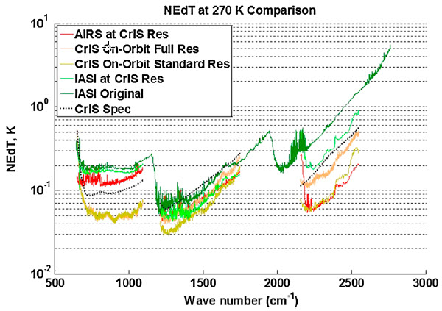
Instrument Noise: Example for 4.2 km GSD
Instrument noise model accounts for
  Trade-offs between spectral resolution and noise
  Trade-offs between horizontal resolution (GSD) and noise (4.2 km GSD results in lower noise)
  Impacts of choice of spectral bands on noise
Notes:
The NEdT for the simulated IR spectra and BT = 270 K (blue line) is similar to or better than operational instruments, e.g., CrIS, AIRS (red line). Bottom panel: NEdT comparison between AIRS and CrIS for comparison with Geo IR Sounder simulations [Zavyalov et al., 2013].

Slide 15
Optimal Estimation Approach
Optimal estimation retrieval provides estimates of
  Vertical sensitivity and retrieval error
Averaging kernels (AK)
  Sensitivity of retrieval to true atmospheric state
  Depends both on instrument characteristics and choice of retrieval constraints
Trace of AK: Degrees of Freedom for Signal (DOFS)
  Number of independent pieces of vertical information in the retrieval
Width of the rows of AK
  Measure of vertical resolution

Slide 16
DOFS: Temperature Retrievals
Frequency Domain | DOFS (MOPD = 5 cm) |  | DOFS (MOPD = 2 cm) |  | DOFS (MOPD = 0.8 cm)
 | 2.1 km GSD | 4.2 km GSD | 2.1 km GSD | 4.2 km GSD | 2.1 km GSD | 4.2 km GSD
V/LWIR | 13.6 | 17.6 | 14.2 | 17.9 | 14.3 | 17.9
MWIR | 5.1 | 7.9 | 5.8 | 8.3 | 6 | 8.1
V/LWIR+MWIR | 13.8 | 17.8 | 14.4 | 18.1 | 14.5 | 18.1
SWIR | 0.2 | 1.6 | 0.3 | 1.8 | 0.4 | 2.0
V/LWIR+MWIR+SWIR | 13.8 | 17.9 | 14.6 | 18.3 | 14.7 | 18.4
Small changes with MOPD, but systematic errors ignored here
4.2 km GSD provides larger DOFS than 2.1 km
Most information comes from LWIR
16
Notes:
Table illustrates the competing effects of spectral resolution and measurement noise. Note that the total integration time for all the instrument configurations are the same; the NESR for the MOPD = 0.8 cm instrument is therefore smaller than those for the MOPD = 2 or 5 cm instruments. In some cases, the higher spectral resolution instrument (MOPD = 2 cm) provides slightly larger DOFS; in some other cases, the lower spectral resolution instrument (MOPD = 0.8 cm) performs the best.
The differences in DOFS for the two GSD values (2.1 km and 4.2 km) are obvious. This shows the trade-off between spatial resolution and the measurement vertical resolution and precision.
Most information coming from LWIR.

Slide 17
DOFS: H₂O Retrievals
Frequency Domain | DOFS (MOPD = 5 cm) |  | DOFS (MOPD = 2 cm) |  | DOFS (MOPD = 0.8 cm)
 | 2.1 km GSD | 4.2 km GSD | 2.1 km GSD | 4.2 km GSD | 2.1 km GSD | 4.2 km GSD
V/LWIR | 7.9 | 11.2 | 8.2 | 11.3 | 8.2 | 11.2
MWIR | 4.6 | 6.9 | 5.0 | 7.3 | 4.6 | 6.6
V/LWIR+MWIR | 8.3 | 11.8 | 8.8 | 12.1 | 8.6 | 11.9
SWIR | 1.2 | 2.2 | 1.3 | 2.1 | 1.4 | 2.1
V/LWIR+MWIR+SWIR | 8.3 | 12.1 | 8.9 | 12.3 | 8.7 | 12.1
Small changes with MOPD, but systematic errors ignored here
4.2 km GSD provides larger DOFS than 2.1 km
Most information comes from LWIR+MWIR
17
Notes:
Table illustrates the competing effects of spectral resolution and measurement noise. Note that the total integration time for all the instrument configurations are the same; the NESR for the MOPD = 0.8 cm instrument is therefore smaller than those for the MOPD = 2 or 5 cm instruments. In some cases, the higher spectral resolution instrument (MOPD = 2 cm) provides slightly larger DOFS; in some other cases, the lower spectral resolution instrument (MOPD = 0.8 cm) performs the best.
The differences in DOFS for the two GSD values (2.1 km and 4.2 km) are obvious. This shows the trade-off between spatial resolution and the measurement vertical resolution and precision.
Most information from LWIR+MWIR.

Slide 18
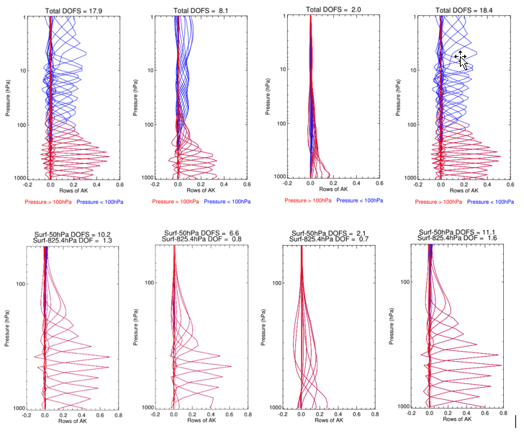
Averaging Kernels: T/H₂O
Temperature
H₂O
V/LWIR
MWIR
SWIR
Combined
Notes:
The characteristics of the TIR temperature and water vapor retrievals are very similar to those obtained by currently operating instruments. Note that the sensitivity of SWIR retrievals, especially for water vapor, is mostly near the surface. Further, the SWIR measurement noise was reduced by a factor of 5 in these figures assuming a larger footprint (averaging 25 pixels).

Slide 19
DOFS: AQ/Climate Relevant Gases
Retrieved Species | Frequency Domain | DOFS (MOPD = 2 cm) |  | DOFS (MOPD = 0.8 cm)
 |  | 2.1 km GSD | 4.2 km GSD | 2.1 km GSD | 4.2 km GSD
Ozone (TATM, H₂O) | LWIR | 3.5 | 4.0 | 3.4 | 4.0
CO | MWIR | 1.7 | 2.1 | 1.6 | 2.1
 | SWIR | 0.08 | 0.96* | 0.1 | 0.96*
 | MWIR+SWIR | 1.7 | 2.3* | 1.7 | 2.3*
CH₄ (TATM, H₂O) | LWIR | 1.5 | 2.0 | 1.6 | 2.1
 | SWIR | 0.7 | 1.9* | 0.8 | 1.9*
 | LWIR+SWIR | 1.6* | 2.7* | 1.8* | 2.8*
CO₂ (TATM, H₂O) | VLWIR | 1.0 | 1.5 | 1.1 | 1.6
 | VLWIR+MWIR | 1.0 | 1.5 | 1.2 | 1.6
 | SWIR | 0.3 | 1.1* | 0.4 | 1.1*
 | VLWIR+MWIR+SWIR | 1.0 | 1.7* | 1.2 | 1.9*
* Instrument noise for GSD = 4.2 km reduced by factor of 5 as a result of footprint averaging
DOFS broadly consistent with prior results from TES, CrIS, IASI, MOPITT, TROPOMI, … teams
Small changes with MOPD, but this is idealized scenario (perfect FM, perfect knowledge of interferences)
For real scenarios, high spectral resolution will reduce systematic errors
19
Notes:
The DOFS in the table are broadly consistent with previously published work on retrievals from the TES, CrIS, IASI, MOPITT and TROPOMI teams. The DOFS are slightly higher for the MOPD = 2 cm case compared to the MOPD = 0.8 cm case, but the differences are small. Results for MOPD = 5 cm case (not shown here) are also similar. It is important to note that these simulated retrievals represent an idealized scenario, where the forward model is perfect and we assume perfect knowledge of interfering species in the spectral range for any given target species. In this scenario, with a constant integration time, the lower spectral resolution option provides similar results to the high spectral resolution option due to the trade-off between spectral resolution and instrument noise. In the real world, higher spectral resolution provides the advantage of improved ability to distinguish between the signal of the target species and the interfering species, resulting in reductions in systematic errors.

Slide 20
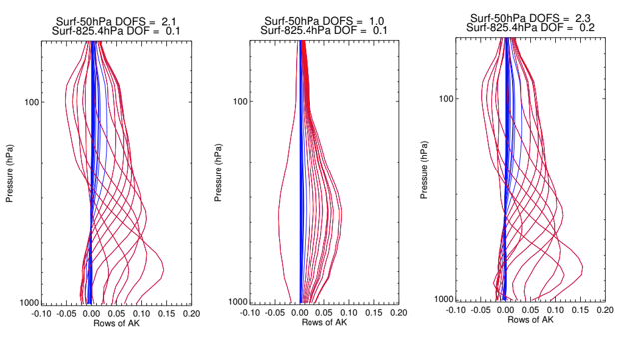
Averaging Kernels: CO
MWIR
SWIR
Combined
Notes:
The combination of wavelength regions provides improved sensitivity to the lower troposphere compared to either region alone.

Slide 21
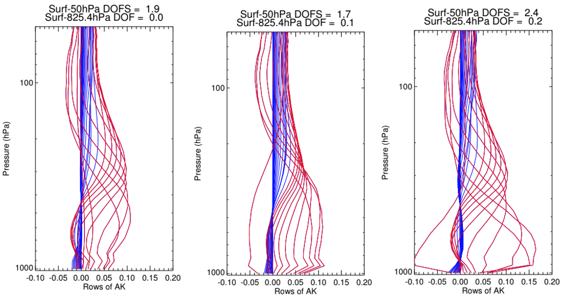
Averaging Kernels: CH₄
LWIR
SWIR
Combined
Notes:
For methane, the addition of SWIR bands also provides noticeable enhancement in lower tropospheric and near surface sensitivity.

Slide 22
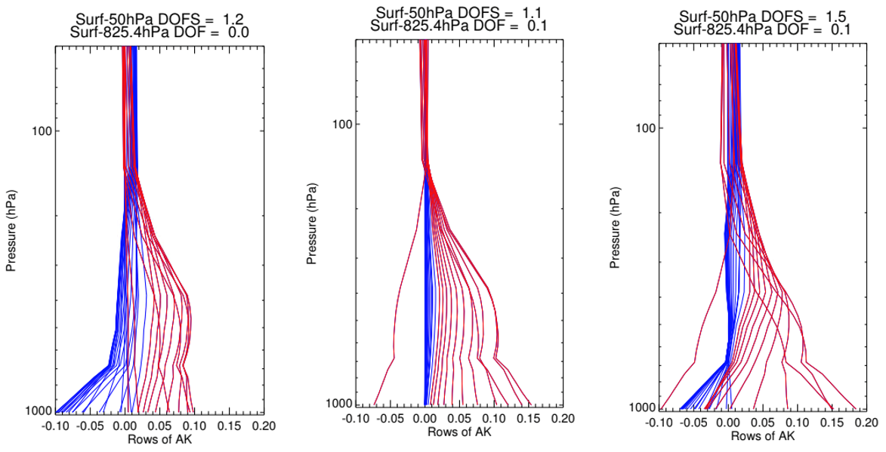
Averaging Kernels: CO₂
VLWIR+MWIR
SWIR
Combined
Notes:
CO₂ retrievals benefit the most from the combination of V/LWIR/MWIR/SWIR retrievals. The SWIR domain adds sensitivity in the lower troposphere and near the surface. The characteristics of the CO₂ retrievals are in good agreement with OCO-2/3 observations.
The reduced DOFS in the CO SWIR band compared to the CH₄ and CO₂ bands is a result of three factors: (1) lower top of the atmosphere solar irradiance (~2X smaller), (2) lower surface albedo (~2.5X smaller), and (3) larger absorption, primarily by H₂O and CH₄ (spectrally variable).

Slide 23
Simulated Retrievals: Summary
High spectral resolution provides improved ability to
  distinguish absorption lines of target species from interferents
  separate tropospheric signal from stratospheric signal
Trade-off between spectral resolution and noise
  comparable DOFS for idealized retrievals
  reduction in systematic errors for real scenarios
Combination of spectral bands enhances lower tropospheric and near-surface sensitivity
Notes:
In the idealized retrievals presented here, we assume perfect knowledge of interfering species. In this case, three different MOPDs tested gave comparable results in terms of DOFS.

Slide 24
Simulated Retrievals: Summary (Continued)
GSD = 2.1 km and 4.2 km both provide excellent results for T and H₂O
SWIR provides clear benefit for CO, CH₄ and CO₂ when footprints are aggregated
Performance of GEO-IR Sounder is similar to or better than currently operational instruments.
Notes:
In the idealized retrievals presented here, we assume perfect knowledge of interfering species. In this case, three different MOPDs tested gave comparable results in terms of DOFS.

Slide 25
Weather OSSE Outline
OSSE overview: objectives, timeline, and status
Regional OSSE system: description and configuration
  Nature run
  Forecast system
Regional OSSE results
  Control forecast
  Impact of assimilating Geo FTS profiles
    TC intensity and track
    Environment
    TC vertical structure
Summary and Conclusions

Slide 26
Observing System Simulation Experiments
Traditionally: evaluation of potential impact of new observations on a NWP forecast (Hoffman and Atlas, 2016; BAMS)
Fundamentally: quantify information provided by a future observing system
This study uses 2 types of OSSE:
  Do measurements provide enough information to estimate geophysical quantities of interest? What are the uncertainties? (retrieval OSSE)
  How does assimilation of new observations affect/improve a weather forecast? (forecast OSSE)

Slide 27
OSSE Timeline
Credible forecast OSSEs typically take years to complete
We were able to complete multiple experiments within 5 months:
  Well tested and calibrated forecast and data assimilation system
  Available high fidelity simulation of a real event
  Assimilation of data that is very similar to types of data already assimilated
OSSE milestones:
  1 September 2020: nature run complete
  15 October 2020: control forecast and conventional data assimilation complete
  18 November 2020: First Geo IR assimilation results finished
  11 January 2021: Comparisons among various averaging kernels finished, analysis of impact on storm structure and environment finished

Slide 28
Regional OSSEs with the WRF EnKF
Regional data assimilation / OSSEs assess impact on a weather event
Focus on tropical cyclones, and utilize heritage in ensemble DA
WRF-based ensemble Kalman filter (WRF-EnKF) developed at PSU
Experiments based on successful ensemble simulation of hurricane Harvey (2017)
Nature run: simulated high resolution TC very similar to Harvey
Generate synthetic conventional and satellite observations, including variants of the proposed Geo FTS
Use EnKF to assimilate observations into an ensemble forecast

Slide 29
Harvey OSSE Configuration: Nature Run
Initial Conditions | APSU analysis (assimilating GOES-16 all-sky BT + conv) The 3rd strongest ensemble member
Boundary Conditions (&environment) | ERA-5
Time Range | Initialized at 00Z/23 AUG 2017 To 00Z/28 AUG 2017
Resolution & Domain Size | D01: 378 x 243 (27 km) D02: 297 x 297 (9 km) D03: 597 x 597 (3 km) D04: 1197 x 1197 (1 km)
Microphysics | Thompson Scheme
Model | WRF3.9.1
Moving Nest | Preset: 00Z/23 – 00Z/24 (by following the TC positions of NR itself from preliminary simulation) Vortex-following: 00Z/24 – 00Z/28 AUG 2017

Slide 30
Harvey OSSE Configuration: OSSE DA Experiment
Initial Conditions | Ensemble forecast from APSU analysis
Boundary Conditions (&environment) | NOAA FNL
Time Range | Spin-up: 00-06Z/23 AUG 2017 DA: 06Z/23 – 00Z/26 AUG 2017
Resolution & Domain size | D01: 378 x 243 (27 km) D02: 297 x 297 (9 km) D03: 297 x 297 (3 km) -
Microphysics | WSM6
Model | WRF3.6.1
Moving Nest | Preset (following the TC positions of NR)
Red text denotes where forecast model differs from the nature run

Slide 31
Hurricane Harvey Nature Run
Based on real event (Hurricane Harvey, 2017)
NR is a free-running forecast initialized from the 3rd strongest member of an EnKF experiment
NR uses higher resolution, newer model version, different physical parameterizations, and different initial and boundary conditions
Forecast uses lower resolution, older model version

Slide 32
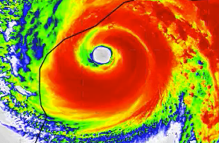
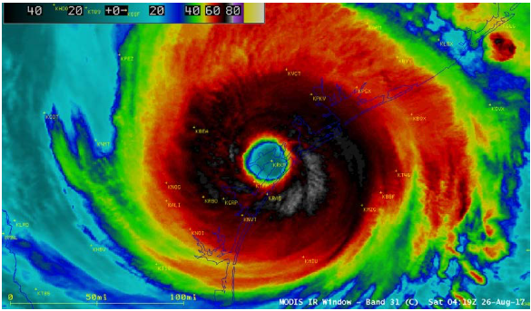
MODIS Brightness Temperatures vs Nature Run
MODIS obs
NR
Nature Run cloud fields are realistic – not meant to reproduce the observations

Slide 33
Regional OSSEs
Initial conditions: NCEP FNL, 60 member ensemble
Start time: 2017/08/23 00UTC
Spin up: 6 hour
Data assimilation: 06 UTC 23 Aug 2017 – 06 UTC 24 Aug 2017
Observational data = synthetic observations from nature run
  Conv: Conventional observations only (surface, ship, radiosonde, satwind), assimilated 3-hourly
  Geo IR: Conventional + Geo IR T/qv soundings
    Assimilate Geo IR soundings every hour
    4 x 4 km horizontal averaging to Geo IR pixels
    Vertical smoothing using Geo IR averaging kernels
    Mask clouds where OLR < 220 W/m²
    Observation errors consistent with information in T,qv retrievals
    Run experiments with varying averaging kernels
33
Notes:
Observation errors: 10% RH, 1 K temperature, no horizontal or vertical thinning, 90 km radius of influence.
Conventional data includes land-based soundings, surface METAR and ship data, P3 dropsondes, and GOES satwinds
TC vitals data is the min SLP interpolated to hourly times

Slide 34
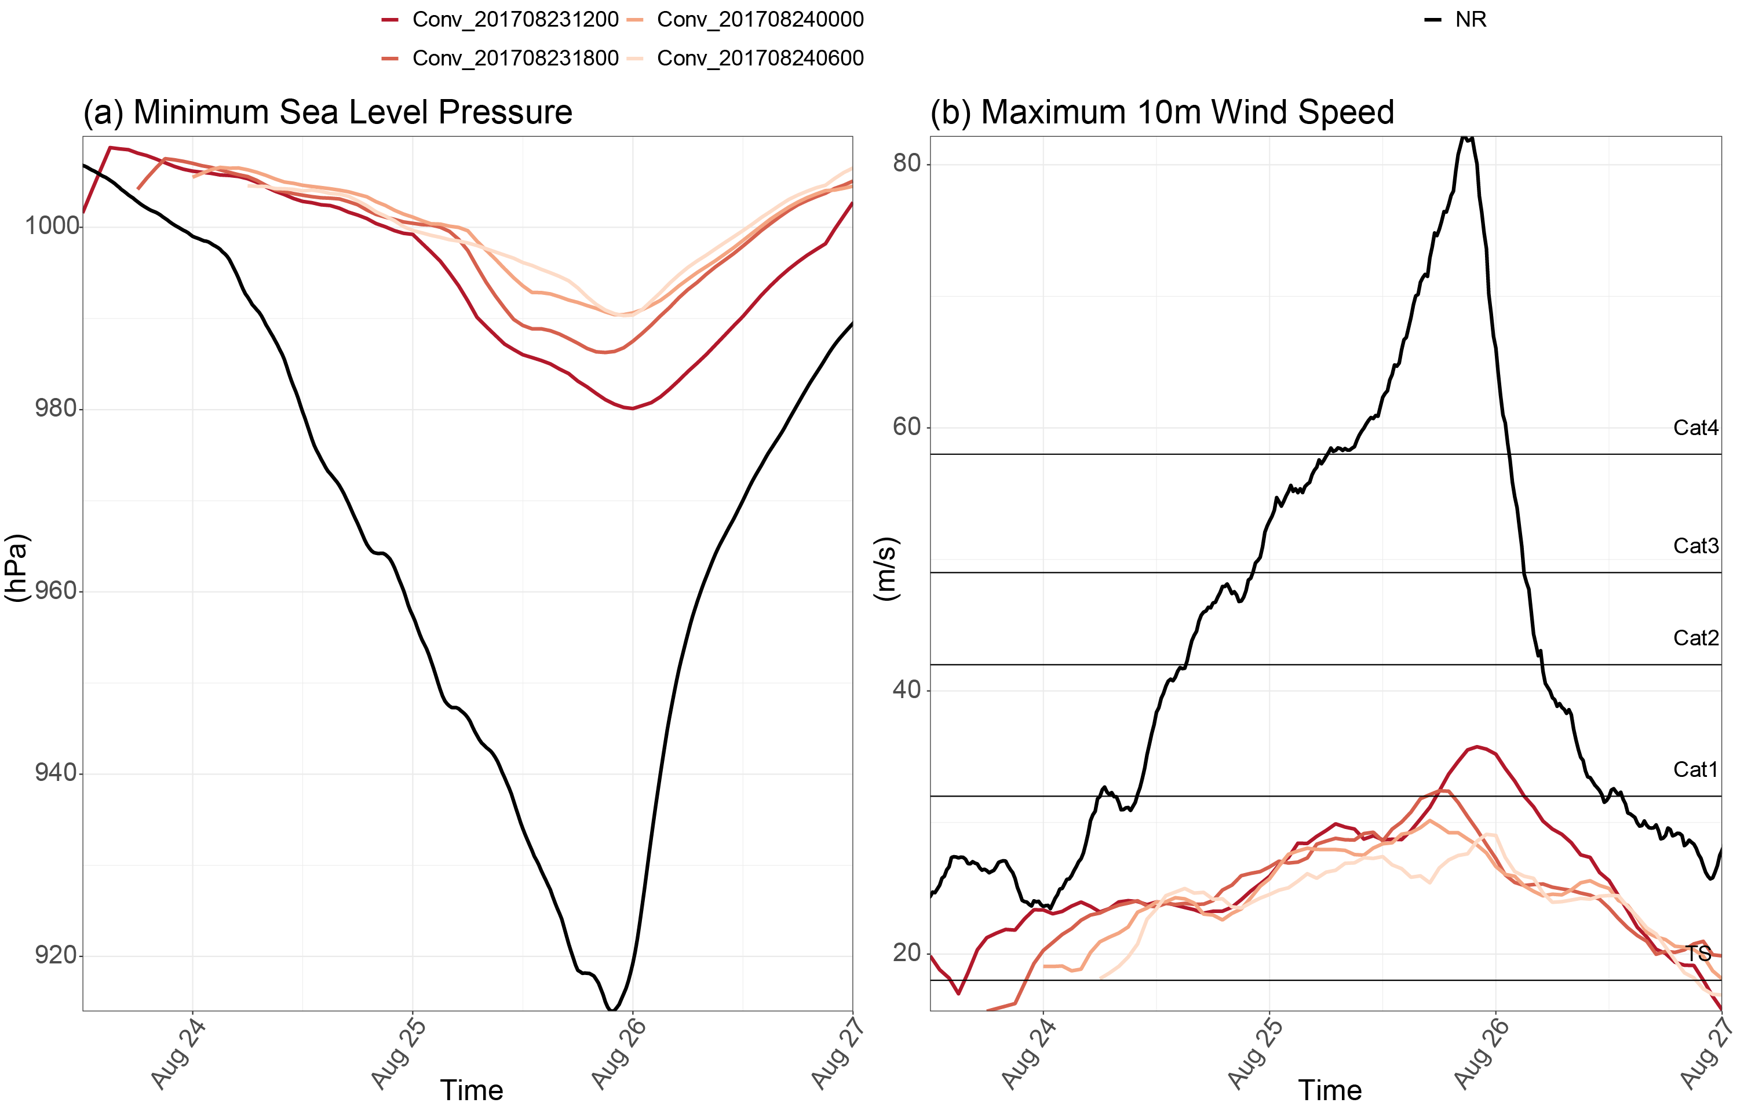
Forecast Performance: TC intensity
Assimilation of conventional observations insufficient

Slide 35
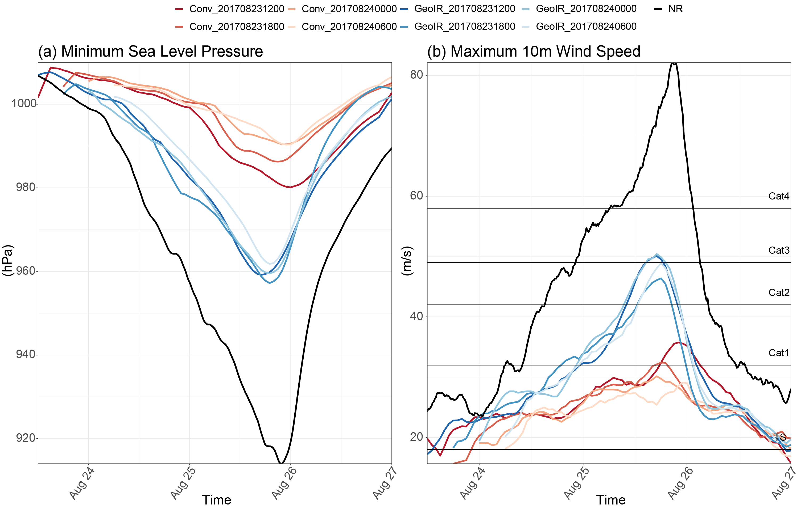
Forecast Performance: TC intensity
Assimilation of conventional observations insufficient
Assimilation of Geo IR soundings significantly improves TC intensity

Slide 36
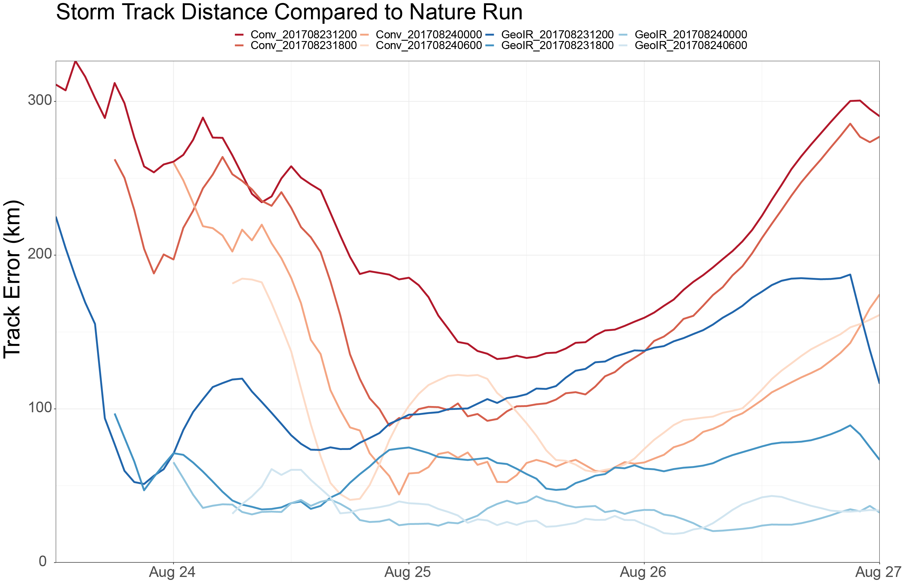
Track errors
Assimilation of Geo IR Sounder data reduced track errors at all forecast times, and especially for forecasts initialized at 00 and 06 UTC 24 August

Slide 37
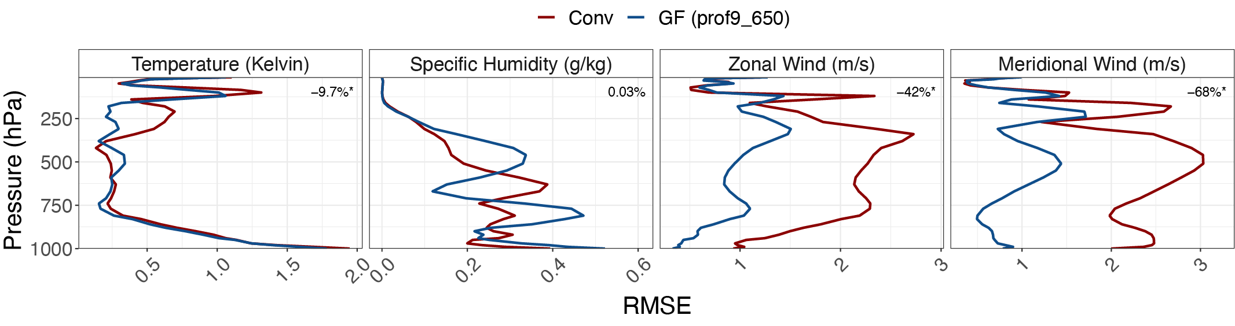
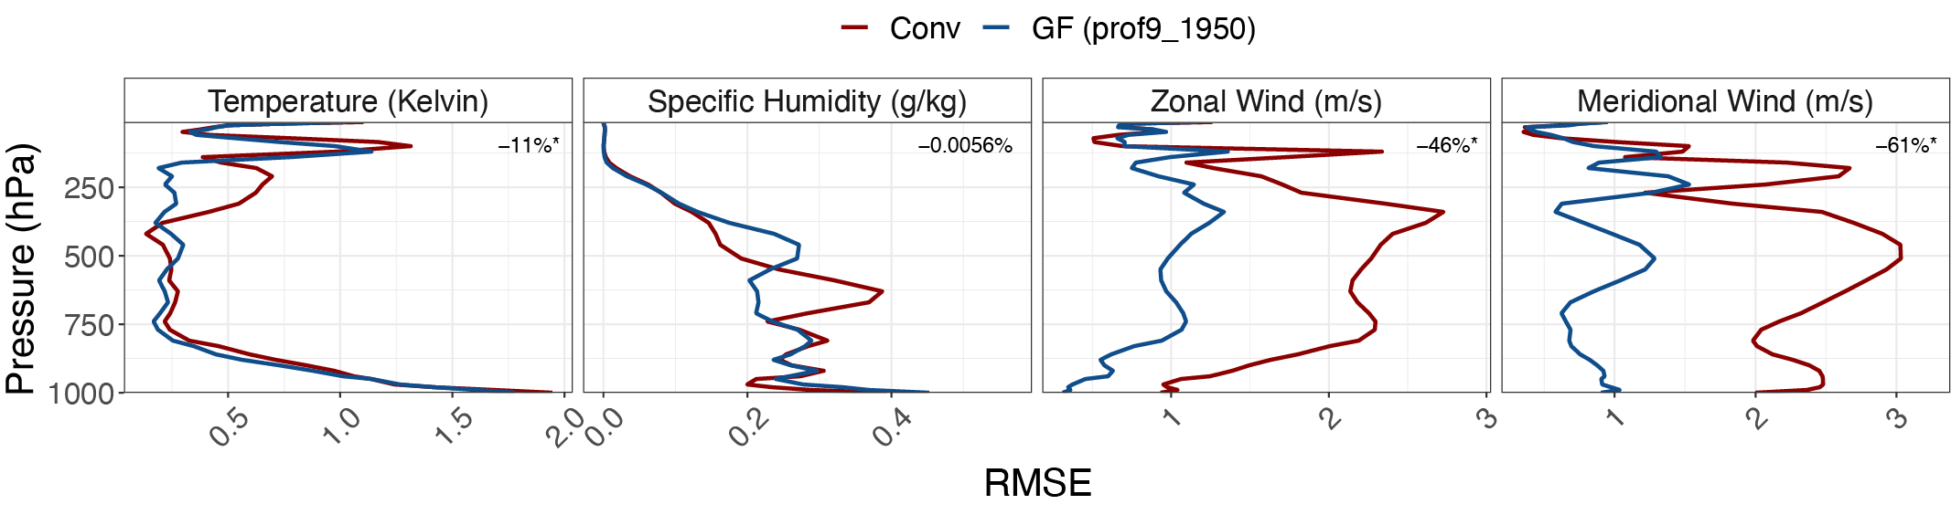
Impact on Thermodynamic and Dynamic State
Fields averaged in the horizontal over the full inner domain (d03)
Blue = Geo FTS
Red = Conventional
Key points:
  Temperature already very accurate. Largest improvements in upper troposphere.
  Water vapor signal is mixed, with most improvements in the lower to middle troposphere
  Assimilation of temperature and water vapor has a significant positive effect on wind through the depth of the troposphere

Slide 38
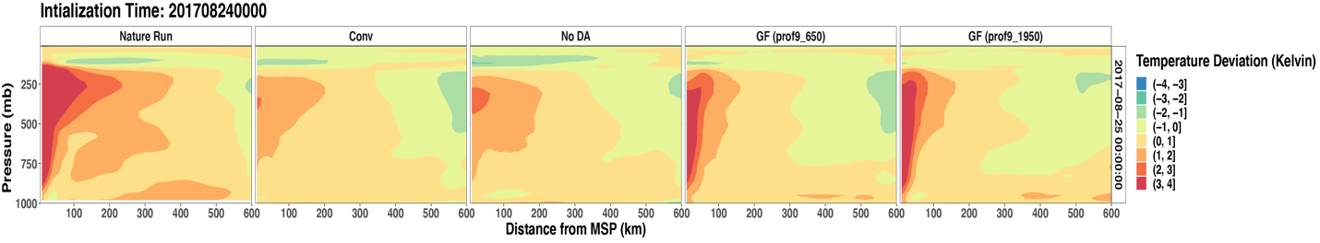
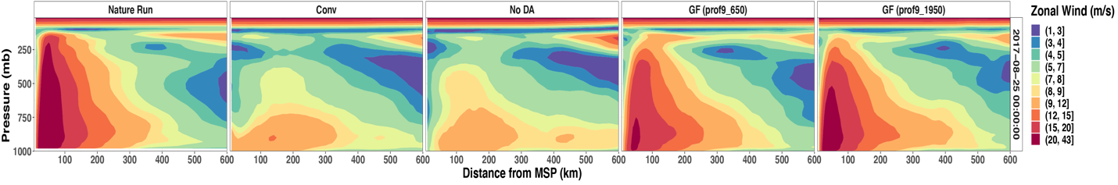
Impact on Thermodynamic and Dynamic State
T,U horizontally averaged in the TC azimuthal direction and time averaged over 12 hours
Key points:
  Geo FTS assimilation results in clear improvements in the wind structure
  The warm core structure (temperature perturbation) is much improved

Slide 39
OSSE Summary
Assimilation of Geo IR Sounder profiles during the first 24 hours of storm development (prior to rapid intensification) resulted in improved:
  storm intensity and track
  warm core temperature perturbation
  environmental winds
Care was taken to ensure credibility of the OSSE:
  We have created a realistic nature run of a strong hurricane
  Nature run is sufficiently different from the forecast model
  Profiles smoothed horizontally and vertically using averaging derived from Geo IR Sounder retrieval system
  Errors in observations quantified and derived from the retrieval

